Slide 1
Fast luminosity monitoring and background measurements at SuperKEKB
(A_RD_08)
LAL (LumiBelle2)
Cécile Rimbault – DEPACC, LAL
Philip Bambade – DEPACC, LAL
Yann Peinaud – SDTM, LAL
Viacheslav Kubytskyi – DEPACC, LAL
Chengguo PANG – PhD stud. (leaves Sep.2019)
Salvatore Di Carlo- PostDoc (leaves Sep.2019)
KEK (ZDLM&Luminosity Dither Feedback)
Sadaharu Uehara – INPS, KEK
Yoshihiro Funakoshi – ACCL, KEK
Mika Masuzawa – ACCL, KEK
Toshiyuki Oki – ACCL, KEK
Takashi Kawamoto – ACCL, KEK
Thesis defense on Sep.5, 2019

Slide 2
Contents
About SuperKEKB
Need for fast luminosity monitor
What we have accomplished in Phase 2
Upgrade From Phase 2 to Phase 3
Phase 3 commissioning
Summary

Slide 3
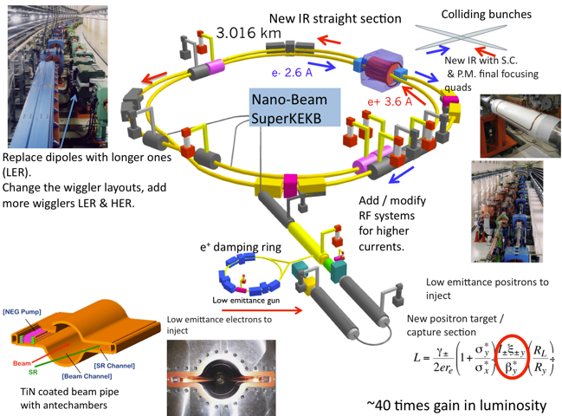
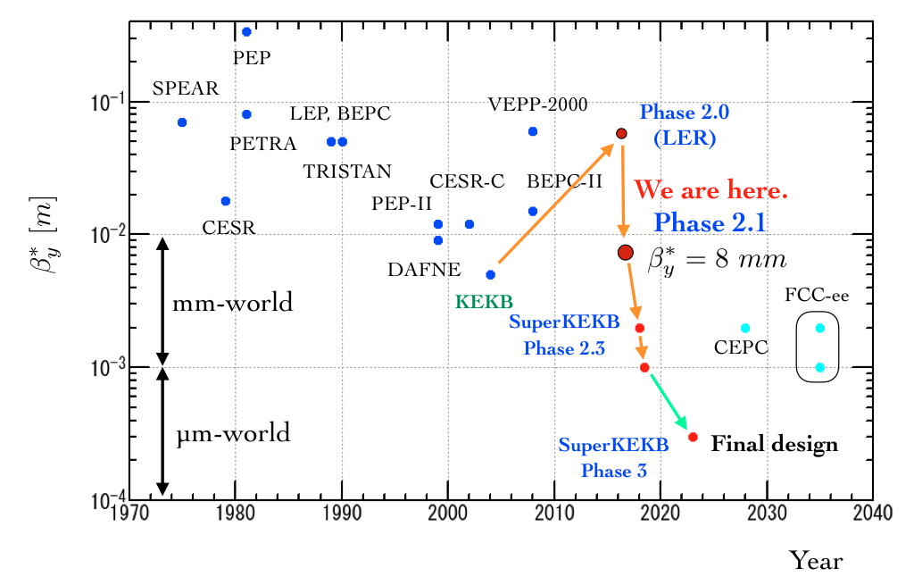
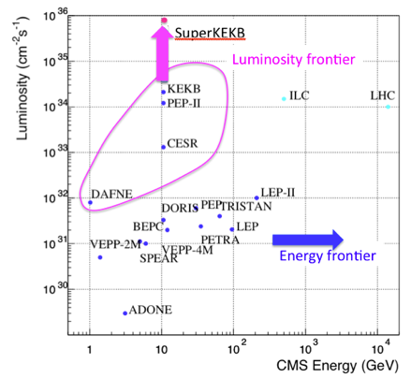
About SuperKEKB
Super small β_{y} * at the IP (Interaction Point)
“Nano”-beam collison
➔Colliding nano-size beams (~60nm in vertical)
to realize “super high” luminosity

Slide 4
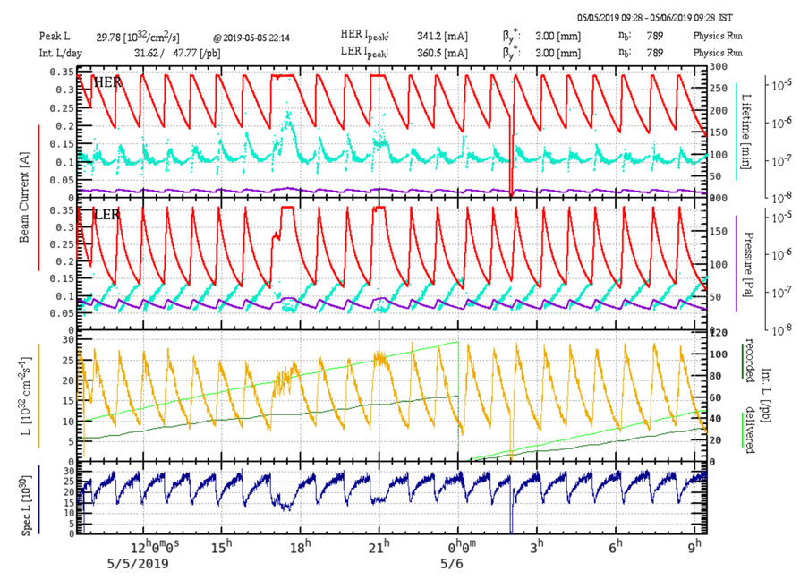
About SuperKEKB
Phase 3 operation started on March 11, 2019
We are currently running with β_{y}* = 3mm
Goals (among many others) are:
Understand/reduce detector background
Beam tuning for increasing luminosity
Collision FB
Fast and reliable luminosity monitors are indispensable to achieve the goals
LumiBelle2 & ZDLM
2 complementary technics developed at LAL (diamond) and KEK (Cerenkov & scintillator)
Please refer to the presentation by C. Pang at this workshop last year in Nara for more details.

Slide 5
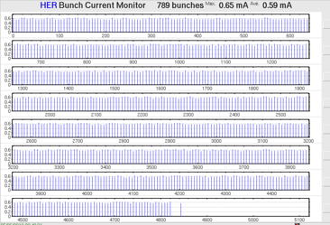
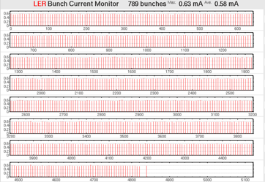
What we have accomplished in Phase 2
Installation and commissioning during the Phase 2 (colliding beam) operation
First collision recorded on April 26th , 2018.
Consistent with Electromagnetic Calorimeter Luminosity (ECL) system.
Analysis of the detector background
87% Bremsstrahlung and 13% Touschek, good agreement with Monte Carlo
Enabled background estimation for Phase 3
Provided great tool for luminosity optimization tuning and collision orbit feedback
“Train Integrated Luminosity” (TIL) signal@1Hz for luminosity tuning
TIL signal@1kHz for collision feedback called “dithering”
“Bunch Integrated Luminosity”(BIL) signal@1Hz for luminosity tuning
Beam size information when collision scan is performed
Scanning offset between LER and HER by creating a bump at the IP. LumiBelle2 gives a clear peak

Slide 6
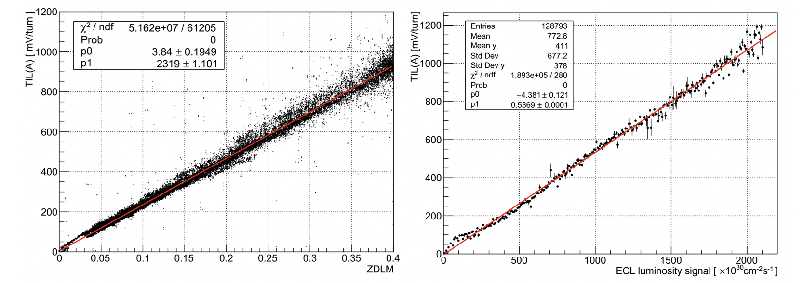
What we have accomplished in Phase 2
LumiBelle2 good correlations with ZDLM and ECL
From C. Pang

Slide 7
What we have accomplished in Phase 2
1% accuracy at 10³⁴cm⁻²s⁻¹ luminosity at 1kHz is foreseen.
This accuracy satisfies the requirement for an input signal of the collision orbit feedback system.
From C. Pang

Slide 8
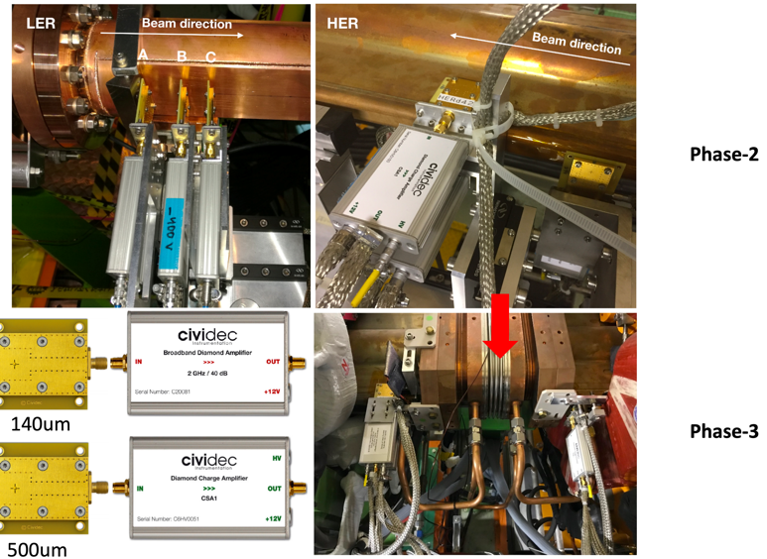
From Phase 2 to Phase 3
LumiBelle2
The diamond sensors (HER) was moved to a new location (~28 m from the IP)
to increase the radiative Bhabha events.
New estimate of the S/N is needed for this new location.
From C. Pang

Slide 9
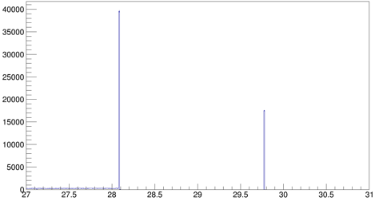
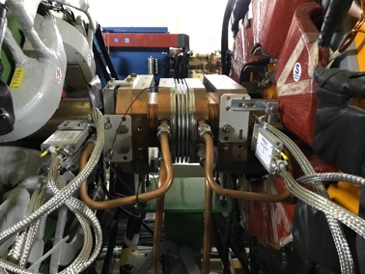
Position update for HER diamonds in Phase 3
The HER side of LumiBelle2 provided low rates during Phase 2, due to the not optimal location of the diamond sensors along the beam-pipe;
A better position was found by detailed tracking simulation of Bhabha photons inside the HER beam pipe;
To place the sensors in the new position, new special holders were designed at LAL;
The position of the sensors was updated in the last week of February (25-28/02/2019);
Precision is extrapolated from Phase 2 and early Phase 3 data.
PHASE 3 SIMULATED EXIT POINTS
New position
Old
position
s(m)
ZDLM
28.1 m
Phase | Luminosity | $ΔL/L$ (1ms) HER/LER (before update) | $ΔL/L$ (1ms) HER/LER (after update)
Phase 3 | $$1×{10}^{34}cm^{−2}s^{−1}$$ | 30 / 1 % | 10 – 3 / 1 %
Design | $$8×{10}^{35}cm^{−2}s^{−1}$$ | 3 / 0.1 % | 1 - 0.3 / 0.1 %
s(m)
LumiBelle2
From S. Di Carlo

Slide 10
Upgrade From Phase 2 to Phase 3
ZDLM
Some new detectors “miniaturized version of ZDLMs” were added to improve the dynamic range
From S.Uehara

Slide 11
Upgrade From Phase 2 to Phase 3
From S.Uehara

Slide 12
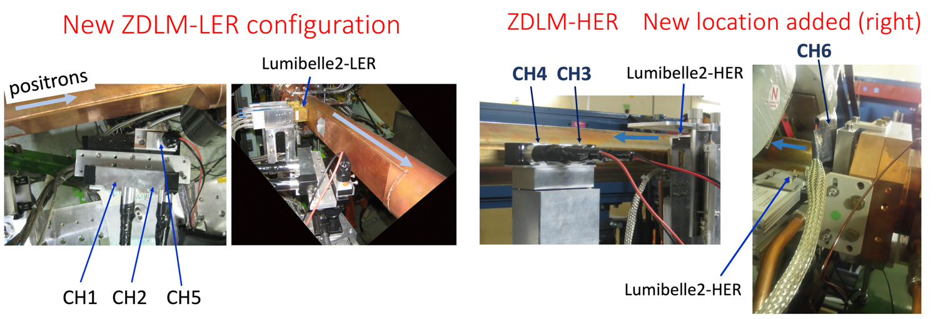
Upgrade From Phase 2 to Phase 3
New configuration Summary
More detectors to cover wider range of luminosity
New locations for better signal
Two sets (lumiBelle2 and ZDLM) at the same location to provide complementary measurements
From S.Uehara

Slide 13
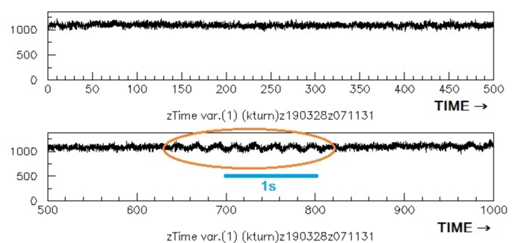
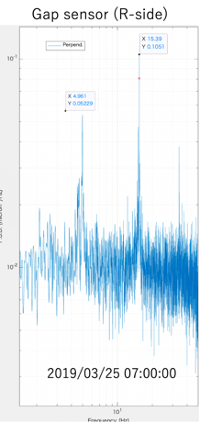
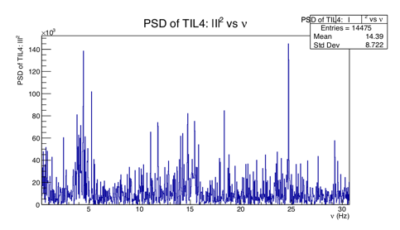
Phase 3 commissioning
Background data are being taken for the single beam mode and colliding beam mode.
being analyzed.
Fast luminosity presented some fluctuation, which are correlated with the ground motion.
Second phase of the Luminosity FB “dithering” test will start soon.
From S. Uehara
From S. Di Carlo

Slide 14
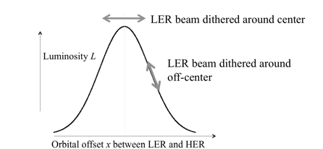
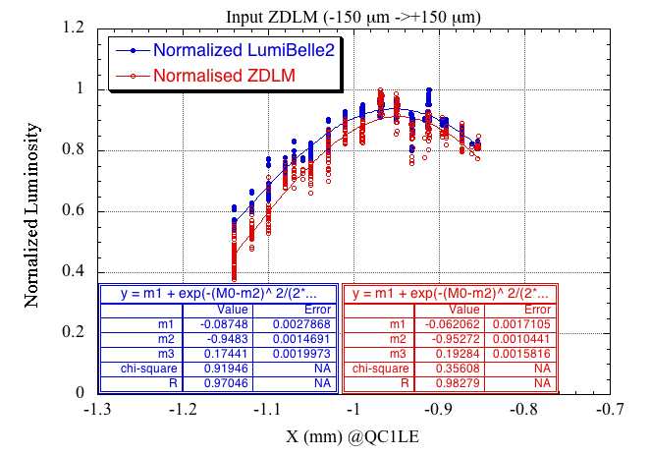
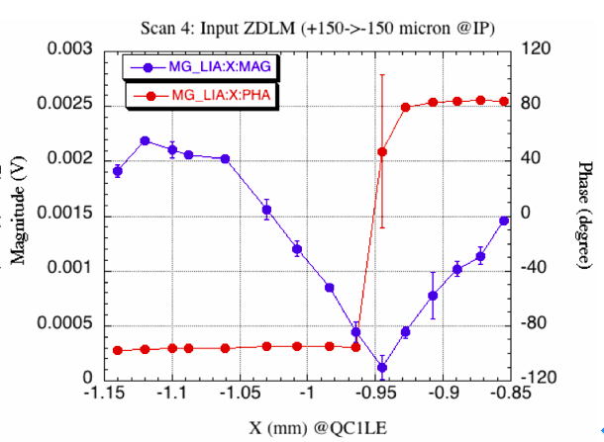
Phase 3 commissioning
Background data are being taken for the single beam mode and colliding beam mode.
being analyzed.
Fast luminosity presented some fluctuation, which are correlated with the ground motion.
Second phase of the Luminosity FB “dithering” test will start soon.
When the beam is dithered around the “center,” where luminosity peaks, luminosity drops on either side of the peak, giving a modulation at 2ω. When dithered off center, there is additional modulation at the fundamental.
Find the orbit which minimizes the amplitude of the fundamental and phase changes by 180 degree
That orbit is the golden orbit where luminosity is maximum!

Slide 15
Summary
SuperKEKB Phase 3 commissioning started on March 11, 2019, followed by the Belle II physics run.
Some modifications/upgrades to the fast luminosity monitors were done after Phase 2 commissioning.
Collision orbit feedback using LumiBelle2 and ZDLM will take place soon.
Upgraded fast luminosity monitors will continue to be very indispensable and powerful tools for machine tuning, and luminosity maximization.

Slide 16
Finally
In the past and present operation the French team has had a full time presence at KEK to support LumiBelle2 because this was an R&D project to develop and build the monitor.
We thank FJPPL and also E-JADE and JENNIFER for their support.
Now we are moving to a longer term collaboration phase
Our hardware at KEK will need to be maintained and supported.
The data should be exploited to pursue some relevant accelerator physics goals.
The goal is to make the SuperKEKB nano-beam scheme a success, and to gain experience for the future colliders.

Slide 17
Achievements
Publications:
A Fast Luminosity Monitor based on diamond detectors for the SuperKEKB Collider, by Chengguo PANG et al., Nuclear Instruments and Methods in Physics Research Section A: Accelerators, Spectrometers, Detectors and Associated Equipment, Volume 931, 1 July 2019, Pages 225-235
Vertical beam size determination at the interaction point of SuperKEKB using offset scans, by Salvatore Di Carlo et al., submitted to PRAB (2019)
First beam loss measurements in the SuperKEKB positron ring using the fast luminosity monitor diamond sensors, by D. El Khechen et al., submitted to PRAB (2018)
Conference reports:
Fast Luminosity Monitoring for the SuperKEKB Collider (LumiBelle2 Project) , by C. Pang et al.: MOPA13.PDF, presented at the 7th International Beam Instrumentation Conference (IBIC 2018), Shanghai, China, 9-13 September 2018, IBIC2018-MOPA13, pp.51-56.
Early Commissioning of the Luminosity Dither Feedback for SuperKEKB, by M. Masuzawa et al.:TUPC13.PDF, presented at the 7th International Beam Instrumentation Conference (IBIC 2018), Shanghai, China, 9-13 September 2018, IBIC2018-TUPC13, pp.328-331.
Early Phase 2 Results of LumiBelle2 for the SuperKEKB Electron Ring , by S. Di Carlo et al.: THYGBE4.PDF, presented at the 9th International Particle Accelerator Conference (IPAC 2018), Vancouver, Canada, 29 April - 4 May 2018 , published in J.Phys.Conf.Ser. 1067 (2018) no.7, 072025
First Tests of SuperKEKB Fast Luminosity Monitors During 2018 Phase-2 Commissioning , by C. Pang et al.: WEPAL038.PDF, presented at the 9th International Particle Accelerator Conference (IPAC 2018), Vancouver, Canada, 29 April - 4 May 2018
Simulation Study on Luminosity Feedback for Horizontal Beam Stabilization at SuperKEKB , by C. Pang et al.: WEPAL037.PDF, presented at the 9th International Particle Accelerator Conference (IPAC 2018), Vancouver, Canada, 29 April - 4 May 2018 , published in J.Phys.Conf.Ser. 1067 (2018) no.7, 072023
Preparation of CVD Diamond Detector for fast Luminosity Monitoring of SuperKEKB , by C. Pang et al.: MOPAB027.PDF, presented at the 8th International Particle Accelerator Conference (IPAC 2017), Copenhagen, Denmark, 14-19 May 2017
First Tests of SuperKEKB Luminosity Monitors during 2016 Single Beam Commissioning , by D. El Khechen et al.: MOPMB006.PDF, presented at the 7th International Particle Accelerator Conference (IPAC 2016), Busan, South Korea, 9-13 May 2016

Slide 18
Students
Doctoral students: 1) Chengguo Pang, PhD in 2019. TYL-FJPPL Student Secondment, March 2019 2) Dima El Khechen, PhD in 2016, TYL-FJPPL Young Investigator Award in 2018 Master students: 1) Watanyu Foosang, 2019 2) Dima El Khechen, 2013

