Slide 1
Connecting the nuclear EOS to the
interplay between low-energy reaction mechanisms
NuSYM 2018
September 10-13, 2018 Busan, SOUTH KOREA
Maria Colonna
INFN - Laboratori Nazionali del Sud (Catania)

Slide 2
Dissipative reaction mechanisms, involving heavy ions, can probe
several aspects of the nuclear effective interaction and nuclear EOS
Outline
Low-energy (E/A ~ 5-10 MeV/A)
reaction mechanisms:
from fusion to quasi-fission and deep-inelastic
The tool: mean-field models (TDHF, Vlasov) and
effective interactions
Sensitivity of selected observables to specific ingredients
of the effective interaction

Slide 3
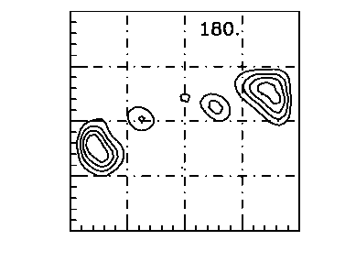

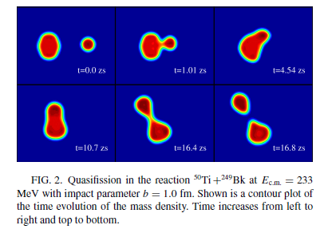
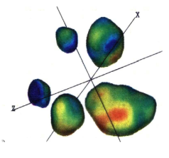
Low-energy reaction mechanisms:
a study within mean-field models
Charge equilibration
Fusion vs Quasi fission or
Deep Inelastic
(Fermi energies)
Fragmentation
Fragment isotopic
composition

Slide 4
(Beyond) Mean-field models and effective interactions
One-body
description
ρ₁ : one-body density
iħ
TDHF
ETDHF
semi-classical approximation
k
δk
Residual interaction:
in-medium NN cross section σ_{NN}
2-body correlations, Fluctuations
Vlasov
BUU, Boltzmann-Langevin
H_{eff} : effective Hamiltonian
Effective interactions are phenomenological
(ex: Skyrme interactions, …)
Expectation value of physical quantities :
EDF, Nuclear matter EOS,
symmetry energy
functions of isoscalar, spin, isospin densities, currents …

Slide 5
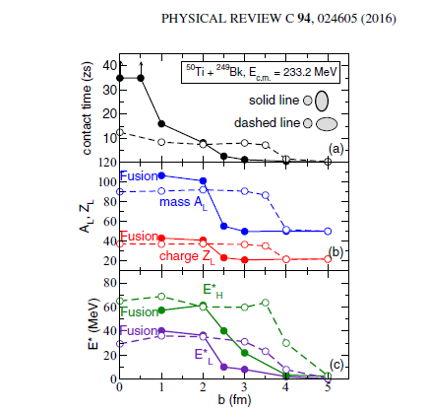
Fusion vs. Quasi Fission: towards the synthesis of SHE
⁵⁰Ti +²⁴⁹Bk 233 MeV
FUSION
Umar, Oberacker, Simenel
side
tip
TDHF calculations
soft
Fusion probability depends on the
deformation/orientation of colliding nuclei
Symmetry energy effects
stiff
Semi-class. calculations with neutron rich systems
l (ћ)
C.Rizzo et al., PRC83, 014604 (2011)

Slide 6
TDHF and effective interactions
D.Lacroix
IPN-Orsay
TDHF equation
Energy density functional with Skyrme interactions
isoscalar
9 parameters → 9 nuclear properties can be fixed

Slide 7
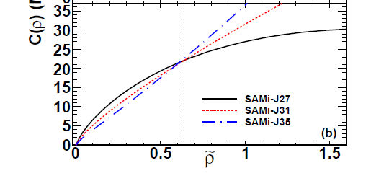

Connecting the reaction dynamics
to nuclear properties
SAMi-J:
changing the symmetry energy slope
Taking SAMi-J31 as a reference:
consider interactions with different
compressibility
effective mass
n/p effective mass splitting
surface terms
(ground state properties are affected
by less than 5%)
(MeV)
J-L correlations
SAMi-J:

Slide 8
Employed effective interactions

Slide 9
Fusion vs quasi-fission:
TDHF simulations
at the threshold between fusion and quasi-fission
Sensitivity of sub-barrier
fusion cross section
to EOS ingredients
P-G Reinhard et al.
tip collisions
²³⁸U is deformed:
→ sensitivity to projectile-target orientation (side or tip)
→ quasi-fission observed for the tip configuration

Slide 10
TDHF simulations
side collisions
quadrupole moment evolution
x
beam axis
G_{S} = 130 Mev fm⁵
SAMi-J31
G_{S} = 140 Mev fm⁵
J35
J31
J27
symmetry energy effects
SAMi-J35
Larger effects are due to the surface term !

Slide 11
TDHF simulations
side collisions
J35
G_{S} = 130 Mev fm⁵
J27
G_{S} = 140 Mev fm⁵
Surface effects
J35
J27
__ G_{S} = 130 Mev fm⁵, G_{V} = 15 MeV fm⁵
- - - G_{S} = 130 Mev fm⁵, G_{V} = 3 MeV fm⁵
Isoscalar surface term → large effects
Compressibility effects
K = 200 MeV
Nuclear compressibility →
large effects
K = 240 MeV
K = 290 MeV

Slide 12
TDHF simulations
side collisions
Isoscalar effective mass
G_{S} = 130 Mev fm⁵
m*_{S} ~ 0.7 m
With increased effective mass :
→ jump from quasi-fission to fusion
m*_{S} = 0.85-1 m
Isovector effective mass
m*_{p} < m*_{n}
m*_{n} < m*_{p}
With increased effective mass splitting:
→ faster quasi-fission
G_{S} = 130 Mev fm⁵
H.Zheng et al.,

Slide 13
Conclusions
Dissipative reactions at low energies open the opportunity
to learn about fundamental properties of the nuclear
effective interaction, of interest also in the astrophysical context
Competition between fusion and quasi-fission
Reaction mechanisms at the borderline with nuclear structure:
In ⁴⁰Ca + ²³⁸U reactions at energies close to the Coulomb barrier
an important sensitivity is observed to nuclear EoS properties:
surface - compressibility – effective mass – symmetry energy
Collaborators: Hua Zheng (LNS), S. Burrello (LNS & Seville),
D. Lacroix (IPN-Orsay), G. Scamps (Tsukuba Univ.)

Slide 14
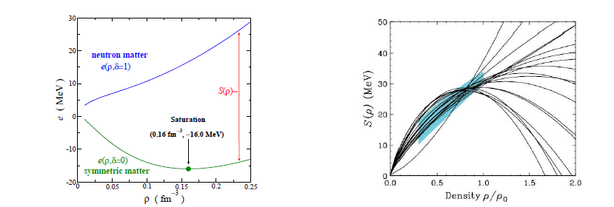
The nuclear Equation of State (T = 0)
and the symmetry energy
Energy per nucleon E/A (MeV)
Symmetry energy E_{sym} (MeV)
soft
poorly
known …
stiff
predictions of several
effective interactions
symm. matter
symm. energy
expansion around normal density
β = asymmetry parameter = (ρ_{n} - ρ_{p})/ρ
analogy with Weizsacker
mass formula for nuclei (symmetry term) !
or J
25 ≤ J ≤ 35 MeV
20 ≤ L ≤ 120 MeV

Slide 15
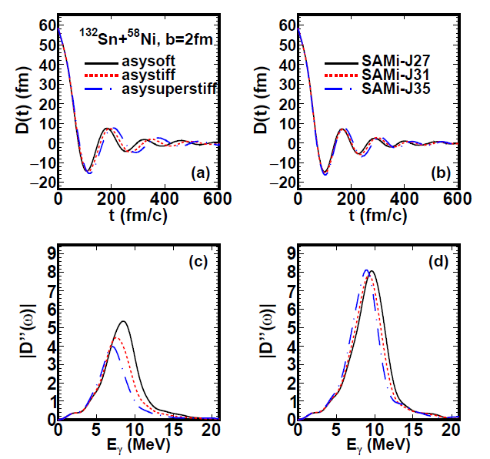
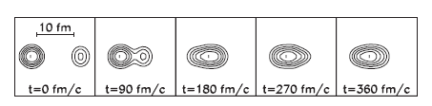
Charge equilibration and dipole oscillations:
dependence on the effective interaction
¹³²Sn + ⁵⁸Ni , D₀ = 45 fm, E/A = 10 MeV
Vlasov calculations
A₁
A₂
3πħc³E_{γ}
MI
MD
The DD emission looks sensitive to E_{sym} at ρ = 0.6 ρ_{sat}
Larger strength seen in the MD case
damping connected to n-n collision time (τ_{coll} )
(damped harmonic oscillator)

Slide 16
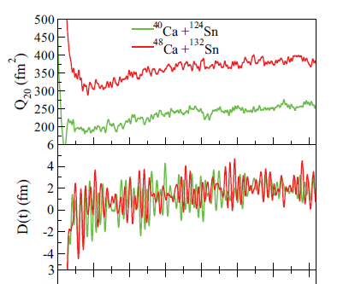
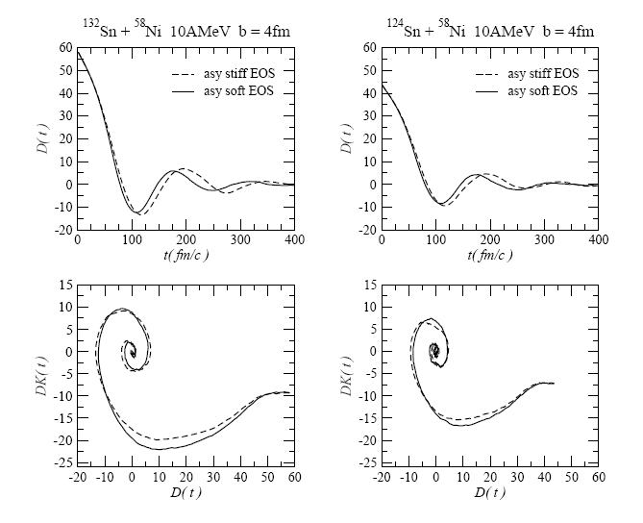
Charge equilibration in heavy ion reactions (Dyn. Dipole)
TDHF
calculations
A₁
A₂
Simenel et al,
PRC 76, 024609 (2007)
Initial Dipole
D(t) : bremss. dipole radiation Compound: stat. GDR
If N₁/Z₁ ≠ N₂/Z₂
Relative motion of neutron and proton centers of mass
+ 2-body
collisional damping
130 MeV
Semi-classical
simulations
¹³²Sn + ⁵⁸Ni , D₀ = 45 fm
E/A = 10 MeV
TDHF calculations
damped oscillations
Oberacker et al., PRC 85,
034609 (2012)
C.Rizzo et al., PRC 83,
014604 (2011)
3000
6000
Time (fm/c)

Slide 17
Dynamical Dipole in heavy ion reactions (DD)
The restoring force is provided by the symmetry term (as in the standard GDR)
probe the symmetry energy in the density conditions and configurations
reached along the reaction path
(low density)
Cooling mechanism in the formation of Super Heavy Elements (SHE)
Theory: a more systematic study of the sensitivity of this mechanism to
the ingredients of the effective interaction and two-body dissipation needed
Ground state deformation important ???
DD in the fusion-evaporation of the ⁴⁰Ca + ¹⁵²Sm heavy system, C.Parascandolo et al., PRC 93, 044619(2016)

