Slide 1


TYL-FJPPL: Computing (new proposal)
Evolution of the computing environment for high-energy and astroparticle experiments
Tomoaki Nakamura (Computing Research Center, KEK)
on behalf of
CC-IN2P3: F. Hernandez* → R. Vernet,
G. Rahal, V. Hamar, S. Gadrat, M. Puel, F. Wernli, J. Bussery
KEK-CRC: T. Nakamura*, W. Takase, S. Kaneko, G. Iwai, K. Murakami, T. Sasaki,
S. Suzuki, W. Takase, H. Matsunaga
* Leader

Slide 2
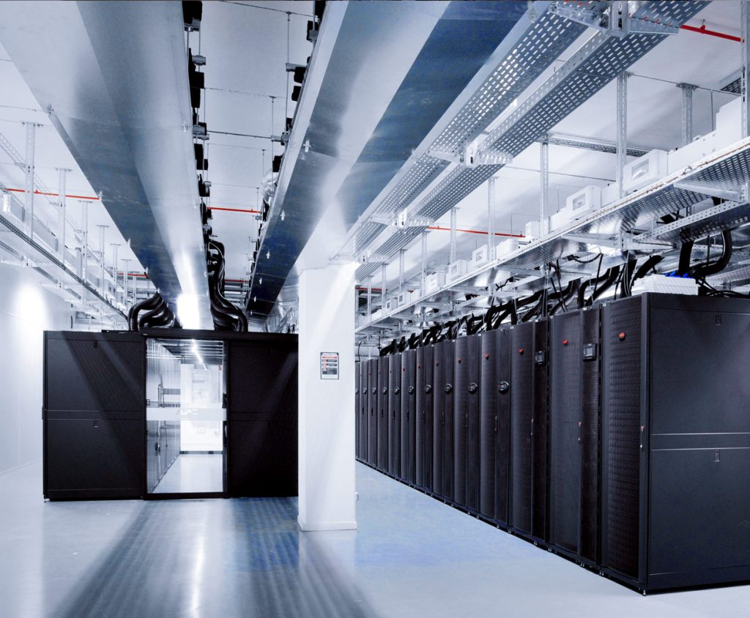
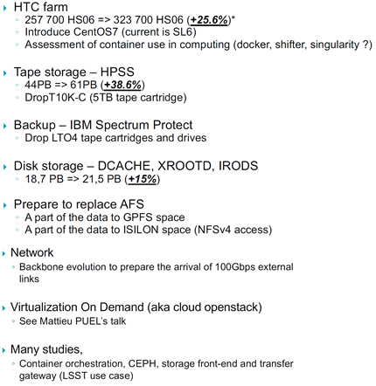
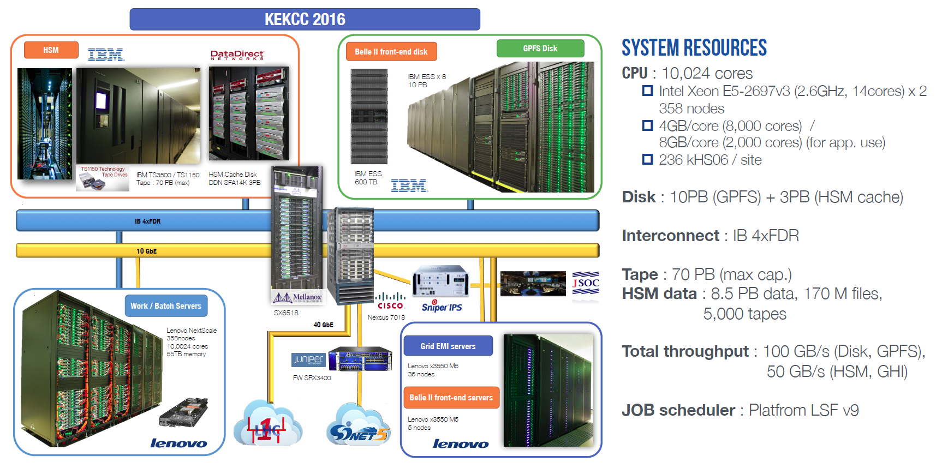
CC-IN2P3 and KEK-CRC
CC-IN2P3
  System upgrade and resource enhancement are made gradually, year-by-year.
KEK-CRC
  System duration is 4~5 years.
  Replace whole HW components at once.
Exchange of experience is quite essential!
  Type of computing cluster, Disk storage system,
  Tape archiving system, etc.
Upgrade of CC-IN2P3 in 2018
The current KEKCC has been in production mode since 2016
=> 395 860 HS06
=> 64PB
=> 35PB
AFS was replaced to;

Slide 3
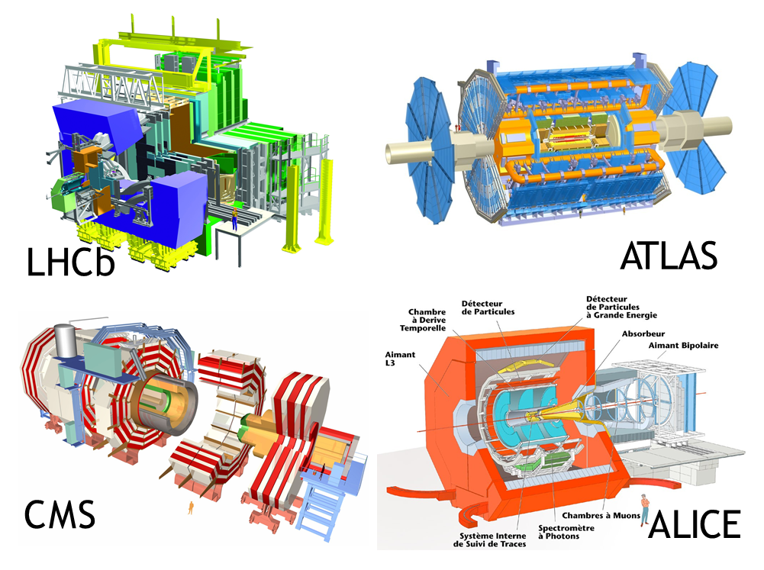
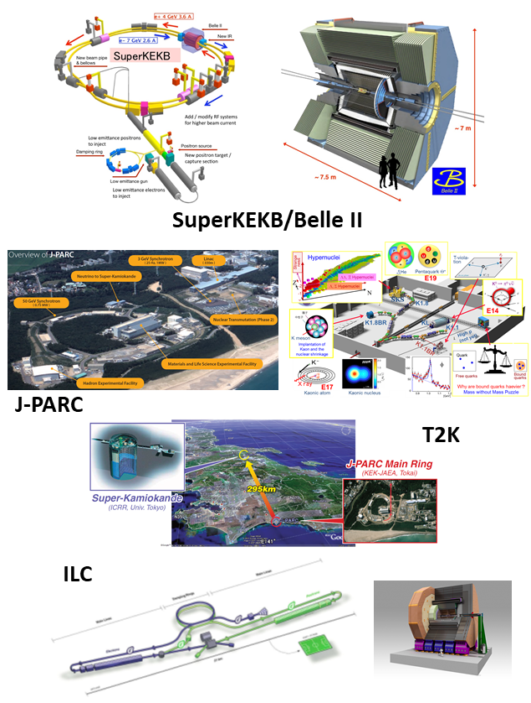
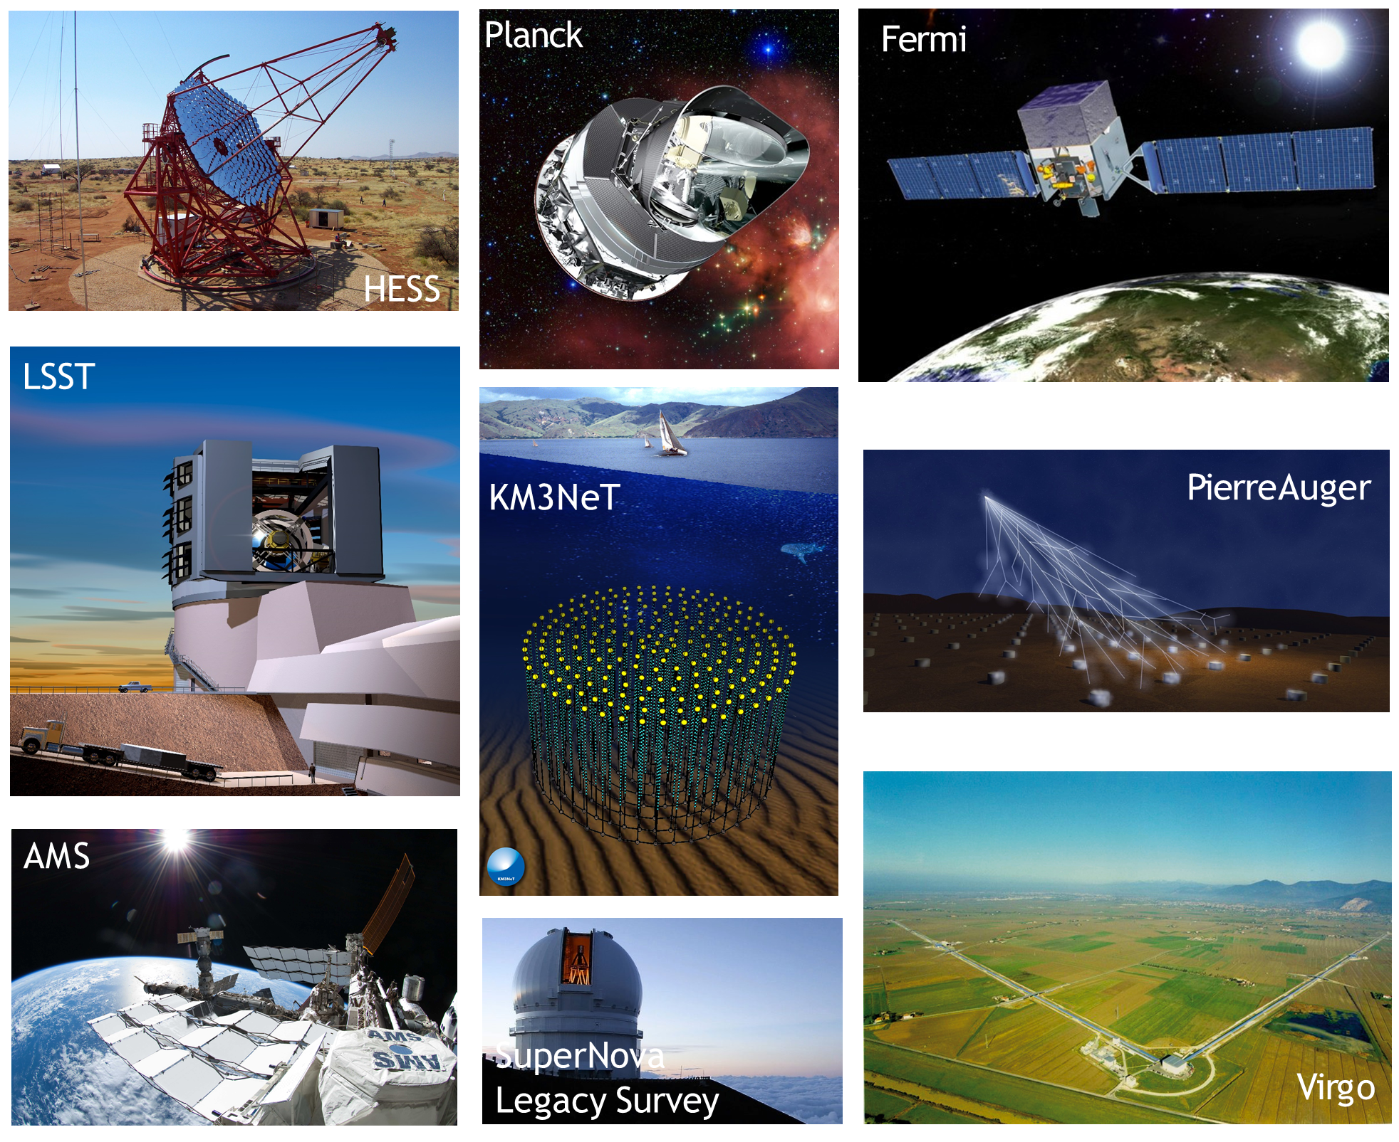
Supporting ongoing/future experiments
LHC

Slide 4
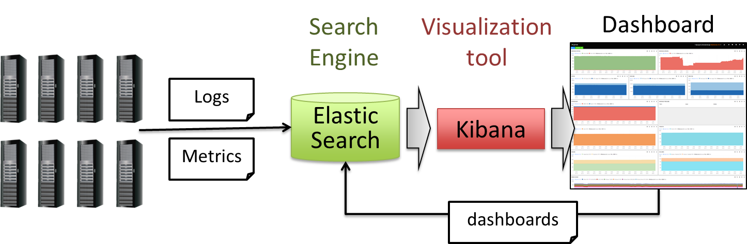
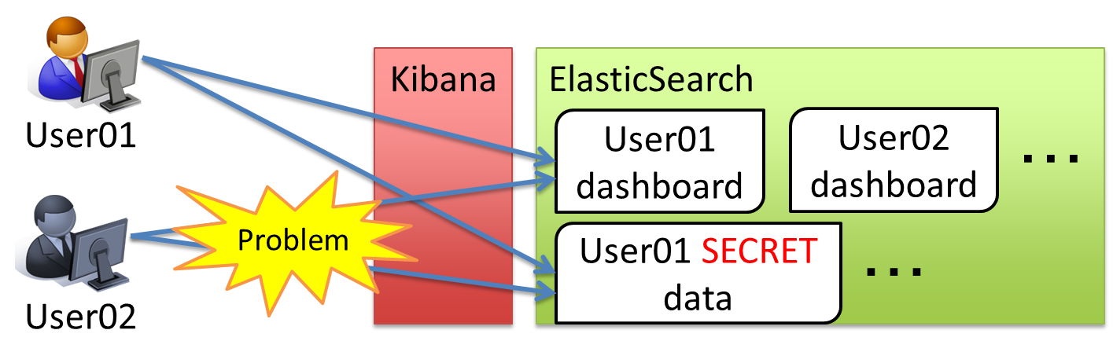

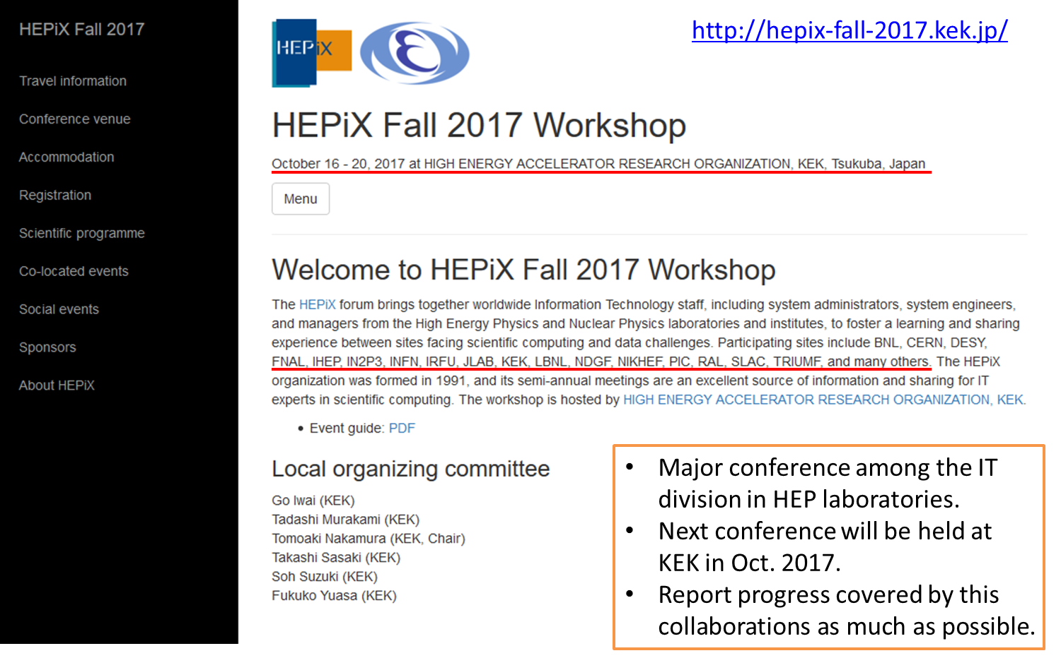
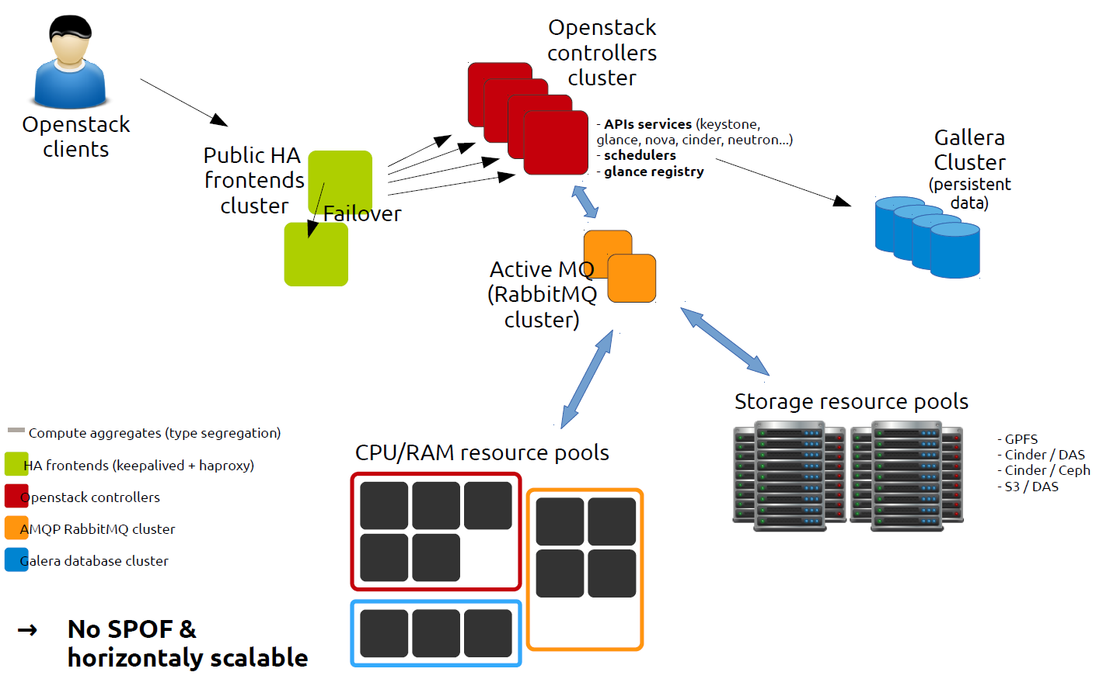
Summary of COMP_03 (2015 - 2019)
“Computing platforms for future experiments”
A lot of fruitful achievements for past four years
Development of AA mechanism for monitoring infr.
Share experience on the operation of HSM
KEK Technology Prize 2017
Exchange technics on the deployment of private Cloud with OpenStack
Significant contribution to the HEPiX WS
Major conference among the IT division in HEP laboratories.
Many talks were given by people in both centers.

Slide 5
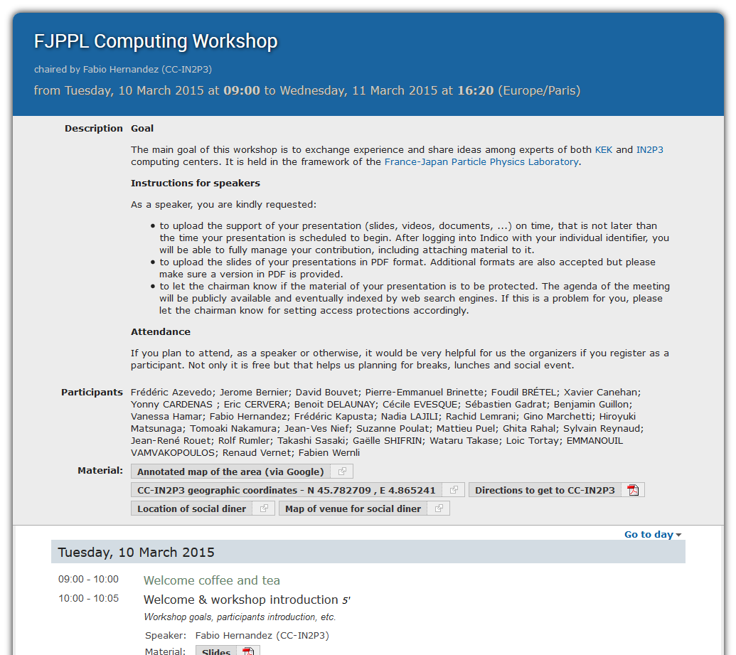
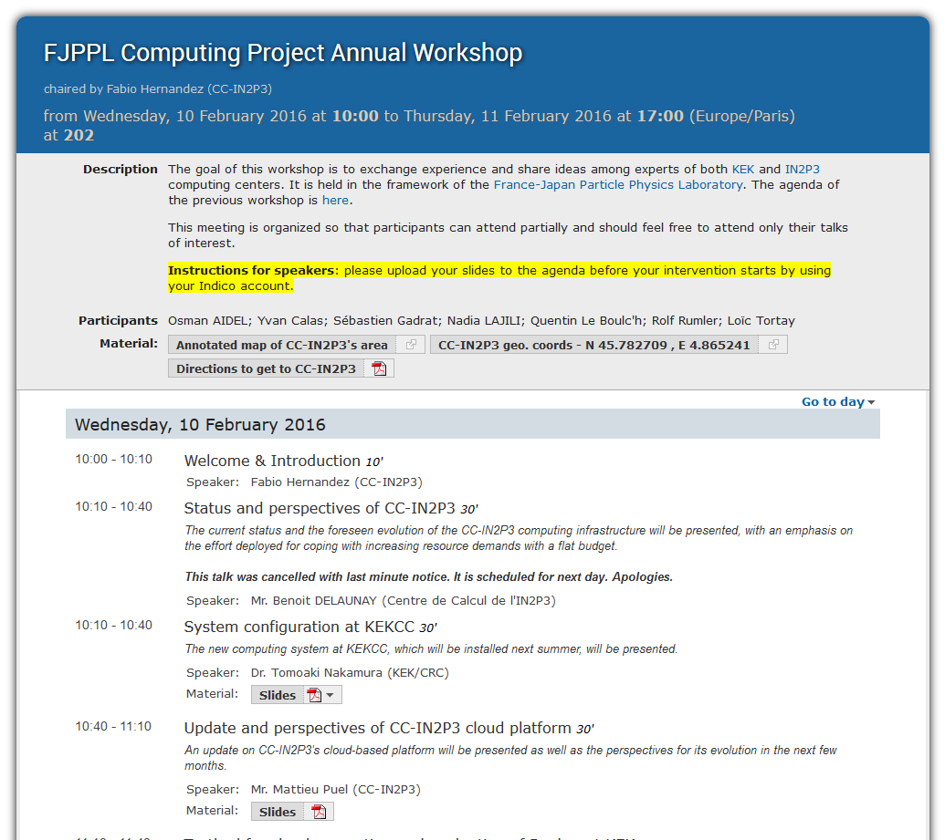
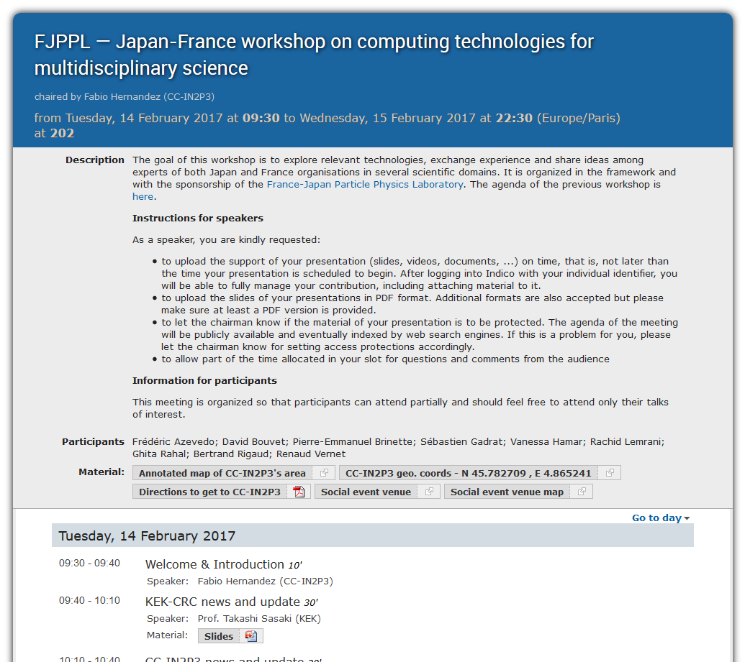
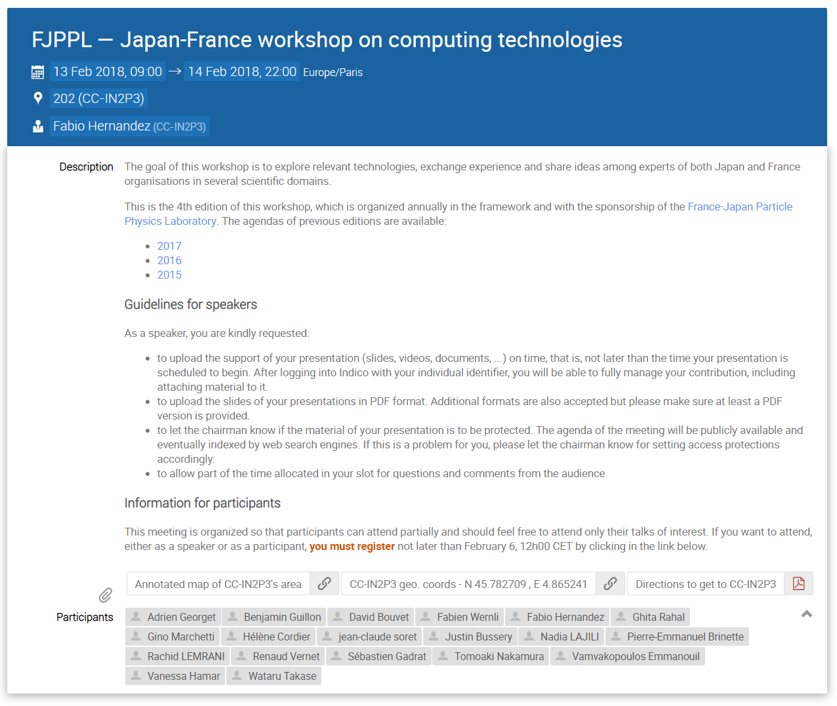
Meetings
2015: 23 talks
https://indico.in2p3.fr/event/11289/
2016: 12 talks + hands on + discussion
https://indico.in2p3.fr/event/12701/
2017: 18 talks + discussion
https://indico.in2p3.fr/event/14157/
2018: 16 talks + discussion
https://indico.in2p3.fr/event/16922/
Information exchange
Share experience
Common interests for both centers
Determine the specific subjects to collaborate
Regularly held in Lyon

Slide 6
R&D plans of the new project
We have set the following concrete plans for our R&D theme based on the collaborative work conducted for several years between CC-IN2P3 and KEK-CRC as a successor project of COMP_03 (2015 - 2019).
(a) Deployment of HTTP based data transfer system
  Near term (to be completed within a few years)
  Expected to be replaced from GridFTP
  Necessary for the network-oriented data distribution/process for new experiments
(b) Study of hybrid computing system of on-premise resource and
commercial cloud services
  Need to keep track continuously
  Deployment and operational experience of Hybrid cluster system at KEK-CRC
  CC-IN2P3 is involved in Helix Nebula Science Cloud project and ESCAPE project
Application and development of machine learning for computer system
  Middle term
  Optimization for the effective use of limited computing resource
  Balance many kinds of requests by leveraging available system logs with ML

Slide 7
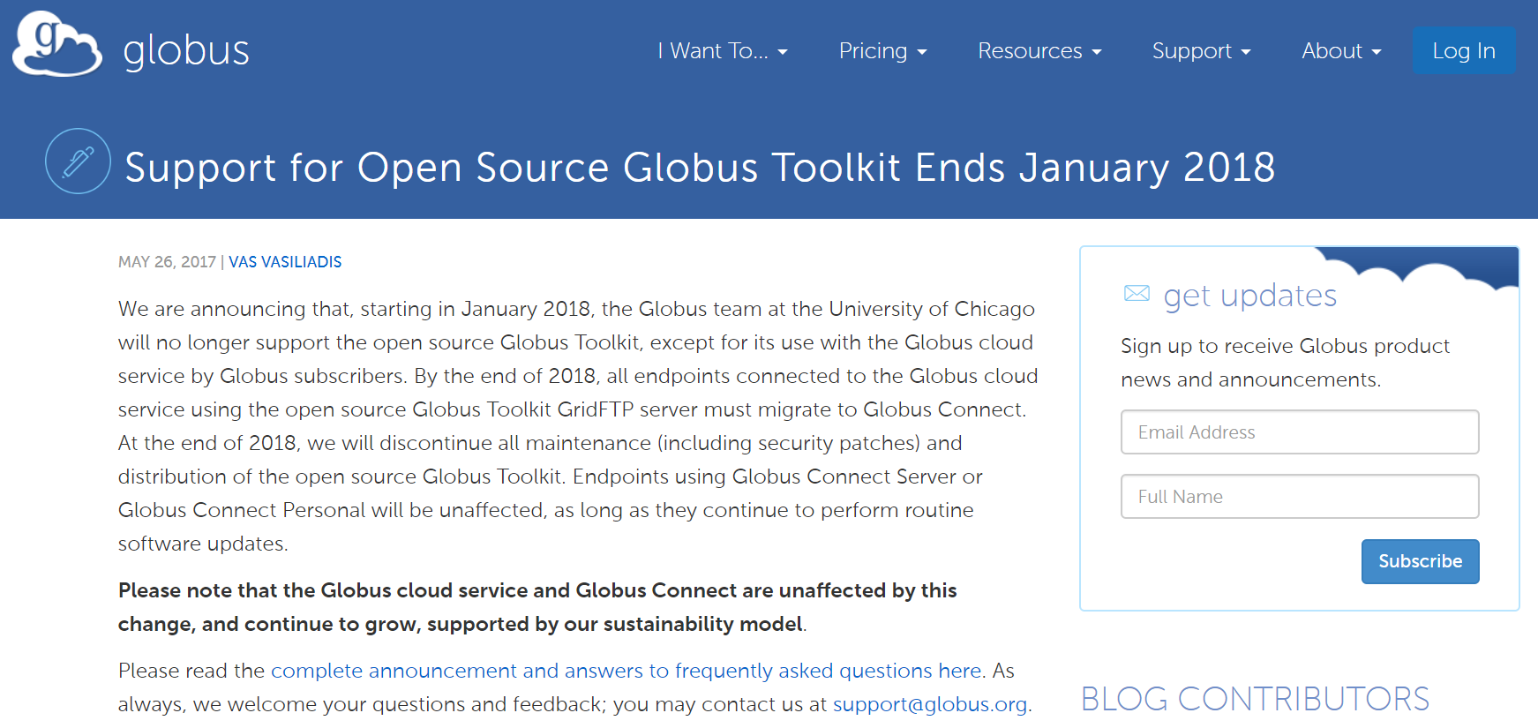
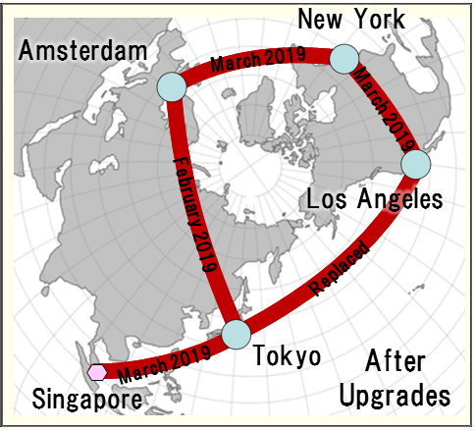
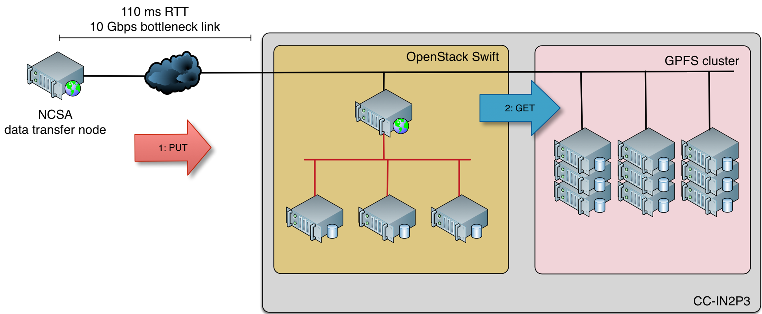
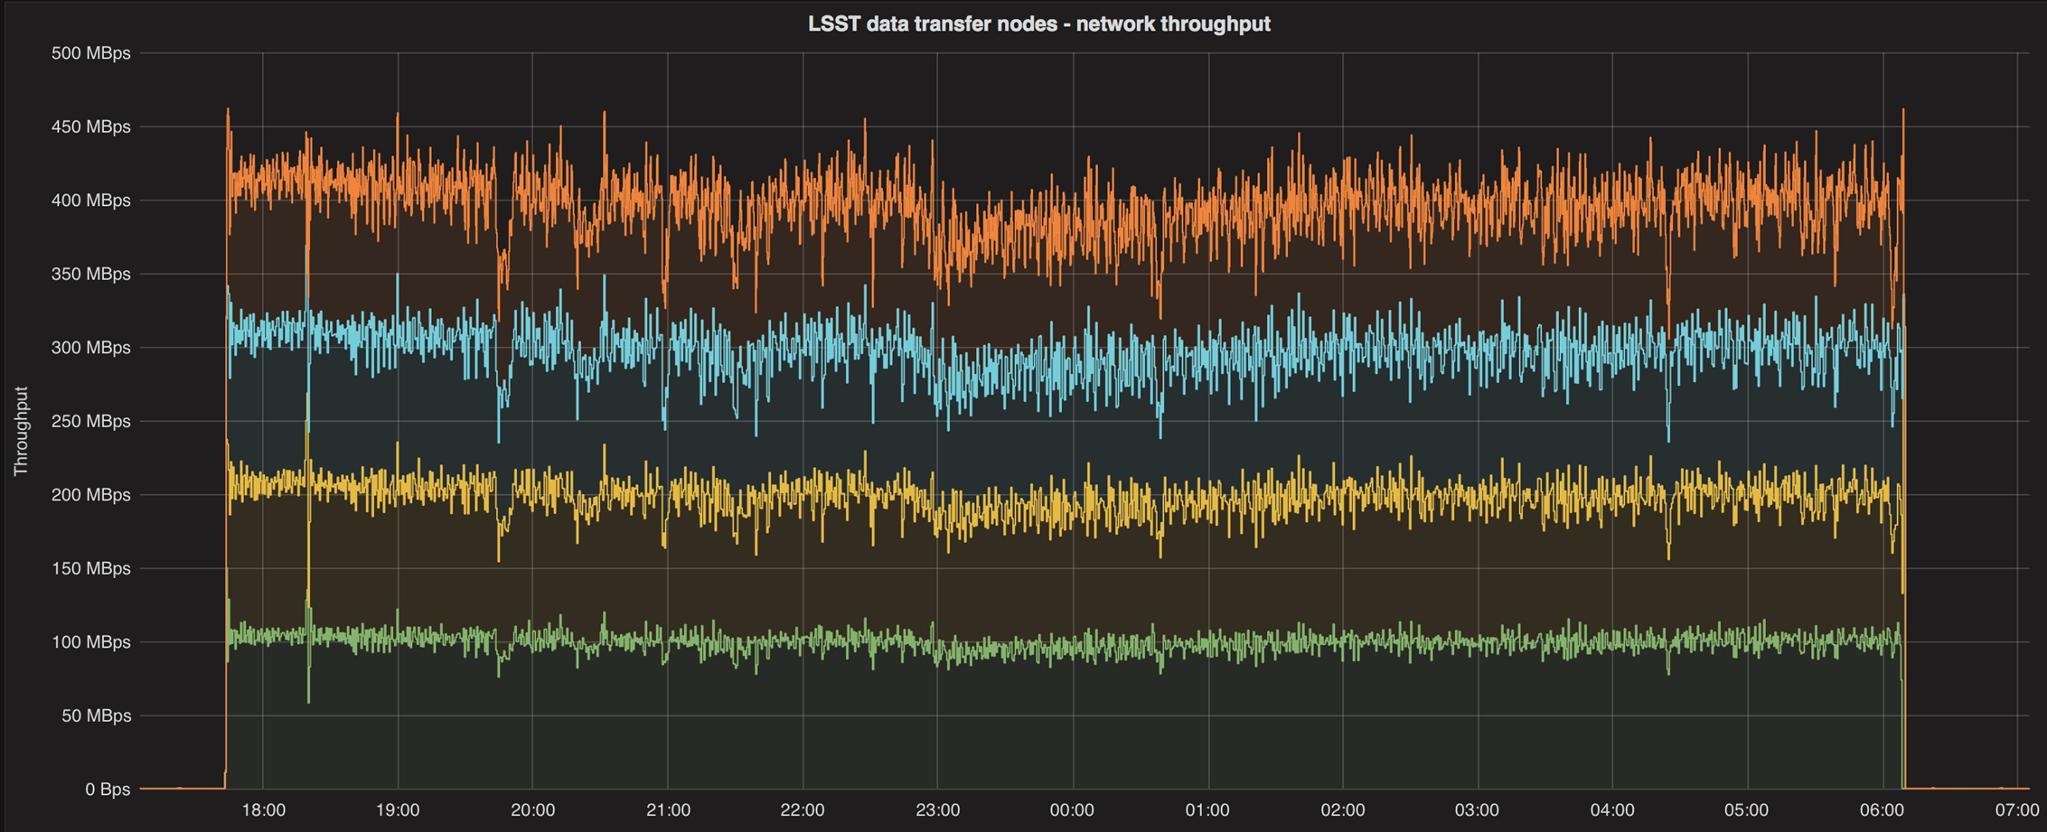
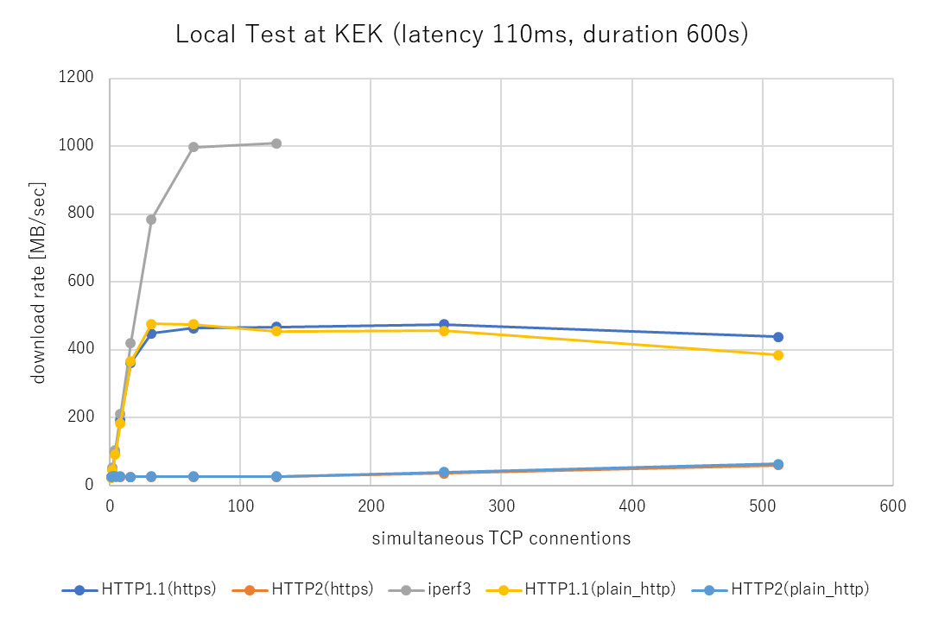
Plan (a)
Deployment of HTTP based data transfer system
100G global link is available since Mar. 2019 (SINET5)
EOL of GridFTP will be coming soon
Alternatives: HTTPS, XrootD, others
~360MB/sec
Transition to the new mechanism is urgent
System has been developed at CC-IN2P3 for LSST
Pilot study was started on the transfer test between KEK-CRC and CC-IN2P3
Implementation of convectional functionality like FTS and so on
A pilot test has already been done between CC-IN2P3 and KEK-CRC.
Transfer throughput is reached at ~100MB/s by limited network link (1Gbps)

Slide 8
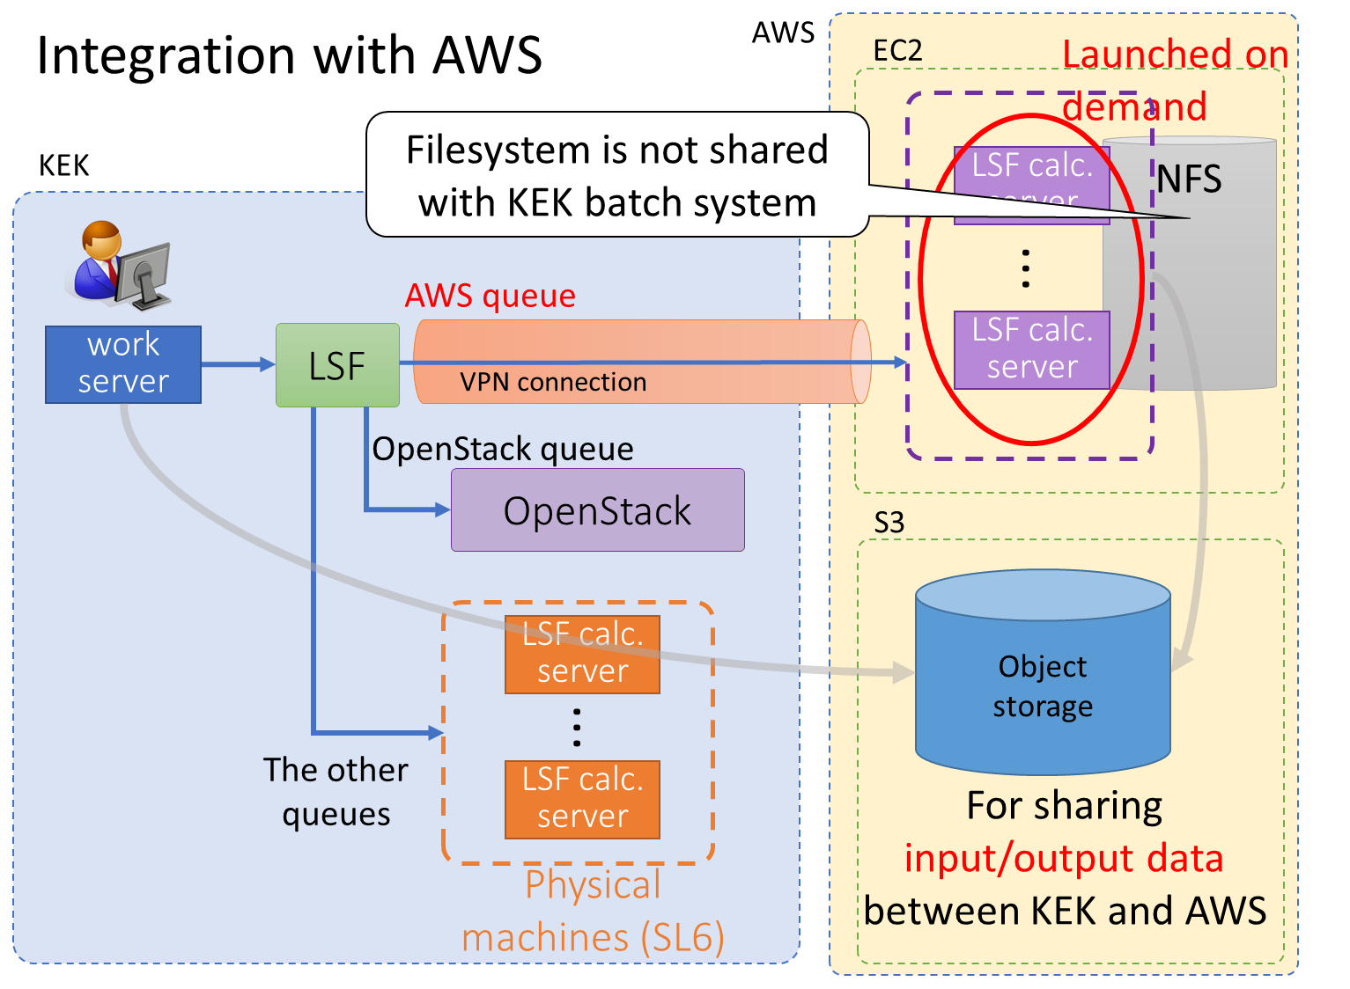
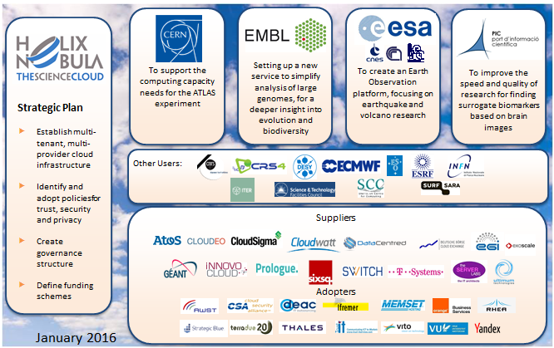
Plan (b)
Study of hybrid computing system of on-premise resource and commercial cloud services
How to compensate seasonal peak of requirement for CPU usage?
Possible candidate: Utilize public Cloud
Hybrid system integrating public cloud with local cluster was developed at KEK
CC-IN2P3 is involved in an European-wide effort: Helix Nebula Science Cloud
HNSCiCloud (driven by CERN) was finished at the end of 2018
and new project has been lunched since Feb. 2019.
ESCAPE (European Science Cluster of Astronomy and Particle physics
ESFRI (European Strategy Forum on Research Infrastructures))
https://www.escape2020.eu/
Keep track two complementary approaches continuously to catch up with the cutting-edge technology and knowhow

Slide 9
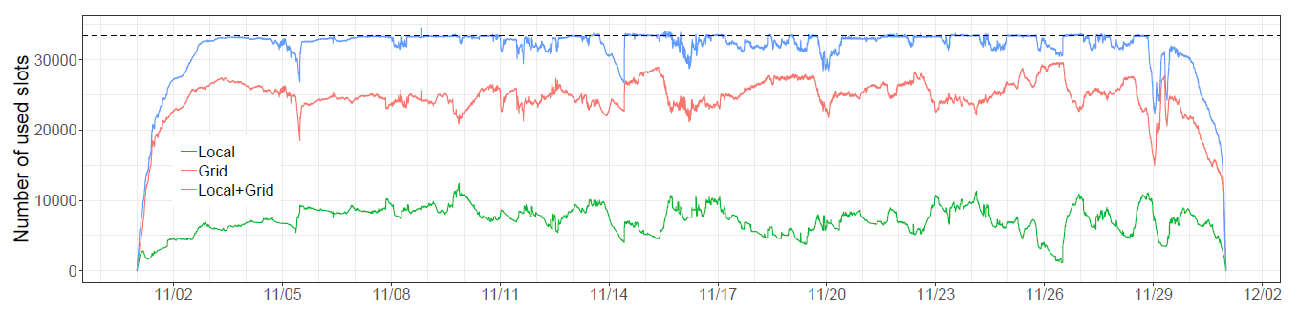
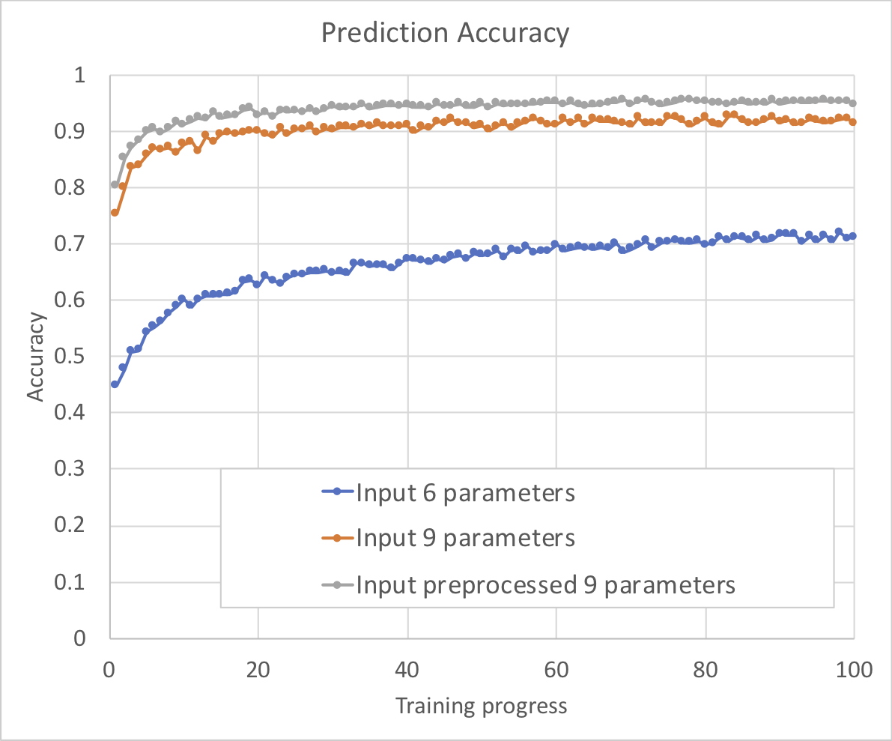
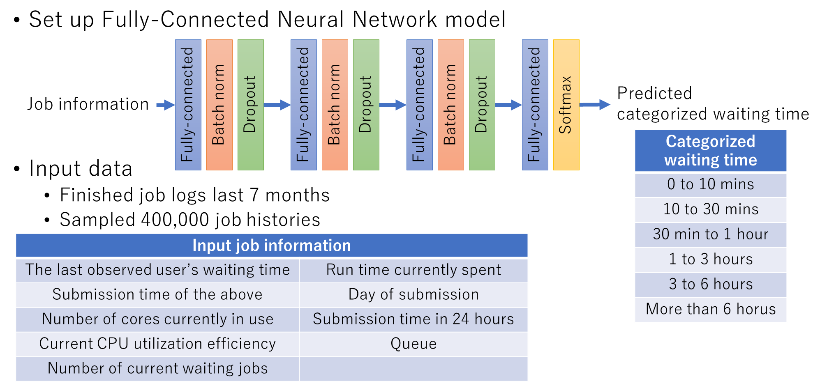
Plan (c)
Application and development of machine learning for computer system
Provide information on the cluster to users by using Deep Learning
Workload analysis: Local vs. Grid jobs (F. Suter, CC-IN2P3)
Efforts to reduce the unused resource: fair-share among the various experimental groups
Further optimization towards more than 90% utilization
Provide real-time status to users
Is such information predictive?
Identify the source of conflicts and hardware issue
Tune the ML algorithm
Develop the ML-based tools for users
Developed at KEK

Slide 10
Summary
In this new proposal, we have set the following research plans based on the knowledge and experiences from the previous project
(FJPPL-TYL COMP_03, 2015 - 2019):
(a) Deployment of HTTP based data transfer system
(b) Study of hybrid computing system of on-premise resource and
commercial cloud services
(c) Application and development of machine learning for computer system
Several pilot studies have already been started for those subjects.
We can expect promising R&D achievements by this new project.

