Slide 1
LAMPS (Large Acceptance Multi-Purpose Spectrometer)
Brief history of LAMPS
‘13 7월 기준 LAMPS 예산 350억 필요

Slide 2
LAMPS (Large Acceptance Multi-Purpose Spectrometer)
Brief history of LAMPS
약 35억 예상
350억 → 315억

Slide 3
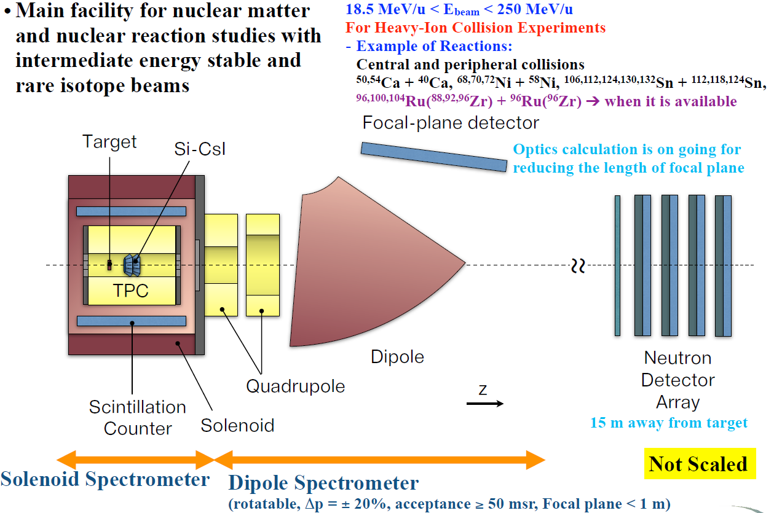
LAMPS (Large Acceptance Multi-Purpose Spectrometer)
Brief history of LAMPS
Dipole spectrometer:
약 95억 예상
Si-CsI array:
약 25억 예상
315억 → 195억

Slide 4
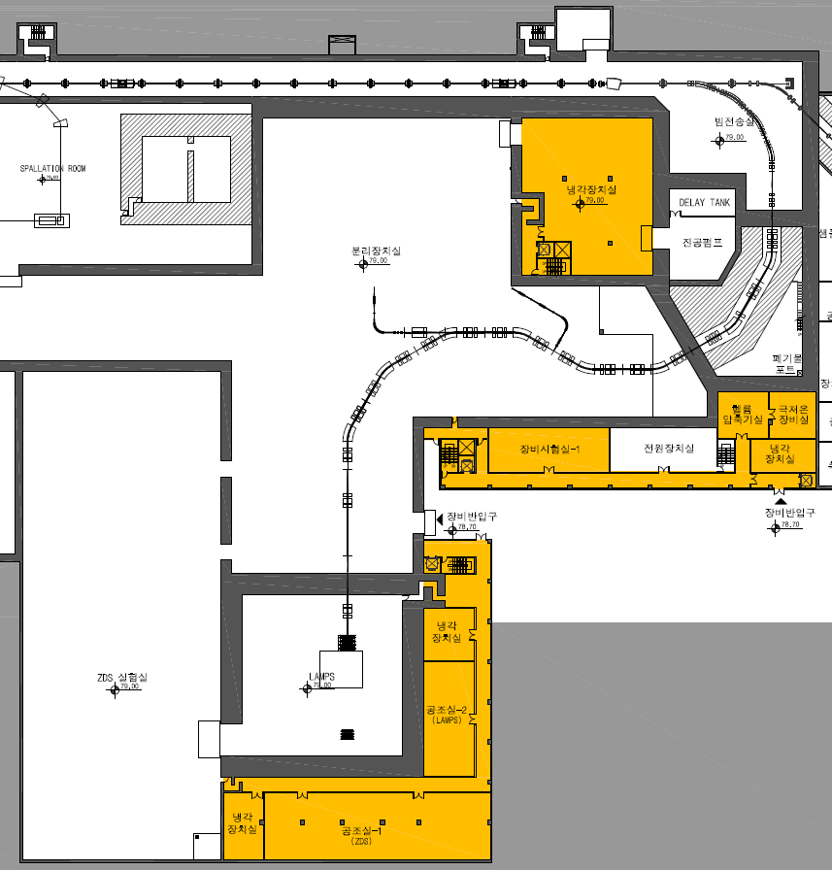
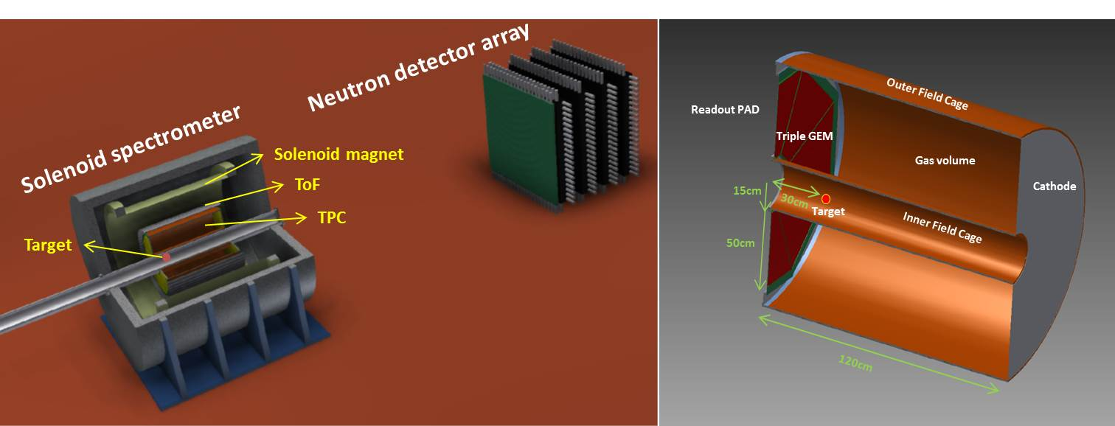
LAMPS (Large Acceptance Multi-Purpose Spectrometer)
Main Research Subject:
Study of nuclear symmetry energy at supra-saturation density via heavy-ion collision experiment using rare isotope beam with varying beam energies and collision systems (e.g. measure n/p ratio & collective flow at the same time in the combination of ^{106,112,124,130,132}Sn + ^{112,118,124}Sn)
Beam Energy: up to 250 MeV/u
Solenoid Spectrometer
- Max. 1T solenoid magnet
- TPC (~ 3π sr acceptance, charged particle tracking)
- Scintillation counter (trigger & ToF)
Neutron Wall (neutron tracking)
IF separator
Neutron Detector Array
Solenoid magnet, TPC, etc
Installation
Commissioning

Slide 5
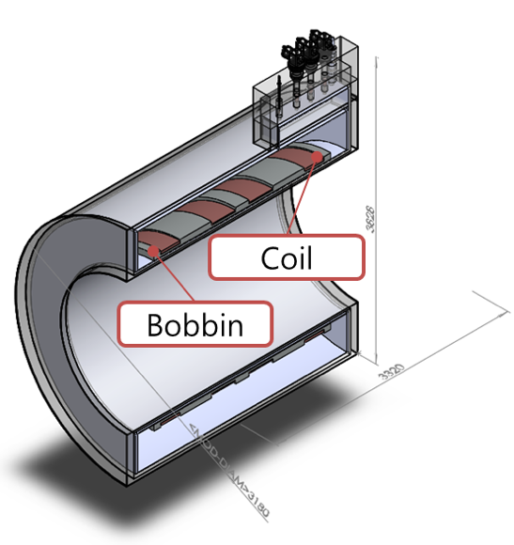
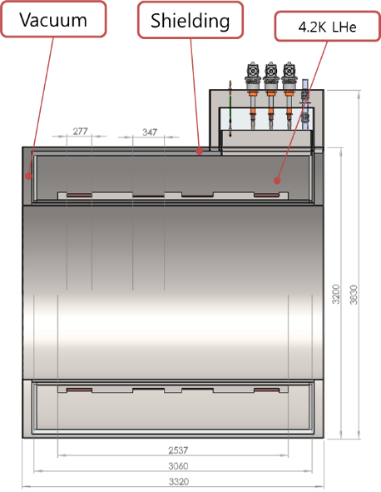
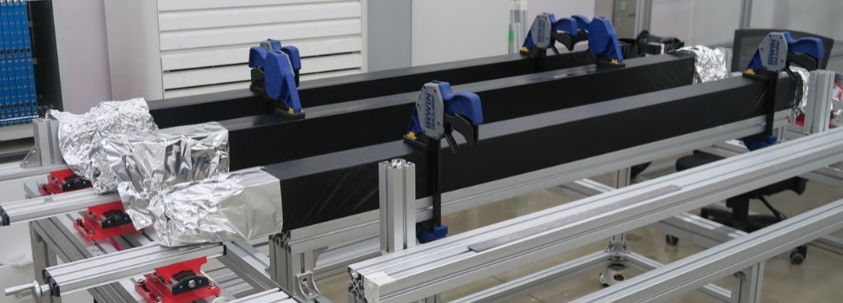
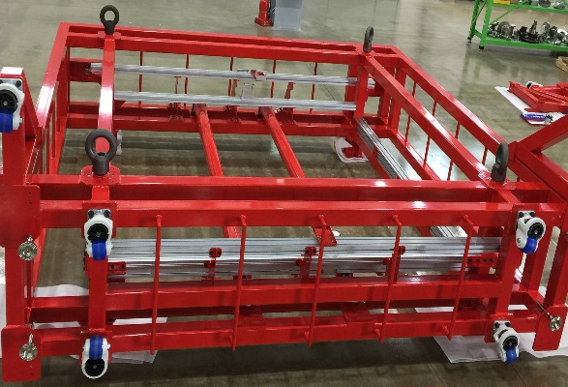
LAMPS (Large Acceptance Multi-Purpose Spectrometer)
Solenoid Magnet
Forward Neutron Detector Array
Completed design of superconducting magnet
Procurement will be started next year
Time Projection Chamber (TPC)
- Completed all R&D processes
- Detector production in progress
- Plan to finish detector production & installation by the end of 2018
- Complete integration & test by the middle of 2019
- Test of real size GEM foil is underway
- Final design of readout chamber, gas vessel, field cage is in progress
- LAMPS TPC will be constructed and tested from 2019 to 2020
All of LAMPS system will be ready by 2020
Start installation from 2021 then standalone commissioning during 2021

Slide 6
LAMPS (Large Acceptance Multi-Purpose Spectrometer)
Present
장관TF 이후 LAMPS 예산: 195억 → 140억
낙찰율 80~85% 예상, 7개 활용시설 제작, 활용활성화
’18 7월 기준 사용 예산: 약 34억
Neutron Detector Array 확보 (제작비 필요)
TPC electronics 확보 (# of readout channel: 100k → 30k
cable, cooling system, LV system 필요)
LAMPS 필요장치
Solenoid magnet: 약 23억 (without moving platform)
IF-LAMPS beam line magnet: 약 10억
Beam line (beam pipe, vacuum pump & chamber, beam diagnostic detector), target: 약 10억
TPC system (GEM foil, GEM HV system, field cage, gas vessel, support structure inside
solenoid magnet, gas system, calibration system, etc.): 약 20억
ToF/trigger 검출기 (scintillator, light guide, meshed PMT, support structure inside solenoid
magnet) + electronics: 10억
DAQ (network switch, data storage 포함): 약 20억
기타 (control system, etc.) : 약 13억

