Slide 1
A_RD_15 report/application Development of an optical cavity system for the advanced photon sources based on Compton backscattering
A. Aryshev (KEK) and A. Martens (LAL) on behalf of
KEK (Omori, Honda, Fukuda), Wasda (Sakaue), Hiroshima (Takahashi)
LAL(Amoudry*, Cassou, Chiche, Le Barillec⁺, Nutarelli, Soskov, Wang*, Zomer)
*: PhD students
⁺: non-permanent contract

Slide 2
Collaboration history
Snowmass 2005:
ILC Polarized positron source proposal: significant LAL and KEK contributions
2005
Start of FJPPL/TYL collaboration: Proposal of a demonstrator on KEK ATF
2008
Start of installation of joint LAL/KEK experiment at KEK ATF
2009
Earthquake
2011
Upgrade and second part of the experiment
2013
Lighter collaboration:
Yearly micro-workshops with some common publications
LAL PhD student (P. Favier) went to KEK (Honda-san) thanks to JSPS
2014
–
2017
Idea of LAL/KEK optimized burst operation demonstrator
2018

Slide 3
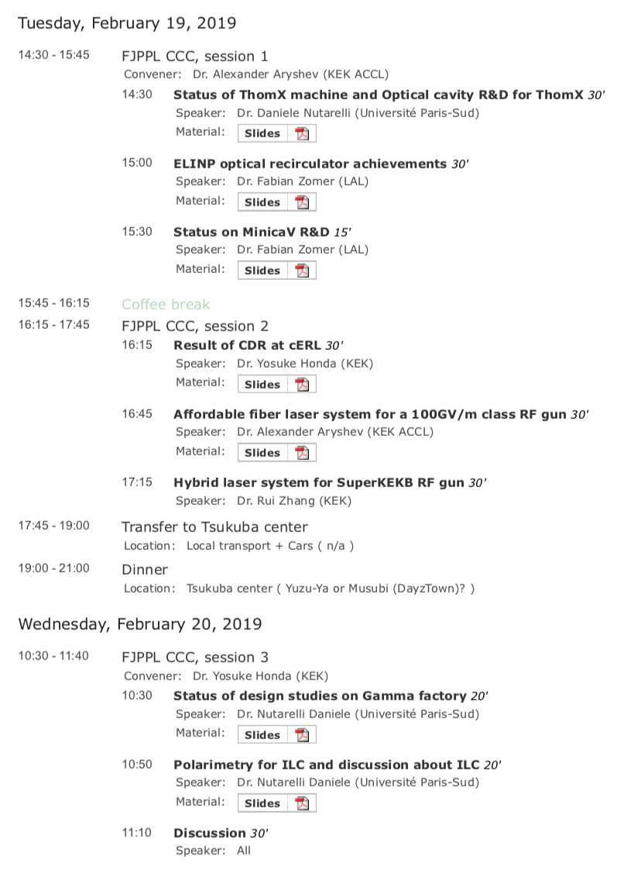
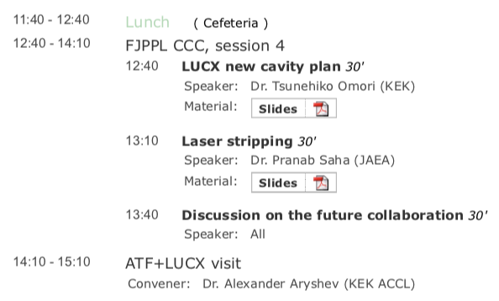
This year’s meeting agenda
Many subjects are discussed, covering the activities of both groups
I will only cover a small subset of the activities where the developments are tightly linked

Slide 4
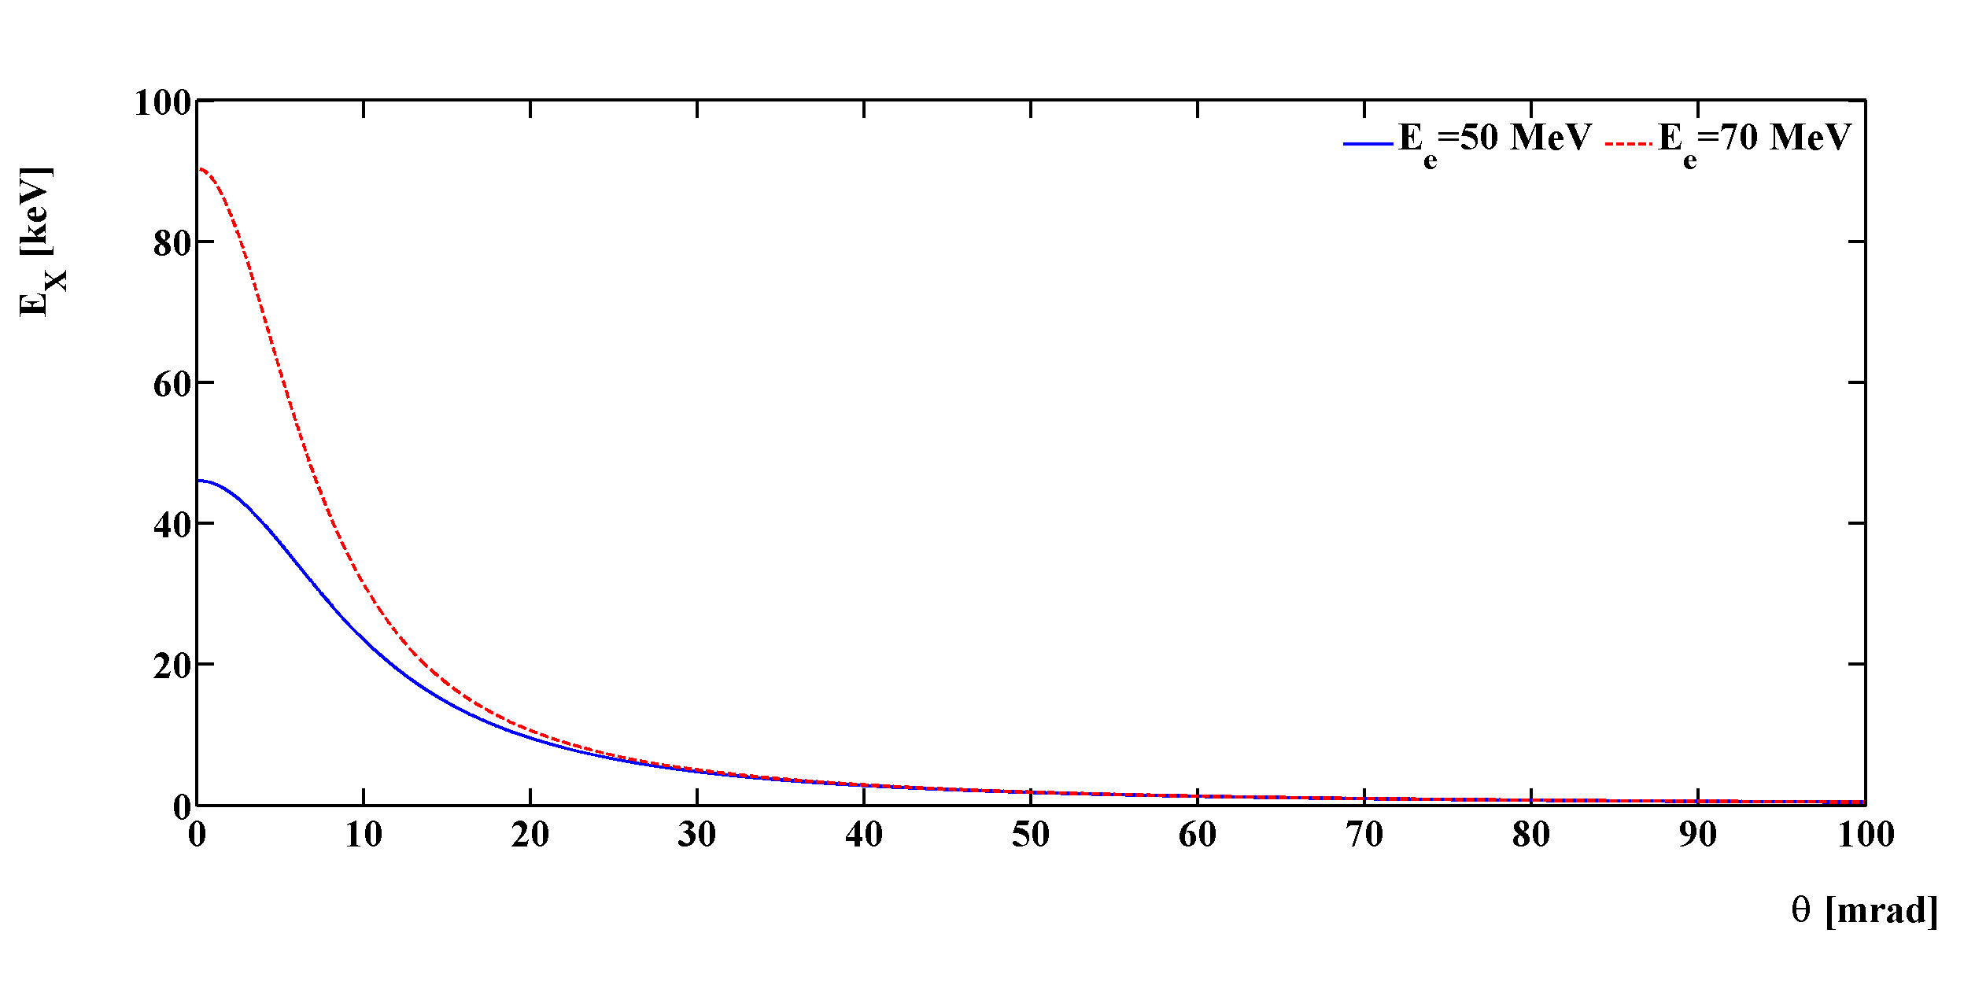


Compton backscattering
laser (E_{λ}=hc/𝜆=1.2eV)
α
Compton photon $E_{X/γ}≃{\frac{4γ^{2}}{1+γ^{2}θ²}E}_{λ}≈45 keV$
θ
e⁻ beam $Ee=50 MeV$

Slide 5

A monochromatic source
laser (E_{λ}=hc/𝜆=1.2eV)
α
Compton photon $E_{X/γ}≃{\frac{4γ^{2}}{1+γ^{2}θ²}E}_{λ}≈45 keV$
θ
e⁻ beam $Ee=50 MeV$
Advantage:
Excellent monochromaticity obtained by use of collimator
Price to pay:
Flux reduction

Slide 6
With a wide range of applications
Compton energy threshold for λ_{laser} = 1µm
Scattered photon energy [MeV]
electron energy [MeV]
Low energy: 10keV to 1 MeV
Radiography & Radiotherapy
Art history
Material science
Medium energy (1 to 100 MeV)
Nuclear fluorescence, GDR
Nuclear physics
Nuclear waste management
Medical isotopes production
High energy (>100 MeV)
Electron beam polarimetry
𝛾𝛾 collider
Secondary beam production (ex: polarized positrons)

Slide 7
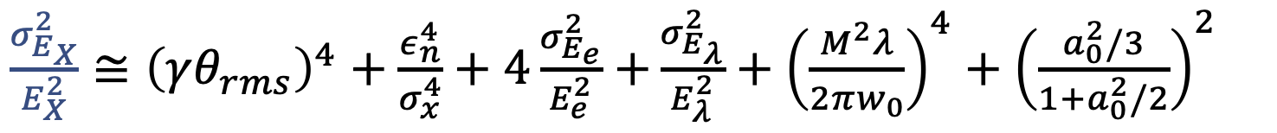
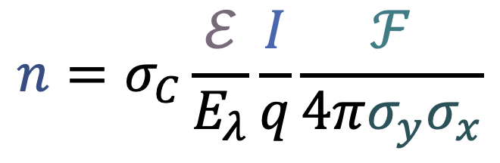
Choosing a figure of merit
Laser-beam single pulse energy
Electron beam intensity
RMS average of transverse beam sizes
Geometrical overlap form factor (Piwinski contribution typically)
$$n=σ_{C}\frac{ℰ}{E_{λ}}\frac{I}{q}\frac{ℱ}{4π{σ_{y}σ}_{x}}$$
Photon rate
Spectral purity
$\frac{σ_{E_{X}}^{2}}{E_{X}^{2}}≅{\left(γθ_{rms}\right)}^{4}+\frac{ε_{n}^{4}}{σ_{x}^{4}}+4\frac{σ_{E_{e}}^{2}}{E_{e}^{2}}$ $+\frac{σ_{E_{λ}}^{2}}{E_{λ}^{2}}+{\left(\frac{M^{2}λ}{2πw_{0}}\right)}^{4}+{\left(\frac{a_{0}^{2}/3}{1+a_{0}^{2}/2}\right)}^{2}$
Collimator opening
Beam emittance
Energy spread
Laser bandwidth
Diffraction spread
Strong field electron rest mass shift
On-axis harmonics
Usually limiting contribution

Slide 8
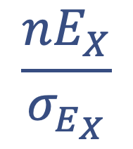
Combined figure of merit
$$n=σ_{C}\frac{ℰ}{E_{λ}}\frac{I}{q}\frac{ℱ}{4π{σ_{y}σ}_{x}}$$
Photon rate
$$\frac{nE_{X}}{σ_{E_{X}}}$$
Spectral density
Spectral purity
$\frac{σ_{E_{X}}^{2}}{E_{X}^{2}}≅{\left(γθ_{rms}\right)}^{4}+\frac{ε_{n}^{4}}{σ_{x}^{4}}+4\frac{σ_{E_{e}}^{2}}{E_{e}^{2}}$ $+\frac{σ_{E_{λ}}^{2}}{E_{λ}^{2}}+{\left(\frac{M^{2}λ}{2πw_{0}}\right)}^{4}+{\left(\frac{a_{0}^{2}/3}{1+a_{0}^{2}/2}\right)}^{2}$
Collimator opening
Beam emittance
Energy spread
Laser bandwidth
Diffraction spread
Strong field electron rest mass shift
On-axis harmonics
Usually limiting contribution

Slide 9
Some limitations of existing designs
source
dump
Examples:
newSUBARU: single shot
HI𝛾S: e-beam driven FEL light
Lyncean: industrial product
ThomX: Demonstrator at Orsay
Limitations:
Limited flexibility
Non-linearities in optical cavity
Quality determined by equilibrium of ring
Ring option:
Advantages:
High flux up to 10¹³ photons/s (ThomX)
Optical resonator
Optical circulator
source
Examples of projects:
ELI-NP-GBS: 32 bunches, S+C-band
STAR: single bunch, S-band
Smart*Light: single bunch, X-band
Limitations:
Flux up to 10⁹ photons/s
Dedicated optical system for multibunch
LINAC option:
Advantages:
Excellent source quality
Low average power optical system
Lower cost
dump

Slide 10
Ways out
Optical resonator
💡: The best of both world
Excellent source quality
High-flux thanks to high repetition rate
dump
source
ERL option:
Examples:
cERL @ KEK
PERLE project @ Orsay
Expansive
Optical resonator in burst mode
source
💡: Large number of bunches to overcome flux limitations
Dedicated gun, Low Level RF
RF pulse duration, beam loading
Develop small optical resonator in burst mode
Few 10 cm optical system for 1 to 2 ns bunch spacing
Optimize optical parameters
LINAC option:
dump
Used for LUCX at KEK
Possible option for upgrades of:
STAR @ University of Calabria
Smart*Light @ TU Eindhoven
Low cost but R&D required

Slide 11
Burst operation of optical resonator
source
Beam charge
LINAC option:
time
dump
Optical resonator continuous operation:
limited by average power, flux reduced (duty cycle)
Laser pulse energy
time
Burst operation of optical cavity to render optical duty cycle similar to that of RF
Optical resonator burst operation:
Optimizes peak power useful for collisions
Laser pulse energy
time

Slide 12
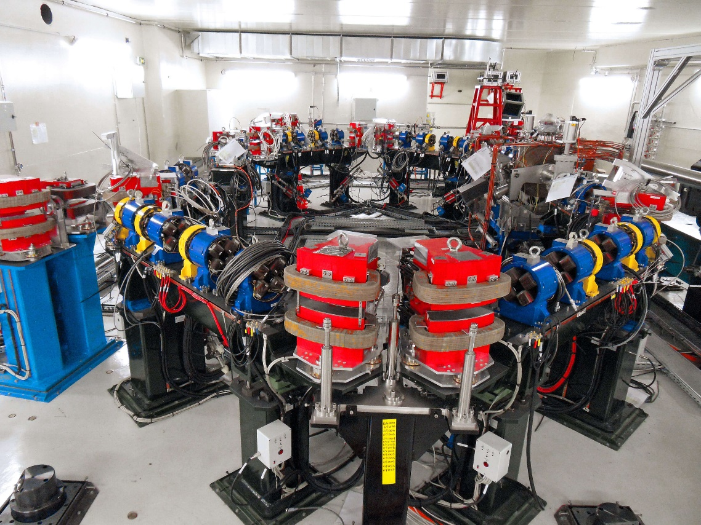
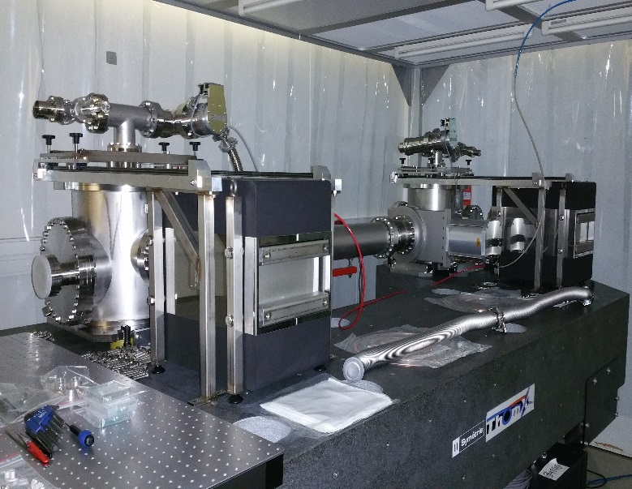
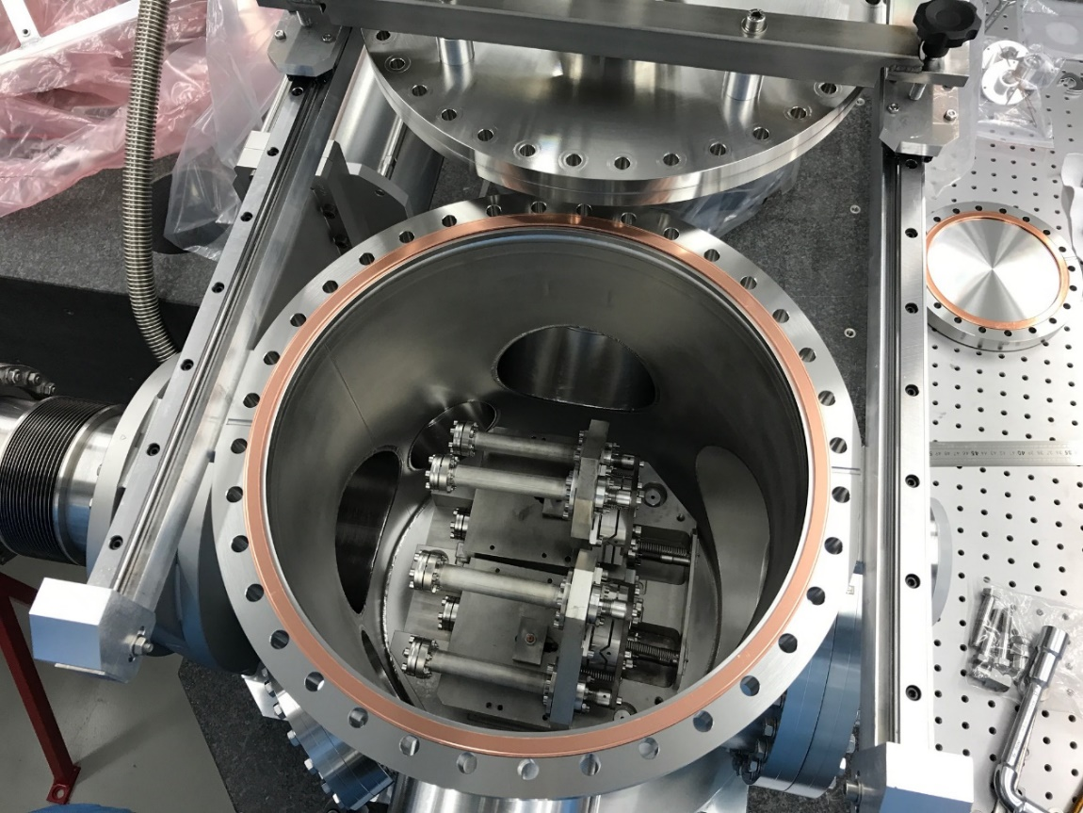
ThomX: R&D and implementation
Amoudry L. & H. Wang, PhD theses (ongoing)
Aim:
High flux up to 10¹³ photons/s
Requires:
About 300kW stable in optical cavity
Extreme cleanliness !
30000 Finesse optical cavity

Slide 13
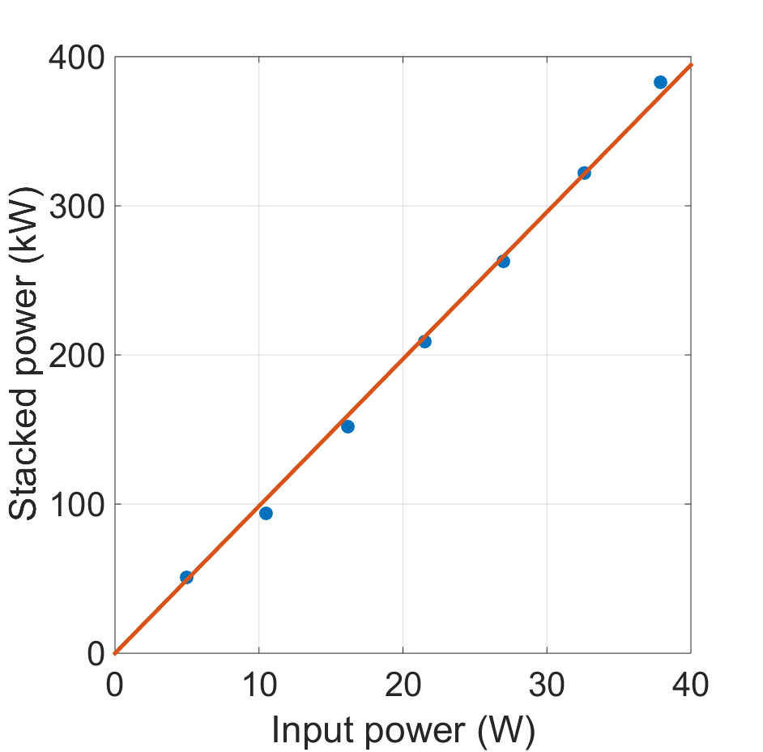
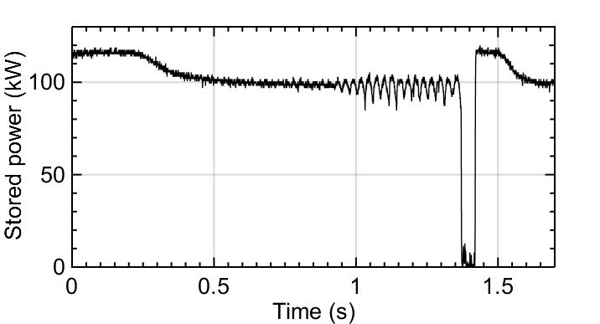
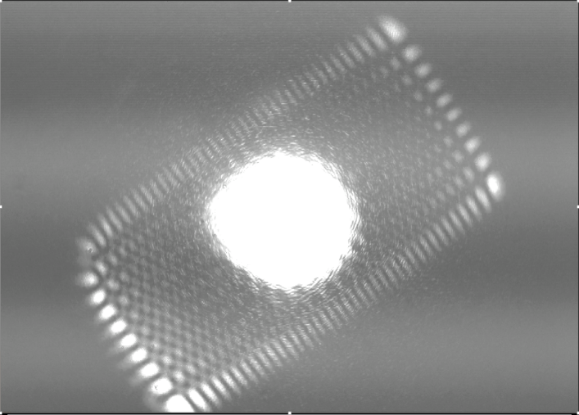
ThomX: R&D and implementation
But unstable at high-power
Favier P., PhD thesis, Amoudry L. & H. Wang, PhD theses (ongoing)
High-order mode instability
Difficult path requiring engineering-like clean procedures
LINAC option does not require average power

Slide 14
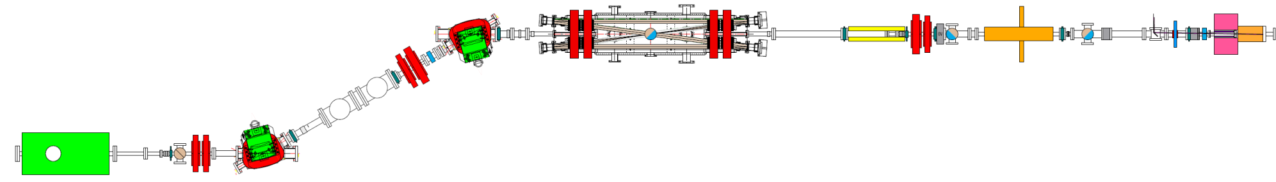
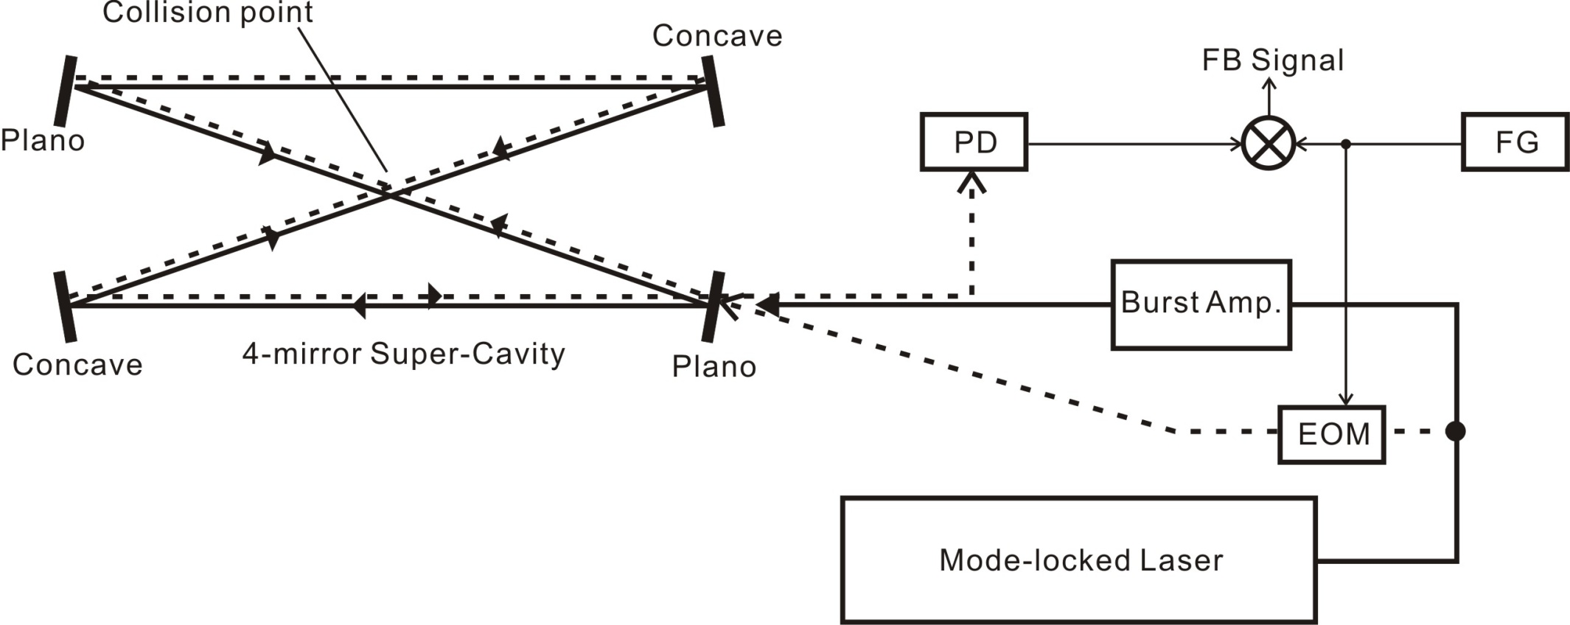
LUCX performances
$Ee=18−24 MeV$, 0.6nC/bunch, 3ns separation, 1000 bunches max
X-ray Detector
(MCP, HyPix-3000)
X-ray
B
Q
Q
Q
3.6cell
rf-gun
Q
4-mirror optical resonator Finesse 440, 1.9m length, 7.5degree collision angle,
Burst peak power 1MW
12cell booster
B
Q
B
Sakaue et al., Review of Scientific Instruments 89, 023305 (2018)
Contra-propagative laser locking technique
NB: the optical resonator configuration is not optimized for burst operation

Slide 15
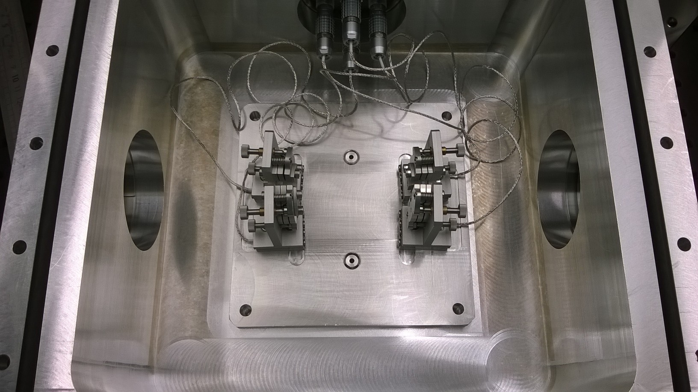
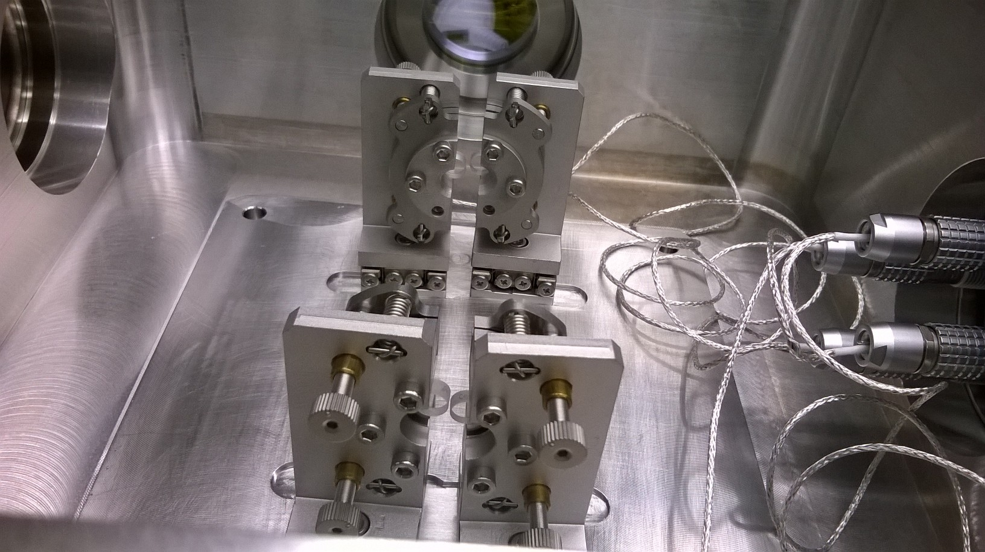
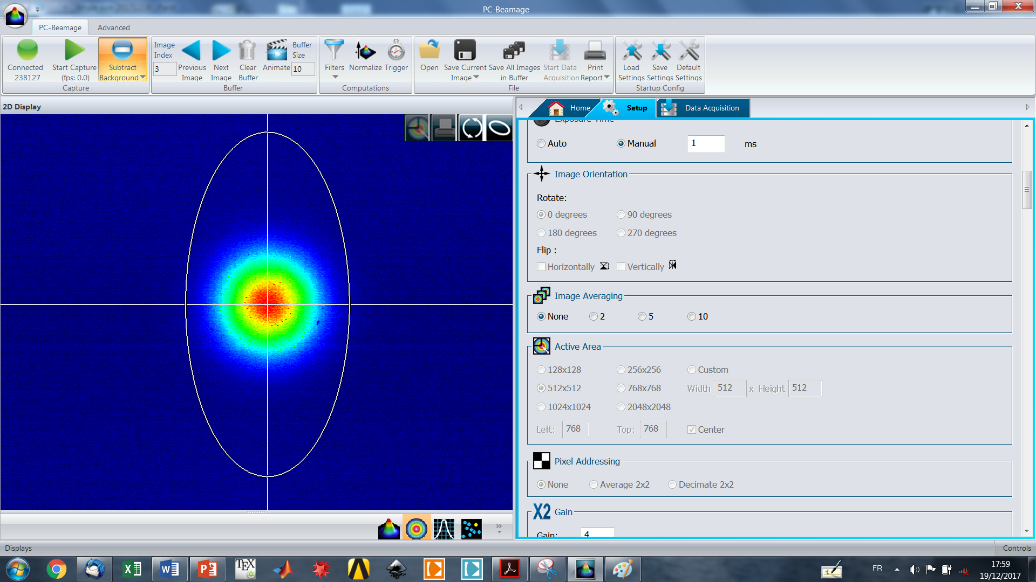
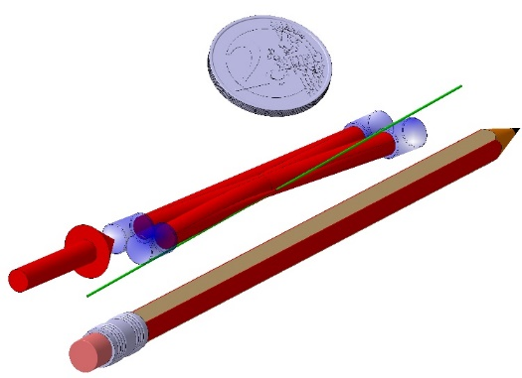
Burst minicav: modeling and R&D
Upgrades of STAR and Smart*Light sources and LUCX
Reach peak powers of several 10MW, with small waist ideal for a clean e-beam source
LAL designed a “small” optical cavity to increase bunch repetition rate to a couple of GHz
Favier et al., Phys. Rev. Accel. and Beams 21 (2018) 121601
waist 15µm

Slide 16
Burst minicav: modeling and R&D
Upgrades of STAR and Smart*Light sources and LUCX
Reach peak powers of several 10MW, with small waist ideal for a clean e-beam source
LAL designed a “small” optical cavity to increase bunch repetition rate to a couple of GHz
GHz oscillator (Amplitude development, CNRS LabCom) will be available in 2019
→ pursue R&D to demonstrate burst minicav operation within LabCom
Favier et al., Phys. Rev. Accel. and Beams 21 (2018) 121601
Accelerator based demonstration on LUCX in 2019-2021 ?
KEK Multi-national Partnership Laboratory proposal submitted
substansial fund request to TYL/FJPPL for travel support for experiment
waist 15µm

Slide 17
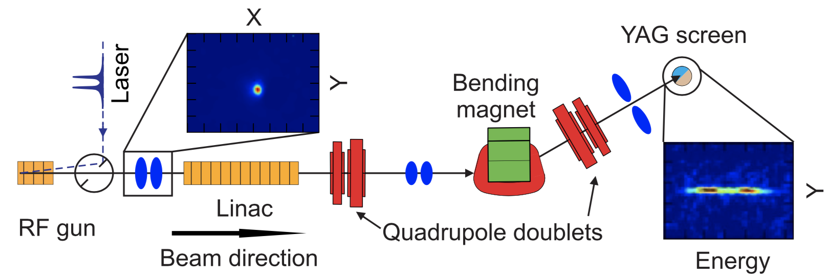
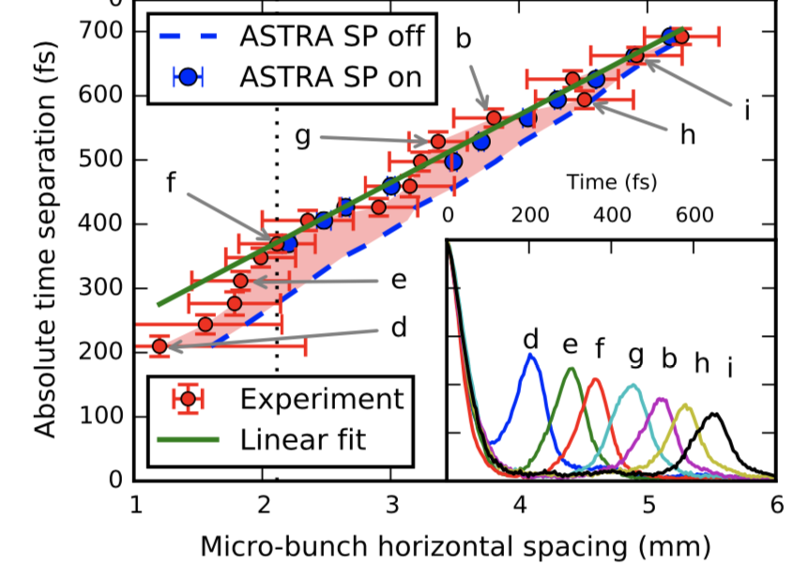
LUCX: microbunched e- beam
LUCX laser design being improved for operation with micro-bunches filling all buckets (3GHz)
→ Interesting in association with an optimized optical resonator
Aryshev et al., Appl. Phys.Lett. 111 (2017) 033508
Inconvenients:
Loss of monochromaticity within a group of micro-bunches
Space-charge effects deteriorates beam quality
Advantages:
At least a gain by an order of magnitude in flux

Slide 18
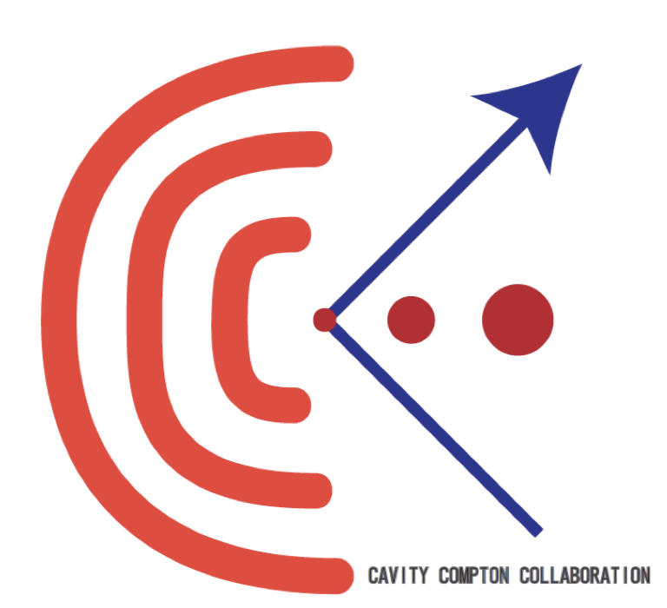
Conclusion & prospects
LAL and KEK collaboration is 15years old on the topic
(MightyLaser experiment started 10 years ago at KEK ATF)
KEK know-how in optical systems for Compton backscattering
(LUCX, cERL) and RF accelertors
(LUCX microbunching)
LAL know-how in optical systems for Compton backscattering
(ThomX, ELI-NP-GBS, HERA TPOL)
High-potential for an optimized burst mode experiment at KEK LUCX
Will overtake on any previous experiment on the topic
Expected technology for emerging compact, ‘low’ cost X-ray sources
Experiment co-financing maybe with KEK MNPL, CNRS LabCom with Amplitude Laser
TYL/FJPPL requested to support substantial travels to help achieving this experiment
On a very long term:
Possibility of a (joint ?) contribution to ILC Compton polarimeters

