Slide 1


France-Korea
Particle Physics Laboratory and e-science
Jeju, Korea, May 8-10, 2019

Slide 2
13 FKPPL projects presented
12 French & 14 Korean academic partners
Hadronic physics (1 IN2P3/CEA)
  GPD
    C. Munoz, S. Choi
R&D (3)
  CMS RPC (iRPC)
    M. Gouzevitch, T. J. Kim
  ILC CALICE (PCB)
    R. Poeschl, M. Ghergherehchi
  SITRINEO
    J. Baudot, C.-S. Moon
Interdisciplinary & computing (2)
  Beam / Geant4
    M. Verderi, K. Cho
  Protontherapy @ NCC
    S. Incerti, S. B. Lee
HEP: experiments (3 IN2P3)
  ALICE Muon (MuTR, MuFT, ITS)
    R. Tieulent, G. Batigne, Y. Baek
  ALICE HF (b-jet in p-Pb)
    R. Guernane, M. J. Kweon
  CMS IL (quarkonia probes of QGP)
    M. Nguyen, B. Hong
HEP: theory (1+2 INP)
  CompHS
    G. Cacciapaglia, S. J. Lee
  FNPES (DM models)
    Y. Mambrini, H. M. Lee
  H-Potential (Higgs pot. for EWSB)
    B. Fuks, P. Ko
Neutrino physics (1)
  Reactor neutrinos (D Chooz, RENO, Daya Bay)
    A. Cabrera, S. H. Seo
Notes:
CMS-RPC: The project is organized around the upgrade of the CMS muon spectrometer with new improved RPC chambers (iRPC) that shall cover the forward region for |h| > 1.9 ( 2 innermost rings of stations 3 and 4). Our project contains two components: a software prospection part and a hardware R&D part.
Finding New Physics : From the Earth to the Sky
Printed Circuit Boards

Slide 3
2018 research highlights
R&D, science and outreach
ALICE-HF :
  p-Pb coll. @ 5.02 TeV : measurement of the b-jet production cross section and b-jet fraction
  p-p coll. @ 13 TeV: measurement of differential cross section of electrons from semi-leptonic decays of b hadrons and charm-strange baryon production in the semi-electronic decay channel
ALICE Muons
  Subsystem run coordination @ CERN for muon spectrometer
  First level qualification of tests of sensors for the ITS and the MFT
  12th ALICE ITS upgrade, MFT and 02 Asian Workshop
CompHS
  Publication on light mass window 14-65 GeV (di-tau final state as potential discovery channel)
  Exploration of mass range up to 10 TeV for HL and HE runs
  Couplings of light composite scalars and pseudo-scalars to top partners
  NLO cross section calculations for the top partner production
FNPES
  Alternative DM scenario looking at non-abelian candidates, leading to self interaction (measurable) to better constrain parameter space
H-POTENTIAL
  Proceedings of the MadAnalysis5 workshop on LHC recasting
  Quartic Higgs coupling at future 100 TeV hadron colliders
  New ideas of Standard Model extensions with a new strongly coupled sector
GPD
  DVCS @ Jlab Hall C – joint FR/KR PhD, STAR funding on EIC
  Jlab physis workshop at APCTP
Reactor Neutrinos
  Daya Bay, Double Chooz and RENO are reviewig their analyses (less tension)
  Close dialog between DC and RENO for the resolution of the most precise value of theta13
BEAM
  Contribution to release Geant4 10.5 (biasing, low energy physics profiling for brachytherapy on KISTI-4 SuperComputer)
  Beam simulations for RISP
PROTONTHERAPY
  Irradiation at NCC of aptamers to detect amino acids and irradiation of ultra performance liquid chromatography columns (coll. with CNES)
  Geant4 tutorial in collaboration with BEAM
  Geant4-DNA new electron elastic scattering model in liquid water – cotutelle PhD FR/KR
CMRS-RPC
  Tracking algo. from GEM chambers propagating to iRPC
  Design & validation of large size prototype for iRPC upgrade + test beams at GIF++ & SPS
ILC/CALICE
  Validation of the technology of the thin Printed Circuit Board (FEV_COB) for a silicon tungsten electromagnetic calorimeter for a future e+e- collider
  First signals with radioactive source + cosmic muons
SITRINEO
  Simulation, analysis algo. and hardware assembly for the tabletop tracker
  STAR funding
Neut.
HEP : exp.
Interdiscpilnary
HEP : theory
R&D
Hadr.
Notes:
HSPC Heavy stable charged particle
Asia Pacific Center for Theoretical Physics
development of publicly available tools and methods for reinterpreting the results of the LHC
GEM = Gas Electron Multiplier

Slide 4
2018 key figures
8 exchanges Korea to France
  314 days
22 exchanges France to Korea
  241 days
8 workshops / conferences
2 schools
14 publications, 8 contributions to book
15 contributions to conferences
9 on going PhDs (2 cotut.)
8 postdoctoral fellows
6 students
8 workshops & conferences
  12th ALICE ITS upgrade, MFT and 02 Asian Workshop (Incheon)
  Heavy-flavour and heavy-flavour tagged jet analysis workshop (Inha U.)
  IBS focus meeting on “Exotic Top Partners” (IBS)
  "The Nature of Hadron Mass and Quark-Gluon Confinement from JLab Experiments in the 12-GeV Era" workshop (APCTP)
  Rencontres ALICE France-Corée (LPSC)
  International LIO Workshop on “Fundamental Theories for BSM and Cosmology” (IPNL)
  2018 Geant4 International User Conference at the Physics – Medicine – Biology frontier (Bordeaux)
  FKPPL BEAM - PROTONTHERAPY face-to-face meeting (Lund)
2 schools
  Introduction & Hands-on session on Machine Learning Techniques (Inha U.)
  Geant4 international tutorial (KIRAMS)

Slide 5


2018 FTE
14.5 vs 13.8
Balanced !

Slide 6
2018 Budget
All funding sources
(keuros)

Slide 7
Projects & funding over the years

Slide 8
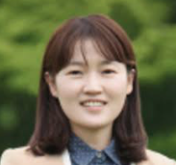
2018 FKPPL Awards
Korean Woman Scientist
  Initiated in 2018
  Established « more senior » scientist
  Possibly already collaborating within FKPPL (not mandatory)
  Korean citizen
  For 2018, the winner is
  Prof. Minjung Kweon (Inha U.)
Young Researcher Award
  Initiated in 2017 (thanks to TYL !)
  PhD student or postdoctoral fellow
  Already collaborating within FKPPL
  for 2018, the winner is
  Mr. Wook Geun Shin (Bordeaux U.)

Slide 9

« Infinités Plurielles »
Woman scientist ceremony @ SNU
Infinity of « Shining Scientist Women »
Initiated by the Institut Français in Seoul, in collaboration with FKPPL
Deliver two highly pedagogical talks by
two reknown Korean and French scientist women
  Dr Seon Hee Seo
  (ghost particles)
  Dr Frédérique Marion (gravitationnal waves)
October 5th, 2018 @ SNU
On-going discussions for 2019

Slide 10
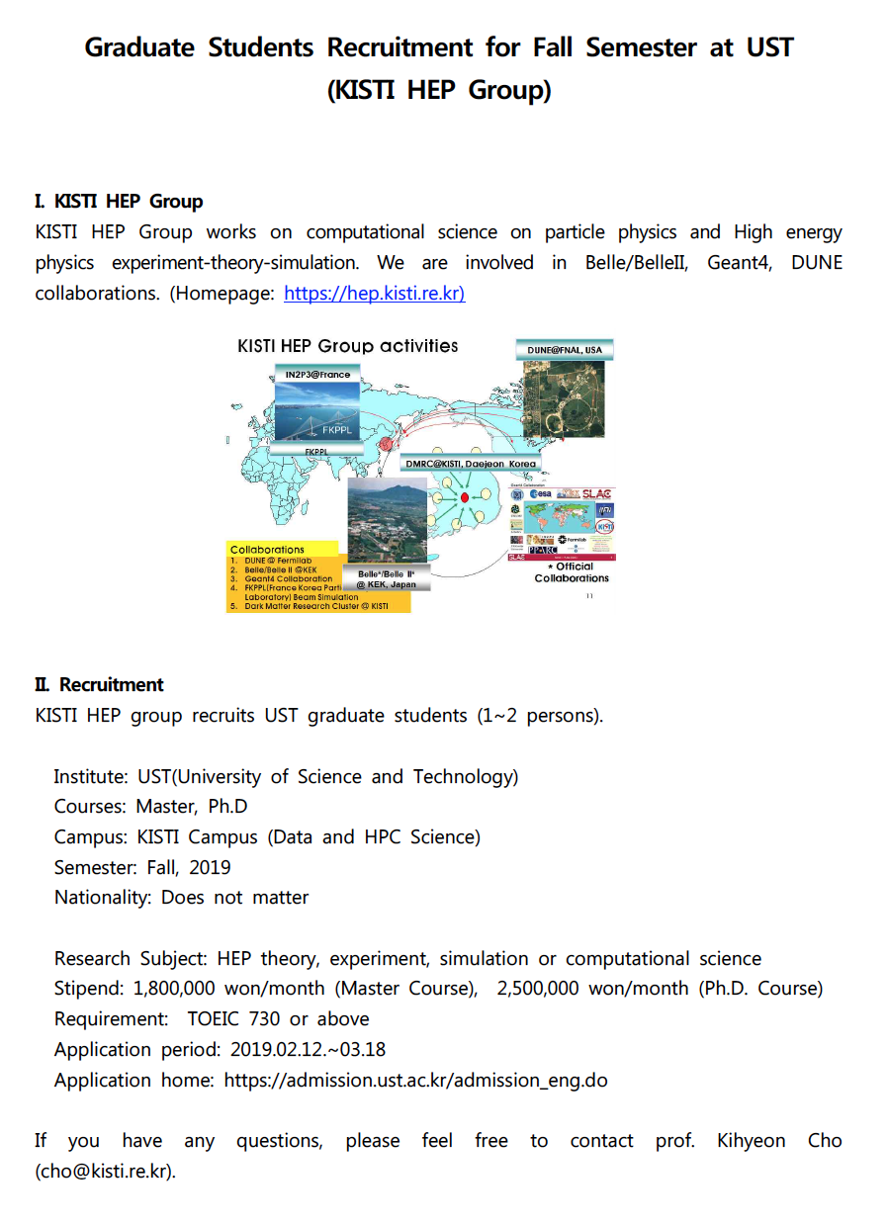
Miscellaneous
Calls (e.g. Institut français in Seoul grants, STAR, Univ….)
  Make sure to check regulalry our web page: http://fkppl.in2p3.fr
KISTI HEP group announcement
  Grad. stud recruitment
  Please contact Pr K. Cho: cho@kisti.re.kr
FKPPL term will end in Dec. 2019
  Teams will be contacted for 4-year activity reporting and for preparation of new collabration tool
  New topics ?
    Accelerator R&D
    DM search (axions)
    Muon tomography
2020 joint workshop will be announced by Isabelle
Notes:
OSQAR @ CERN
(Optical Search of QED vacuum magnetic birefringence, Axion and photon Regeneration

Slide 11
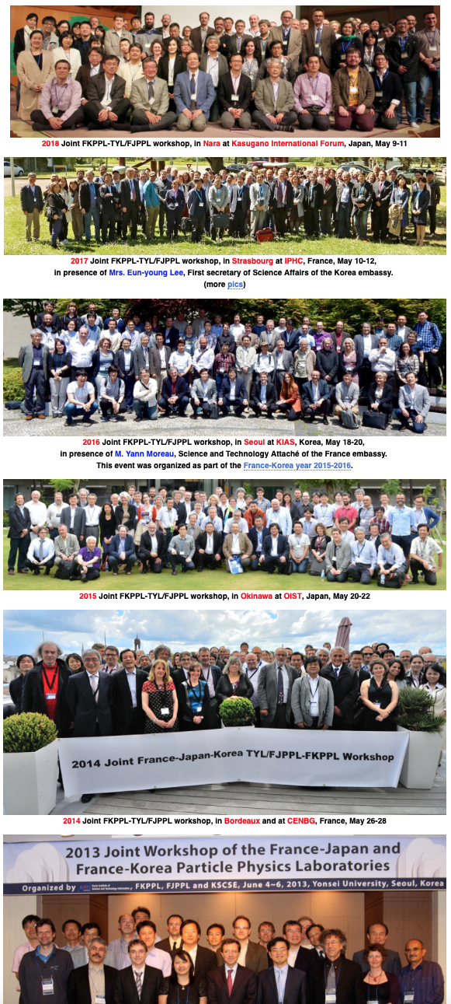
THANK YOU TO ALL
2018
FKPPL term is ending this December 2019
  a temporary co-directeur for France kindly accepted to help for transition :
  Dr Vincent Breton (IN2P3/LPC Clermont) in collaboration with David Sarramia (UCA) and Marc Besançon (CEA) for France side
Our successful collaborations :
  14 Korean partners, CNRS (IN2P3+INP) + CEA & associated universities in France
  growing number of PhD students (9), incl. « cotutelle », and postdocs (8)
  Young Researcher and Woman Scientist awards
  « Infinités Plurielles »
  regular workshops and schools (e.g. Geant4 in Asia)
  attracting further funding
  in last 3 years: 551 days KtoF, 593 days FtoK, 29 events, 63 co-signed publications …
  with strong & lasting links to TYL/FJPPL
  and above all: in a FRIENDLY spirit
2013
모든 것에 감사드립니다
どうもありがとう

Slide 12
Backup

Slide 13
Participating academic partners in 2018
13
France (12)
  CNRS/IN2P3 laboratories (10)
    APC
    CENBG
    IPHC
    IPNL
    IPNO
    LAL + OMEGA
    LLR
    LPC Clermont
    LPSC
    Subatech
  CNRS/INP laboratories (1)
    LPTHE
  CEA, Saclay (1)
    DPhN
Korea (14)
  Institute for Basic Science Daejeon
  Korea Institute for Advanced Study
  Chung-Ang U.
  Gangneung-Wonju National U.
  Hanyang U.
  Inha U.
  KISTI
  Konkuk U.
  Korea U.
  Kyungpook National U.
  Pusan National U.
  Seoul National U.
  Sungkyunkwan U.
  Yonsei U.
  National Cancer Center
Balanced !

Slide 14
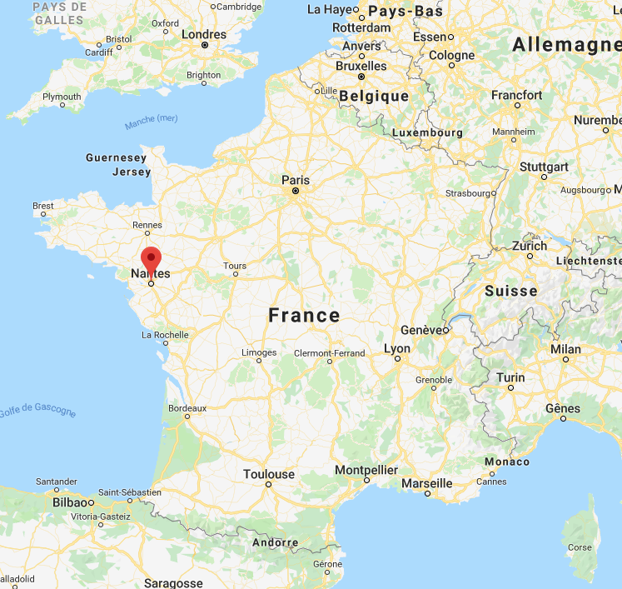
2020 Joint Workshop
Kindly organized by Dr Guillaume Batigne and colleagues @ SUBATECH Nantes
Stay tuned !

