Slide 1
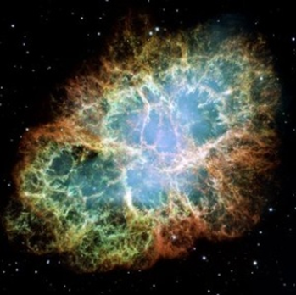
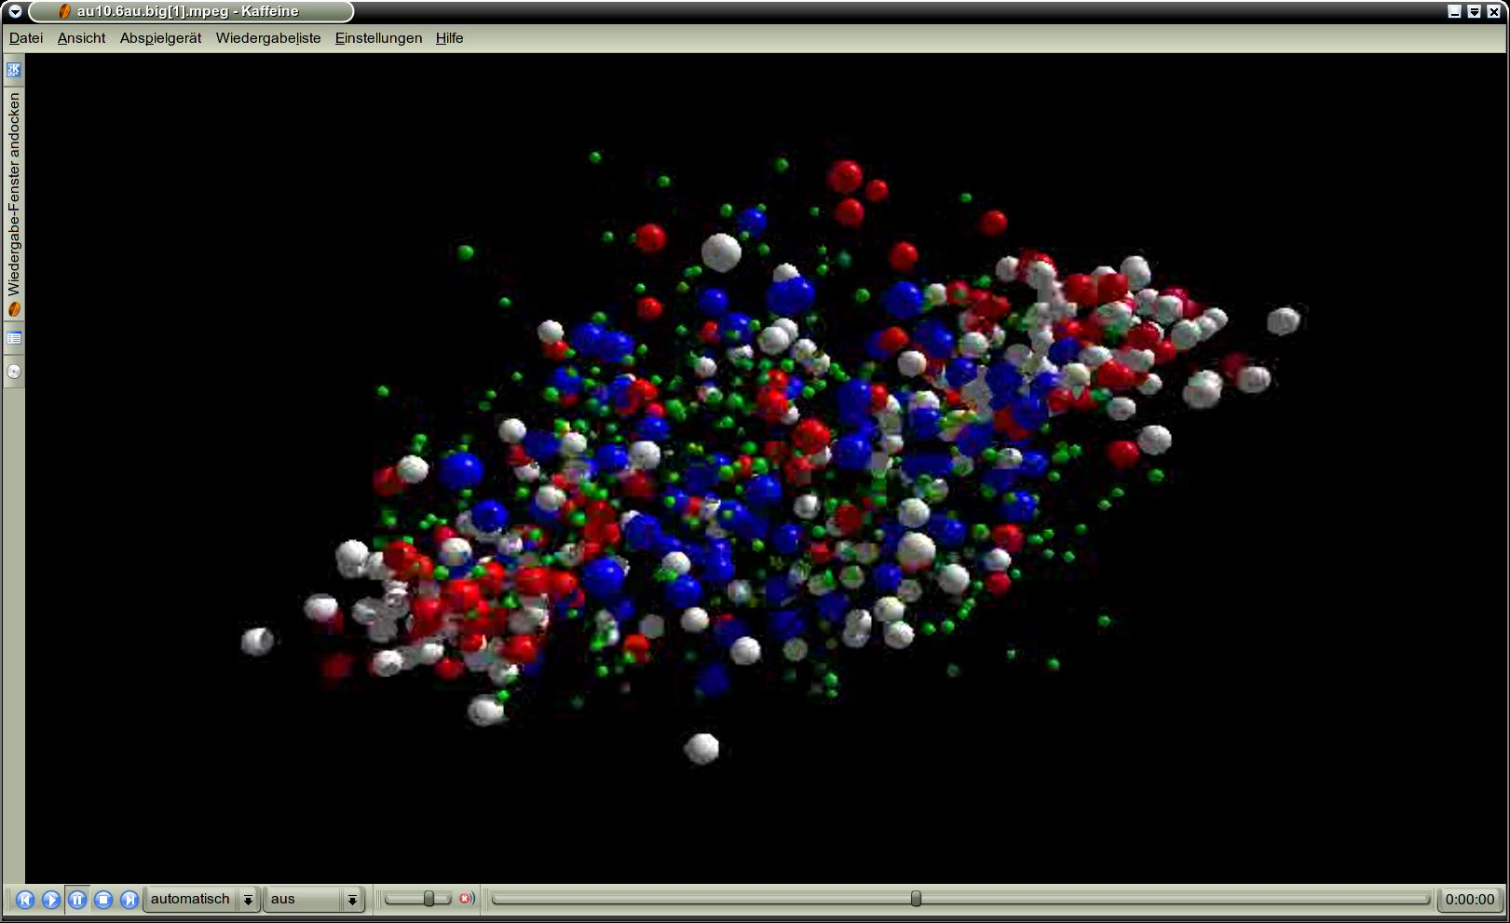





Exploring the nuclear matter equation-of-state
at neutron star core densities:
The Compressed Baryonic Matter experiment at FAIR
Peter Senger
Outline:
The Facility of Antiproton and Ion Research (FAIR)
The CBM experiment and its research program
Probing the EOS of (a)symmetric matter at high densities
Status of FAIR
8th International Symposium on Nuclear Symmetry Energy (NuSYM2018)
10-13 September 2018, Hanwha Resort, Haeundae, Busan

Slide 2
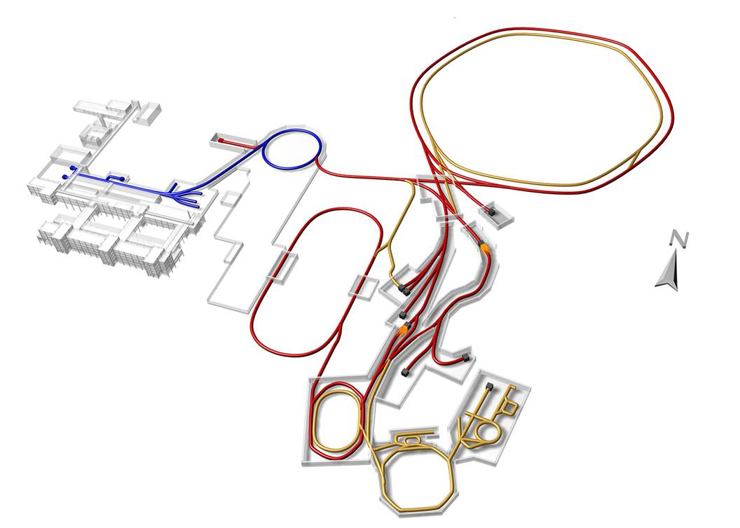










Facility for Antiproton & Ion Research
SIS100/300
p-Linac
SIS18
Compressed Baryonic Matter
Primary Beams
10¹²/s; 1.5 GeV/u; ²³⁸U²⁸⁺
10¹⁰/s ²³⁸U⁹²⁺ up to 11 (35) GeV/u
3x10¹³/s 30 (90) GeV protons
Anti-Proton Physics
HESR
Super Fragment-Separator:
Nuclear Structure and Astrophysics
Secondary Beams
radioactive beams up to 1.5 - 2 GeV/u;
10¹¹ antiprotons 1.5 - 15 GeV/c
Technical Challenges
FAIR phase 1
FAIR phase 2
CR
rapid cycling superconducting magnets
dynamical vacuum
2
100 m

Slide 3
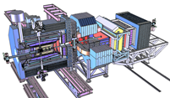
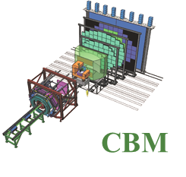
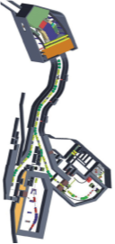
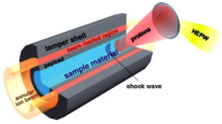
Facility for Antiproton & Ion Research
Experimental programs:
APPA: Atomic & Plasma Physics & Applications
➢ Highly charged atoms
➢ Plasma physics
➢ Radiobiology
➢ Material science
SIS18
SIS100/300
p-Linac
Compressed Baryonic Matter
HESR
CBM: Nucleus-nucleus collisions
➢ Exploring nuclear matter at
high baryon densities
➢ EOS and phase transitions
Anti-Proton Physics
Super Fragment-Separator:
Nuclear Structure and Astrophysics
NUSTAR: Rare Isotope beams
➢ Nuclear structure far off stability
➢ Nucleosynthesis in stars and supernovae
CR
PANDA: Antiproton-proton collisions:
➢ Charmed hadrons (XYZ)
➢ Gluonic matter and hybrids
➢ Hadron structure
➢ Double Lambda hypernuclei
FAIR phase 1
FAIR phase 2
100 m
3

Slide 4
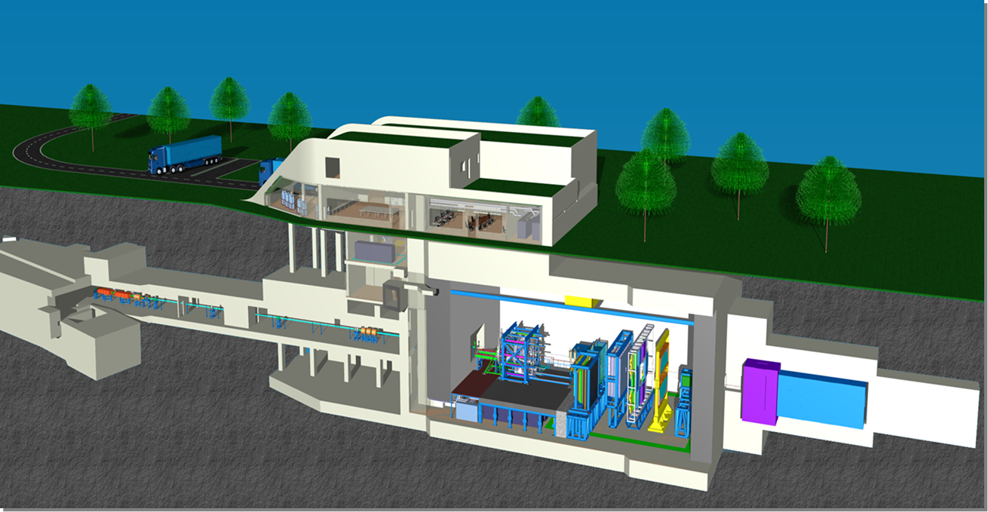
The Compressed Baryonic Matter (CBM)
experiment
4

Slide 5
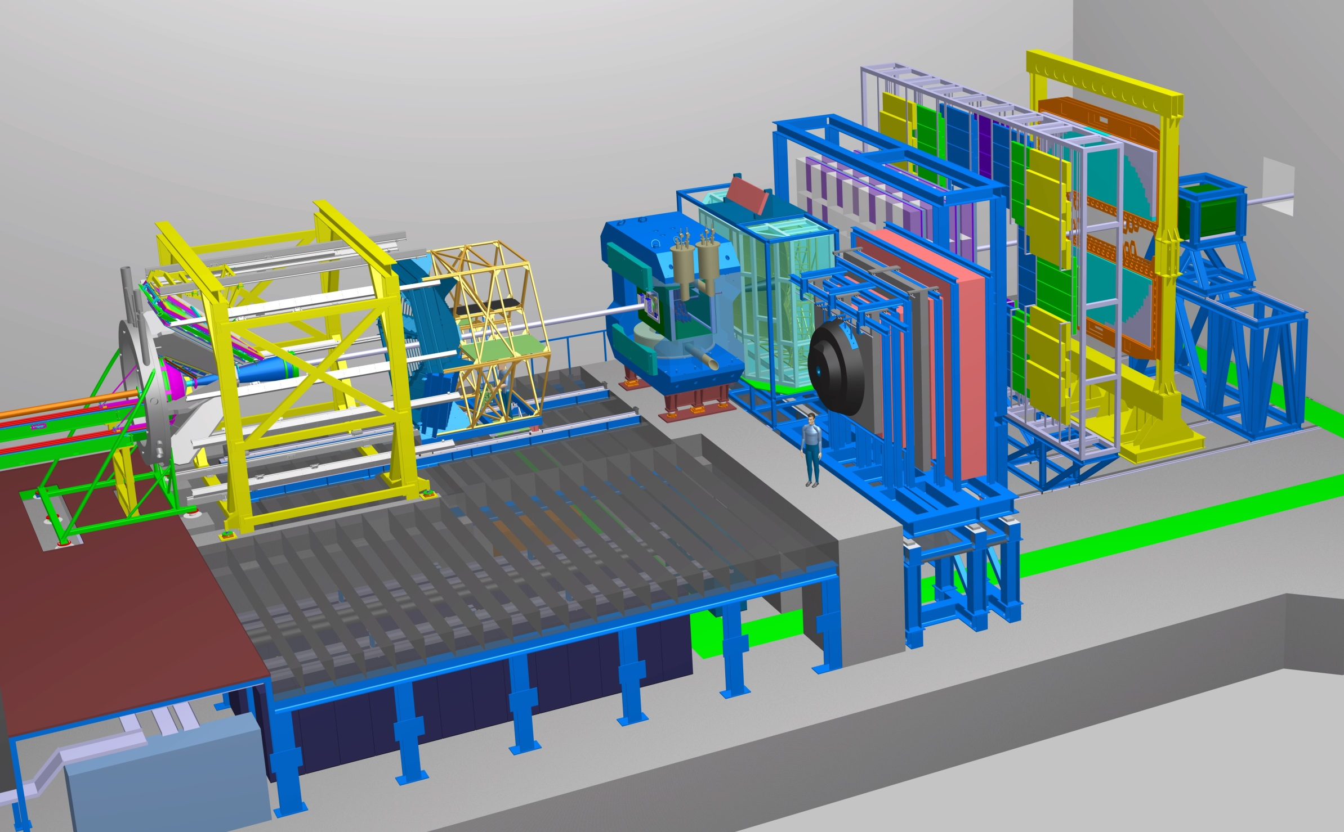
The CBM experiment
Transition
Radiation
Detector
Time of Flight
Detector
Ring
Imaging
Cherenkov
Dipol
Magnet
Silicon
Tracking
System
HADES
p+p, p+A
A+A (low mult.)
Micro
Vertex
Detector
Muon
Detector
Projectile
Spectator
Detector
DAQ/FLES HPC cluster

Slide 6
Exploring the QCD phase diagram

Slide 7
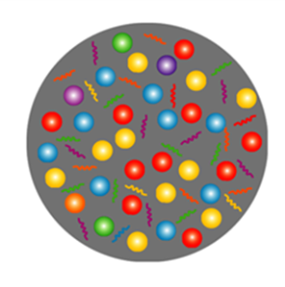
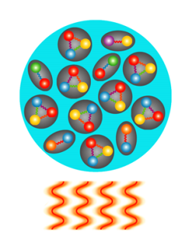
Exploring the QCD phase diagram
At very high temperature:
➢ N of baryons ≈ N of antibaryons, situation similar to early universe
➢ L-QCD finds crossover transition between hadronic matter and Quark-Gluon Plasma
➢ Experiments: ALICE, ATLAS, CMS at LHC, STAR, PHENIX at RHIC

Slide 8
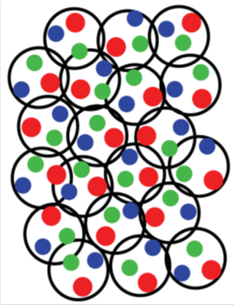
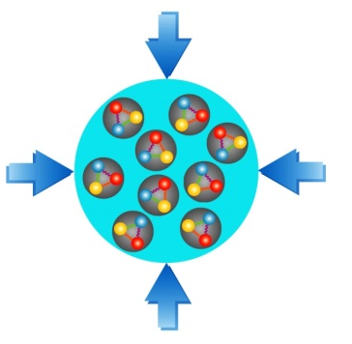
Exploring the QCD phase diagram
At high baryon density:
➢ N of baryons >> N of antibaryons , densities like in neutron star cores
L-QCD not (yet) applicable, models predict phase transitions and exotic phases
Experiments: BES at RHIC, NA61 at CERN SPS, CBM at FAIR, NICA at JINR,

Slide 9
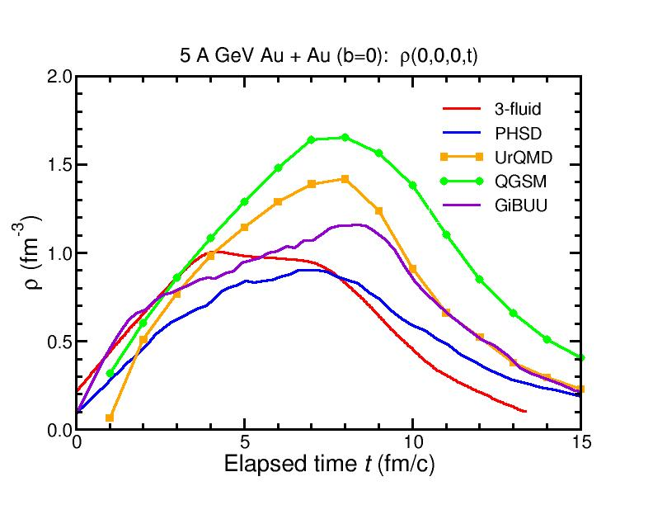
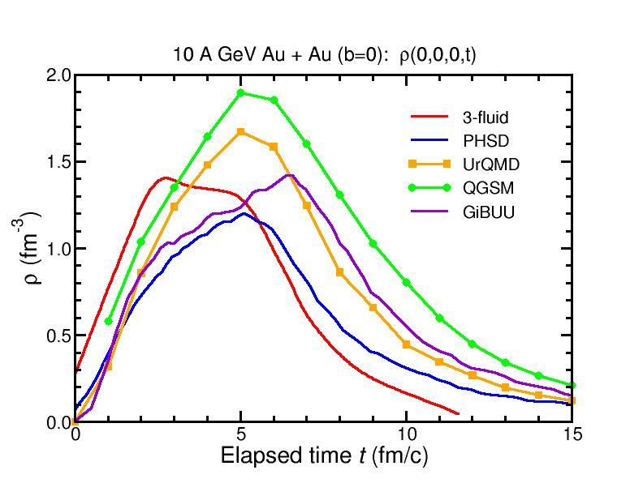
Baryon densities in central Au+Au collisions
I.C. Arsene et al., Phys. Rev. C 75, 24902 (2007)
5 A GeV
10 A GeV
8 ρ₀
5 ρ₀
∼ 2 ρ₀
∼ 5 ρ₀
9
courtesy Toru Kojo (CCNU)

Slide 10
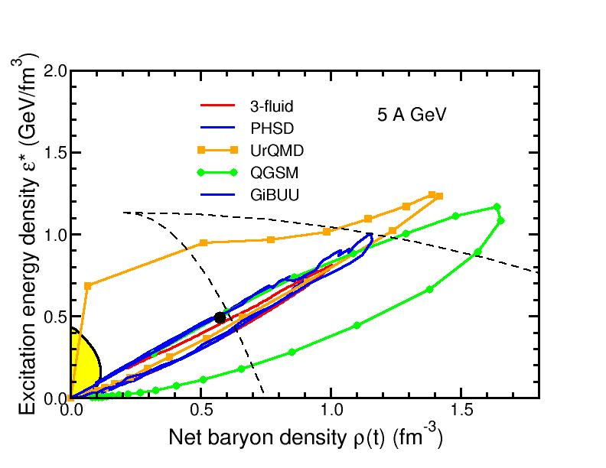
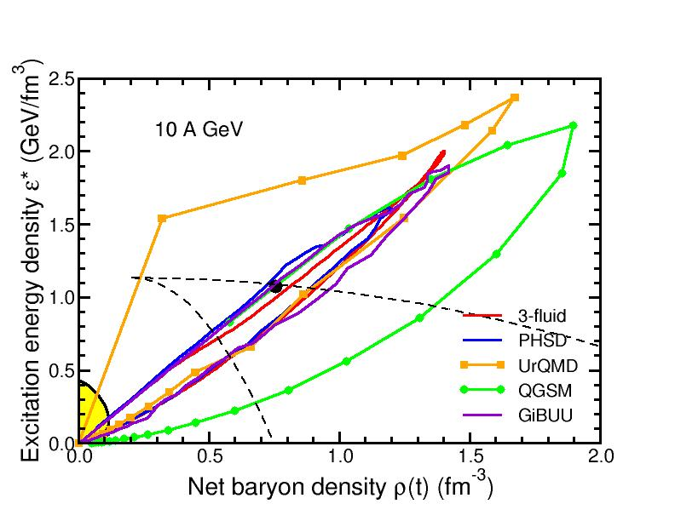
Baryon densities in central Au+Au collisions
I.C. Arsene et al., Phys. Rev. C 75, 24902 (2007)
5 A GeV
10 A GeV
8 ρ₀
5 ρ₀
phase
coexistence
phase
coexistence
10

Slide 11
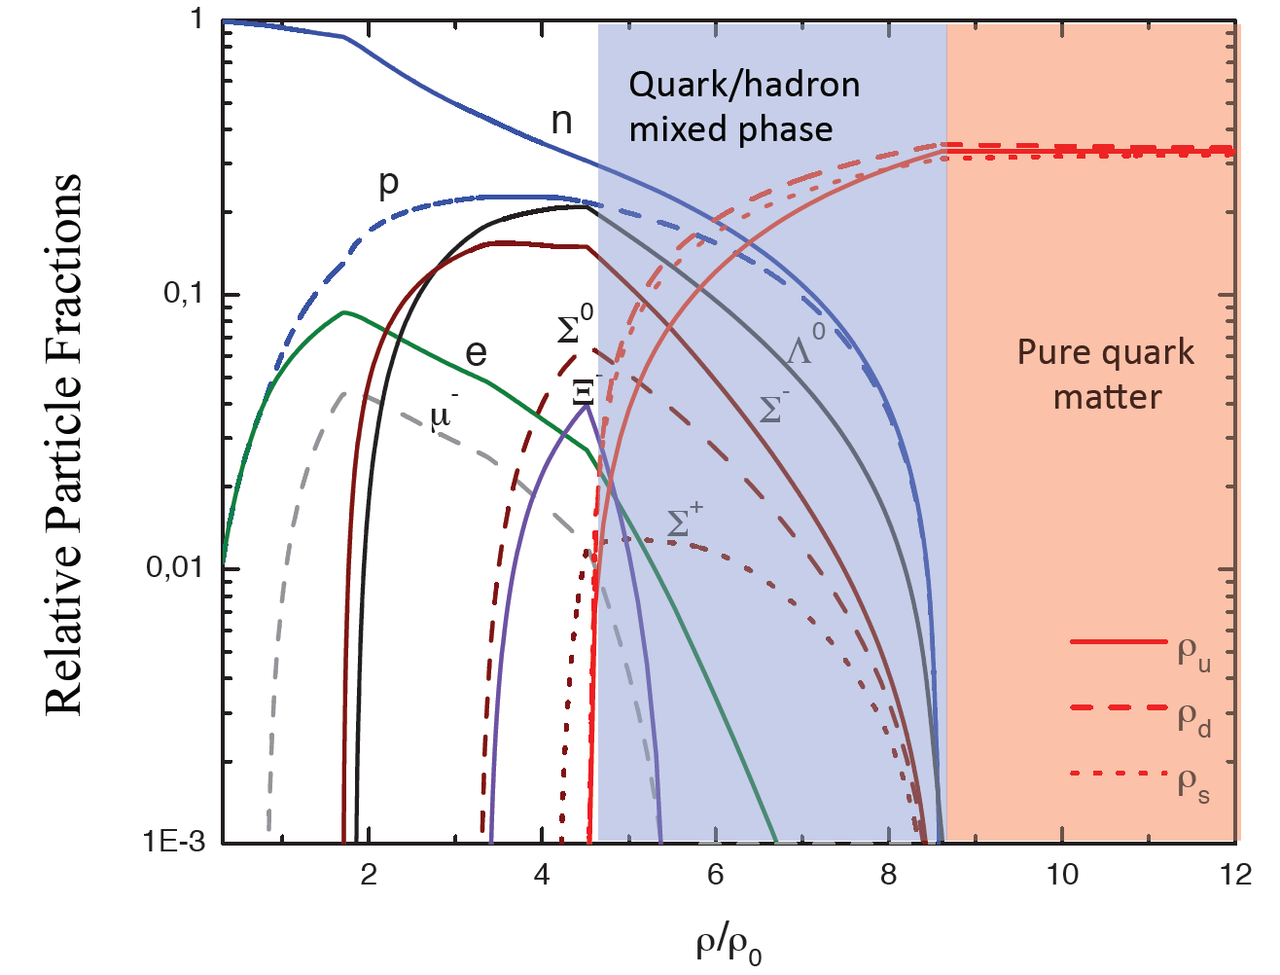
Quark matter in massive neutron stars?
M. Orsaria, H. Rodrigues, F. Weber, G.A. Contrera, arXiv:1308.1657
Phys. Rev. C 89, 015806, 2014

Slide 12
CBM physics case and observables
Phase transitions from partonic to hadronic matter
excitation function of strangeness: Ξ⁻(dss),Ξ⁺(dss),Ω⁻(sss),Ω⁺(sss)
→ chemical equilibration at the phase boundary
Phase coexistence
excitation function (invariant mass) of lepton pairs:
thermal radiation from QGP, caloric curve
anisotropic azimuthal cluster distributions: “spinodal decomposition”
Critical point
event-by-event fluctuations of conserved quantities (B,S,Q)
“critical opalescence”
Onset of chiral symmetry restoration at high ρ_{B}
➢ in-medium modifications of hadrons: ρ,ω,φ →e⁺e⁻(μ⁺μ⁻)
➢ dileptons at intermediate invariant masses: 4 π → ρ-a₁ chiral mixing
N-Λ, Λ-Λ interaction, strange matter?
➢ (double-) lambda hypernuclei
➢ meta-stable objects (e.g. strange dibaryons)
Charm production at threshold energies in cold and dense matter
➢ excitation function of charm production in p+A and A+A (J/ψ, D⁰, D±)
The QCD matter equation-of-state at neutron star core densities

Slide 13
Neutron star mergers and heavy-ion collisions
density
temperature
M. Hanauske et al.,
J. Phys.: Conf. Ser.
878 012031
n-star merger
EOS
Au +Au
1.5A GeV

Slide 14
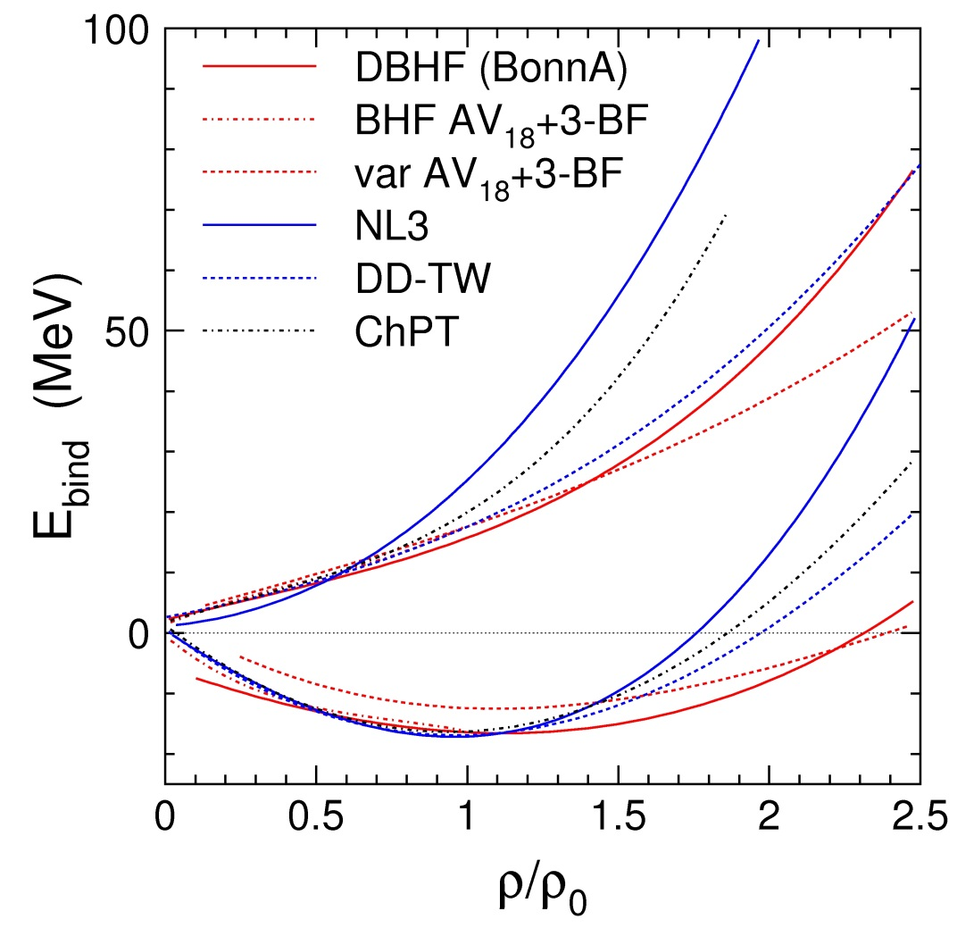
The equation-of-state of nuclear matter
?
Fuchs and Wolter, EPJA 30 (2006)
Neutron matter
E_{sym}
Symmetric matter

Slide 15
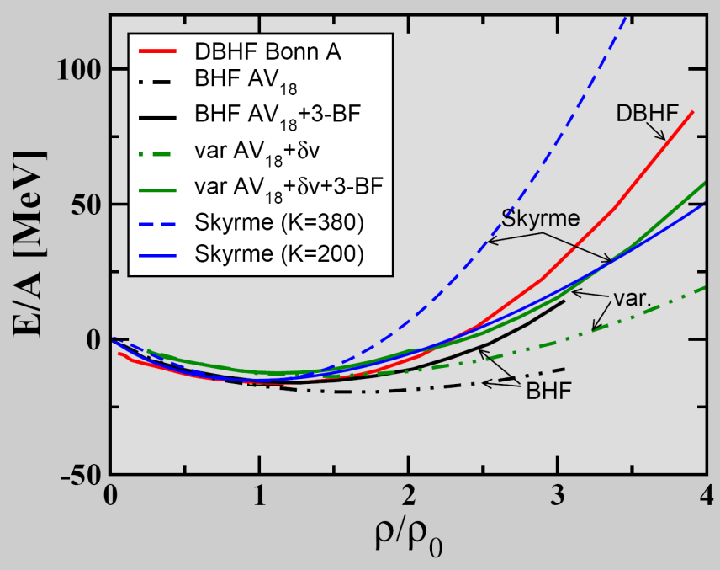
The equation-of-state of (symmetric) nuclear matter
E_{A}(ρ,δ) = E_{A}(ρ,0) + E_{sym}(ρ)·δ² + O(δ⁴)
P = δE/δV⏐_{T=const}
V = A/ρ
δV/ δρ = - A/ρ²
P = ρ² δ(E/A)/δρ⏐_{T=const}
C. Fuchs, Prog. Part. Nucl. Phys. 56 (2006) 1
T=0: E/A = 1/ρ ∫ U (ρ)dρ
Effective NN-potential:
U(ρ)=αρ+βρ^{γ}
➢ E/A(ρ_{o}) = -16 MeV
¬ δ(E/A)(ρ_{o})/δρ = 0
K_{nm} = 9ρ² δ²(E/A)/δρ²
(nuclear incompressibility)
K_{nm} = 200 MeV: "soft" EOS
K_{nm} = 380 MeV: "stiff" EOS

Slide 16
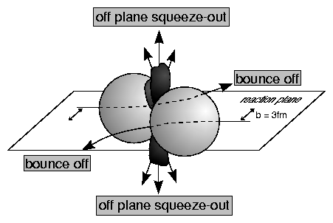
EOS of symmetric matter from elliptic flow of fragments in Au+Au collisions at SIS18 energies (ρ < 3ρ₀)
A. Le Fevre , Y Leifels, W. Reisdorf, J. Aichelin, Ch. Hartnack, arXiv:1501.02546
HM
SM

Slide 17
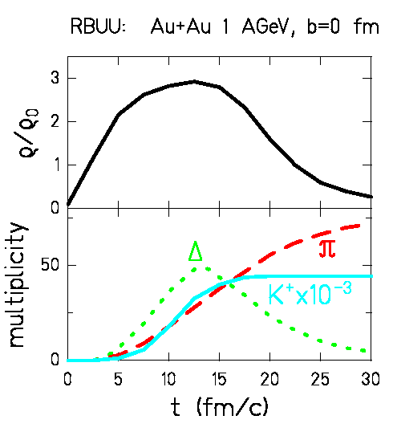
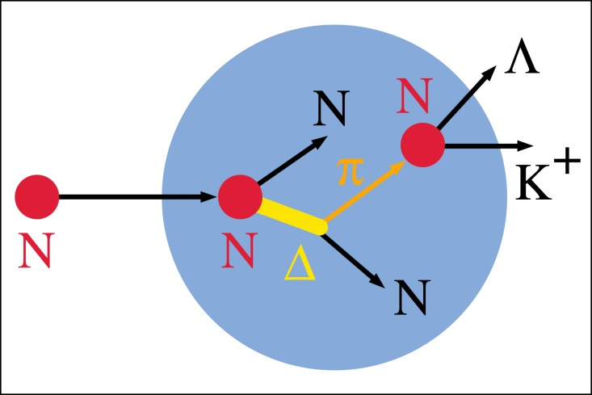
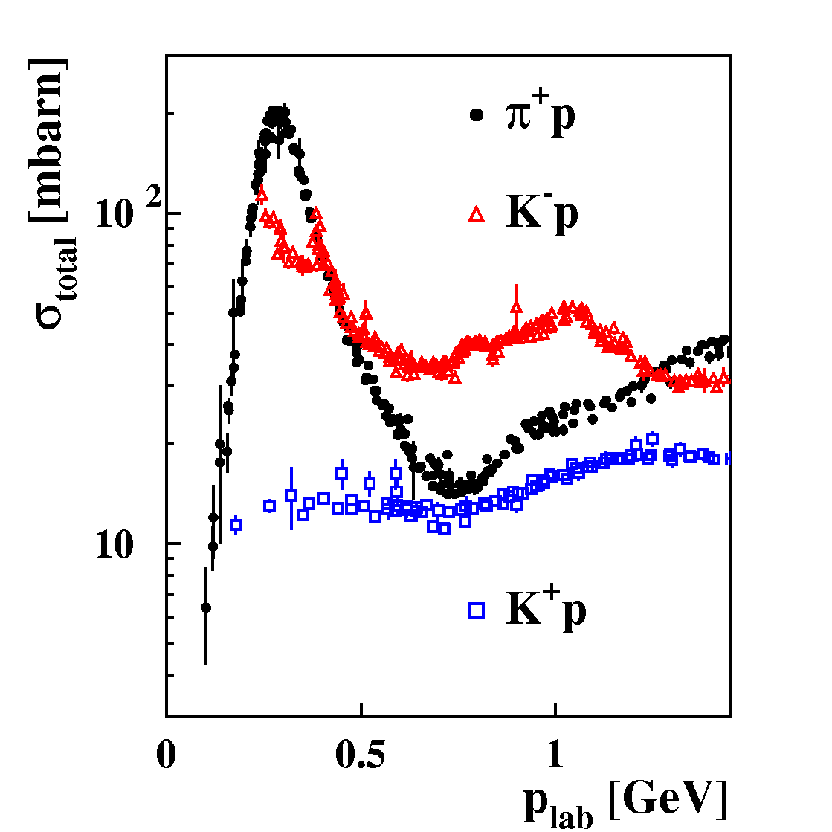
Probing the nuclear equation-of-state (ρ = 1 – 3 ρ₀)
by K⁺ meson subthreshold production in HI collisions
pp → K⁺Λp (E_{thres}= 1.6 GeV)
K⁺ mesons probe high densities
K⁺ mesons scatter elastically only

Slide 18
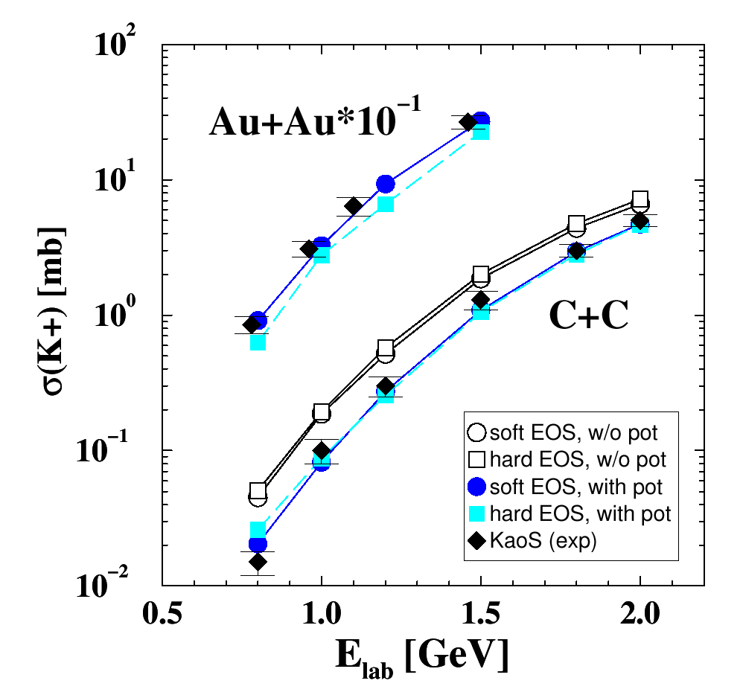
Probing the nuclear equation-of-state (ρ = 1 – 3 ρ₀)
by K⁺ meson production in C+C and Au+Au collisions
Idea: K⁺ yield ∝ baryon density ∝ compressibility
Transport model (RBUU)
Au+Au at 1 AGeV:
κ = 200 MeV ⇨ ρ_{max}≈ 2.9 ρ₀ ⇨ K⁺
κ = 380 MeV ⇨ ρ_{max}≈ 2.4 ρ₀ ⇨ K⁺
Reference system C+C:
K⁺ yield not sensitive to EOS
Experiment:
C. Sturm et al., (KaoS Collaboration),
Phys. Rev. Lett. 86 (2001) 39
Theory:
Ch. Fuchs et al.,
Phys. Rev. Lett. 86 (2001) 1974

Slide 19
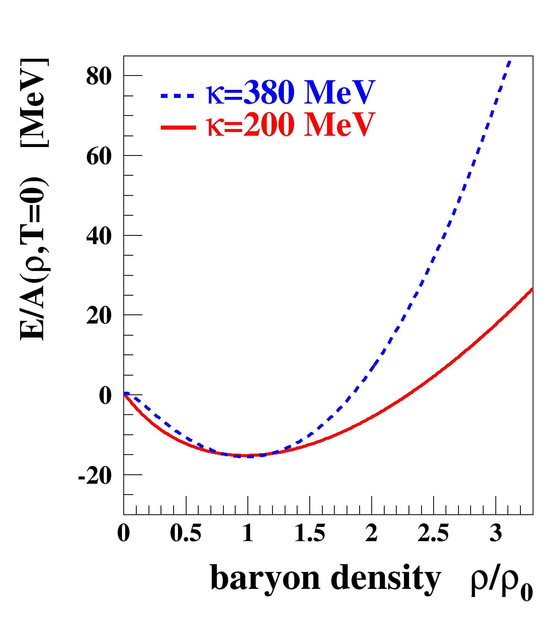
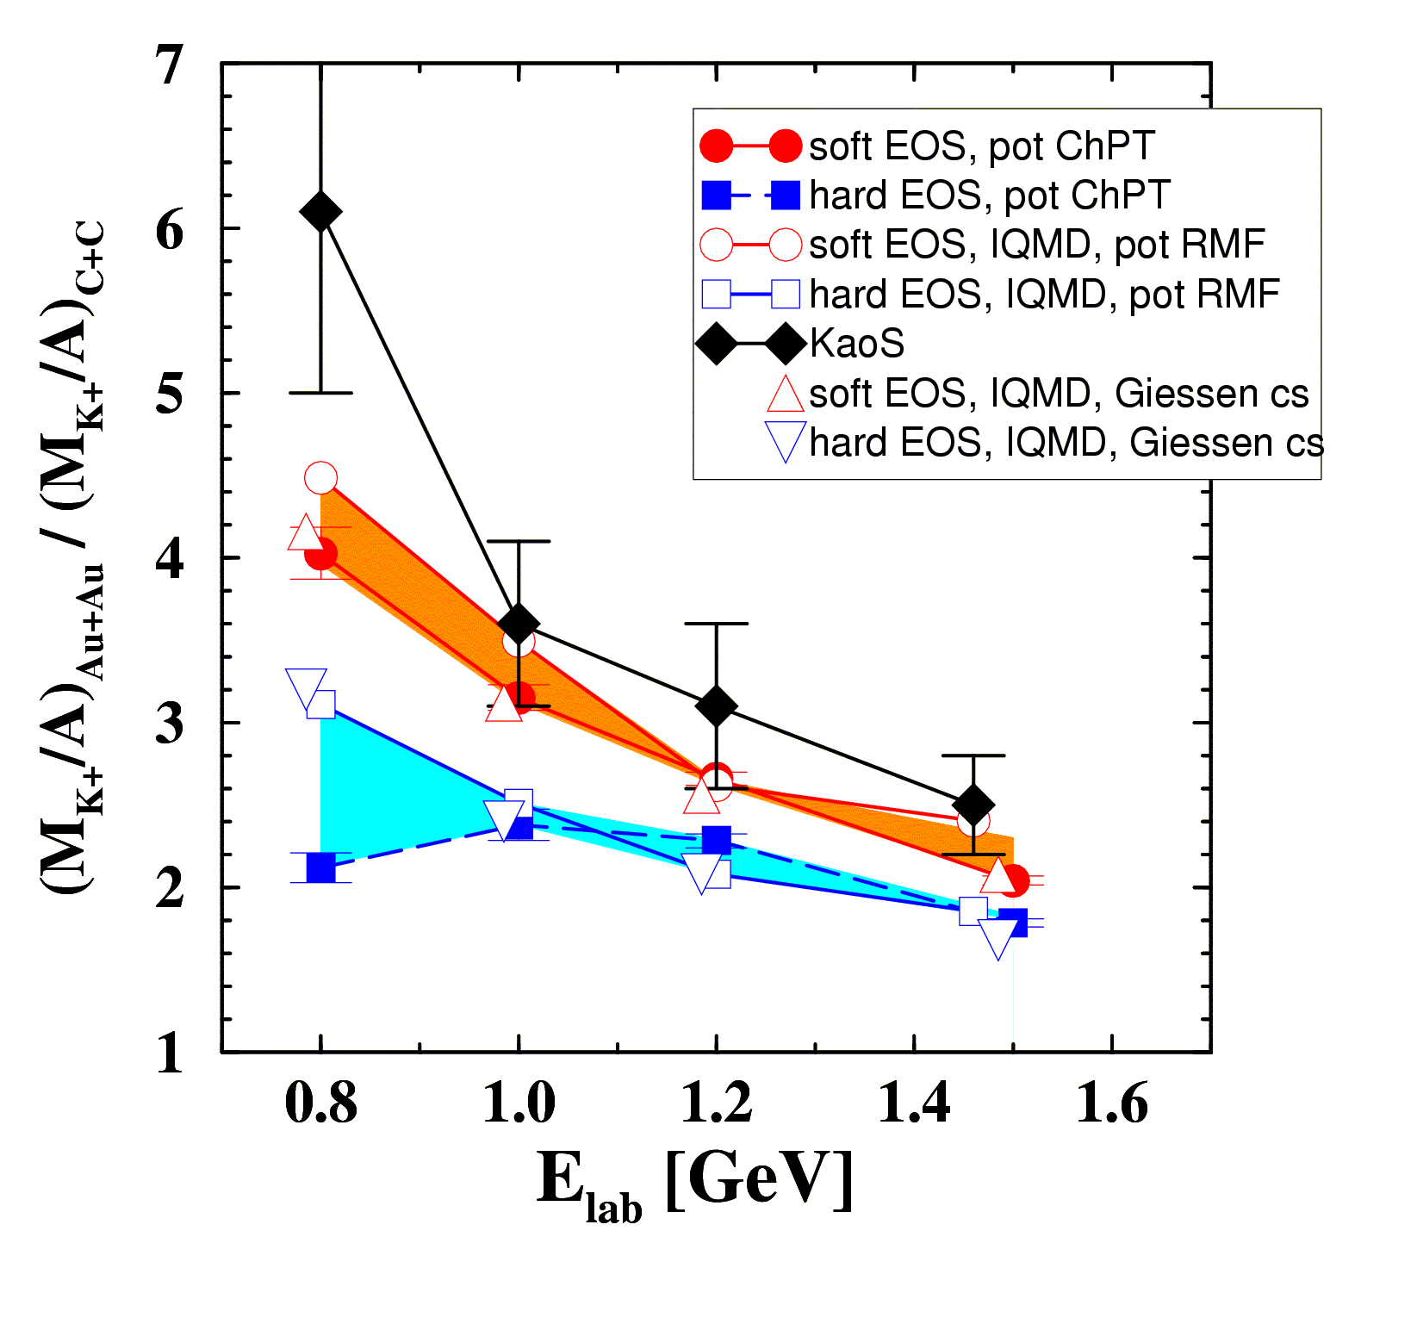
The compressibility of (symmetric) nuclear matter
Experiment: C. Sturm et al., (KaoS Collaboration) Phys. Rev. Lett. 86 (2001) 39
Theory: QMD Ch. Fuchs et al., Phys. Rev. Lett. 86 (2001) 1974
IQMD Ch. Hartnack, J. Aichelin, J. Phys. G 28 (2002) 1649
Au/C ratio: cancellation of systematic errors both in experiment and theory

Slide 20
The compressibility of (symmetric) nuclear matter
Experiment: C. Sturm et al., (KaoS Collaboration) Phys. Rev. Lett. 86 (2001) 39
Theory: QMD Ch. Fuchs et al., Phys. Rev. Lett. 86 (2001) 1974
IQMD Ch. Hartnack, J. Aichelin, J. Phys. G 28 (2002) 1649
Soft equation-of-state: κ ≤ 200 MeV
Confirmation of flow measurements

Slide 21
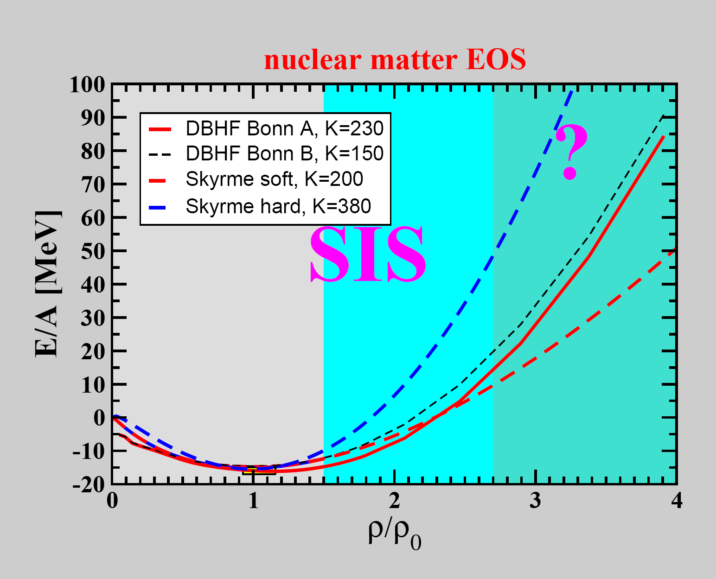
K⁺ production,
Fragment flow

Slide 22
?
K⁺ production,
Fragment flow

Slide 23
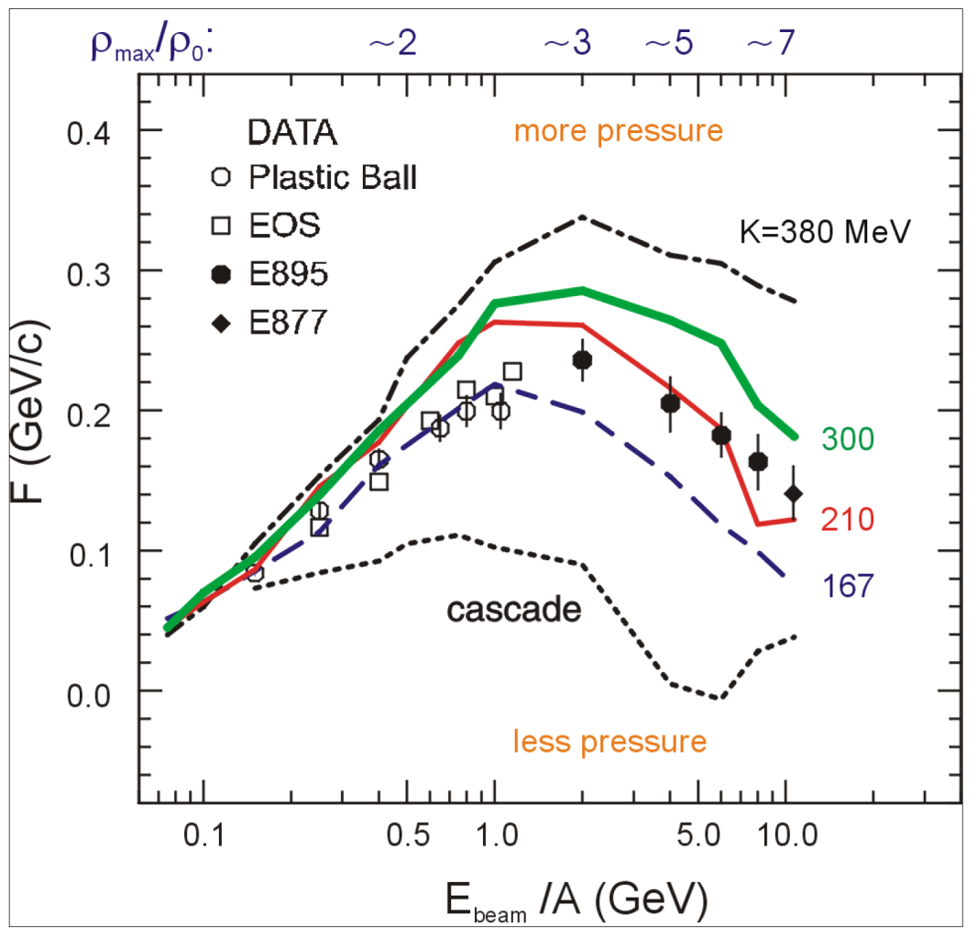
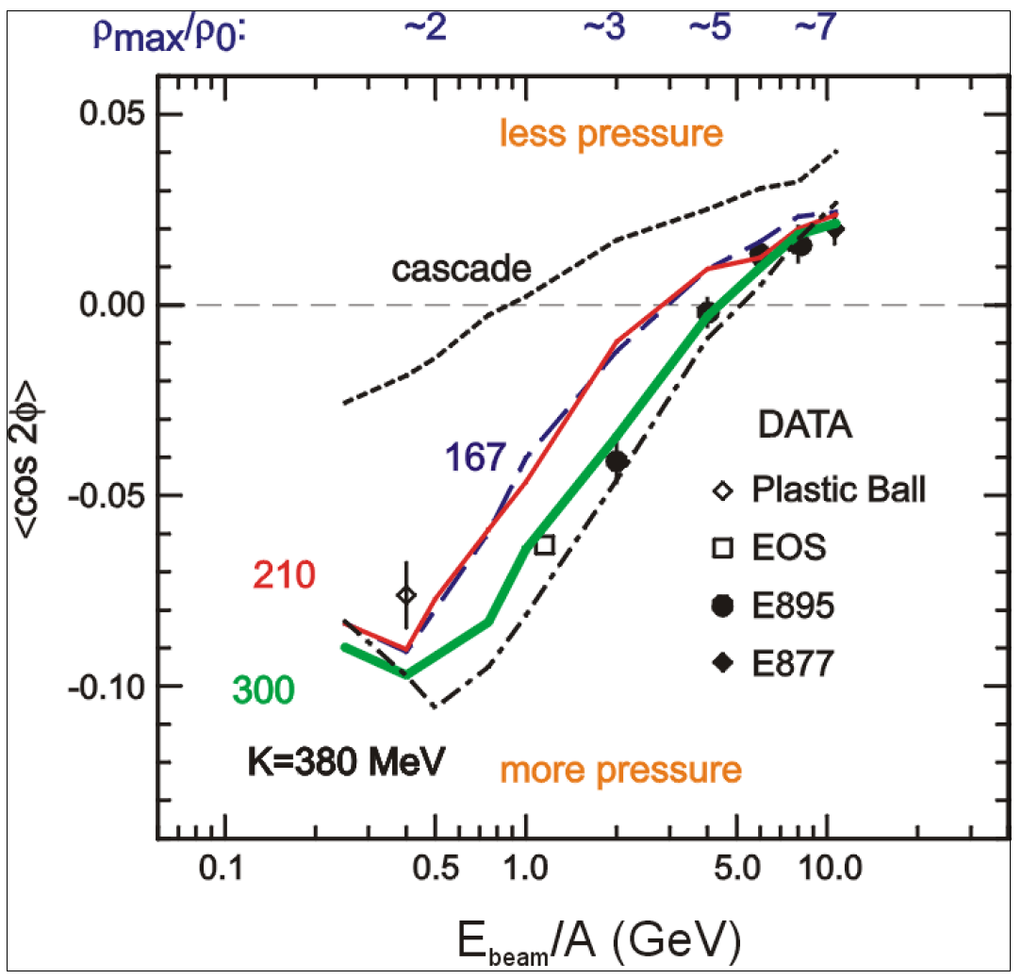
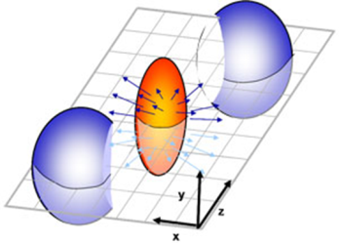
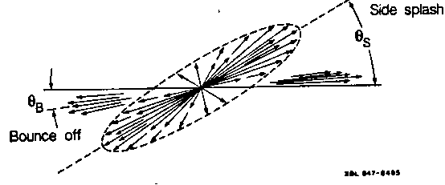
Nuclear incompressibility from collective proton flow
P. Danielewicz, R. Lacey, W.G. Lynch, Science 298 (2002) 1592
Transverse in-plane flow:
Elliptic flow:
F = d(p_{x}/A)/d(y/y_{cm})
dN/dΦ ∝ (1 + 2v₁ cosΦ + 2v₂ cos2Φ)

Slide 24
Observables sensitive to the EOS at high density
➢ collective flow of identified particles (π,K,p,Λ,Ξ,Ω,...)
driven by the pressure gradient in the early fireball
particle production at (sub)threshold energies via multi-step processes
(multi-strange hyperons, charm)
pp → K⁺pΛ⁰
pp → K⁺pΛ⁰
pp → K⁺pΛ⁰
Direct multi-strange hyperon production:
pp → Ξ⁻ K⁺K⁺p (E_{thr} = 3.7 GeV)
pp → Ω⁻ K⁺K⁺K⁰p (E_{thr} = 7.0 GeV)
pp → Λ⁰Λ⁰ pp (E_{thr} = 7.1 GeV)
pp → Ξ⁺ Ξ⁻ pp (E_{thr} = 9.0 GeV)
pp → Ω⁺ Ω⁻ pp (E_{thr} = 12.7 GeV
Λ⁰Λ⁰→ Ξ⁻ p
Λ⁰ Ξ⁻ → Ω⁻ n
p
p
p
p
Λ⁰
(uds)
Hyperon production via multiple collisions
pp → K⁺Λ⁰p, pp → K⁺K⁻pp,
pΛ⁰→ K⁺ Ξ⁻ p, πΛ⁰→ K⁺ Ξ⁻ π,
Λ⁰Λ⁰→ Ξ⁻ p, Λ⁰K⁻ → Ξ⁻ π⁰
3 . Λ⁰ Ξ⁻ → Ω⁻ n, Ξ⁻K⁻ → Ω⁻ π⁻
Antihyperons
1. Λ⁰ K⁺ → Ξ⁺π⁰ ,
2. Ξ⁺ K⁺ → Ω⁺ π⁺.
p
K⁺
p
Λ⁰
Ξ⁻
(uds)
(dss)
Ω⁻
p
K⁺
p
(sss)
p
Λ⁰
(uds)
K⁺
p
n

Slide 25
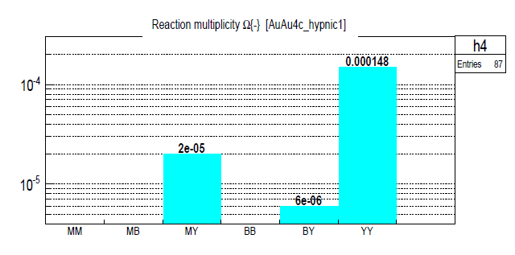
Observables sensitive to the EOS at high density
➢ collective flow of identified particles (π,K,p,Λ,Ξ,Ω,...)
driven by the pressure gradient in the early fireball
particle production at (sub)threshold energies via multi-step processes
(multi-strange hyperons, charm)
Direct multi-strange hyperon production:
pp → Ξ⁻ K⁺K⁺p (E_{thr} = 3.7 GeV)
pp → Ω⁻ K⁺K⁺K⁰p (E_{thr} = 7.0 GeV)
pp → Λ⁰Λ⁰ pp (E_{thr} = 7.1 GeV)
pp → Ξ⁺ Ξ⁻ pp (E_{thr} = 9.0 GeV)
pp → Ω⁺ Ω⁻ pp (E_{thr} = 12.7 GeV
Ω⁻ production in 4 A GeV Au+Au
Hyperon production via multiple collisions
pp → K⁺Λ⁰p, pp → K⁺K⁻pp,
pΛ⁰→ K⁺ Ξ⁻ p, πΛ⁰→ K⁺ Ξ⁻ π,
Λ⁰Λ⁰→ Ξ⁻ p, Λ⁰K⁻ → Ξ⁻ π⁰
3 . Λ⁰ Ξ⁻ → Ω⁻ n, Ξ⁻K⁻ → Ω⁻ π⁻
Antihyperons
1. Λ⁰ K⁺ → Ξ⁺π⁰ ,
2. Ξ⁺ K⁺ → Ω⁺ π⁺.
HYPQGSM calculations , K. Gudima et al.

Slide 26
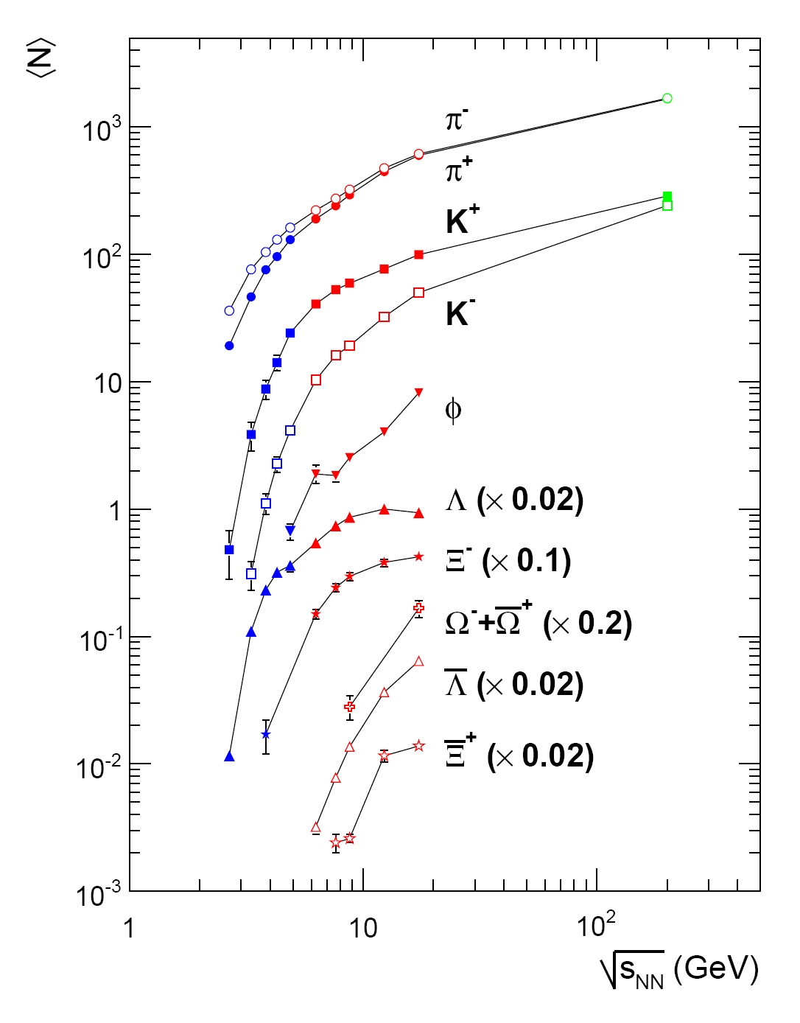
Observables sensitive to the EOS at high density
➢ collective flow of identified particles (π,K,p,Λ,Ξ,Ω,...)
driven by the pressure gradient in the early fireball
particle production at (sub)threshold energies via multi-step processes
(multi-strange hyperons, charm)
Direct multi-strange hyperon production:
pp → Ξ⁻ K⁺K⁺p (E_{thr} = 3.7 GeV)
pp → Ω⁻ K⁺K⁺K⁰p (E_{thr} = 7.0 GeV)
pp → Λ⁰Λ⁰ pp (E_{thr} = 7.1 GeV)
pp → Ξ⁺ Ξ⁻ pp (E_{thr} = 9.0 GeV)
pp → Ω⁺ Ω⁻ pp (E_{thr} = 12.7 GeV
Hyperon production via multiple collisions
pp → K⁺Λ⁰p, pp → K⁺K⁻pp,
pΛ⁰→ K⁺ Ξ⁻ p, πΛ⁰→ K⁺ Ξ⁻ π,
Λ⁰Λ⁰→ Ξ⁻ p, Λ⁰K⁻ → Ξ⁻ π⁰
3 . Λ⁰ Ξ⁻ → Ω⁻ n, Ξ⁻K⁻ → Ω⁻ π⁻
Antihyperons
1. Λ⁰ K⁺ → Ξ⁺π⁰ ,
2. Ξ⁺ K⁺ → Ω⁺ π⁺.
FAIR

Slide 27
EOS with phase transition
in symmetric matter
T. Fischer, N. Bastian, M. Wu, S. Typel, T. Klähn, D. Blaschke, arXiv:1712.08788
*
* P. Danielewicz, R. Lacey, W.G. Lynch, Science 298 (2002) 1592

Slide 28
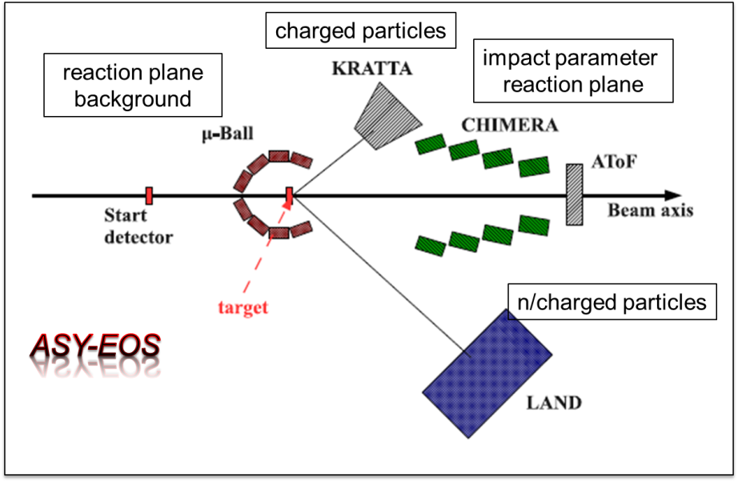
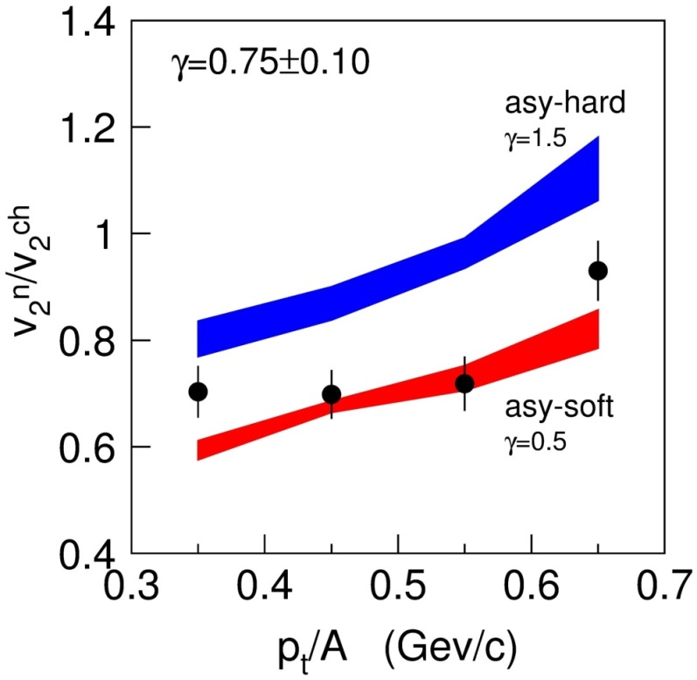
The ASY-EOS experiment at GSI:
The symmetry energy at supra-saturation density
P. Russotto et al.,
Phys. Rev. C 94, 034608 (2016)
Measuring the elliptic flow of
charged particles and neutrons
in Au+Au collisions at 400A MeV

Slide 29
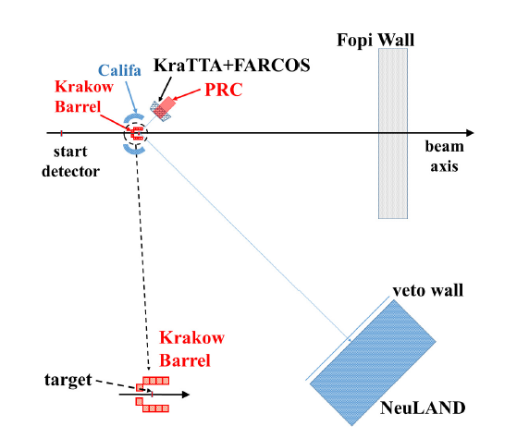
Proposal to measure E_{sym} at 2 – 3 ρ₀
ASY – EOS II experiment at SIS18 (P. Rusotto, Y. Leifels et al.):
Measurement of n/p-elliptic flow in Au+Au collisions up to 1A GeV

Slide 30
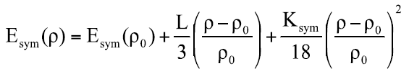
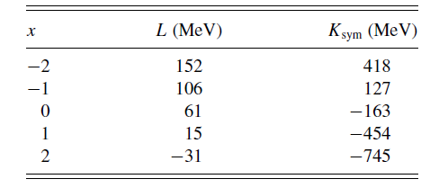
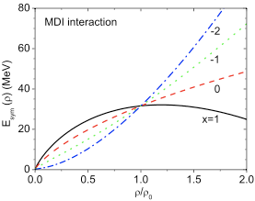
The symmetry energy from pion production
M. D. Cozma, Phys. Rev. C 95, 014601 (2017)
Au+Au collisions at 400A MeV
FOPI data: pink shadow

Slide 31
The symmetry energy from pion data
and from n/p elliptic flow data
π
Au+Au 400A MeV
flow
flow
π
π
W.-M. Guo et al., Physics Letters B738 (2014) 397

Slide 32
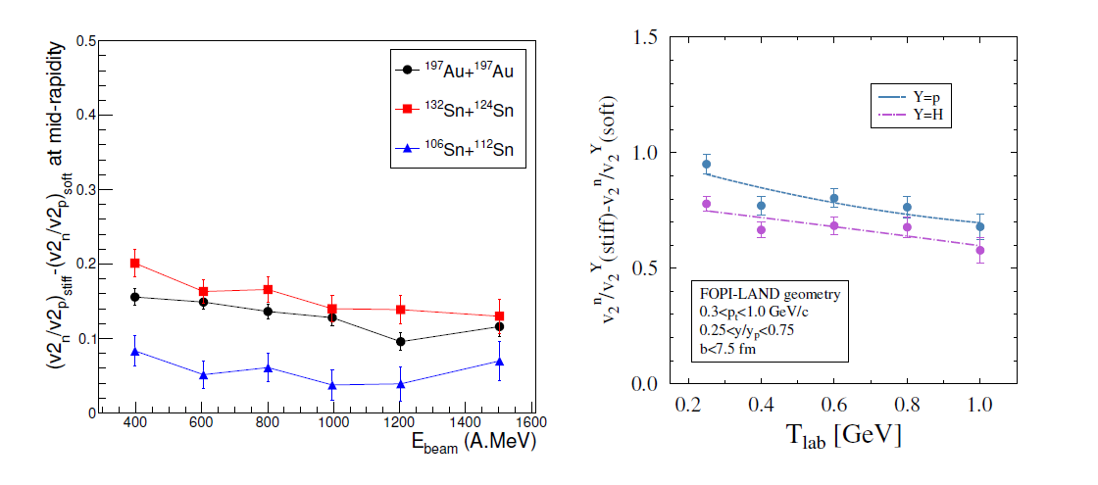
Sensitivity of neutron-to-proton elliptic flow ratios to E_{sym} as function of beam energy
IQMD: C. Hartnack et al., Eur. Phys. J. A 1 (1997) 151
TüQMD: M.D. Cozma, Phys. Lett. B 700 (2011) 139
Au + Au, b = 7.5 fm
b = 6 fm
?
?
Taken from P. Russotto, proposal to the GSI G-PAC , June 2017

Slide 33
Sensitivity of the π⁻/π⁺ ratio to E_{sym}
as function of beam energy
?
Jun Hong and P. Danielewicz, Phys. Rev. C90, 024605 (2014)

Slide 34
Studying E_{sym} by measuring particle yield ratios
and collective flow in heavy-ion collisions
at higher energies/densities ?
Possible candidates:
Particles produced closed to threshold with opposite isospin
I₃ | particle | production | E_{thr} | decay
+1 | Σ⁺(uus) | pp → Σ⁺K⁺n pp → Σ⁺K⁰p pn → Σ⁺K⁰n | 1.8 GeV | Σ⁺ → pπ⁰ Σ⁺→ nπ⁺
-1 | Σ⁻(dds) | pn → Σ⁻K⁺p nn → Σ⁻K⁺n | 1.8 GeV | Σ⁻ → nπ⁻
+½ | Ξ⁰ (uss) | pp → Ξº K⁺K⁰p pn → Ξ⁰ K⁰K⁰p nn → Ξ⁰K⁰K⁰n | 3.7 GeV | Ξ⁰ → Λπ⁰
-½ | Ξ⁻ (dss) | pp → Ξ⁻ K⁺K⁺p pn → Ξ⁻ K⁺K⁺n nn → Ξ⁻ K⁰K⁺n | 3.7 GeV | Ξ⁻ → Λπ⁻

Slide 35
Reconstruction of hyperons
with one neutral daughter
Σ hyperons in
Au+Au 10 AGeV
(dds)
missing mass analysis
(uus)
(uus)

Slide 36
Simulation and reconstruction
Strange hadrons in central Au+Au 10 AGeV
(ds)
(uds)
(uds)
(dss)
(dss)
(sss)

Slide 37
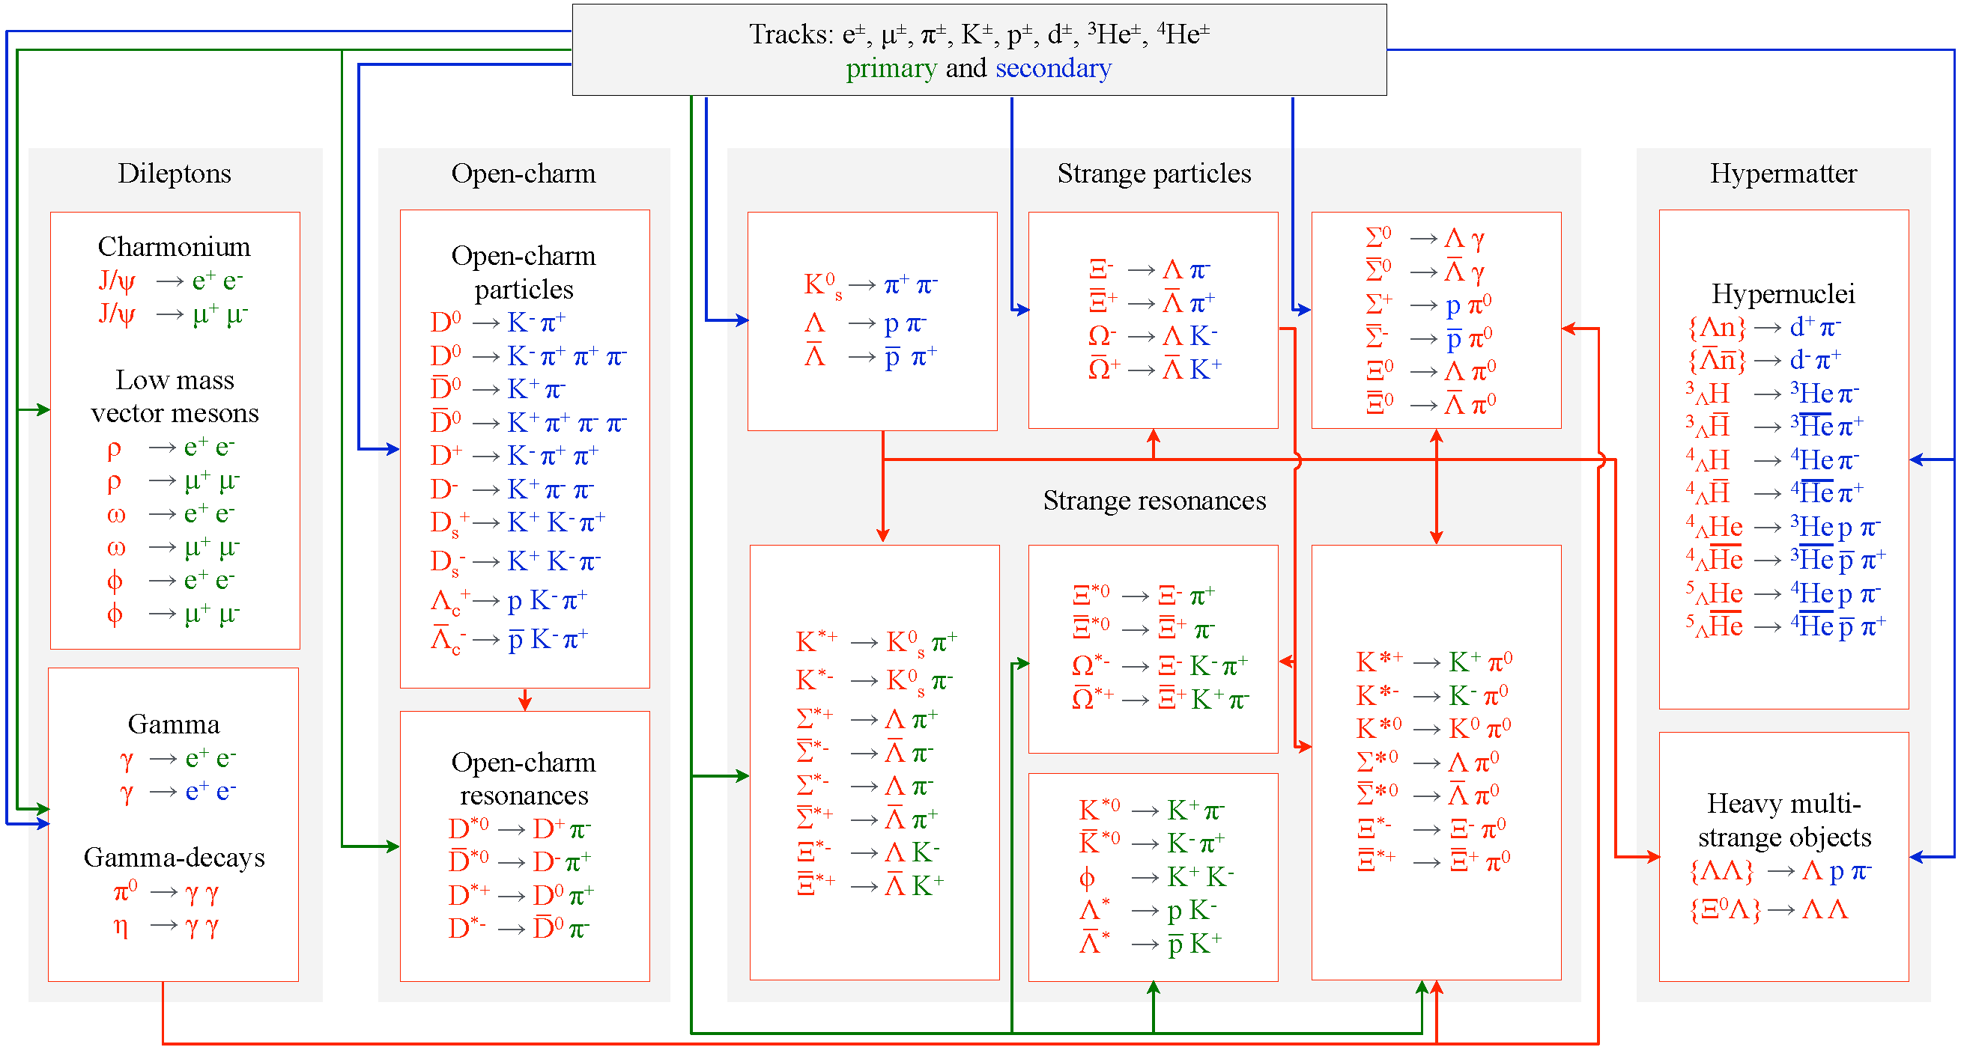
CBM observables Online particle identification by the KF Particle Finder
successfully used online in the STAR experiment

Slide 38
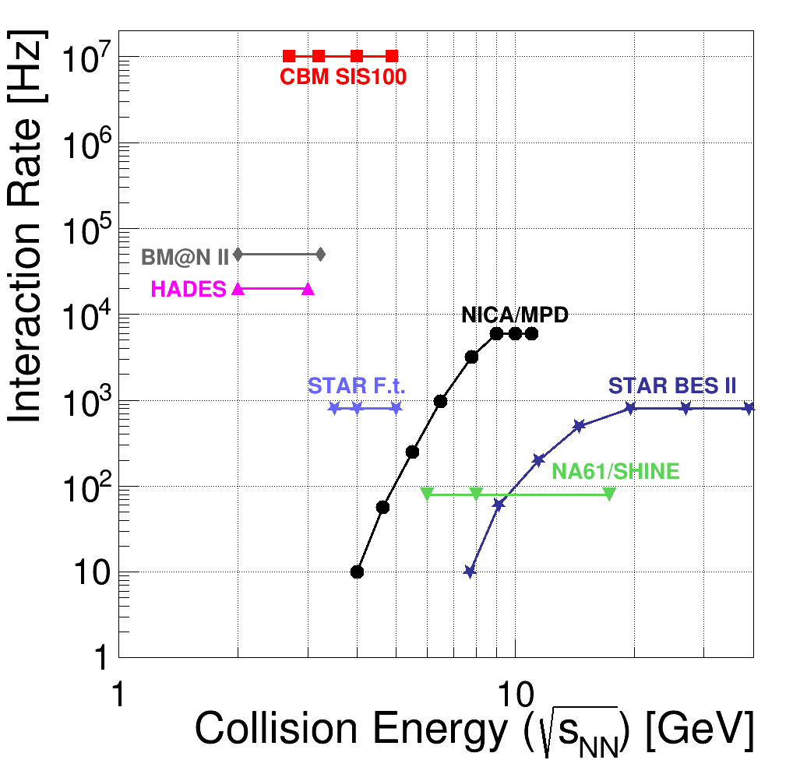
The CBM key feature: high reaction rates
high
net-baryon densities
The CBM Collaboration,
arXiv:1607.01487

Slide 39
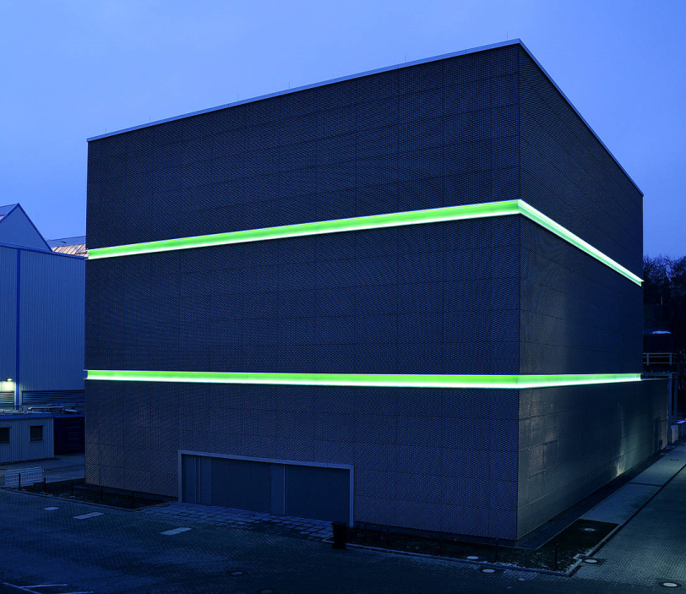
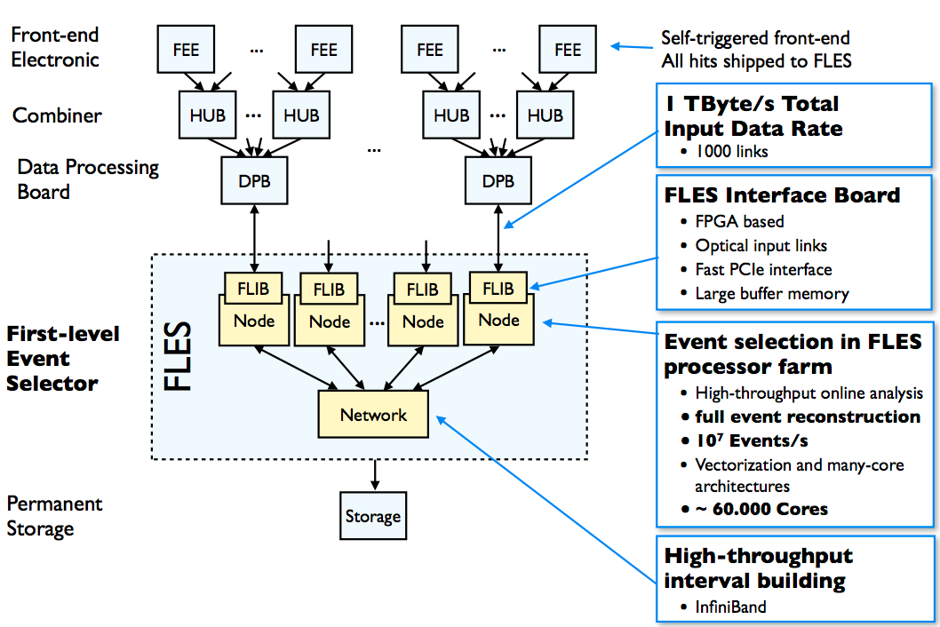
CBM DAQ and online event selection
Novel data readout system:
no hardware trigger on events
detector hits with time stamps
online 4-D track reconstruction
online event reconstruction/selection.
First-level Event Selector
GSI Green IT Cube (27 x 30 x 22 m³)
Space for 300000 cores,
5% of the energy is used for cooling
39

Slide 40

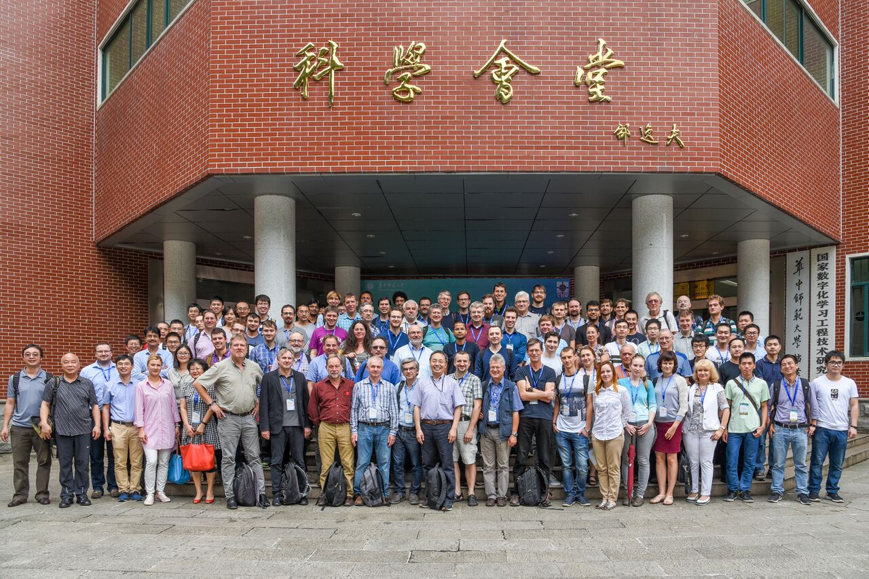
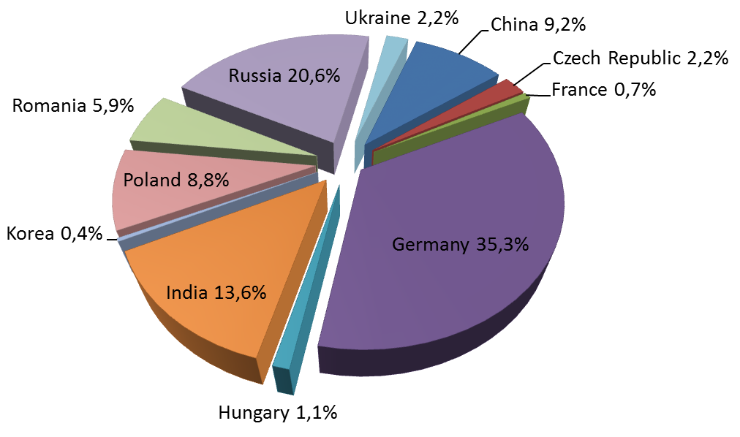
The CBM Collaboration: 56 institutions, > 460 members
China:
CCNU Wuhan
Tsinghua Univ.
USTC Hefei
CTGU Yichang
Chongqing Univ.
Czech Republic:
CAS, Rez
Techn. Univ. Prague
France:
IPHC Strasbourg
Hungary:
KFKI Budapest
Eötvös Univ.
Germany:
Darmstadt TU
FAIR
Frankfurt Univ. IKF
Frankfurt Univ. FIAS Frankfurt Univ. ICS
GSI Darmstadt
Giessen Univ.
Heidelberg Univ. P.I.
Heidelberg Univ. ZITI
HZ Dresden-Rossendorf
KIT Karlsruhe
Münster Univ.
Tübingen Univ.
Wuppertal Univ.
ZIB Berlin
Russia:
IHEP Protvino
INR Troitzk
ITEP Moscow
Kurchatov Inst., Moscow
VBLHEP, JINR Dubna
LIT, JINR Dubna
MEPHI Moscow
PNPI Gatchina
SINP MSU, Moscow
Ukraine:
T. Shevchenko Univ. Kiev
Kiev Inst. Nucl. Research
India:
Aligarh Muslim Univ.
Bose Inst. Kolkata
Panjab Univ.
Rajasthan Univ.
Univ. of Jammu
Univ. of Kashmir
Univ. of Calcutta
B.H. Univ. Varanasi
VECC Kolkata
IOP Bhubaneswar
IIT Kharagpur
IIT Indore
Gauhati Univ.
Korea:
Pusan Nat. Univ.
Poland:
AGH Krakow
Jag. Univ. Krakow
Warsaw Univ.
Warsaw Univ. Tech.
Romania:
NIPNE Bucharest
Univ. Bucharest
?
CBM Scientists
30th CBM Collaboration meeting
24-28 Sept. 2017, CCNU, Wuhan, China
40

Slide 41
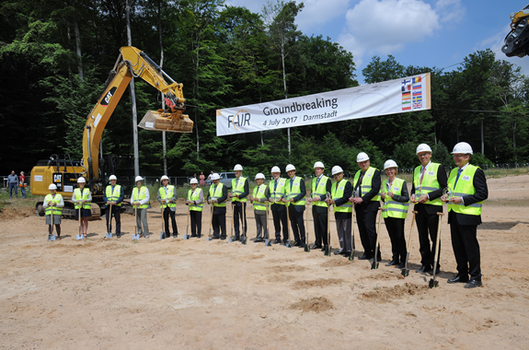
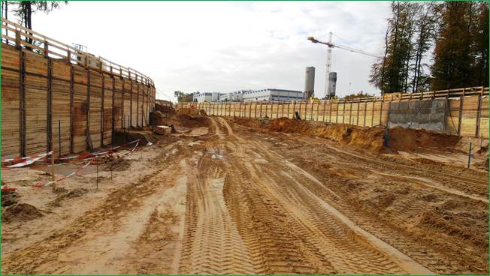
FAIR Project Status
Successful restart in 2015 and 2016
Comprehensive civil construction plan: completion of all buildings by 2022
Full integrated planning for construction and commissioning of the entire project: Completion of the full FAIR facility by 2025.
Civil construction as well as procurement of accelerators and realization of experiments are progressing
Ground breaking - 4 July 2017
Drone video of construction site from June 2018:
https://www.youtube.com/watch?v=NN_1t2mrgUI&feature=youtu.be
Excavation SIS100 tunnel - Nov 2017

Slide 42
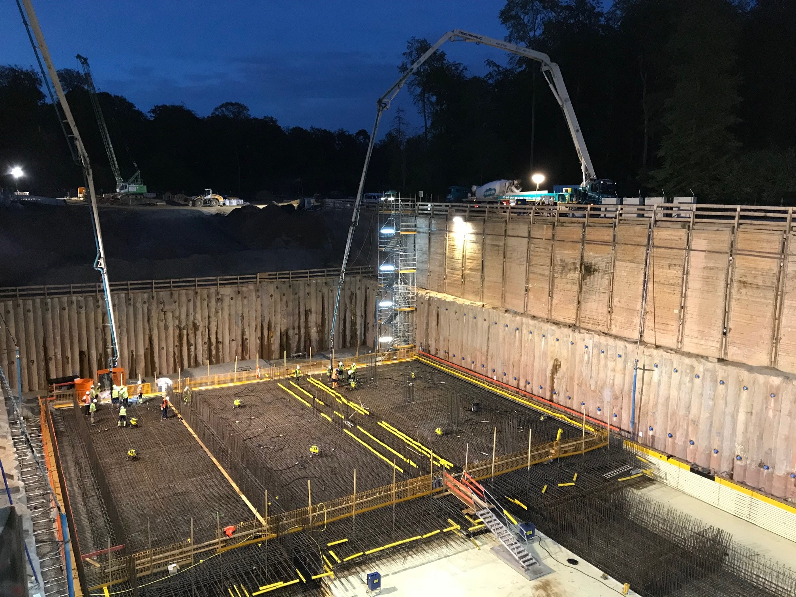
August 2018

Slide 43

August 2018

Slide 44

Conclusions and outlook
CBM measurements relevant to astrophysics:
The determination of the EOS of symmetric nuclear matter at
high baryon densities by measuring excitation functions of:
- the collective flow of identified particles
- multi-strange hyperon production
The investigation of the symmetry energy of nuclear matter at
high baryon densities by measuring the multidifferential yields
and collective flow of particles with opposite isospin for
different collision systems and energies (optional: neutron flow)
Required for interpretation of the data:
transport codes describing observables which are sensitive to
the EOS up to beam energies of about 11 A GeV
➢ The study of ΛΛ and ΛN interactions by measuring yields,
livetime, and collective flow of (double) Λ hypernuclei
44
CBM will be ready to take the first beams from SIS100 in 2025

