Slide 1

Dynamical properties and secondary decay effects of projectile fragmentations
in ¹²⁴Sn,¹⁰⁷Sn + ¹²⁰Sn collisions at 600 MeV/nucleon
Jun Su
Sino-French Institure of Nuclear Engineering & Technology,
Sun Yat-sen University, Zhuhai 519082, China.
E-mail: sujun3@mail.sysu.edu.cn
2018

Slide 2
Outline
Introduction
Theoretical framework
Results

Slide 3
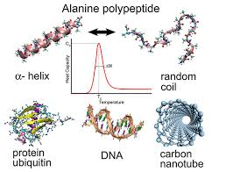
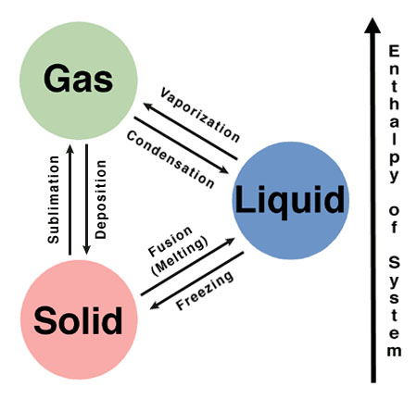
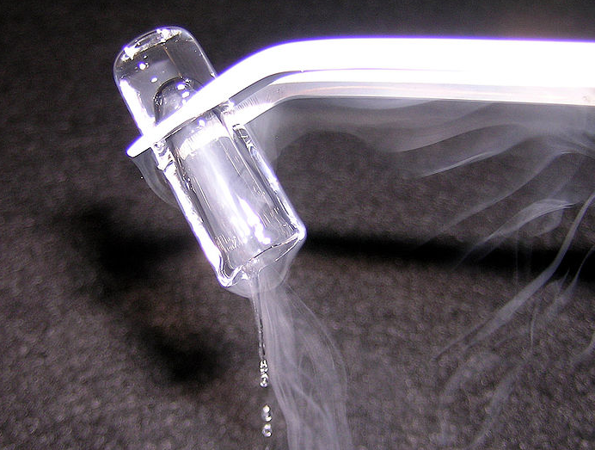
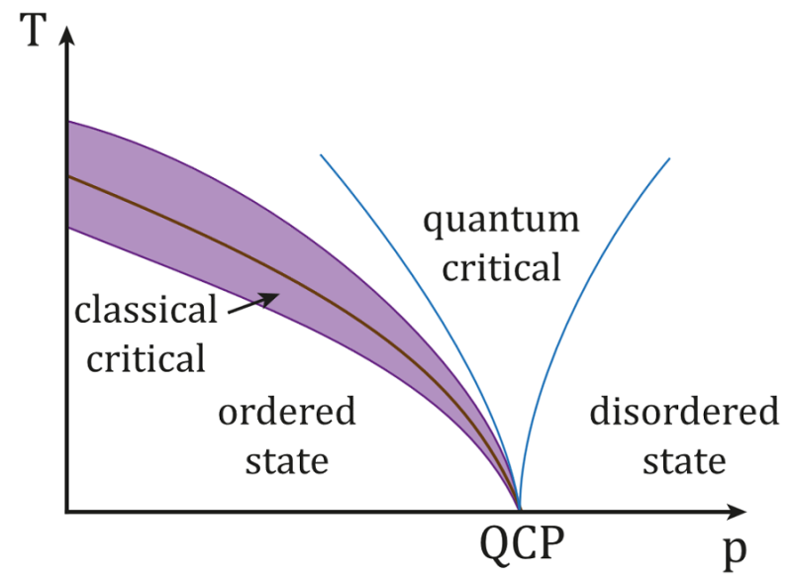
Phase Transition
Nuclear
Classics,
Quantum
Materials
Atomic
Polymer
Phase transitions in finite systems have attracted much attention in many different fields of physics.

Slide 4
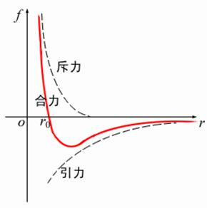
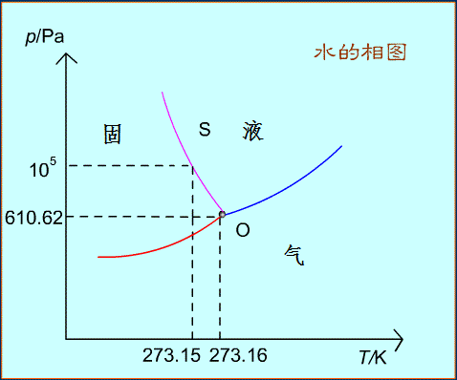
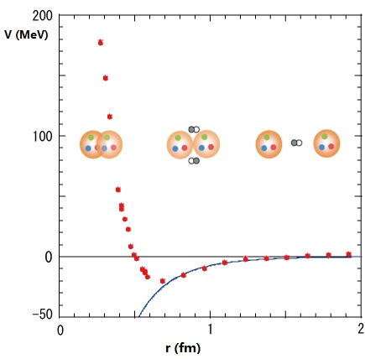
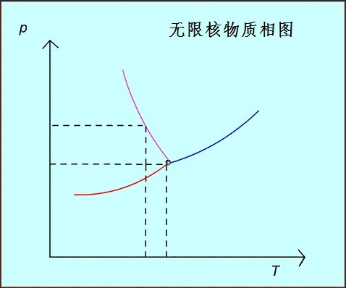
Phase Transition in nuclear matter
molecular force：Van-der-Waals type, attraction but repulsive core
nuclear force：attraction but repulsive core
？
The liquid-gas phase transition is expected to occur in the highly excited nuclei, due to the Van-der-Waals type of the nuclear force.

Slide 5
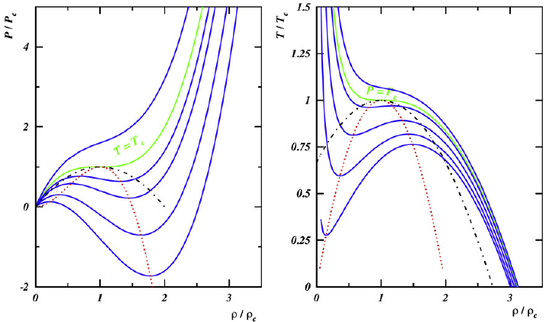
Phase Transition in finite nuclei and its relation to fragmentation
Caloric curve
Power law
Bimodality
Campi scatter
…
Many efforts have been devoted to explore the signals of the phase transition in the nuclear fragmentation.
B. Borderie and M.F. Rivet , Prog. Part. Nucl. Phys. 61 (2008) 551
J. Su, et al., Physics Letters B 782 (2018) 682–687

Slide 6
Fragmentation modes
Fragmentation
Central HICs
near Fermi energy
Peripheral HIC
at hundreds of MeV/nucl.
Spallation
at GeV
…
Same:
Intermediate-mass fragments
Deference:
Dissipation of incident kinetic energy
Temperature of the fragmenting source
Breakup mechanisms
Isospin dynamics
A large diversity of fragmentation modes has been observed in several types of nuclear reactions
Physical Review Letters 75 (6) (1995) 1040
Physical Review C 67 (6) (2003) 064613
Physical Review C 70 (5) (2004) 054607

Slide 7
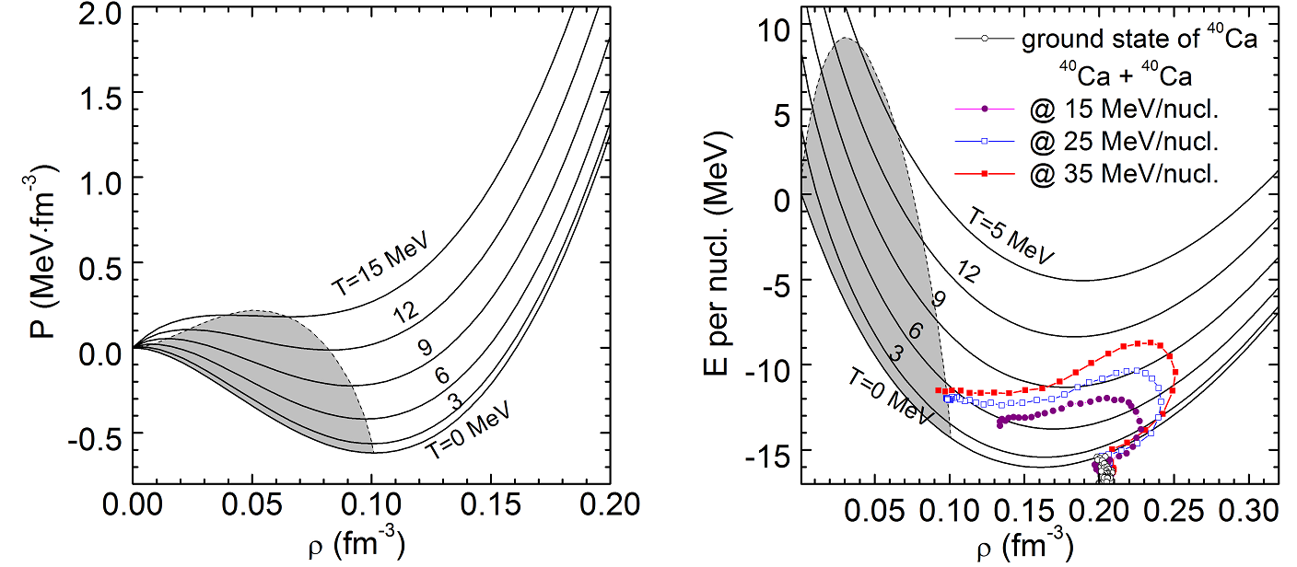
Central HICs near Fermi energy
undergoes successively the compression and expansion;
decays via multi-fragmentation, i.e., splits into clusters and unbound nucleons in a short time span.;
the spinodal decomposition is a major mechanism;
Physics Reports 389 (5-6) (2004) 263
J. Su, et al., Physics Letters B 782 (2018) 682–687

Slide 8
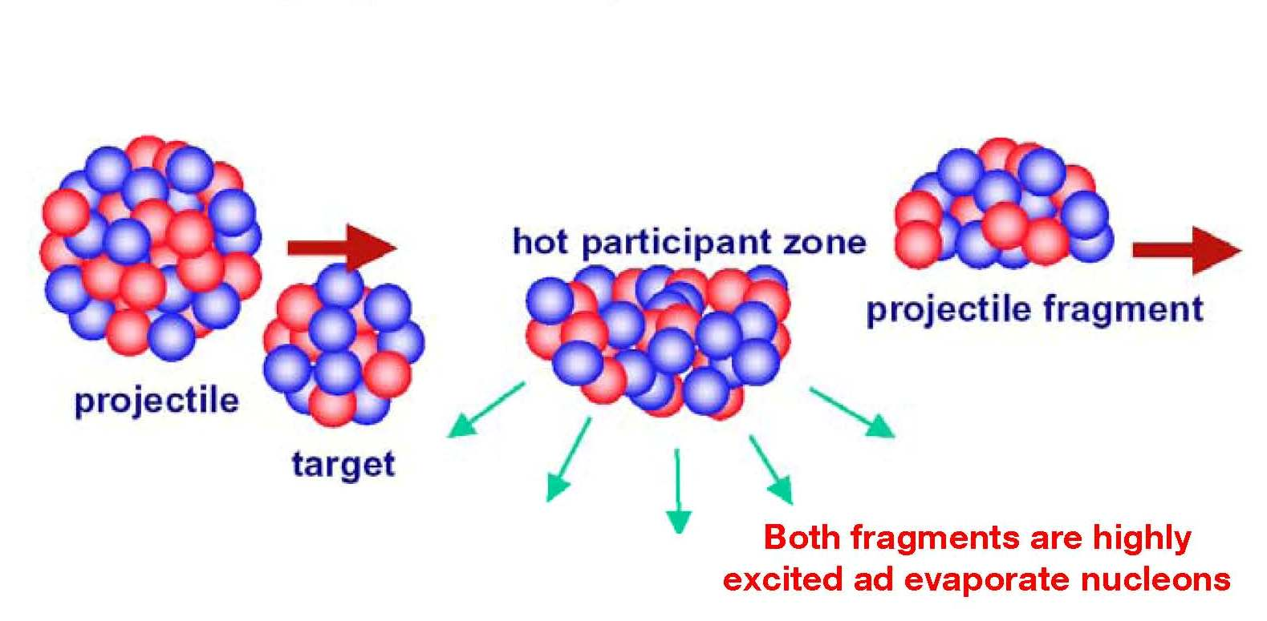
Projectile fragmentation peripheral HIC at hundreds of MeV/nucl.
To study the reaction mechanism of nuclear collisions
To extract the nuclear equation of state.
Phys. Rev. Lett. 103, 072701 (2009)
Phys. Rev. Lett. 90, 212302 (2003).

Slide 9
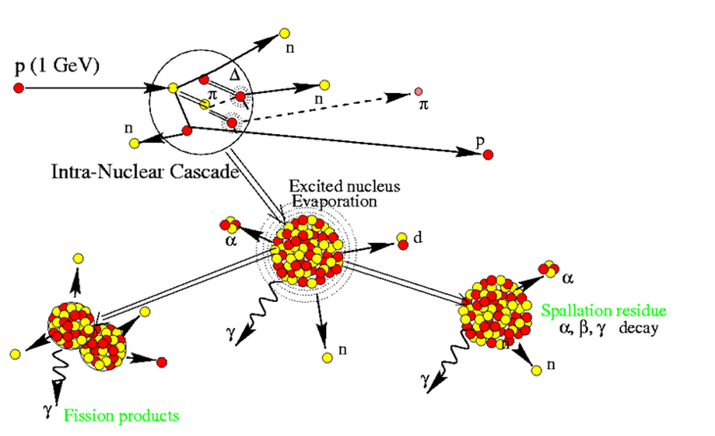
Spallation at GeV
https://www-nds.iaea.org/spallations.

Slide 10
phase transition in projectile fragmentation and spallation ?
Many researches focus on the study of thermodynamic observables from the projectile fragmentation and spallation [25, 26]. However, the signals of phase transition in those reactions is amphibolous, because the expansion phase is absent in those reactions while the spinodal region is considered in the subnormal density region.
B. Borderie and M.F. Rivet , Prog. Part. Nucl. Phys. 61 (2008) 551
J. Su, et al., Physics Letters B 782 (2018) 682–687

Slide 11
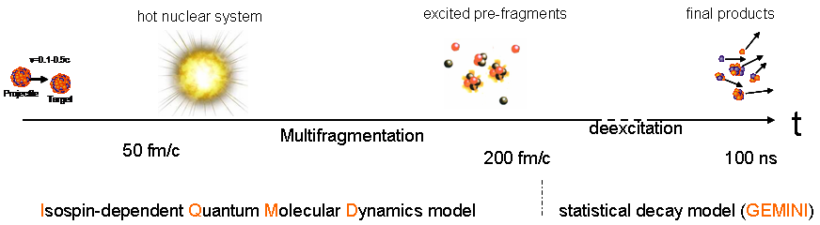
Theoretical framework
IQMD: describe formation of the hot fragments.
GEMINI: simulate the light-particle evaporation of the hot fragments

Slide 12
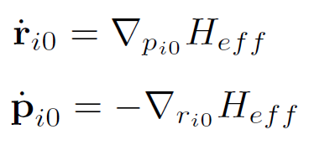

IQMD model
Density in phase space
time evolution
Hamiltonian
Nucleon-nucleon collisions
Pauli blocking
Code version: IQMD-BNU (Beijing Normal University)

Slide 13

GEMINI code
Decay modes
light-particle evaporation
symmetric fission
asymmetric fission → IMFs
……
Only light-particle evaporation is allowed in this work.
The partial decay widths are taken from the Hauser-Feshbach formalism

Slide 14
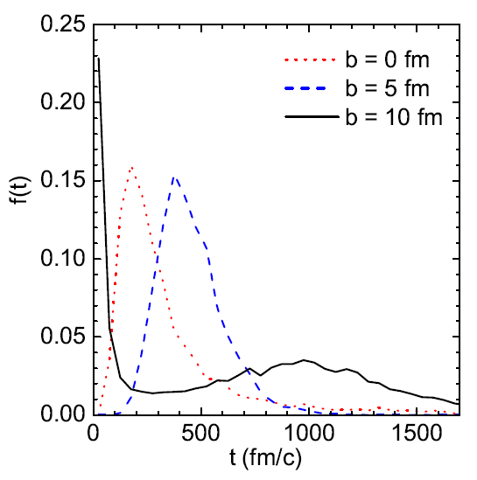
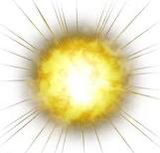
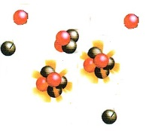
Emphasis of the model
Phase-space density constraint (PSDC) is significant to describe the IMFs
Stop IQMD evolution until the excitation energy is less than a special value Estop
Only light-particle evaporation is allowed in GEMINI
Switching time depends on
the excitation energy
lower than Estop ~ 3 MeV/u
Describe the emission of IMFs dynamically
(PSDC is significant)
Secondary decay of IMFs
statistically
Hot and equilibrium system
excited pre-fragments
final products
Multifragmentation
de-excitation
t
Isospin-dependent Quantum Molecular Dynamics model
statistical decay model (GEMINI)

Slide 15
Results
Properties of projectile spectator
Influence of secondary decay on fragmentation observables
Isospin dependence
Different break-up mechanism in
Central HICs near Fermi energy,
Peripheral HIC at hundreds of MeV/nucl.,
Spallation at GeV

Slide 16
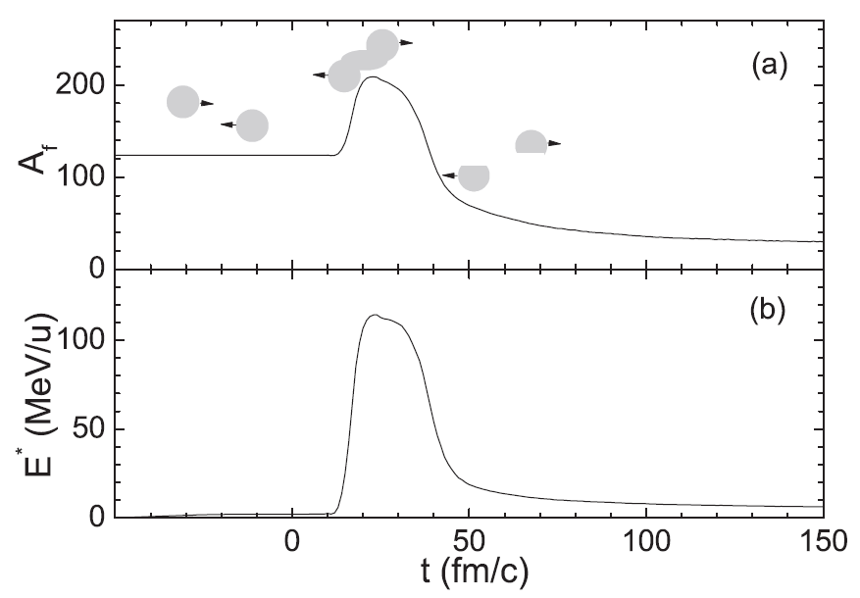
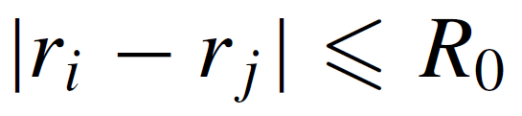
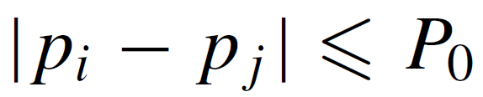
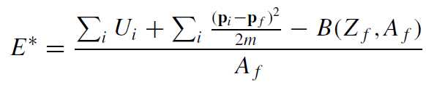
Properties of projectile spectator
At any time during the reaction process, fragments can be recognized
by a minimum spanning tree (MST) algorithm, in which
nucleons with small relative distance of coordinate and momentum belong to a fragment
The excitation energy of the
fragments can be calculated
The MST algorithm is unable to distinguish the onset of the equilibrated projectile spectator.

Slide 17
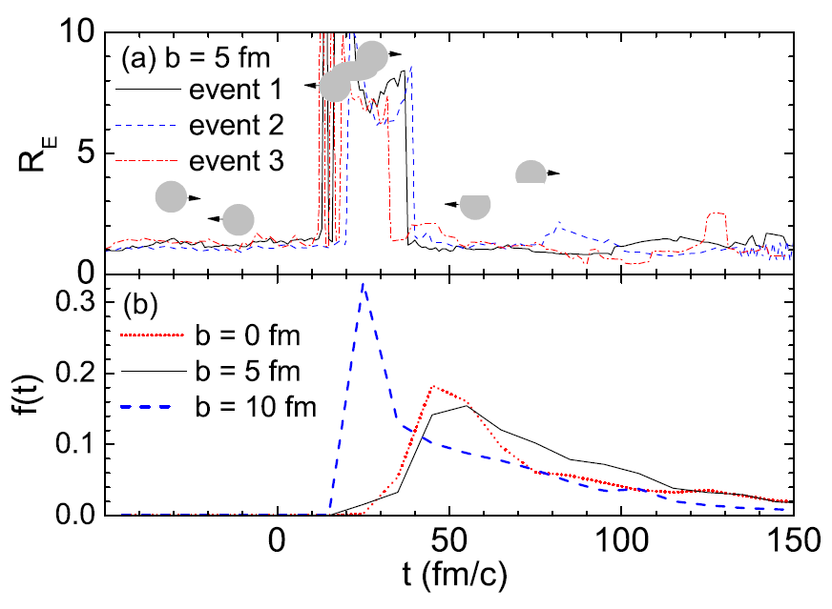
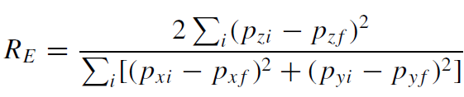
The ratio of parallel to transverse quantities is further used to distinguish the equilibrated projectile spectator:
After the projectile spectator is separated from the participant region, its value of RE decreases and gets close to 1. Considering the observed fluctuation, the projectile spectator with a value of 0.9 < RE < 1.2 is regarded as equilibrated.

Slide 18
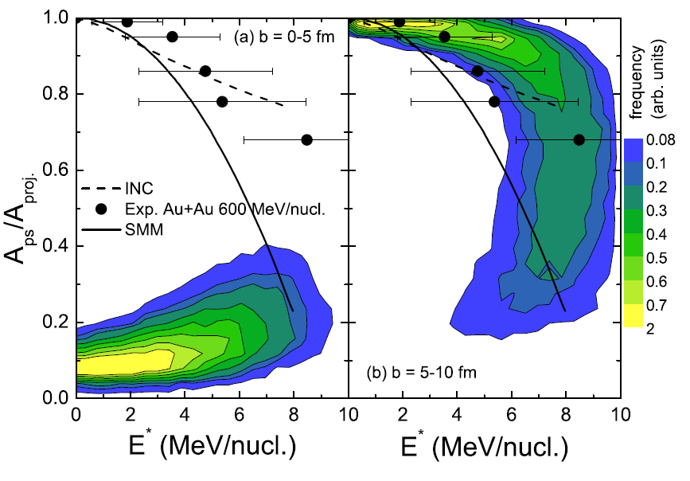
The correlations between the mass and the excitation energy of the equilibrated projectile spectator
¹²⁴Sn+¹²⁰Sn
@600 MeV/nucl.

Slide 19
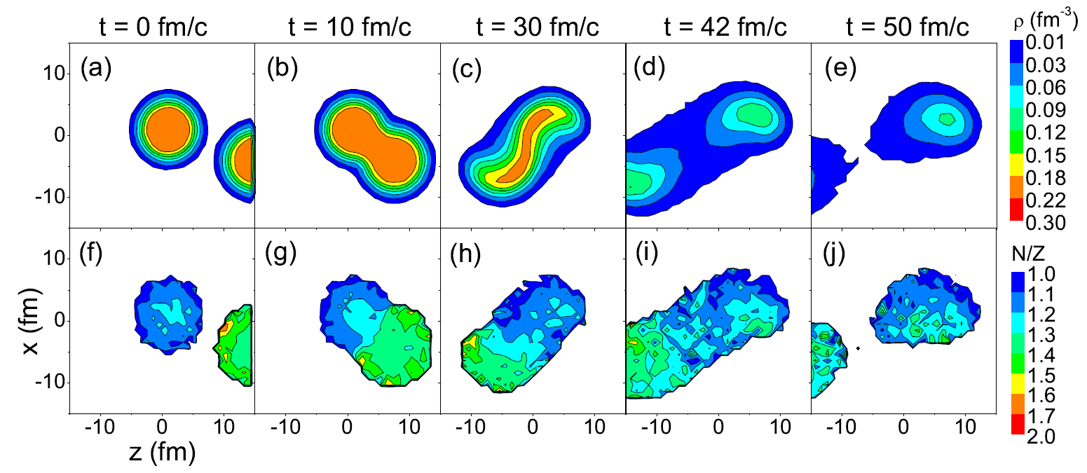
¹⁰⁷Sn+¹²⁰Sn@600MeV/nucl.
b = 5 fm
The timescale:
50 fm/c for the interaction between projectile and target
~100 fm/c for isospin diffusion [Eur. Phys. J. A 50, 33 (2014)]
~1000 fm/c for isospin drift [Phys. Rev. C 87, 061601 (2013)]
Thus the isospin diffusion will take place in the formation of the projectile spectator especially for small impact parameter.

Slide 20
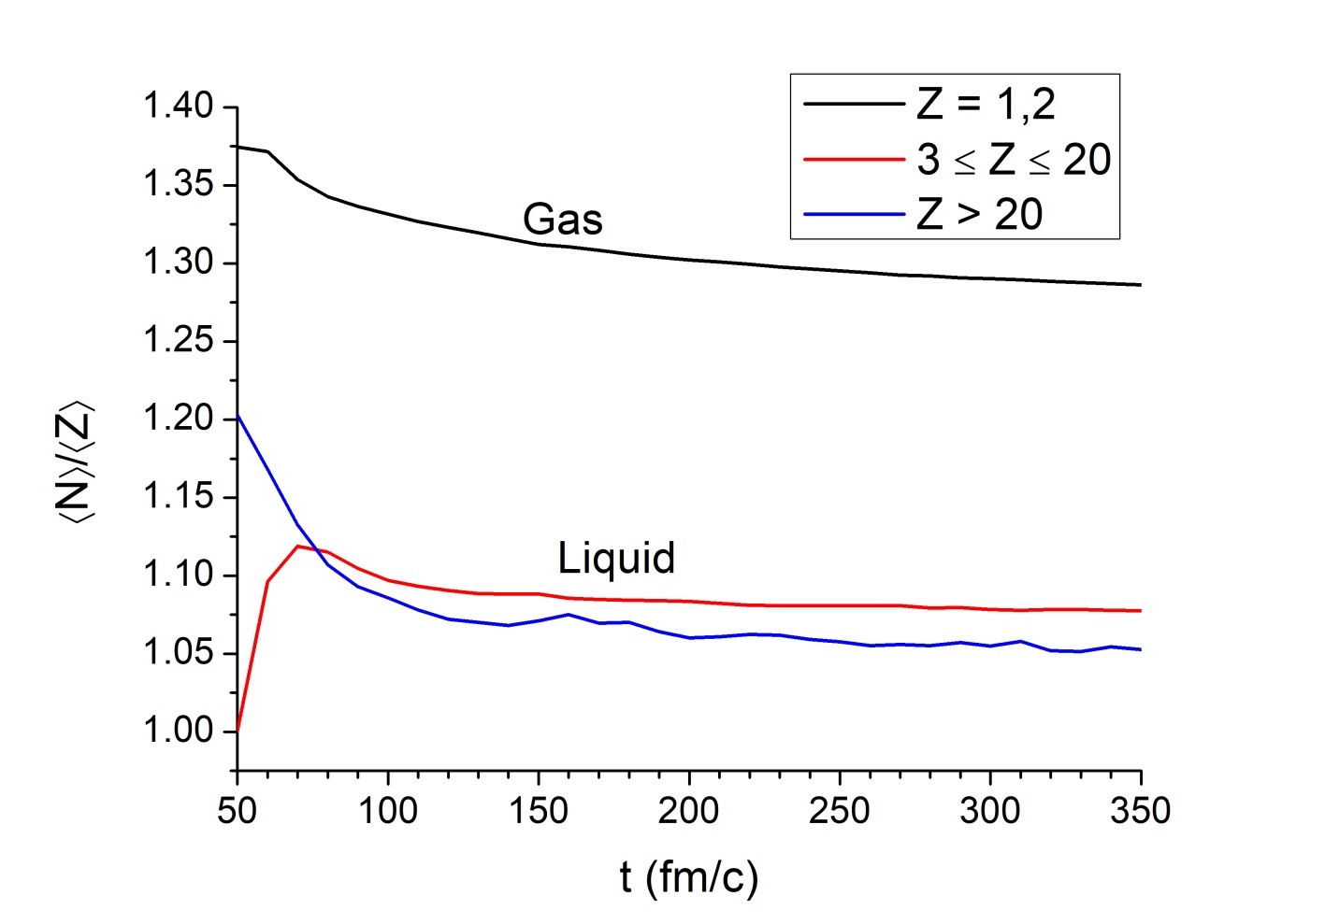
N/Z_{gas} > N/Z_{liquid}
¹⁰⁷Sn+¹²⁰Sn@600MeV/nucl.
b = 5 fm
The timescale:
50 fm/c for the interaction between projectile and target
~100 fm/c for isospin diffusion [Eur. Phys. J. A 50, 33 (2014)]
~1000 fm/c for isospin drift [Phys. Rev. C 87, 061601 (2013)]
The isospin drift (fractionation) will take place in the fragmenting process.

Slide 21
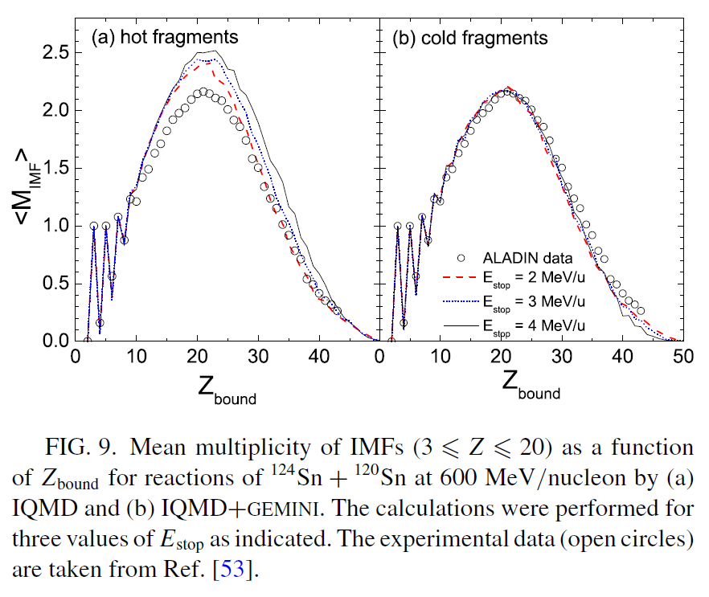
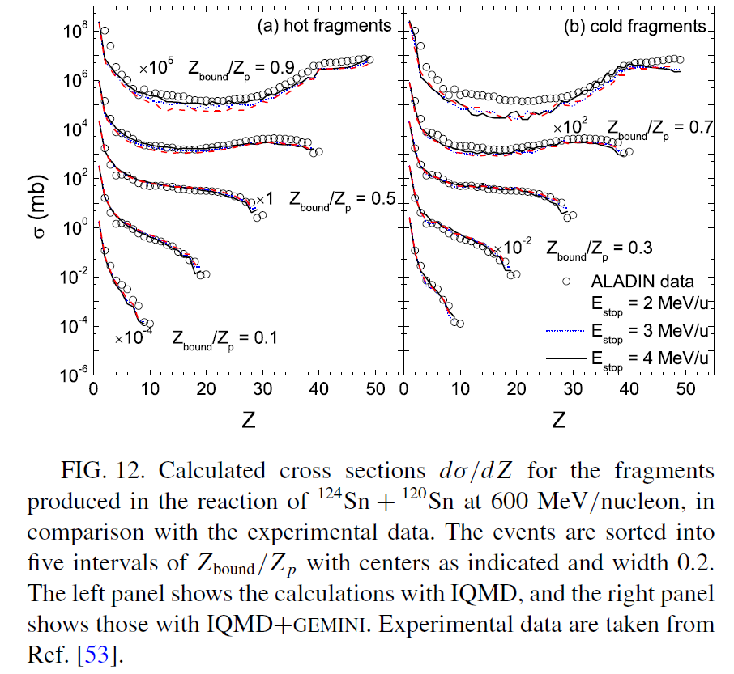
Influence of secondary decay on fragmentation observables
The nucleon evaporations of the hot fragments reduce the multiplicity of intermediate-mass fragments slightly.

Slide 22
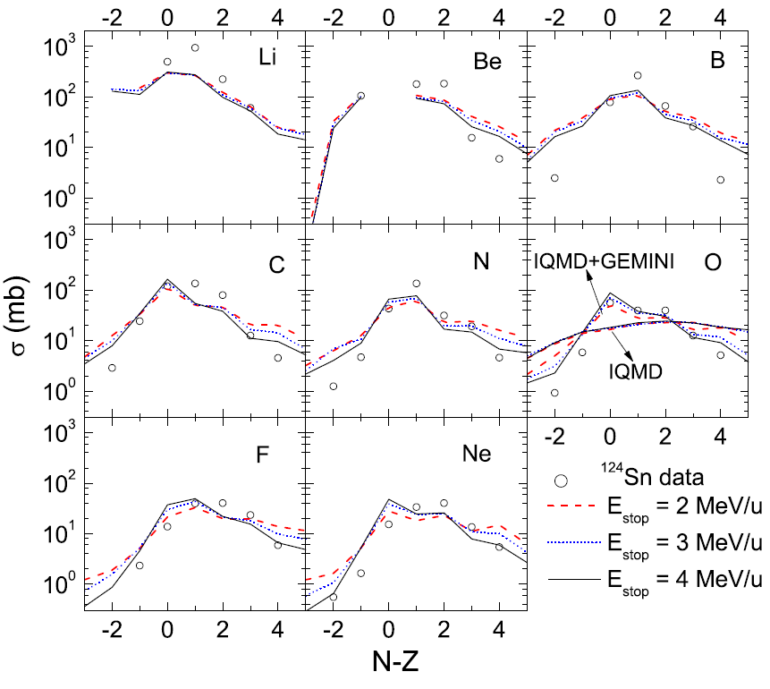
The sequential decay also leads to narrower isotope distributions

Slide 23
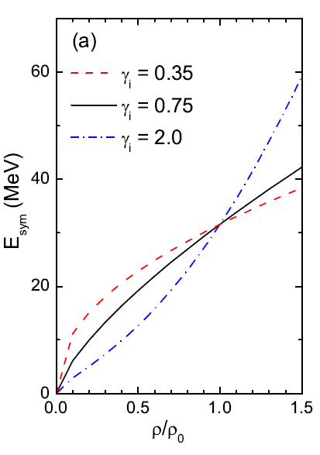
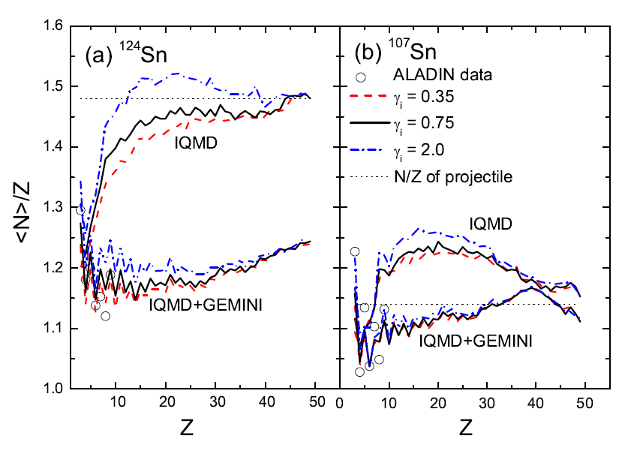
Isospin dependence
The sequential decay
reduce the neutron to proton ratio of the fragments.
weakens the symmetry energy dependence of the observable ⟨N⟩/Z.

Slide 24
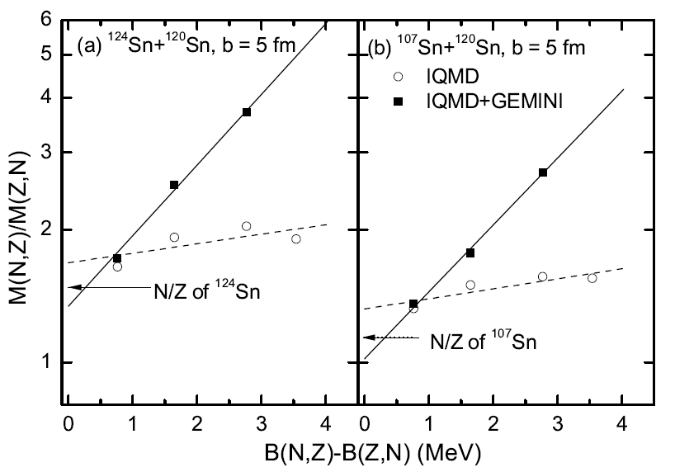
The ratio between yields of mirror nuclei is isospin observable.
However, there are sequential decay effects.
⁷Li/⁷Be
¹¹B/¹¹C
³H/³He

Slide 25
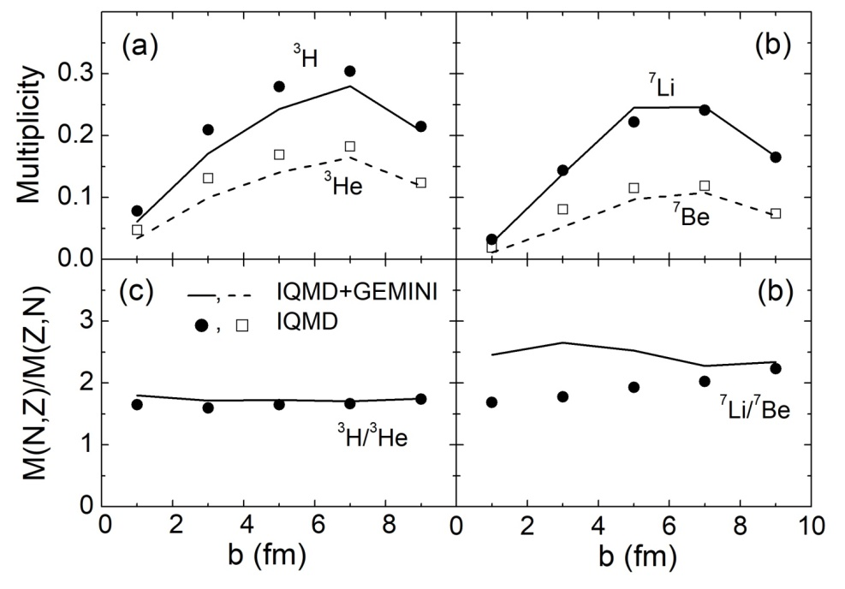
The ratio between yields of mirror nuclei is isospin observable.
However, there are sequential decay effects.
As a result of the small binding energy difference, the yield ratio between tritium and helium-3 is slightly distorted from the secondary decay.

Slide 26
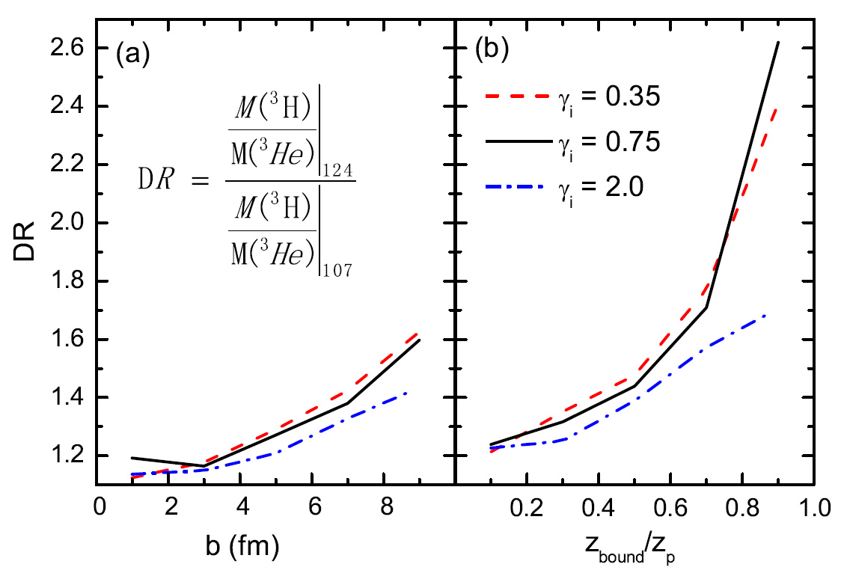
Two robust isospin observables:
yield ratio of the mirror nuclei ³H/³He,
double ratio of this quantity formed with two projectile fragmentations with different isospin asymmetry
The suggested isospin observables are more robust for the peripheral collisions. It is beneficial to obtain high precision data.

Slide 27
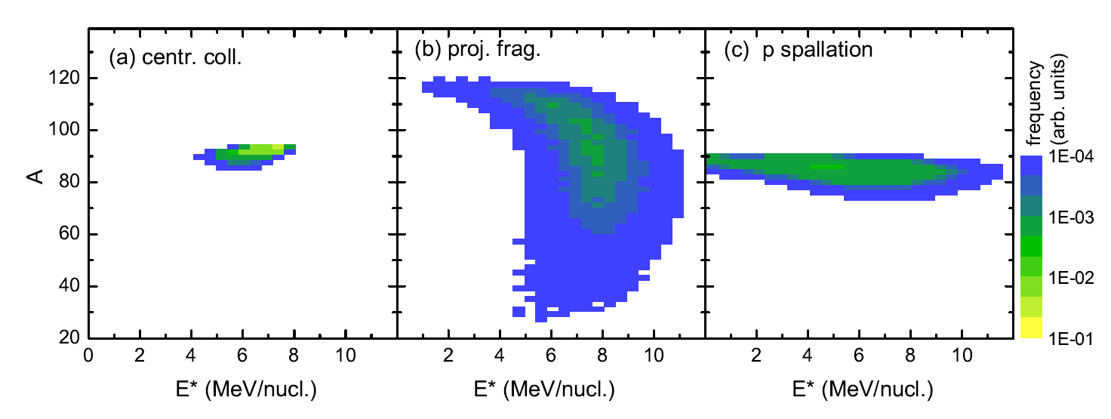
Break-up mechanism
⁴⁸Ti+⁴⁸Ti@30MeV/nucl.
b = 0 fm
¹²⁰Sn+¹²⁰Sn@600MeV/nucl.
b = 8 fm
⁹⁰Zr+p@2000MeV/nucl.
b = 0 fm

Slide 28
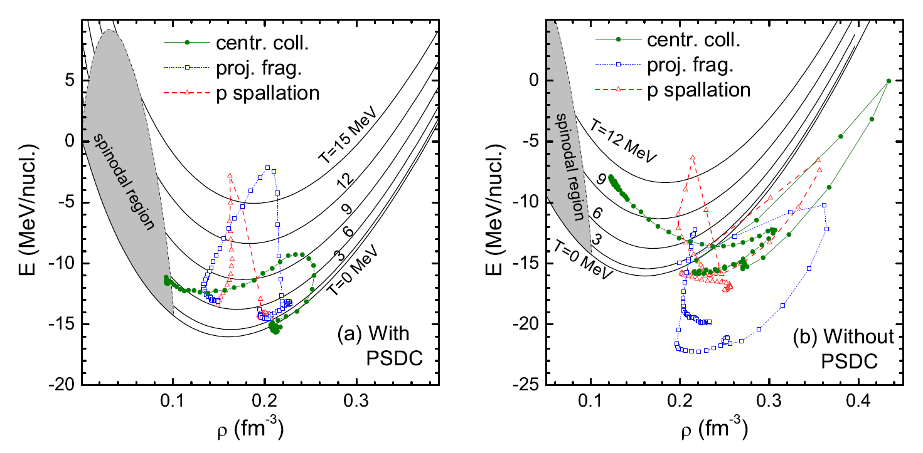
The dynamics track in E-ρ diagram of the projectile center
Central collision: compression and heating at the beginning of the collision, and then the expansion and cooling by the light particle emission.
Projectile fragmentation: The cooling stage accompanies with the expansion, but the ending is far from the spinodal region.
Spallation: heating and cooling

Slide 29
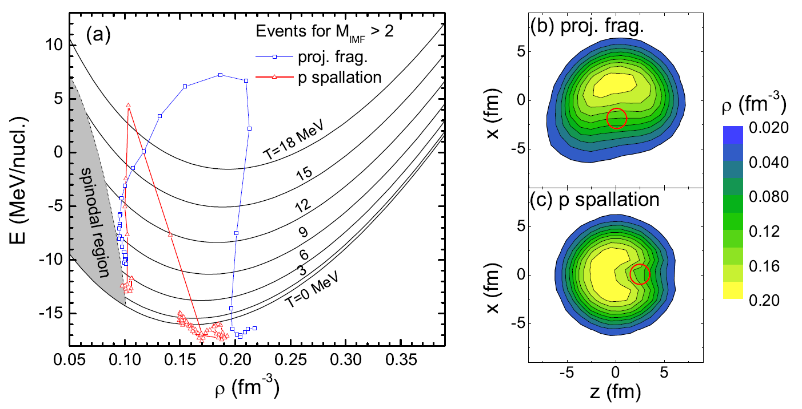
The dynamics E- trajectory of the fragmenting area is different to that of the center.

Slide 30
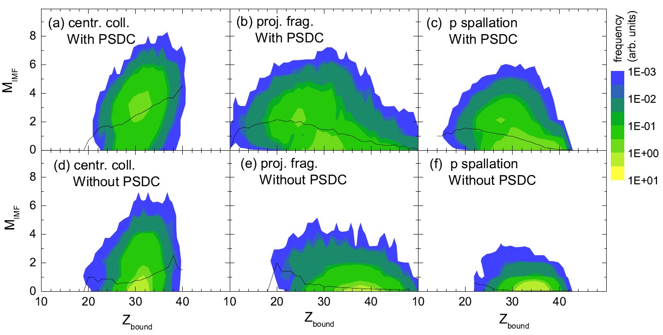
The correlations between the multiplicity of IMFs and the
total bound charge Z_{bound} of the productions.

Slide 31
Conclusions
IQMD+GEMINI model
with phase-space density constraint
stop dynamics evolution until the excitation energy is less than a special value Estop
only light-particle evaporation is allowed in GEMINI
can able to reproduce the main features of projectile fragmentation.
Two robust isospin observables:
yield ratio of the mirror nuclei ³H/³He,
double ratio of this quantity formed with two projectile projectile fragmentations with different isospin asymmetry

Slide 32
Cooperators
W. Trautmann， GSI
Feng-Shou Zhang， BNU
Wen-Jie Xie，Yuncheng U
Long Zhu， SYSU
Chenchen Guo

Slide 33
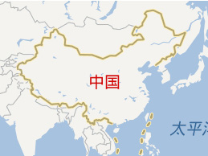
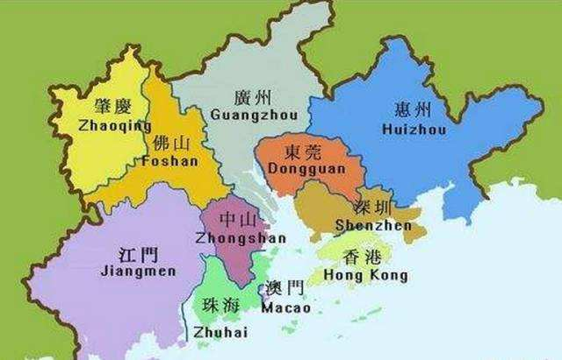
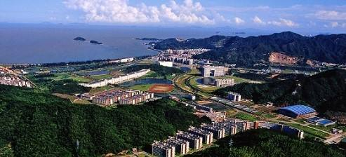
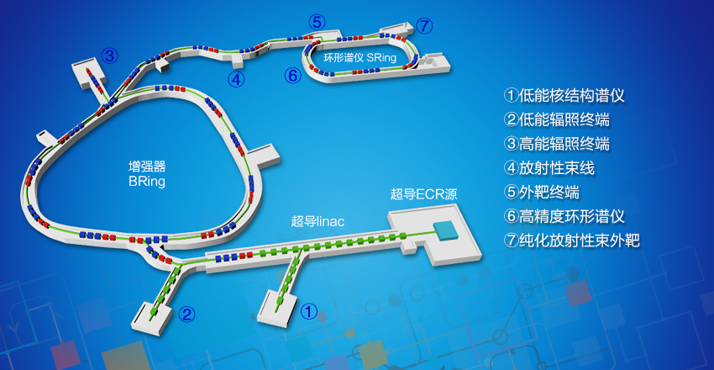
Welcome to Zhuhai
Nuclear physics at SYSU
HIAF@Huizhou

