Slide 1
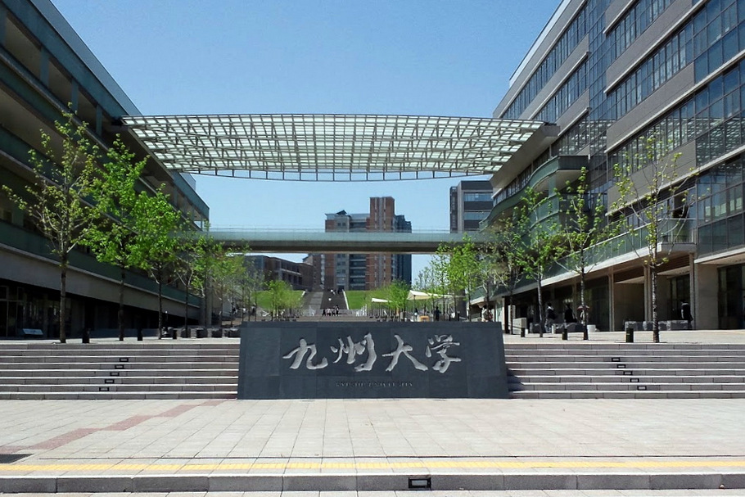
Astrophysical implications of the nuclear symmetry energy
Ken’ichiro Nakazato = 中里 健一郎
（Kyushu University）
8th International Symposium on Nuclear Symmetry Energy
@ Hanwha Resort, Haeundae, Busan, 2018 Sep. 11th

Slide 2
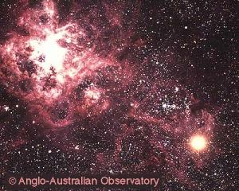
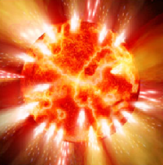
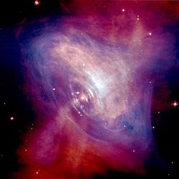
Compact stars
Supernova core
core collapse supernova
Proto-neutron star （PNS）
Neutron star （NS）

Slide 3
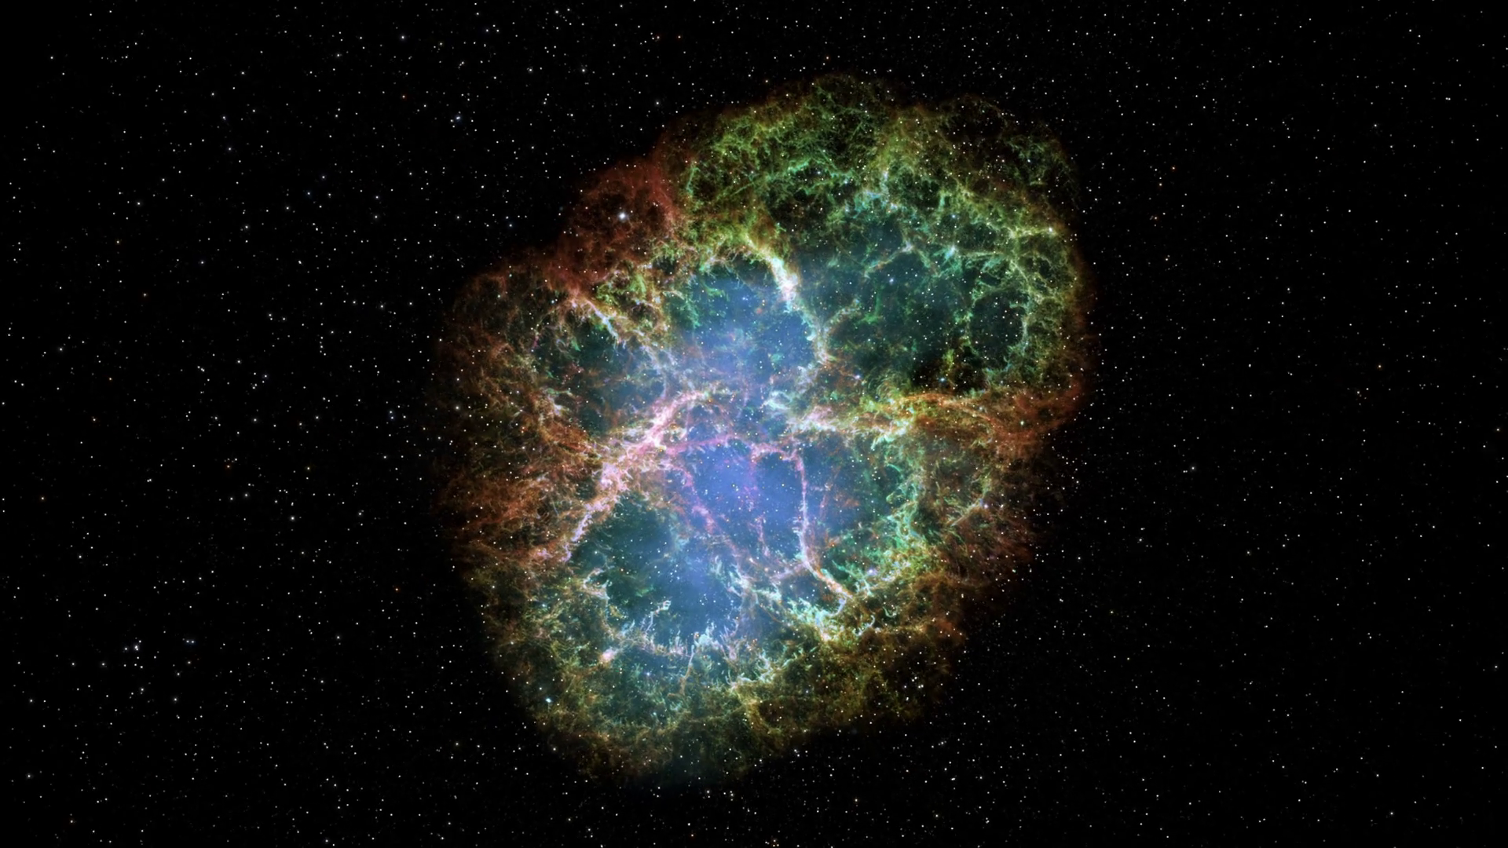
§1. Implication for neutron star
role of symmetry energy
@ HIGH density
Crab

Slide 4
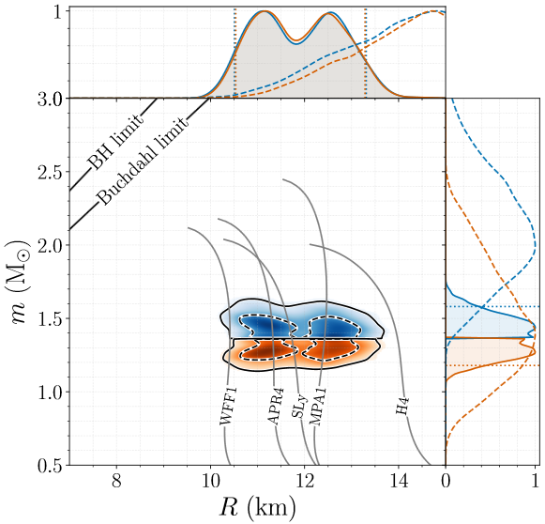
Big news: GW170817
Merger of neutron stars with 1.36-1.60 M☉
＋ 1.17-1.36 M☉
↑ Abbott et al. arXiv:1805.11581
← Abbott et al. PRL 119 (2017), 161101

Slide 5
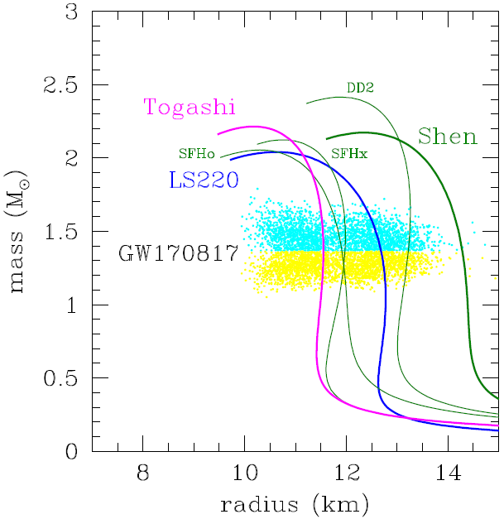
Comparison with SN EOSs
green, Relativistic mean field
blue, Skyrme type interaction
pink, Variational method

Slide 6
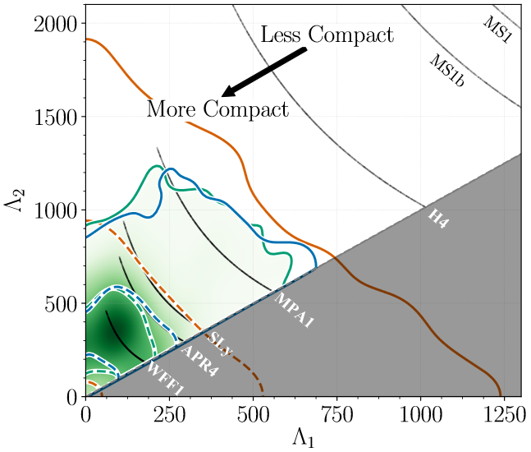
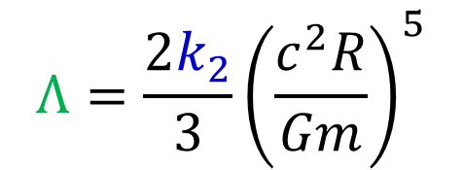
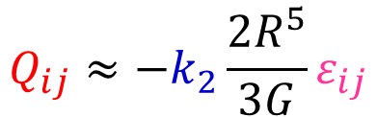
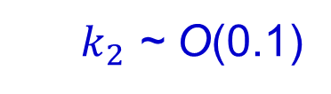
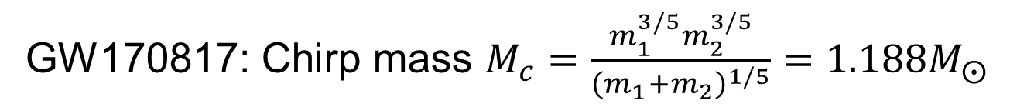
Tidal deformability
quadrupole moment
$$Q_{ij}≈−k_{2}\frac{2R^{5}}{3G}ε_{ij}$$
$k_{2}$ ~ O(0.1)
Abbott et al. arXiv:1805.11581
2nd Love number
tidal field
tidal deformability
$$Λ=\frac{2k_{2}}{3}{\left(\frac{c^{2}R}{Gm}\right)}^{5}$$
GW170817: Chirp mass $M_{c}=\frac{m_{1}^{3/5}m_{2}^{3/5}}{{\left(m_{1}+m_{2}\right)}^{1/5}}=1.188M_{⨀}$
Compact （small radius） EOSs are favored.

Slide 7
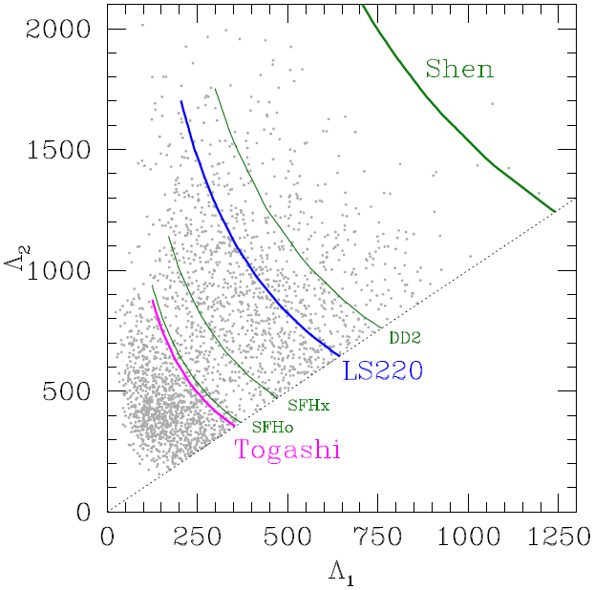
Comparison with SN EOSs
green, Relativistic mean field
blue, Skyrme type interaction
pink, Variational method

Slide 8
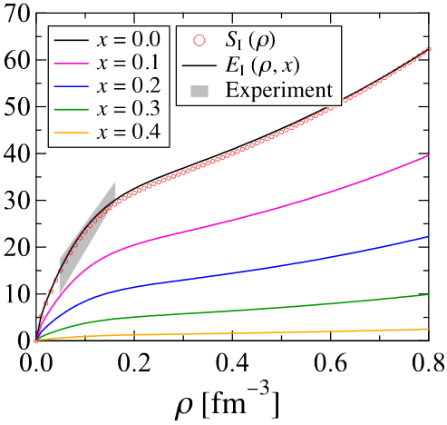
EOS properties
Togashi & Takano
NPA 902 (2013),53
S(ρ) [MeV]
EOS | Togashi | LS220 | Shen
K [MeV] | 245 | 220 | 281
S₀ [MeV] | 30.0 | 28.6 | 36.9
L [MeV] | 35 | 73.8 | 111
ρ₀ [10¹⁴ g/cm³] | 2.66 | 2.57 | 2.41
w₀ [MeV] | 16.1 | 16.0 | 16.3
Togashi EOS has small symmetry energy at high densities.
→ more neutron-rich, soft and compact!

Slide 9
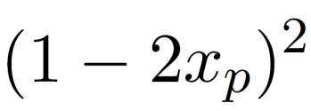

Uncertainties in high densities
$$≈$$
density dependent symmetry energy S(n)
S(n)
L
S₀
uncertainties
n₀
n

Slide 10
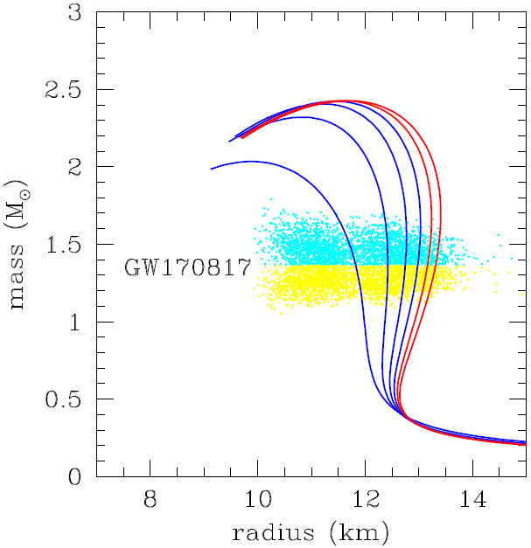
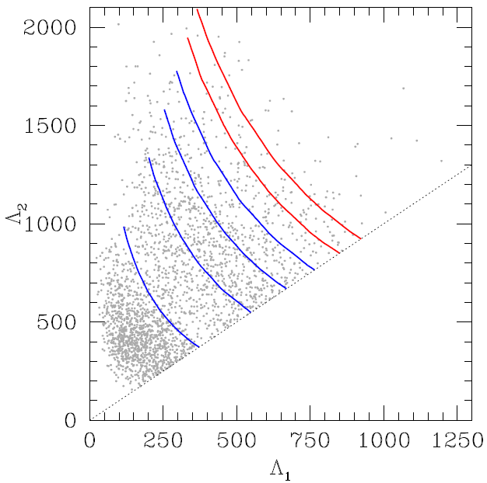
Within the uncertainties…
Taking K₀ = 245 MeV, (S₀, L) = (31 MeV, 50 MeV)
large
S(>n₀)
small
Symmetry energy in high densities is crucial to determine the NS structure.

Slide 11
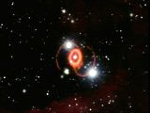
§2. Implication for proto-neutron star
role of symmetry energy
@ LOW density
SN1987A

Slide 12
Proto-neutron star cooling
Proto-neutron star （PNS） is formed at the center of SN.
→ cooled by ν emission.
EOS dependence of PNS evolution after the shock revival is studied.
onset
accretion
bounce
shock propagation
this
phase
proto-neutron star

Slide 13
Supernova neutrino
Neutrinos come from deep inside supernova.
Interaction with nucleons.
n₀ : nuclear density
~ 3×10¹⁴ g/cm³
ν
density
n₀
0.1n₀
0.01n₀
uniform matter
Inhomogeneous matter
neutron
proton

Slide 14
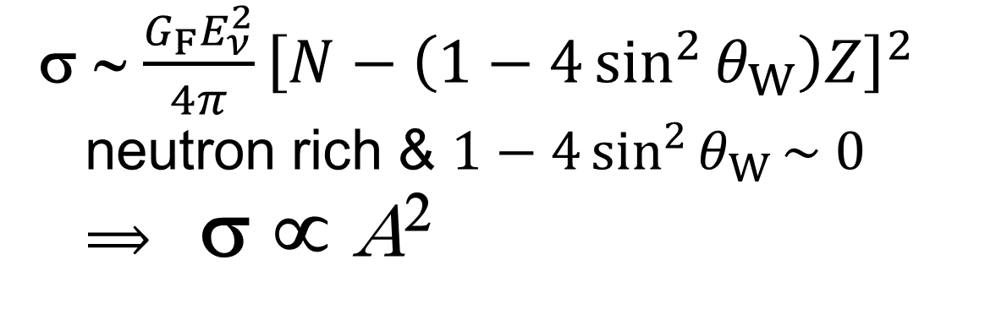
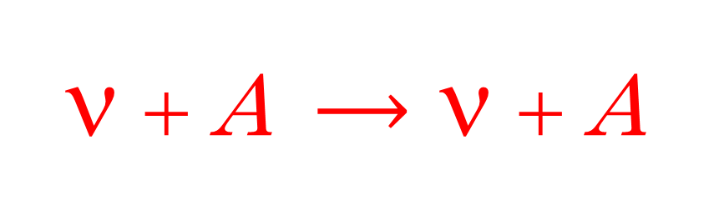
In the inhomogeneous phase…
ν
ν
ν + A $⟶$ ν + A
Z
A
A
Coherent elastic scattering
→ If nuclear size is much lower than neutrino
wave length, cross section gets larger.
σ ∼ $\frac{G_{F}E_{ν}^{2}}{4π}{\left[N−\left(1−4\sin^{2}{θ_{W}}\right)Z\right]}^{2}$
neutron rich & $1−4\sin^{2}{θ_{W}}\sim 0$
$⟹$ σ ∝ A²

Slide 15
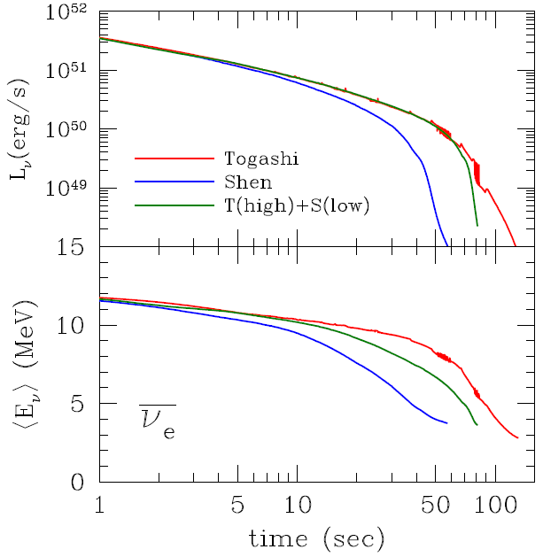
Neutrino light curve
High density EOS determines luminosity.
Luminosity drops steeper for faster cooling
Variational EOS results high density / slow cooling
Av. energy depends also on low density EOS.
red, Togashi (variational method)
blue, Shen (relativistic mean field)
green, Hybrid
→ Togashi EOS in high densities
+ Shen EOS in low densities
Nakazato et al. PRC 97 (2018), 035804 →

Slide 16
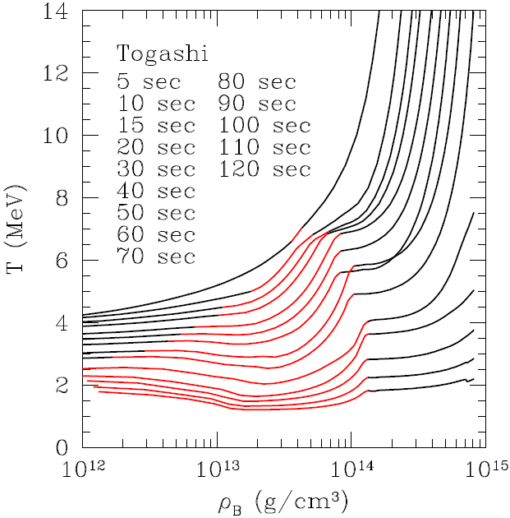
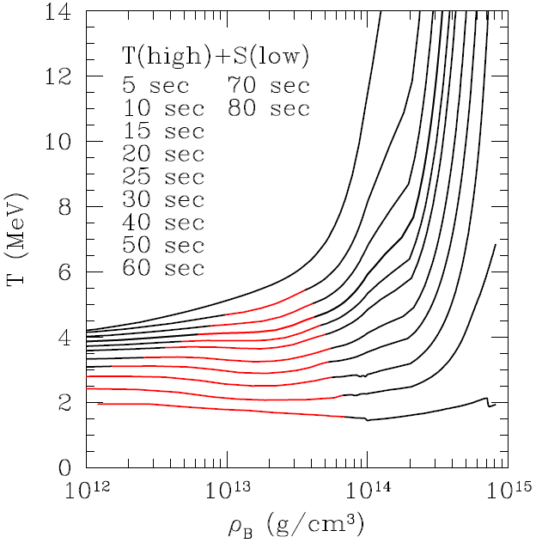
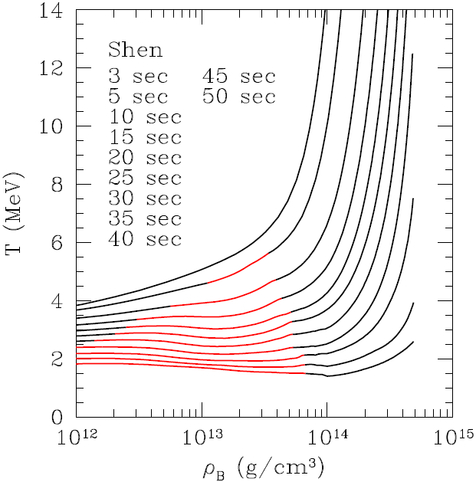
Inhomogeneous region
larger for Togashi EOS.
→ This is because Togashi EOS has large
symmetry energy in low density.
(for details, please stay tuned for the next talk!)
Togashi
Hybrid
Shen
inhomogeneous

Slide 17
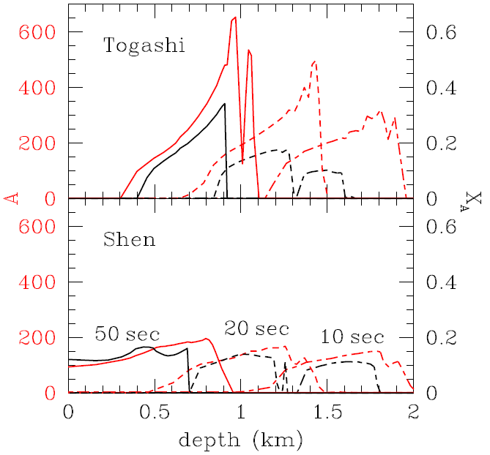
Nuclear size near PNS surface
Large nuclear mass number is estimated for Togashi EOS.
→ Cross section of the coherent elastic scattering is
enhanced making cooling time scale longer.
Thermal insulation by
nuclei
σ ∝ A²
1 / λ ∝ X_{A}・A
A; mass number
Ｘ_{A}; fraction of nuclei

Slide 18
Summary
To determine the neutron star structure, symmetry energy in high densities is crucial.
In the proto-neutron star cooling, neutrino luminosity is determined by high density EOS and average energy is affected also by low density region due to coherent scattering.
Density dependence of symmetry energy is important.

Slide 19
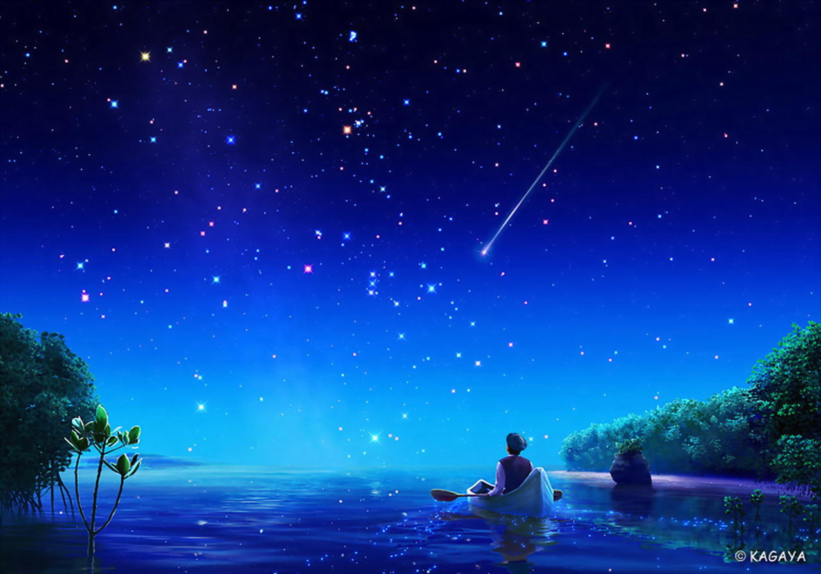
Thank you for your attention

Slide 20



Tidal deformability parameter
OK
NG
[PRL 119, 161101より]
$$m \sim 1.36M_{⨀}$$
→ 半径への制限

Slide 21
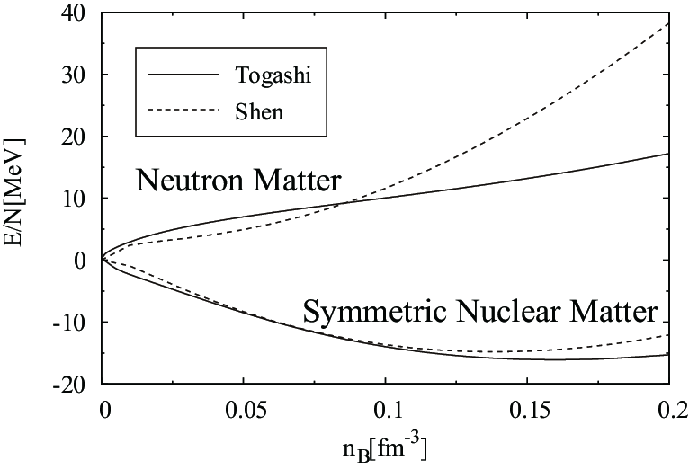
Comparison at T = 0
Difference in neutron matter （Y_{p} = 0） EOS.
seen in symmetry energy E_{sym} and gradient L.
E / N [MeV]
New EOS
（Variatinal）
E_{sym} = 30 MeV
L = 35 MeV
Shen EOS
E_{sym} = 37 MeV
L = 111 MeV
Variational
Shen EOS
Y_{p} = 0
gradient L
E_{sym}
Y_{p} = 0.5
n_{B} [fm⁻³]

Slide 22
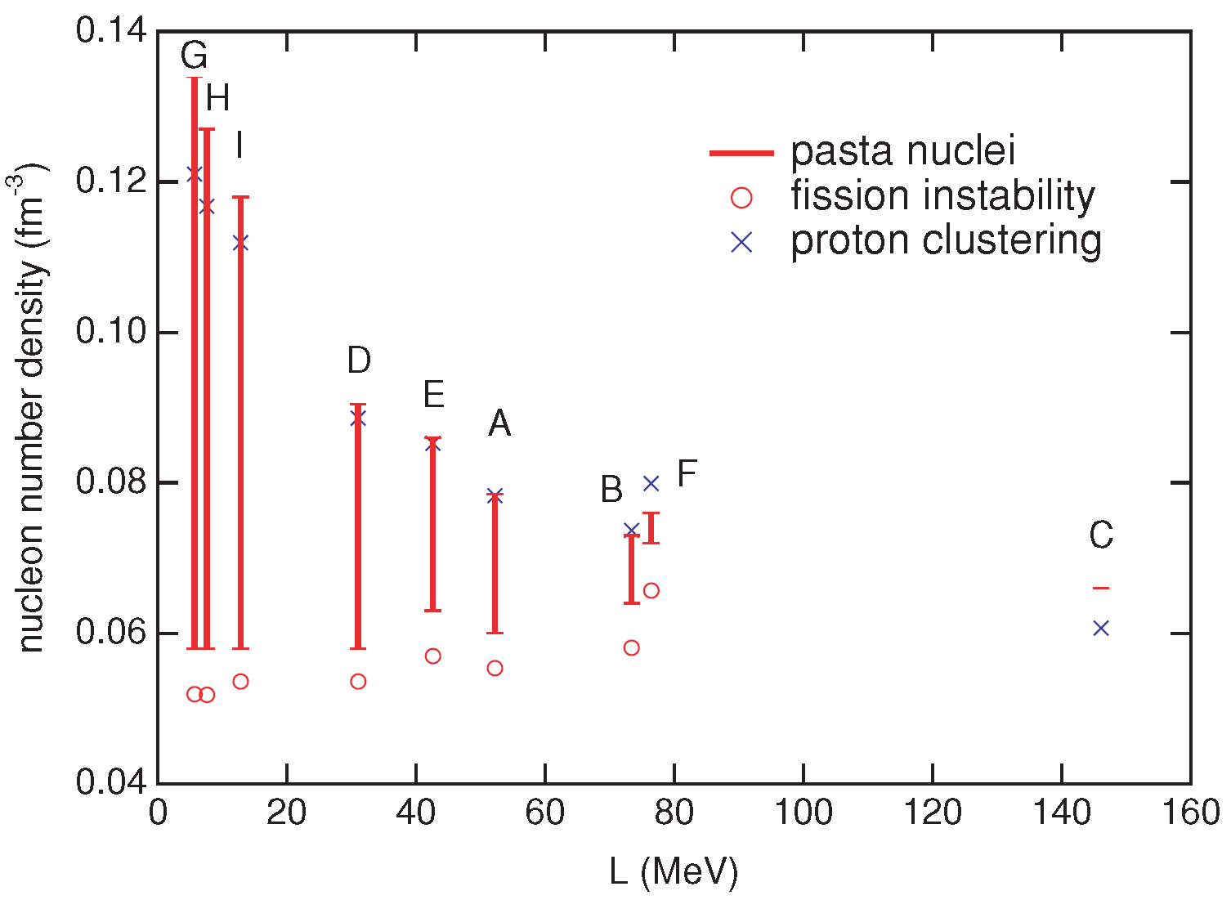
Crust of neutron stars (T = 0)
Transition density to uniform phase depends
on L.
higher transition density for smaller L
uniform
nonuniform
Oyamatsu & Iida （2007）
Our EOS
LS EOS
Shen EOS
Notes:
sub nuclear 密度での対称エネルギーは our EOS のほうが大きい
proton clustering の driving force は sub nuclear 密度での対称エネルギーである
proton clustering により相分離が誘発される

Slide 23
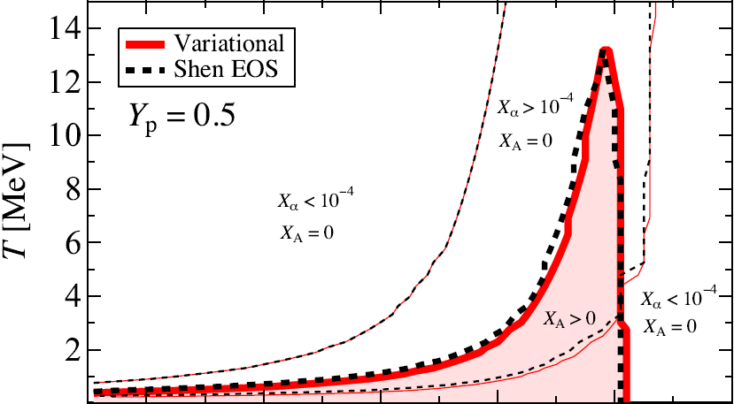
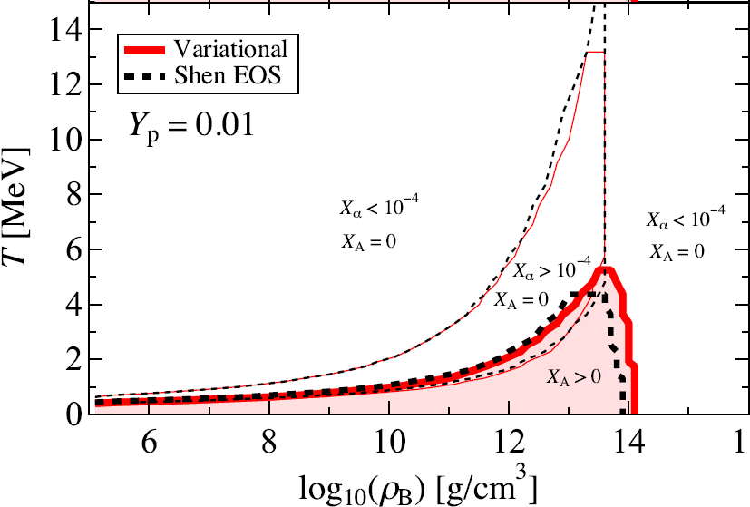
Finite temperature phase diagram
Inhomogeneous phase: subnuclear densities and T < 10 MeV.
Low Y_{e} (elec. fraction) → low critical T and low transition density.
Reflecting the property of nuclear matter model, the region of inhomogeneous phase is different among EOS.
Y_{e} = 0.5
inhomogeneous
Y_{e} = 0.01

Slide 24
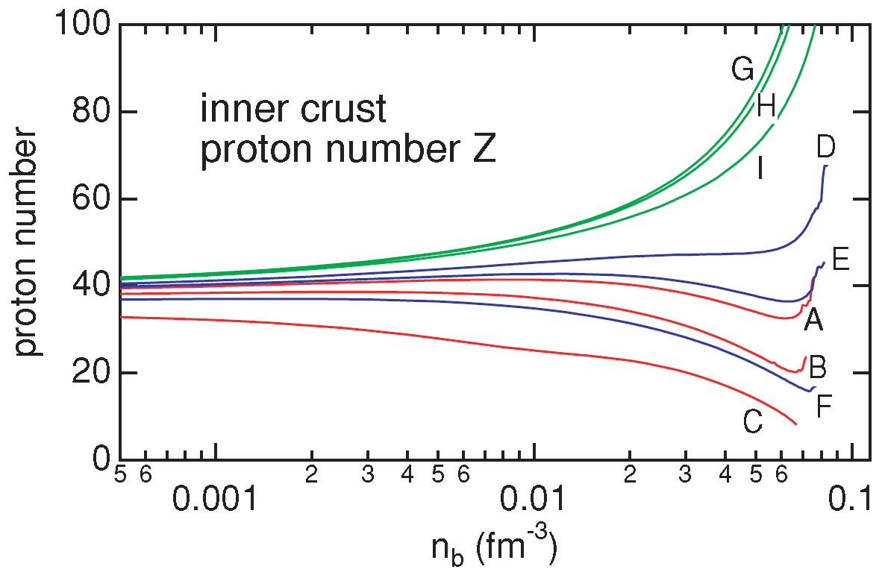
Crust nuclei and L parameter
Proton number of crust nuclei depends on L.
Our EOS
LS EOS
larger L
Shen EOS
Oyamatsu & Iida （2007）
Proton number is small, if L is large.

Slide 25
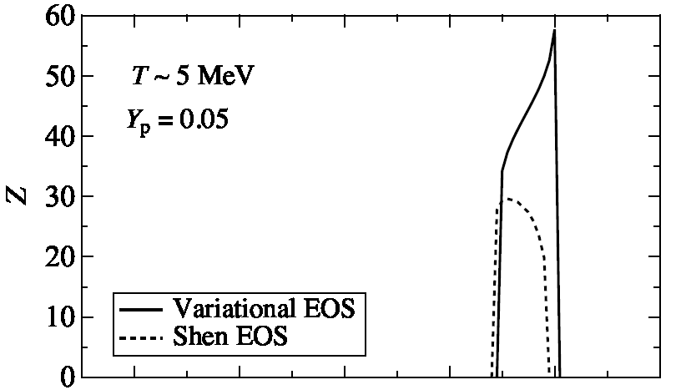

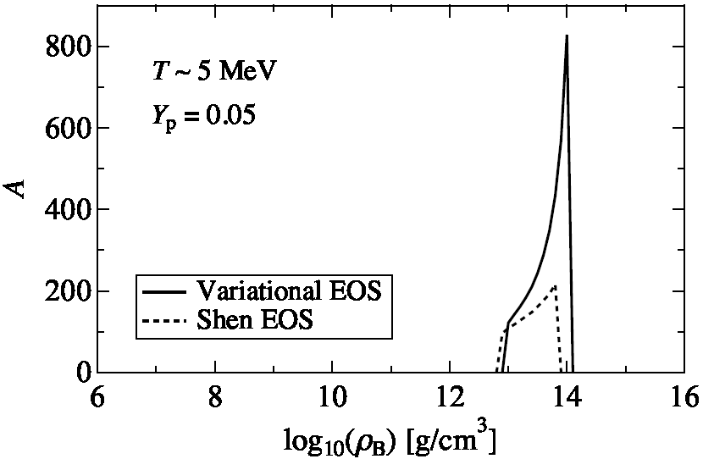
Comparison of A and Z
Togashi EOS has larger A and Z than Shen EOS.
→ L dependence seen in zero temperature EOSs holds. （Oyamatsu & Iida 2007）
Does L parameter affect supernova physics?
this
study
Shen

Slide 26
Setup
Step1: Core-collapse simulation of spherical GR ν radiation hydrodynamical simulation for 15M☉ star （Woosley & Weaver 1995） until 0.3 sec.
Step2: After that, quasi-static evolutionary calculation of PNS （~1.5M☉） cooling.
transfer of ν_{e} ,‾ν_{e} , ν_{μ} ( = ν_{τ} =‾ν_{μ} =‾ν_{τ} ) is treated in Multigroup Flux Limited Diffusion scheme
EOS: ① Variational model （Togashi）, ② Shen ③ Mixed （Togashi for ≥ 2×10¹⁴ g/cc, Shen for ≤ 10¹⁴ g/cc, and they are interpolated）

Slide 27
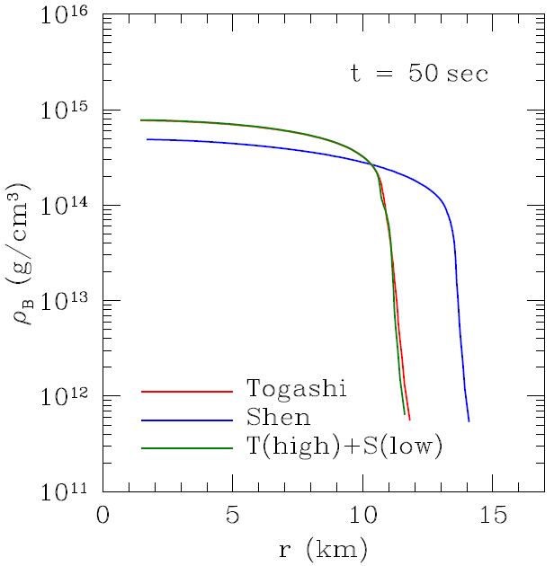
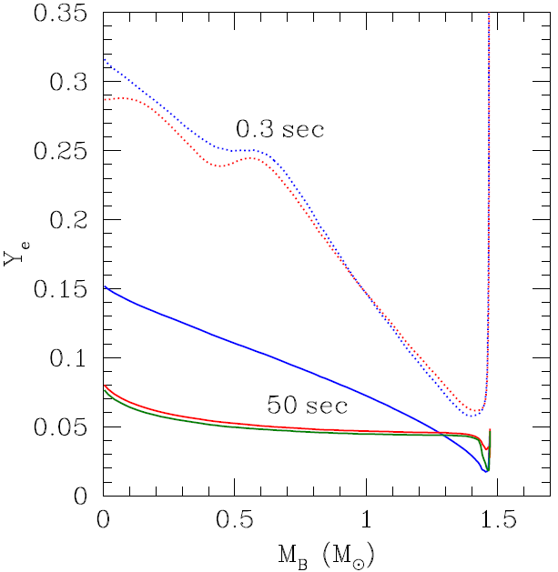
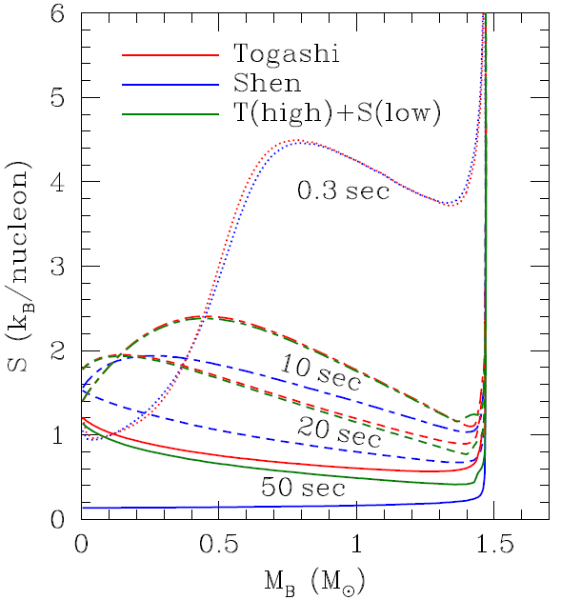
Profiles of PNS
density
electron fraction
entropy
Soft EOS makes compact PNS.
→ high density and small radius
Low L EOS results in low Y_{e} due to small symmetry energy at high densities.

Slide 28
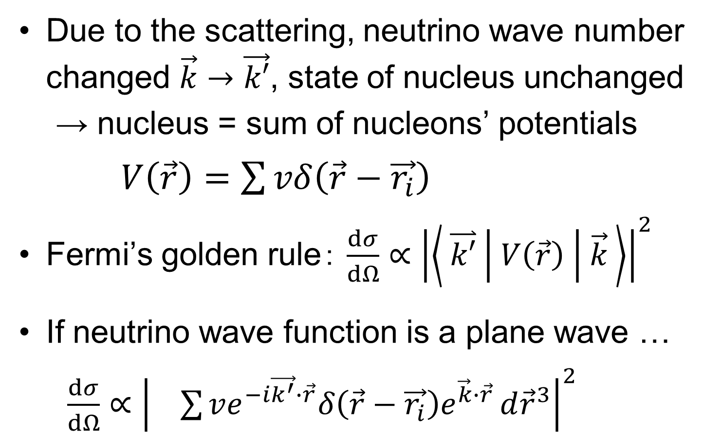




Coherent effect
Due to the scattering, neutrino wave number changed $\vec{k}→\vec{k′}$, state of nucleus unchanged
→ nucleus = sum of nucleons’ potentials
$V\left(\vec{r}\right)=\sum{vδ\left(\vec{r}−\vec{r_{i}}\right)}$
Fermi’s golden rule： $\frac{dσ}{dΩ}∝{\left|\left\langle \overset{⃑}{k′} | V\left(\vec{r}\right) | \vec{k} \right\rangle \right|}^{2}$
If neutrino wave function is a plane wave …
$\frac{dσ}{dΩ}∝{\left| \sum{ve^{−i\vec{k^{′}}∙\vec{r}}δ\left(\vec{r}−\vec{r_{i}}\right)e^{\vec{k}∙\vec{r}}}d{\vec{r}}^{3}\right|}^{2}$
$$A$$
$$i=1$$
$$A$$
$$i=1$$

Slide 29





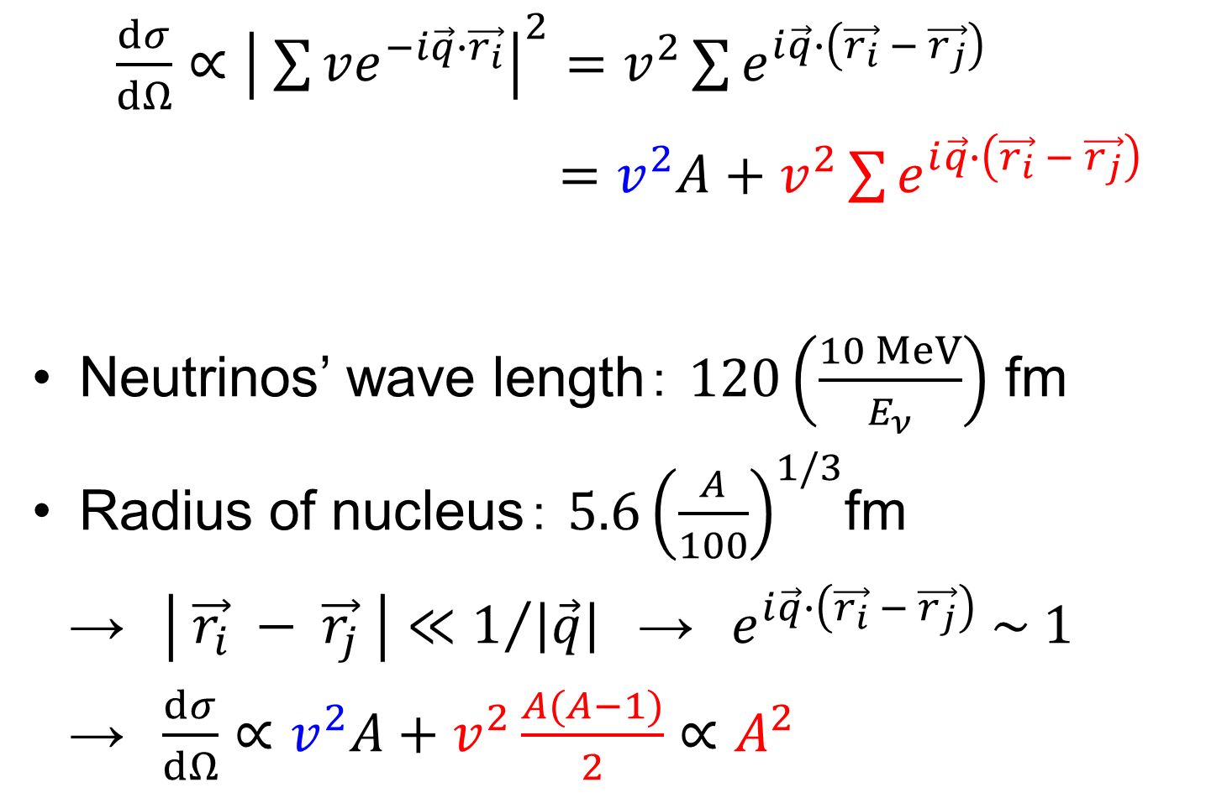






Coherent effect (cont.)
$$A$$
$$A$$
$\frac{dσ}{dΩ}∝{\left| \sum{ve^{−i\vec{q}∙\vec{r_{i}}}}\right|}^{2}=v^{2}\sum{e^{i\vec{q}∙\left(\vec{r_{i}} − \vec{r_{j}}\right)}}$
$=v^{2}A+v^{2}\sum{e^{i\vec{q}∙\left(\vec{r_{i}} − \vec{r_{j}}\right)}}$
Neutrinos’ wave length： $120\left(\frac{10 MeV}{E_{ν}}\right)$ fm
Radius of nucleus： $5.6{\left(\frac{A}{100}\right)}^{1/3}$fm
→ $\left| \vec{r_{i}} − \vec{r_{j}} \right|≪1/{\left|\vec{q}\right|}$ → $e^{i\vec{q}∙\left(\vec{r_{i}} − \vec{r_{j}}\right)} \sim 1$
→ $\frac{dσ}{dΩ}∝v^{2}A+v^{2}\frac{A(A−1)}{2}$ $∝A^{2}$
$$i=1$$
$$i,j$$
$$A$$
$$\vec{k′}$$
$$\vec{q}$$
$$θ$$
$$\left|\vec{k}\right|=\left|\vec{k′}\right|$$
$$i≠j$$
$$\vec{k}$$
per nucleon
coherence

Slide 30

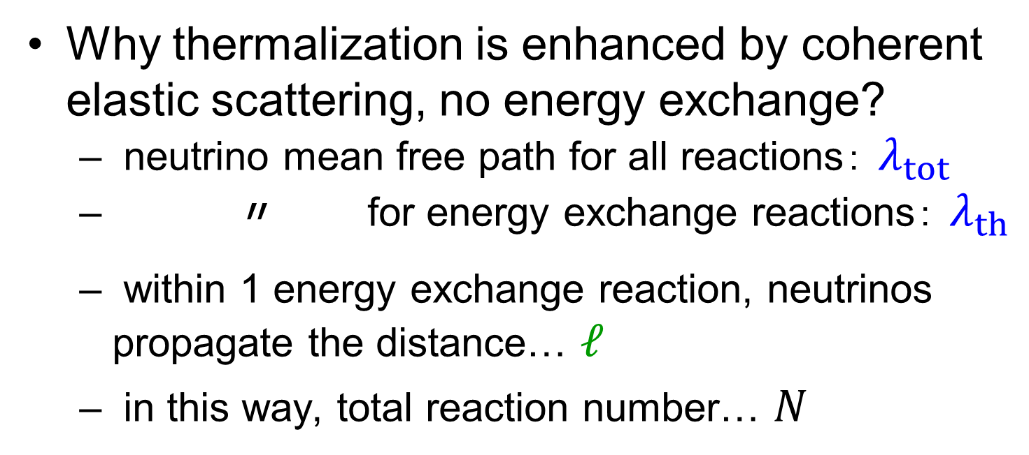
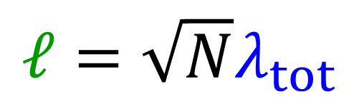

Neutrino Energy Sphere (1)
Why thermalization is enhanced by coherent elastic scattering, no energy exchange?
neutrino mean free path for all reactions： $λ_{tot}$
〃 for energy exchange reactions： $λ_{th}$
within 1 energy exchange reaction, neutrinos propagate the distance… $ℓ$
in this way, total reaction number… $N$
$$λ_{tot}$$
$$ℓ=\sqrt{N}λ_{tot}$$
（random walk）
$$ℓ$$

Slide 31

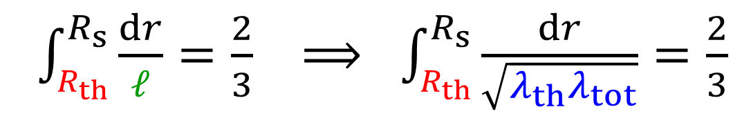

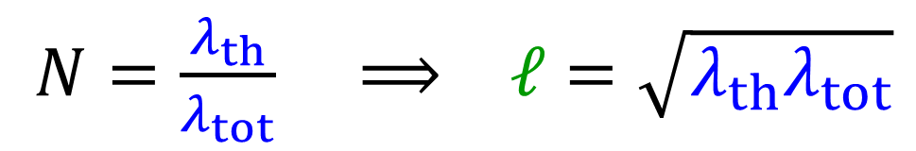


Neutrino Energy Sphere (2)
$$λ_{tot}$$
$$ℓ=\sqrt{N}λ_{tot}$$
（random walk）
$$ℓ$$
In this way, neutrinos travel… $Nλ_{tot}$
→ it is nothing but $λ_{th}$
Thermalization radius： $R_{th}$
$N=\frac{λ_{th}}{λ_{tot}} ⟹ ℓ=\sqrt{λ_{th}λ_{tot}}$
$\int_{R_{th}}^{R_{s}}{\frac{dr}{ℓ}}=\frac{2}{3} ⟹ \int_{R_{th}}^{R_{s}}{\frac{dr}{\sqrt{λ_{th}λ_{tot}}}}=\frac{2}{3}$

Slide 32
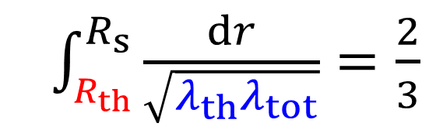
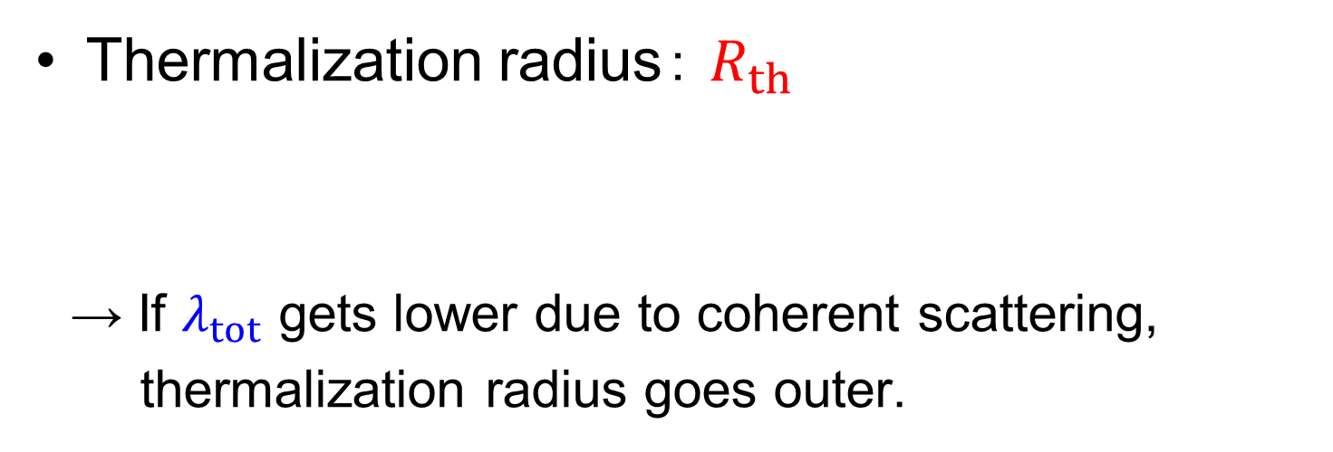
Neutrino Energy Sphere (3)
Thermalization radius： $R_{th}$
→ If $λ_{tot}$ gets lower due to coherent scattering,
thermalization radius goes outer.
$\int_{R_{th}}^{R_{s}}{\frac{dr}{\sqrt{λ_{th}λ_{tot}}}}=\frac{2}{3}$
ν
PNS surface
neutrino sphere
Neutrino Energy Sphere （surface of them. region）

