Slide 1
D-RD-19
LiquidO R&D: Novel Detector Concept
for Neutrino Experiments
A. Cabrera: CNRS/IN2P3, LAL, LNCA, France
F. Suekane: Tohoku Univ. Japan
Joint workshop of FKPPL & TYL/FJPPL :
@ Jeju Island, Korea 2019/05/10

Slide 2
Contents
* D-RD-9 group
* About LiquidO Detector
* 2018 achievement
* 2019 plan

Slide 3
FJPPL Project Members
LAL/IN2P3: C. Anatael, M.Grassi
SUBATECH: Y.Frederic, V.Benoit, J. Thiago
CENBG: M.Christine, C.Emmanuel
CPPM: B.Jose
Tohoku U.: F.Suekane

Slide 4
Publication:
* Neutrino-Antineutrino Identification in a Liquid Scintillator Detector: Towards a Novel
Decay-at-Rest-based Neutrino CPV Framework.
Grassi M. et al. (LiquidO Team), arXiv:1807.04731
Talks:
* LiquidO Novel Detection Technique and ββ Program.
A.Cabrera, Conference: NOW-2018 Conference, Italy
* LiquidO Talk:
A.Cabrera, France ββ Physics Workshop (APC, Paris, France)
* LiquidO Talk:
A.Cabrera, https://indico.in2p3.fr/event/17804/contributions/64467/attachments/
49788/63356/2018Sept-LiquidO-France_Anatael.pdf

Slide 5
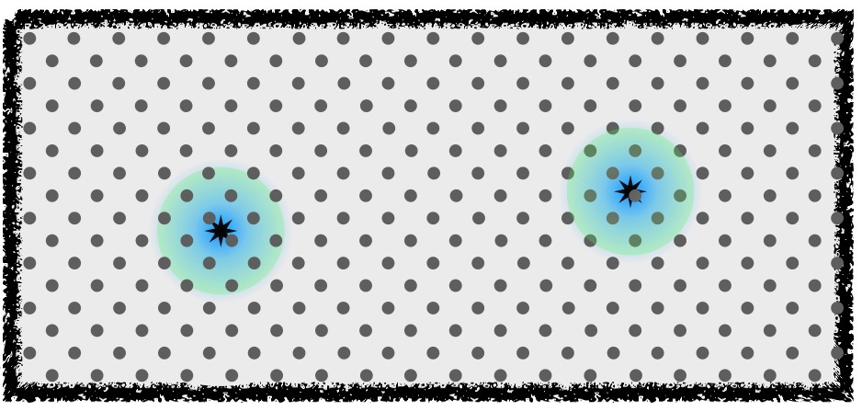
What is LiquidO?
* LiquidO is a detector technology to observe spatial pattern of signals
by using opaque LS and WLS fibers.
Opaque (milky, cloudy, waxy)
LS
Scintillation lights are
confined in a small region
Wave Length Shifting fibers
readout position, timing,
amplitude

Slide 6
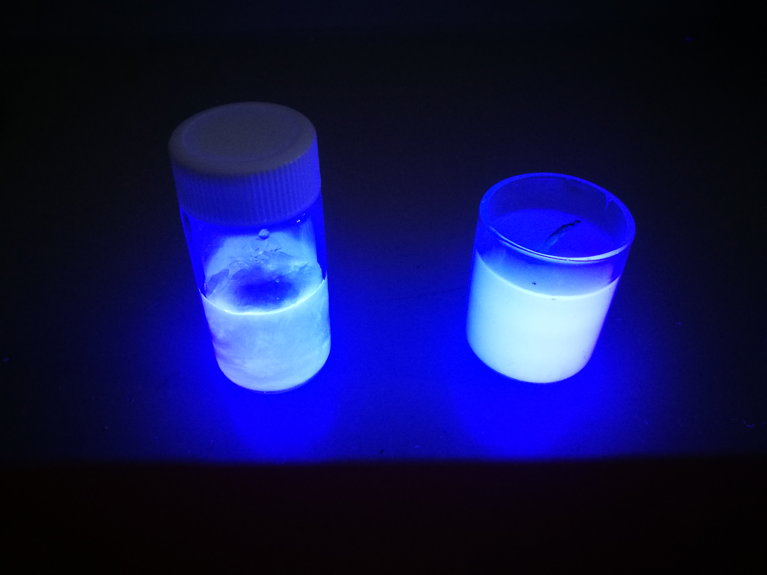
Opaque scintillator→ new technology!
6

Slide 7
For “O(1cm) resolution”…
e⁻ ≈ α ≈ p-recoil (fast-n)
dE/dx→ Bragg peak
(e- starts as MIP)
α and p are scintillation quenched→ PSD is possible!
γ (gamma ray)
@ few MeV→ Compton scattering
(ended by photon-electric effect)
e⁺ ≈ e⁻ + 2x γ(511keV)
hybrid-like event

Slide 8
Common issue of low energy neutrino experiments
* Because neutrino interacts only Weakly, the event rate is generally very very small:
While backgrounds (gamma ray, cosmic ray related) are large.
* Tough issue of Neutrino Experiments = Battle against backgrounds.
* The low energy neutrino signals are often e⁻, e⁺, while the backgrounds come from
γ and p recoiled by fast neutron.
* If separation of e⁻, e⁺ ⬄ γ ⬄ p can be done, the backgrounds can be removed.
* In addition, if e⁻ ⬄ e⁺ can be separated, the original ν_{e} or can be separated.
* LiquidO technology is to measure the spatial pattern of those signals and separate them.

Slide 9
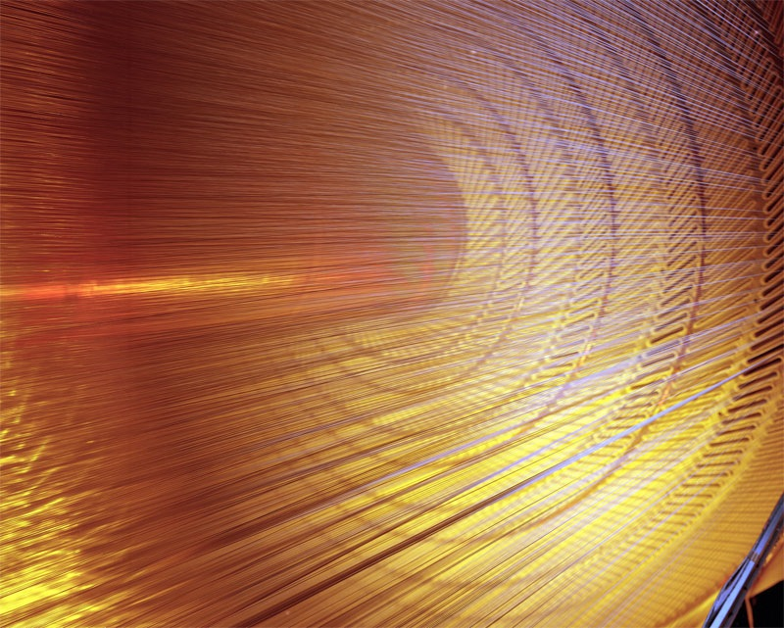
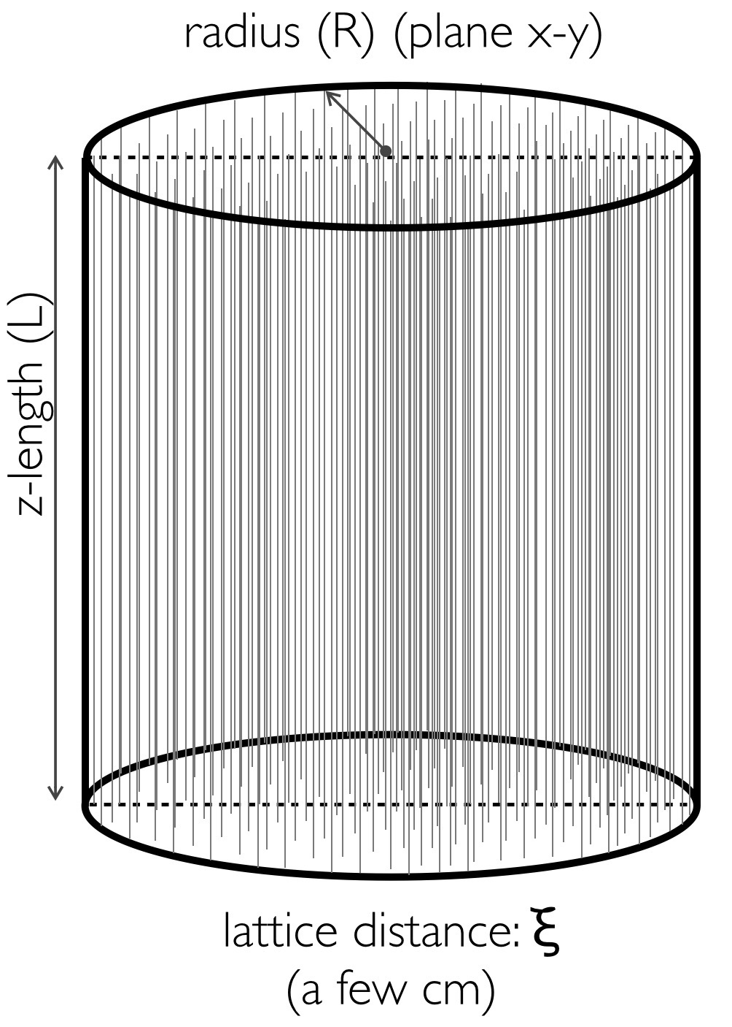
Simplest LiquidO design: 2D⊕time…
(x,y) info → image pixelation
(z) info → time difference
(also z-pixelation possible→ envisaged for R&D)

Slide 10
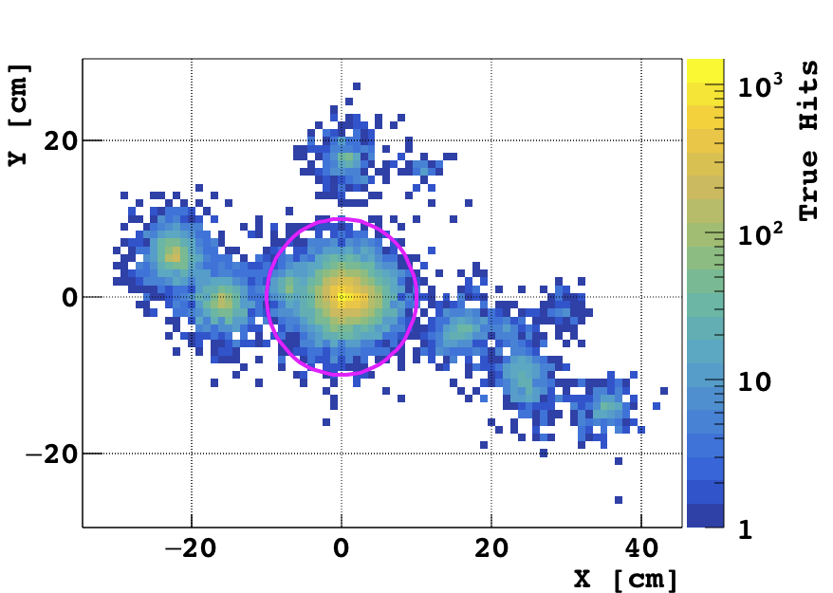
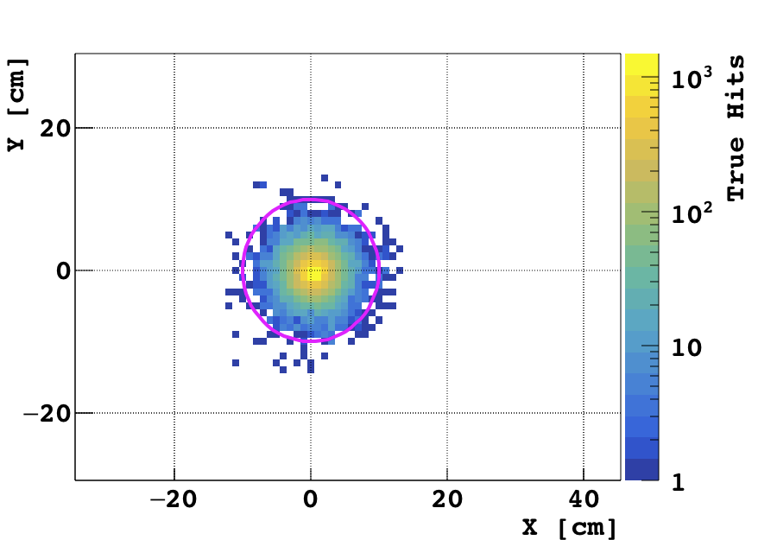
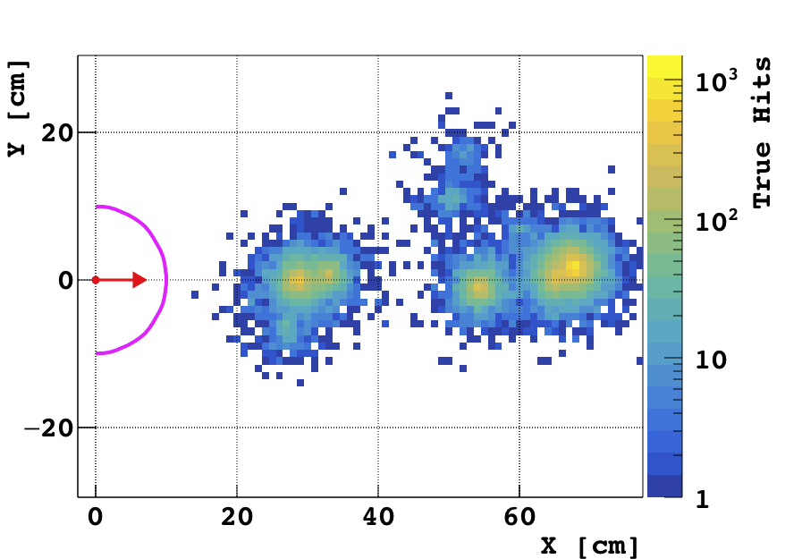
Eventa pattern Simulation
e+ 2MeV
e- 2MeV
γ 2MeV
If signal(e-) ⇒ rejection e⁺,γ
PID e⁻:γ ≈100:1 PRELIMINARY

Slide 11
Physics possibilities …
•improved geo-neutrino, including first ⁴⁰K detection?
•background-less reactor neutrino detection?
•CP-Violation via νe & anti-νe
•solar neutrino (including pp)?
•supernova’s CC (νe & anti-νe) & NC?
•multi-ton ββ & first observation β⁺β⁺?
•unprecedented proton-decay capabilities?
•TeV collider calorimetry?
•technology: medical, non-proliferation
:

Slide 12
An example
Clean CPV measurement using decay at rest neutrinos (arXiv:1807.04731)
Separation ➔ CPV measurement
* # of = # of ☺
* Negligible matter effect (L~15km)☺
* Energy spectra are perfectly known. ☺
: & other good things ☺☺
:
* >100ktons of target mass is necessary. ☹☹
But ... 40 years ago, no one expected there would be 1kton LS detector and 50kton
water cherenkov detector 20 years after.

Slide 13
LiquidO R&D

Slide 14
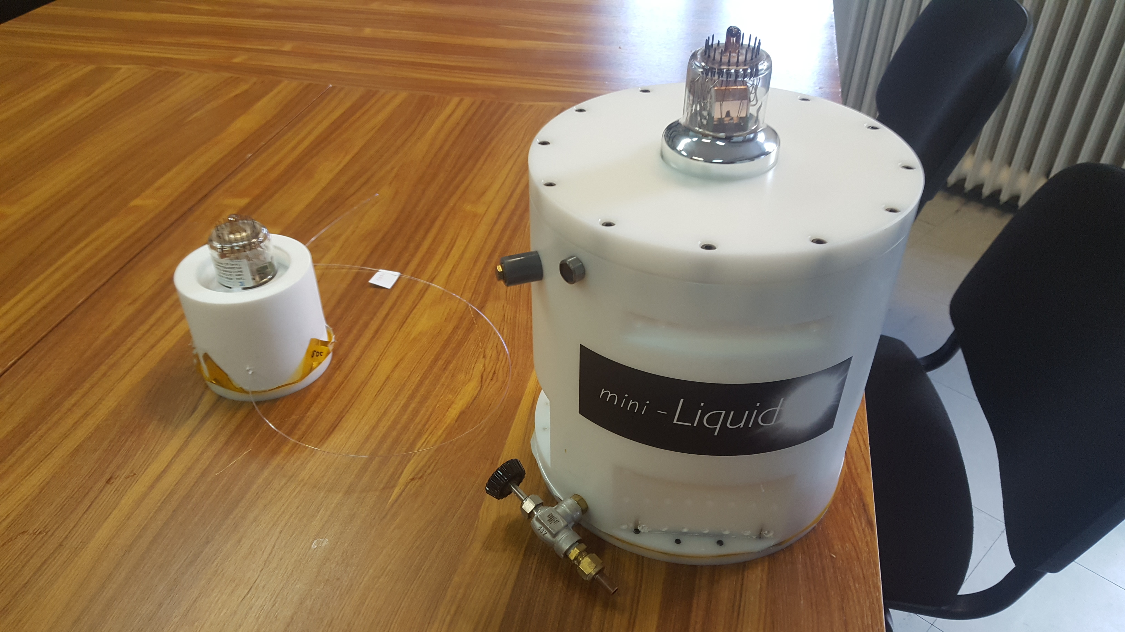
2 prototypes
μ-LiquidO:
3 fibers
Mini-LiquidO:
many fibers

Slide 15
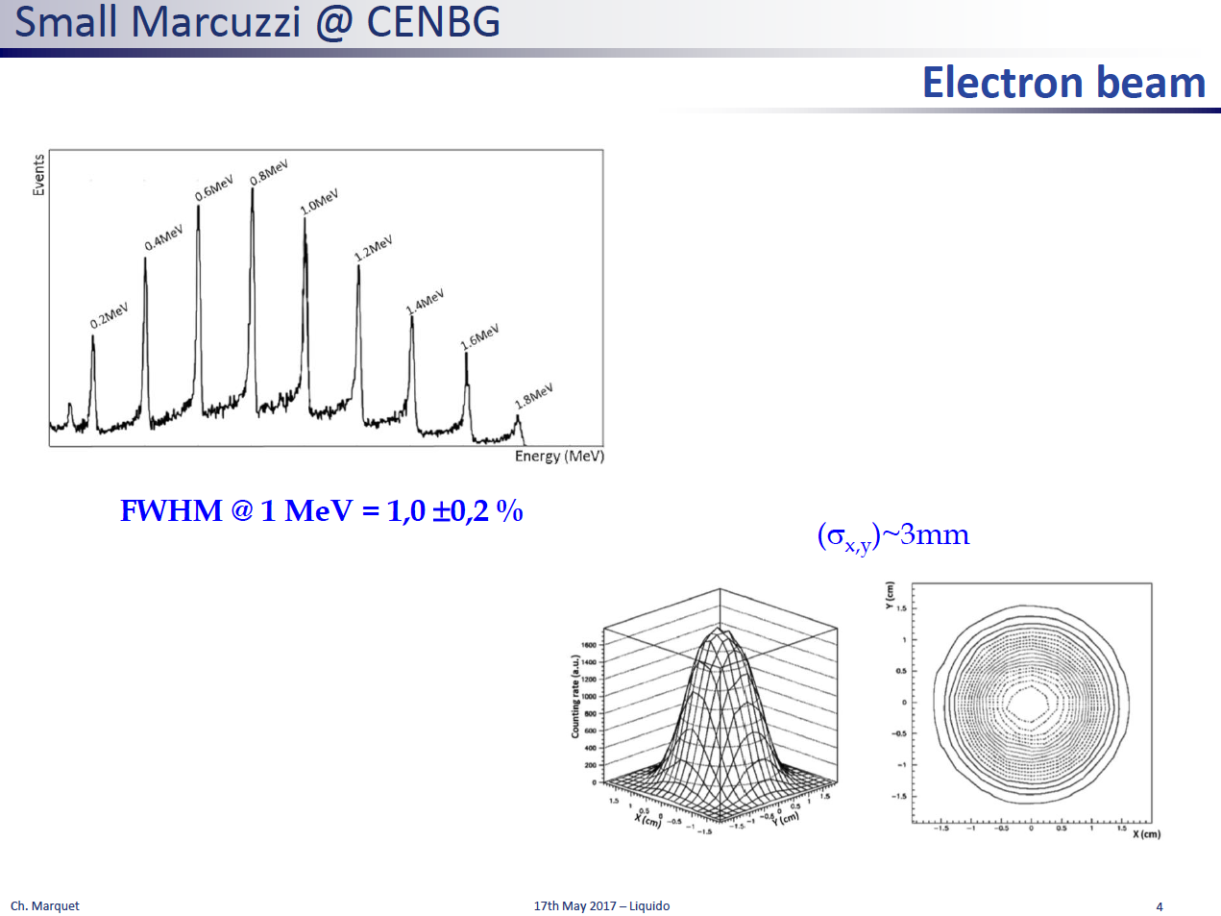
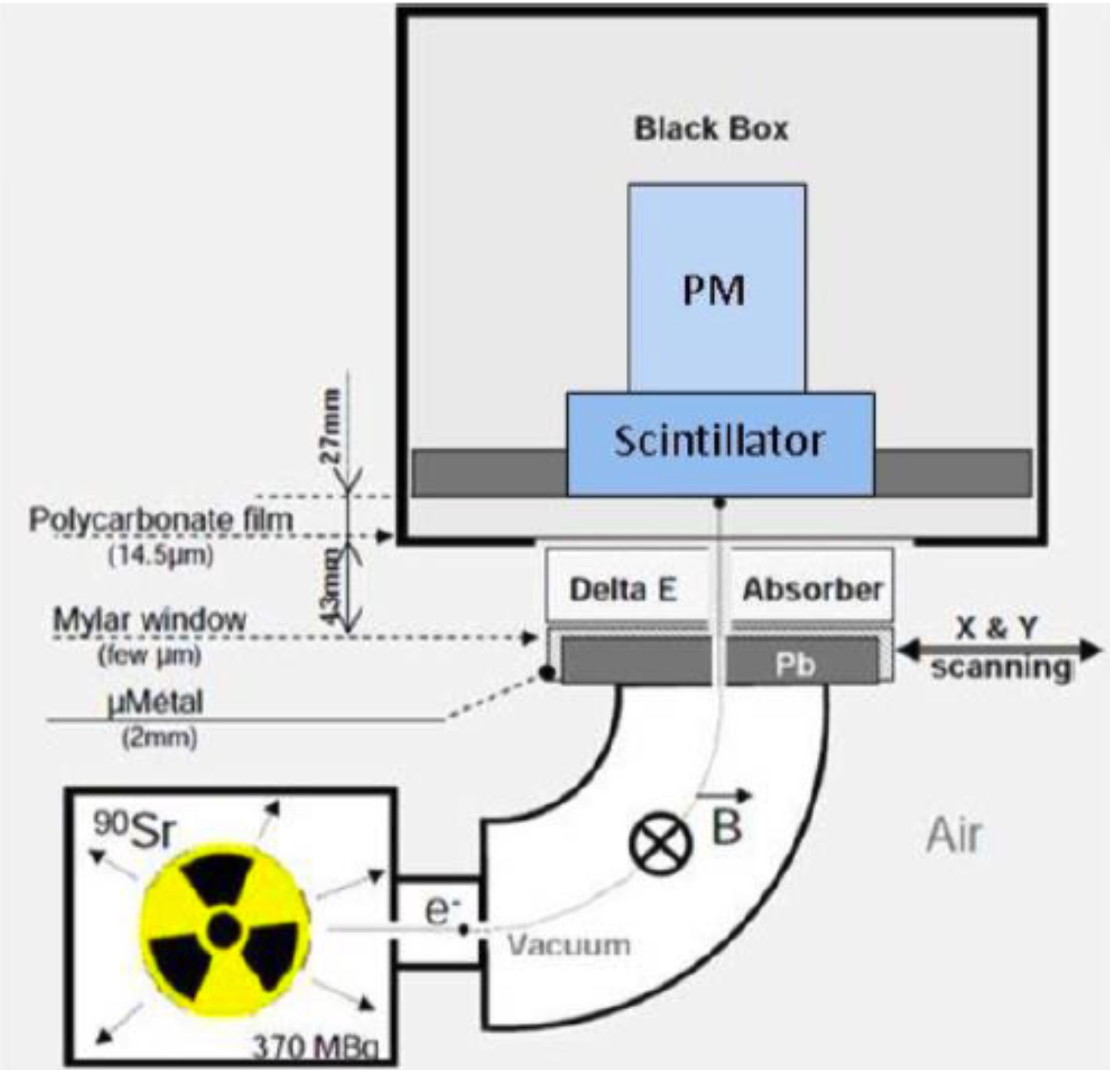
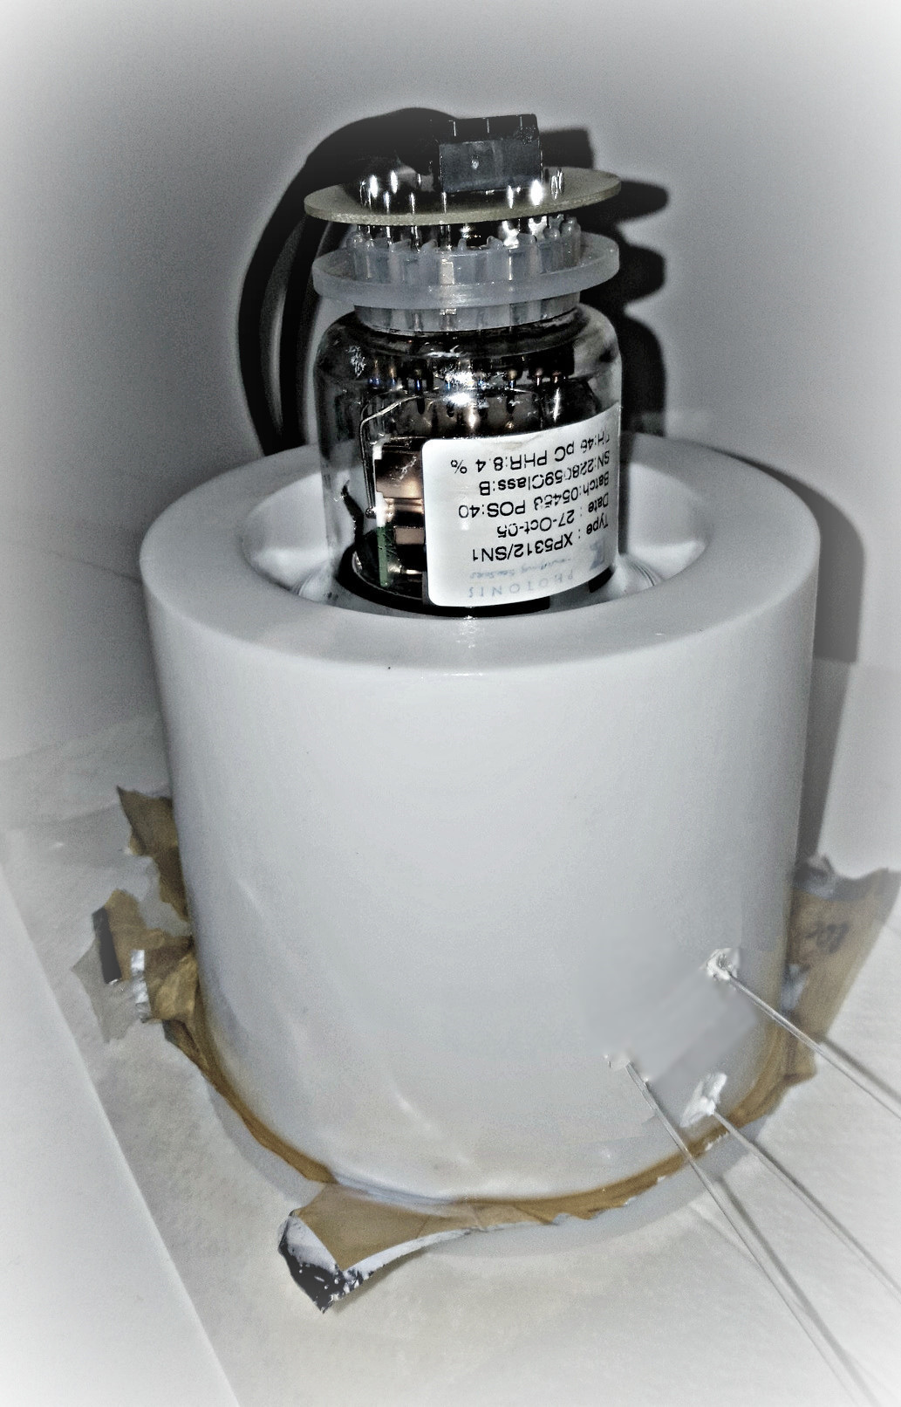
Use monochromatic e⁻ as scintillation source
e- energy ≤1%
e- position ≤1mm

Slide 16
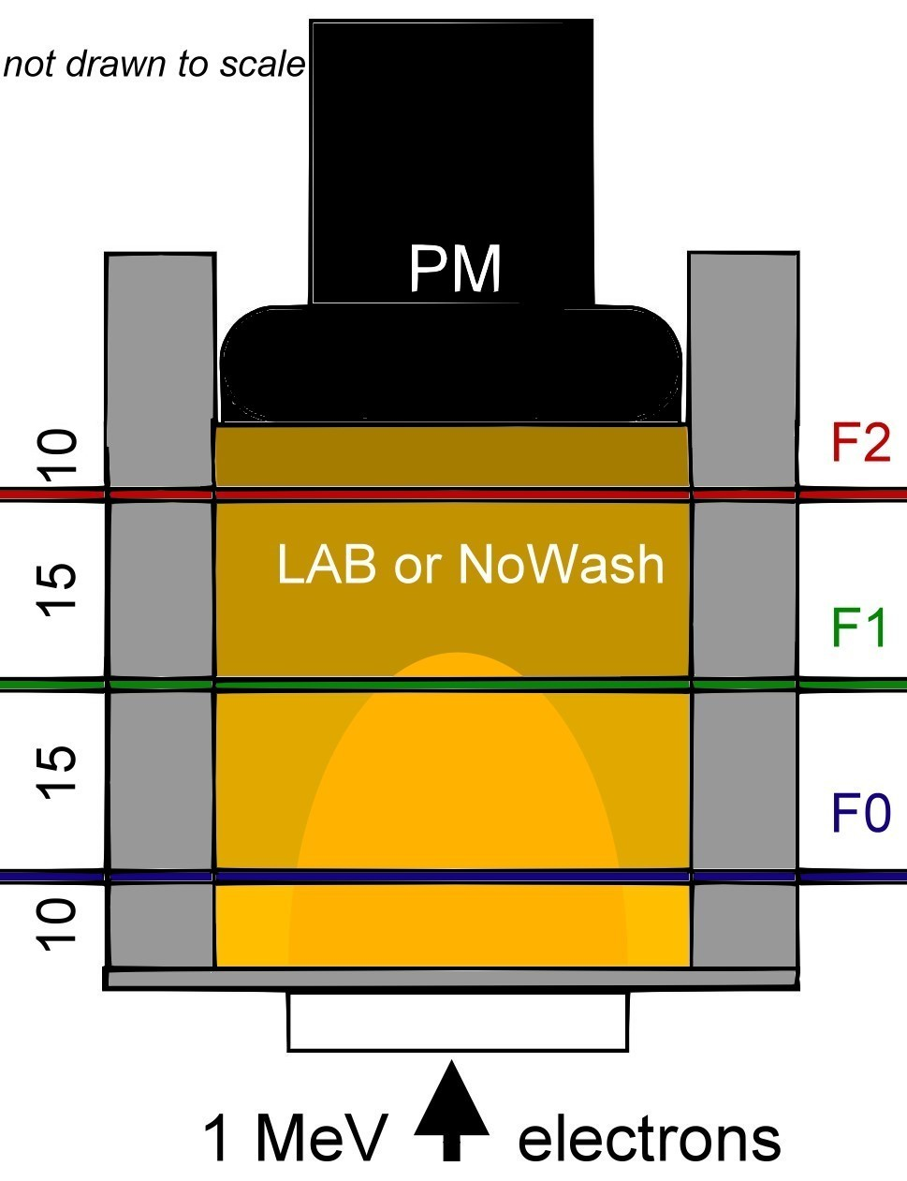
Change the opaque-ness
by changing temperature
and see the change of light yields of
F0, F1, F2 and the top PMT.
Scintillation light confinement will show ...
F0
F1
F2
PM
Light Yield
Opaque
Transparency of LS
(Temperature)

Slide 17
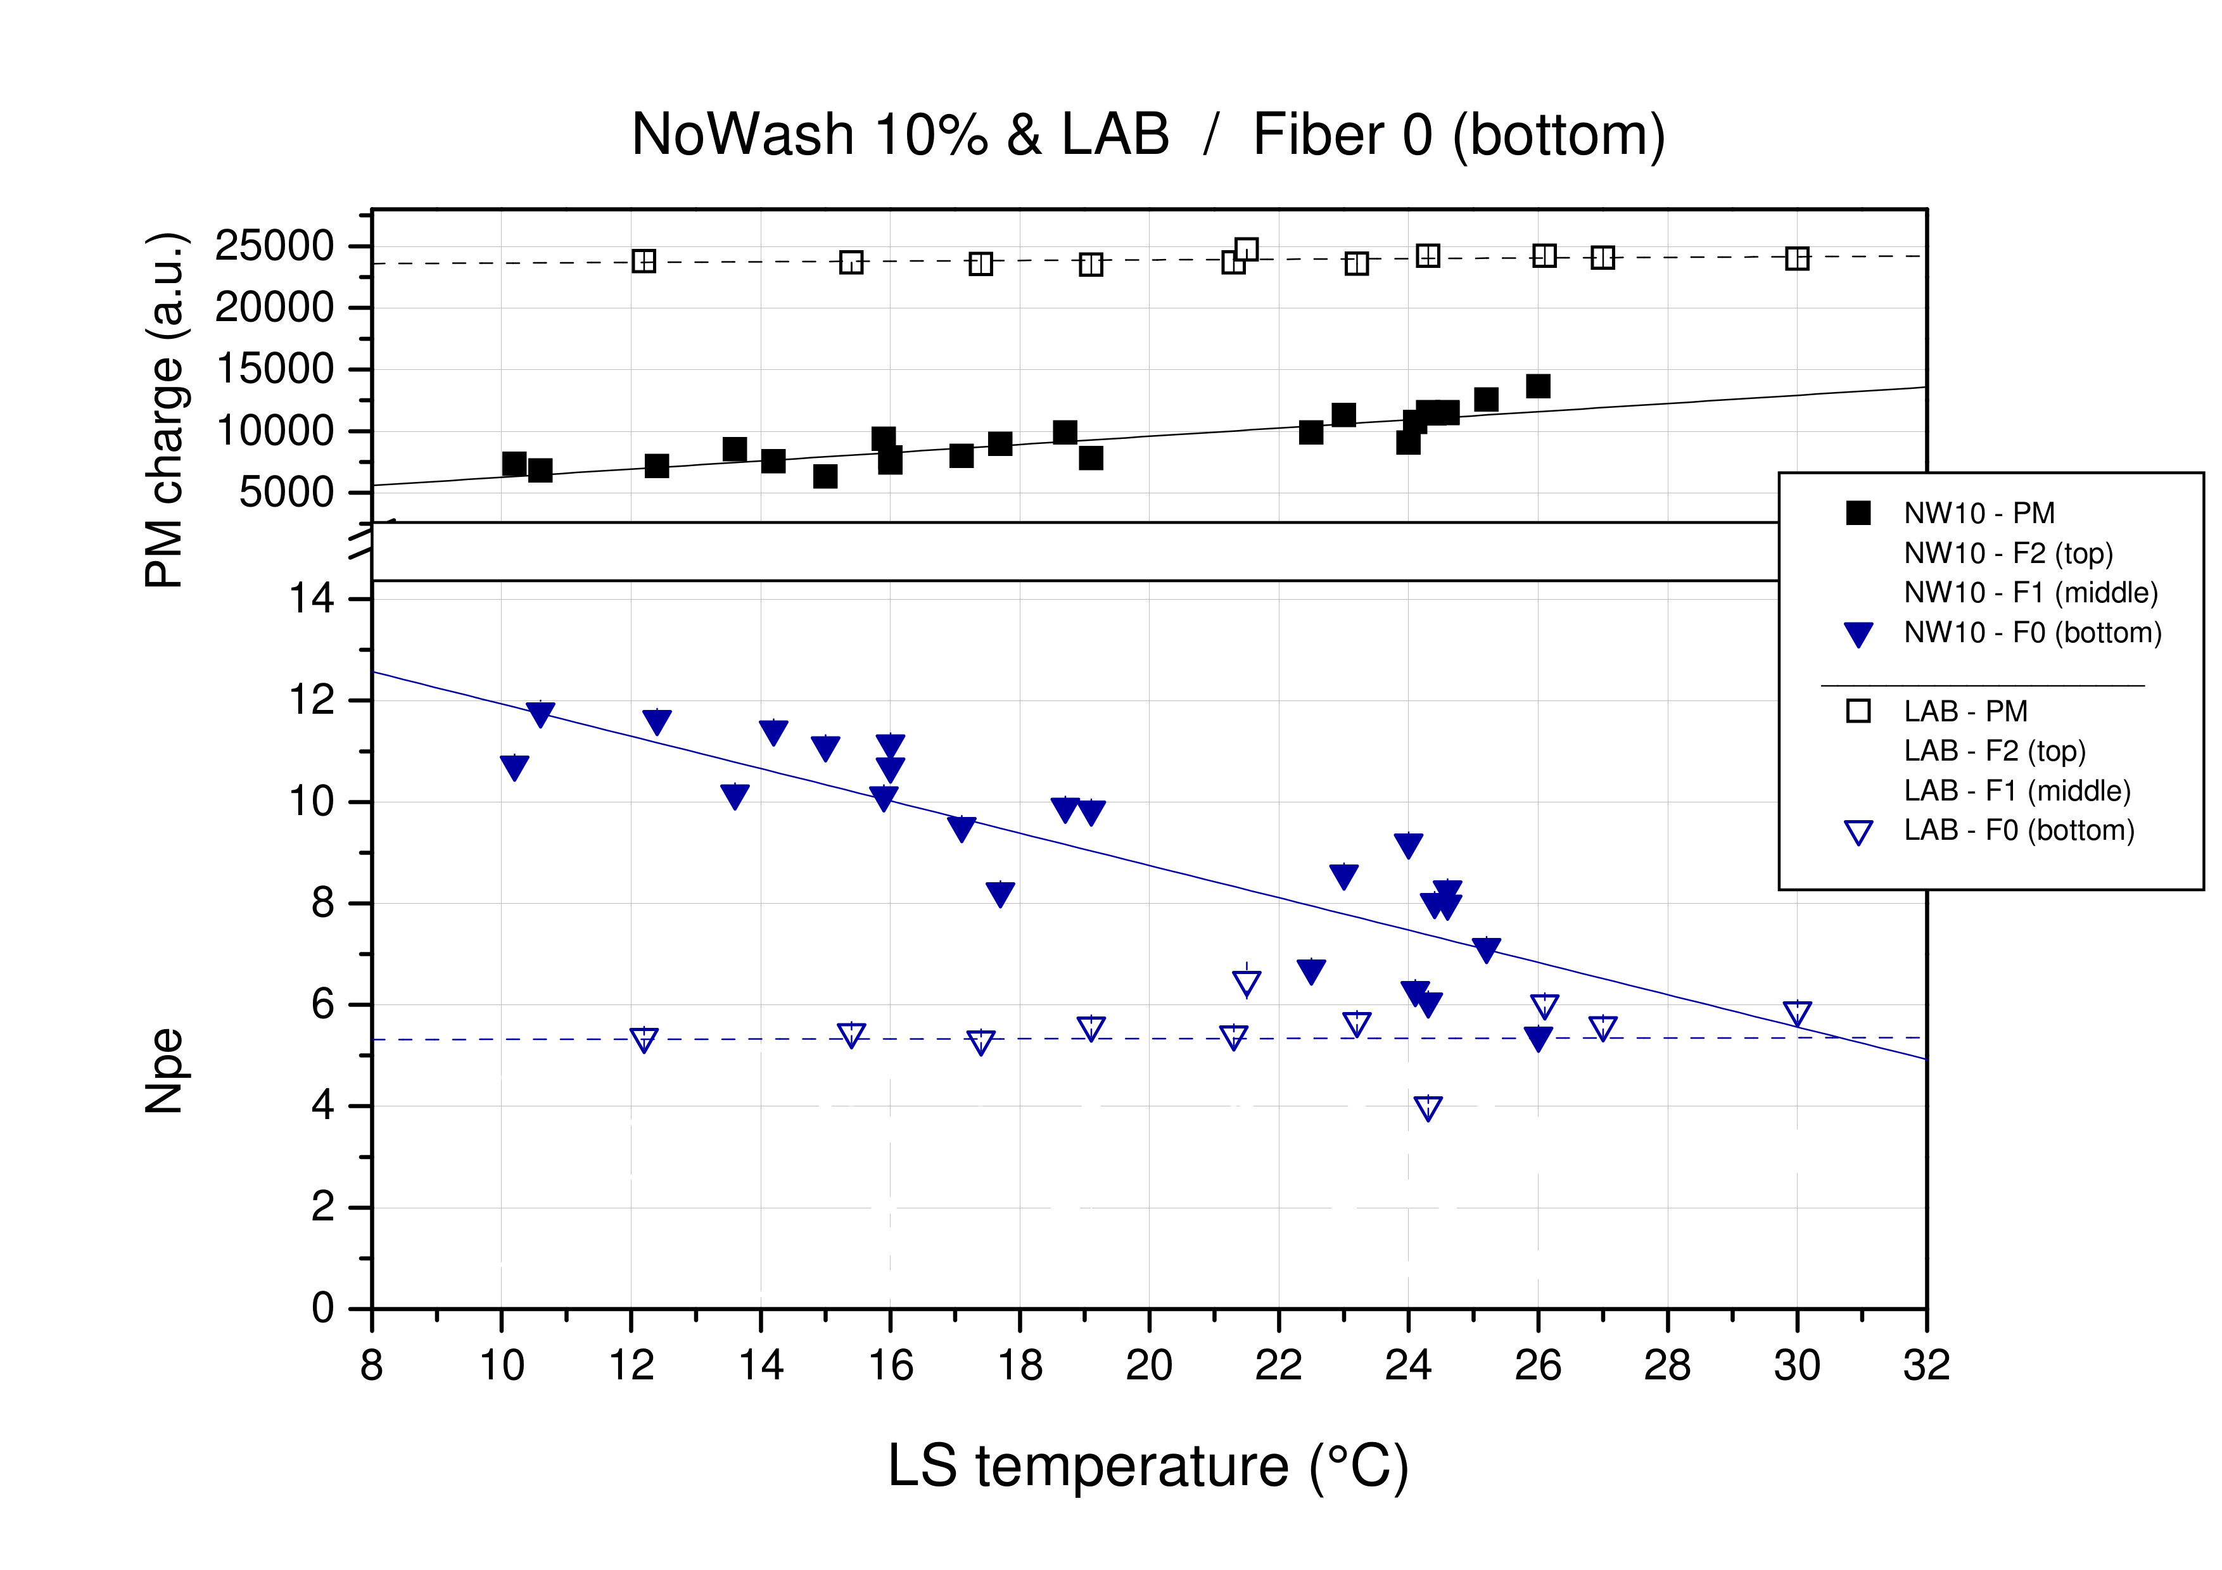
Measurement
x1/4
x1/2
Opaque-LS
X2.5
LAB LS
~opaque
~transparent

Slide 18
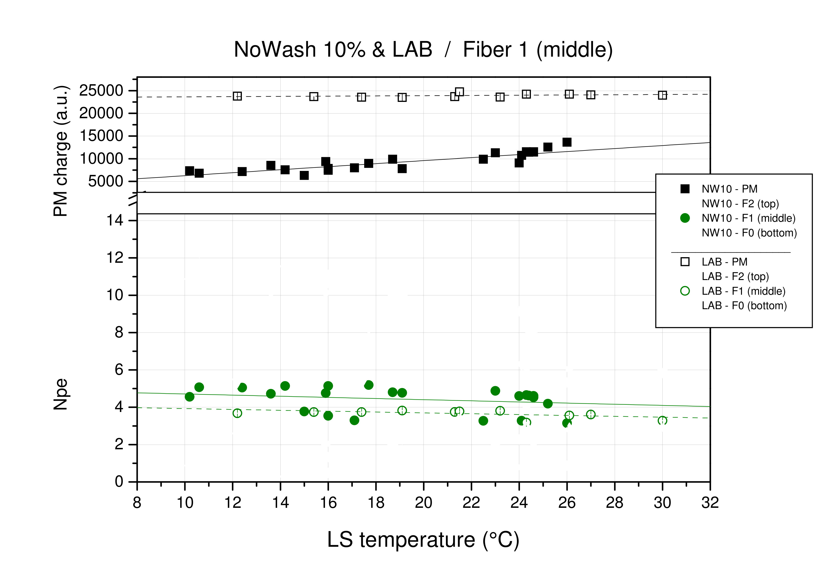
:4 :2
X1.1 X1.1

Slide 19
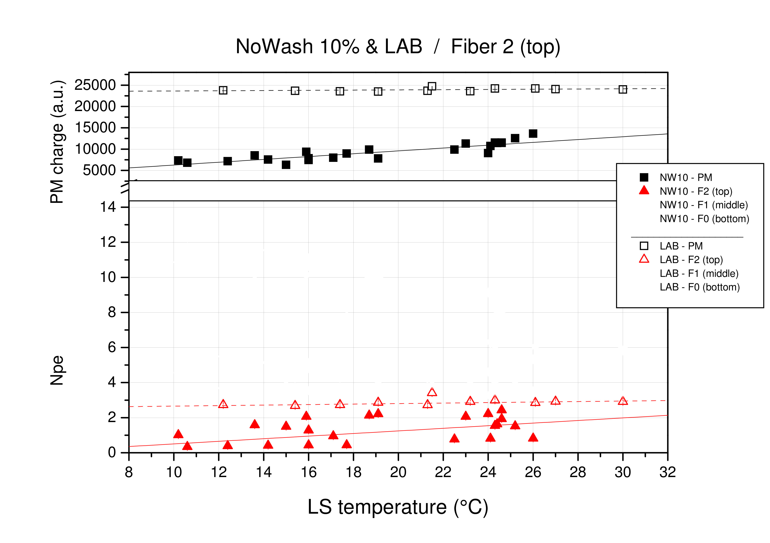
:4 :2
:4 :1.5

Slide 20
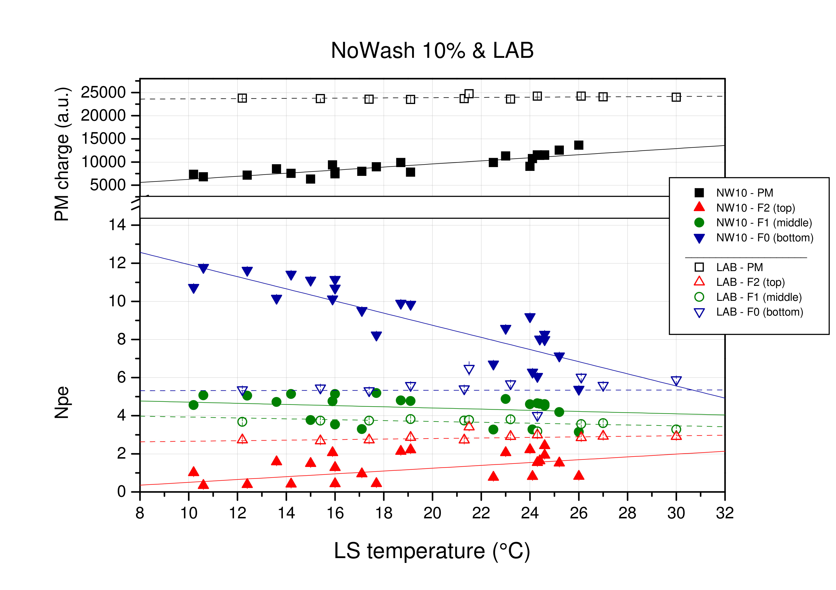
Fiber 0 (bottom) Fiber 1 (middle) Fiber 2 (top) s
Opaque LS
all measurements
all lines are linear fits of data
➔ Scintillation light
confinement

Slide 21
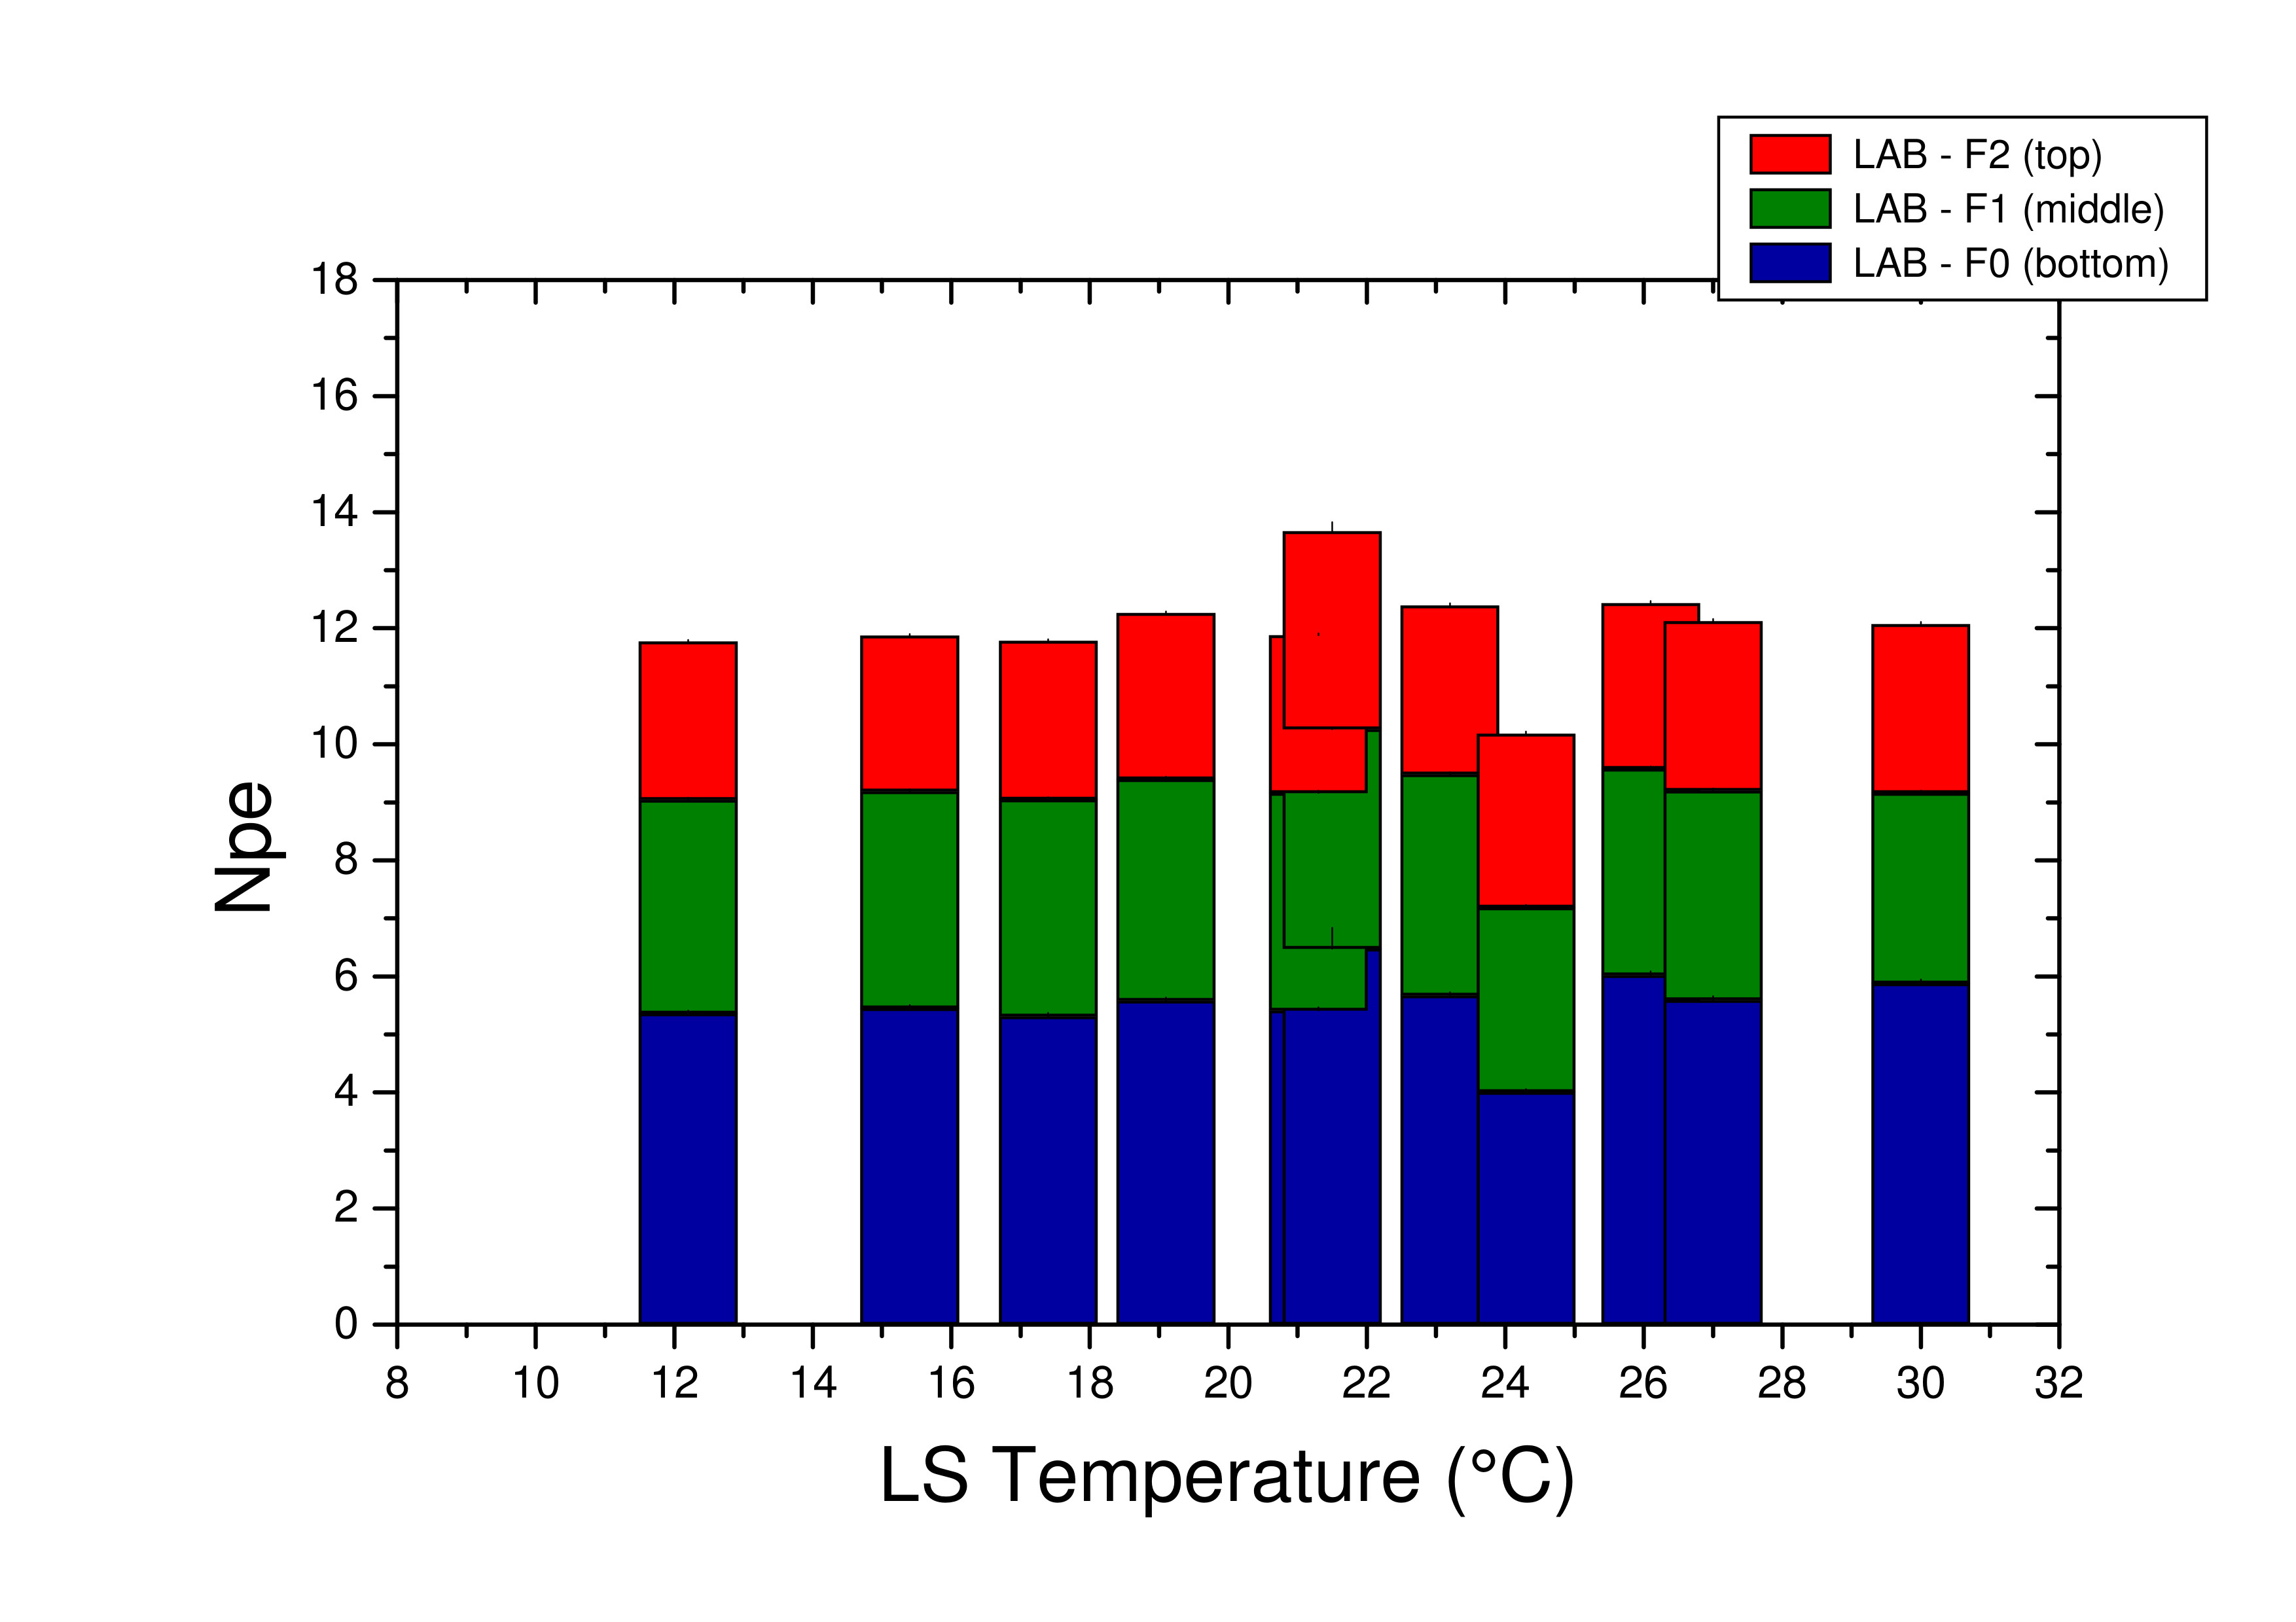
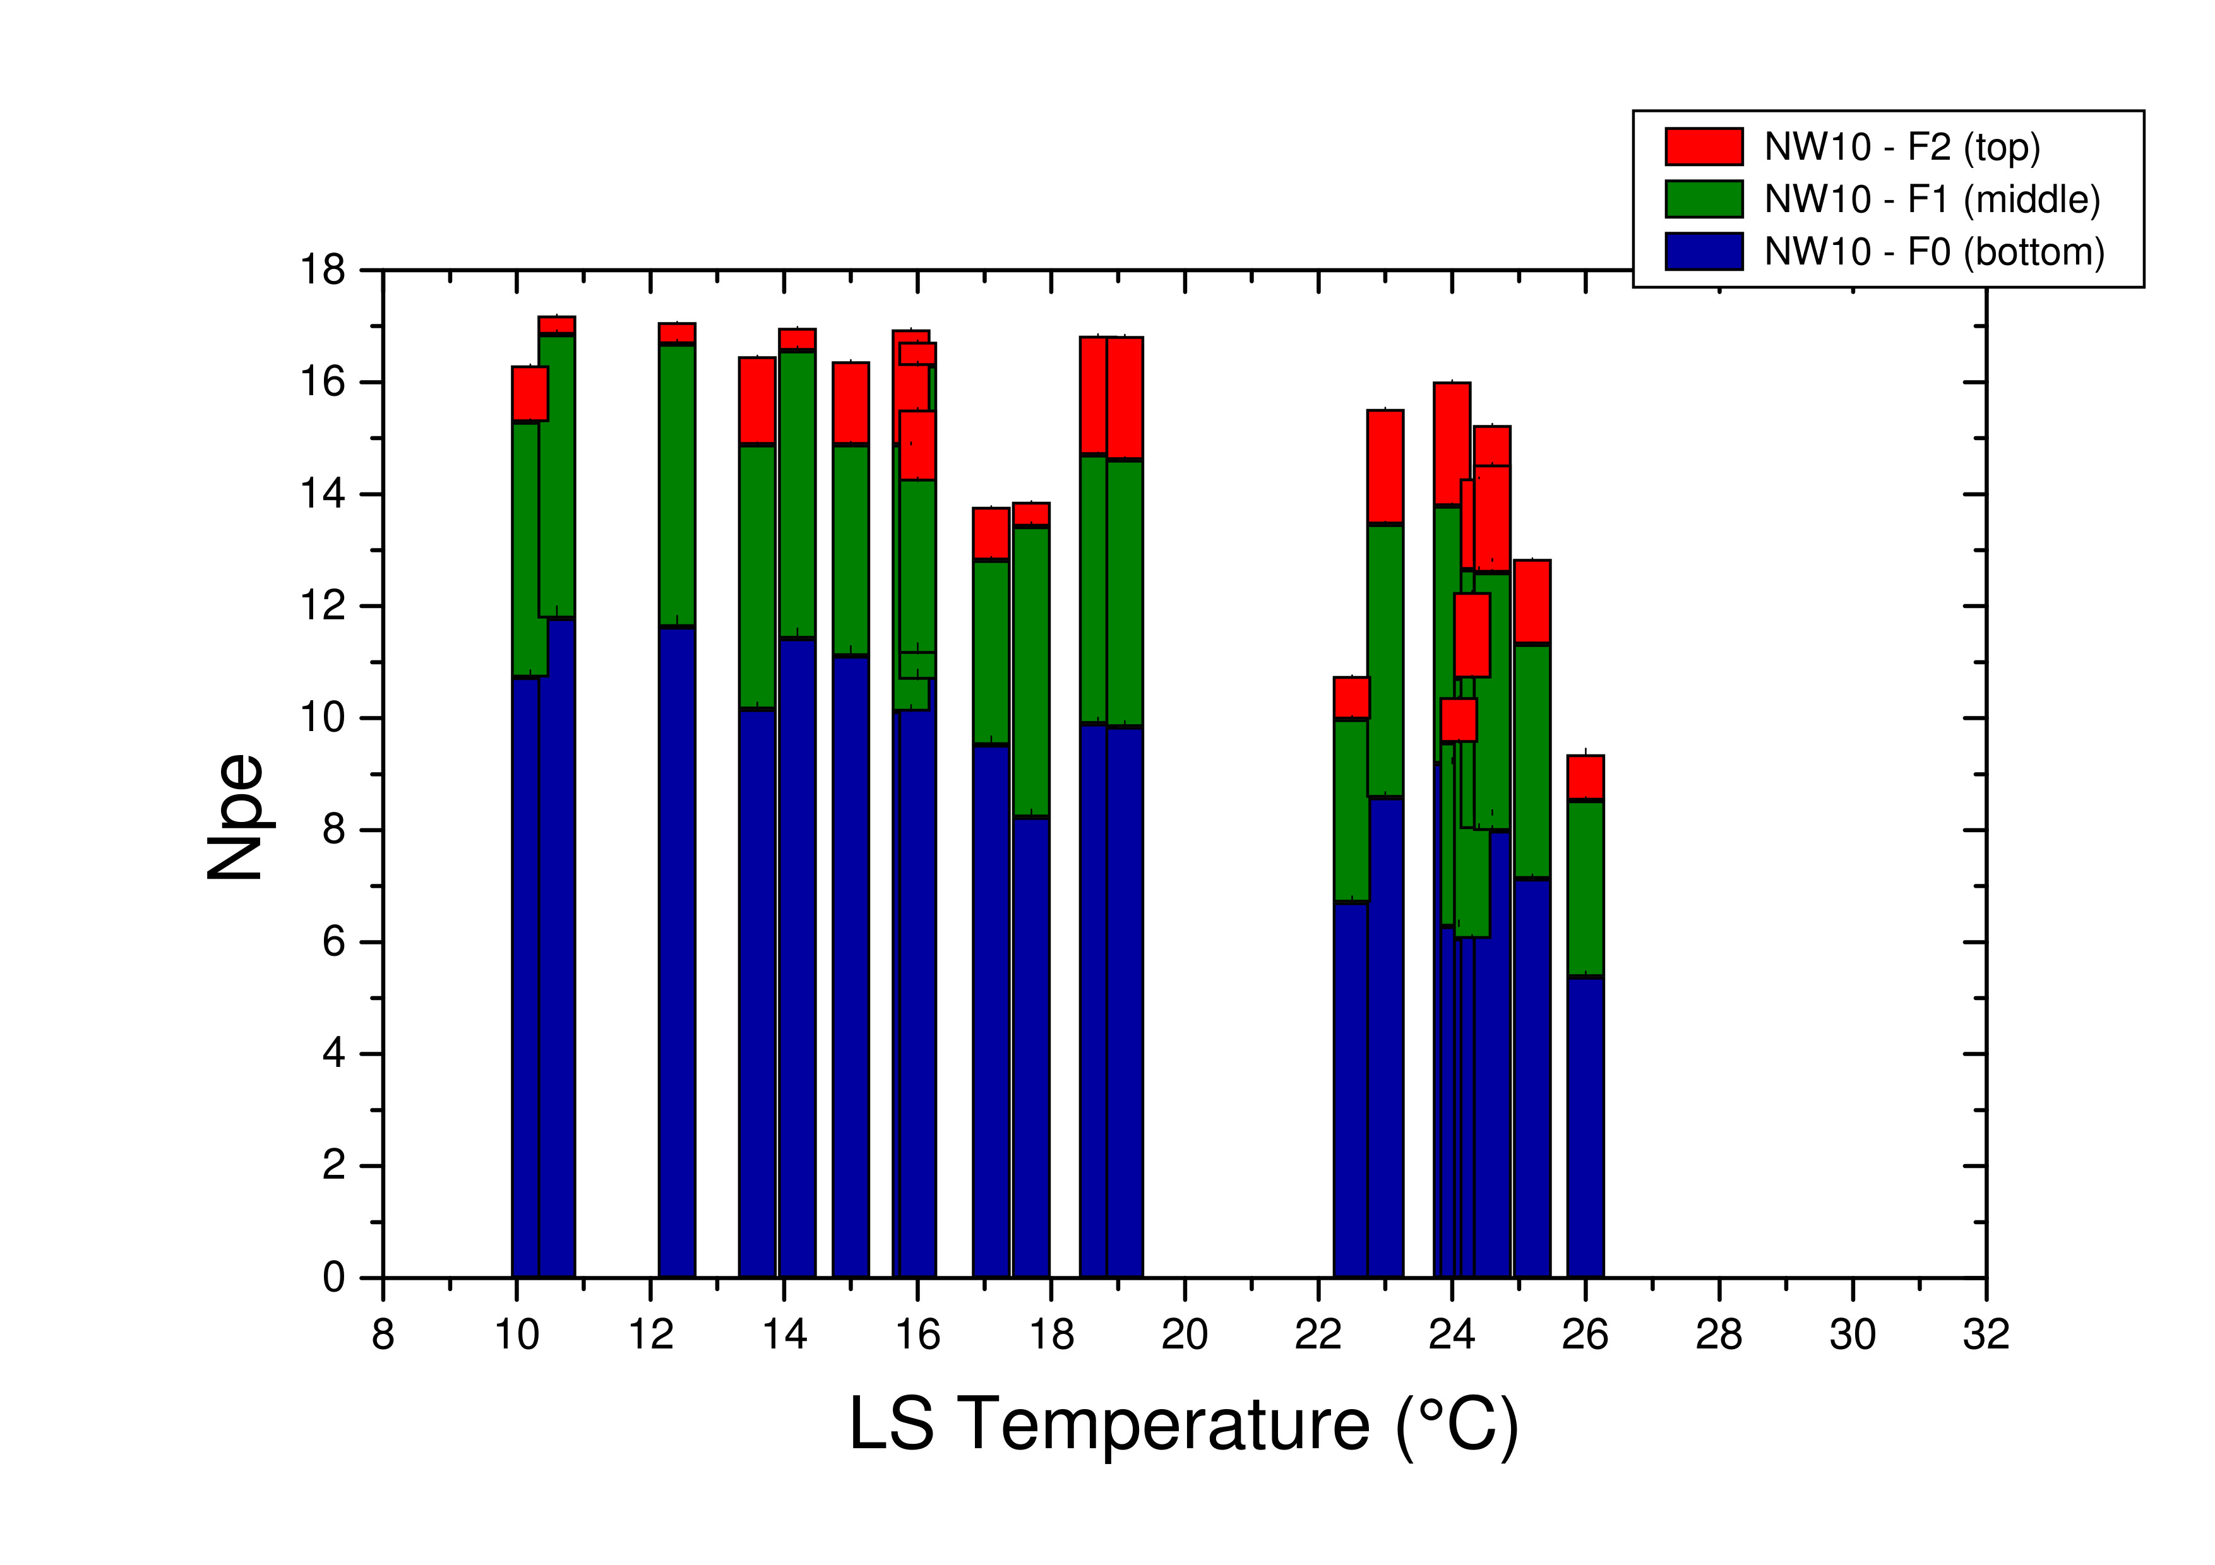
stacked Npe values
Total Light yield increased
LAB
Opaque LS
< F2
< F1
< F0
< F2
< F1
< F0

Slide 22
2019~
Micro-Liquid:
3 fibers
Mini-Liquid:
many fibers

Slide 23
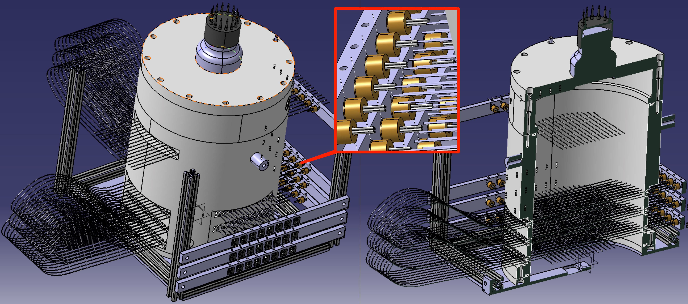
Mini-LiquidO Test detector

Slide 24
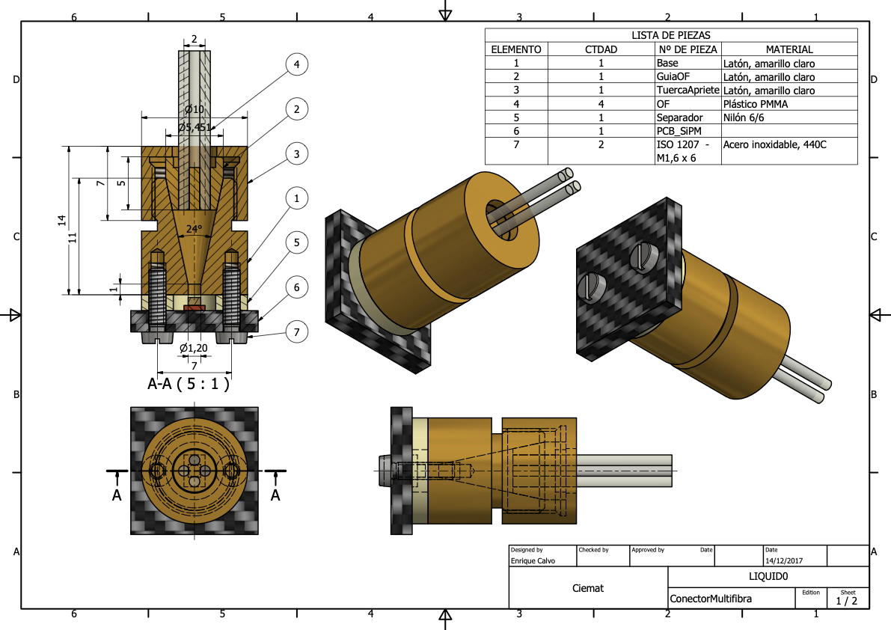
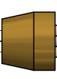
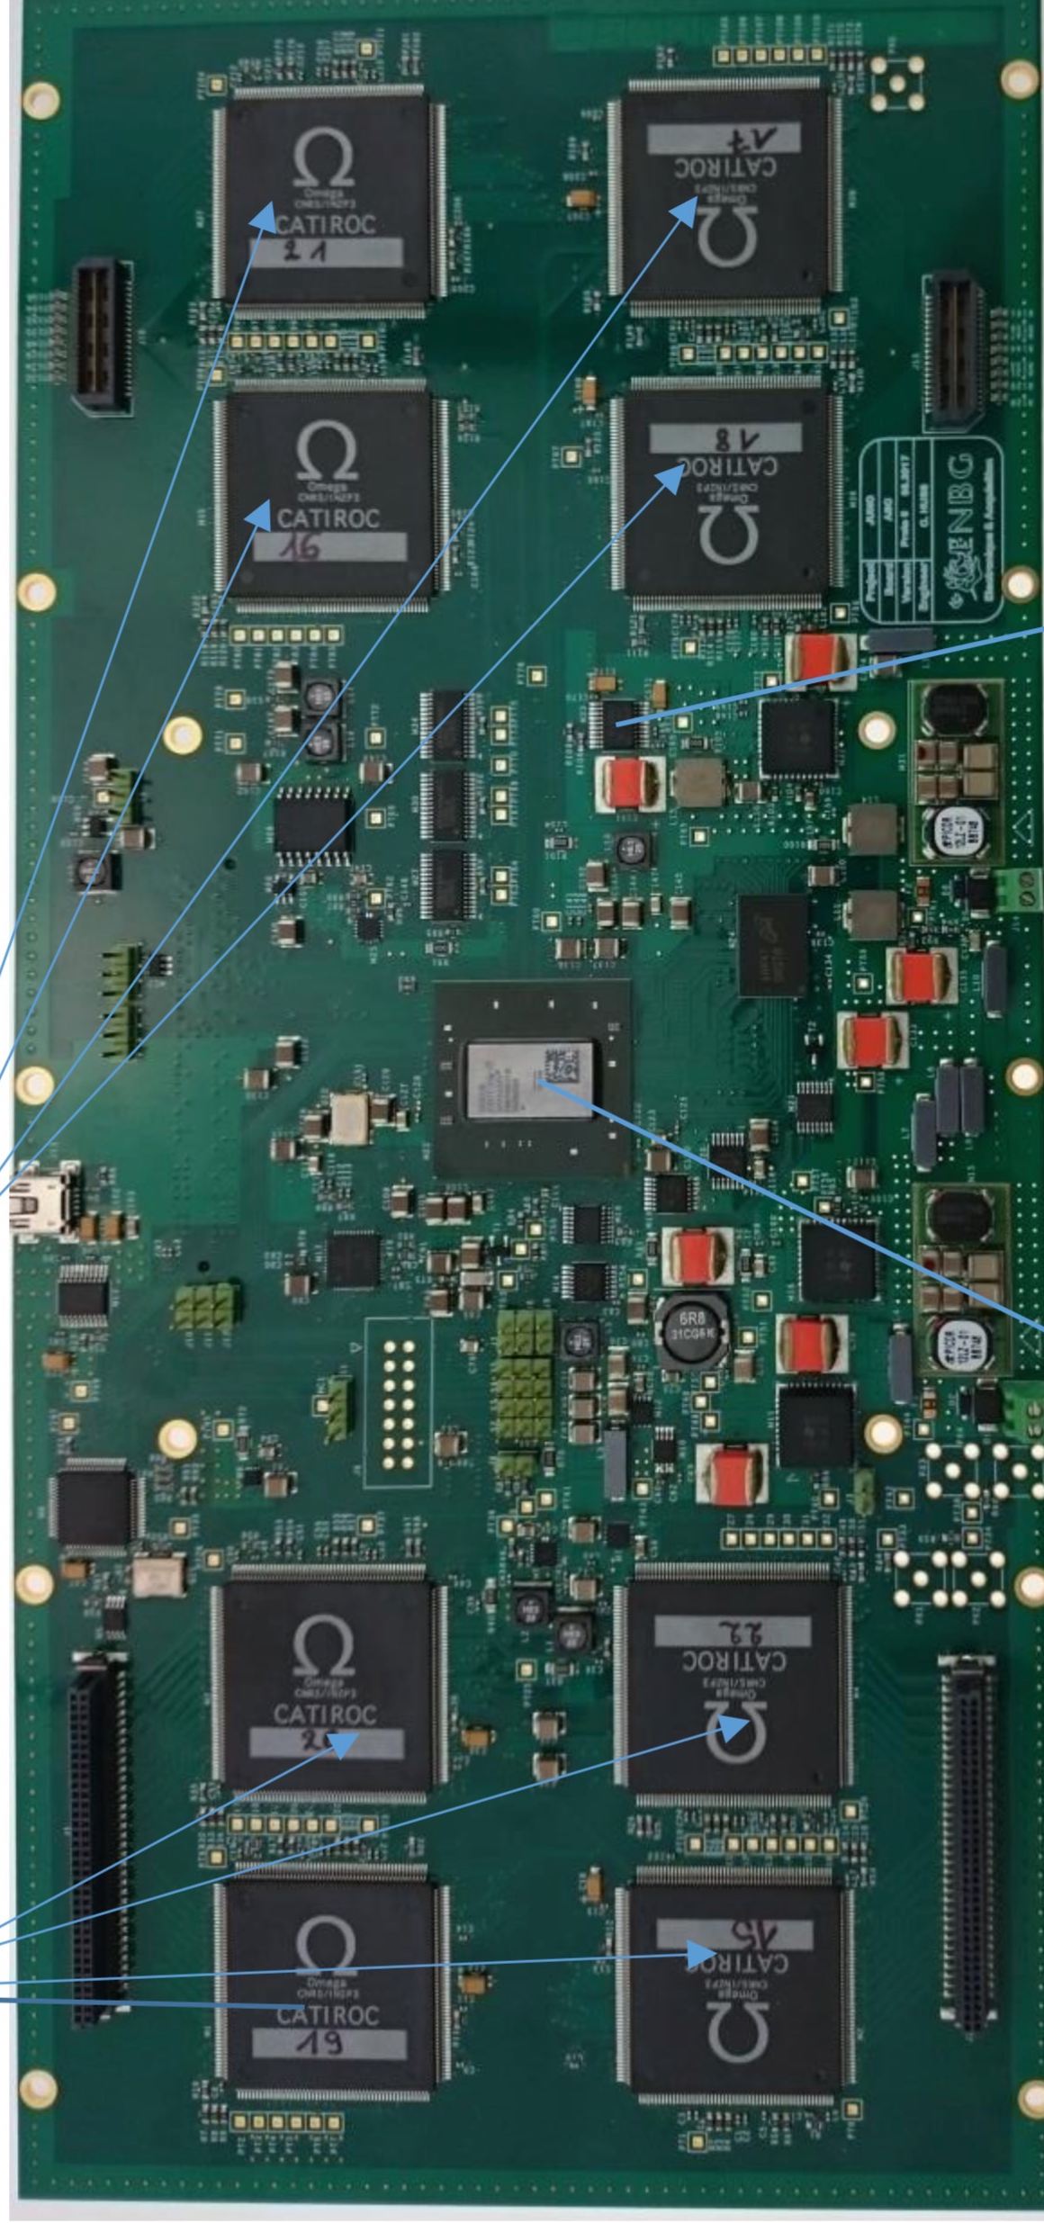
Ω readout (single-layer)
detector vessel
LED pulser
readout
electronics

Slide 25
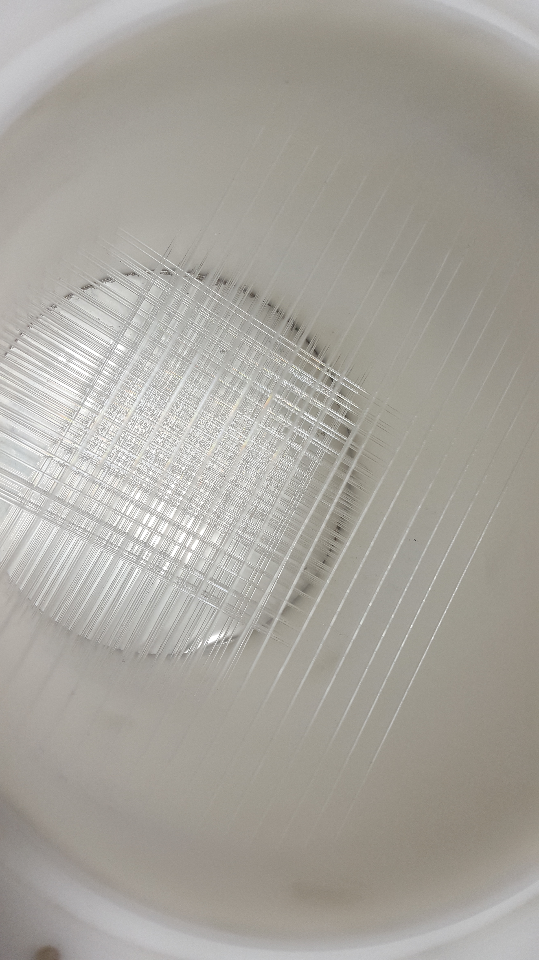
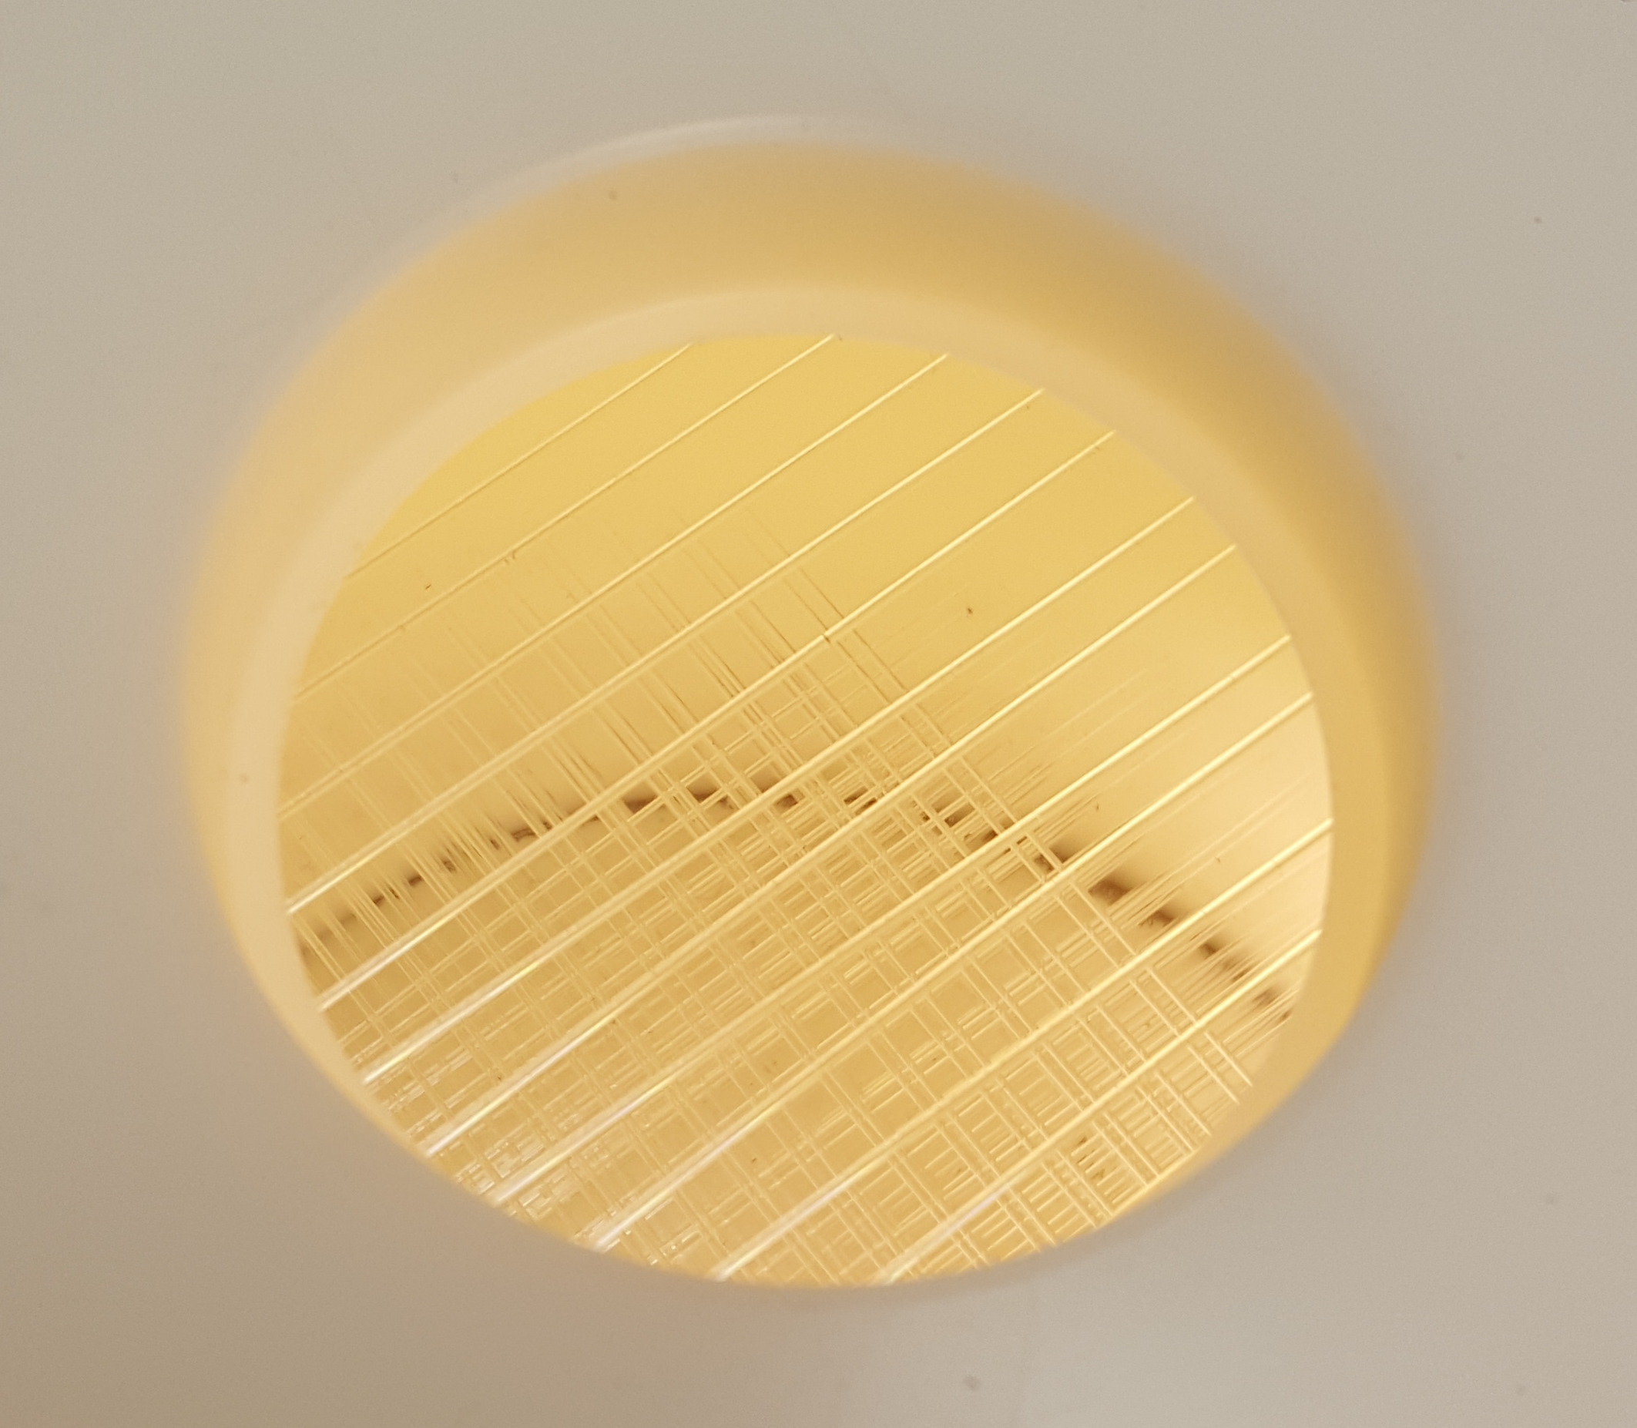
WLS Fiber pattern
inside the Mini LiquidO
closed detector now (PMT window)

Slide 26
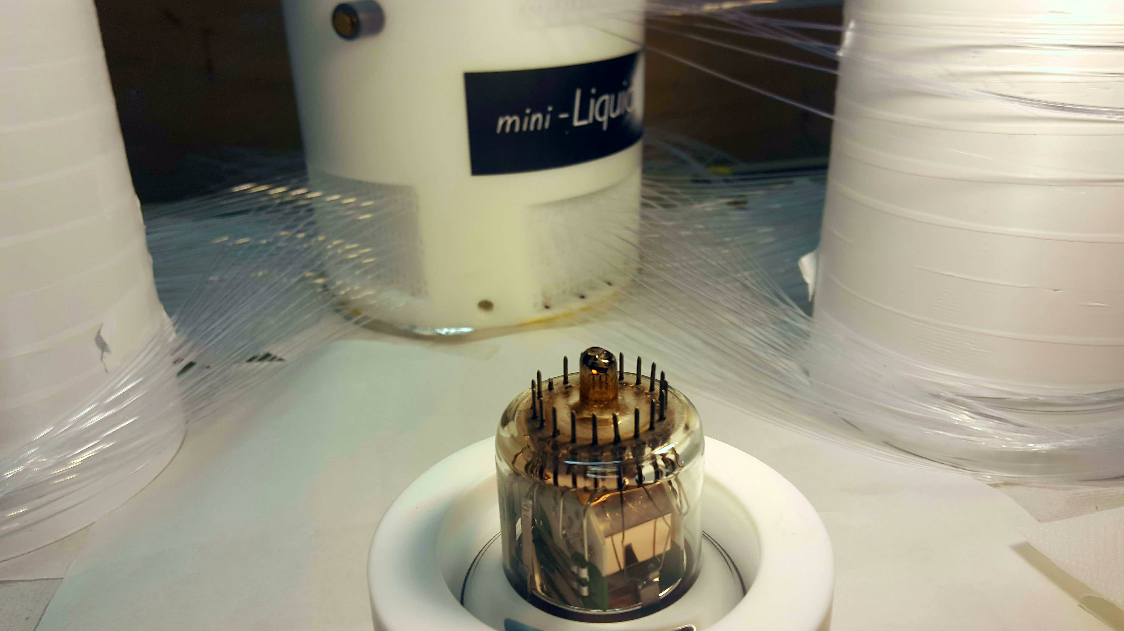
Fiber route outside

Slide 27
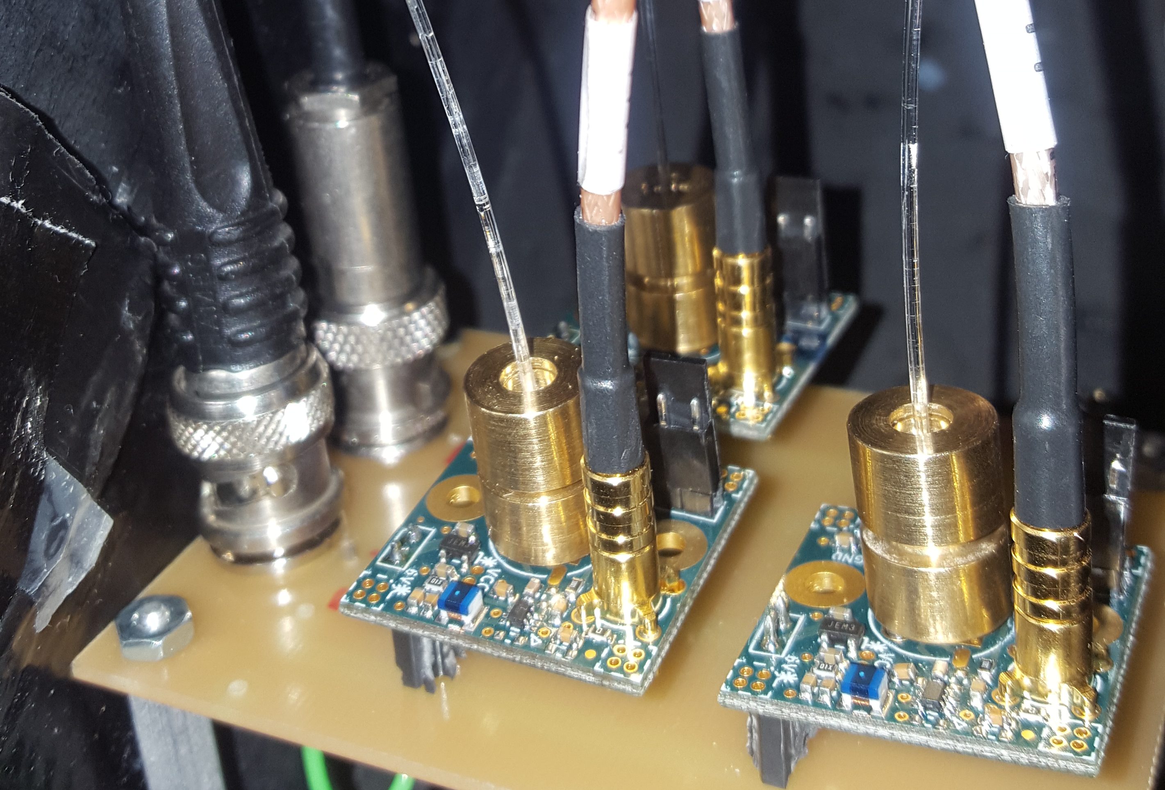
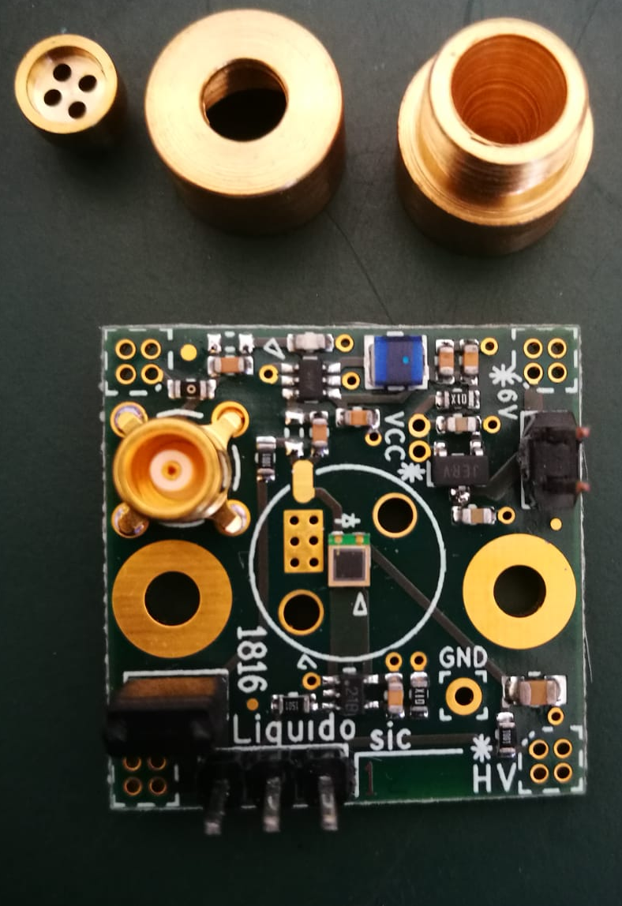
new readout

Slide 28
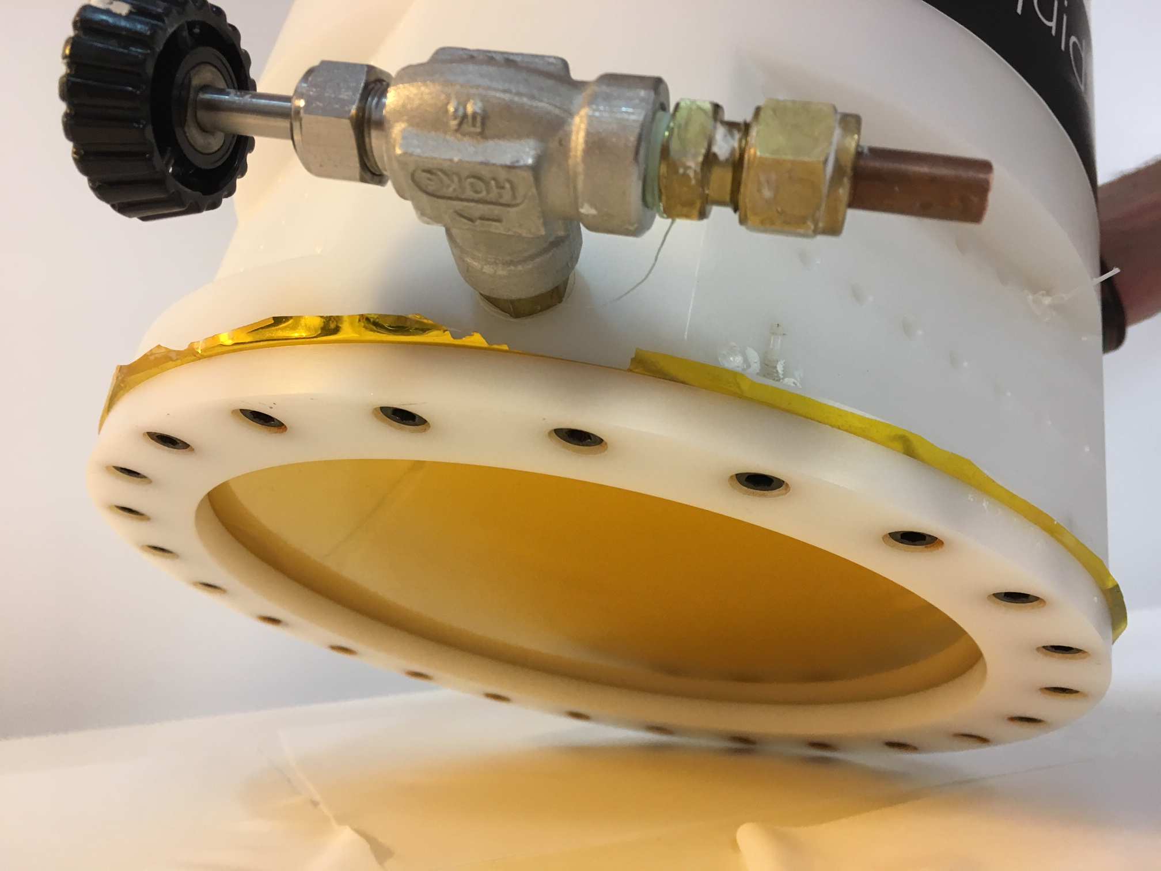
Will see 1 MeV electron
signal pattern!!
➔ Data take in 2019.

Slide 29
Summary
* LiquidO is a detector technology to observe the signal spatial pattern by using
opaque LS and WLS fibers.
* From the signal pattern, particle ID is possible and the backgrounds can be removed.
Charged current interaction of ν_{e} or can be separated.
* In 2018, the proof of principle of the scintillation light confinement was successfully
performed by using the μ-LiquidO
* In 2019, we will measure the e⁻ signal pattern by using Mini-LiquidO.
* R&D is continuing steadily....

Slide 30
Back ups

Slide 33
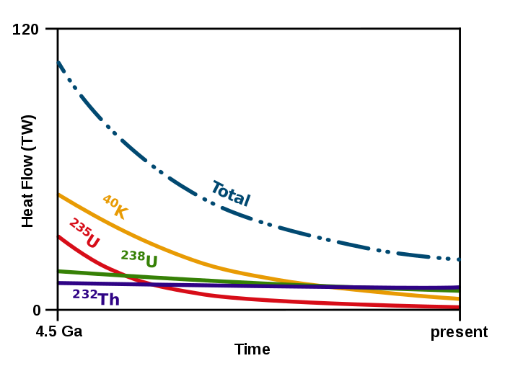
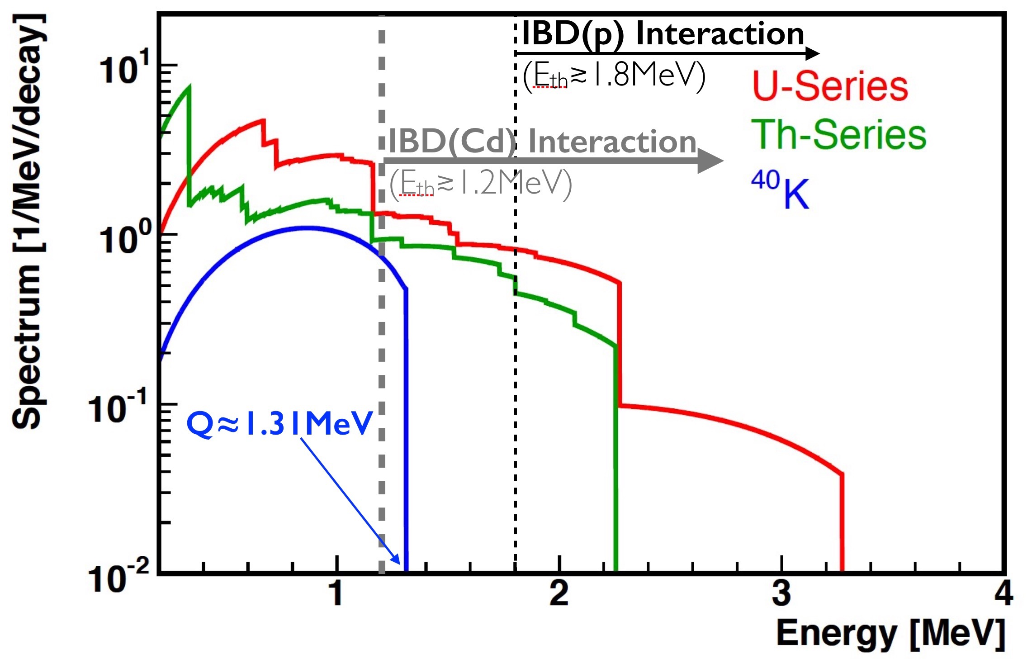
geo-ν(⁴⁰K) detection ever?
hope to detect geo-ν(⁴⁰K)? [impossible so far]
33
Earth Formation Heat Contribution
⁴⁰K-ν mystery
(volatility vs Earth center)
Cd-ν interaction: ⁴⁰K and more! U⊕Th geo-ν’s?

Slide 34
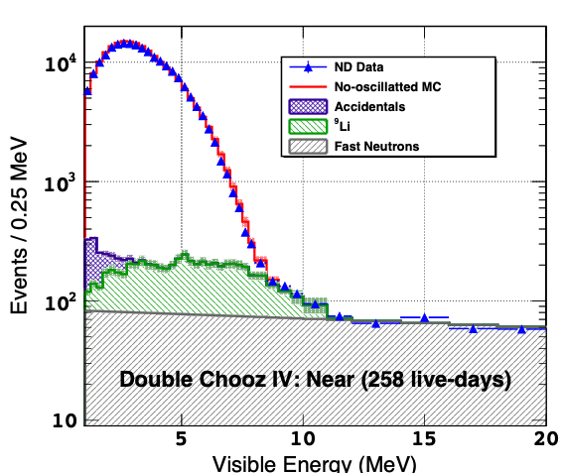
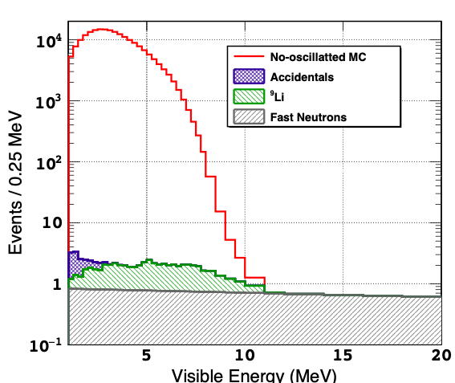
from Double Chooz to LiquidO…
34
e+
Signal:BG ≈ 10:1
LiquidO @ Chooz
PRELIMINARY
e⁻/γ
e⁻/α
n→p-recoil
Signal:BG ≈ ≥1000:1
[conservative]
cosmogenic rejection→ PID(e+:e-) ≥100x (expected ~1000x)
accidentals rejection→ ≥100x [time⊕space coincidence & PID(e+)]
“background-less” IBD detection?

Slide 35
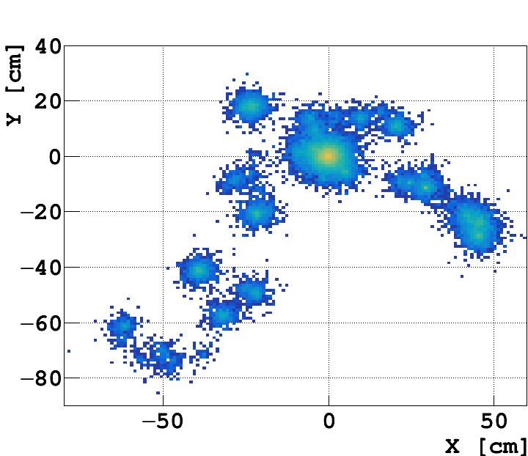
¹⁰⁶Cd 2β+ (first) observation?
first β+β+ observation? [impossible so far]
35
Cd doped LS
e+→ difficult to mimic
2x e+→ impossible?
study: γ’s ≥ 2.6MeV
3 channels: 2β+(ok) ⊕ β+ε (ok) ⊕ εε (no)

Slide 36
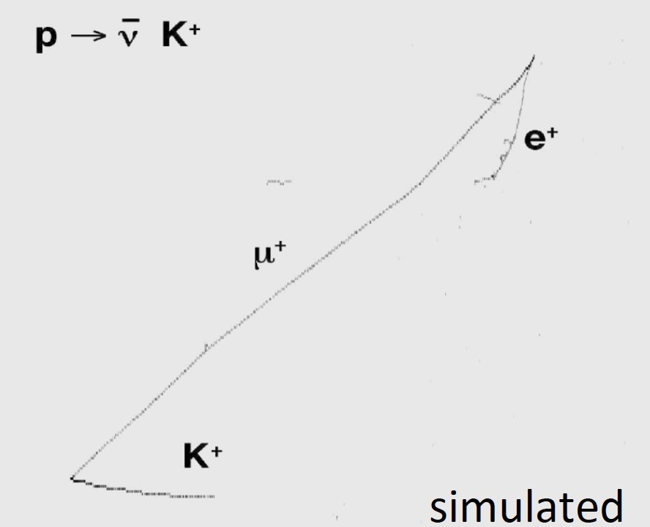
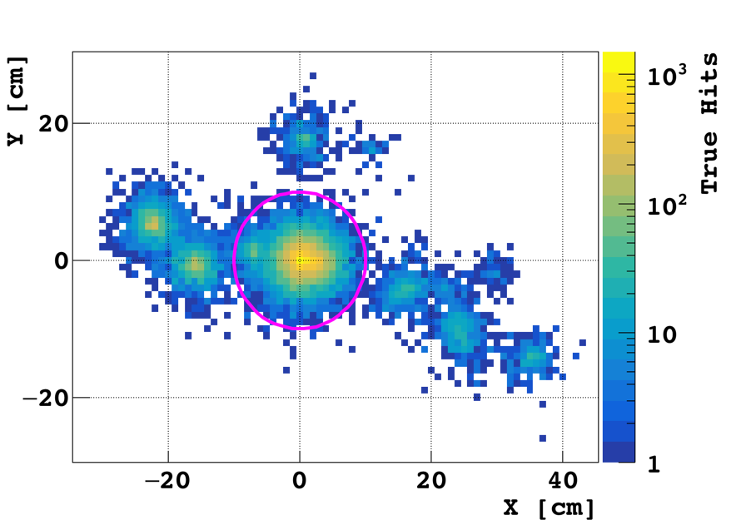
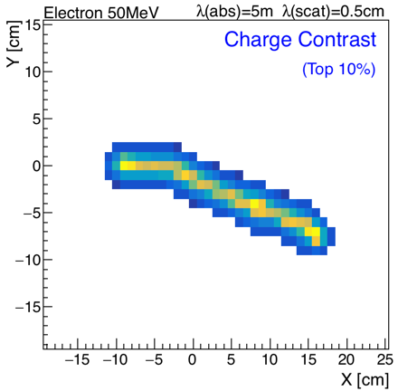
proton decay potential…
proton tracked by e⁺
(regardless of decay-mode)
36
2 tracks: K⁺ and μ⁺

