Slide 1
NuSYM2018
10-13 September 2018
Busan, South Korea
Marcella Grasso
From dilute matter to the equilibrium point in the energy-density-functional theory

Slide 2
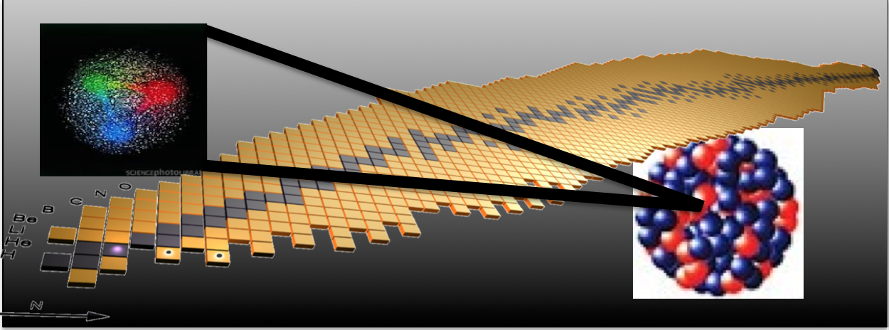
OUTLINE
Introduction of new functionals (in the EDF philosophy): very low-density nuclear matter ->
New functionals designed to correctly reproduce ALSO the low-density behavior, bridging with EFT/ ab initio
YGLO functional (resummed formula from EFT)
Lee-Yang inspired functional (density-dependent scattering length)
Applications to matter and neutron drops
Conclusions

Slide 3
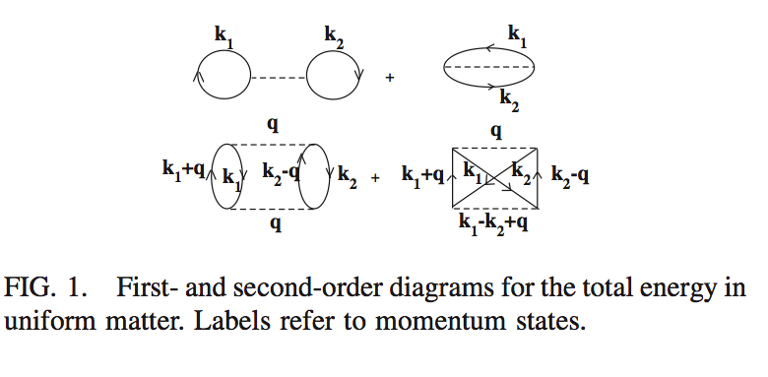
Moghrabi, Grasso, Colo’, Van Giai, PRL 105, 262501 (2010)
⬥ Yang, Grasso, Roca-Maza, et al., PRC 94, 034311 (2016)
Grasso, Lacroix, van Kolck, Invited Comment, Phys. Scr. 91, 063005 (2016)
Yang, Grasso, and Lacroix, PRC 96, 034318 (2017)
Yang, Grasso, et al., PRC 95, 054325 (2017)
Equation of state of nuclear matter with a Skyrme-type interaction.
The perturbative many-body problem:
First order
Second order
k_{F} = (3/2 π² ρ) ^{1/3} SM
k_{F} = k_{N} = (3π² ρ) ^{1/3} NM
k_{F} -> Fermi momentum
This second-order contribution diverges ->
For ex. the square of the Skyrme t₀ term has a k_{F}⁴ dependence and is the sum of a finite part plus a term linearly dependent on the cutoff (on the transferred momentum q) -> REGULARIZATION

Slide 4
Low-density for neutron matter (EFT satisfies this regime -> Hammer, Furnstahl, NPA 678, 277 (2000)) Lee-Yang expansion in (ak_{N}). Low-density EOS
YGLO functional
a -> neutron-neutron scattering length, -18.9 fm
k_{N} -> neutron Fermi momentum = (3π² ρ)^{1/3}
α = 1/3
Lee and Yang, Phys. Rev. 105, 1119 (1957)
What about the mean-field Skyrme EOS?
Skyrme term | kN dependence in the EOS
t ₀ | k_{N}³
t ₃ | k_{N}^{3α+3}
t ₁ and t ₂ | k_{N}⁵

Slide 5
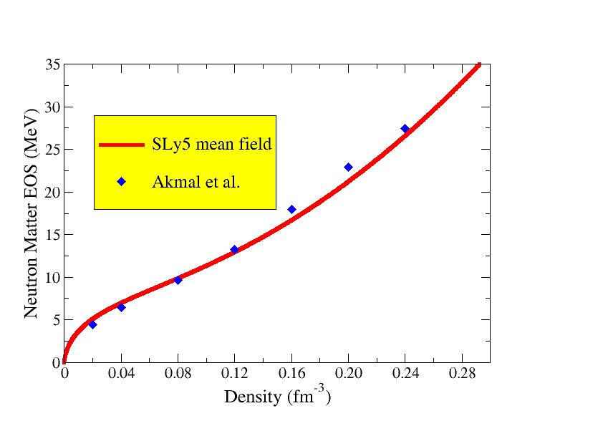
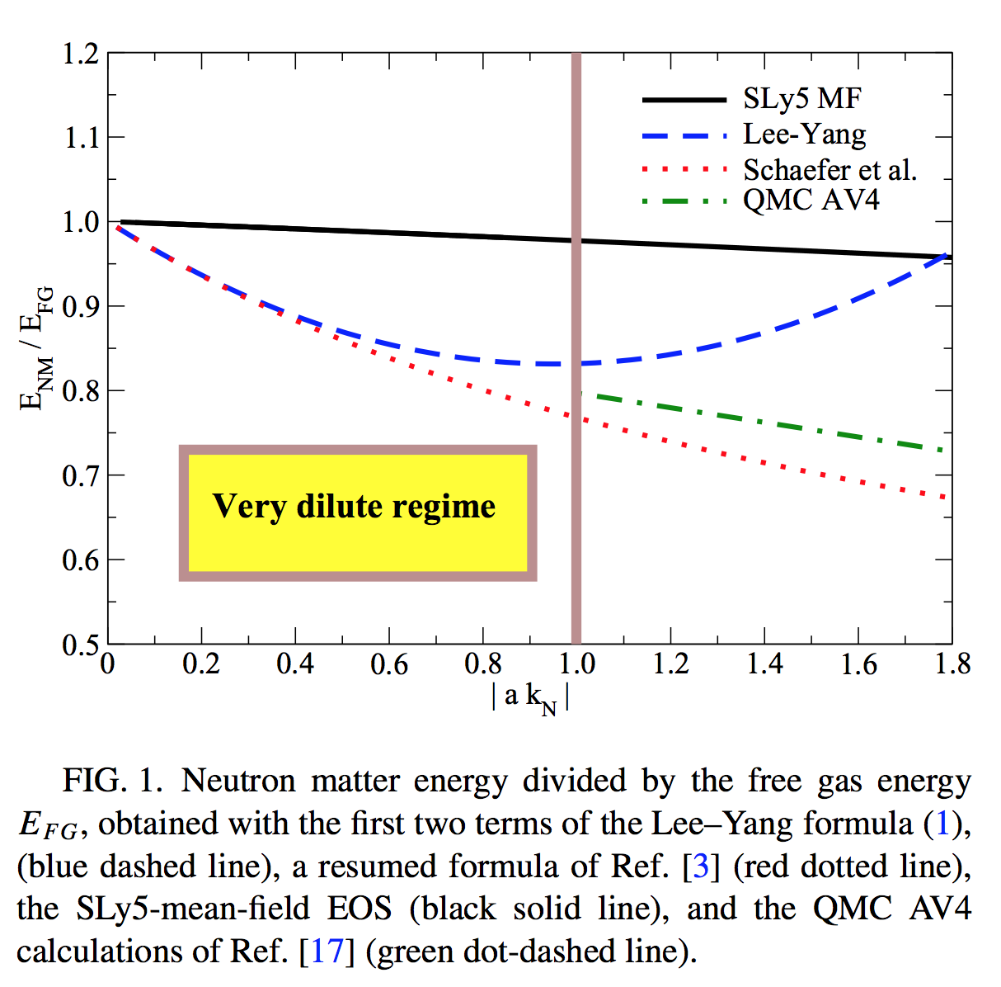
Neutron matter at ‘usual’ density scales. Example of Lyon-Saclay forces adjusted on the neutron EOS
Low-density regime
SLy5 -> Chabanat et al. NPA 627, 710 (1997); 635, 231 (1998), 643, 441 (1998)
Akmal et al. -> PRC 58, 1804 (1998)
Neutron matter energy divided by the free gas energy

Slide 6
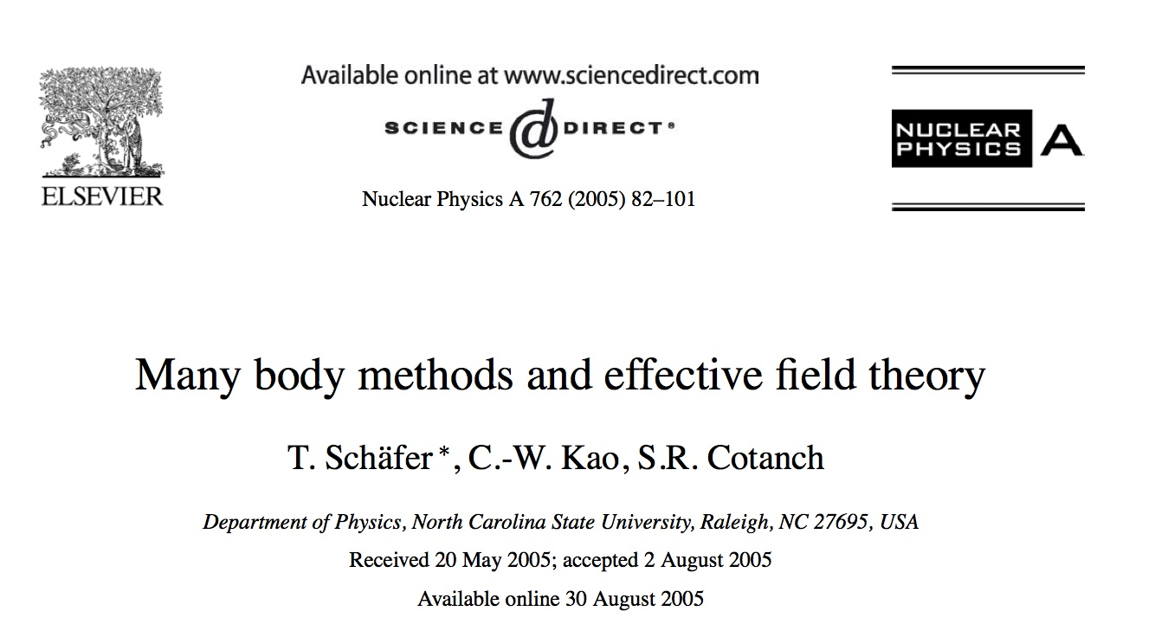
Some indications from second-order calculations: the second-order contribution has the required k_{F}⁴ term (second term of Lee-Yang exp.)
… but only second order is not enough (if one wants to keep the correct value of the scattering length)
Resummation techniques
Steele, arXiv: nucl-th/0010066v2
Kaiser, NPA 860, 41 (2011)
Schaefer, NPA 762, 82 (2005)
Effective field theories capable of describing systems with anomalously large scattering lengths require summing an infinite number of Feynman diagrams at leading order …

Slide 7
Guided by:
The fact that the second-order t₀ contribution leads to the correct dependence on the Fermi momentum in neutron matter;
The resumed formulae;
Good properties of Skyrme functionals
A hybrid functional, YGLO (Yang, Grasso, Lacroix, Orsay):
Matching the low-density limit with the Lee-Yang expansion of the energy
Beta = 1 - > symmetric matter
Beta =0 -> neutron matter

Slide 8
YGLO functional: Inspired by resummed expressions (resummed functional) (EFT)
Constrained by the first two terms of Lee Yang formula (scattering length)
EOS for symmetric and neutron matter:
Mimic velocity- and density-dependent terms
Resummed expression
Other parameters adjusted on QMC results at extremely low densities and on Friedman et al. or Akmal et al. EOSs at higher densities
Yang, Grasso, Lacroix, PRC 94 , 031301(R) (2016)

Slide 9
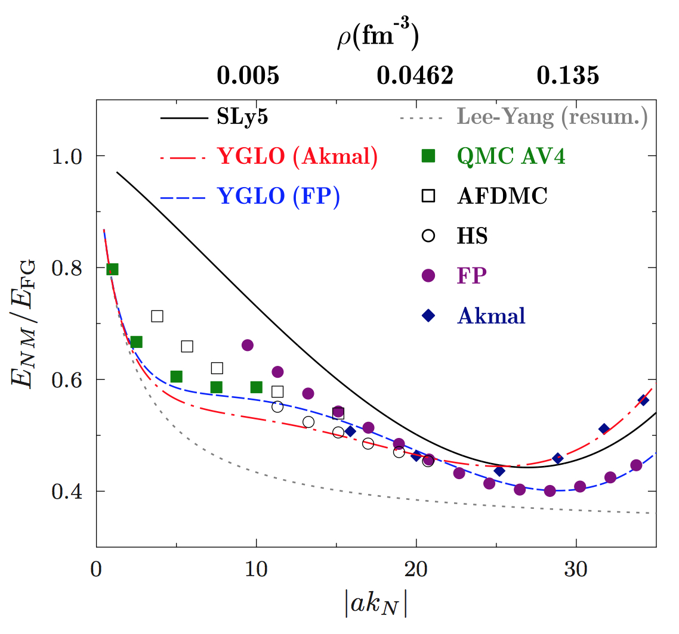
YGLO. Very low-density behavior of neutron matter
Energy divided by the free gas energy
Yang, Grasso, Lacroix, PRC 94, 031301(R) (2016)

Slide 10
Using the experimental values of the electric dipole polarizability in the three nuclei correlation between the electric dipole polarizability times the symmetry energy J and the slope of the symmetry energy L
²⁰⁸Pb -> J=(24.5 ± 0.8)+(0.168 ± 0.007) L
⁶⁸Ni -> J=(24.9 ± 2.0)+(0.19 ± 0.02) L
¹²⁰Sn -> J=(25.4 ± 1.1)+(0.17 ± 0.01) L
Roca-Maza et al, PRC 92, 064304 (2015)

Slide 11
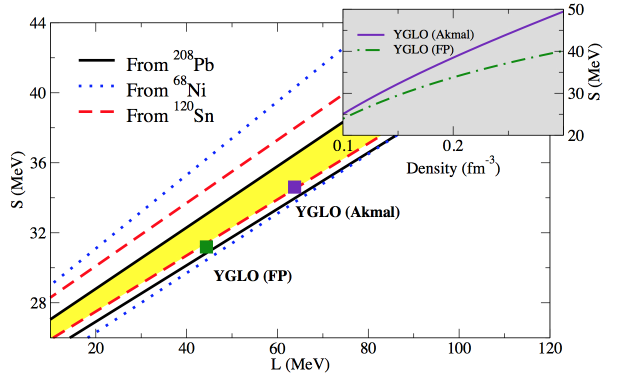
Symmetry energy and its slope
Lines delimit the phenomenological areas constrained by the exp. determination of the electric dipole polarizability
Yang, Grasso, Lacroix, PRC 94, 031301(R) (2016)

Slide 12
No resummation. Imposing a Lee-Yang regime at all densities at leading order

Slide 13
… Without resummation, how to handle the different density scales ?
… A Lee-Yang type expression for the EOS of neutron matter-> if the low-density regime is always satisfied
s-wave scattering length
Associated effective range
We choose to keep terms containing only the s-wave scattering length. The next term in the Lee-Yang expansion contains the p-wave scattering length
Grasso, Lacroix, Yang,Phys. Rev. C 95, 054327 (2017)

Slide 14
Neutron-neutron scattering length.
Low-density regime:
We impose a low-density constraint: - a k_{F}=1 ->
a =-18.9 fm up to a max momentum so that 18.9 k_{F}=1.
Beyond this value, we tune the scattering length so that –a = 1/k_{F}

Slide 15
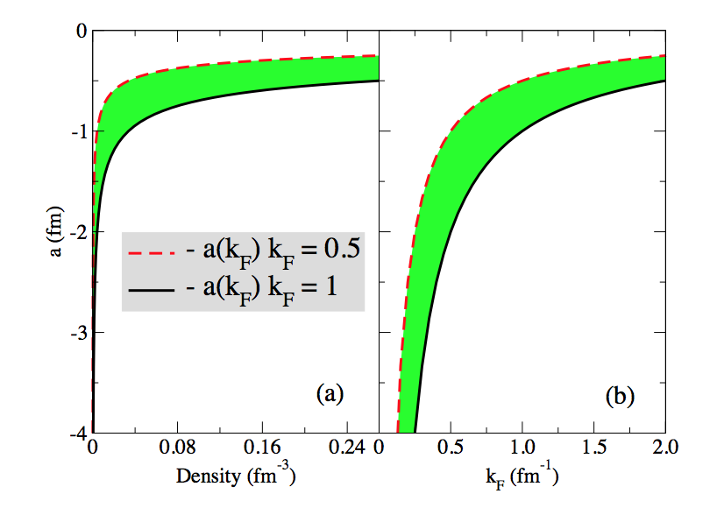
Neutron-neutron scattering length
Grasso, Lacroix, Yang, PRC 95, 054327 (2017).

Slide 16
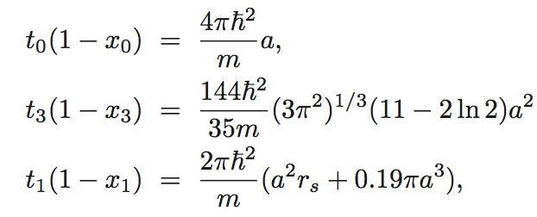
We introduce a Skyrme-type functional containing only s-wave terms and leading, at the mean-field level, to a neutron matter EOS given by the LY expression, with the relations :
The power of the density-dependent term is chosen equal to 1/3
Grasso, Lacroix, Yang, PRC 95, 054327 (2017).

Slide 17
We require that:
The functional correctly describes neutron matter at all density scales
The functional leads to a reasonable EOS for symmetric matter around the equilibrium point
This may be obtained by imposing a low-density regime everywhere (with a density-dependent neutron-neutron scattering length)

Slide 18
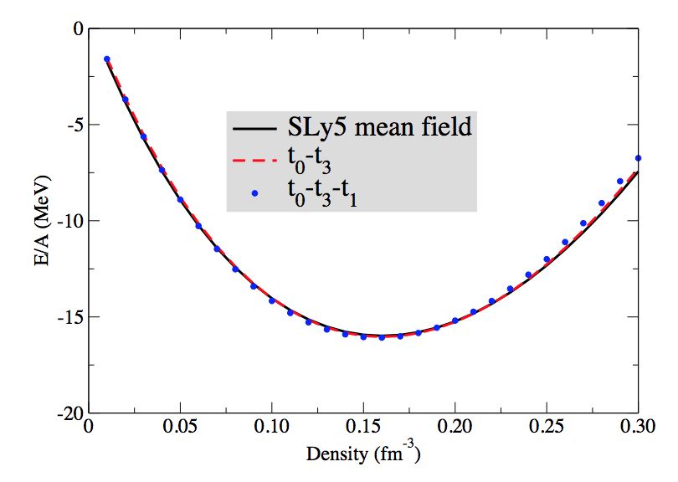
The parameters x_{i} do not enter in the EOS of symmetric matter.
We may thus adjust the parameters t_{i} to have a reasonable EOS of symmetric matter and tune the neutron-neutron scattering length by imposing, at each density scale, a low-density constraint
Symmetric matter, two cases
t₀-t₃
t₀-t₃-t₁
Grasso, Lacroix, Yang,Phys. Rev. C 95, 054327 (2017)

Slide 19
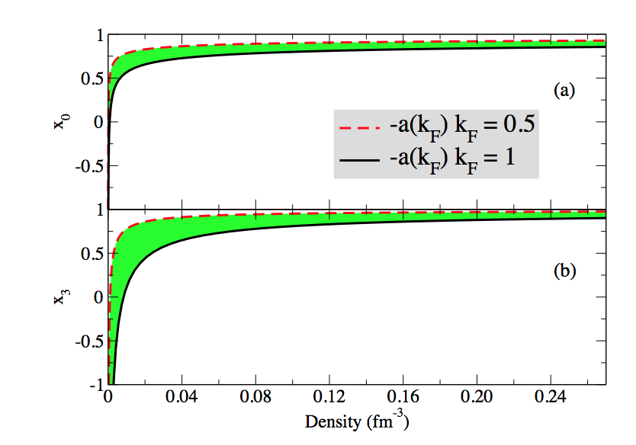
Density dependence of the parameters x₀ and x₃
Typical Skyrme values at densities around the saturation point
Grasso, Lacroix, Yang,Phys. Rev. C 95, 054327 (2017)

Slide 20
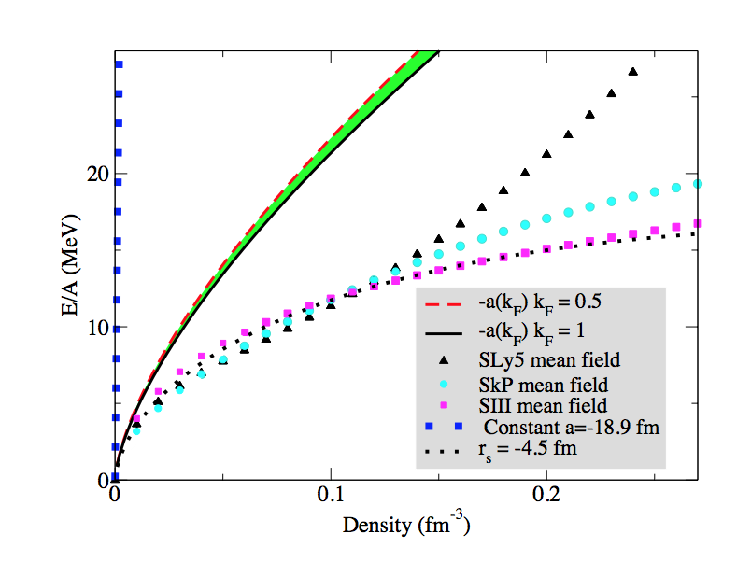
First two terms of the Lee-Yang expansion. EOS of neutron matter
LY with -18.9 fm
First two terms
SLy5 mean field
SkP mean field
Huge discrepancy
SIII mean field
Grasso, Lacroix, Yang,Phys. Rev. C 95, 054327 (2017)

Slide 21
Including the s-wave k_{F}⁵ terms and adjusting the effective range
Grasso, Lacroix, Yang, PRC 95, 054327 (2017).

Slide 22
Towards finite-size systems Applications to neutron drops trapped in isotropic harmonic potentials of frequency ω Applications shown for : YGLO ELYO (extended Lee Yang, Orsay -> density-dependent scattering length) KIDS (Papakonstantinu et al)

Slide 23
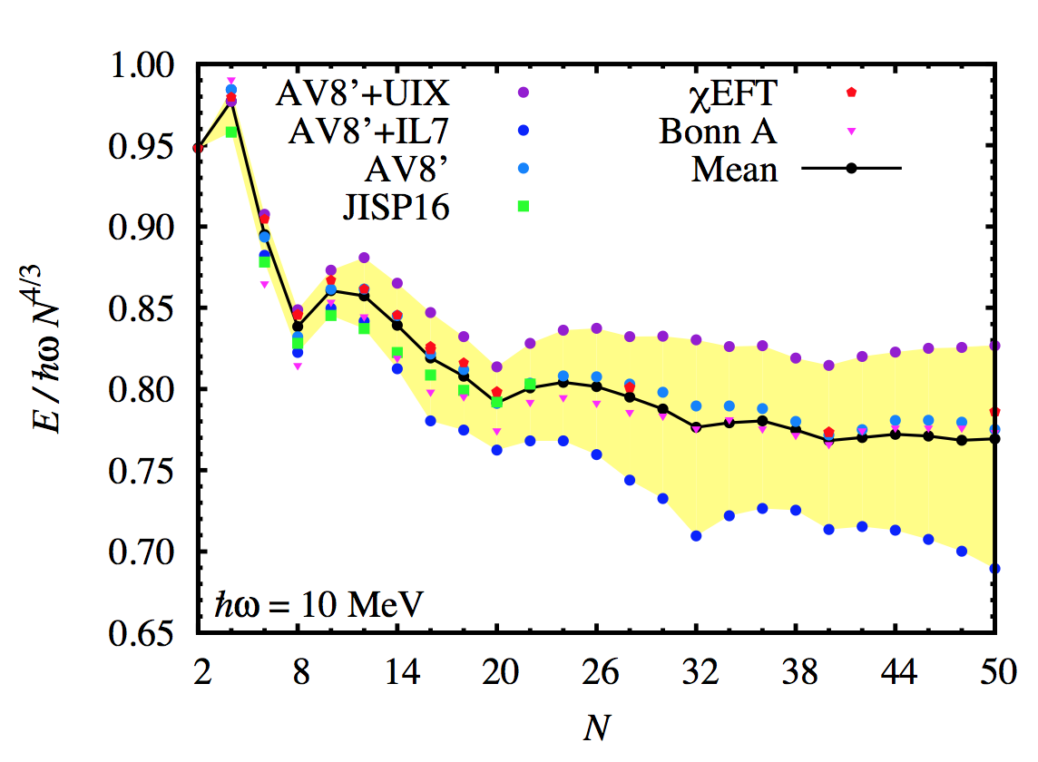
Adding spin-orbit and pairing to our functionals Adjusting to preudodata: using the average of the results shown in the figure below (except Brueckner HF Bonn A)
Dots: Green’s function and auxiliary field diffusion QMC
- Maris et al., PRC 87, 054318 (2013)
- Gandolfi et al., PRL 106, 012501 (2011)
- 2-body AV8’, Pudliner 1997
- 3-body UIX, Pudliner 1995
- 3-body IL7, Pieper 2008
Squares: configuration-interaction (Maris et al)
Pentagones: no-core shell model and coupled cluster (Potter et al. PLB, 739, 445 (2014))
Bonnard, Grasso, Lacroix, arXiv:1806.01084 , in press Phys. Rev. C

Slide 24
Adding spin-orbit and pairing to our functionals Adjusting to preudodata: using the average of the results shown in the figure below (except Brueckner HF Bonn A)
Additional parameters in finite-size systems:
Pairing and spin-orbit parameters adjusted for the case of a 10 MeV trap for N= 8, 12, 14, 16, 20
Benchmark data are the average (solid black line in the figure) up to N=20
Bonnard, Grasso, Lacroix, arXiv:1806.01084 , in press Phys. Rev. C

Slide 25
Adding spin-orbit and pairing to our functionals Adjusting to preudodata: using the average of the results shown in the figure below (except Brueckner HF Bonn A)
Additional parameters in finite-size systems:
Additional parameter: W, to disentangle between a density-dependent term (with alpha=2/3) and velocity-dependent terms
For example, in the YGLO case:
Bonnard, Grasso, Lacroix, arXiv:1806.01084 , in press Phys. Rev. C

Slide 26
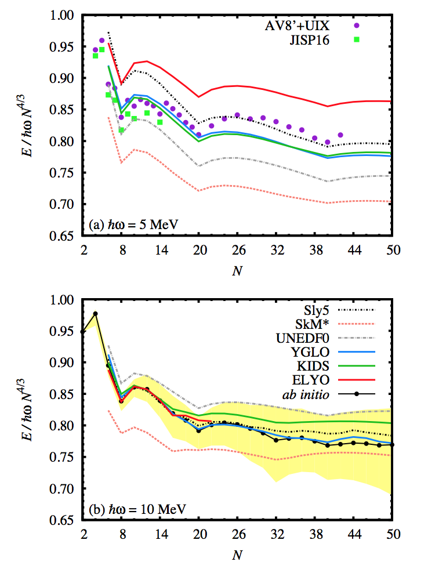
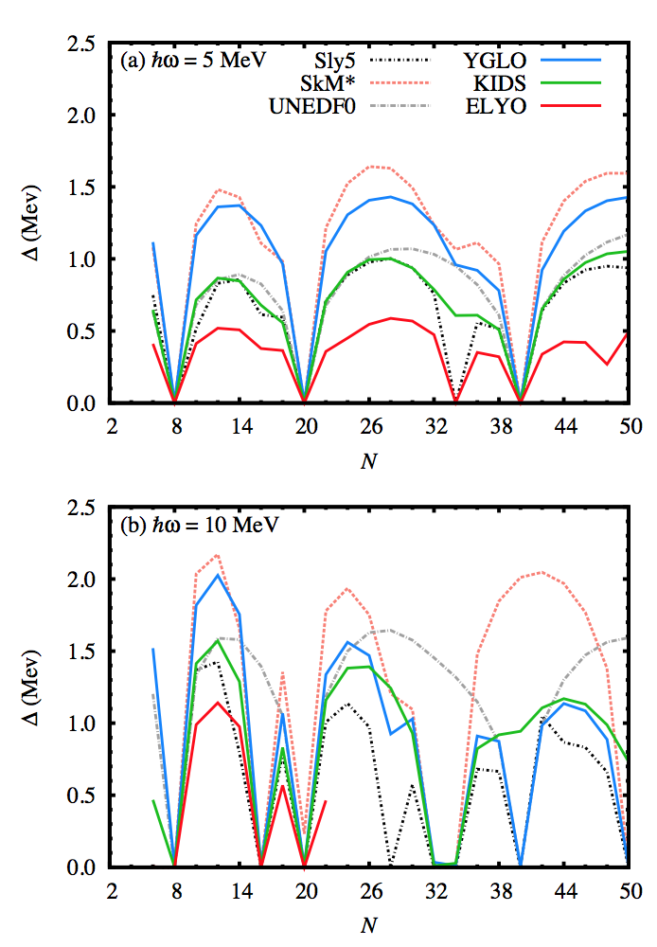
After adjustment of spin-orbit and pairing
Bonnard, Grasso, Lacroix, arXiv:1806.01084 , in press Phys. Rev. C

Slide 27
Conclusions
New functionals valid at all density scales for neutron matter and at densities around saturation for symmetric matter
-> YGLO (resummation from EFT and good properties of Skyrme forces : a hybrid functional)
-> without resummation -> density-dependent neutron-neutron scattering length
-> not only nuclear matter. Towards finite-size systems: neutron drops
-> perspectives: finite nuclei and extensions (for example, p-wave terms in the ELYO functional)

