Slide 1
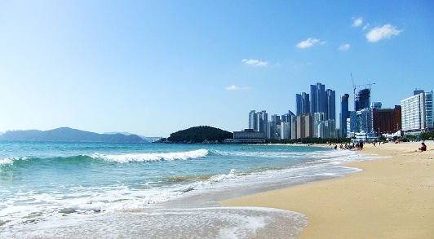
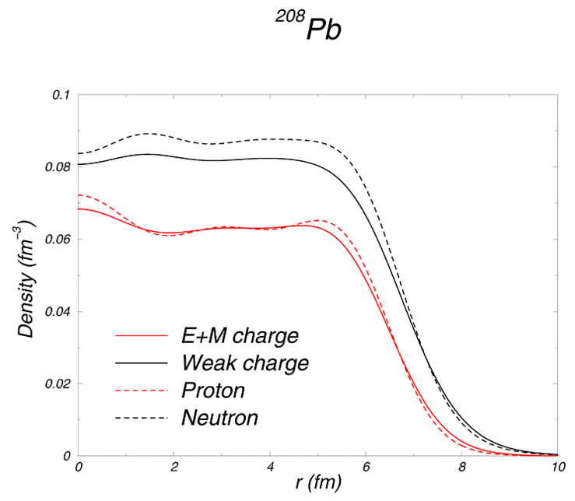

PREX and CREX
Robert Michaels
Jefferson Lab
²⁰⁸Pb
⁴⁸Ca
NuSYM2018
http://hallaweb.jlab.org/parity/prex
2
+
C. J. Horowitz
Electroweak Asymmetry in
Elastic Electron-Nucleus Scattering
Neutron Skin
1/15

Slide 2
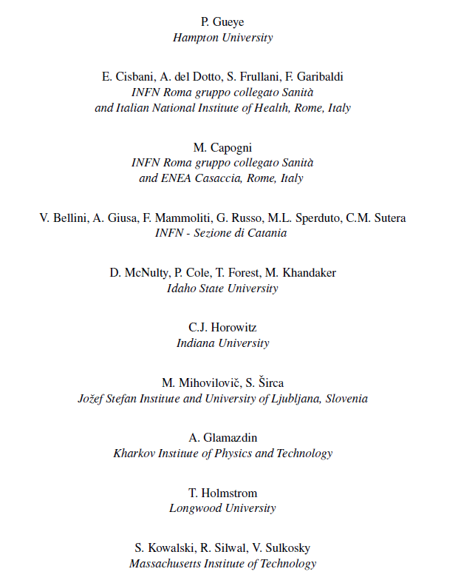
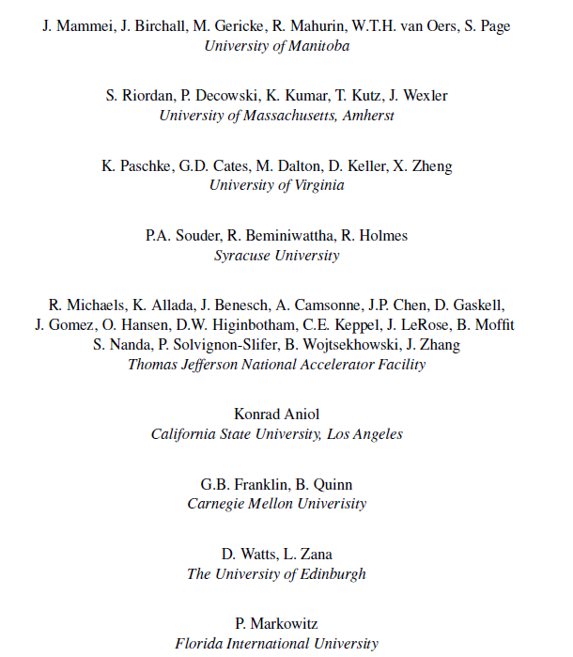
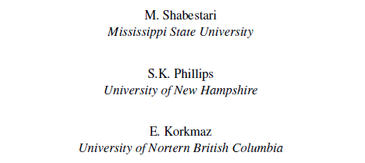
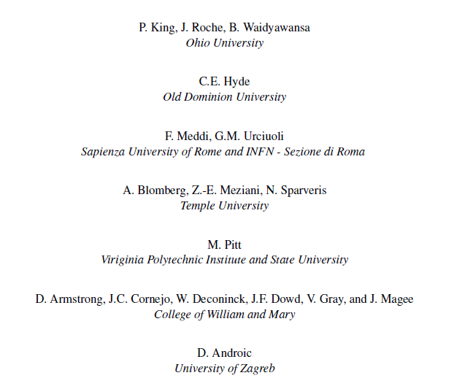
PREX
CREX
Seamus Riordan* | Argonne National Lab
Robert Michaels | Jefferson Lab
Kent Paschke | UVa
Paul Souder | Syracuse Univeristy
Dustin McNulty | Idaho State University
Juliette Mammei | Manitoba University
Silviu Covrig | Jefferson Lab
Kent Paschke * | UVa
Krishna Kumar | Stony Brook University
Robert Michaels | Jefferson Lab
Paul Souder | Syracuse Univeristy
Guido Urcioli | INFN Rome
* contact persons
p2 / 22

Slide 3

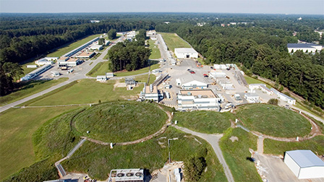
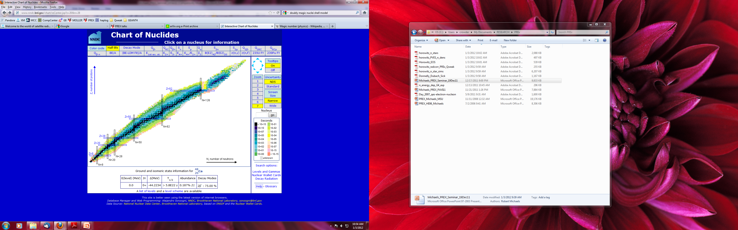
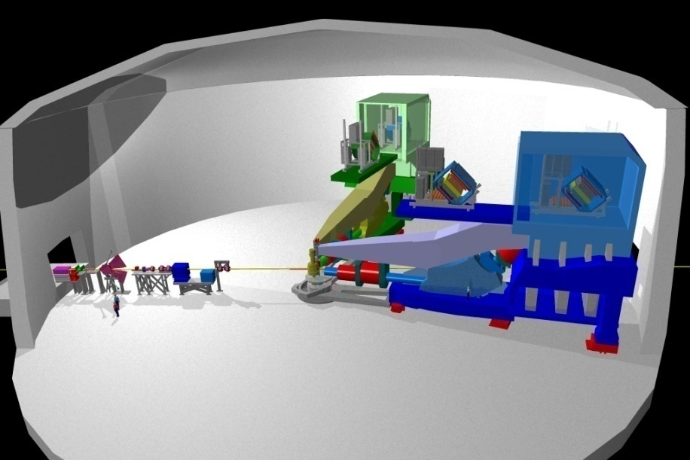
Neutron form factor
Hall A
Choice of Nuclear Targets
First excited state far from elastic
Neutron excess
Doubly-magic
Stable
High Resolution ( 10⁻⁴ ) Spectrometers
²⁰⁸Pb
⁴⁸Ca
Hall A
Robert Michaels, NuSYM2018

Slide 4
Using Parity Violation
Electron - Nucleus Potential
electromagnetic
axial
208
is small, best observed by parity violation
Pb is spin 0
neutron weak charge >> proton weak charge
Proton form factor
Neutron form factor
Parity Violating Asymmetry
Robert Michaels, NuSYM2018
p4 / 22

Slide 5
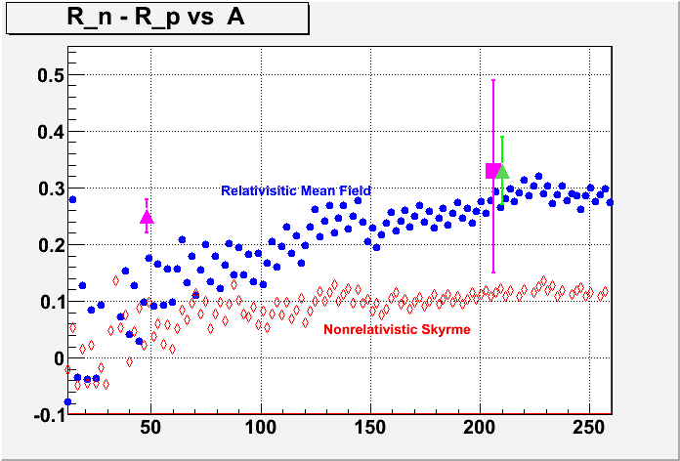
Neutron Skin vs Mass Number A
C-REX
PREX-I
PREX-II
published
Approved proposal
Approved proposal
R_{N} – R_{P} (fm)
Theory : P. Ring et al. NPA 624, 349 (1997)
A
Robert Michaels, NuSYM2018
p5 / 22

Slide 6
Weak Interaction: Sees the Neutrons
T.W. Donnelly, J. Dubach, I. Sick
Nucl. Phys. A 503, 589, 1989
 | proton | neutron
Electric charge | 1 | 0
Weak charge | 0.08 | 1
Measured Asymmetry
Correct for Coulomb
Distortions
Weak Density at one Q²
APPLICATIONS
Nuclear Theory (Symmetry Energy )
C. J. Horowitz
Small Corrections for
n
s
G
G
MEC
E
E
surface thickness
Atomic Parity Violation
Heavy
Skin
Neutron
Stars
R_{N} - R_{P}
Ions

Slide 7
Ways to Find Neutron Distribution and Symmetry Energy
Proton-Nucleus Elastic
Pion, alpha, d Scattering
Heavy ion collisions
Rare Isotopes (dripline)
Pion Photoproduction
Electric Dipole Polarizabilities
Magnetic scattering
PREX / CREX A_{PV}
Neutrino-nucleus coherent
Theory
Involve strong probes
Electromagnetic probes
Weak interaction
MFT fit mostly by data other than neutron densities
Robert Michaels, NuSYM2018
p7 / 22

Slide 8
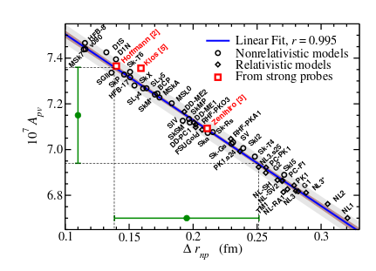
Neutron skin measured by APV
Robust correlation between ²⁰⁸Pb APV and the neutron skin over existing nuclear structure models
X. Roca-Maza (et al.) PRL 106 (2011) 252501
Apv in PVES provides a clean probe of the neutron distribution
PREX: APV to 3% from ²⁰⁸Pb
-> rn to 0.06 fm accuracy
CREX: APV to 2.5% from ⁴⁸Ca
-> rn to 0.02 fm accuracy
Robert Michaels, NuSYM2018
p8 / 22

Slide 9
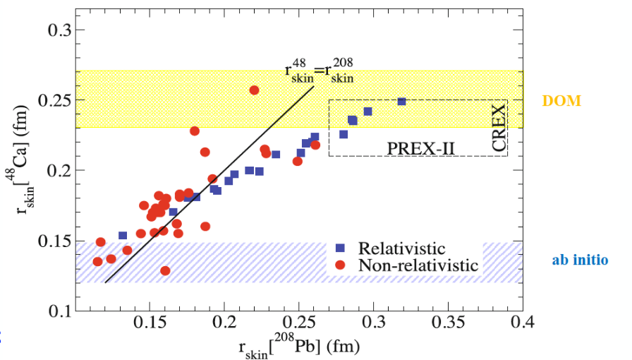
“Ab Initio” (exact microscopic) calculations of R_{skin} for ⁴⁸Ca have recently been published.
Can be compared to Density Functional Theory (the red and blue points) and Dispersive Optical Model (DOM)
W. Dickhoff, et al.
PRL 119, 222503 (2017)
Fattoyev, Piekarewicz
PRC 86, 015802 (2012)
G. Hagen, et al.
Nature 12, 186 (2015)

Slide 10
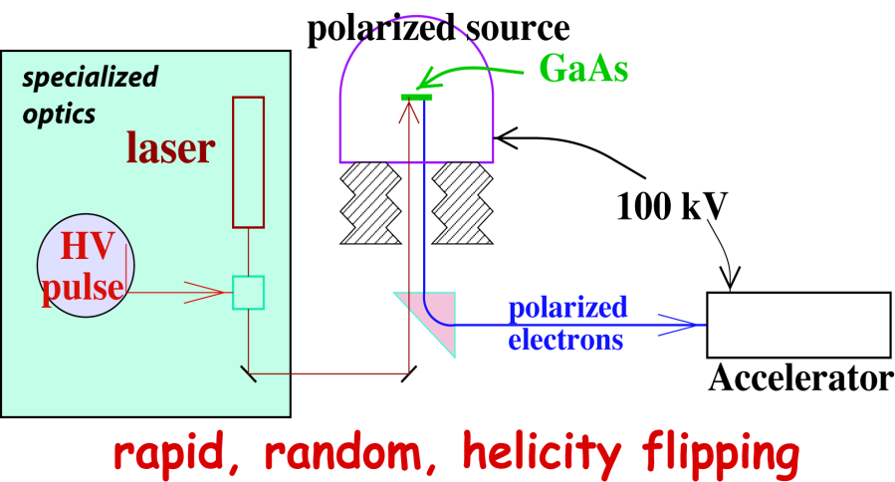
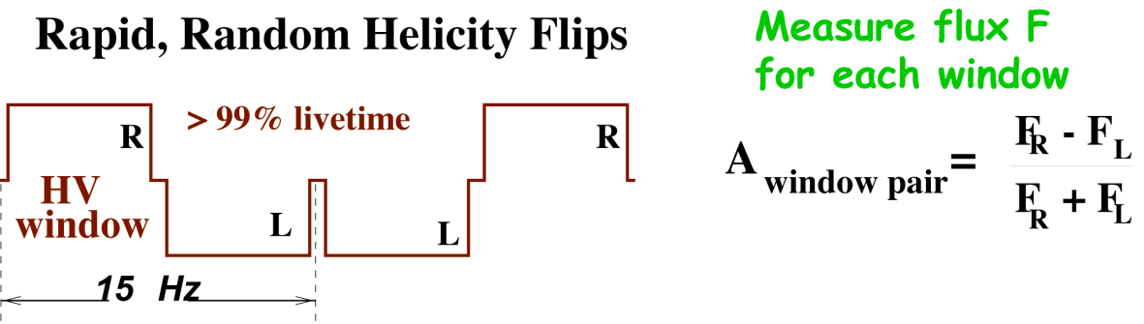
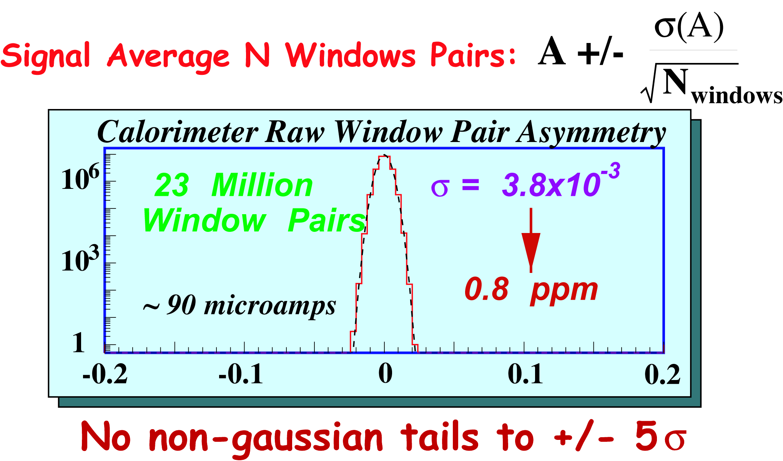
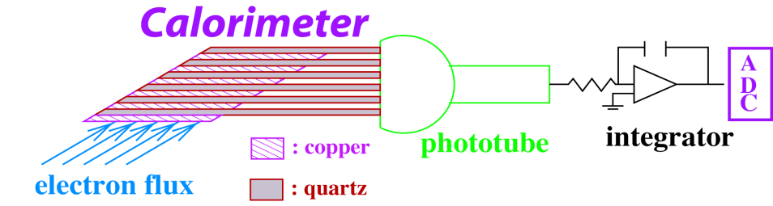
Parity Experiment Method
(integrating mode)
Flux Integration Technique:
C-REX : 140 MHz
PREX: 500 MHz
Example : HAPPEX
Robert Michaels, NuSYM2018

Slide 11
Parity Violating Asymmetry
2
+
A_{PV} from interference
²⁰⁸Pb
²⁰⁸Pb
Applications of A_{PV} at Jefferson Lab
Nucleon Structure
Test of Standard Model of Electroweak
Nuclear Structure (neutron density) : PREX
Strangeness s s in proton (HAPPEX, G0 expts)
e – e (MOLLER) or e – q (PVDIS)
elastic e – p at low Q² (QWEAK)
& CREX
Robert Michaels, NuSYM2018
p 11 / 22

Slide 12
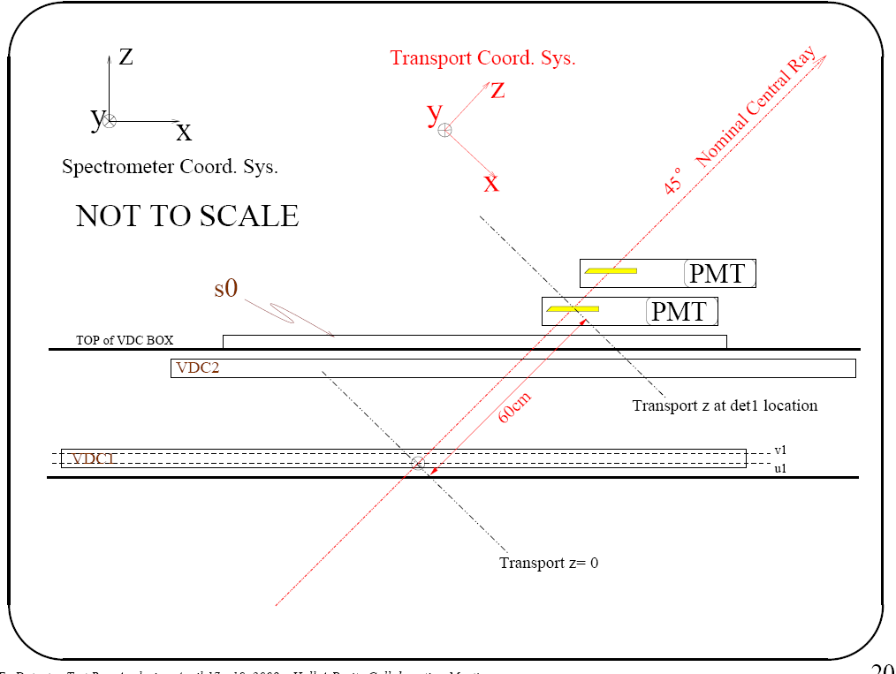
Hall A High Resolution Spectrometers
Resolve Elastic Scattering
Discriminate Excited States
Elastic
detector
Inelastic
PREX 1.0 GeV 5⁰
CREX 2.0 GeV 5⁰
Quad
target
Quartz
detectors
Dipole
Quads
scintillator
Drift chambers
Robert Michaels, NuSYM2018
p 12 / 22

Slide 13
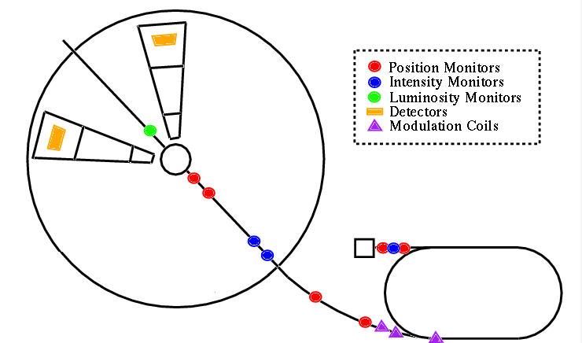
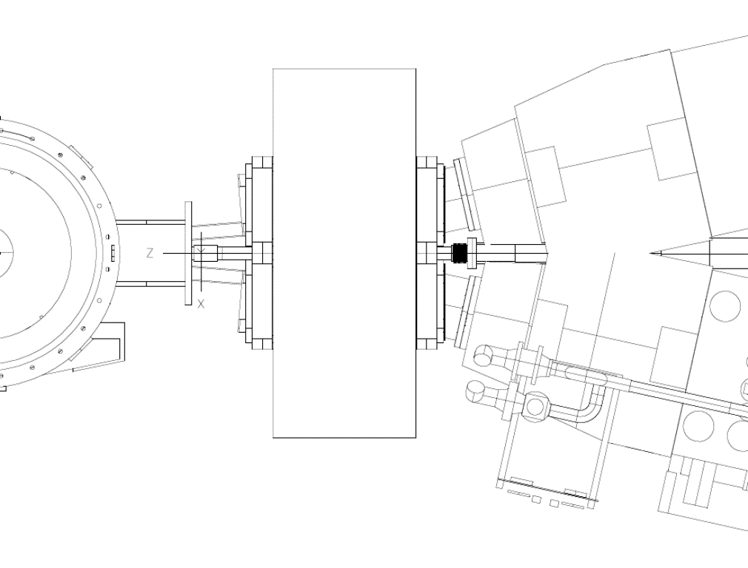
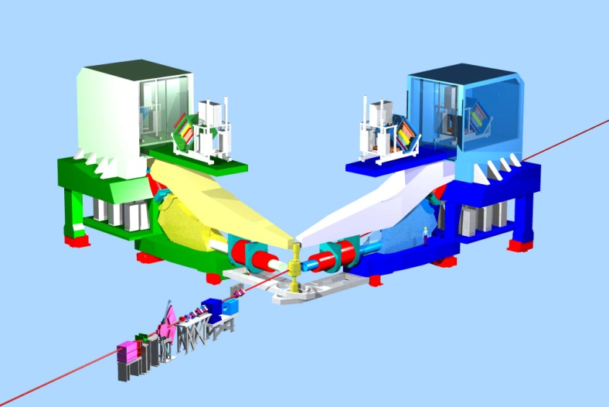
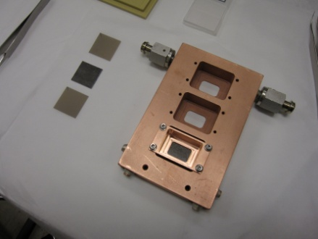
PREX-I
Results
PRL 108 (2012) 112502
HRS + septum
Physics Asymmetry
Pb target
Hall A
JLAB
Pol. Source
Statistics limited ( 9% )
Systematic error goal achieved ! (2%)
CEBAF
HRS
Septum Magnet
Pb target
5⁰
13 / 22

Slide 14
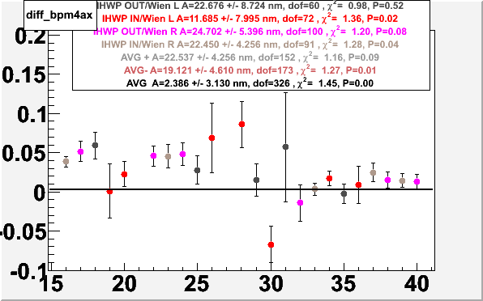
Parity Quality Beam : Unique Strength of JLab
Helicity – Correlated Position Differences
Plotted below
A_{raw} = A_{det} - A_{Q} + α Δ_{E}+ Σβ_{i} Δx_{i}
Points: Not sign-corrected. 20-50 nm diffs. with pol. source setup & feedback
Measured separately
Sign flips using ½ wave plate & Wien filter ++ -+ +- --
This BPM, Average = 2.4 3.1 nm
Sign flips provide further suppression : Average with signs = what experiment feels
achieved
< 5 nm
Units: microns
PREX data
Slug # ( ~ 1 day)
Robert Michaels, NuSYM2018
14 / 22

Slide 15
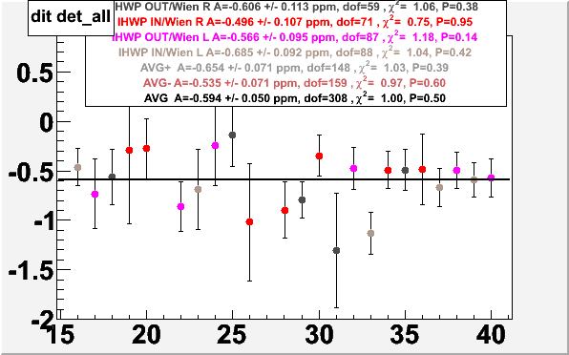
PREX-I Asymmetry (P_{e} x A)
A
(ppm)
Slug # ( ~ 1 day)
Robert Michaels, NuSYM2018
15 / 22

Slide 16
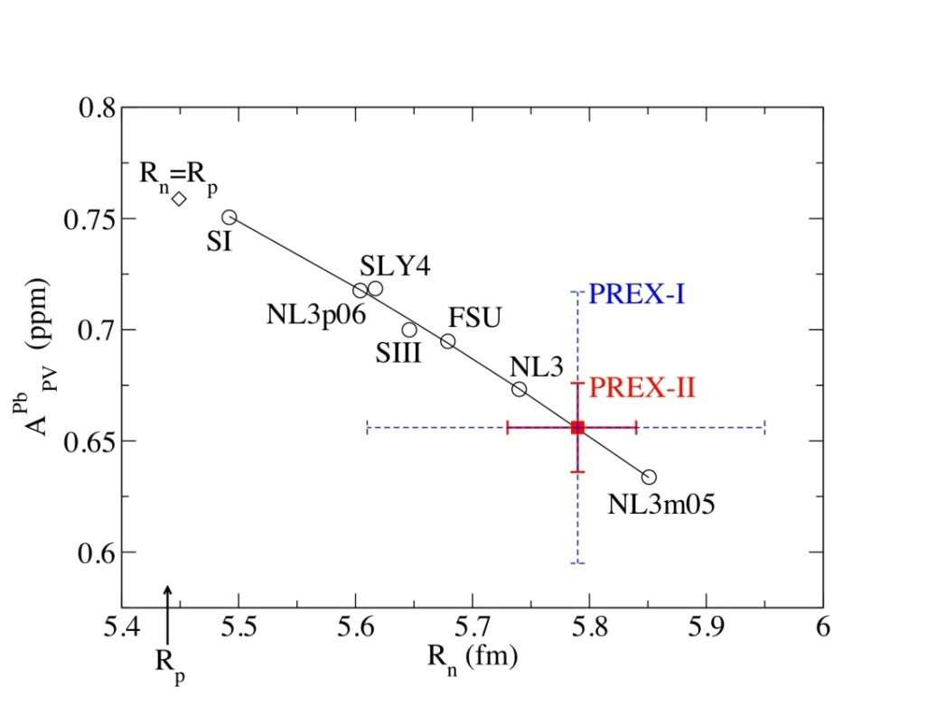
Asymmetry leads to R_{N}
PREX-I has established a neutron skin
at ~95 % CL
Neutron Skin = R_{N} - R_{P} = 0.33 + 0.16 - 0.18 fm
PRL 108 (2012) 112502
Robert Michaels, NuSYM2018

Slide 17

PREX-II and C-REX
Experiments approved
PREX-II A rating 35 days
C-REX A- rating 45 days
Systematic Error Goals for PREX-II demonstrated by PREX-I
Scheduled to run in 2019
Status
Improve the shielding and vacuum seals
spectrometers
targets
²⁰⁸Pb
⁴⁸Ca
Robert Michaels, NuSYM2018
p 17 / 22

Slide 18
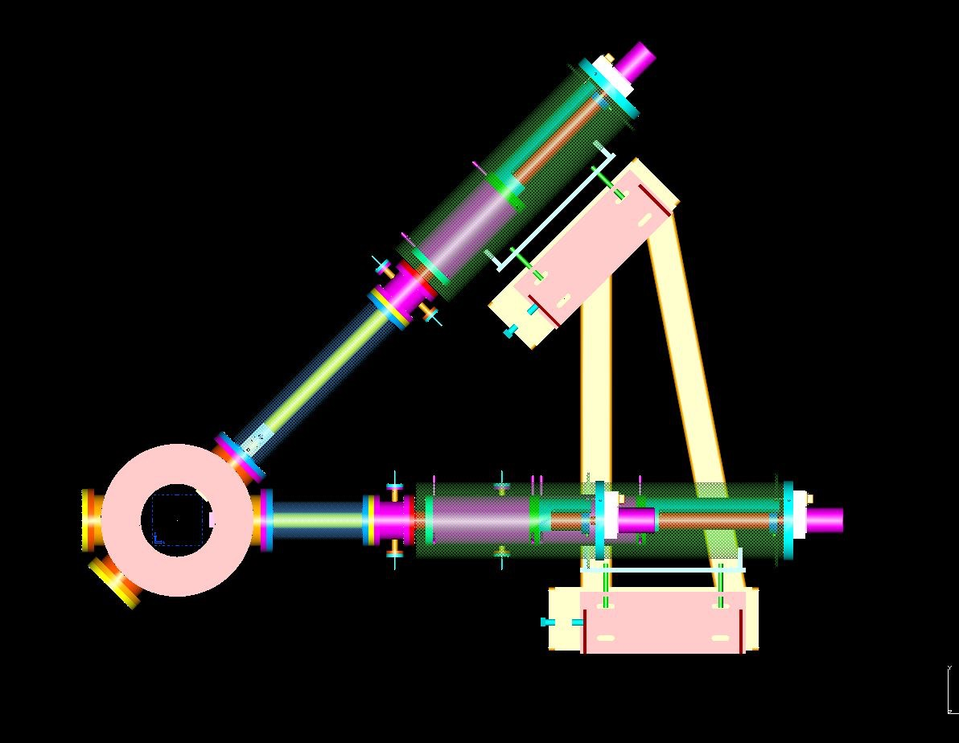
New PREX / CREX Scattering Chamber
One cryo-cooled production target ladder and one calibration-target ladder.
Improved (hard) vacuum seals
Run PREX and CREX with one installation
Small chamber allows efficient shielding
Beam
Septum magnet
Collimator Box
Scattering Chamber
Beam
Robert Michaels, NuSYM2018
18 / 21

Slide 19
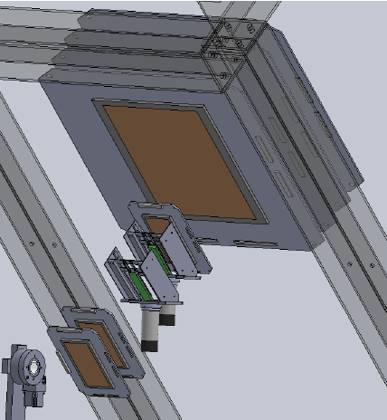
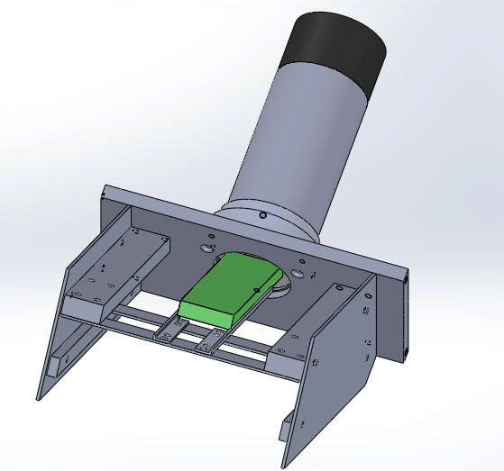
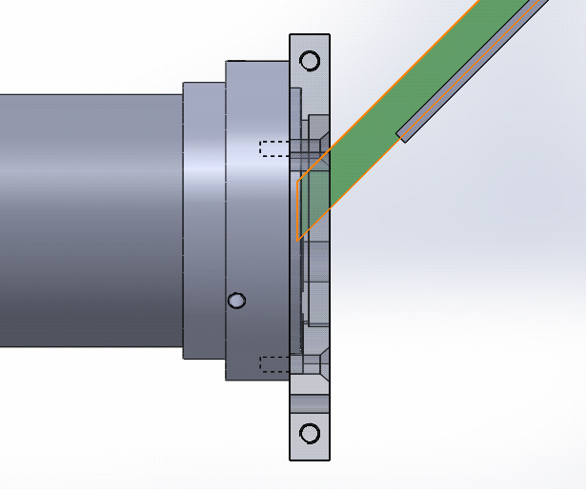
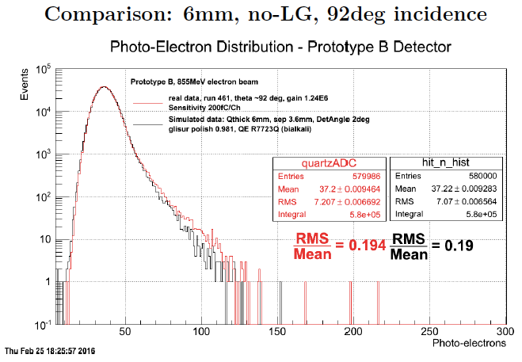

Detectors Developments
GEMs
Cherenkov radiation from electrons traversing thin quartz.
Simulation and data benchmarked quartz properties
Also, GEMs for high-rate tracking
PMT
2 Quartz detectors
Quartz detector
e⁻
Electrons in HRS
Tested at Idaho and Stony Brook
Beam tests at Mainz
RMS/Mean ~ 19%

Slide 20
PREX / CREX Experiments
PREX-2: 3% stat, 0.06 fm
CREX: 2.4% stat, 0.02fm
PREX-I
E=1.1 GeV, 5º
A=0.6 ppm
PREX-II
E=1.1 GeV, 5º
A=0.6 ppm
70 μA, 25+10 days
CREX
E=1.9 GeV, 5º
A = 2.3 ppm
150 μA, 35 + 10 days
Charge Normalization | 0.2%
Beam Asymmetries | 1.1%
Detector Non-linearity | 1.2%
Transverse Asym | 0.2%
Polarization | 1.3%
Target Backing | 0.4%
Inelastic Contribution | <0.1%
Effective Q² | 0.5%
Total Systematic | 2.1%
Total Statistical | 9%
Charge Normalization | 0.1%
Beam Asymmetries* | 1.1%
Detector Non-linearity* | 1.0%
Transverse Asym | 0.2%
Polarization* | 1.1%
Target Backing | 0.4%
Inelastic Contribution | <0.1%
Effective Q² | 0.4%
Total Systematic | 2%
Total Statistical | 3%
Charge Normalization | 0.1%
Beam Asymmetries | 0.3%
Detector Non-linearity | 0.3%
Transverse Asym | 0.1%
Polarization | 0.8%
Target Contamination | 0.2%
Inelastic Contribution | 0.2%
Effective Q² | 0.8%
Total Systematic | 1.2%
Total Statistical | 2.4%
Achieved, published
*Experience suggests that leading systematic errors can be improved beyond proposal
statistics limited result, systematics well under control

Slide 21
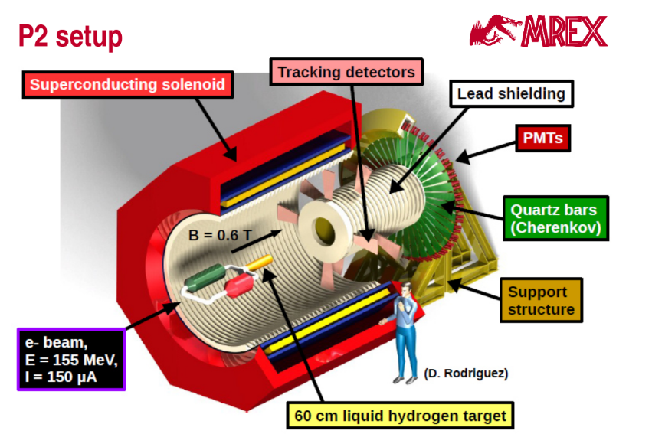
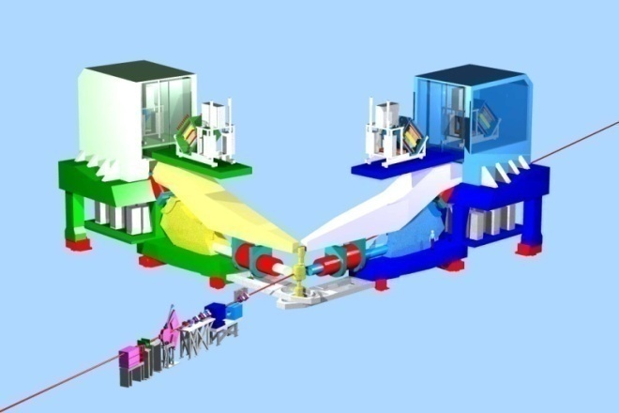
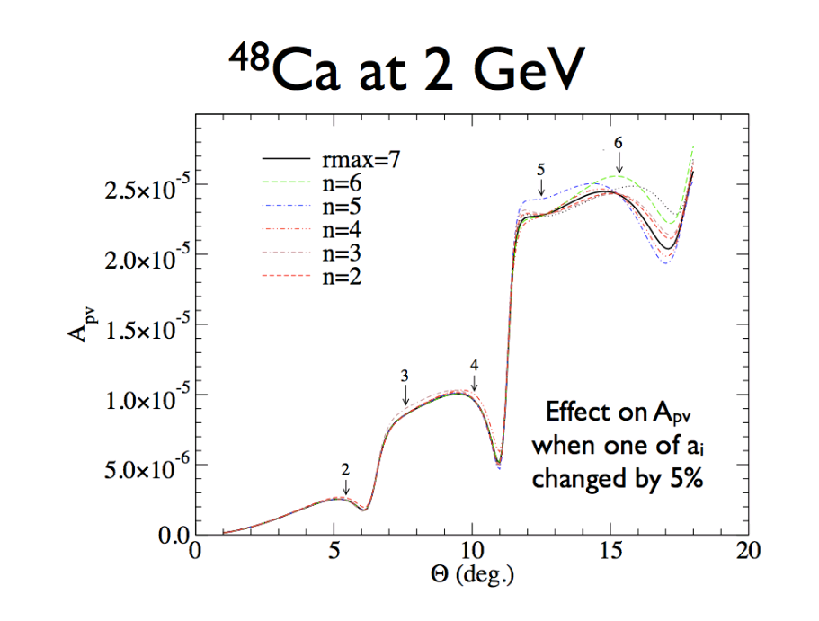
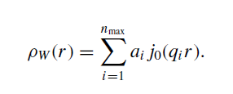
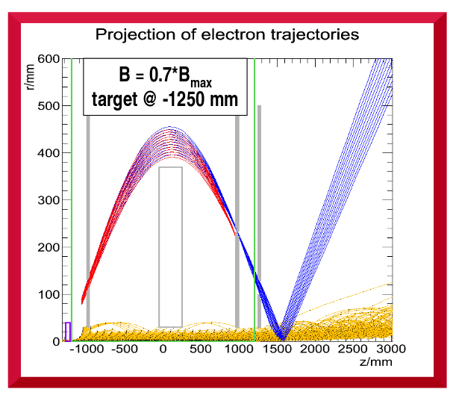

Future
Weak Charge Scan ?
Electron Scattering
lower Q² at Mainz
higher Q² at JLab
Focusing Solenoid
M. Thiel, D. Becker, P. Souder
Z. Lin, S. Ban, C.J. Horowitz
J. Phys. G39 014104 2012 ; PRC C92, 014313 2015
p 20 / 21

Slide 22
PREX, C-REX : Summary
Fundamental Nuclear Physics with many applications
PREX-I : 9% stat. error in Asymmetry Goals: PREX-II 3 % 0.06 fm , C-REX 2.4% 0.02 fm
Systematic Error Goals Achieved
Apparatus is under construction.
Scheduled to run in 2019
Robert Michaels, NuSYM2018
http://hallaweb.jlab.org/parity/prex

