Slide 1
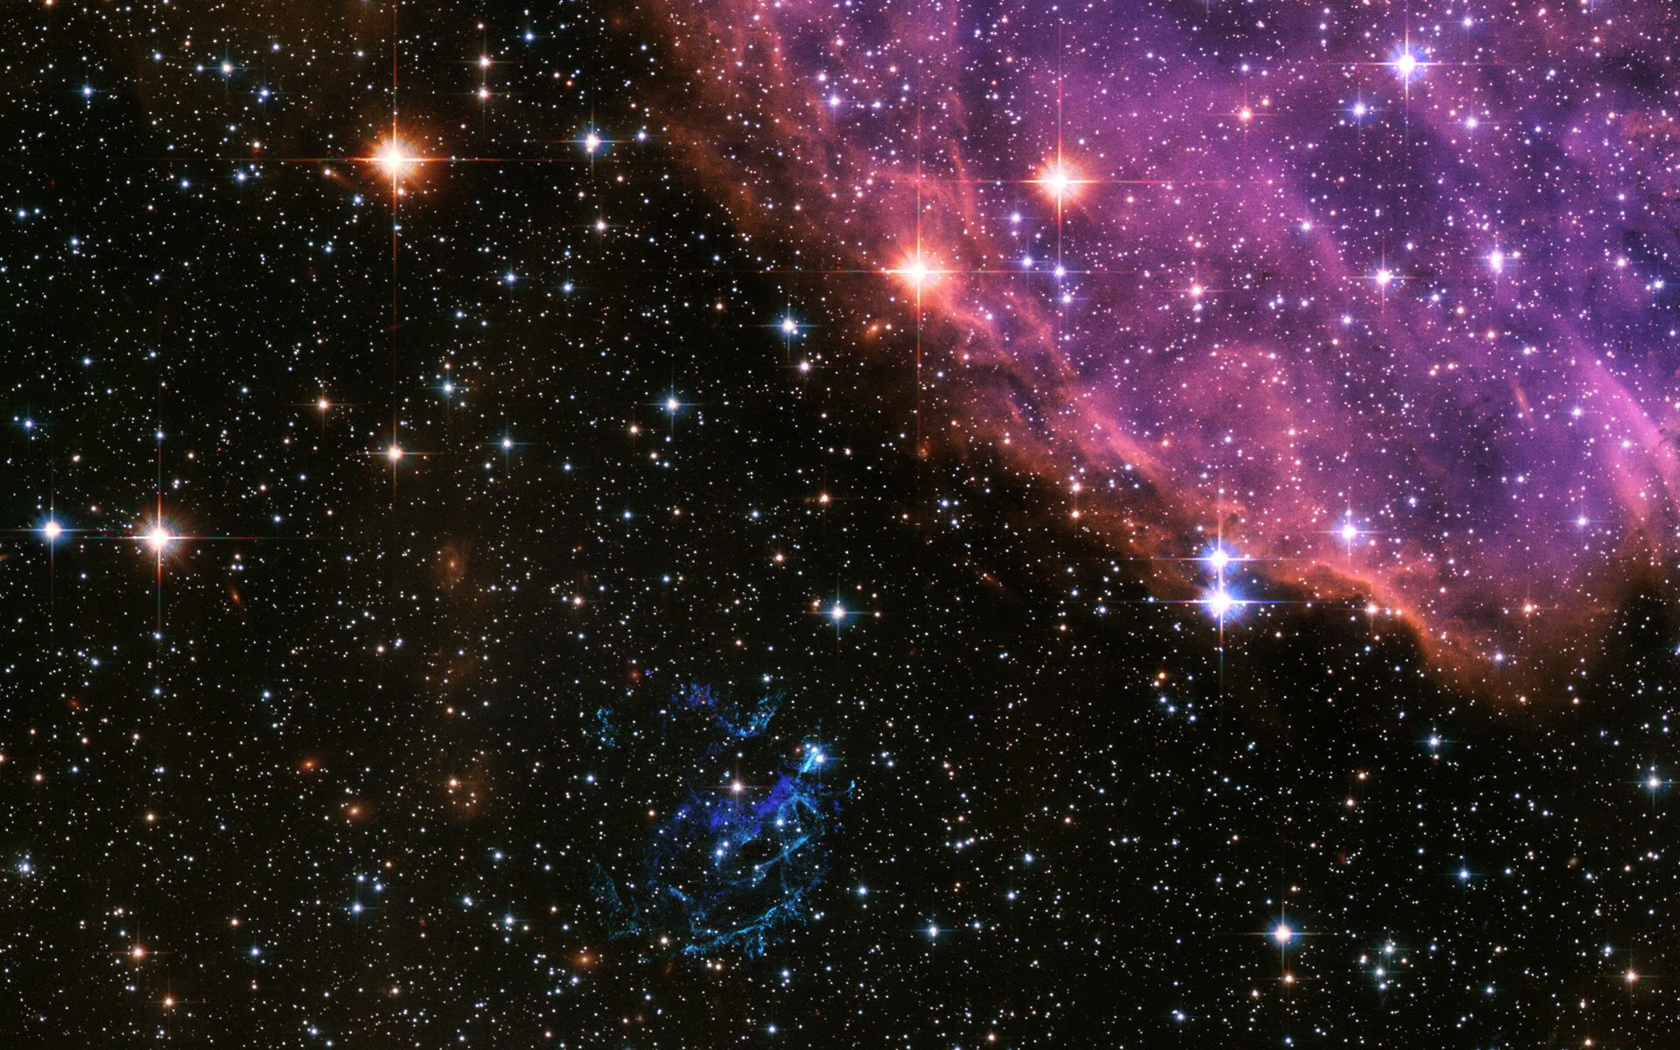
NuSYM2018@Korea
Several aspects on probing the high-density symmetry energy by HI collisions
Gao-Chan Yong
Institute of Modern Physics, Chinese Academy of Sciences
2018/9/11/14:00

Slide 2
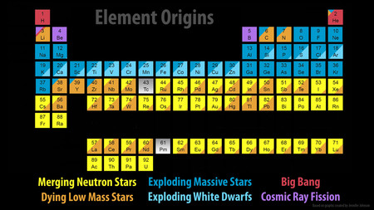
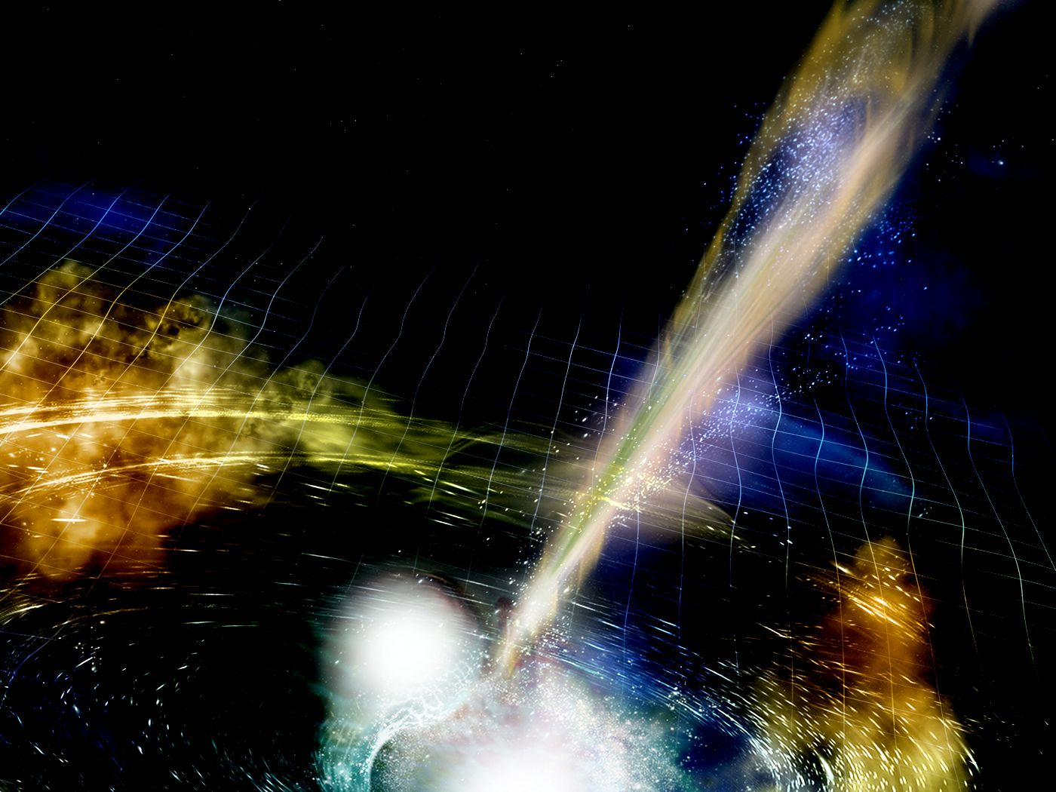
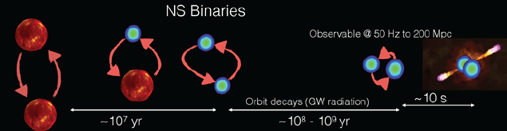
GW170817
Analogous to 2 neutron-rich
giant nuclei collide driven by gravitational force
GRB
EOS
Heavy elements production
GW

Slide 3
Equation of Sate of nuclear matter
N=Z
N-rich
Symmetry
energy
Constraints at high densities have been extracted
poorly known especially at high densities
more data
Less data
B.A. Li , L.W. Chen, Che Ming Ko, Phys. Rep. 464, 113 (2008).
W.G. Lynch, et al., arXiv: 090.0412, [nucl-ex]
P. Danielewicz, R. Lacey, W.G. Lynch, Science 298 (2002) 1592

Slide 4
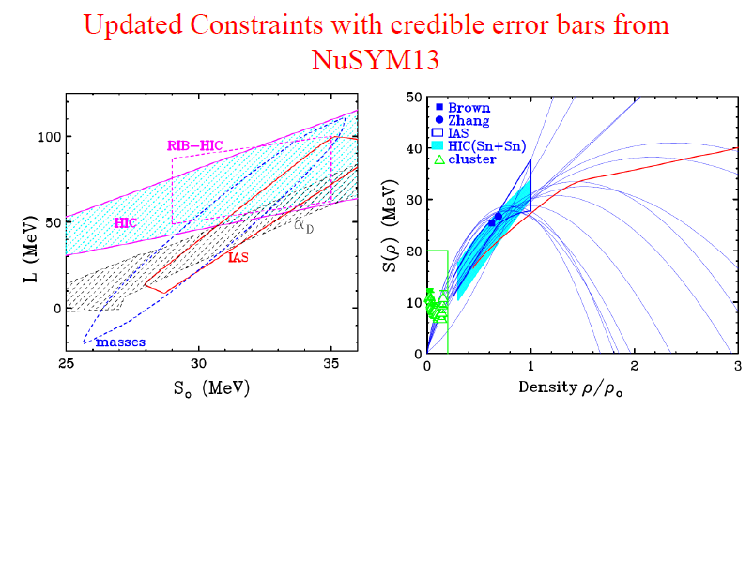

Current status of symmetry energy
???
Pion ratio
Low-density
effect
20 years---？
2010-2030---年
studied
20 years
???
???
clusterization
Short-range
correlations
kinetic esym
C. J. Horowitz, et al., J. Phys. G: Nucl. Part. Phys. 41 (2014) 093001

Slide 5

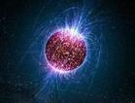
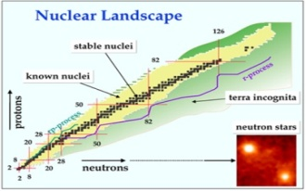
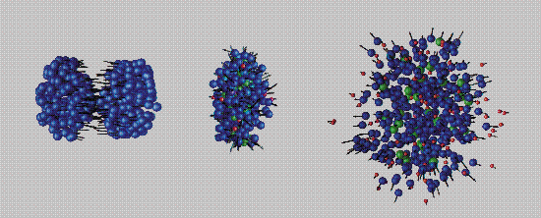
Pursuing at worldwide Facilities
世界范围重离子加装置上的角逐
Neutron star matter produced on earth:
N-rich nuclei
HIC at medium energies
NS matter

Slide 6
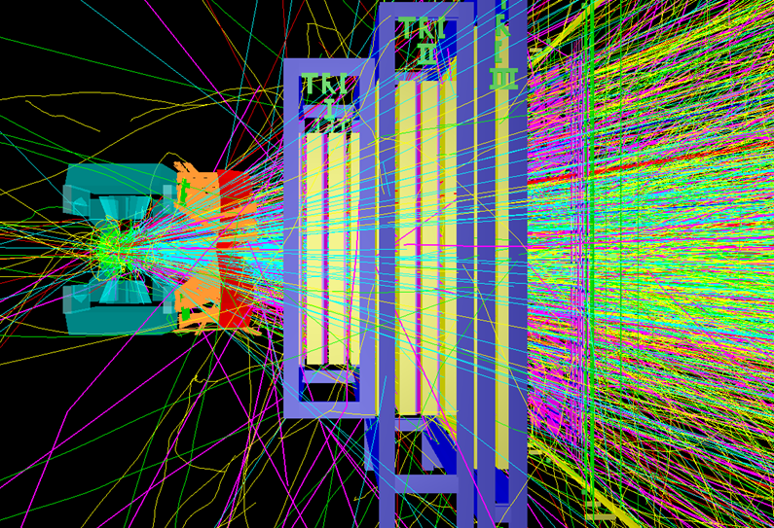
Simulations are
very necessary!

Slide 7
Equation of Sate of nuclear matter
N=Z
N-rich
~ 0.2
Symmetry
energy
In HIC, ~10%!
Constraints at high densities have been extracted
more data
Less data
B.A. Li , L.W. Chen, Che Ming Ko, Phys. Rep. 464, 113 (2008).
W.G. Lynch, et al., arXiv: 090.0412, [nucl-ex]
P. Danielewicz, R. Lacey, W.G. Lynch, Science 298 (2002) 1592

Slide 8
Model
dependence
Qualitative
probe
Short-range correlation
High-density
Symmetry energy
Sensitive
probe
Density region
Cross constraints

Slide 9
Model
dependence
Qualitative
probe
Short-range correlation
High-density
Symmetry energy
Sensitive
probe
Density region
Cross constraints

Slide 10
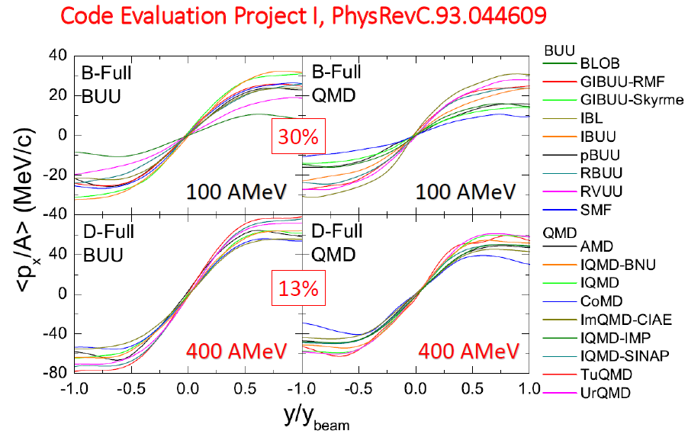
BUU / QMD framework dependence
for iso-independent observable

Slide 11
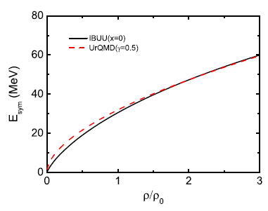
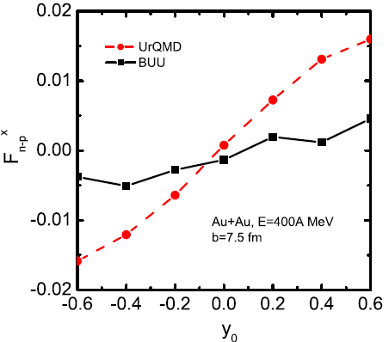
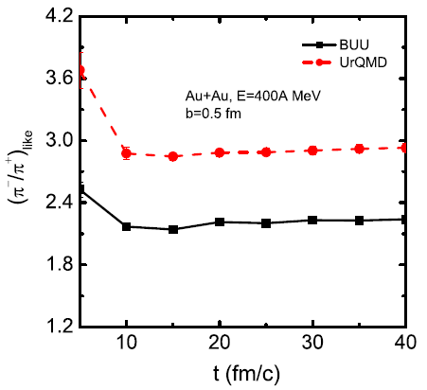
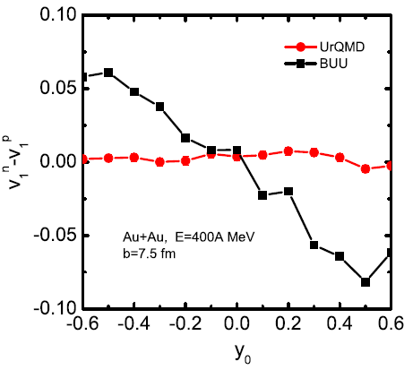
BUU / QMD framework dependence
for iso-dependent observables
UrQMD
IBUU
UrQMD
IBUU
UrQMD
UrQMD
IBUU
IBUU
Guo et al., Physics Letters B 726 (2013) 211

Slide 12
Model
dependence
Qualitative
probe
Short-range correlation
High-density
Symmetry energy
Sensitive
probe
Density region
Cross constraints

Slide 13
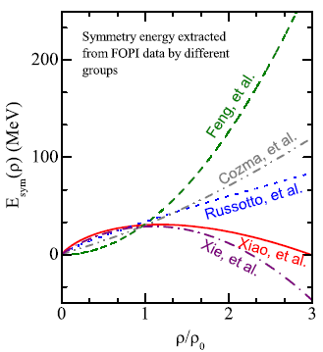
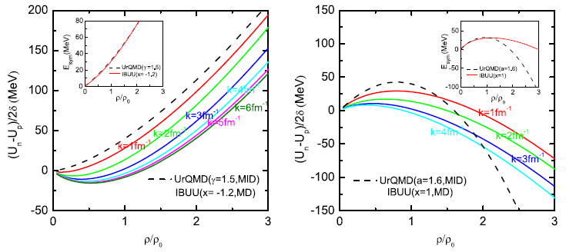
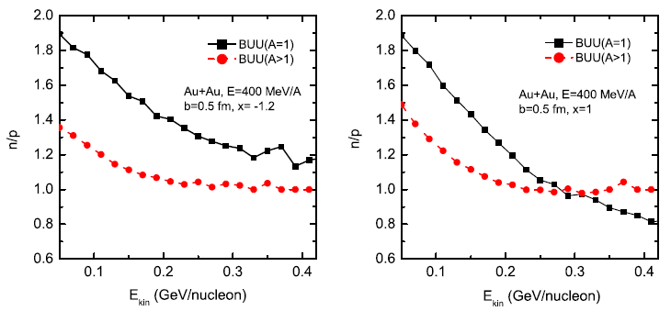
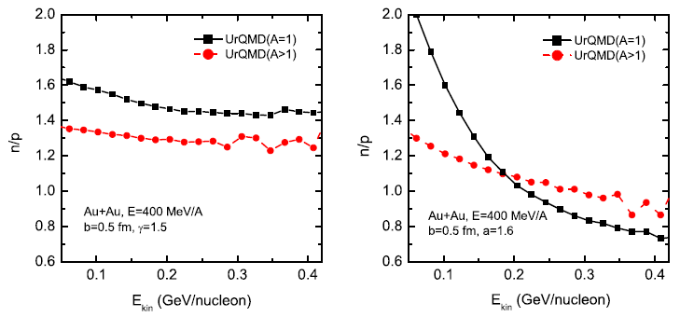
A qualitative probe from BUU+QMD models?
First-step:
qualitative
Judgment?
gas
gas
liquid
liquid
liquid
liquid
gas
gas
IBUU/stiff-Esym
IBUU/soft-Esym
UrQMD/stiff-Esym
UrQMD/soft-Esym
Guo et al., Physics Letters B 738 (2014) 397

Slide 14
Model
dependence
Qualitative
probe
Short-range correlation
High-density
Symmetry energy
Sensitive
probe
Density region
Cross constraints

Slide 15
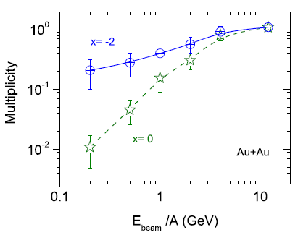

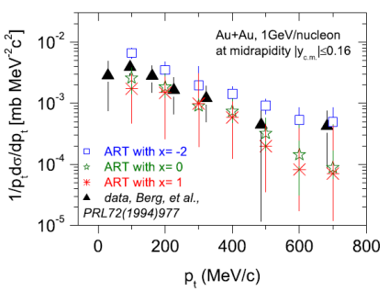
A sensitive probe from ART(BUU) model?
Stiff
？
eta:
Hidden strangeness
Soft
data comparison
Yong and Li, Physics Letters B 723 (2013) 388

Slide 16
Model
dependence
Qualitative
probe
Short-range correlation
High-density
Symmetry energy
Sensitive
probe
Density region
Cross constraints

Slide 17
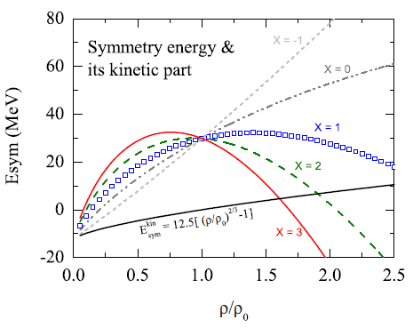
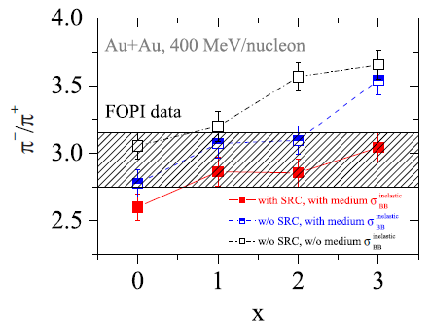
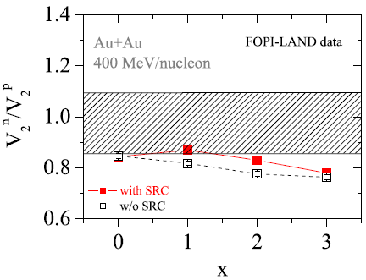
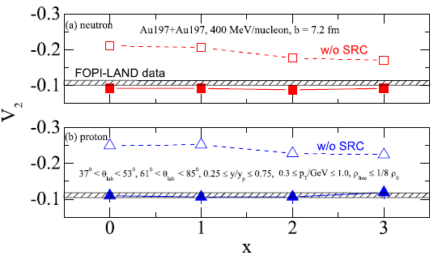
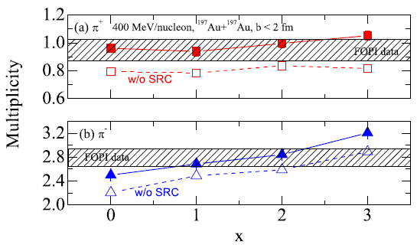
Many-observable constraints from the same model
n
pion+
p
pion-
Yong, Physical Review C 93, 044610 (2016)

Slide 18
Model
dependence
Qualitative
probe
Short-range correlation
High-density
Symmetry energy
Sensitive
probe
Density region
Cross constraints

Slide 19
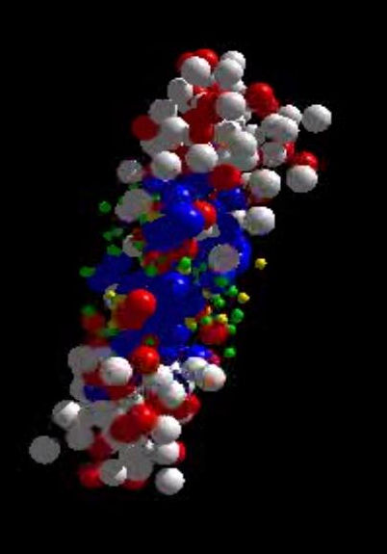
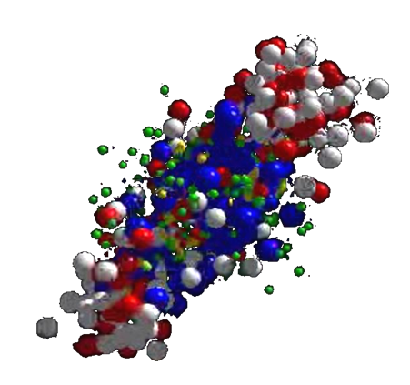
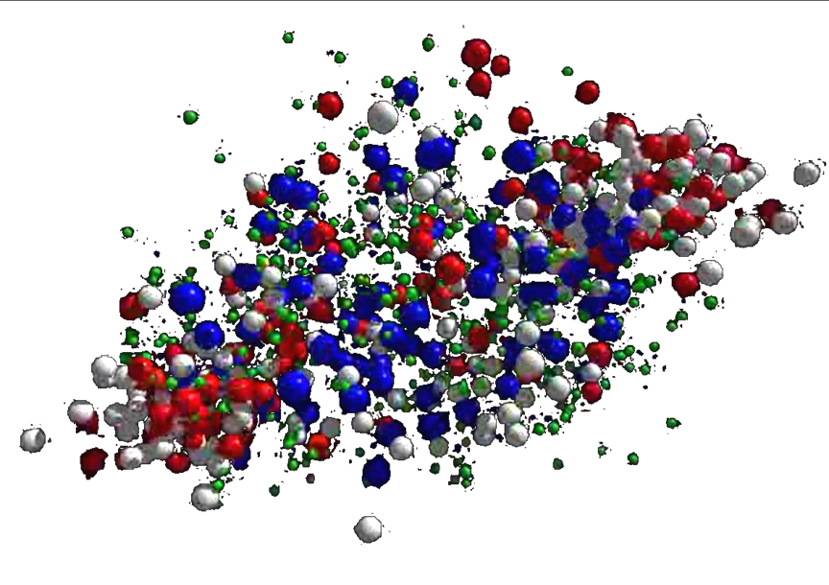
Final paricles, such as pion,
go through high and low density regions

Slide 20
To determine the density-region of nuclear symmetry energy probed by observables in HICs
Method I:
Method II:
We can do in this way because
the isovector part is overall much small than the isoscalar part.

Slide 21
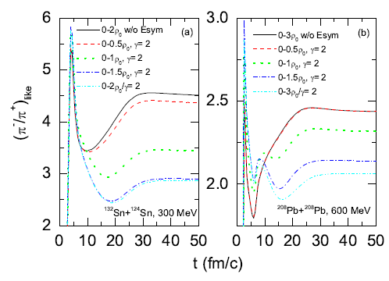
Pion probes high-density symmetry energy should
use high-energy Heavy-Ion C?
Low-density
effect
Low-density
effect
High-density
effect
High-density
effect
Yong et al., arXiv:1704.05166

Slide 22
Model
dependence
Qualitative
probe
Short-range correlation
High-density
Symmetry energy
Sensitive
probe
Density region
Cross constraints

Slide 23
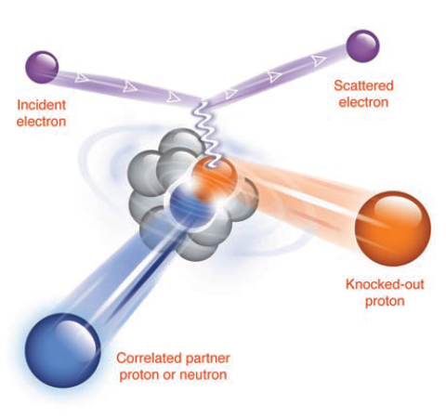
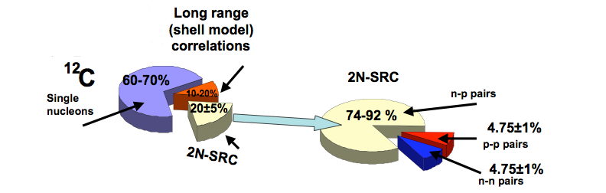
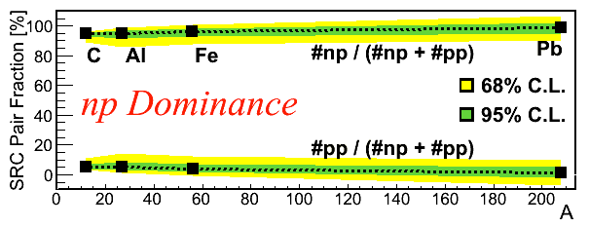
Nucleon-nucleon Short-range-Correlations
Jlab
R. Subedi et al., Science 320, 1476 (2008).
O. Hen et al., Science 346, 614 (2014).

Slide 24
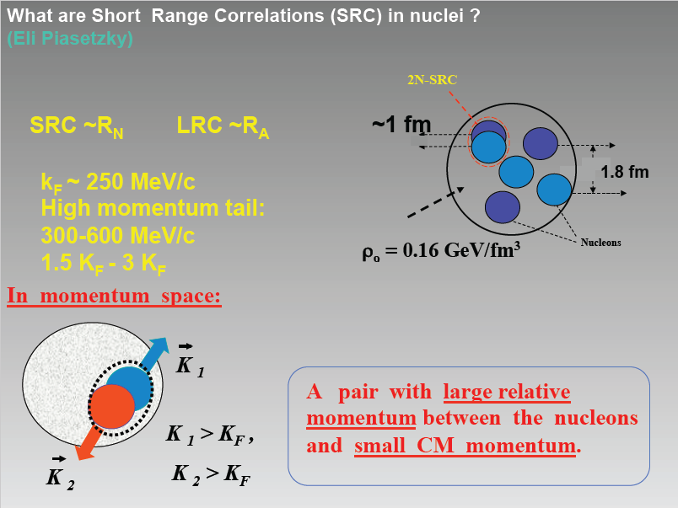

Slide 25
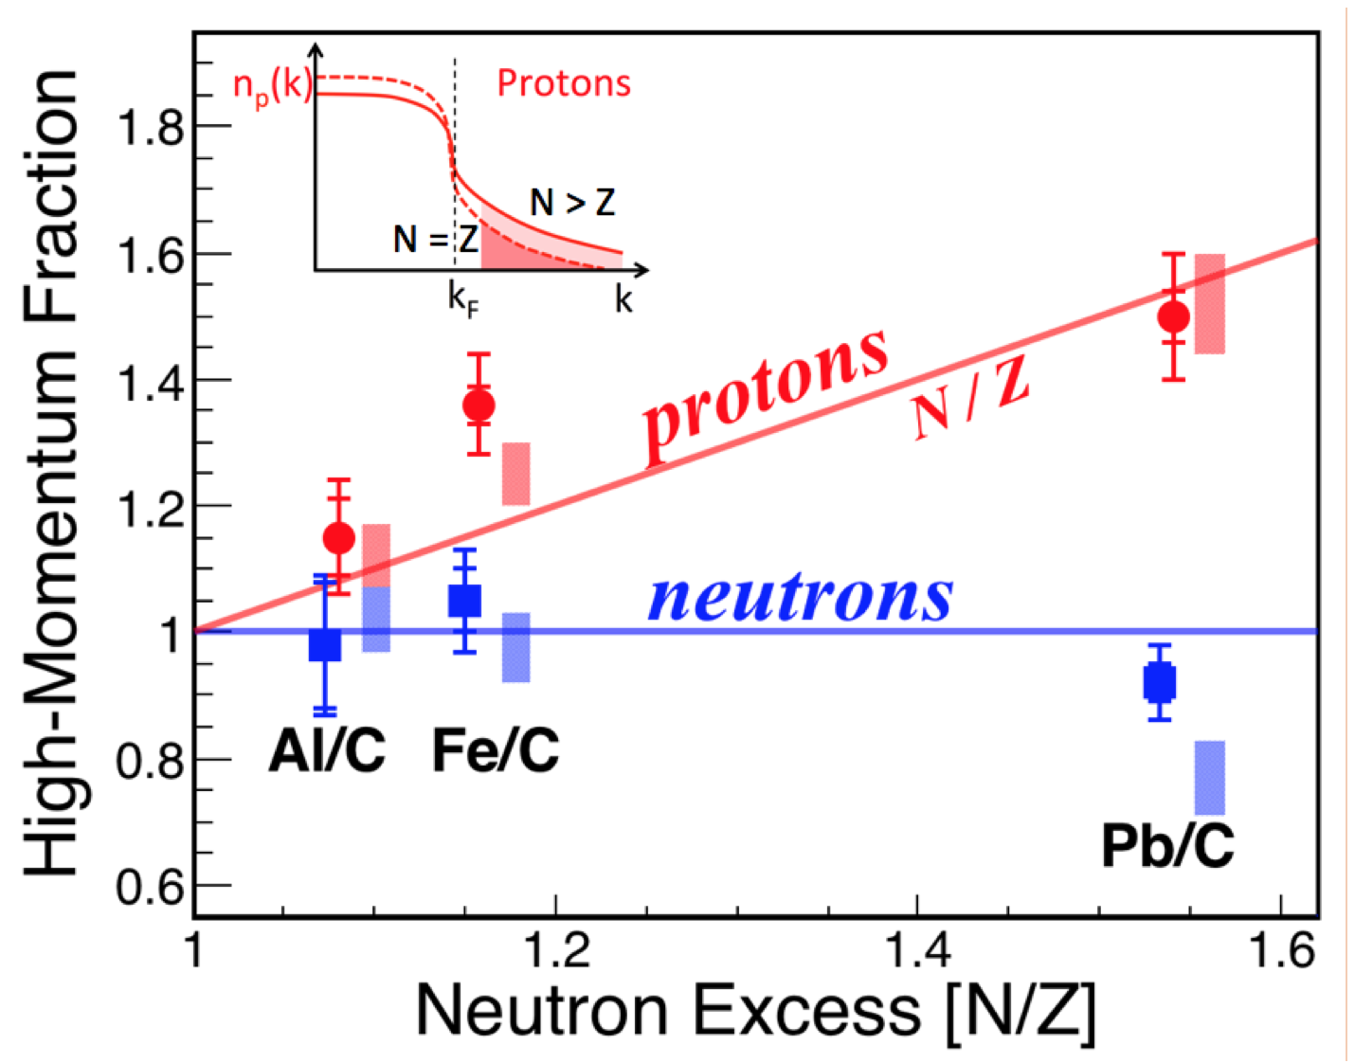
n-p
dominance
The CLAS Collaboration,
Nature 560, 617–621 (2018)

Slide 26
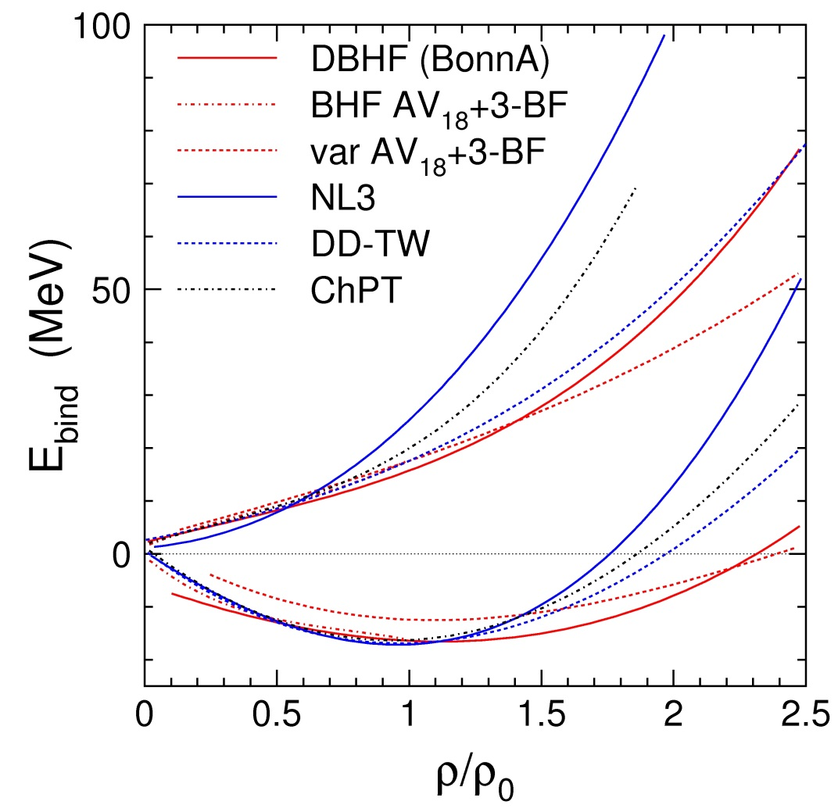
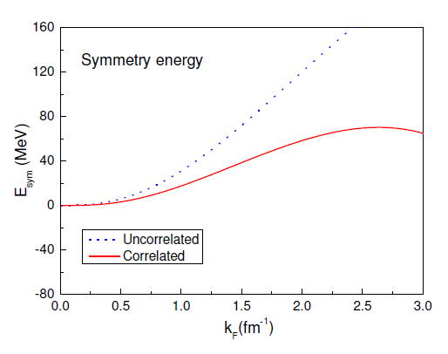
How SRC affect symmetry energy
Fuchs and Wolter, EPJA 30 (2006)
n
p
Neutron matter
n-p SRC:
En-Ep Esym
δ = 1
Symmetric matter
SRC
E_{sym}
δ = 0
The Esym is decided by
the difference of En and Ep
Xu and Li, arXiv:1104.2075

Slide 27
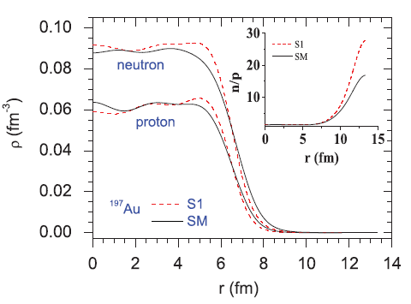
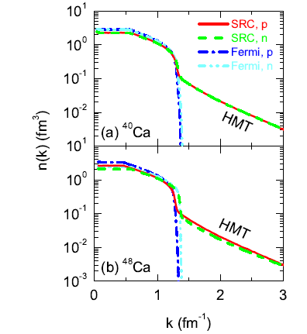
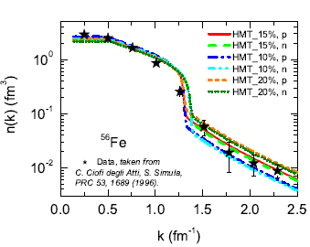
(1) Initialization:
Nucleons in coordinates, RMF, SHF
(2) Momentum-space: localThomas-Fermi
Yong and Li, PRC96, 064614(2017).

Slide 28
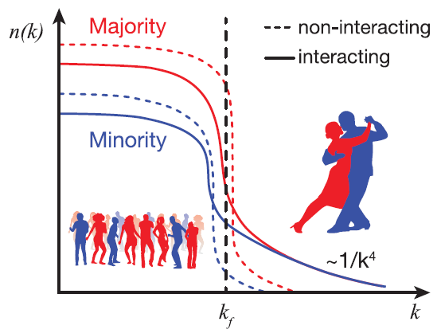
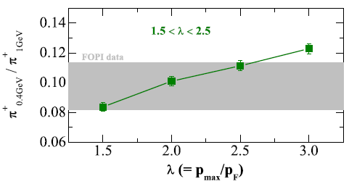
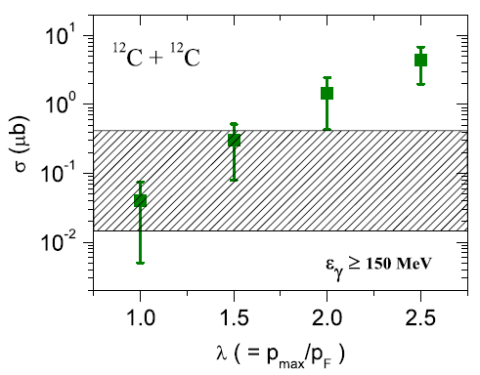
Constrain nucleon move from HIC
O. Hen et al., Science 346, 614 (2014).
In nuclei：
How fast nucleon moves？
Yong, Physics Letters B 765 (2017) 104

Slide 29
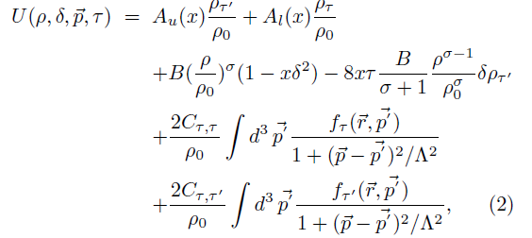
(2) Mean-field:
~1.0 fm
1.7 fm
Yong,PRC93,044610 (2016)
ρ₀ = 0.16 fm⁻³
Considering n-p correlations:
The parameters A, B, C, et al., are re-adjusted

Slide 30
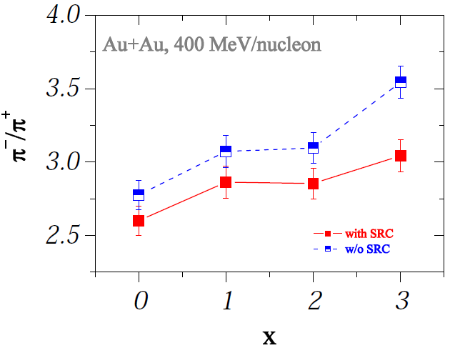
SRC effects on pion ratio in HIC-1
stiff
soft
Yong, Phys. Rev. C 93, 044610 (2016)

Slide 31


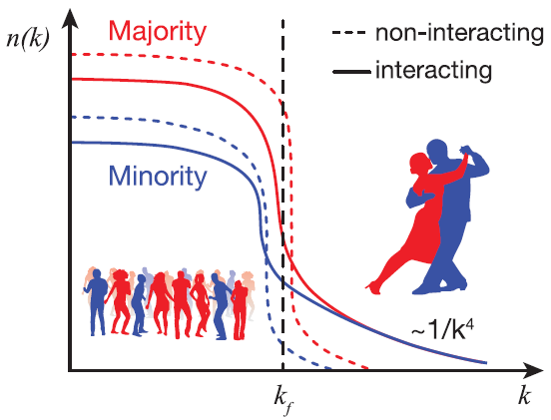
Neutron-rich matter:
A)
B)
Transition momentum

Slide 32
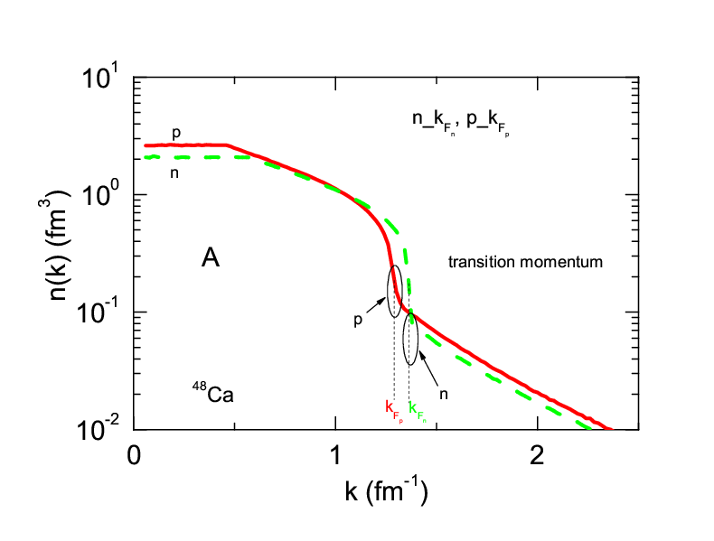
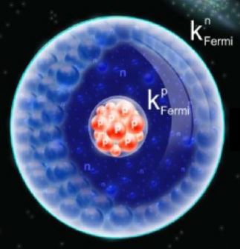
Neutron-star matter
k_proton: small
Transition mom. = Respective Fermi mom.

Slide 33
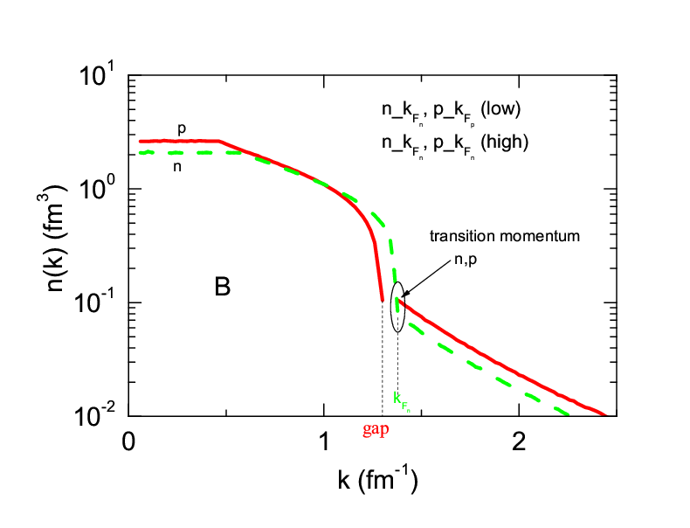
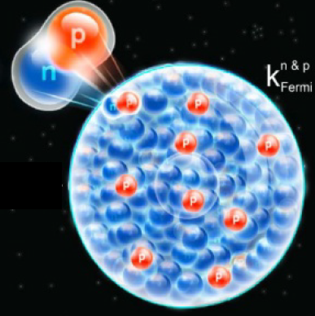
Neutron-star matter
k_proton: large
Minority transition mom.
= majority transition mom.

Slide 34
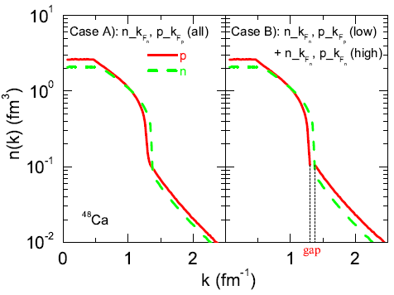
Which one is correct?
A
B
Momentum
Jump!

Slide 35

On Nucleon kinetic energy
Proton fraction in matter
Neutron-rich
More neutron-rich
no jump
jump

Slide 36

SRC effects on pion ratio in HIC-2
Yong
PLB776 (2018) 447
no jump
jump

Slide 37
More about model dependence
※Model is never equal to reality.
※It seems that in-medium effect of moving particles in HIC can never be figured out thoroughly.
※To reduce all kinds of uncertainties, more data are needed to let model fit, thus to improve reliability of model.
Information theory:
Uncertainty
Increase Information
Uncertainty reduction

Slide 38

e.g., needing data from 3~4 different asymmetric systems
benchmark
Isospin extention1
data2
data1
Isospin extention2
Isospin extention3
data3
data4
at least have 3 asymmetries including case

Slide 39

Summary & outlook
Neutron star mergers in heaven and the constructed/constructing rare-isotope facilities on earth set off a new upsurge to pursue the high-density symmetry energy.
Both are complicated (whether from heaven or earth).
To probe the high-density symmetry energy by HIC, the model dependence, qualitative probe, sensitive probe, probed density region, many-observable comparison and isospin-dependent SRC, etc., are meaningful.
Matching the results from heaven and earth (mutual recognition) is fascinating!!
high-density Symmetry Energy

Slide 40
Summary & outlook
Neutron star mergers in heaven and the constructed/constructing rare-isotope facilities on earth set off a new upsurge to pursue the high-density symmetry energy.
Both are complicated (whether from heaven or earth).
To probe the high-density symmetry energy by HIC, the model dependence, qualitative probe, sensitive probe, probed density region, many-observable comparison and isospin-dependent SRC, etc., are meaningful.
Matching the results from heaven and earth (mutual recognition) is fascinating!!
Thanks for your attention！

