Slide 1
Uncanny Workings of Nuclear Tensor Force
From Asymmetric Nuclei to Compact Stars
Mannque Rho
Busan 2018

Slide 2
Where does the nucleon mass come from?
Dong-Pil Min’s Dream→ “Brain Child”: IBS
My Dream

Slide 3
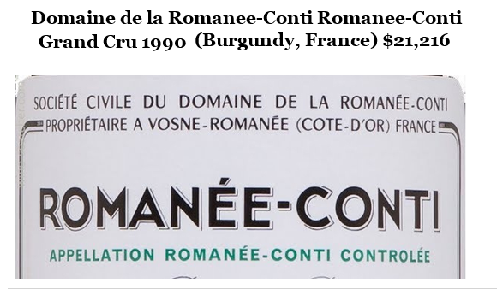
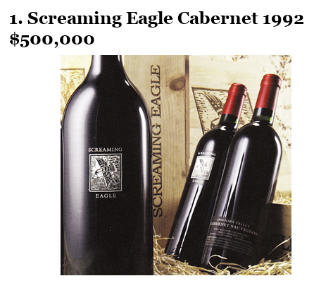
~ $ 5000/per glass

Slide 4
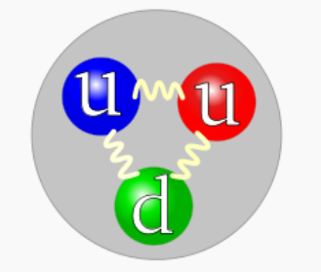
m_{u} ≈ 2.5 MeV, m_{d} ≈ 5.7 MeV from Higgs mechanism
Naïvely
M_{proton} =2m_{u} + m_{d} + “??” =10.7 MeV + “??”
cf. Nature ~ 1000 MeV
99% of the proton mass is missing!
So the quarks, the “apparent constituents” of the proton, fail miserably to account for the proton mass and also its spin!
Englert & Higgs 2013
EMC

Slide 5
Puzzling
“We find that ~ 90% of the proton (and neutron) mass,
and therefore ~ 90% of ordinary matter, emerges from an
idealized theory – QCDLite -- whose ingredients are
entirely massless.”
F, Wilczek 2012
A deep philosophical, not just physics, problem
of “Mass without Mass” and “Something for Nothing”

Slide 6
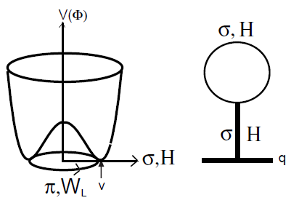
Nambu’s “Standard” Model for Nucleon Mass
Nambu-Jona-Lasinio Lagrangian
More recently
M. Schumacher 1807.10798
QCD analog of Higgs is

Slide 7
Nambu’s Nobel Prize Scenario
Constituent quark Q: Mass m_{Q} is generated almost completely by
Nambu mechanism of spontaneously broken chiral symmetry:
Works very well for hadrons at low energy (e.g., electroweak properties …)
In nuclear matter at high density as the quark condensate goes to zero,
the proton mass must go to zero, as chiral symmetry is restored.
This scenario is in tension with what
must be happening at high density!

Slide 8
This proton mass problem is a nuclear physics problem !

Slide 9
The crux of the matter:
Parity Doubling at high density leading to
Suggest: This may be related to the emergence of
“pseudo-conformal”symmetry in compact stars with
the conformal sound speed
Nuclear tensor force could hint at what’s happening.

Slide 10
Story of Tensor Forces
π, ρ
N
N

Slide 11
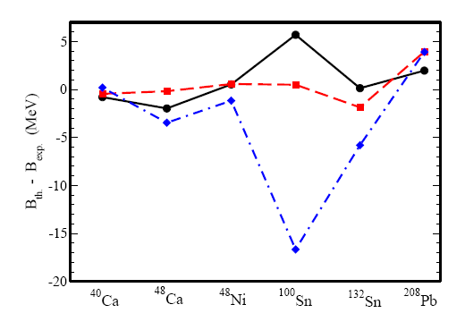
Tensor forces and nuclear BE
Lalazissis et al arXiV:0909.2364
No tensor force
Reduced tensor
force by ~ 1/2
Pion tensor force
And BPS skyrmion
model?

Slide 12
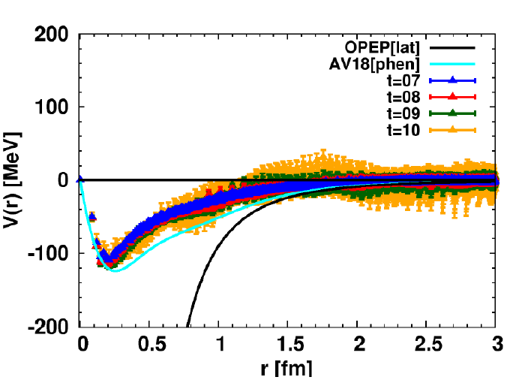
Lattice QCD

Slide 13
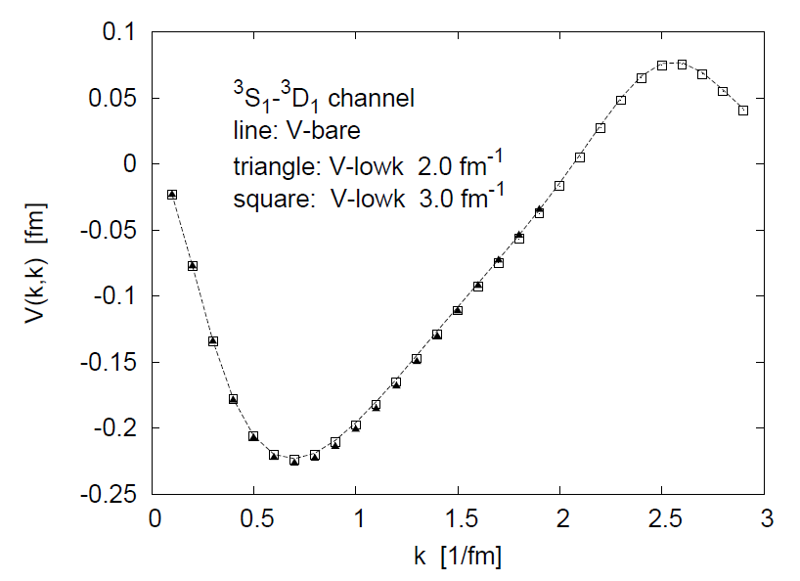
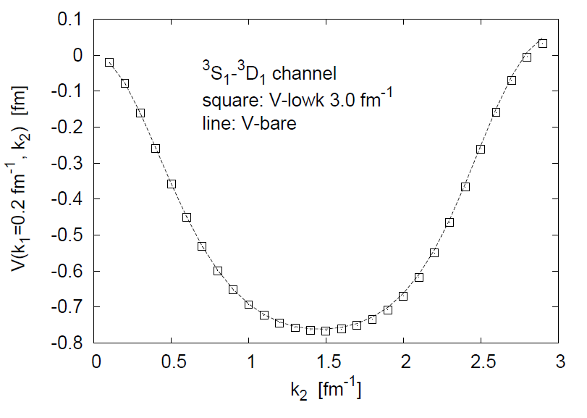
Tensor force is NOT (!) renormalized
in matter-free space (vacuum)
Courtesy of
Tom Kuo
Diagonal Off-diagonal

Slide 14
Tensor Force is NOT (!!)(?) Renormalized
either
by Nuclear Correlations
T. Otsuka 05
Single-particle level evolution in exotic nuclei
“Monopole” matrix element:
Evolution of single-particle energy:
Tensor force contribution can be cleanly singled out

Slide 15
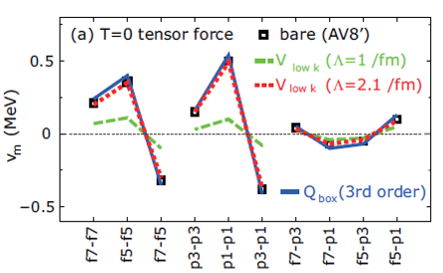
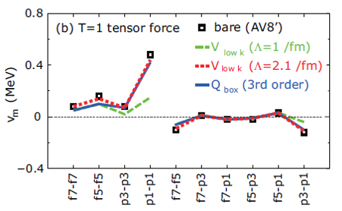
χPT does not agree?
Possible resolution: “Induced density dependence (DD_{induced})” which is not
associated with the vacuum change, dubbed “IDD”. See C14 dating later.
Holt et al 1712.05013

Slide 16
The Surprise
There seems to be no strong interaction renormalization of the fundamental tensor force!
But
What happens when the “vacuum” is changed?
Brown & R. 1991

Slide 17
Tensor Forces
π, ρ
N
N
Note: Sign change

Slide 18
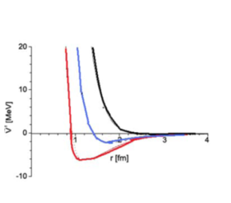
But tensor force must change as “vacuum” is changed by density (“IDD”) Because masses change with the “vacuum” change

Slide 19
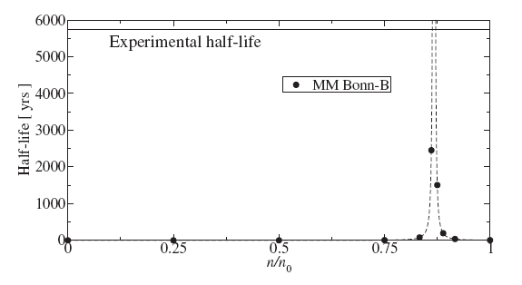
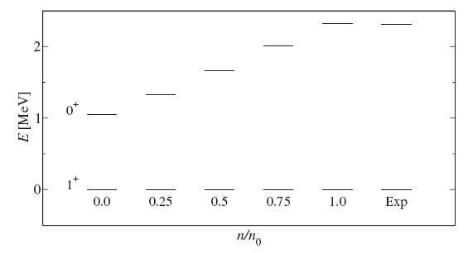
¹⁴C dating
Holt et al 2008
Carbon 14 has a long life-time τ = 5730 yrs ~ 1/|M_{GT}|²
M_{GT} is controlled by the tensor forces given by the π and ρ exchanges
In medium the properties of the mesons are affected by the vacuum change;
increased ρ tensor suppresses the GT matrix element.
With Φ(n₀)≡m_{ρ}(n₀)/m_{ρ}(0)
≈0.85
Energy
Probes density
∼ n₀
Lifetime

Slide 20
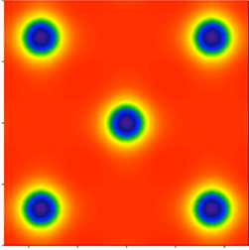
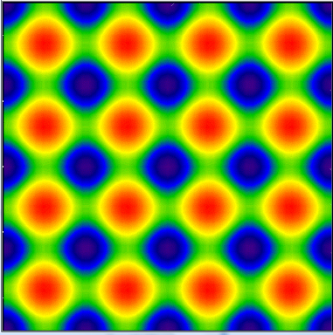
There can be a dramatic vacuum change at ~2n_0 seen in the skymion picture
Dense ½-skyrmion matter at n_{1/2} ≈ (1.5-3.0) n₀
← Tidal polarizability
skyrmions
half-skyrmions
Parity doubling &
Emerging scale symmetry
Connection to quarkyonic phase?
Analog to condensed matter: pseudo-gap …

Slide 21
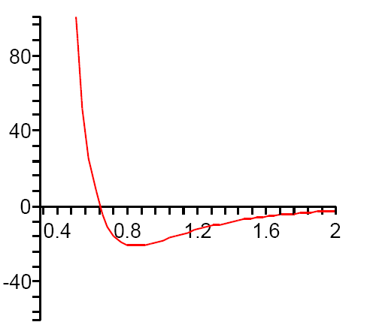
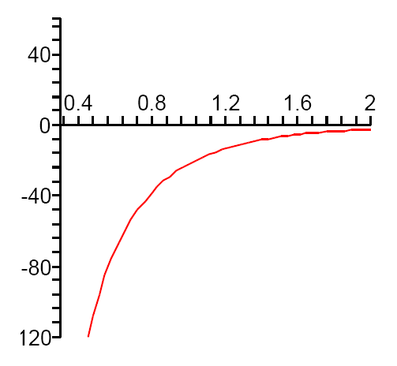
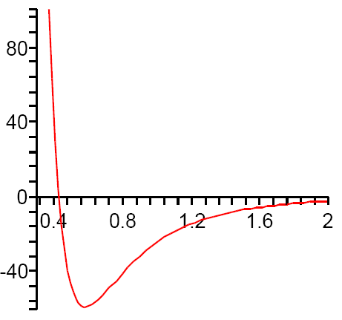
Tensor forces drastically changed at n_{1/2} ≈ 2n₀
n_{1/2}
n=0
n=n₀
,
π+ρ
n> 2n₀
Decreasing tensor
Increasing tensor
Above n_{1/2,} the ρ tensor gets “killed,” enabling the pions (π⁰’s) to condense
→ pionic crystal in dense neutron matter ( e.g., Pandharipande and Smith 74).

Slide 22
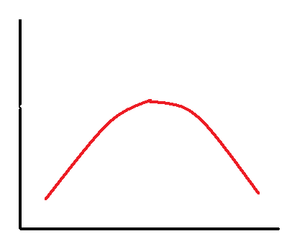
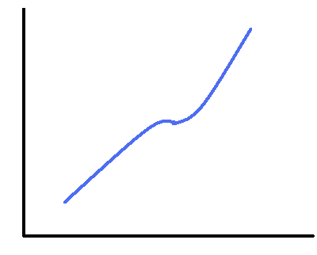
Impact on symmetry energy at n>n₀
“Symmetry energy is dominated by the tensor forces”:
G.E. Brown and Machleidt 1995
Schematically predicts
E_{sym}
(a) Without ½-s
(b) With ½-s
n

Slide 23
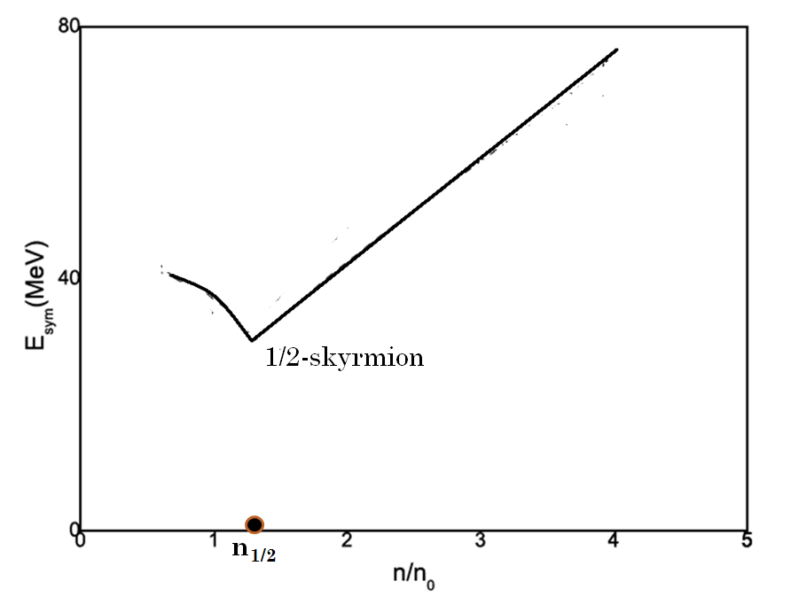
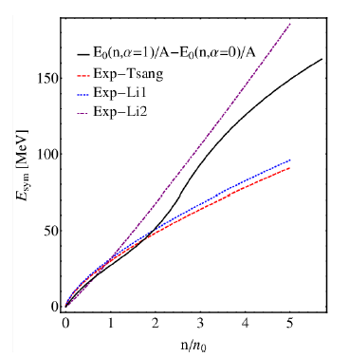
E_{sym} with topology change
H.K. Lee, B.Y. Park, R. 2011
Ma, Lee, Paeng, R. 2018
Quantum effects

Slide 24
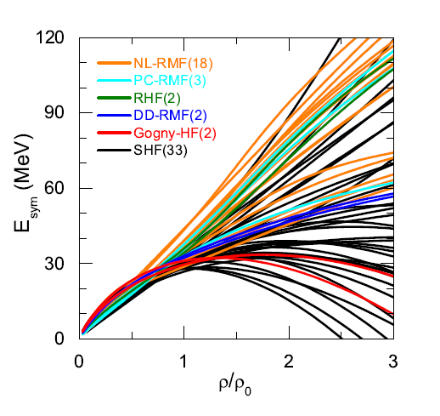
Weed-out the jungle!
L.-W. Chen 1506.09057

Slide 25
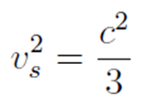
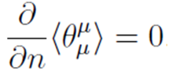
Trace of Energy Momentum Tensor
where
“Conformal velocity”

Slide 26
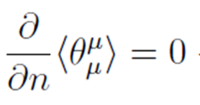
QCD trace anomaly makes but it is possible with density independent
This can happen because scale symmetry emerges in dense medium. The scale symmetry is spontaneously broken and a dilaton, a Nambu-Goldstone boson, is excited.
With the parity doubling,
“Pseudo-conformal”
sound velocity
density independent

Slide 27
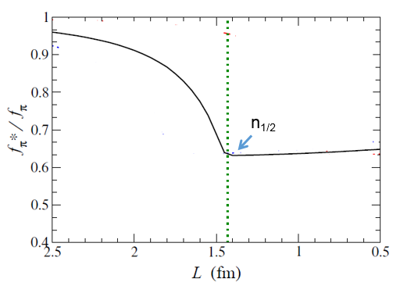
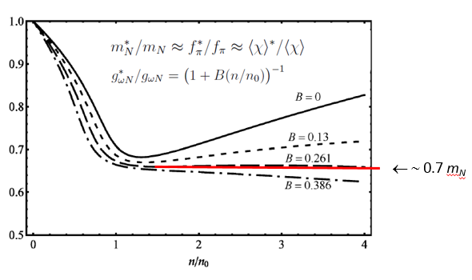
Evidences
Ma et al 2013
Paeng et al 2013
Topology Change in Skyrmion Crystal
Mean-Field plus One Loop
with “bsHLS” Lagrangian

Slide 28
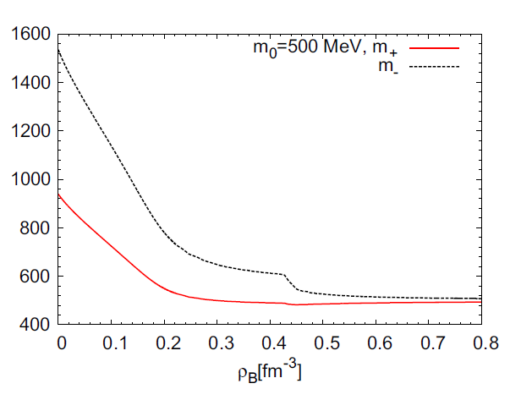
Indication in finite nuclei
for m₀ ≈ 700 MeV?
Harada, Y. Kim et al 2018
?

Slide 29
Also Proton Spin?
Nambu’s constituent quarks Q→ S_{proton} (QQQ) = 1/2
EMC experiment → ΔΣ/2=(1/2) x (0.26-0.38)
The missing spin is ∝(1/2) m₀ /m_{N} ≈ (1/2) x (1-0.3) from parity doubling
Are the proton mass problem and the proton spin problem related??

Slide 30
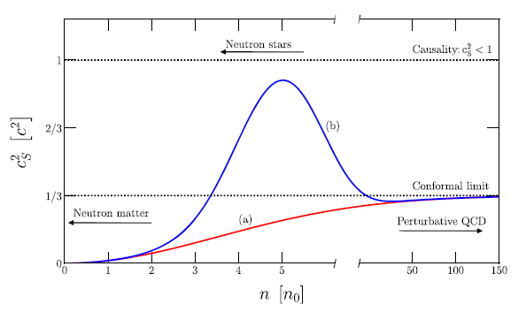
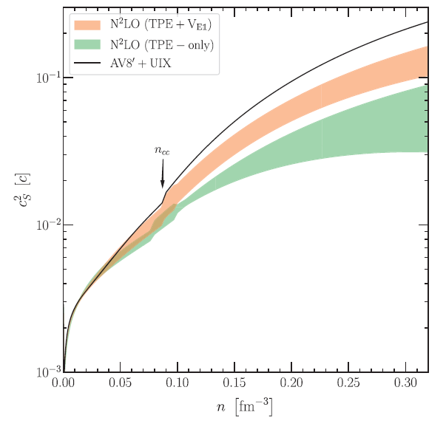
Standard Scenario for Sound Speed v_{s}² in Compact Stars
Tews et al 2018
Bedaque, Steiner 2015
Current Lore: “Wise” Guess
“Standard” Chiral Perturbation (SχPT)
∼2n₀

Slide 31
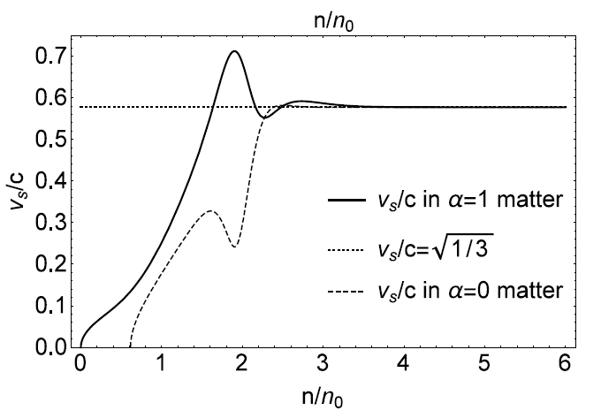
Striking contrast: Pseudo-conformal prediction
Paeng et al 2017 & 2018
Pseudo-conformality
At super precocious
density n > ∼ 3 n₀

Slide 32
The Claim by Tews et al 2018
“The conformality (or PC) with v_{s}² =1/3 is in tension with
(a) current nuclear physics constraint
(b) observation of 2-solar mass neutron stars.”
How Does PC fare?
(a)
(b)
And GW170818?

Slide 33
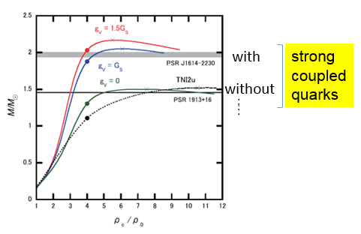
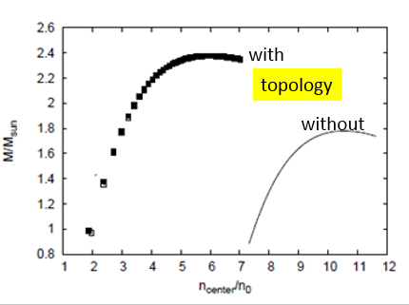
Not “Torpedoed” Yet
But the Claim Continues
“If the conformal limit was found to hold at all densities this would imply that nuclear physics models breakdown below 2n₀.”
Way-out:Topology/hadron-SC quark change that takes over for n > 2n₀
Topology Change: Paeng et al
Hadron-SC Quarks: Baym et al.

Slide 34
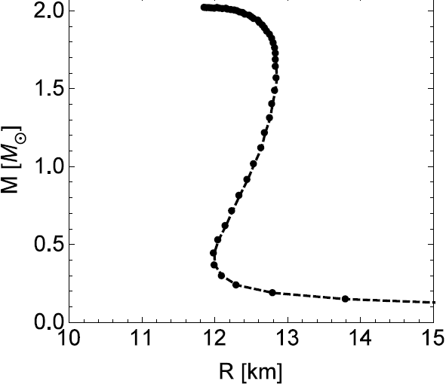
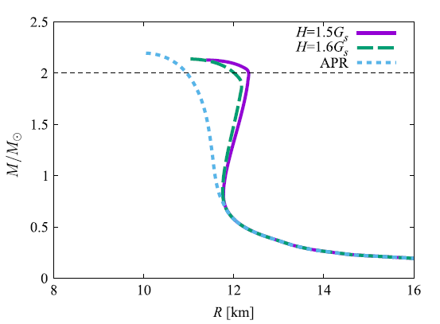
“Cheshire Cat” at Work
Nadkarni, Nielsen, Zahed 1984
ss
Topology
Change
½-skyrmions
Crystal
Hong, Zahed, R. 1999
Paeng, Ma et al 2018
(A)
Sigma
model
Sigma
model
duality
n_{1/2} ~ (2 -3)n₀
n
Baryons-to
- SC quarks
Baryons → SC quarks → CFL
(quarkyonic?)
Fukushima, Kojo 2016
Baym et al, 2017
(A)
Massive stars
(B)

Slide 35
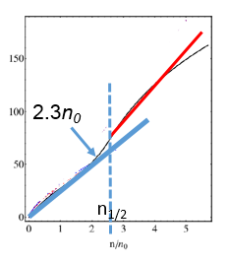
Could Λ_{1.4} closer to ∼ 170, say, far from ∼ 600
torpedo the pseudo-conformal scenario?
The answer is definitely NO.
Λ_{1.4} (and E_{sym} (n₀)) probe density regime n < n_{1/2} before topology change takes place
So
What can torpedo PC?
Experimental: ??
Theoretical: If Standard χPT works up to ∼ 7 n₀ !

Slide 36
Future in nuclear physics
Symmetry is never perfect in Nature, so let’s take
the pseudo-conformality as the leading order
and figure out corrections for New Physics.
e.g.
Tensor force, free of nuclear distortions,
can probe for vacuum change → RIB-physics,
portal to a source of proton mass
(and proton spin(?))

Slide 37
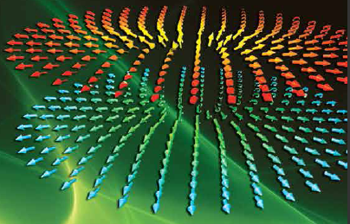
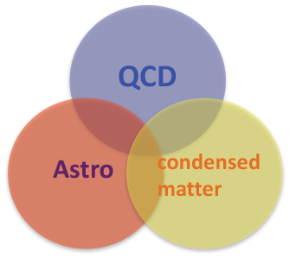
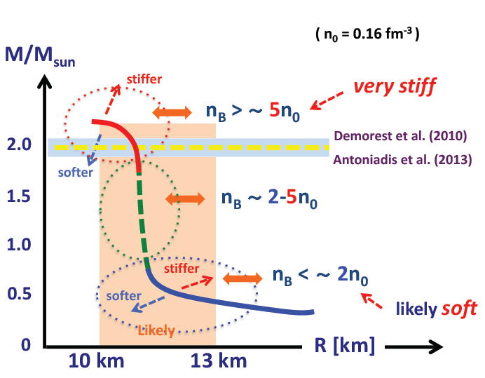
(B)
Gravity
≈
(A)
1/2 skyrmions
(C)

