Slide 1
Status on LED circuit

Slide 2
Circuit

Slide 3
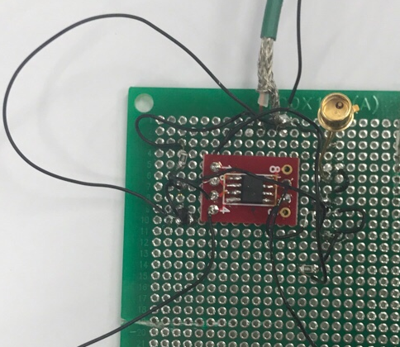
Schematic view_LED circuit
Uref = 4.023V
Izener= 5V/R1 = 10mA
Iled= Uref/R2 = 50.29mA
R1
200

Slide 4
Temperature Monitoring Circuit
There are 4 resistors which are same as a 500ohm.
DMM read a Output Voltage which means a Kelvin/100.
DMM can log a data(time vs Voltage)

Slide 5
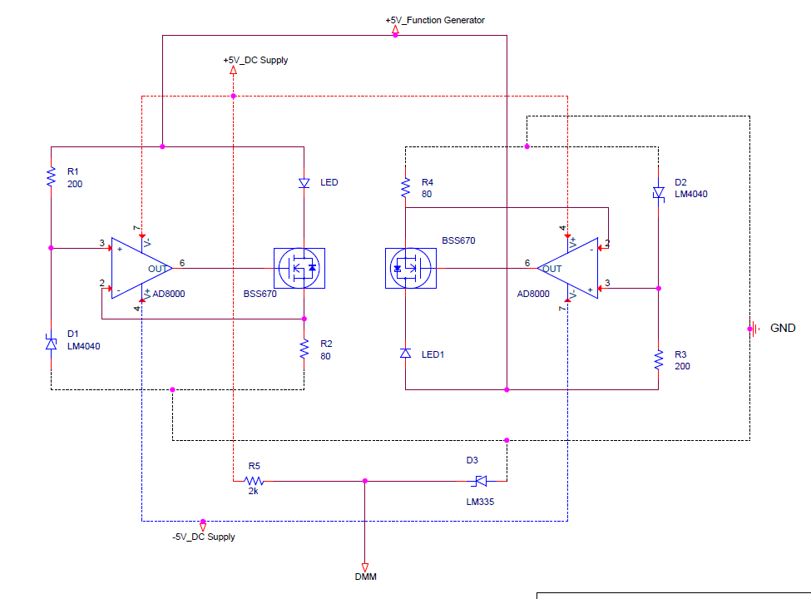
Setup

Slide 6
Plan
Make a circuit again including frame which can be inserted a ND filter.
Make a Compensate circuit for constant temperature.

