Slide 1
Monte Carlo Simulation
M.J Kumwenda
19.07.2016

Slide 2
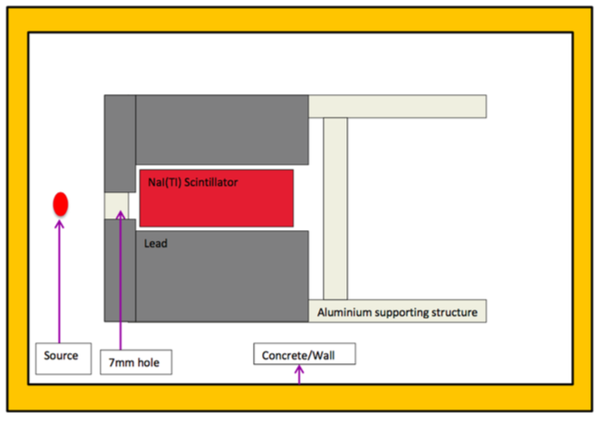
Influence of the surrounding materials

Slide 3
Materials
Source used ¹³⁷Cs
NaI crystal
Glass
PMT structure attached to the crystal
Concrete materials
Lead
Aluminium

Slide 4
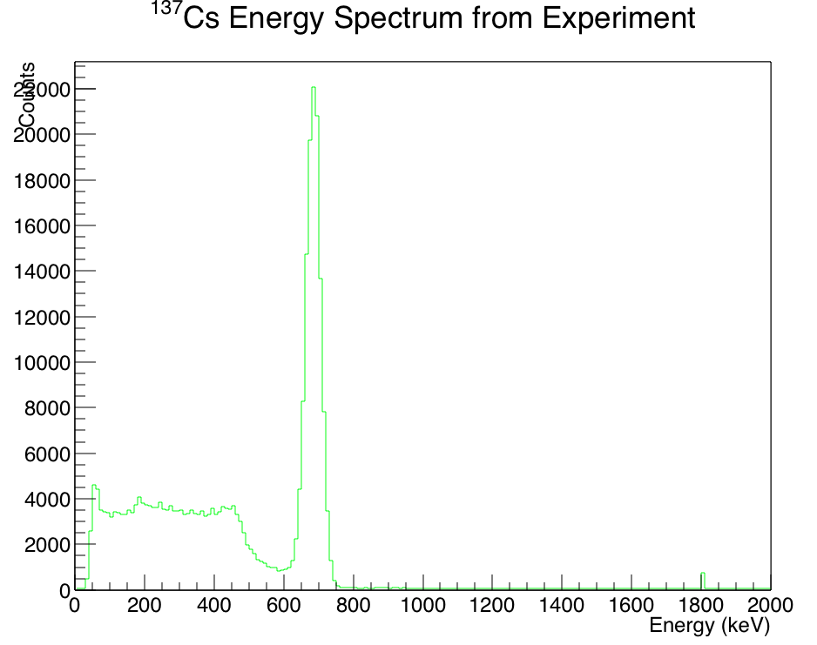
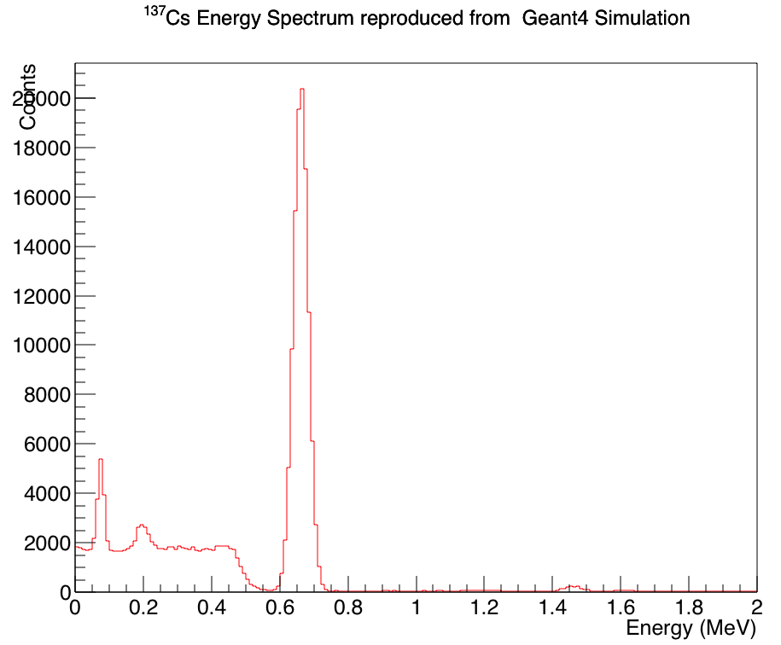
Results
Measured
Simulated

