Slide 1
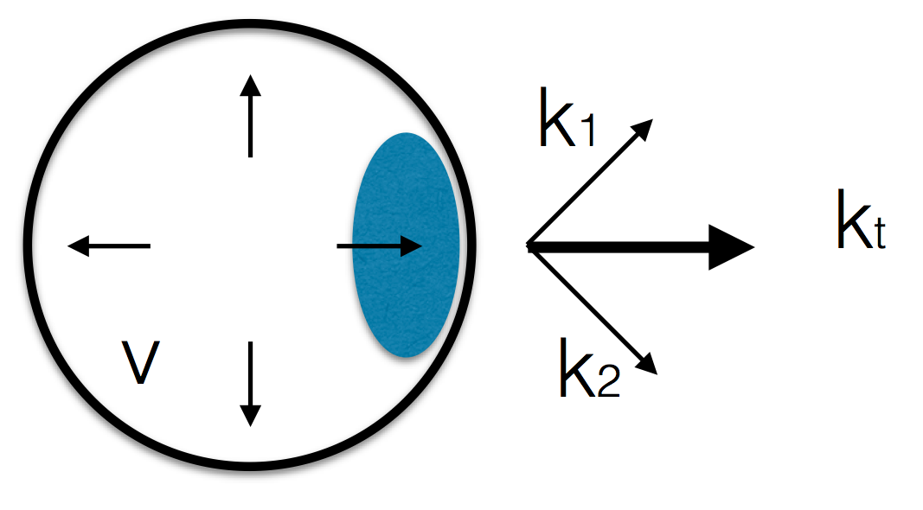
Femtoscopic signature of strong radial flow in high-multiplicity pp collisions [Phys. Rev. C 91, 054915 (2015)]
Yuji Hirono [BNL]
in collaboration with E. Shuryak [Stony Brook U]

Slide 2
Collective flow in small systems?
Large v2 & v3 in pPb, dAu, He3-Au
Near-side ridge in pp (CMS)
…

Slide 3
Radial flow in high-multiplicity pp collisions ?
HBT radii
Motivated by results from ALICE [PRD(2011) [1101.3665] ]

Slide 4
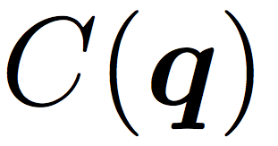
HBT interferometry
Use two-(or more) particle correlations of identical particles
Extract space-time structure of emission source
2
1

Slide 5
out-side-long parametrization
[Pratt (1986)]
[Bertsch, Gong, Tohyama (1988)]
long
side
out

Slide 6
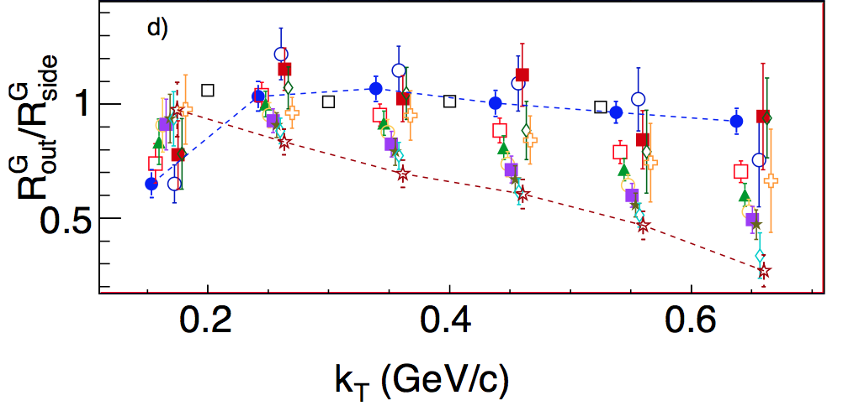
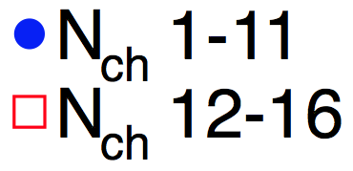
out/side ratio @pp from ALICE (2011)

Slide 7
Radial flow in pp?
We use hydro
We’d like to parametrize the strength of radial flow
Axisymmetric

Slide 8
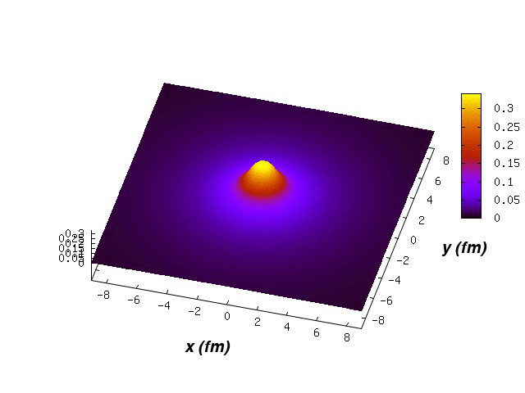
Radial flow in pp?
We use hydro
We’d like to parametrize the strength of radial flow
Axisymmetric
Gubser flow

Slide 9
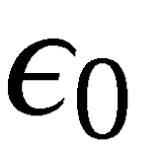
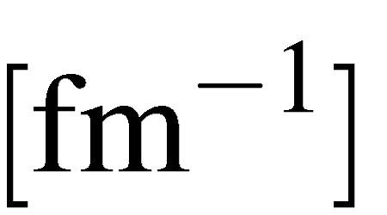
Gubser flow
[Gubser (2010)]
Parameters:
fixed by multiplicity

Slide 10
Gubser flow
[Gubser (2010)]
large q
small q

Slide 11
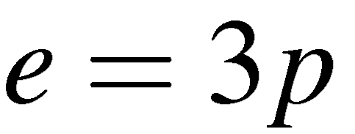
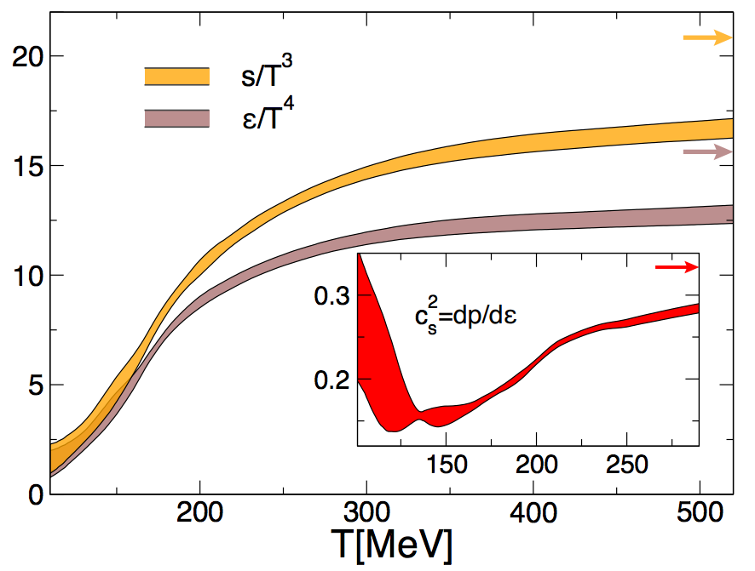
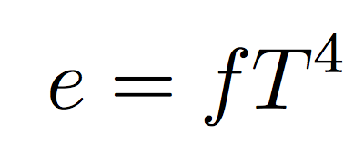
Equation of state from lattice
Gubser solutions are for conformal EOS
Evolved with lattice EOS after 0.6 fm
[Wuppertal-Budapest coll.(2014)]

Slide 12
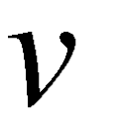
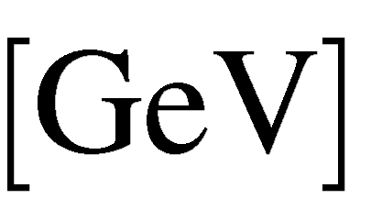
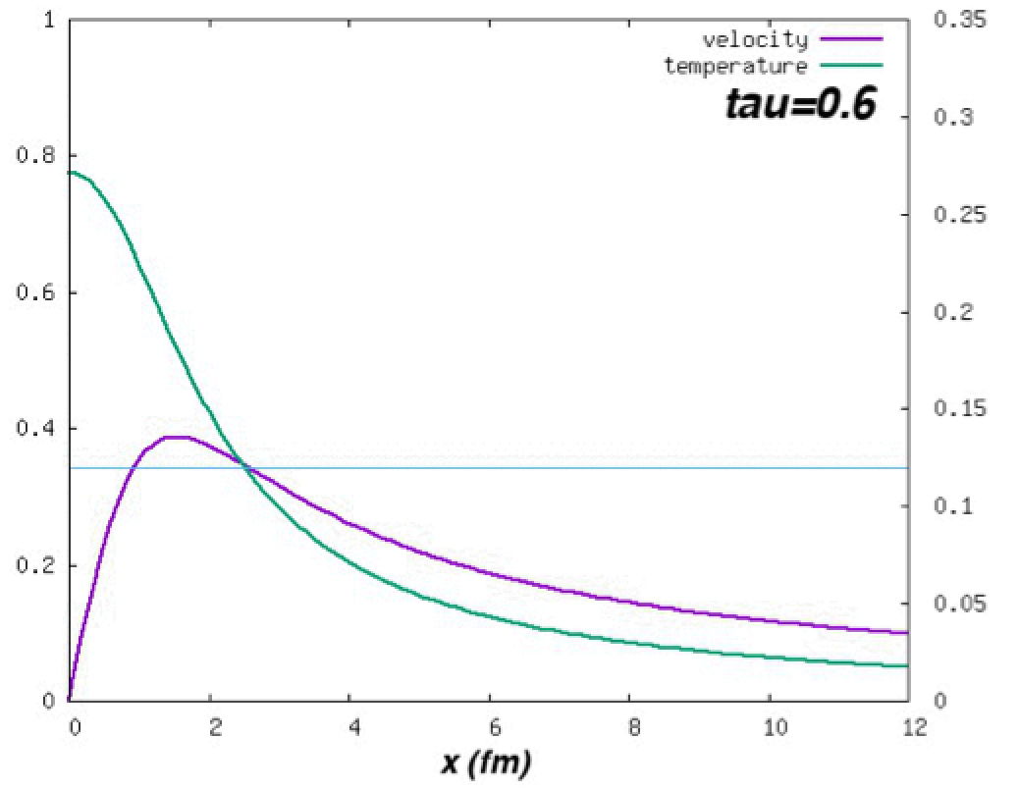
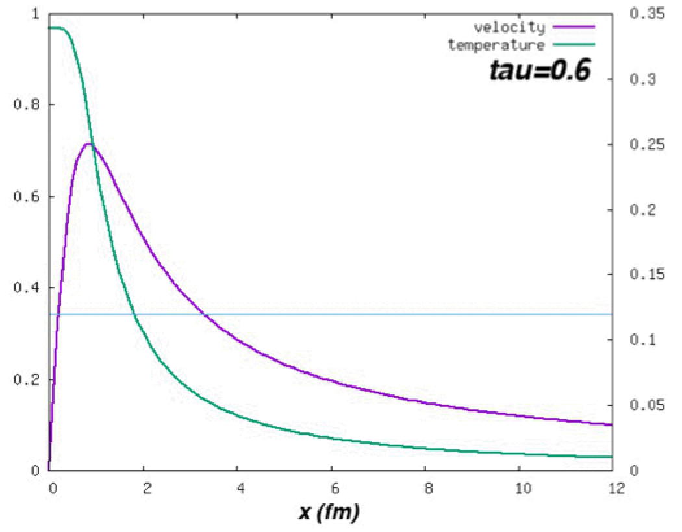
Large q results in strong radial flow
q=0.7/fm
q=1.7/fm
Small radial flow
Large radial flow

Slide 13
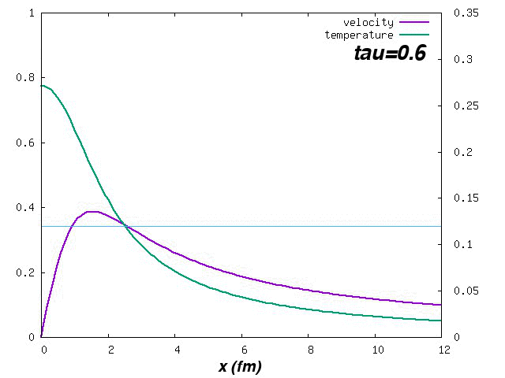
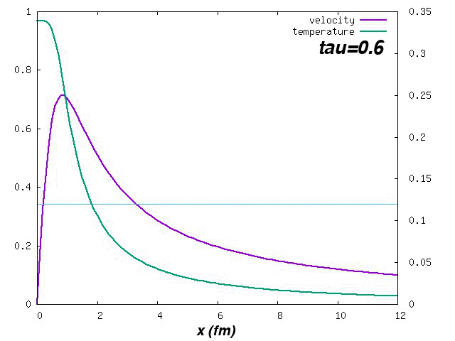
Large q results in strong radial flow
q=0.7/fm
q=1.7/fm
Small radial flow
Large radial flow

Slide 14
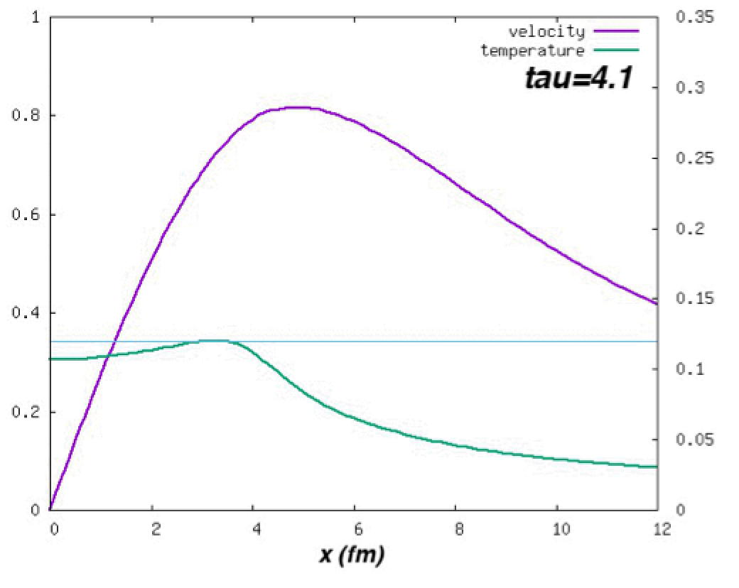
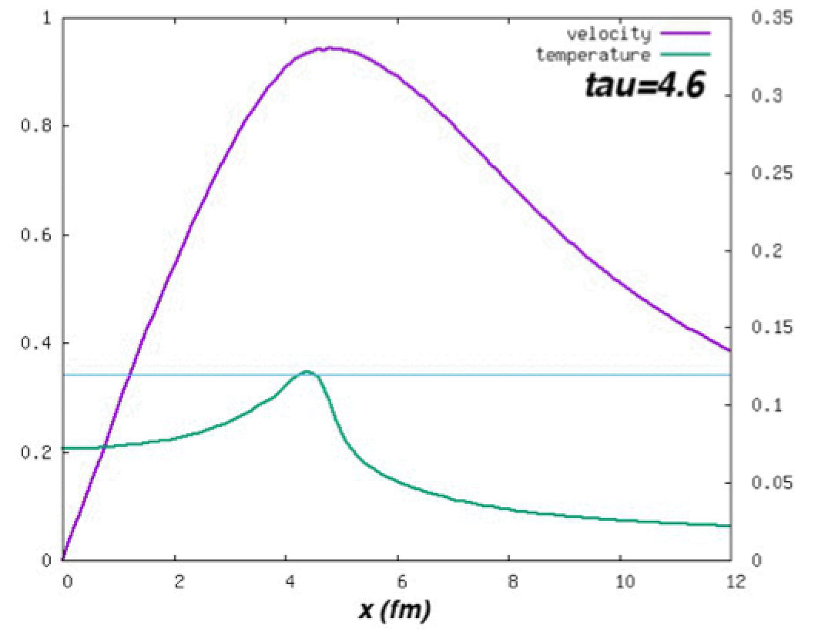
Large q results in strong radial flow
q=0.7/fm
q=1.7/fm
Small radial flow
Large radial flow

Slide 15
Two-particle Correlation function
Freezeout surface
MC sampling of pions via Cooper-Frye prescription
Two-particle correlation
- evaluated in the longitudinally comoving system
Radii are determined by fitting

Slide 16
HBT volume
16

Slide 17
Rout/Rside
Suppressed
for larger flow
17

Slide 18
Why out/side ratio is small for large radial flow?
side
out
: dist. of pair displacements
Notes:
\begin{align*}
\Delta {\bf X}
= \left(
X_t, X_o, X_s, X_\ell
\right)
\end{align*}
\begin{align*}
P(\Delta {\bf X}, k_{\rm T})
\end{align*}

Slide 19
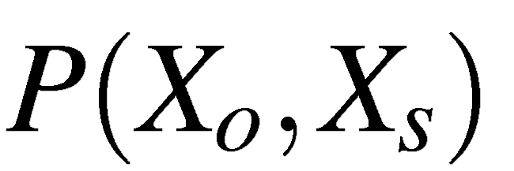
out-side
q=1.5/fm (large flow)
side
out
q=0.5/fm (small flow)

Slide 20
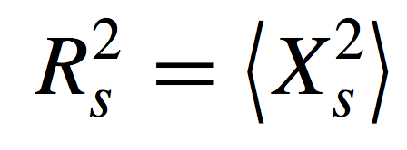
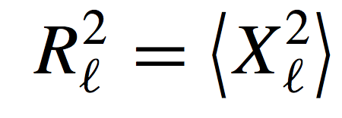
HBT radii and moments of pair displacements
Notes:
\begin{align*}
R_s^2=L_s^2
\end{align*}
\begin{align*}
R_\ell^2=L_\ell^2 + L_t^2 \beta_{\rm L}^2
\end{align*}

Slide 21
Why out/side ratio is suppressed at hight kt for large radial flow?
Notes:
\begin{align*}
\left(
\frac{L_t}{L_s}
\right)_{\rm small \ q}
>
\left(
\frac{L_t}{L_s}
\right)_{\rm large \ q}
\end{align*}

Slide 22
Why out/side ratio is suppressed at hight kt for large radial flow?
Enhanced for a stronger flow!
Consistent with [Kisiel PRC(2011)]
Notes:
\begin{align*}
\left(
\frac{L_t}{L_s}
\right)_{\rm small \ q}
>
\left(
\frac{L_t}{L_s}
\right)_{\rm large \ q}
\end{align*}

Slide 23
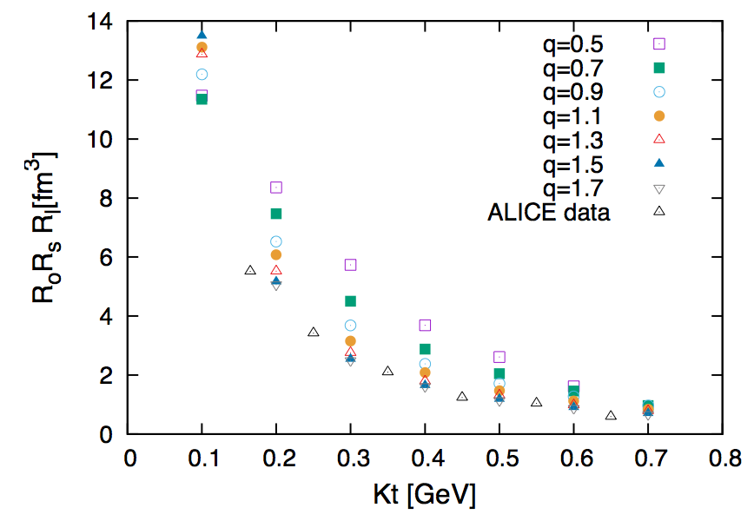
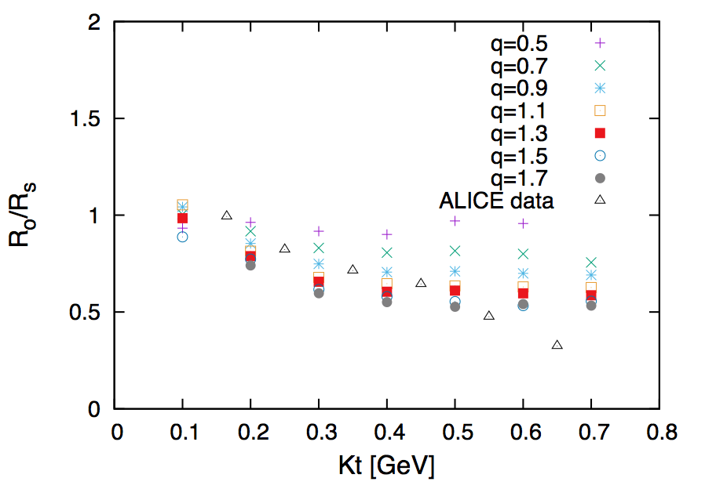
Summary
Radial flow in high-multiplicity pp collisions?
Calculated HBT radii @pp
Gubser + lattice EOS
Strong radial flow is favored [ q ~ 1.7 /fm ]
Suppression of Ro/Rs is driven by space-temporal correlation (Xo-Xt)
23
Notes:
\begin{align*}
\left(
\frac{L_t}{L_s}
\right)_{\rm small \ q}
>
\left(
\frac{L_t}{L_s}
\right)_{\rm large \ q}
\end{align*}

Slide 24
Backup slides

Slide 25
HBT radii

