Slide 1
Interplay between collective expansion and Mach cone
International Symposium
on Multiparticle Dynamics
Aug. 29-Sep.2, 2016,
Jeju Island, South Korea
Tetsufumi Hirano
Sophia Univ.
References:
Y. Tachibana and T. Hirano, Phys. Rev. C 90, 021902 (2014); C 93, 054907 (2016).
Collaborators:
Yasuki Tachibana (CCNU)
Michito Okai (Sophia Univ.)

Slide 2
Contents
1. Introduction
2. QGP fluid + jet model
3. gamma-jet event
4. Many mini-jet case
5. Summary

Slide 3
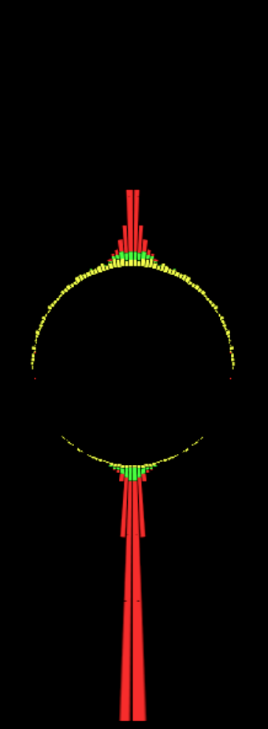

Introduction
Azimuthal angle dist.
CMS Collaboration (Quark Matter 2011)
Di-jet asymmetric event
$E\sim 200 GeV$ jet dragged by medium with $T\sim 300 MeV$ in a few femtometer
→ Jet quenching in heavy ion collisions

Slide 4
Introduction (contd.)
Jet quenching
→ One of the main topics in heavy ion physics
→ How can this happens?
Bjorken (1983), Gyulassy, Plumer (1990), Gyulassy, Wang (1994),…
Medium (Hydrodynamic) response to jet quenching
Where the lost energy and momentum go?
(Di-jet asymmetric events) → Previous study
Gamma-jet events
Many mini-jet cases
This study

Slide 5
Contents
1. Introduction
2. QGP fluid + jet model
3. gamma-jet event
4. Many mini-jet case
5. Summary

Slide 6


QGP fluid + jet model
$$∂_{μ}T_{QGP}^{μν}=\sum_{jet}{J_{jet}^{ν}}$$
Energy-momentum tensor of the QGP fluid
Energy and momentum
deposited from jets
Assumption: Instantaneous thermalization of deposited energy and momentum
$$J_{jet}^{μ}\left(x\right)= −\frac{dp_{jet}^{μ}}{dt}δ\left(x−x_{jet}\left(t\right)\right)$$
Equation of state from Wuppertal-Budapest Coll.
Borsanyi et al. (2014)

Slide 7





Energy loss of a parton
Simple assumption: ${dE}/{dl} ∝ ρ ∝T^{3}$
$$\frac{dp_{jet}^{0}}{dt}=−{\left(\frac{T\left(t, x_{jet}(t)\right)}{T_{0}}\right)}^{3}{\left.\frac{dE}{dl}\right|}_{0}$$
$$T_{0}=500 MeV$$
$${\left.\frac{dE}{dl}\right|}_{0}=15 {GeV}/{fm}$$
(for a few 100 GeV jets)
ATLAS (2015)
$$=5 {GeV}/{fm}$$
(for mini-jets)

Slide 8
Contents
1. Introduction
2. QGP fluid + jet model
3. gamma-jet event
4. Many mini-jet case
5. Summary

Slide 9
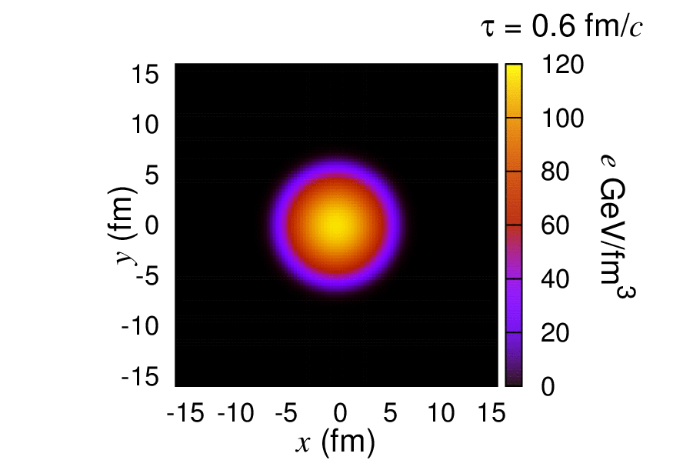



Jet propagation in $γ$-jet event
Movies: Courtesy of Y. Tachibana
Production point of jet
$\left(x_{0}, y_{0}\right)=\left(3, −3\right)[fm]$
Momentum of jet
$\left(p_{0,x}, p_{0,y}\right)=\left(−200, 0\right)[GeV]$
Mach cone distorted by radial flow
Satarov, Stoecker, Mishustin (2005)

Slide 10

Snapshots of energy density distribution ($τ=12 fm$)
Initial position
Initial momentum
Mach cone clearly tilted in an off-central jet path

Slide 11





Initial conditions for $γ$ and jet
Momentum distribution
$$\frac{dσ}{dp_{T, jet}dη}=\frac{1}{p_{0}}{\left(\frac{p_{0}}{p_{T, jet}}\right)}^{α}$$
$p_{0}=205 GeV$, $α=6.43$
ATLAS (2015)
*No cold nuclear matter effects
$$φ_{p}=\frac{π}{2}$$
for jet
Back-to-back at LO
$$φ_{p}=0$$
for gamma
Spatial distribution
Binary collision distribution

Slide 12
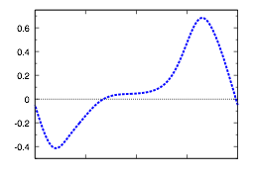
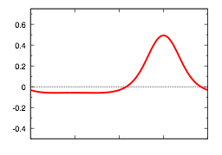




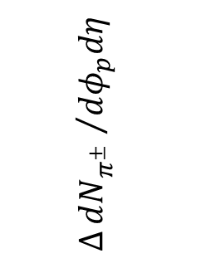


Azimuthal angle distribution in $γ$-jet event
$$∆\frac{dN_{π^{±}}}{dφ_{p}dη}=\frac{dN_{π^{±}}}{dφ_{p}dη}−{\left.\frac{dN_{π^{±}}}{dφ_{p}dη}\right|}_{no jet}$$
*No contribution from jet fragmentation
event average
$$∆{dN_{π^{±}} }/{dφ_{p}dη}$$
single event
$$γ$$
$$\left(x_{0}, y_{0}\right)=\left(3, −3\right)[fm]$$
bump
-¼/2
0
¼/2
¼
3¼/2
$$φ_{p}$$
Dip
$$p_{T, jet}>80 GeV, 1<p_{T}<2 GeV$$

Slide 13
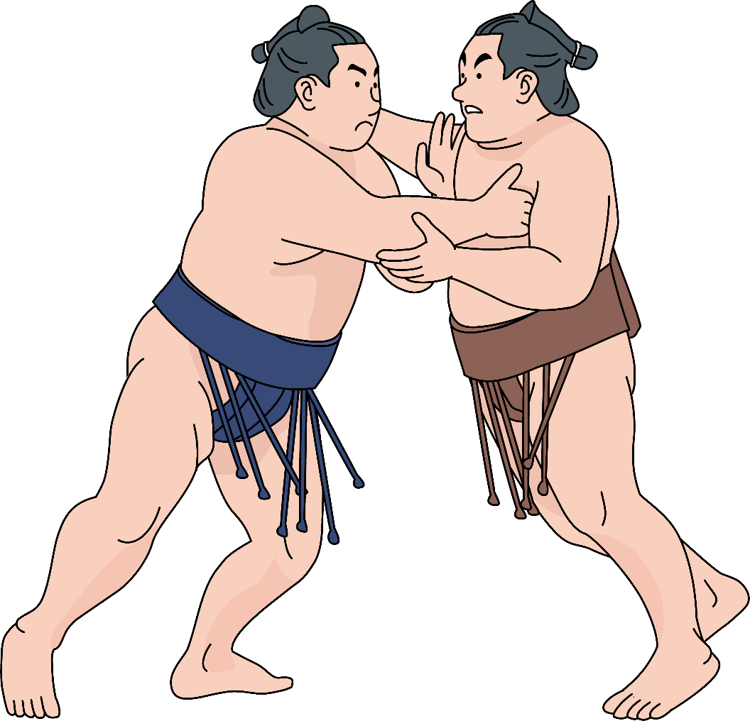
Interplay between Mach cone and collective expansion
Mach cone
direction
(≠ jet direction)
Radial expansion
Suppressed radial expansion → Dip in $dN/dφ_{p}$

Slide 14
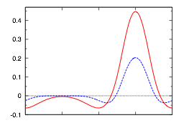

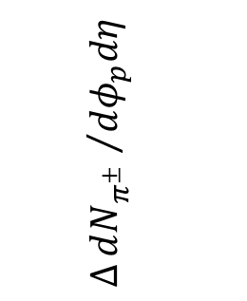






Triggered event average
$p_{T, jet}=100$ - $110 GeV$
$p_{T, jet}=110$ - $120 GeV$
$$y_{0}>0$$
$$∆{dN_{π^{±}} }/{dφ_{p}dη}$$
$$1<p_{T}<2 GeV$$
$$y_{0}<0$$
-¼/2
0
¼/2
¼
3¼/2
$$φ_{p}$$
Trigger condition
Distribution of jet production point with triggers
$$110<p_{T, γ}<120 GeV$$
Constraint on the jet path

Slide 15
Contents
1. Introduction
2. QGP fluid + jet model
3. gamma-jet event
4. Many mini-jet case
5. Summary

Slide 16

Source of higher harmonics?
ALICE Collaboration, arXiv:1606.06057[nucl-ex]
$$v_{n}=\left\langle \cos{n\left(φ_{p}−ψ_{n}\right)}\right\rangle$$
Conventional source of higher harmonics
→ Fluctuations of transverse position of nucleons in colliding nuclei
One of unconventional sources
→ Disturbance by (mini-)jet propagation
Schulk, Tomášik (2014)

Slide 17
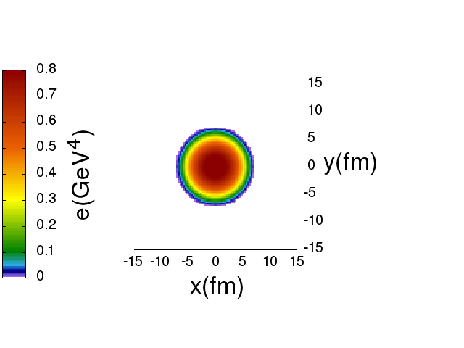



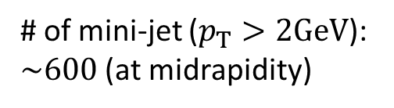

Many mini-jet propagation
Smooth initial condition for a QGP fluid
(optical Glauber)
+
~600 mini-jets
(from PYTHIA8)
$$Pb+Pb 2.76 TeV$$
$$b=0 fm$$
$N_{coll}: 1983$, $N_{part}: 411$
Bumpy freezeout
hyperdurface
→Finite $v_{n}$ ?
# of mini-jet ($p_{T}>2GeV$):
$\sim 600$ (at midrapidity)

Slide 18
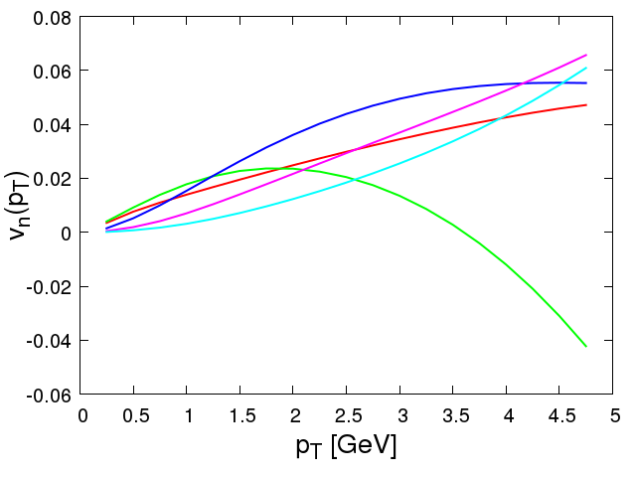







Higher harmonics in ultra-central collisions
Pb+Pb 2.76 TeV, b=0 fm,
10 events
$$n=4$$
$$n=3$$
$$n=1$$
$$n=5$$
$$n=2$$
ALICE Collaboration,
arXiv:1606.06057[nucl-ex]
Correct order of $v_{n}$!?
$v_{3}>v_{4}>v_{2}≈v_{5}$ at $3 GeV$
Sizable contribution from mini-jet propagation

Slide 19
Contents
1. Introduction
2. QGP fluid + jet model
3. gamma-jet event
4. Many mini-jet case
5. Summary

Slide 20

Summary
Hydrodynamic response to jet propagation by using QGP fluid + jet model
$γ$-jet event
Interplay between Mach cone and collective flow
Dip in azimuthal distribution
Possibility to constrain the jet path in triggered events
Many mini-jet case
QGP fluids disturbed by many mini-jets
Sizable contribution to higher harmonics

Slide 21

감사합니다!

Slide 22
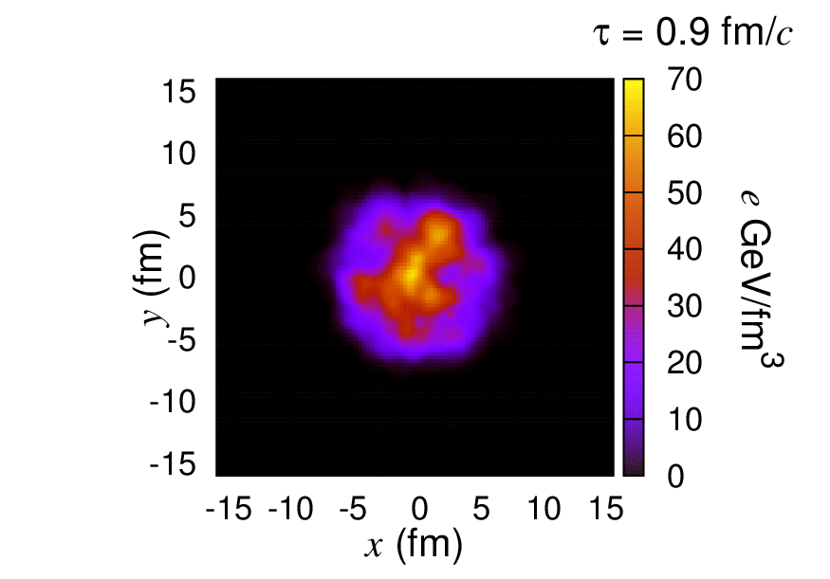
More realistic bulk evolution
Bumpy profile case
(Just for demonstration, not used in analysis)

Slide 23






Hydro to Particles
One-particle distribution from a fluid element
F.Cooper, G.Frye (1974)
$$E\frac{d^{3}ΔN}{d^{3}k}=\frac{g}{{\left(2π\right)}^{3}}\frac{k⋅Δσ}{exp\left[k⋅u/T_{fo}\right]±1}$$
$$Σ:T\left(x\right)=T_{fo}$$
$${Δσ}^{μ}$$
$$T_{fo}=145 MeV$$
$$N^{μ}$$
Thermal dist. in switching hypersurface $Σ$
boosted by fluid velocity $u^{μ}$

Slide 24




Analysis of $v_{n}$ in hydro
Event plane angle
Higher harmonics
$$ψ_{n}=\frac{1}{n}\tan^{−1}{\frac{\left\langle \sin{nφ}\right\rangle }{\left\langle \cos{nφ}\right\rangle }}$$
$$v_{n}=\left\langle \cos{n\left(φ_{p}−ψ_{n}\right)}\right\rangle$$
*No contribution from survived mini-jets
**No self-correlation
Note: ALICE analysis
Scalar product method
Subevents $a:−0.8<η<0, b:0<η<0.8$
Non-flow subtracted assuming a value in p+p collision
Small rapidity gap

Slide 25





Higher harmonics in ultra-central collisions
$$n=3$$
$$n=4$$
$$n=2$$
$$n=5$$
$$n=1$$

