Slide 1
A Pulse Shape Discrimination Method in High Energy Physics
LIU Dong, Jewou Ko and Jong-Kwan Woo* Department of Physics, Jeju National University, Republic of Korea

Slide 2
Liquid Xenon is Used in Pulse Shape Discrimination (PSD) for Dark Matter Research
Liquid xenon detectors are usually operated around 170 K using refrigerators or cryogen. Because the atomic number of xenon is large, the coefficient is large compared with other detector materials.
In addition, the response of the gamma ray is fast compared to crystal scintillators.
For xenon, the event rate for the spin independent interaction is larger than argon and germanium detectors because the atomic mass number is larger than in those detectors.
Furthermore, the cross section of 129Xe and 131Xe for spin dependent interactions is large.
With those advantages, xenon is considered to be a good target material for dark matter search. In addition, it should be noted that 136Xe is one of the double beta decay nuclei.

Slide 3
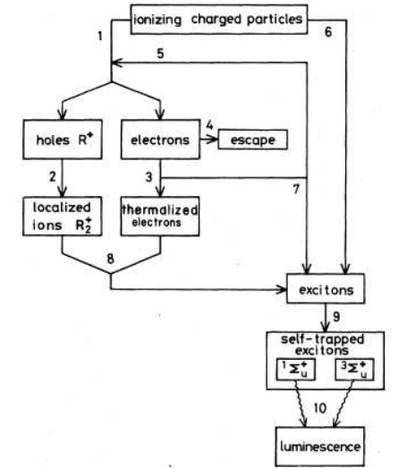
The cintillation process of noble gas
In noble gases like neon, argon and xenon, scintillation
light is produced by the deexcitation of dimer states
1. production of electron-ion pairs.
2. Formation of molecular ions (R2+).
3. Thermalization of hot electrons.
4.Escape of hot electrons from the Coulomb attraction of R+2 ions.
5. Production of electron-ion pairs by secondary electrons. 6. Production of excitons by the ionizing particle.
7. Production of excitons by secondary electrons.
8. Recombination of free electrons and molecular ions forming excitons.
9. Self-trapping of excitons forming excitons forming excited molecules.
10. De-excitation of excited molecules emitting scintillation photons.

Slide 4
Excimer X₂* Singlet state and Triplet state
Meta stable Target molecule X₂* → 2-body problem
4 types of two ½ spin nuclei combination
|X₁,X₂> =|↑,↑>
|X₁,X₂> =|↑,↓> + |↓,↑>
|X₁,X₂> =|↑,↓> - |↓,↑>
|X₁,X₂> =|↓,↓>
Spin of target nucleus1/2ℏ → total spin = 1ℏ or 0.
For s=1 → s_{z} m=1, 0, -1 → (triplet state)
For s=0 → s_{z} m=0 → (singlet state)
Τ_{Triplet} = (27 ns) << T_{singlet} = (2.2 s)
Ratio of Τ_{triplet}/ T_{singlet} = is depend on the incident particles
N_{S}/N_{T})_{MIP} > (N_{S}/N_{T})_{HIP}
N_{T}: fast signal form triplet state
N_{S}: slow signal from singlet signal
neutron ∈ HIP, gamma ray ∈ MIP

Slide 5
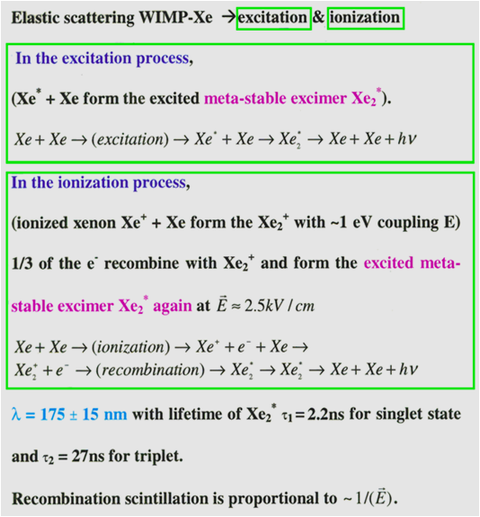
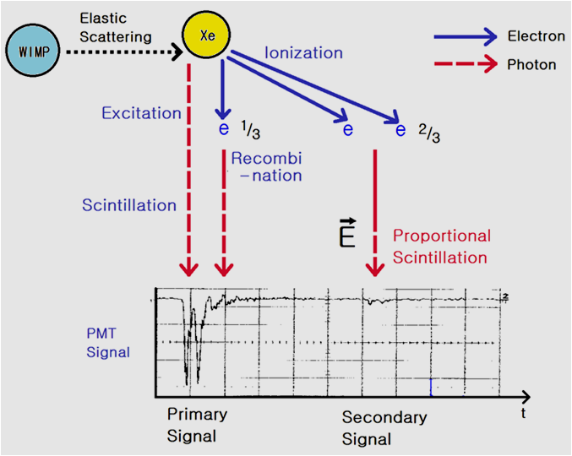
The Mechanism of Pulse Generation

Slide 6
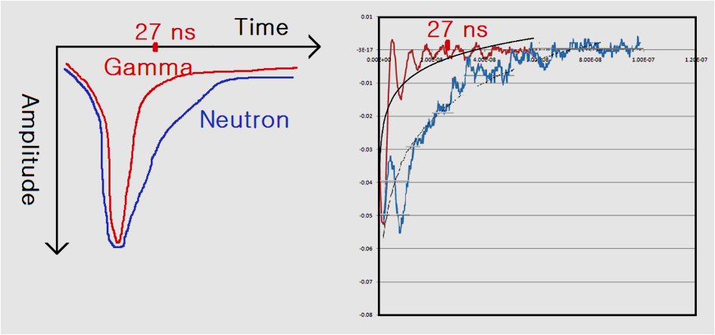
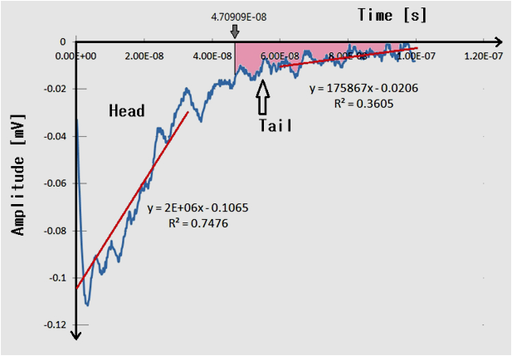
Typical Pulse Shapes induced by γ and Neutron

