Slide 1
Task Timing Studies
 | Avg time/ev (s) |  | Trk-weight avg time/ev (s)
 | Real Time | CPU Time | Real Time | CPU Time
PSA | 3.407 (62.7%) | 2.785 (66.9%) | 4.142 (58.0%) | 3.32 (60.7%)
HitClustering | 0.221 (4.1%) | 0.098 (2.4%) | 0.383 (5.4%) | 0.171 (3.1%)
SM | 0.012 (0.2%) | 0.002 (0.0%) | 0.014 (0.2%) | 0.004 (0.1%)
RiemannTracking | 1.795 (33.0%) | 1.276 (30.7%) | 2.6 (36.4%) | 1.972 (36.1%)
Total time | 5.435 | 4.161 | 7.139 | 5.467

Slide 2
Inside PSATask
 | Avg time/ev (s) |  | Trk-weight avg time/ev (s)
 | Real Time | CPU Time | Real Time | CPU Time
PSATask | 3.407 | 2.785 | 4.142 | 3.32
PSA Analyzer | 3.223 | 2.667 | 3.32 | 3.128
We already waste 0.8 s (~20% of real time) between starting the PSATask and the PSAAnalyzer → removing the logger printouts will partially take care of this
One simulated event with 175 particle tracks hits 8800 pads
Average time spent to analyze one pad: ~0.4ms
Average time spent to analyze the event: ~3.5s
We need to lower this by a factor or 10 ☹

Slide 3
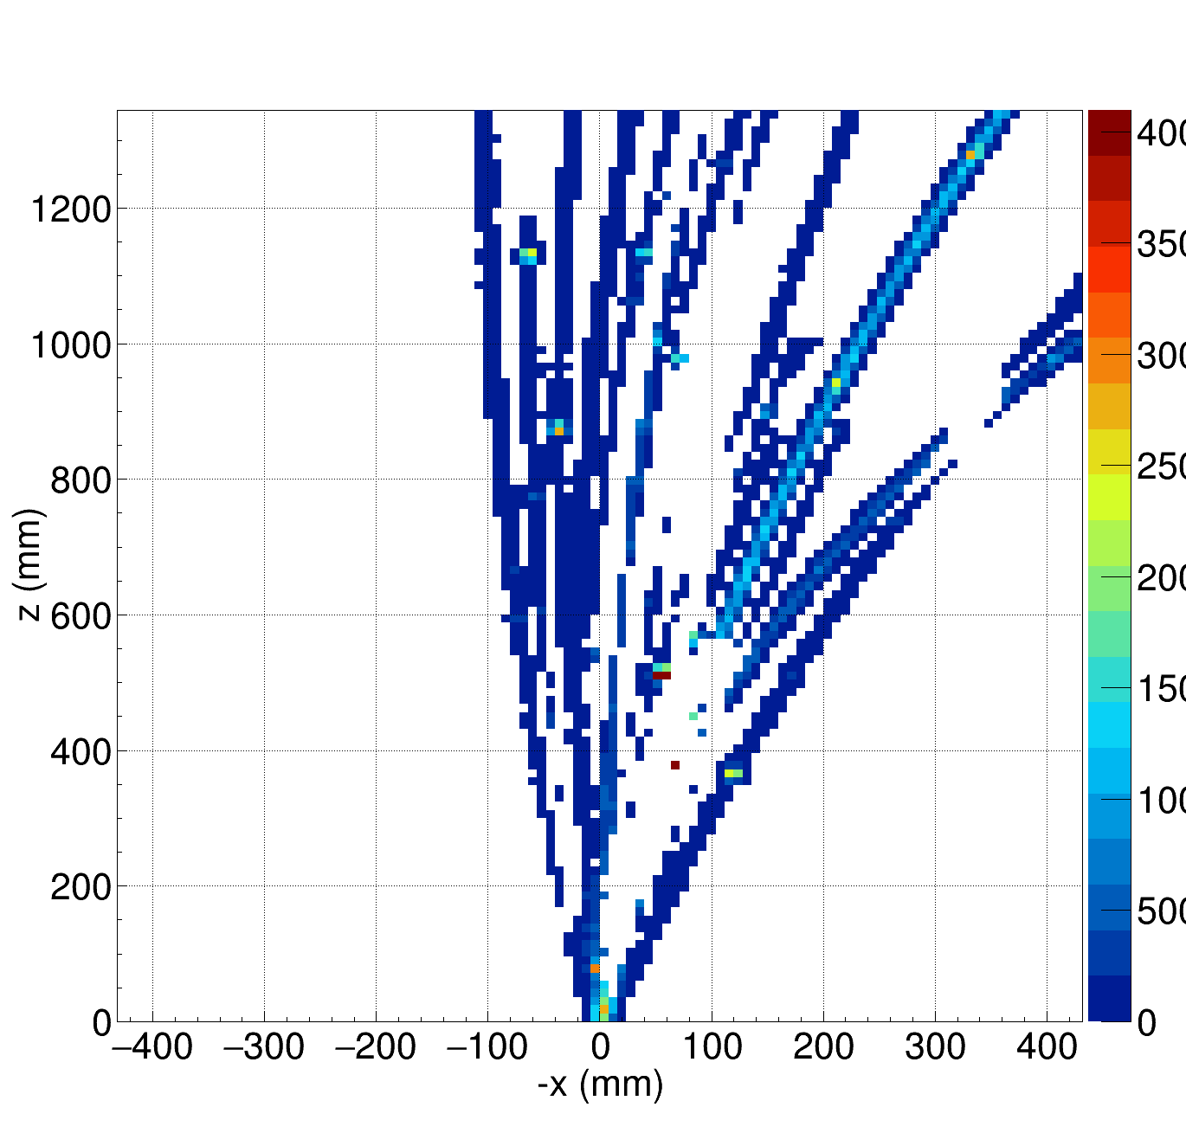
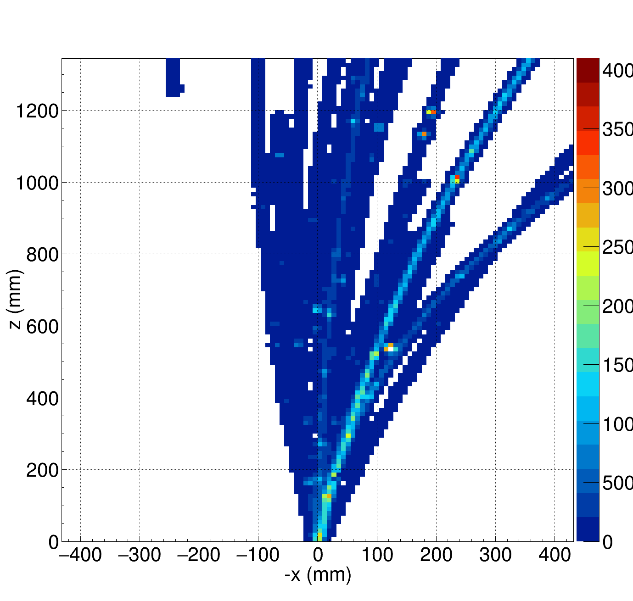
Drastic Solution
We look for pads with only one peak and compare
1 hit per pad
original

Slide 4
Task Timing Studies for 1 Hit/Pad
 | Avg time/ev (s) |  | Trk-weight avg time/ev (s)
 | Real Time | CPU Time | Real Time | CPU Time
PSA | 4.092 | 3.001 | 4.632 | 3.5
HitClustering | 0.024 | 0.013 | 0.034 | 0.016
SM | 0.01 | 0 | 0.01 | 0
RiemannTracking | 0.628 | 0.298 | 0.668 | 0.316
Total time | 4.754 | 3.312 | 5.344 | 3.832
Reduction of the total reconstruction time by 25% (mostly RiemannT)
Loss in track definition in the higher density regions (closer to vertex)
The speed of PSA can be improved with c.o.g. algo (to be done)

Slide 5
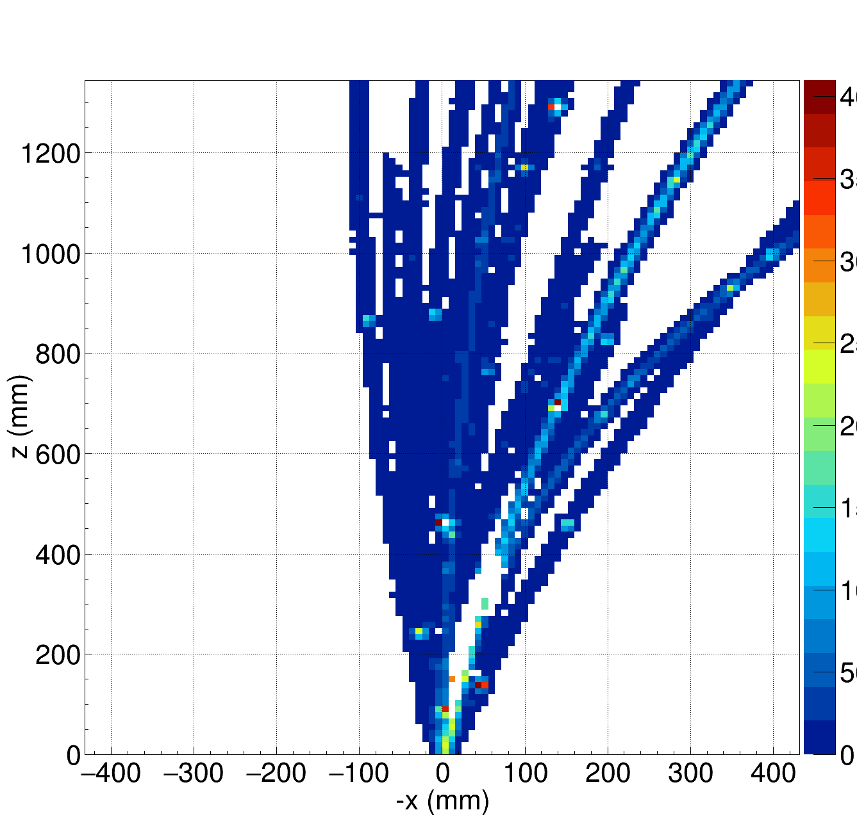
Less Drastic Solution
Pads with 1 or 2 pulses
1 or 2 hits per pad
original

Slide 6
Task Timing Studies for 1-2 Hit/Pad
 | Avg time/ev (s) |  | Trk-weight avg time/ev (s)
 | Real Time | CPU Time | Real Time | CPU Time
PSA | 4.070 | 2.932 | 4.721 | 3.437
HitClustering | 0.098 | 0.042 | 0.119 | 0.053
SM | 0.01 | 0 | 0.01 | 0
RiemannTracking | 1.413 | 0.849 | 1.707 | 1.049
Total time | 5.591 | 3.823 | 6.558 | 4.540
Reduction of the total reconstruction time by 10% (mostly RiemannT)
Most of the trajectories are well defined
Better track definition in the higher density regions (closer to vertex)
To speed up → hybrid solution: c.o.g. for 1 pulse, fit for 2 pulses (to be done)

