Slide 1

Light-front ab initio Approach to QED and QCD
Xingbo Zhao (赵行波)
With Yang Li, Guangyao Chen,
Paul Wiecki, Lekha Adhikari,
Dipankar Chakrabarti,
Anton Ilderton, Heli Honkanen,
Pieter Maris, James Vary,
Stan Brodsky
Institute of Modern Physics
Chinese Academy of Sciences
Lanzhou, China
ISMD2016, Jeju Island, South Korea, Sept. 2, 2016

Slide 2
Outline
Basis Light-Front Quantization (BLFQ)
Method
Applications: electron, positronium, heavy quarkonium, exotic hadrons…
Time-dependent Basis Light-Front Quantization (tBLFQ)
Method
Applications: nonlinear Compton scattering, electron-ion collision, dipole-nucleus collision…

Slide 3
Basis Light-front Quantization
Based on quantum field theory
For both first-principles and effective theory
Non-perturbative
Hamiltonian formalism
Light-front dynamics

Slide 4
Light-front vs Equal-time Quantization
[Dirac 1949]
equal-time dynamics vs v light-front dynamics
Notes:
The approach I am introducing today is based on the Light-front field theory. Its basic idea is to solve the Schrodinger equation numerically for the quantum field. The difference from the traditional equal time formalism is that we redefine our light-front time to be the linear combination of the regular time and one of the spatial direction, usually we choose z direction. In the traditional equal time formalism we specify the initial state on a equal time plane and the Schroedinger equation will tell us its evolution time on future times. In the light front theory we specify the initial state on the equal light front surface and the Schrodinger equation will evolve afterwards. The benefits of the lightfront theory includes the fact that the Hamiltonian operator does not have the square root in it. also its amplitude is boost invariant and has simpler vacuum structure.

Slide 5
Common Variables in Light-front Dynamics
LF-time
LF-Hamiltonian
Longitudinal coordinate
Longitudinal momentum
Transverse coordinate
Transverse momentum
Equal-time dispersion relation
LF dispersion relation

Slide 6
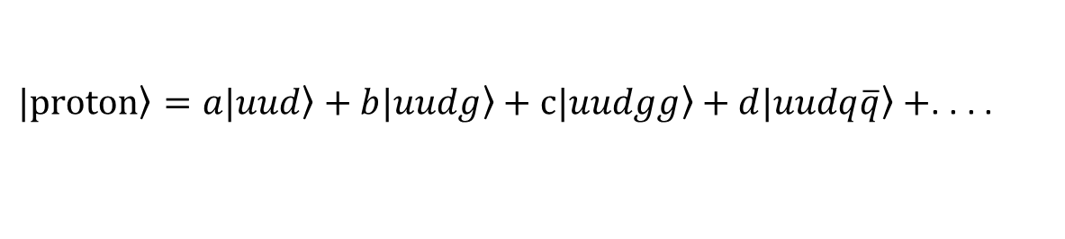
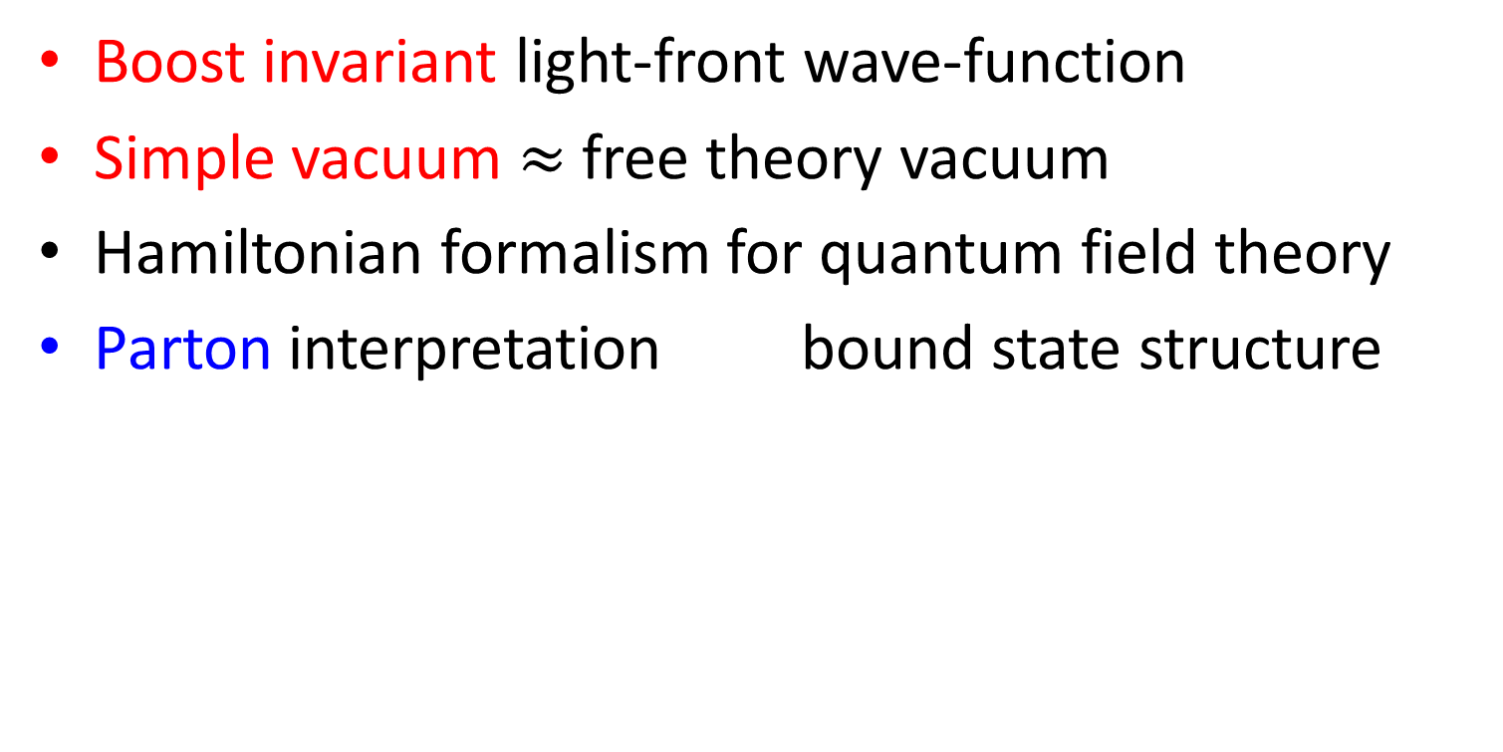
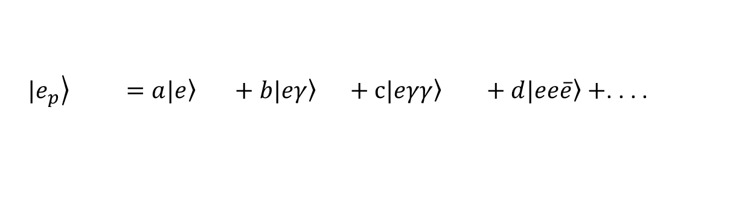
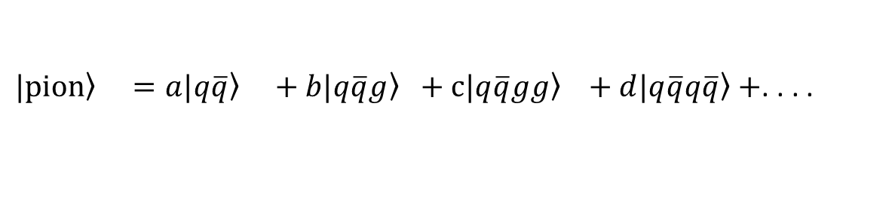
Why Go To Light-front?
Boost invariant light-front wave-function
Simple vacuum $≈$ free theory vacuum
Hamiltonian formalism for quantum field theory
Parton interpretation bound state structure
$\left.|e_{p}\right\rangle =a\left.|e\right\rangle +b\left.|eγ\right\rangle +c\left.|eγγ\right\rangle +d\left.|ee\overline{e}\right\rangle +$. . . .
$\left.|proton\right\rangle =a\left.|uud\right\rangle +b\left.|uudg\right\rangle +c\left.|uudgg\right\rangle +d\left.|uudq\overline{q}\right\rangle +$. . . .
$\left.|pion\right\rangle =a\left.|q\overline{q}\right\rangle +b\left.|q\overline{q}g\right\rangle +c\left.|q\overline{q}gg\right\rangle +d\left.|q\overline{q}q\overline{q}\right\rangle +$. . . .
. . . .

Slide 7
Basis Light-front Quantization
BLFQ: approach for solving quantum field theory
nonperturbative
for systems with strong interaction / strong background field
first-principles
accept first-principles / effective Hamiltonian as input
Hamiltonian formalism
direct access to wavefunction of bound states
light-front dynamics

Slide 8
Basis Light-front Quantization (BLFQ)
Stationary BLFQ
tBLFQ
Effective theory
QED
Laser physics
Heavy-ion
physics
positronium
electron
positronium
See Paul Wiecki’s talk
spectrum
g-2, GPDs

Slide 9
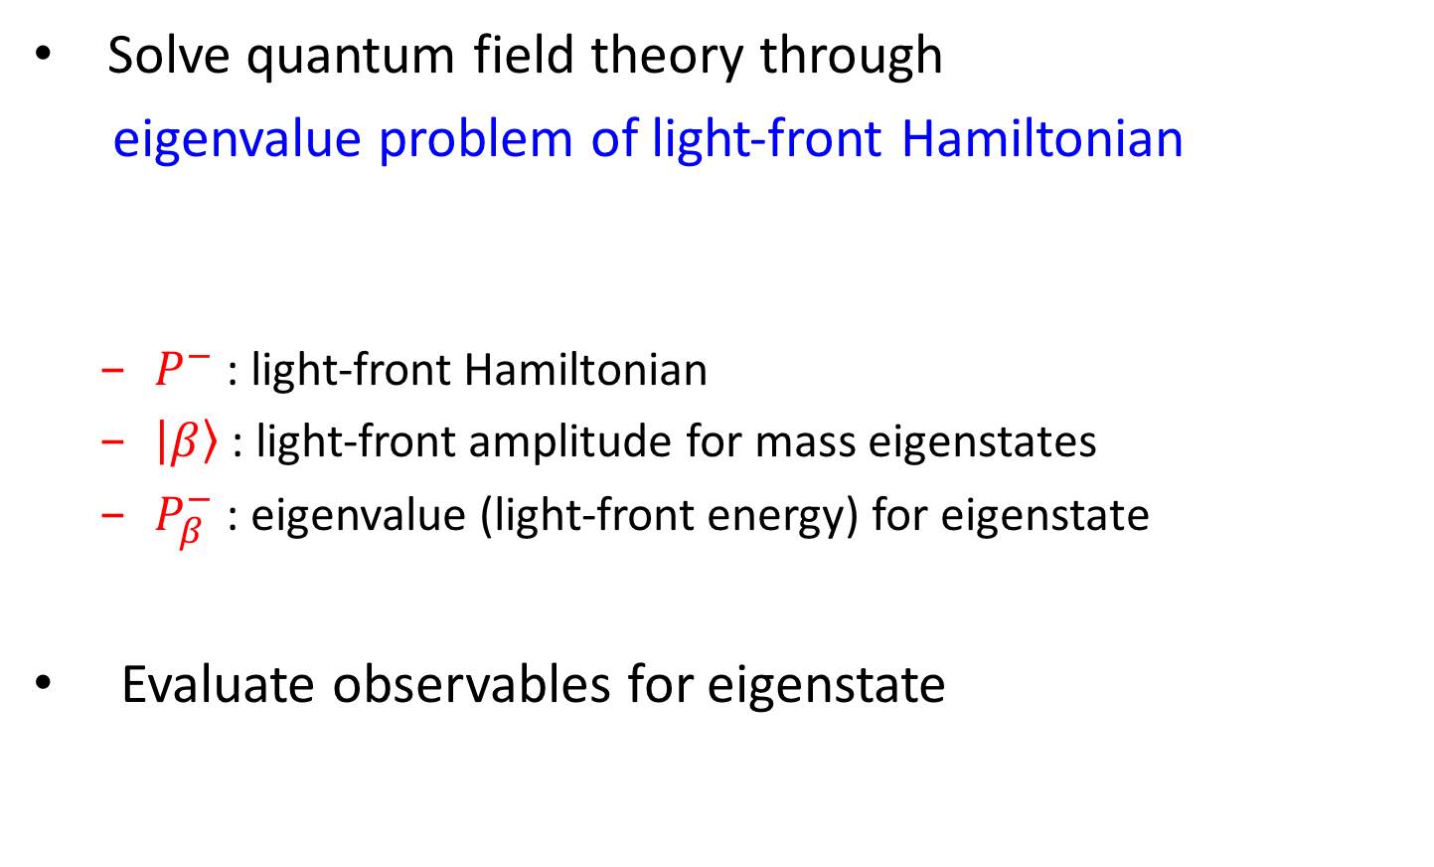
Basis Light-front Quantization
Solve quantum field theory through
eigenvalue problem of light-front Hamiltonian
$P^{−}$ : light-front Hamiltonian
$\left|\left.β\right\rangle \right.$ : light-front amplitude for mass eigenstates
$P_{β}^{−}$ : eigenvalue (light-front energy) for eigenstate
Evaluate observables for eigenstate

Slide 10
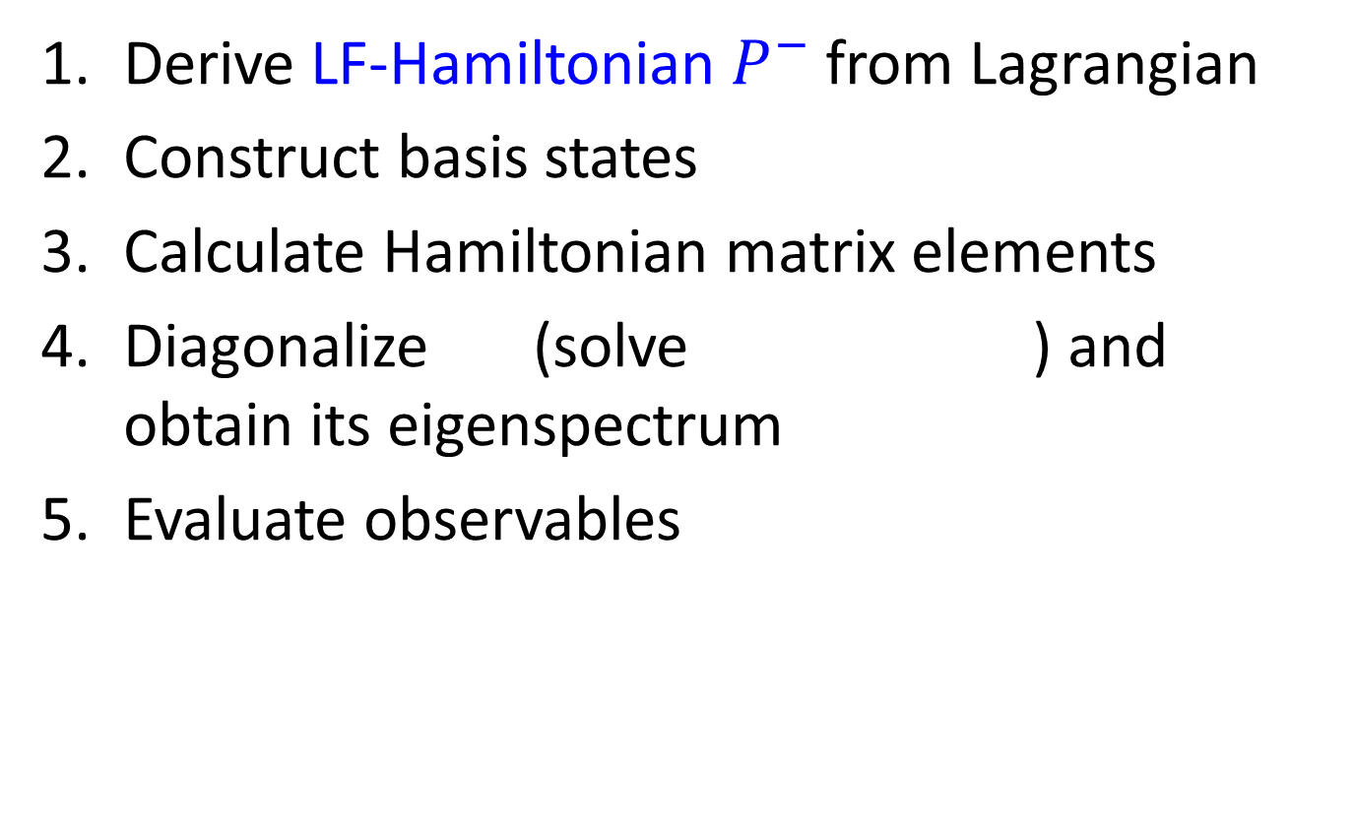
General Procedure for BLFQ
Derive LF-Hamiltonian $P^{−}$ from Lagrangian
Construct basis states
Calculate Hamiltonian matrix elements
Diagonalize (solve ) and obtain its eigenspectrum
Evaluate observables

Slide 11
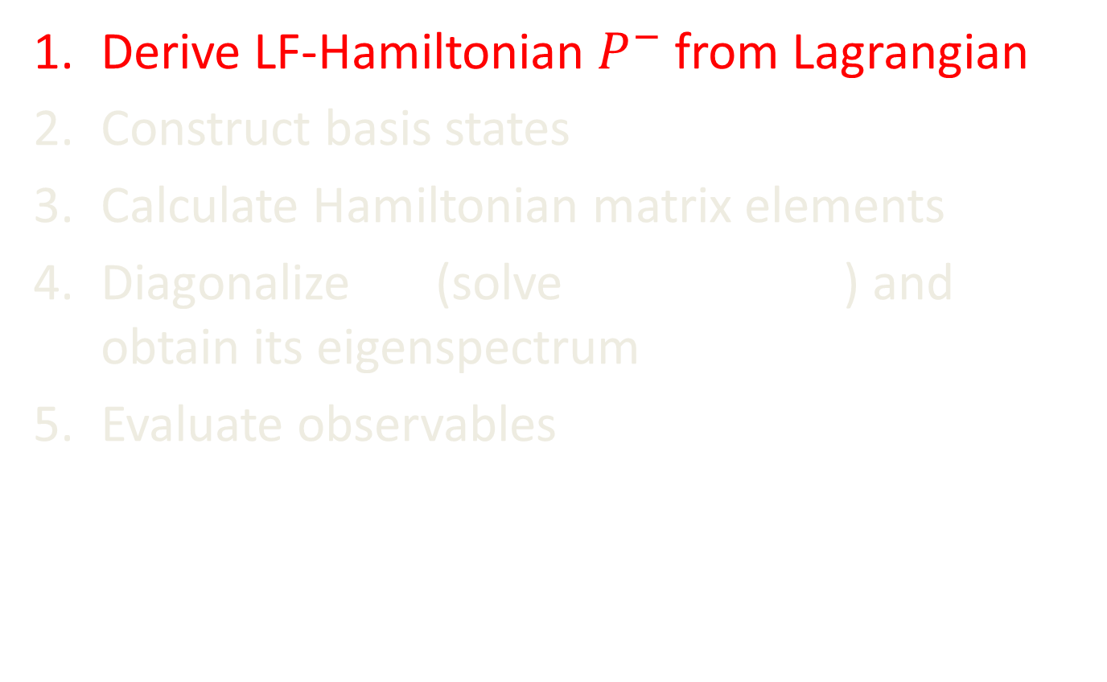
General Procedure for BLFQ
Derive LF-Hamiltonian $P^{−}$ from Lagrangian
Construct basis states
Calculate Hamiltonian matrix elements
Diagonalize (solve ) and obtain its eigenspectrum
Evaluate observables

Slide 12
Example: Obtain LF QED Hamiltonian
QED Lagrangian
Derived Light-front Hamiltonian
kinetic energy terms
vertex interaction
instantaneous photon interaction
instantaneous fermion interaction

Slide 13
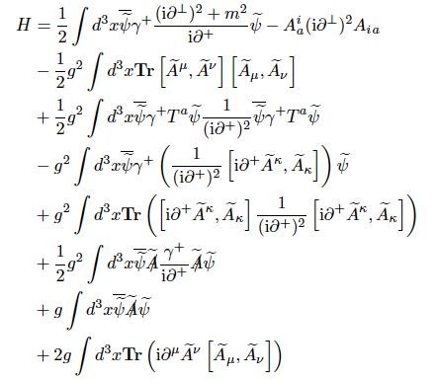

Slide 14

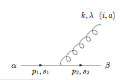

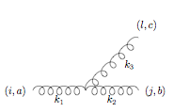
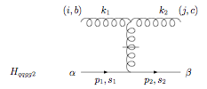
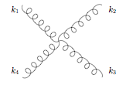
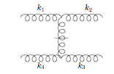
Elementary vertices in LF gauge
QED & QCD
QCD

Slide 15
General Procedure for BLFQ
Derive LF-Hamiltonian from Lagrangian
Construct basis states
Calculate Hamiltonian matrix elements
Diagonalize (solve ) and obtain its eigenspectrum
Evaluate observables

Slide 16
General Procedure for BLFQ
Derive LF-Hamiltonian from Lagrangian
Construct basis states
Calculate Hamiltonian matrix elements
Diagonalize (solve ) and obtain its eigenspectrum
Evaluate observables
Fock-sector expansion + 2D Harmonic Oscillator + 1D Planewave

Slide 17
Field Operator in BLFQ Basis
Orthonormal:
Complete:
=> Wide range of choices for and our choice is

Slide 18
Basis Construction
Example: single physical electron in QED
Fock-space expansion
e.g.
For each Fock particle:
transverse: 2D-HO basis ( ), labeled by n,m quantum number (HO basis parameter )
longitudinal: plane-wave basis, labeled by k
e.g.
with and

Slide 19
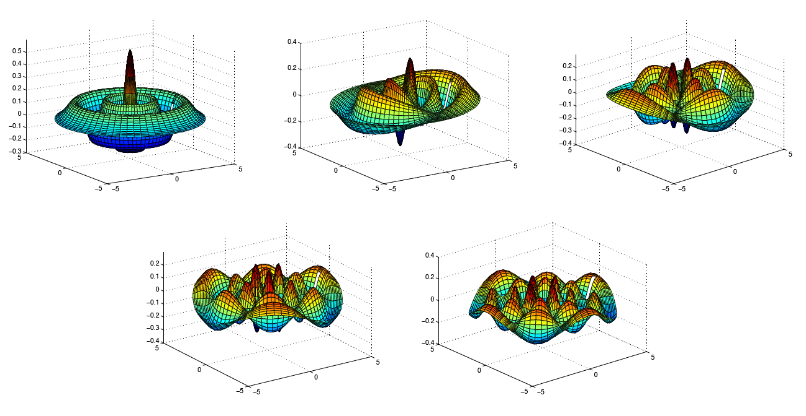
Set of Transverse 2D HO Modes for n=4
m=0
m=1
m=2
m=3
m=4
J.P. Vary, H. Honkanen, J. Li, P. Maris, S.J. Brodsky, A. Harindranath,
G.F. de Teramond, P. Sternberg, E.G. Ng and C. Yang, PRC 81, 035205 (2010).
ArXiv:0905:1411

Slide 20
Basis Reduction
“Pruning” based on symmetry of Hamiltonian:
- net fermion number:
- total angular momentum projection:
- longitudinal momentum:
- global color singlets (QCD)
Truncation:
- Fock sector truncation
- longitudinal periodic boundary condition
(integer or half integer k_{i})
- “N_{max}” truncation in the transverse directions

Slide 21
General Procedure for BLFQ
Derive LF-Hamiltonian from Lagrangian
Construct basis states
Calculate Hamiltonian matrix elements
Diagonalize (solve ) and obtain its eigenspectrum
Evaluate observables

Slide 22
QED Hamiltonian in BLFQ Basis
QED LF-Hamiltonian in a small basis: , N_{max}=2, K=1.5
(MeV)
 | 0.3482 (kinetic energy) | -0.0119 ( )
 | -0.0119 ( ) | 0.9139 (kinetic energy)
Eigenstates:

Slide 23
General Procedure for BLFQ
Derive LF-Hamiltonian from Lagrangian
Construct basis states
Calculate Hamiltonian matrix elements
Diagonalize (solve ) and obtain its eigenspectrum
Evaluate observables

Slide 24
Renormalization in BLFQ
Mass renormalization
sector dependent vs. order-of-coupling dependent
Wave function rescaling
“workaround” for broken Ward identity due to Fock-sector truncation

Slide 25
Eigenspectrum of QED (N_{f}=1)
invariant mass (MeV)
invariant mass (MeV)
Mass drops!
N_{max}=K-1/2
N_{max}=K-1/2
Single electron(bound state) + eγ scattering states (continuum)
Larger basis wider QED spectrum
Renormalization needed for obtaining physical electron mass

Slide 26
Renormalization: Mass
Mass renormalization needed for compensating mass correction due to self-energy interaction
Implementation
sector-dependent: mass counterterm in sector only (if we have )
adjust in iteratively through diagonalization until = 0.511MeV

Slide 27
Eigenspectrum of QED (N_{f}=1) after Renormalization and Removing CM Motion
invariant mass (MeV)
invariant mass (MeV)
N_{max}=K-1/2
N_{max}=K-1/2
Lagrangian multiplier method removes cm motion induced copies
Upon renormalization, physical electron mass (0.511MeV) is achieved

Slide 28
General Procedure for BLFQ
Derive LF-Hamiltonian from Lagrangian
Construct basis states
Calculate Hamiltonian matrix elements
Diagonalize (solve ) and obtain its eigenspectrum
Evaluate observables

Slide 29
General Procedure for BLFQ
Derive LF-Hamiltonian from Lagrangian
Construct basis states
Calculate Hamiltonian matrix elements
Diagonalize (solve ) and obtain its eigenspectrum
5. Adjust and repeat step 3 and 4 until
resulting =0.511MeV
6. Evaluate observables

Slide 30
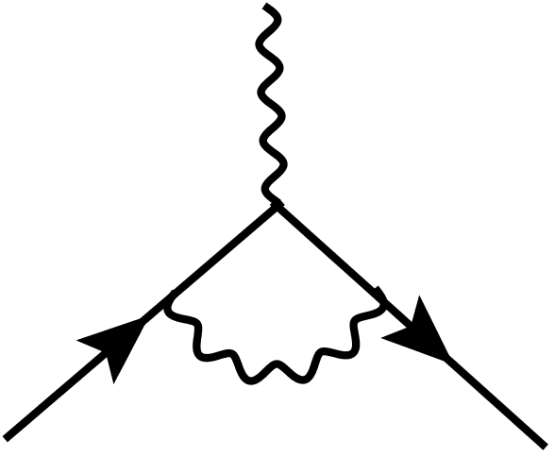
Evaluate Electron g-2 with BLFQ Approach
Electron anomalous magnetic moment
In pert. theory, the following loop gives the Schwinger’s result
In BLFQ , we first solve for the physical electron state , and then use it to sandwich the F₂ operator
[Schwinger 1948]

Slide 31
Electron g-2
[X. Zhao, H. Honkanen, P. Maris, J. P. Vary, S. J. Brodsky, PLB 737, (2014) 65 ]
Without wavefunction renormalization
Naive anomalous magnetic moment -> 0 as N_{max}-> ∞

Slide 32
Amplitude from Diagonalization
Diagrammatic representation of in

Slide 33
Renormalization: Problem
BLFQ amplitude has incorrect norm
norm of always < 1
Perturbative amplitude in has infinite norm
1
1
At small Nmax
Nmax -> ∞

Slide 34
Electron g-2
[X. Zhao, H. Honkanen, P. Maris, J. P. Vary, S. J. Brodsky, PLB 737, (2014) 65 ]
Without wavefunction renormalization
Both anomalous magnetic moment and Z₂ -> 0 as N_{max}-> ∞

Slide 35
Renormalization: Wavefunction
Problem in terms of diagram
Ward-identity broken by Fock-sector truncation
✓
present in
but
✗
truncated (would need )
✗
truncated (would need )

Slide 36
Renormalization: Wavefunction
Extract wavefunction renormalization factor
Rescale the wavefunction direct from diagonalization by

Slide 37
Renormalization: wavefunction
What about overall normalization?
introduce negative norm component in , denoted as so that
For observables
is restricted in sector

Slide 38
General Procedure for BLFQ
Derive LF-Hamiltonian from Lagrangian
Construct basis states
Calculate Hamiltonian matrix elements
Diagonalize (solve ) and obtain its eigenspectrum
5. Adjust and repeat step 3 and 4 until
resulting =0.511MeV
6. Evaluate observables

Slide 39
Single Electron in QED

Slide 40
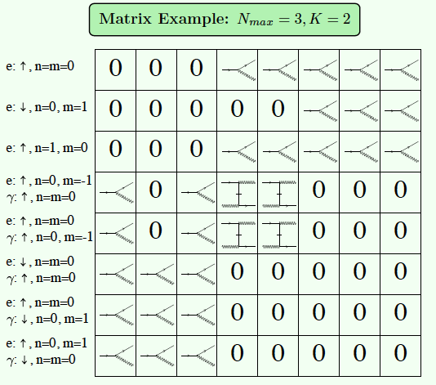
Single Physical Electron in QED
XZ, H. Honkanen, P. Maris, J. P. Vary, S. J. Brodsky,
Phys. Letts. B737, 65 (2014)
Fock-sector truncation:
Interaction part of the Hamiltonian
Ground state is identified as the physical electron

Slide 41
[Shuo, in preparation, 2016]
Fig. 3: Comparison of GPD E(x,q²) obtained from BLFQ and Light Cone perturbation theory, for selected q². Top panel: q² = 0, bottom panel: q² = 5MeV².
Fig. 4: Comparison of the Pauli form factor F₂ as a function of q² obtained from BLFQ and Light Cone perturbation theory. The Pauli form factor F₂ equals the integral of GPD E(x,q²) over the momentum fraction x.
[D. Chakrabarti, X. Zhao, P. Maris, J. P. Vary, PRD 89 (2014) 116004]

Slide 42
Fig. 1: Comparison of GPD H(x,q²) obtained from BLFQ and Light Cone perturbation theory, for selected q². Top panel: q² = 0, bottom panel: q² = 5MeV².
Fig. 2: Comparison of the Dirac form factor F₁ as a function of q² obtained from BLFQ and Light Cone perturbation theory. The Dirac form factor F₁ equals the integral of GPD H(x,q²) over the momentum fraction x.
In the perturbative calculation, UV and IR cutoffs are imposed on the transverse momenta to match the BLFQ basis truncation. UV cutoff , IR cutoff .

Slide 43
Generalized Parton Distribution for Electron
x
x
[D. Chakrabarti, X. Zhao, P. Maris, J. P. Vary, PRD 89 (2014) 116004]

Slide 44
Generalized Parton Distribution for Electron
As Q² increases both GPD H and E “collapse”
BLFQ results for GPD H and E agree with perturbative results

Slide 45
Electron g-2 & GPD E(x, t) BLFQ vs Perturbation Theory
X. Zhao, H. Honkanen, P. Maris, J. P. Vary, S. J. Brodsky, Phys. Letts. B737, 65 (2014)
Anomalous magnetic moment
Less than 0.1% deviation from Schwinger result for
Largest calculation with basis dim > 28 billion

Slide 46
Electron GPD H(x, t): BLFQ vs Perturbation Theory
H (x, t→0)
D. Chakrabarti, X. Zhao, H. Honkanen, R. Manohar, P. Maris, J. P. Vary, Phys. Rev. D89, 116004 (2014)
BLFQ results for GPD H agree with perturbative results
More observables are in progress: gravitational FFs, TMDs...

Slide 47
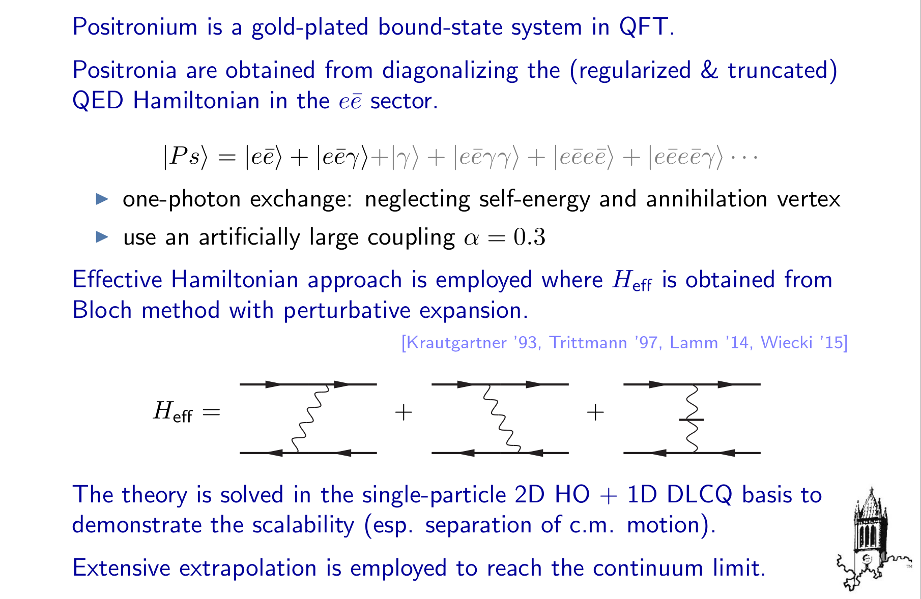
Application: Positronium

Slide 48
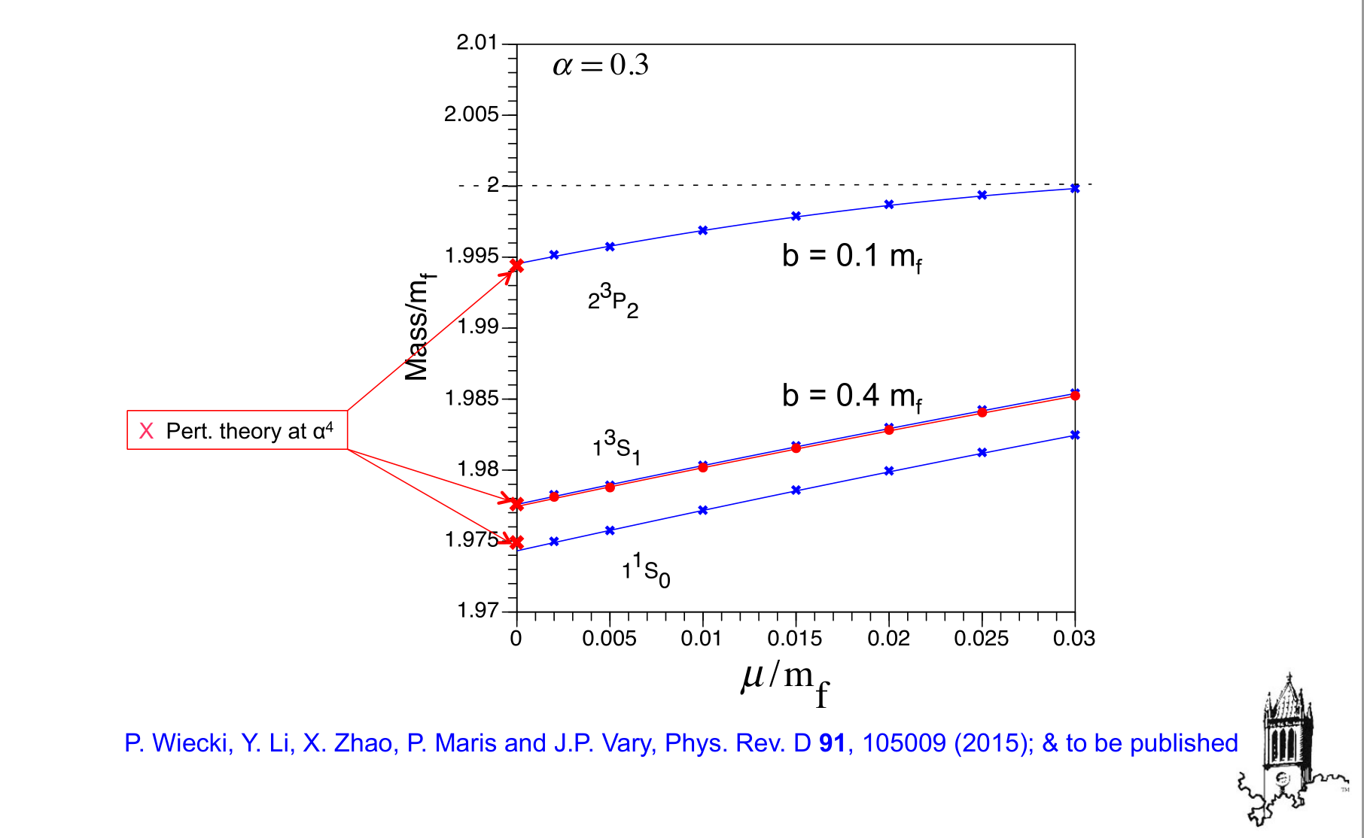
Positronium: Mass Spectrum

Slide 49
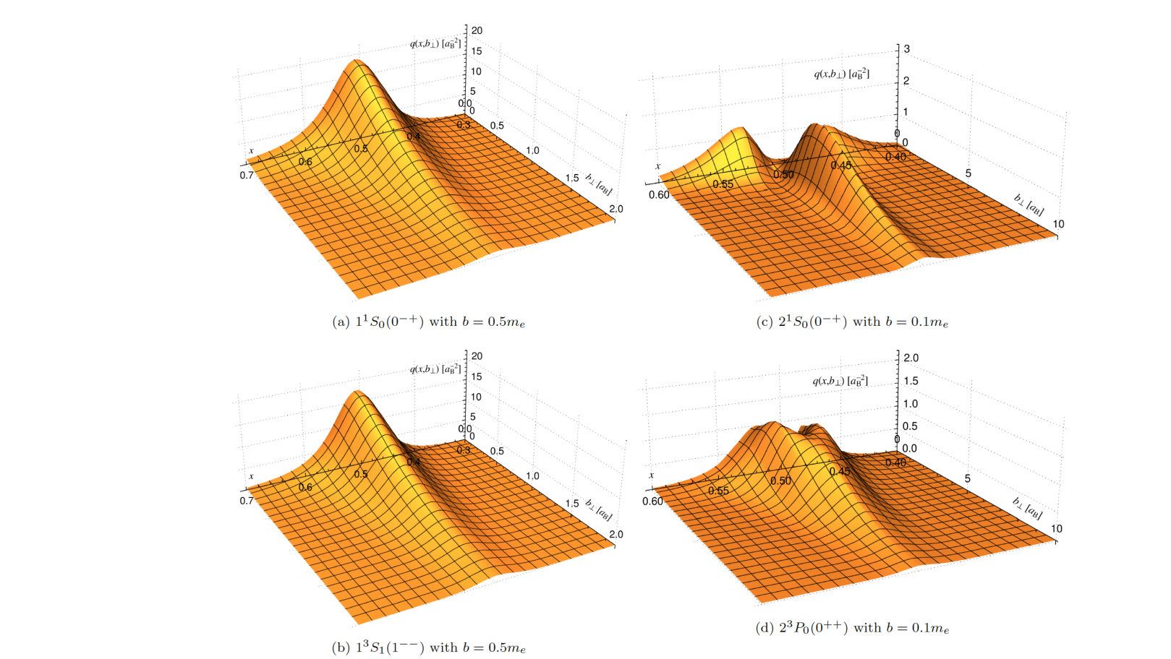
Positronium: GPD

Slide 50
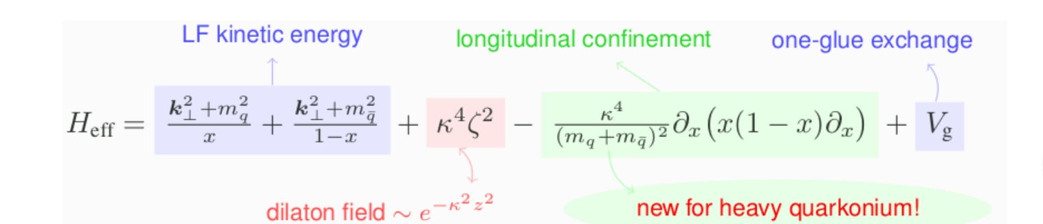
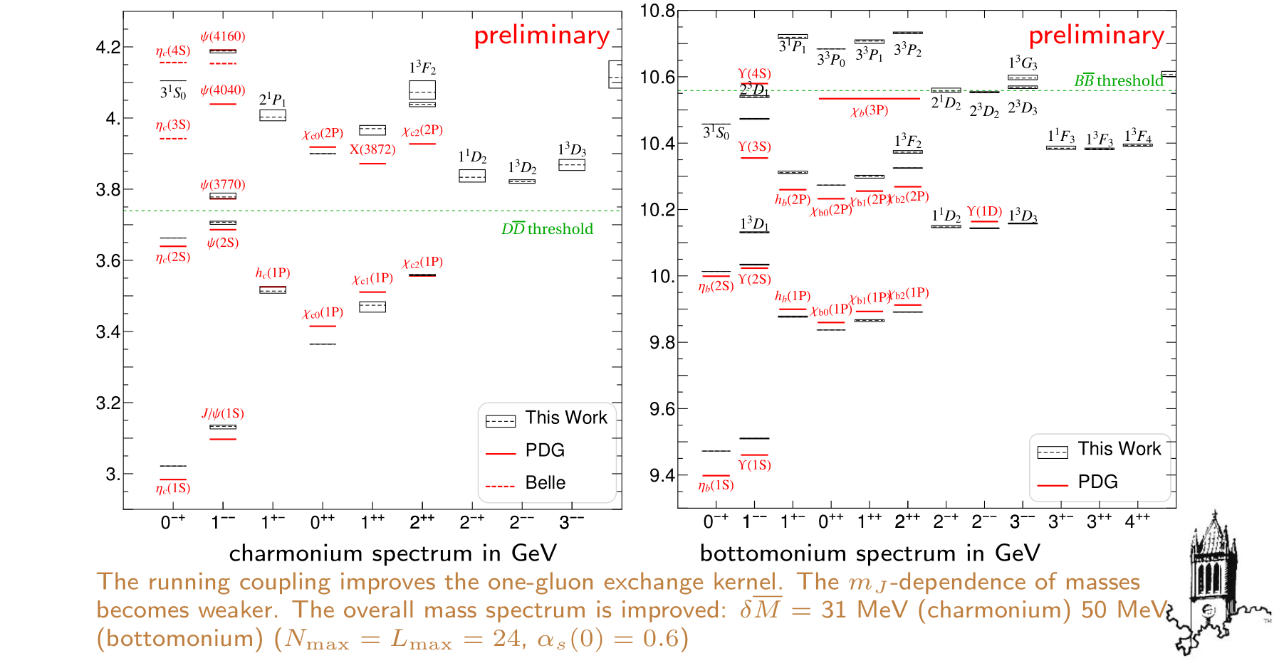
Heavy Quarkonium

Slide 51
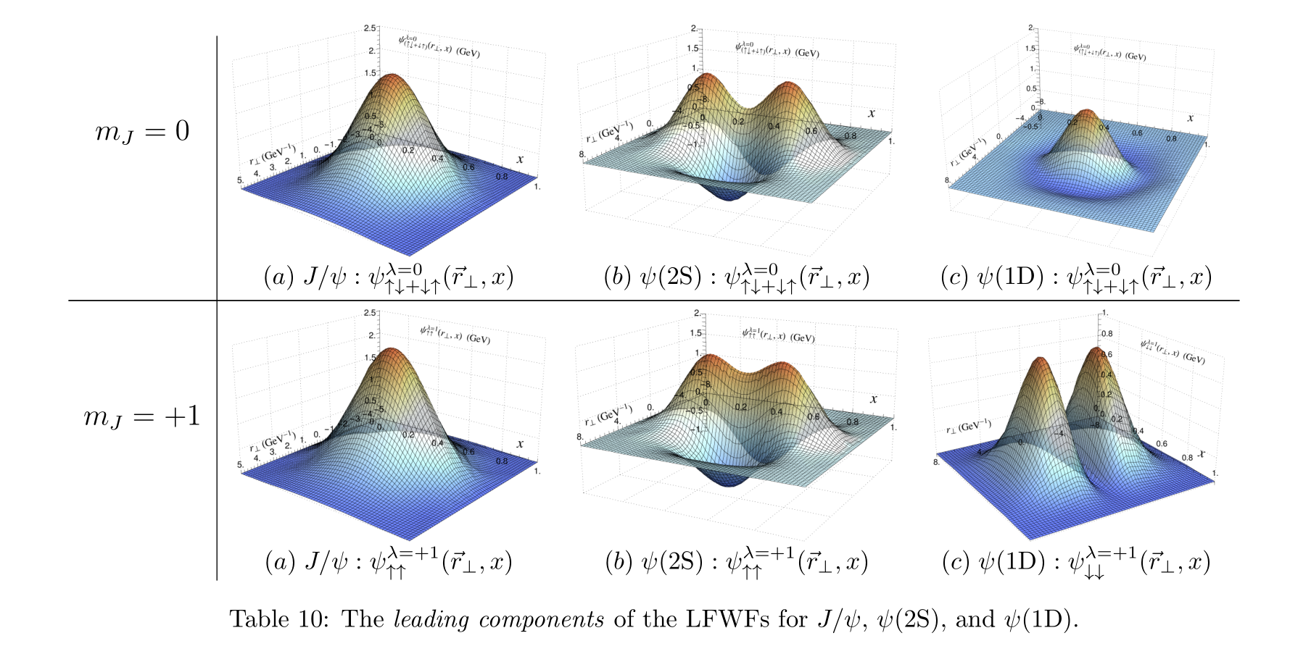
Charmonium Light-front Wavefunctions

Slide 52
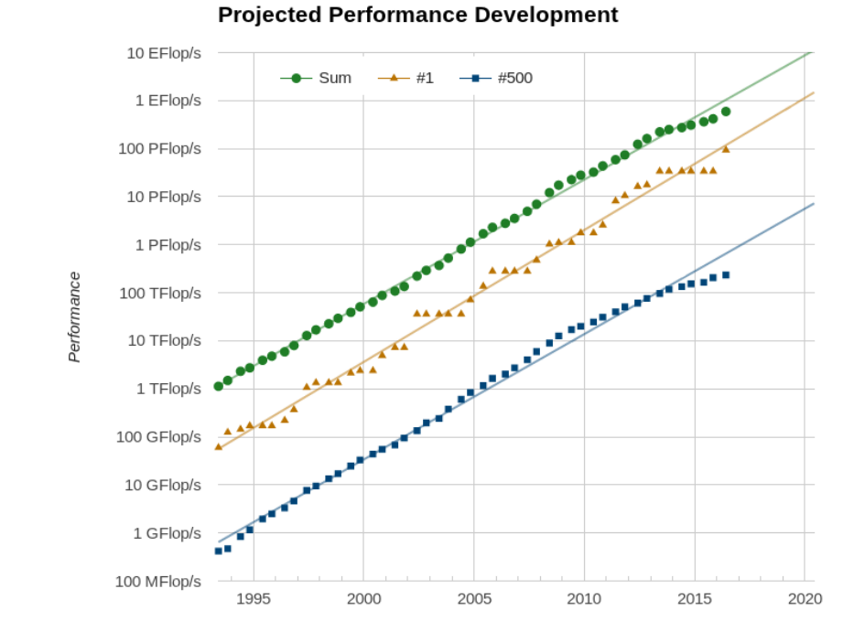
Challenges
Truncation leads to breaking of gauge symmetry
Non-perturbative renormalization
Basis dimensionality proliferates
Moore’s law for supercomputers

Slide 53
Positronium and Heavy-quarkonium
e⁺
γ
e⁻

Slide 54
Amplitude from Diagonalization

Slide 55
Two Approaches
Two-body effective interaction
2. Renormalization

Slide 56
Goal

Slide 57
Two Approaches
Two-body effective interaction
2. Renormalization

Slide 58
Two-body Effective Interaction
P ( ) and Q ( ) space
Find H_{eff} (acts only in P but includes effects in Q)
H_{QED}:
H_{eff}:
PHP
PHQ
H_{eff}
0
QHP
QHQ
0
0

Slide 59
Example: Obtain LF QED Hamiltonian
QED Lagrangian
Derived Light-front Hamiltonian
kinetic energy terms
PHP, QHQ
PHQ,QHP
vertex interaction
instantaneous photon interaction
instantaneous fermion interaction

Slide 60
Two-body Effective Interaction
contains , which is unknown
Eliminate

Slide 61
Two-body Effective Interaction
An ad hoc approximation
This choice cancels out the singularity from instantaneous photon interaction explicitly

Slide 62
Numerical Results
Positronium spectrum at N_{max}=K=19,
is a fictitious photon mass to regulate Coulomb singularity
[P.Wiecki, Y.Li, X. Zhao, P. Maris, J. P. Vary, arXiv: 1404.6234]

Slide 63
Numerical Results
In N_{max}, K , limit, excellent agreement with NR quantum mechanics + pert. theory
is a fictitious photon mass to regulate Coulomb singularity
[P.Wiecki, Y.Li, X. Zhao, P. Maris, J. P. Vary, arXiv: 1404.6234]

Slide 64
Numerical Results
Observable: parton distribution function
is the longitudinal momentum fraction of the constituent electron

Slide 65
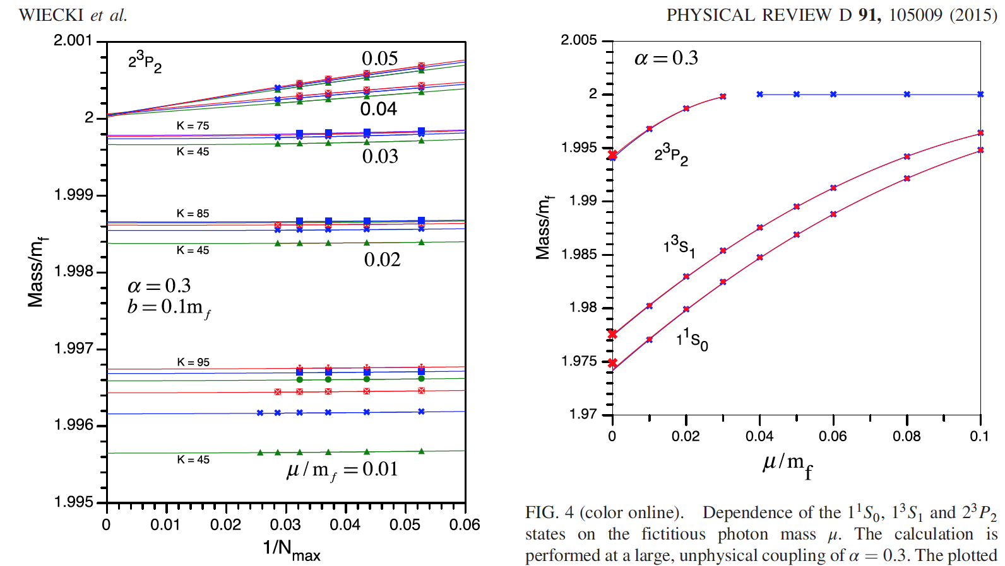
Positronium in QED at Strong Coupling
Covariant Basis Light-Front Quantization (BLFQ)
Examine this region
with greater resolution
in the next slide
X Pert. theory at α⁴
X Pert. theory at α⁴
X Pert. theory at α⁴
P. Wiecki, Y. Li, X. Zhao, P. Maris and J.P. Vary, Phys. Rev. D 91, 105009 (2015)

Slide 66
Positronium in QED at Strong Coupling
Covariant Basis Light-Front Quantization (BLFQ)
b = 0.1 m_{f}
b = 0.4 m_{f}
X Pert. theory at α⁴
P. Wiecki, Y. Li, X. Zhao, P. Maris and J.P. Vary, Phys. Rev. D 91, 105009 (2015); & to be published

Slide 67
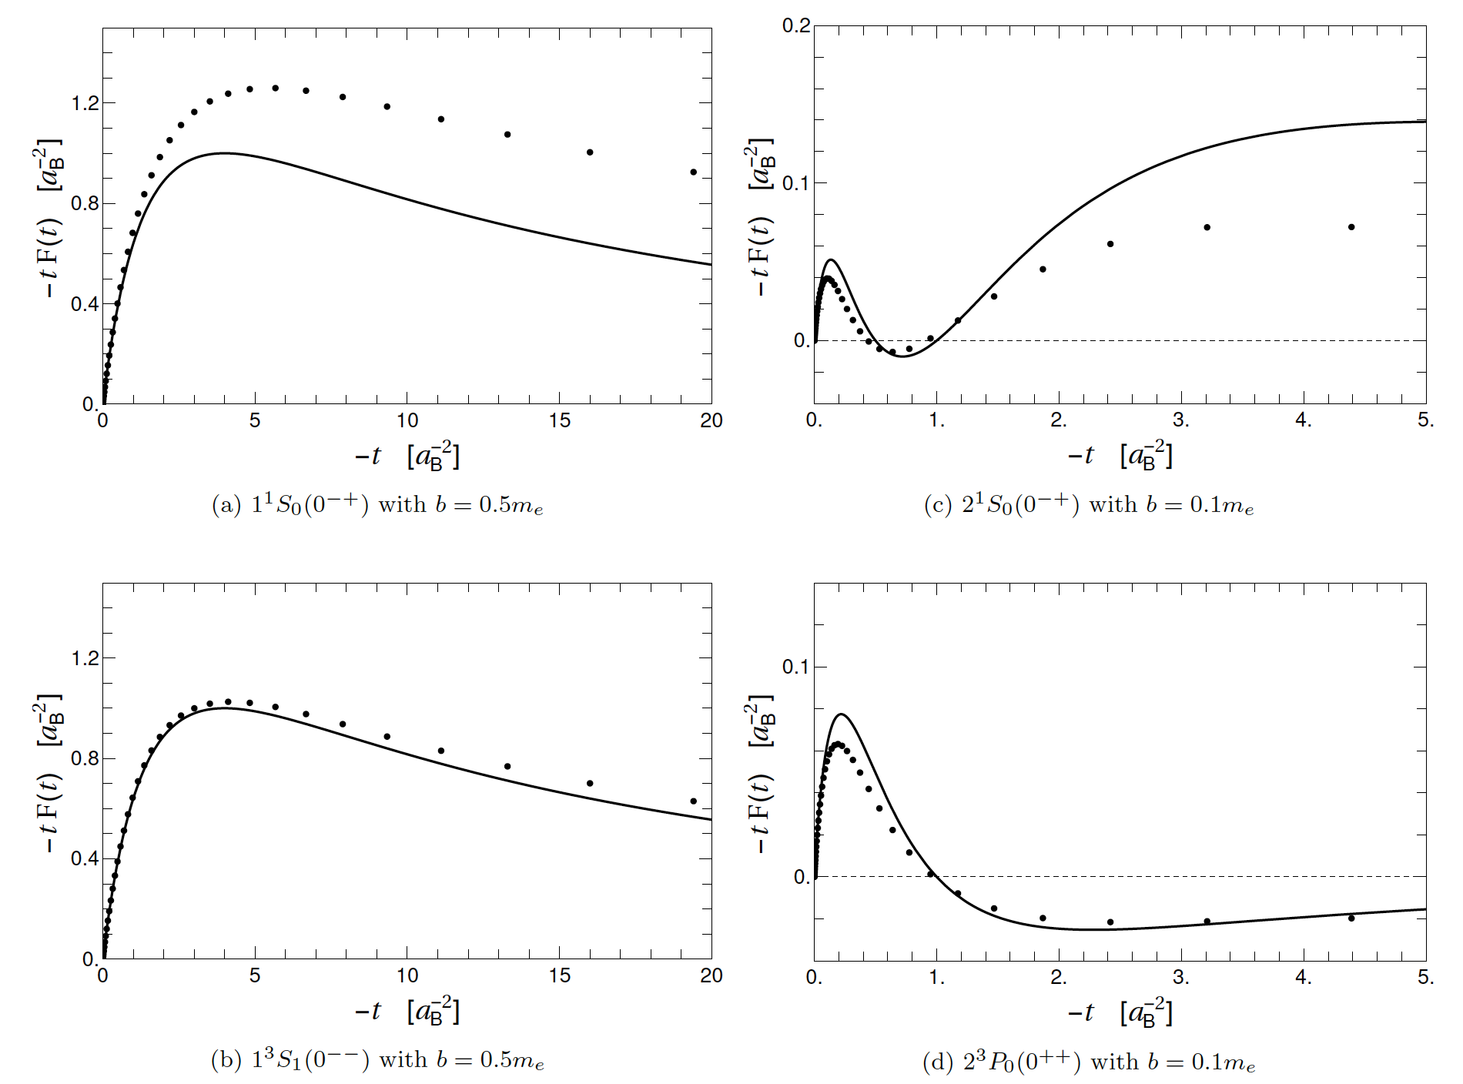
Form Factors for Positronium with BLFQ (α=0.3, N_{max} = 31, K = 61)
Dotted Lines: BLFQ Solid Lines: NRQM
Lekha Adhikari, Yang Li, Pieter Maris, Xingbo Zhao, James P. Vary and Alaa Abd El-Hady, in preparation

Slide 68
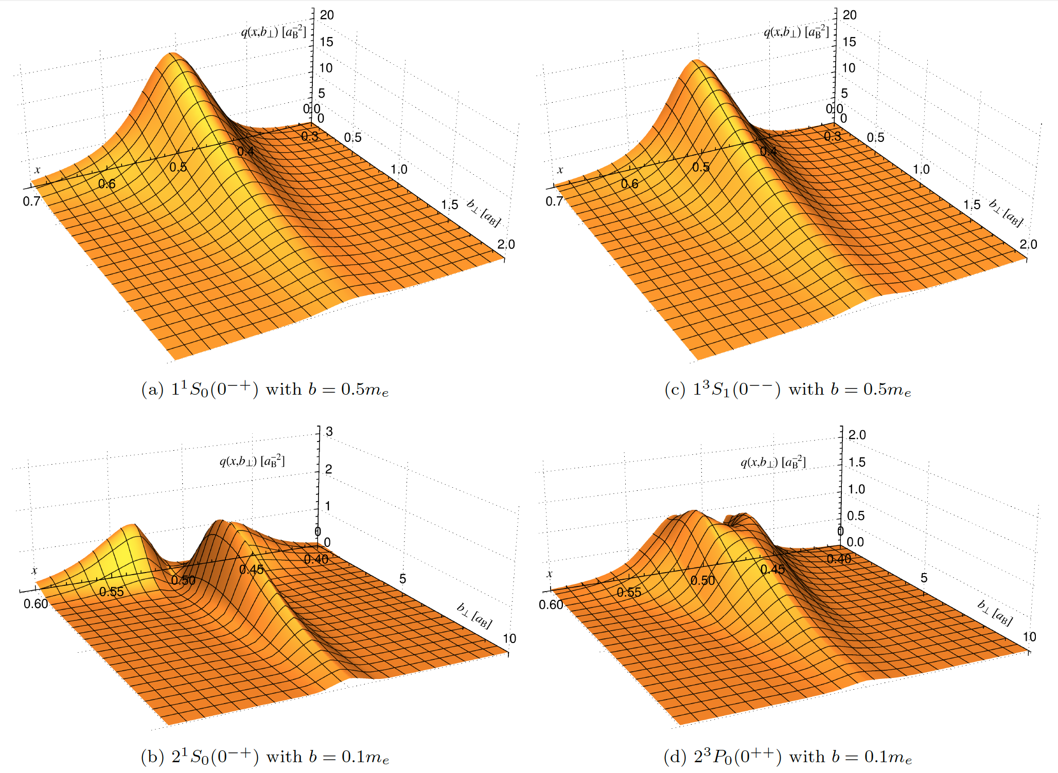
Impact-Parameter Dependent GPDs
Positronium with BLFQ (α=0.3, N_{max} = 31, K = 61)
Lekha Adhikari, Yang Li, Pieter Maris, Xingbo Zhao, James P. Vary and Alaa Abd El-Hady, in preparation

Slide 69
Light Front Holographic H + mass terms + gluon exchange + longitudinal confinement
For the q – anti-q sector this is given by:
LF kinetic energy
longitudinal confinement
one-gluon exchange
dilaton field
Brodsky, et al, 2015
H in the q-anti-q sector
Yang Li, Pieter Maris, Xingbo Zhao and James P. Vary, arXiv:1509.07212

Slide 70
Yang Li, Pieter Maris, Xingbo Zhao and James P. Vary, arXiv:1509.07212

Slide 71
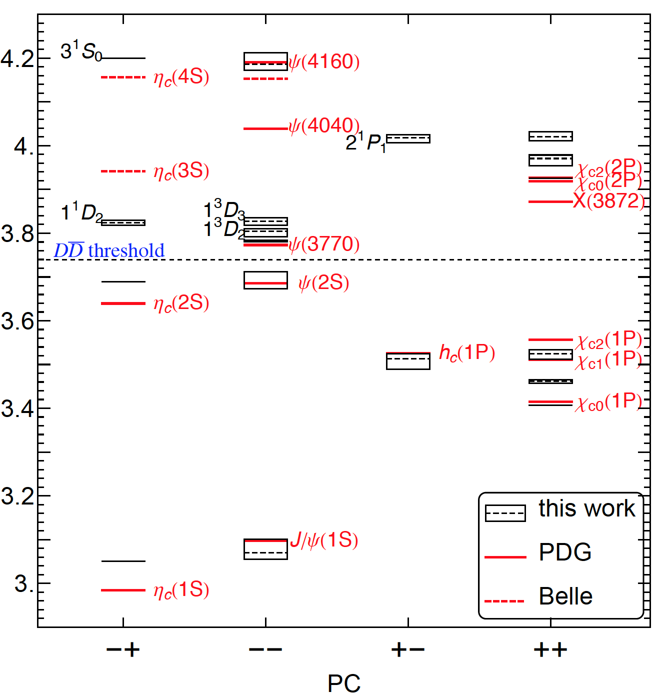
N_{max} = L_{max} = 16
α = 0.25
m_{c} = 1.549 GeV
κ = 0.952 GeV
Yang Li, Pieter Maris,
Xingbo Zhao and
James P. Vary,
arXiv:1509.07212

Slide 72
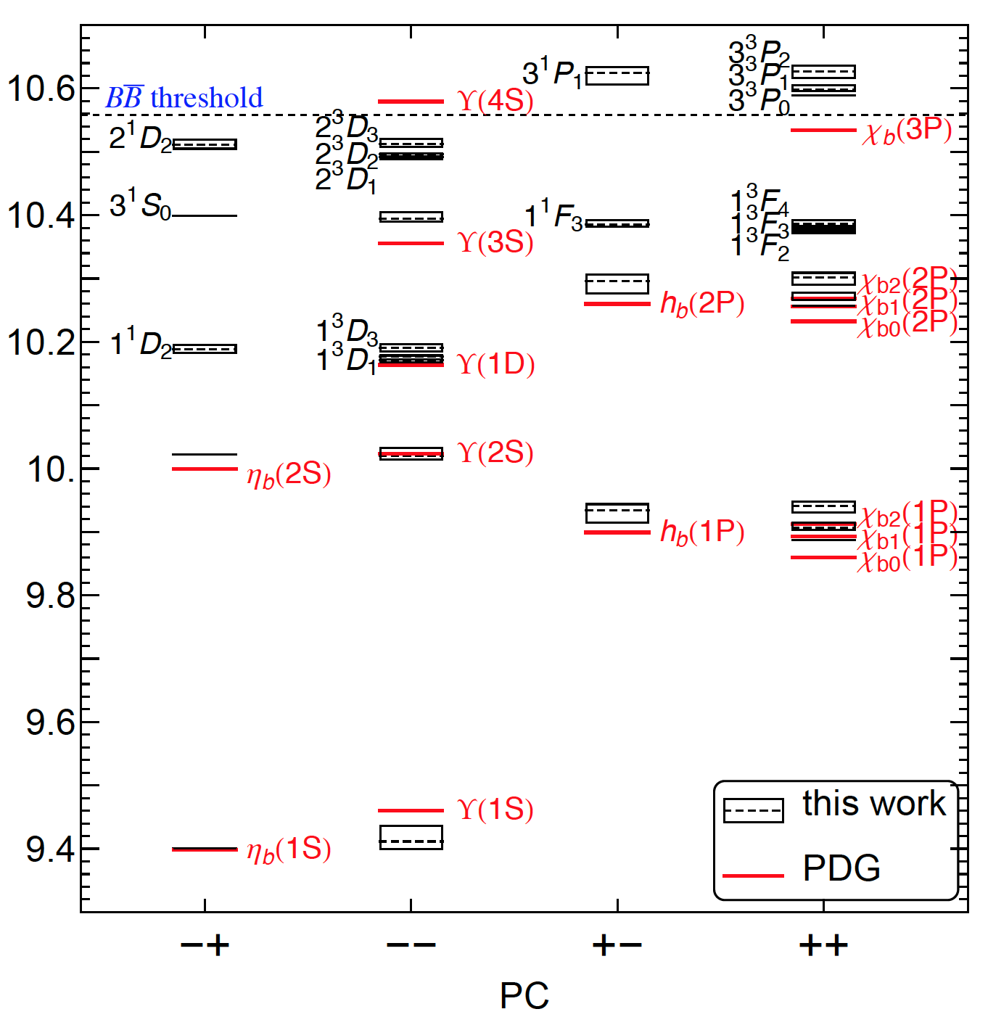
N_{max} = L_{max} = 16
α = 0.25
m_{c} = 4.980 GeV
κ = 1.249 GeV
Yang Li, Pieter Maris,
Xingbo Zhao and
James P. Vary,
arXiv:1509.07212

Slide 73
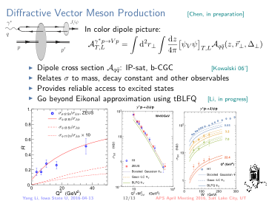

Slide 74
Yang Li, Pieter Maris, Xingbo Zhao and James P. Vary, arXiv:1509.07212

Slide 75
Yang Li, Pieter Maris, Xingbo Zhao and James P. Vary, arXiv:1509.07212

Slide 76
Yang Li, Pieter Maris, Xingbo Zhao and James P. Vary, arXiv:1509.07212

Slide 77
Yang Li, Pieter Maris, Xingbo Zhao and James P. Vary, arXiv:1509.07212

Slide 78
Two Approaches
Two-body effective interaction
2. Renormalization

Slide 79
Remove Blobs
Both and are cutoff dependent!
Basis state dependent and
Solve a series of
embedded single electron systems

Slide 80
Wavefunction Renormalization
Take the positronium wavefunction in from diaganalization,
Rescale by for each basis state
Assemble from embedded
Introduce negative norm component in
to fix the overall norm

Slide 81
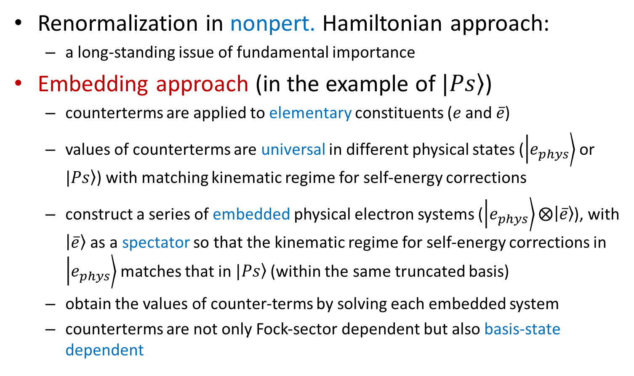
Renormalization
Renormalization in nonpert. Hamiltonian approach:
a long-standing issue of fundamental importance
Embedding approach (in the example of $\left.|Ps\right\rangle$)
counterterms are applied to elementary constituents ($e$ and $\overline{e}$)
values of counterterms are universal in different physical states ($\left.\left|e_{phys}\right.\right\rangle$ or $\left.|Ps\right\rangle$) with matching kinematic regime for self-energy corrections
construct a series of embedded physical electron systems ($\left.\left|e_{phys}\right.\right\rangle ⨂\left.\left|\overline{e}\right.\right\rangle$), with $\left.\left|\overline{e}\right.\right\rangle$ as a spectator so that the kinematic regime for self-energy corrections in $\left.\left|e_{phys}\right.\right\rangle$ matches that in $\left.|Ps\right\rangle$ (within the same truncated basis)
obtain the values of counter-terms by solving each embedded system
counterterms are not only Fock-sector dependent but also basis-state dependent

Slide 82
Embedded Single Electron
Photon is only allowed to be coupled to the electron not the positron (spectator)
Spectator exists for occupying quantum numbers imitating the situation in positronium
Evaluate for each basis state in

Slide 83

Test Case
Mass counterterm from solving
the embedded electron system
Without renormalization
Preliminary
$$α=\frac{1}{π}$$
N_{max1}=2
With renormalization
DA: w/o wavefunction rescaling
RA: w/ wavefunction rescaling
[X. Zhao, Few Body Syst 56 (2015) 257]

Slide 84
Test Case
Mass counterterm
of the embedded electron system
Without renormalization
Preliminary
Nmax1=K=2
With renormalization

Slide 85
Outline
Basis Light-Front Quantization (BLFQ)
Electron
Positronium
Heavy quarkonium
Time-dependent Basis Light-Front Quantization (tBLFQ)
Strong field laser physics
Electron-Ion collision

Slide 86
Time-dependent Basis Light-front Quantization
BLFQ: for quantum field eigenspectrum
tBLFQ: for quantum field evolution
Real-time framework: BLFQ tBLFQ
tBLFQ is designed for:
time-dependence in dynamical processes
in strong/time-dependent background field
BLFQ
tBLFQ

Slide 87
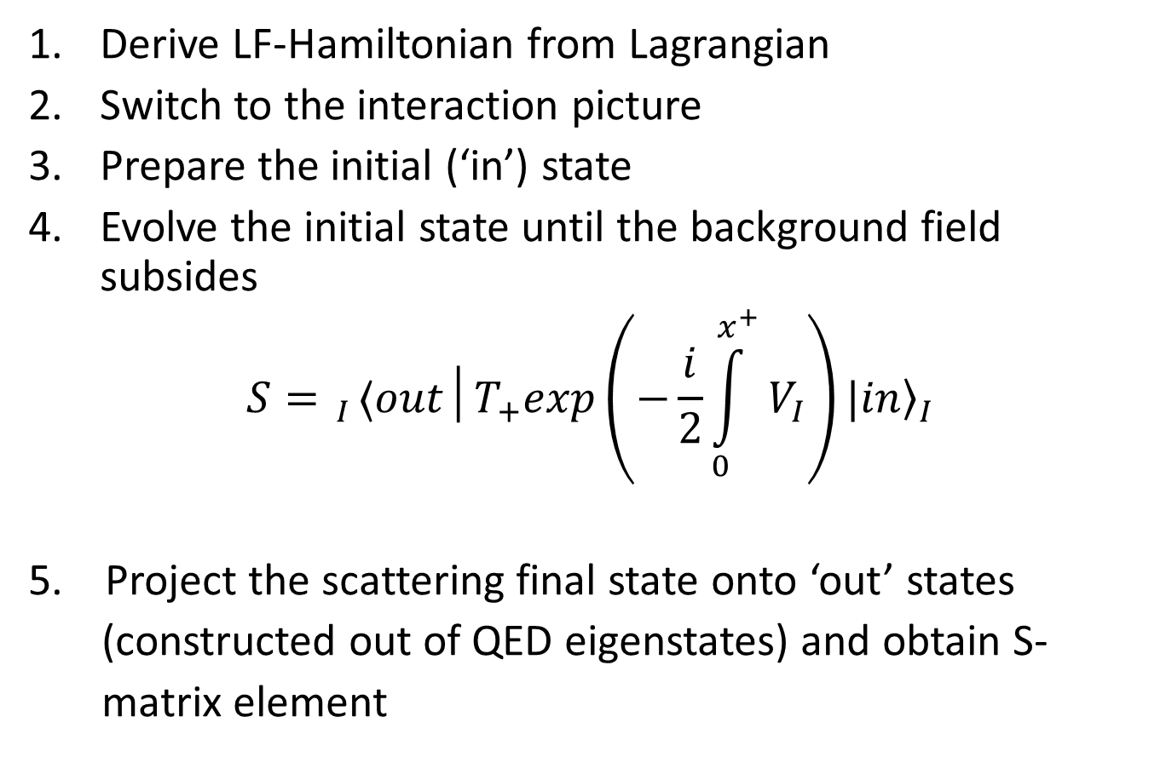
General Procedure for tBLFQ
Derive LF-Hamiltonian from Lagrangian
Switch to the interaction picture
Prepare the initial (‘in’) state
Evolve the initial state until the background field subsides
$$S= _{I}⟨out│T_{+}exp\left(−\frac{i}{2}\int_{0}^{x^{+}}{V_{I}}\right){\left.|in\right\rangle }_{I}$$
5. Project the scattering final state onto ‘out’ states
(constructed out of QED eigenstates) and obtain S-
matrix element

Slide 88
Time-dependent Basis Light-front Quantization
BLFQ: for quantum field eigenspectrum
tBLFQ: for quantum field evolution
Real-time framework: BLFQ tBLFQ
tBLFQ is designed for:
time-dependence in dynamical processes
in strong/time-dependent background field
BLFQ
tBLFQ

Slide 89
General Procedure for tBLFQ
Derive Light-front Hamiltonian from Lagrangian
Switch to the interaction picture
Prepare the initial (‘in’) state
Evolve the initial state until the background field subsides
Project the scattering final state onto ‘out’ states (constructed out of QED eigenstates) and obtain S-matrix element

Slide 90
General Procedure for tBLFQ
Derive Light-front Hamiltonian from Lagrangian
Switch to the interaction picture
Prepare the initial (‘in’) state
Evolve the initial state until the background field subsides
Project the scattering final state onto ‘out’ states (constructed out of QED eigenstates) and obtain S-matrix element

Slide 91
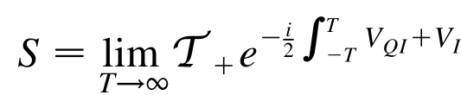
General Procedure for tBLFQ
Derive Light-front Hamiltonian from Lagrangian
Switch to the interaction picture
Prepare the initial (‘in’) state
Evolve the initial state until the background field subsides
Project the scattering final state onto ‘out’ states (constructed out of QED eigenstates) and obtain S-matrix element

Slide 92
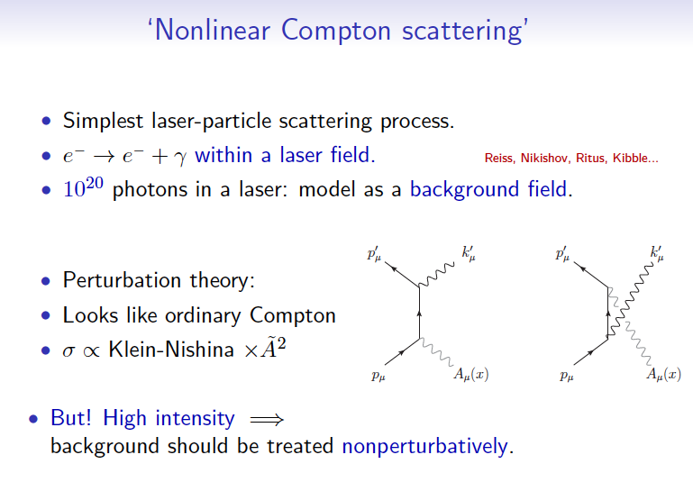
Application to Strong QED: Nonlinear Compton Scattering
10²⁰ photons in a laser: model as background field
Perturbation theory:
At high intensity:
non-perturbative
treatment needed

Slide 93
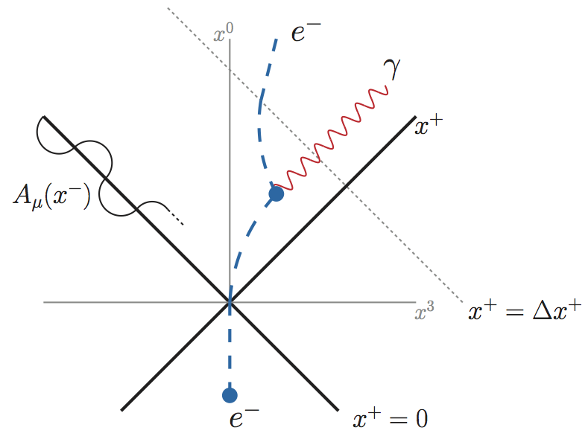
Setup for Nonlinear Compton Scattering
Space-time structure
Two effects: acceleration and radiation
[Zhao, Ilderton, Maris, Vary, PRD 88, 035205 (2013)]
Notes:
The specific process we study is called the nonlinear compton effect, in which an electron absorbs multiple photons from the background laser field and emits a single photon with a frequency which is usually different from the laser frequency. The specific experimental setup in our test case is as follows: initially we put an electron rest in the lab frame and shoot a laser beam to it. At x^0=0 it starts interacting with the laser field, it is accelerated by the laser field as seen from the fact that its trajectory is deflected toward the lightfront surface, in the mean time the electron emits a photon due to bremstrauhlung, after the photon emission the electron continued to be accelerated until leaving the laser area. We also note that the propagating laser beam in the equal-time coordinates sweep out a trajectory between x^+=0 and x^+=Deltax^+ two lines, so propagating

Slide 94
Setup for Nonlinear Compton Scattering
Space-time structure
Two effects: acceleration and radiation
Laser trajectory
[Zhao, Ilderton, Maris, Vary, PRD 88, 035205 (2013)]
Notes:
The specific process we study is called the nonlinear compton effect, in which an electron absorbs multiple photons from the background laser field and emits a single photon with a frequency which is usually different from the laser frequency. The specific experimental setup in our test case is as follows: initially we put an electron rest in the lab frame and shoot a laser beam to it. At x^0=0 it starts interacting with the laser field, it is accelerated by the laser field as seen from the fact that its trajectory is deflected toward the lightfront surface, in the mean time the electron emits a photon due to bremstrauhlung, after the photon emission the electron continued to be accelerated until leaving the laser area. We also note that the propagating laser beam in the equal-time coordinates sweep out a trajectory between x^+=0 and x^+=Deltax^+ two lines, so propagating

Slide 95
QED in background EM field
Time dependence is in external field only
In interaction picture, one need only treat external field induced evolution
Need to work in the eigenstate basis of , obtained by solving

Slide 96
A Simple Laser Field Profile
Key properties:
is treated classically
is in lightcone gauge,
is uniform in x^{1,2} and light-front time x⁺
depends on x⁻ : electric field in longitudinal (x⁻) direction
describes the field strength
describes the laser field’s spatial frequency in x⁻
Notes:
As a test case we calculate results with a simple form for the laser profile. With this laser profile the laser interaction Hamiltnonian term V is related to the laser field similar to the usual JA coupling, with the laser field A has only lower + component and it depends only on the longitudinal coordinate x^-. This laser profile can be interpreted as static electric field in the longitudinal direction. A_0 describes the intensity of the laser field and omega describes the laser field’s spatial frequency in x^-, which can also be interpreted as the longitudinal momentum carried by the laser field.

Slide 97
Results: Nonlinear Compton Scattering
[Zhao, Ilderton, Maris, Vary, PRD 88, 035205 (2013)]
Laser profile: with
Basis space: , N_{max}=8, K: 1.5+3.5+5.5 (three segments)
Initial state (x⁺=0): ground state electron in K=1.5 segment
time (x⁺) evolution
invariant mass (MeV)
invariant mass (MeV)
Notes:
Now let’s come to the numerical results. In this case the laser amplitude is on the same order of the electron mass, so it is expected to be in the nonperturbative regime. The basis includes states with three different longitudinal momenta, 1,4,7 MeVs. The initial state is an electron with longitudinal momenta K=1 MeV. These figures are snapshots of the evolving electron system. In these figures each dot represents a basis state for the system. The y-axis represents its probability and the x-axis represents its invariant mass. The states with invariant mass=0.6 are single-electron states. And the states with invariant mass >0.6 are the electron-photon pair states. Initially the only state in the system is the initial state K=1 ground state electron, no excited states. As time evolves, the single electron states with K=4 eventually 7 emerge as the result of the acceleration by the laser field. At the same time we see excited states populated as a result of the bremsstrahlung.

Slide 98
Results: Nonlinear Compton Scattering
single e states in K=1.5,3.5,5.5 segments
eγ states in K=1.5,3.5,5.5 segments
Acceleration and radiation are treated in the same Hilbert space
Entire process is nonperturbative (initial state changes significantly)
time (x⁺) evolution
invariant mass (MeV)
invariant mass (MeV)
[Zhao, Ilderton, Maris, Vary, PRD 88, 035205 (2013)]
Notes:
From this series of snapshots we can see that the two key effects in the nonlinear Compton scattering acceleration and radiation, are treated in a unified framework. We notice that at the end of evolution the initial state is almost gone.. So it is not a perturbation to the initial state, it is indeed a nonperturbative process.

Slide 99
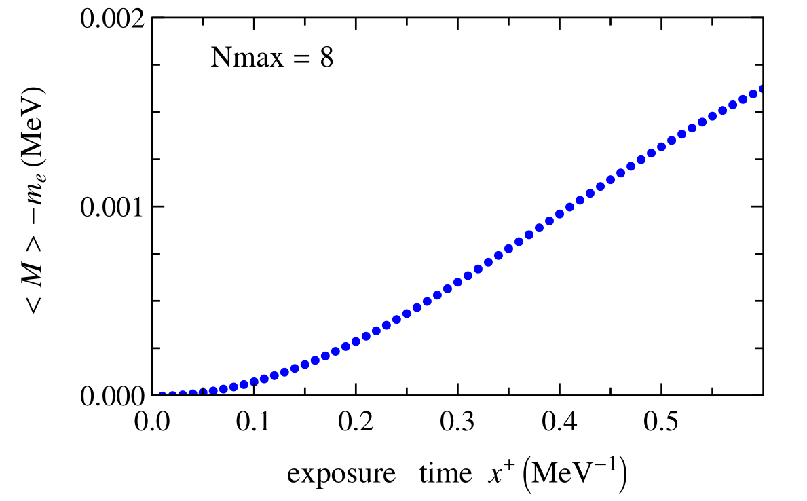
Invariant Mass Increases Over Time
Invariant mass increases due to photon emission, reflecting energy injection by the background laser field
Experimentally accessible by measuring and
[Zhao, Ilderton, Maris, Vary, PRD 88, 035205 (2013)]

Slide 100
Application to Relativistic Heavy-ion Physics
Classical fields generated by a moving heavy-ion from Maxwell equations
Electron treated as a quantum object moving in classical fields
e
Ion
[Guangyao Chen, et al, in preparation]

Slide 101
Goal
Full quantum time-dependent treatment for nuclear scattering process

Slide 102
Effects of relativistic ion on electron
Transition Rate – Non-perturbative effects
Notes:
Transition rate of an electron by the potential which is generated by nuclei with atomic number $Z=1,28,56,79$, the coupling between electron and background field $\alpha \equiv Z \alpha_\text{em}$ is $1/137,28/137,56/137,79/137$ respectively. The nucleus is moving along positive $z$-axis with $y=5.3$. The initial and final states are kinetic energy eigenstates with energies $P^\LCm_{\beta,i}=0.455$~GeV and $P^\LCm_{\beta,f}=2.211$~GeV. The calculation is performed using $N_\text{max}=32$, $K=32$, $L=10$~GeV$^{-1}$ and $b=1000 m_e$, see text for details.

Slide 103
Effects of relativistic ion on electron
Transverse momentum distribution
Notes:
Snapshots of the transverse momentum distribution of an electron inside e.m. field generated by a gold nucleus along positive $z$-axis with rapidity $y=5.3$. The initial states of the electron is BLFQ basis state with $k=\frac{17}{2}$, $n=0$, $m=0$ and $\lambda=\frac{1}{2}$ at $x^\LCp=0$. The calculation is performed using $N_\text{max}=32$, $K=32$, $L=10$~GeV$^{-1}$ and $b=1000 m_e$.

Slide 104
Effects of relativistic ion on electron
Longitudinal momentum distribution
Notes:
Snapshots of longitudinal momentum distribution for the same process previous slides. Bars indicate the adoption of discretized plane waves in the longitudinal direction.

Slide 105
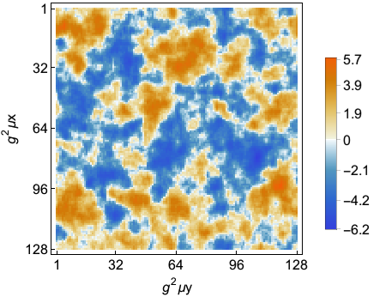
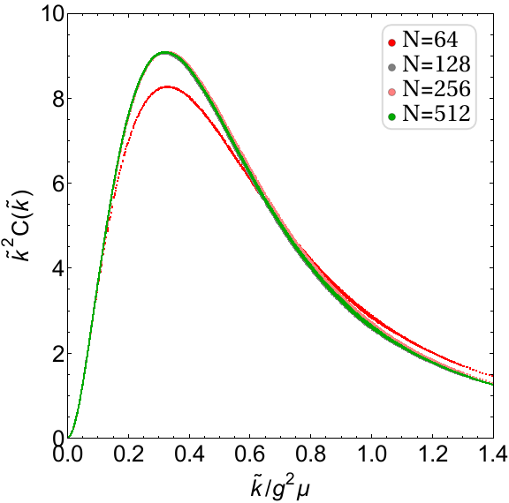
Particles Travel through Color E&M Fields
, one color component of gluon field in covariant gauge is plot above. The scale parameter
=1.0 GeV. Lattice size
=100. Grid Number N=128. The Wilson line correlator is .
Saturation scale is identified as the lattice momentum corresponding the maximum . is the Fourier transform of Wilson line correlator
Each curve on the plot is a result averaging over 500 color configurations. Lattice spacing , lattice size L=Na. Saturation scale
for different N values.
Notes:
Left figure: Field from the heavy ion is solved from simulated charge density under the CGC framework. The transverse plane is discretized into a lattice with periodic boundary conditions.
Right figure: As a justification of the gluon field obtained, we calculate the saturation scale and study its convergence on lattice size, lattice spacing and gluon mass.

Slide 106
Summary
BLFQ is an ab initio nonperturbative approach for QFT
BLFQ calculates the light-front wavefunction of bound states beyond valence sector
Connect various observables on hadron structure: form factors, GPDs, TMDs, GTMDs…
Exotic hadrons
tBLFQ is for time-evolution of QFT
tBLFQ is ideal for systems in strong/time-dependent background field
tBLFQ’s applications: laser physics, heavy-ion physics, electron-ion collider physic esp. w/particle production
BLFQ and tBLFQ are developed for the supercomputing era!

Slide 107
Thank you!

