Slide 1

ISMD 2016
August 29, 2016
Jeju island, South Korea
Analysis of flow observables in small systems using an integrated dynamical model
Koji Kawaguchi¹⁾
In collaboration with Koichi Murase²⁾ and Tetsufumi Hirano¹⁾
Department of Physics, Sophia University, Japan.
Department of Physics, The University of Tokyo, Japan.
Notes:
First of all, I would like to thank the organizers for giving me an opportunity to talk here.
I’d like to talk about “Analysis of flow observables in small systems using an integrated dynamical model”.
My collaborators are Koichi Murase and Tetsufumi Hirano.

Slide 2
Contents
1.Introduction
2.Integrated dynamical model
3.Results
4.Summary
2
Notes:
These are the contents of my talk.
First, I start with introduction of this talk, and then explain an integrated dynamical model.
After that I will show you the results, and finally I will summarize this talk.

Slide 3
Contents
1.Introduction
2.Integrated dynamical model
3.Results
4.Summary
3

Slide 4
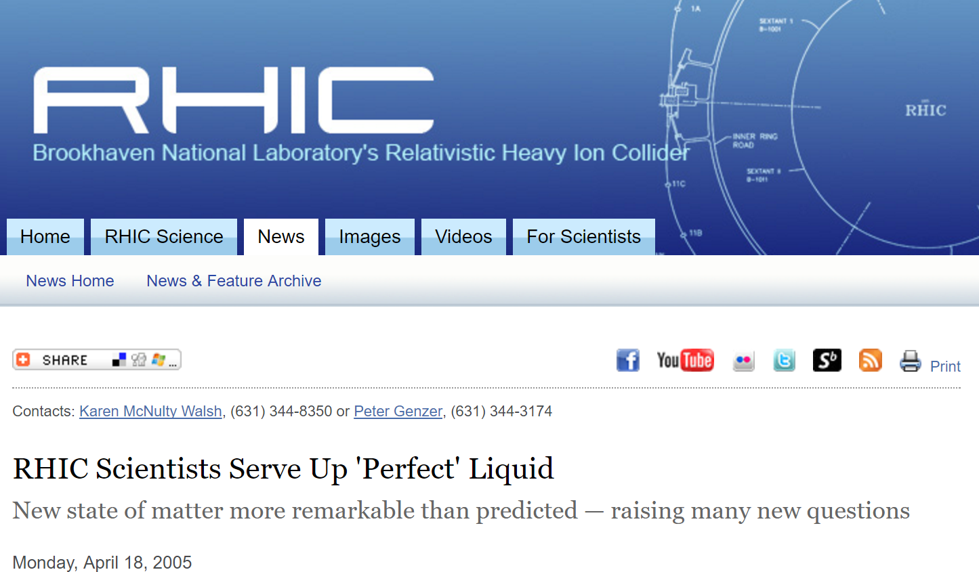
Perfect fluid in large system at RHIC
https://www.bnl.gov/rhic/news2/news.asp?a=303&t=pr
Collective behavior observed
in heavy ion collisions
Quark gluon plasma as
strongly coupled medium
Whether the QGP is also formed in small systems such as p+Au, d+Au and ³He+Au
Notes:
Almost 10 years ago, the perfect fluidity of the quark gluon plasma was discovered at RHIC.
This is the article from BNL which says “RHIC Scientists Serve Up Perfect Liquid”.
Collective behavior of The quark gluon plasma was observed in relativistic heavy ion collisions
That behavior can be well described by relativistic hydrodynamics.
Thus, a new paradigm of the strongly coupled QGP was established.
The discovery was made in large colliding systems such as Au+Au collisions.
Here, a natural question would be whether the QGP is also formed in small colliding systems such as p+Au, d+Au and 3He+Au.

Slide 5
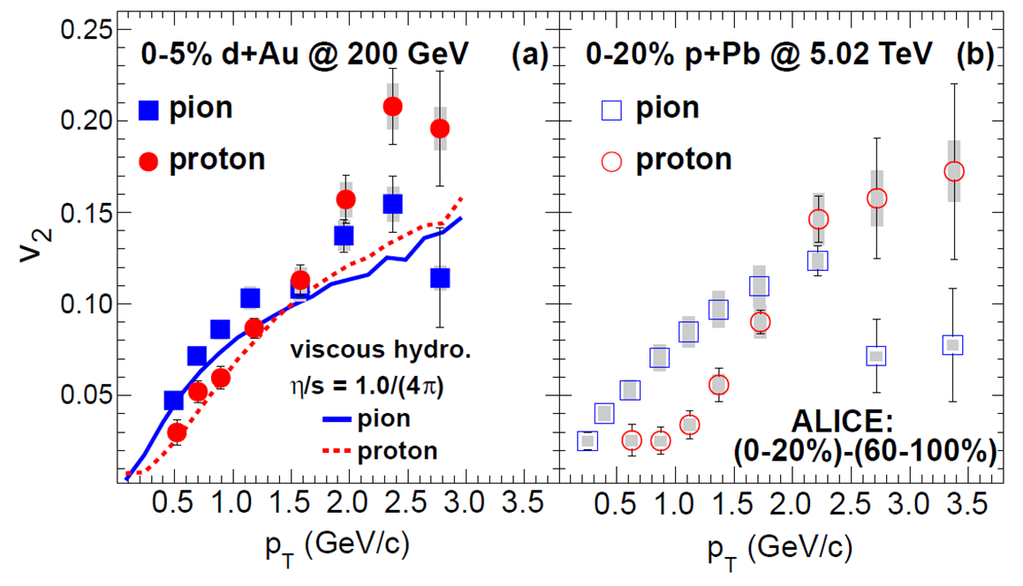
Collective-flow-like behaviors in small systems
Mass ordering for identified hadrons
Consistent with
hydrodynamic flow
A. Adare et al., Phys. Rev. Lett. 114,192301(2015).
Purpose of this study
Analysis of collectivity in small colliding system
by employing an integrated dynamical model
Notes:
In fact, collective-flow-like behaviors are observed in small colliding systems at RHIC and LHC energies.
These figures show elliptic flow parameter, v2, as a function of transverse momentum, pT, from PHENIX and ALICE.
Left figure shows the results in d+Au collisions at RHIC and right figure shows the results in p+Pb collisions at LHC.
In these figures, mass ordering pattern is seen for pions and protons, which is consistent with hydrodynamic-flow picture.
So the purpose of this study is to analyze flow observables in small colliding systems at the RHIC energy by employing an integrated dynamical model with QGP fluid formation.

Slide 6
Contents
1.Introduction
2.Integrated dynamical model
3.Results
4.Summary
6

Slide 7

Integrated dynamical model
Hadronic rescatterings
Hadron cascade (JAM)
time
Fluid to particles
Cooper-Frye formula
$$T_{sw}=155\left(MeV\right)$$
Hydrodynamic QGP evolution
collision axis
0
Fully (3+1) dimensional
ideal hydrodynamics
p/d/³He
Au
Generating initial conditions
T. Hirano et al., Prog. Part. Nucl. Phys. 70, 108 (2013).
Notes:
This is the schematic figure of space-time evolution of the quark gluon plasma
We describe the whole process by employing the integrated dynamical model.
Space-time evolution of the QGP is described by fully 3-dimensional ideal hydrodynamic simulations.
We switch from fluid to hadron gas with Cooper-Frye formula at the switching temperature 155 MeV.
Finally for the evolution of the hadronic gas, we use hadron cascade simulations JAM.
We model the initial conditions including event-by-event fluctuations of geometry and multiplicity.
Let me explain more details about this initial conditio

Slide 8
Asymmetric longitudinal profile
A.Adil and M.Gyulassy, Phys. Rev. C 72, 034907 (2005).
Au side
d side
Rapidity triangle/trapezoid clearly observed at RHIC
Multiparticle production in longitudinal space reflects
difference of the number of participants
Notes:
Left figure shows pseudorapidity distributions of charged hadrons in minimum bias and central 0-10% d+Au collisions at 200 GeV from PHOBOS. and p+pbar collisions from UA5.
If you take a ratio of the d+Au distributions to the HIJING p+p result, the rapidity triangle or trapezoid appear, which is shown in the right figure.
This indicates multiparticle production in longitudinal space reflects the difference of the number of participants between colliding systems.
So we are going to consider this in the initial condition of hydrodynamic simulations.

Slide 9

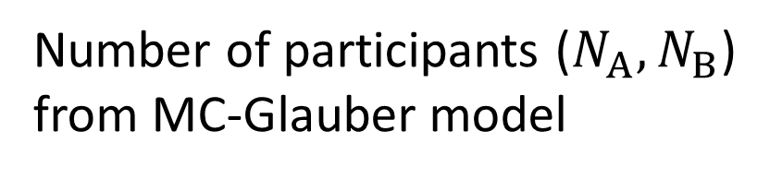



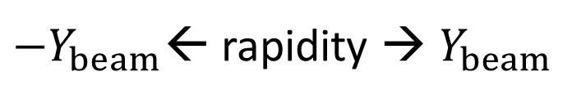
Modified BGK model
hadronic strings formation
$$N_{A}$$
$$N_{B}$$
${−Y}_{beam}$← rapidity → $Y_{beam}$
Number of participants ($N_{A},N_{B}$)
from MC-Glauber model
$$N_{A}$$
$$N_{B}$$
S.J.Brodsky, J.F.Gunion and J.H.Kuhn, Phys.Rev.Lett.39, 1120 (1977).
T.Hirano et al., Phys.Lett.B 636, 299 (2006).
Notes:
This is the schematic figure of hadronic string formation in heavy ion collisions.
Let us suppose some transverse point.
For example, two nucleons come from this nucleus and three nucleons from that nucleus, which are undergoing binary collision. We can simulate this by using the Monte Carlo version of the Glauber model and count the number of participants for each nucleus.
In this case, totally six hadronic strings are supposed to form like this.
These hadronic strings are dominant sources of multiplicity.
We suppose this is the origin of rapidity trapezoid, so we take into account the rapidity structure of this in initial condition of hydrodynamic simulations.

Slide 10
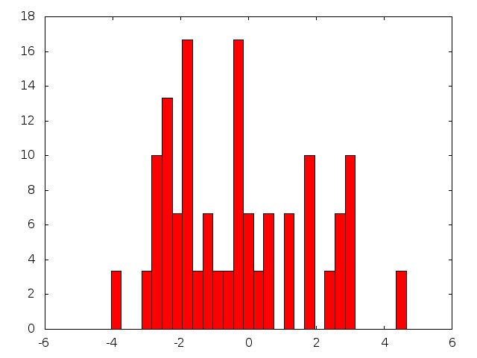

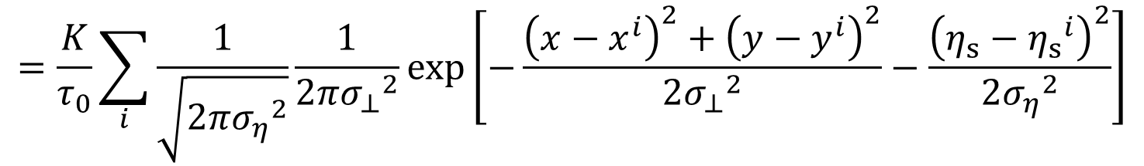
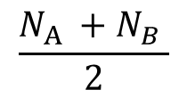











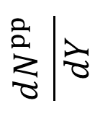

Rapidity dependence of initial entropy density
$$\frac{N_{A} +N_{B} }{2}$$
PYTHIA
$$\frac{dN^{pp}}{dY}$$
$$⨂$$
$$N_{A}$$
$$N_{B}$$
$$η_{s}$$
$${−Y}_{beam}$$
$$0$$
$$Y_{beam}$$
$$Y$$
Rapidity triangle/trapezoid
Rapidity distribution
in pp collisions at 200 GeV
Multiplicity scaling in rapidity space
Normalization
Smearing parameters
Initial entropy density
$$K=5.6$$
$$σ_{⊥}=0.3 \left[fm\right]$$
Initial time
$$σ_{η}=0.3$$
$$τ_{0}=0.6 [fm]$$
$$s_{0}\left(τ_{0}, η_{s}, x_{⊥}\right)$$
$$=\frac{K}{τ_{0}}\sum_{i}{\frac{1}{\sqrt{2π{σ_{η}}^{2}}}\frac{1}{2π{σ_{⊥}}^{2}}}exp\left[−\frac{{\left(x−x^{i}\right)}^{2}+{\left(y−y^{i}\right)}^{2}}{2{σ_{⊥}}^{2}}−\frac{{\left(η_{s}−{η_{s}}^{i}\right)}^{2}}{2{σ_{η}}^{2}}\right]$$
Notes:
For each binary collision, we run PYTHIA for one event.
This is an example of rapidity distribution from PYTHIA.
We convolute this for all binary collision pairs so that the multiplicity scales with the number of participants for a given rapidity.
For example, at midrapidity, the multiplicity scales with N_A + N_B divided by 2.
We assume the initial entropy density distribution is proportional to the number distribution of produced particles.
We also assume each produced particle is associated with Gaussian in configuration space.
So, initial distribution is the sum of these Gaussians.

Slide 11
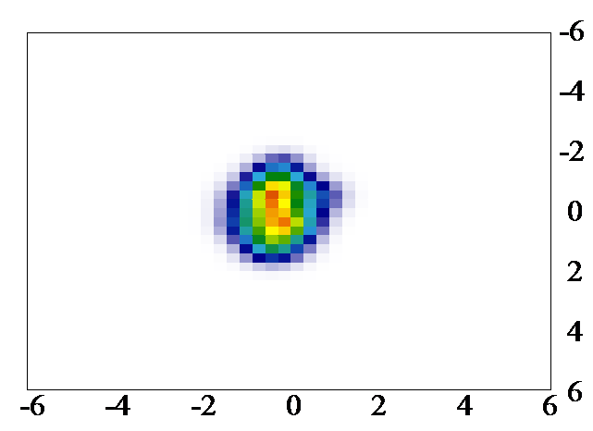
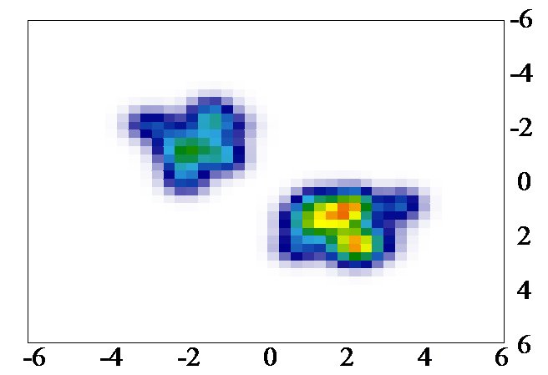
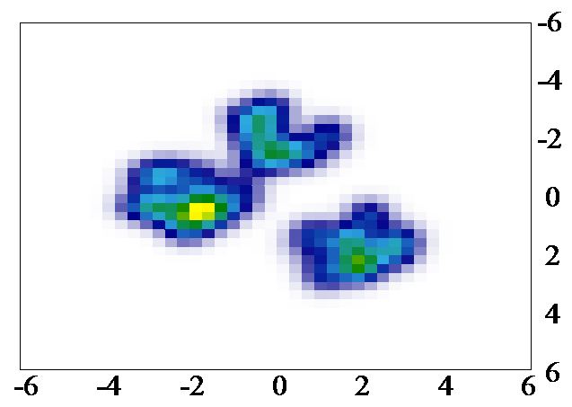
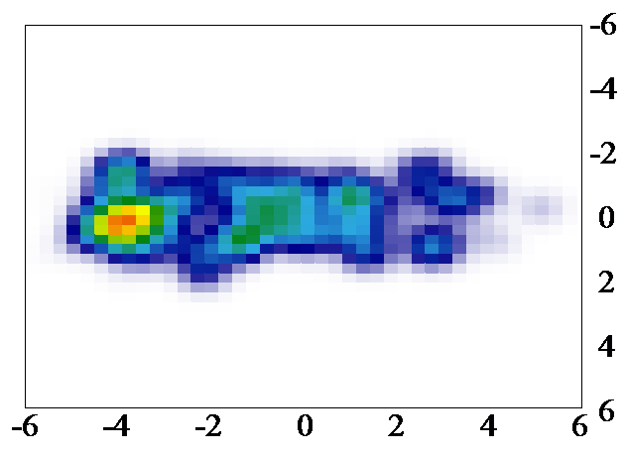
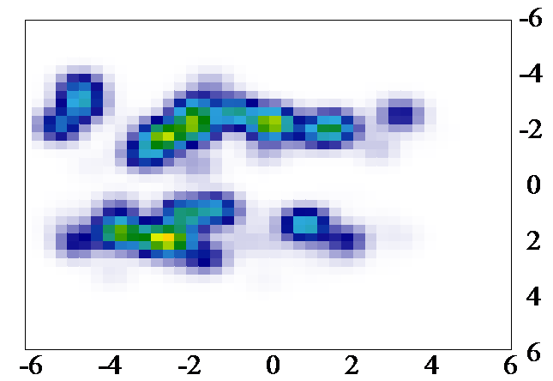
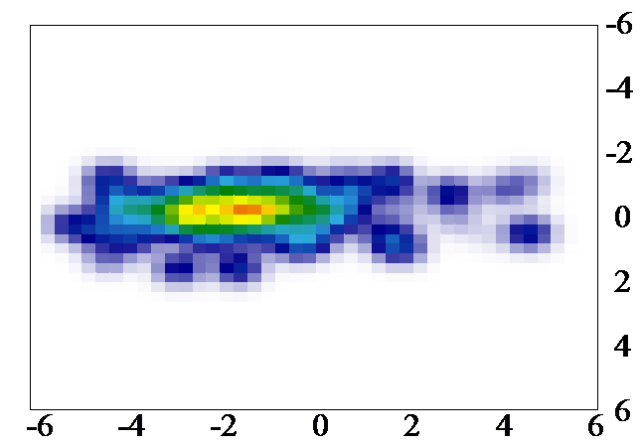












Initial entropy density in various small systems
Transverse profile
$$(η_{s}=0)$$
$$y [fm]$$
$$y [fm]$$
$$y [fm]$$
p+Au
d+Au
³He+Au
$$x [fm]$$
$$x [fm]$$
$$x [fm]$$
Longitudinal profile
$$(x=0 [fm])$$
$$y [fm]$$
p+Au
d+Au
³He+Au
$$η_{s}$$
$$η_{s}$$
$$η_{s}$$
Notes:
These figures show an example of initial condition of the entropy density in p+Au, d+Au and 3He+Au collisions。
Upper figures shows transverse profile at space-time rapidity, eta_s=0 and lower figures shows longitudinal profile at one of the transverse coordinates, x=0.
One can see the different number of separated hot spots, which correspond to transverse positions of nucleons in p, d, and 3He.
In lower figures, entropy density is distributed mainly in the left side which is Au-going direction.
As you see in this figure, initial entropy density has a bumpy structure in both x-y plane and y-eta plane due to particle production from breaking of a hadronic string

Slide 12
Contents
1.Introduction
2.Integrated dynamical model
3.Results
4.Summary
12

Slide 13
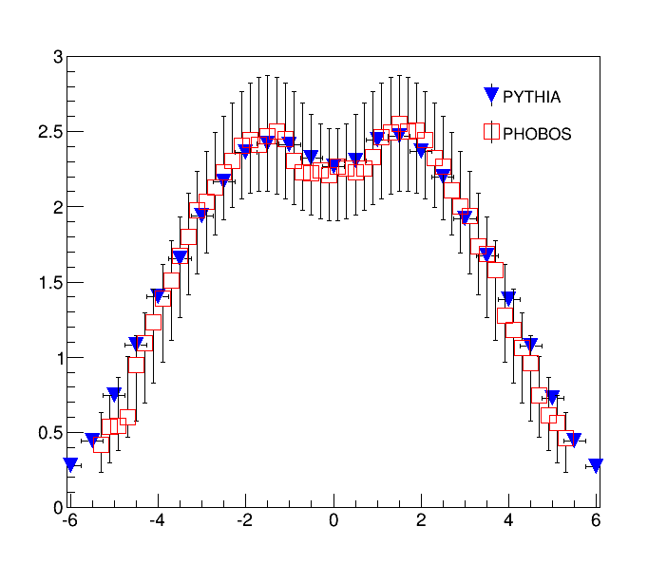
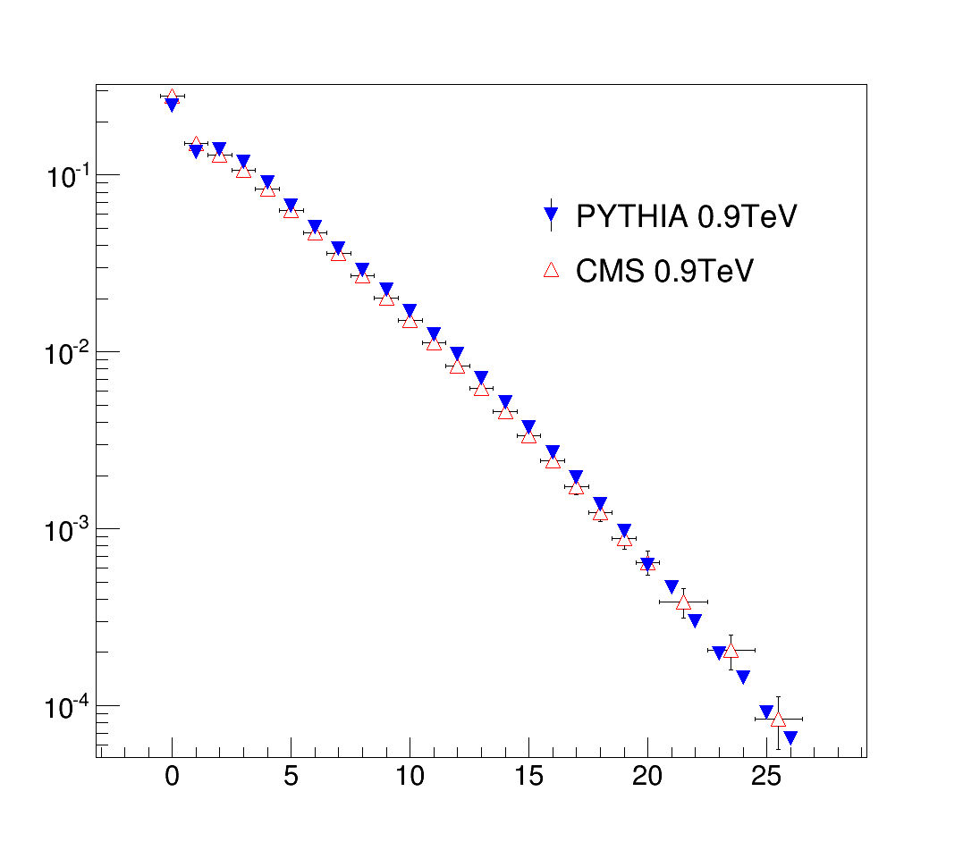

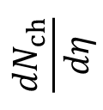



Event Generator PYTHIA8
$$\left|η\right|<0.5$$
$$\frac{{dN}_{ch}}{dη}$$
$$N_{event}$$
$$η$$
$$N_{ch}$$
PYTHIA work very well at the RHIC energy
T. Sjöstrand et al., Comput. Phys. Commun. 191, 159 (2015).
B. B. Back et al. [PHOBOS Collaboration],Phys. Rev. C 72, 031901 (2005).
Notes:
We first make sure whether PYTHIA works really well at the RHIC energy.
Left panel shows pseudorapidity distribution of charged hadrons in p+p collisions at the RHIC energy from PYTHIA compared with PHOBOS data.
Right panel shows multiplicity distribution in p+p collisions at the LHC energy from the PYTHIA compared with CMS data.
In both cases, PYTHIA works very well in elementary collisions.

Slide 14
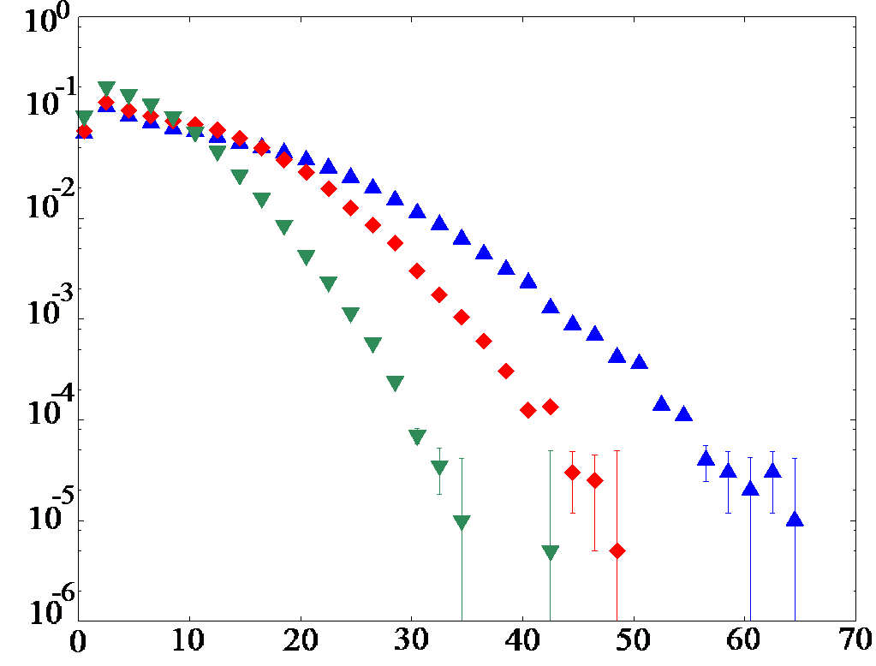



Multiplicity distribution
Blue: ³He+Au
Red: d+Au
Green: p+Au
$$−3.9<η<−3.0$$
Au-going side
$$N_{ev}={10}^{7}$$
Event fraction
$$N_{ch}$$
Fluctuations of multiplicity
Larger colliding nucleus, higher multiplicity
Use for centrality cut
Notes:
This figure shows multiplicity distribution in negative rapidity region in p+Au, d+Au and 3He+Au collisions.
The number of simulation events for each colliding system is ten to the seventh.
As you see, multiplicity is fluctuating.
The larger colliding nucleus, the higher multiplicity.
We are going to use these multiplicity distributions for centrality cut in the later stu

Slide 15
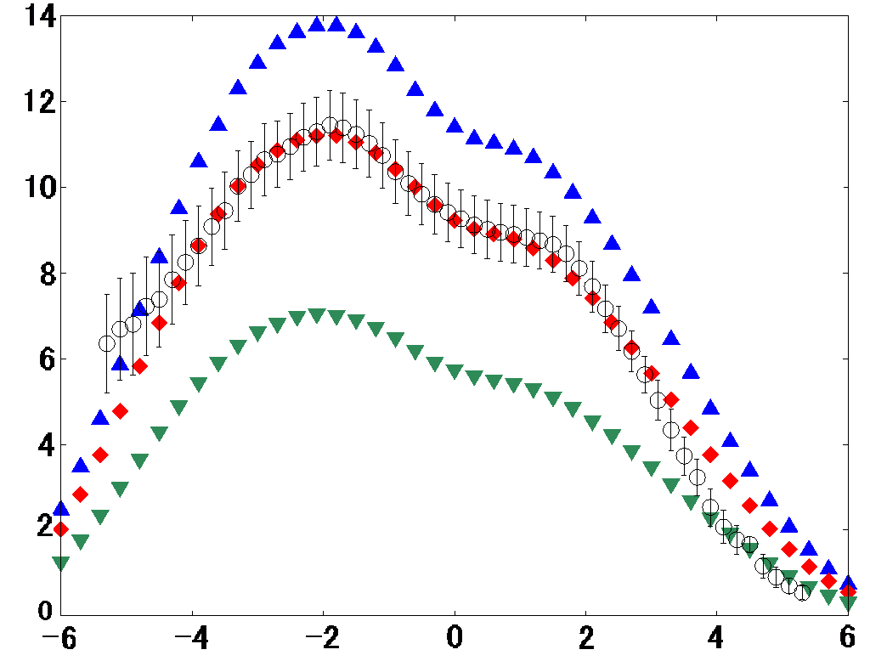
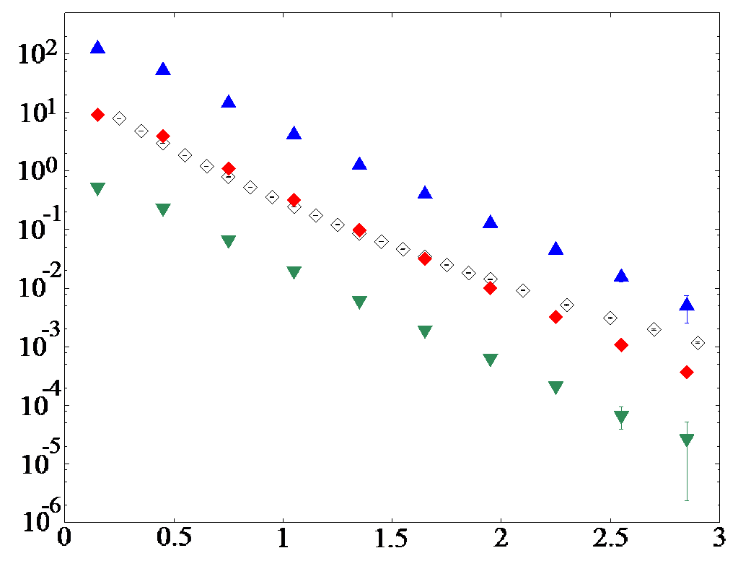


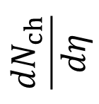


Blue: ³He+Au
p+Au, d+Au, and ³He+Au at RHIC energy
Red: d+Au
Green: p+Au
Black: PHOBOS
min. bias
$$\frac{{dN}_{ch}}{dη}$$
$${\left(2πp_{T}\right)}^{−1}d^{2}N/dηdp_{T}{\left(GeV\right)}^{−2}$$
$$0.2<η<1.4$$
Centrality 0-20%
$$η$$
$$p_{T}(GeV)$$
Reasonable agreement with PHOBOS data
B. B. Back et al. [PHOBOS Collaboration],Phys. Rev. C 72, 031901 (2005).
B. B. Back et al. [PHOBOS Collaboration],Phys. Rev. 91, 072302 (2003).
Notes:
Left panel shows the pseudorapidity distribution and right panel shows the pT distribution of charged hadrons in p+Au, d+Au and 3He+Au collisions.
We compare our d+Au results with PHOBOS data.
To see the spectra clearly 3He+Au results are multiplied by ten and p+Au results are divided by ten.
We reasonably reproduce the shape and the yield of pseudorapidity distribution by employing a rapidity trapezoid picture.
In the low pT regions, our pT slope is consistent with PHOBOS data.
But, in high pT regions, our result deviates from PHOBOS data because we don’t have jet component in this model.

Slide 16
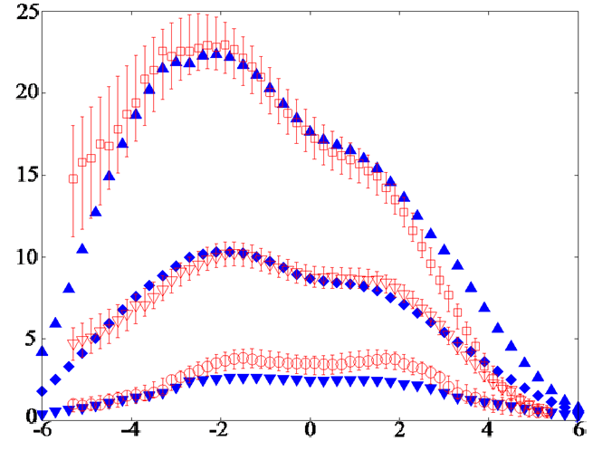

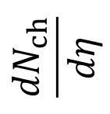
Centrality dependence in d+Au collisions
Pseudorapidity distribution
PHOBOS
Model
0-20%
$$\frac{{dN}_{ch}}{dη}$$
40-60%
80-100%
$$η$$
Centrality and pseudorapidity dependences are also reasonably reproduced
B. B. Back et al. [PHOBOS Collaboration],Phys. Rev. C 72, 031901 (2005).
Notes:
We calculate centrality dependence of dN/deta in d+Au collisions and compare them with PHOBOS data.
We reasonably reproduce centrality and pseudorapidity dependence of multiplicity within our model.

Slide 17
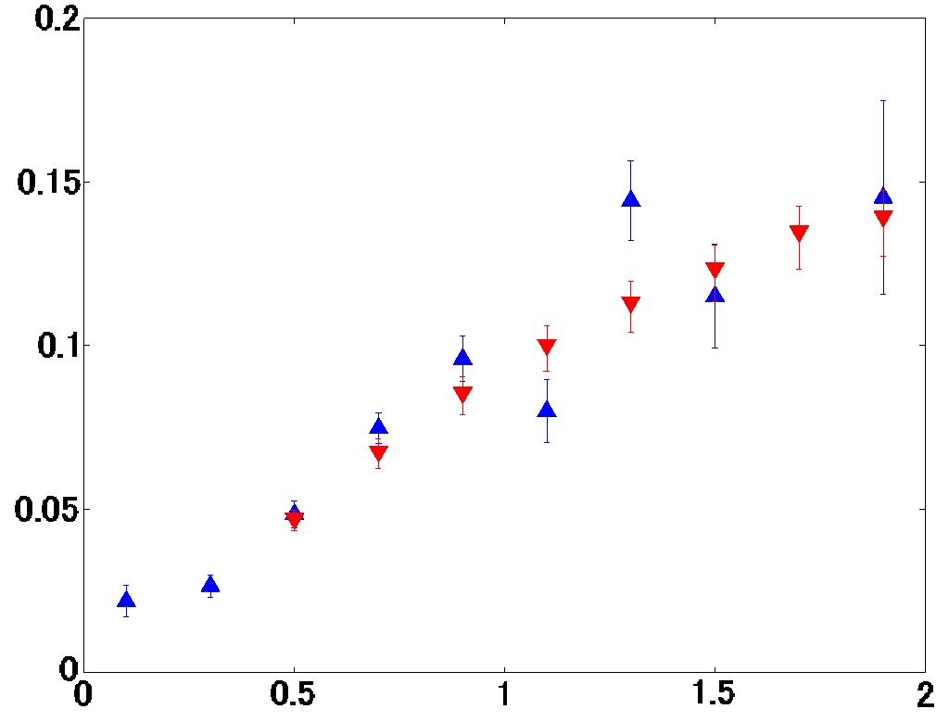

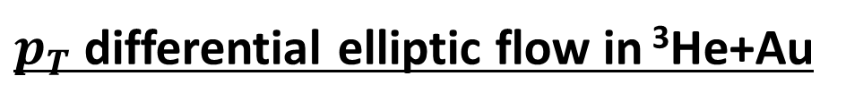


$p_{T}$ differential elliptic flow in ³He+Au
Centrality 0-5%
$$|η|<0.35$$
$$v_{2}\{EP\}$$
PHENIX
Model
$$p_{T}(GeV)$$
Reasonable agreement with PHENIX data
QGP fluid + hadronic gas picture works
in small colliding system
A. Adare et al. (PHENIX Collaboration) Phys. Rev. Lett. 115, 142301
Notes:
This figure shows pT differential elliptic flow parameter of charged hadrons at midrapidity in 3He+Au collisions.
Blue plots are our model results and red plots are PHENIX data in 0 to 5% centrality.
In both analyses, event plane method is used to obtain elliptic flow parameter v2.
As you see, we reasonably reproduce the PHENIX v2 data.
This indicates QGP fluid + hadronic gas picture works also in small colliding system.

Slide 18
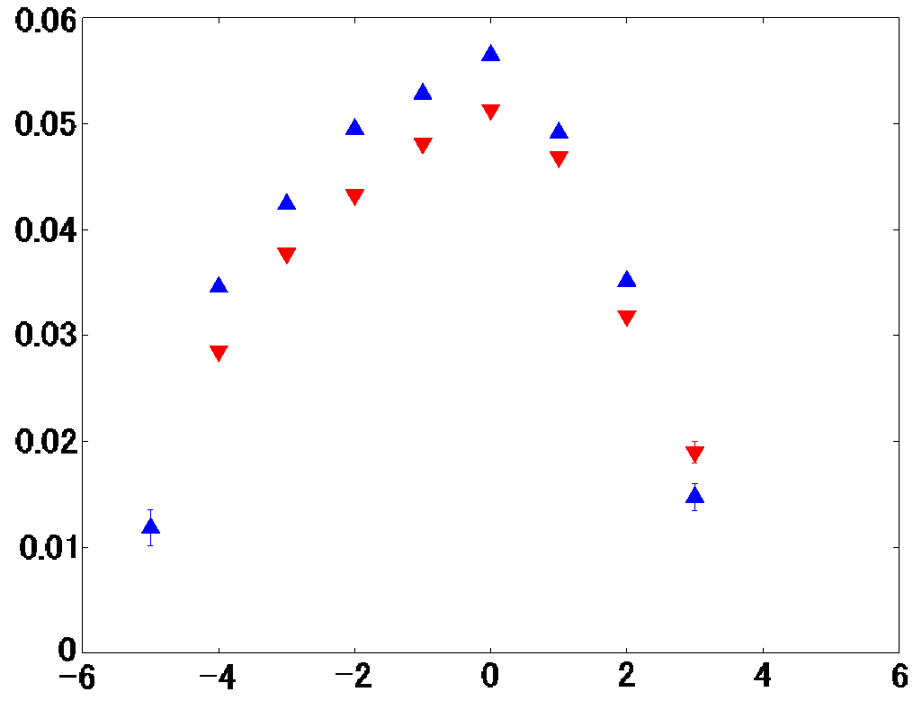
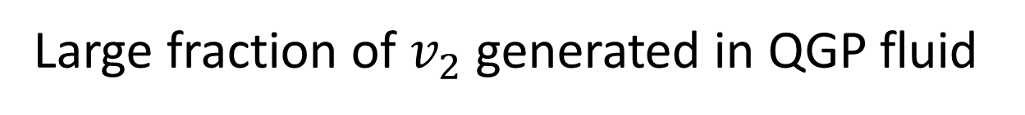
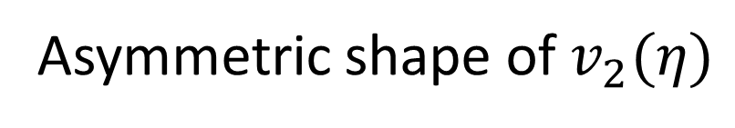


Pseudorapidity dependence of elliptic flow in ³He+Au
min. bias
$$v_{2}\{2\}$$
Blue: w. rescatterings
Red: w.o. rescatterings
$$η$$
³He side
Au side
Asymmetric shape of $v_{2}(η)$
Large fraction of $v_{2}$ generated in QGP fluid
Notes:
Next, let me show you pseudrorapidity dependence of elliptic flow in 3He+Au collisions.
Blue plots are our results by using two particle cumulant methods.
To see how much elliptic flow is generated in the QGP fluid stage, I also show you the results by switching off hadronic rescatterings in cascade.
These are shown in red plots.
The shape of elliptic flow is asymmetric with respect to pseudrorapidity.
Elliptic flow in Au going side is larger than that in 3He going side due to difference of multiplicity
Roughly 90 percent of final elliptic flow is generated in the QGP fluid stage.
This situation is quite similar to Au+Au collsions at the RHIC energy.

Slide 19
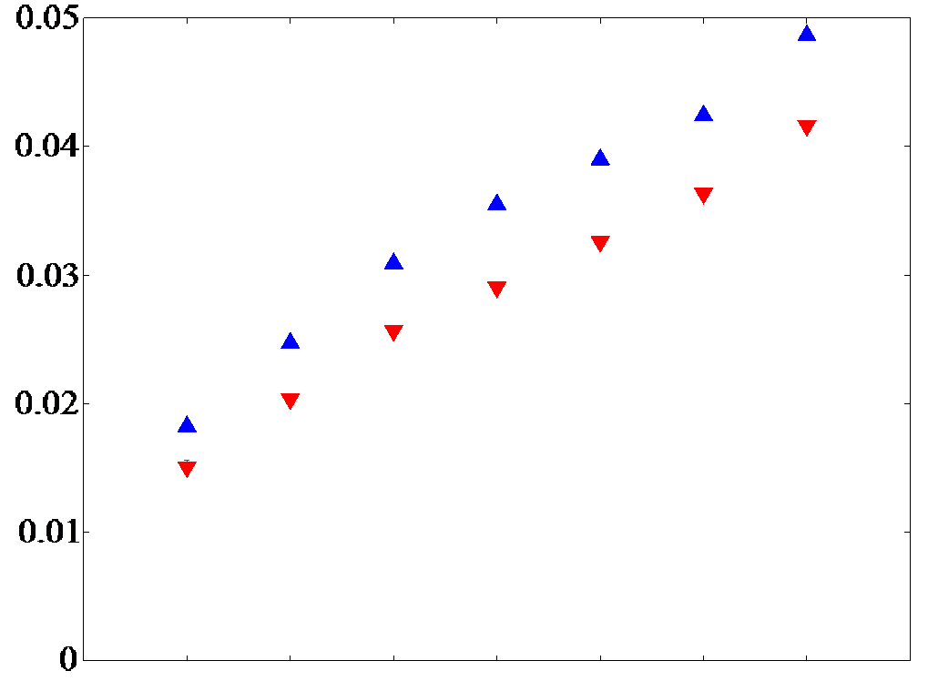


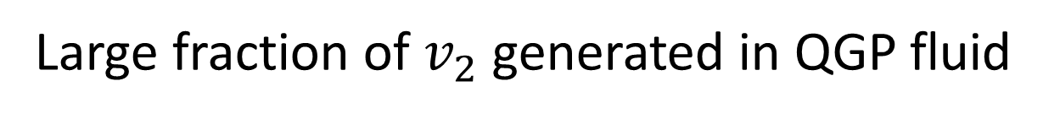






Centrality dependence of elliptic flow parameter in ³He+Au
$$v_{2}\{2\}$$
Blue: w. rescatterings
Red: w.o. rescatterings
60-$70\%$
50-$60\%$
40-$50\%$
30-$40\%$
20-$30\%$
10-$20\%$
0-$10\%$
Elliptic flow increase with multiplicity
Large fraction of $v_{2}$ generated in QGP fluid
Notes:
Finally, let me show you centrality dependence of elliptic flow.
From right to left, top ten percent, ten to twenty percent centrality and so on.
Blue plots are our final results by using two particle cumulant methods.
Again I also show you the results without hadronic rescatterings.
Elliptic flow increases with multiplicity,
We can see large fraction of v2 is generated in QGP fluid sta

Slide 20
Contents
1.Introduction
2.Integrated dynamical model
3.Results
4.Summary
20

Slide 21
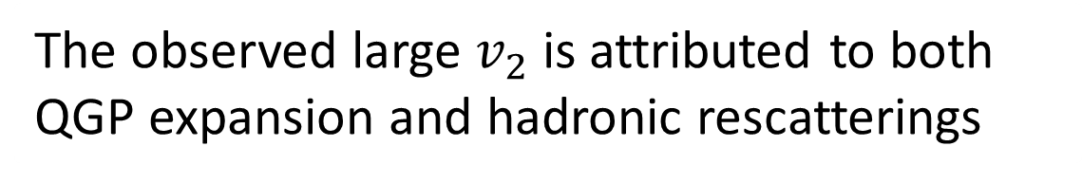
Summary
・Development of a novel hydrodynamic initialization model
・Analysis of flow observables in ³He+Au collisions
The observed large $v_{2}$ is attributed to both
QGP expansion and hadronic rescatterings
The hadronic afterburner also plays an important role
in the whole dynamical evolution
Large fraction of v2 is generated
in QGP fluid stage even in small system
Notes:
This is the summary of this study.
We analyze flow observables in 3He+Au collisions by using a novel version of an integrated dynamical model.
Our results suggest that the observed large v2 is attributed to both QGP expansion and hadronic rescatterings and the hadronic afterburner also plays an important role in even in small colliding system.
We demonstrate that large fraction of v2 is generated in GGP fluid stage even in small; colliding system.

Slide 22
Back up

Slide 23
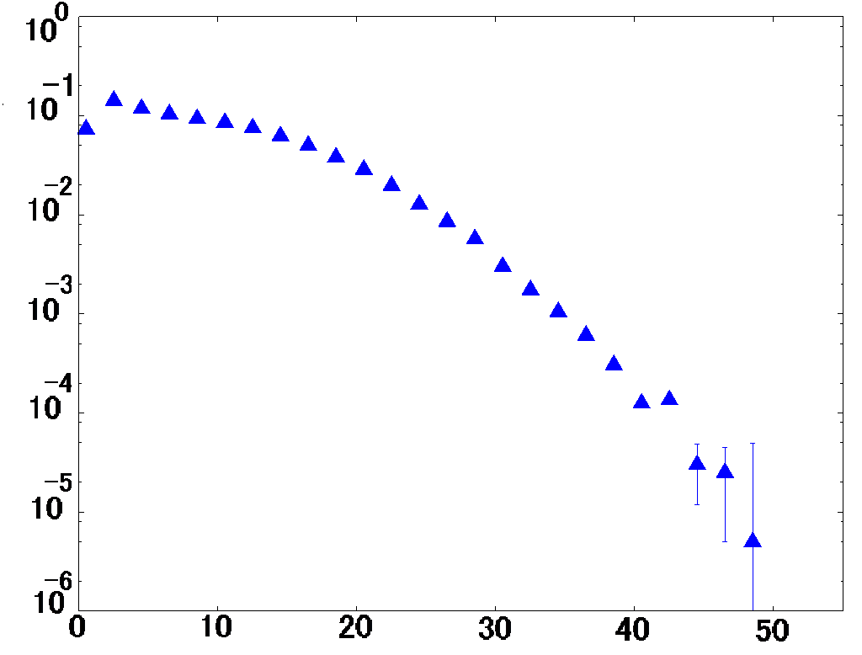



Multiplicity distribution in d+Au collision
$$−3.9<η<−3.0$$
Au-going side
$$Event fraction$$
$$N_{ch}$$
Fluctuations of multiplicity
Use for centrality cut

Slide 24
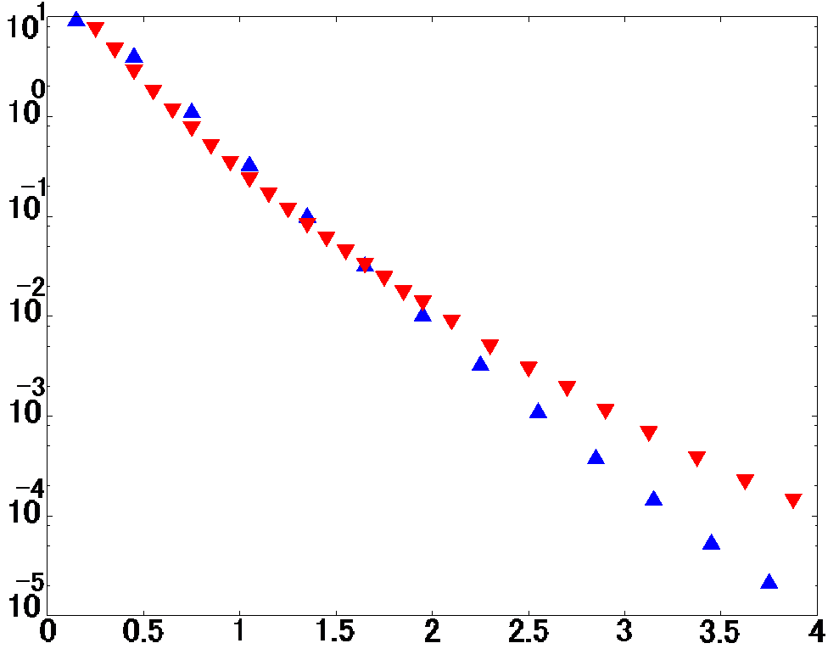


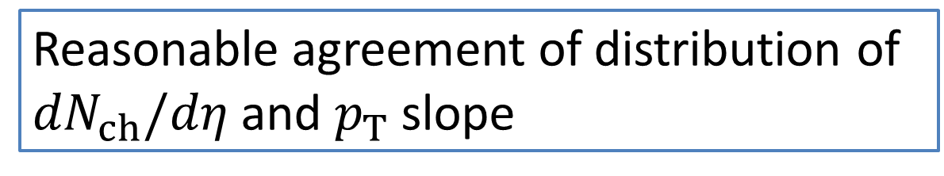

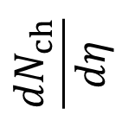

Spectra in d+Au collisions
Pseudorapidity distribution
Transverse momentum spectra
PHOBOS
Model
$$0.2<η<1.4$$
Centrality 0-20%
0-20%
$$\frac{{dN}_{ch}}{dη}$$
$${\left(2πp_{T}\right)}^{−1}d^{2}N/dydp_{T}{\left(GeV\right)}^{−2}$$
40-60%
80-100%
PHOBOS
Model
$$η$$
$$p_{T}(GeV)$$
Reasonable agreement of distribution of ${dN}_{ch}/dη$ and $p_{T}$ slope
B. B. Back et al. [PHOBOS Collaboration],Phys. Rev. C 72, 031901 (2005).

Slide 25


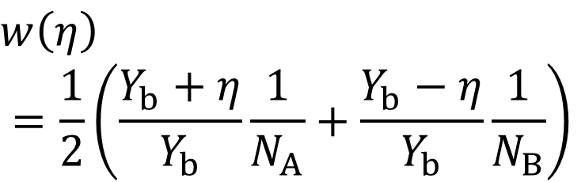

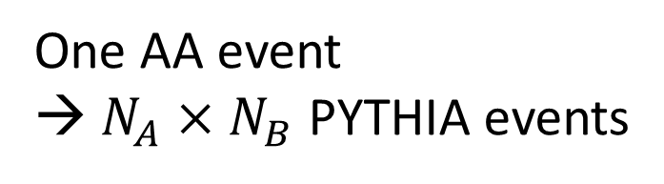
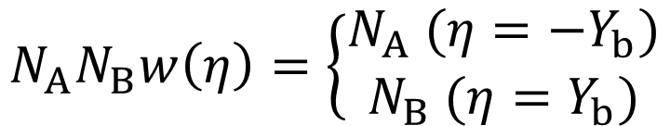
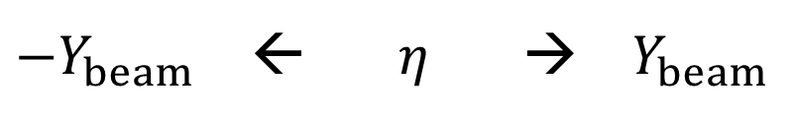
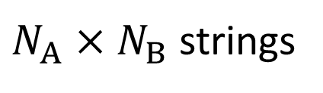
Rejection sampling
$N_{A}×N_{B}$ strings
One AA event
→ $N_{A}×N_{B}$ PYTHIA events
Weight in one PYTHIA event
$$w\left(η\right)$$
$$=\frac{1}{2}\left(\frac{Y_{b}+η}{Y_{b}}\frac{1}{N_{A}}+\frac{Y_{b}−η}{Y_{b}}\frac{1}{N_{B}}\right)$$
$$N_{A}$$
$$N_{B}$$
$$N_{A}N_{B}w\left(η\right)=\left\{\begin{matrix}N_{A} (η=−Y_{b}) \\ N_{B} (η=Y_{b})\end{matrix}\right.$$
${−Y}_{beam}$ ← $η$ → $Y_{beam}$

Slide 26

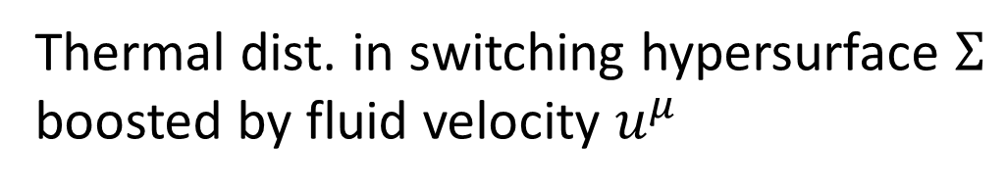
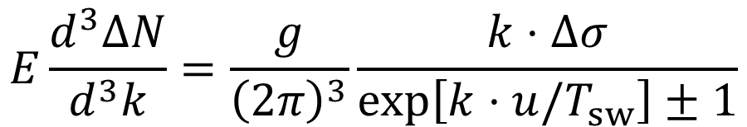



Hydro to cascade
One-particle distribution from a fluid element
F.Cooper, G.Frye (1974)
$$E\frac{d^{3}ΔN}{d^{3}k}=\frac{g}{{\left(2π\right)}^{3}}\frac{k⋅Δσ}{exp\left[k⋅u/T_{sw}\right]±1}$$
$$Σ:T\left(x\right)=T_{sw}$$
$${Δσ}^{μ}$$
$$T_{sw}=155 MeV$$
$$N^{μ}$$
Thermal dist. in switching hypersurface $Σ$
boosted by fluid velocity $u^{μ}$
Output from hydro as initial condition for cascade

Slide 27
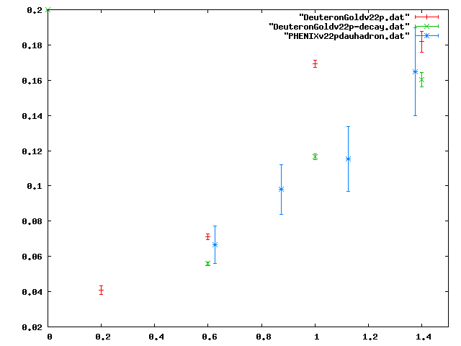
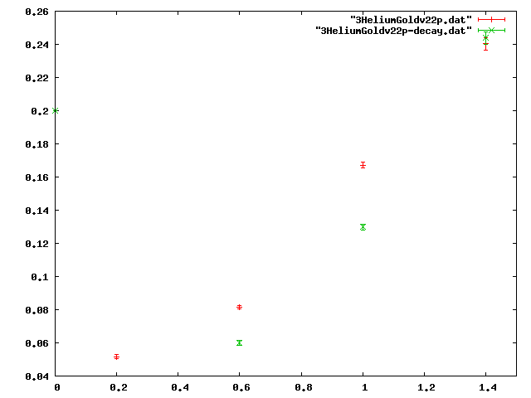


Elliptic flow parameter
$$\left|η\right|<0.35$$
$v_{2}${2p}
pT（GeV）
pT（GeV）

Slide 28
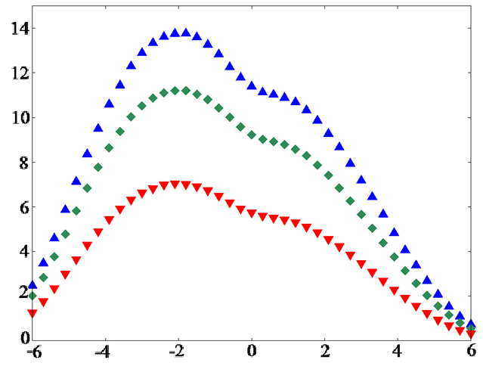

Slide 29
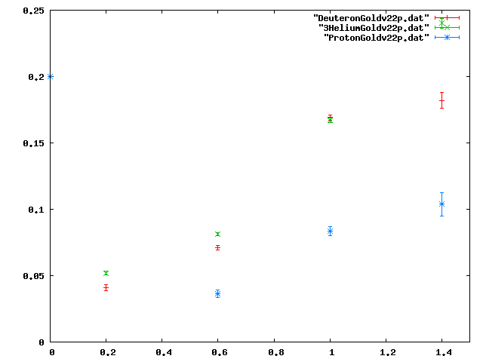


Elliptic flow parameter
$$\left|η\right|<1$$
min. bias
$v_{2}${2p}
pT（GeV）

Slide 30
Novel type of initial condition
・Transverse profile fluctuation
MC-Glauber model
・Asymmetric longitudinal profile
BGK type initial nuclear effects
・Multiplicity fluctuation
PYTHIA8
・Longitudinal fluctuation and correlation
PYTHIA8

