Slide 1
A Measurement about two gamma fusion and one missing gamma for a Neutral Kaon Decay,
Jeju National Universit
Jewou Ko

Slide 2
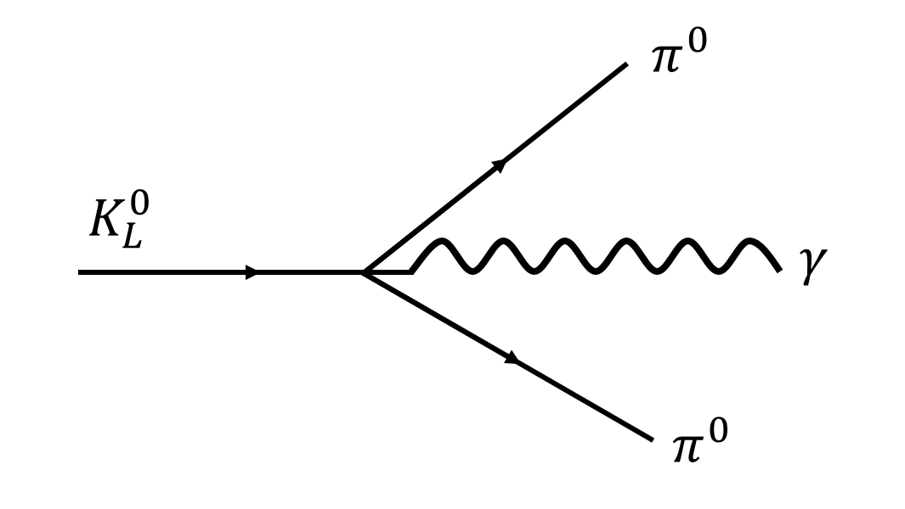
Introduction
We have focused $K_{L}^{0}→π^{0}π^{0}γ$ decay mode.
$K_{L}^{0}→π^{0}π^{0}γ$ decay mode are produced 5 gamma rays.
Theorically calculated branch ratio is $1×{10}^{−8}$
KTeV team has proposed an upper limit is $2.43×{10}^{−7}$.

Slide 3
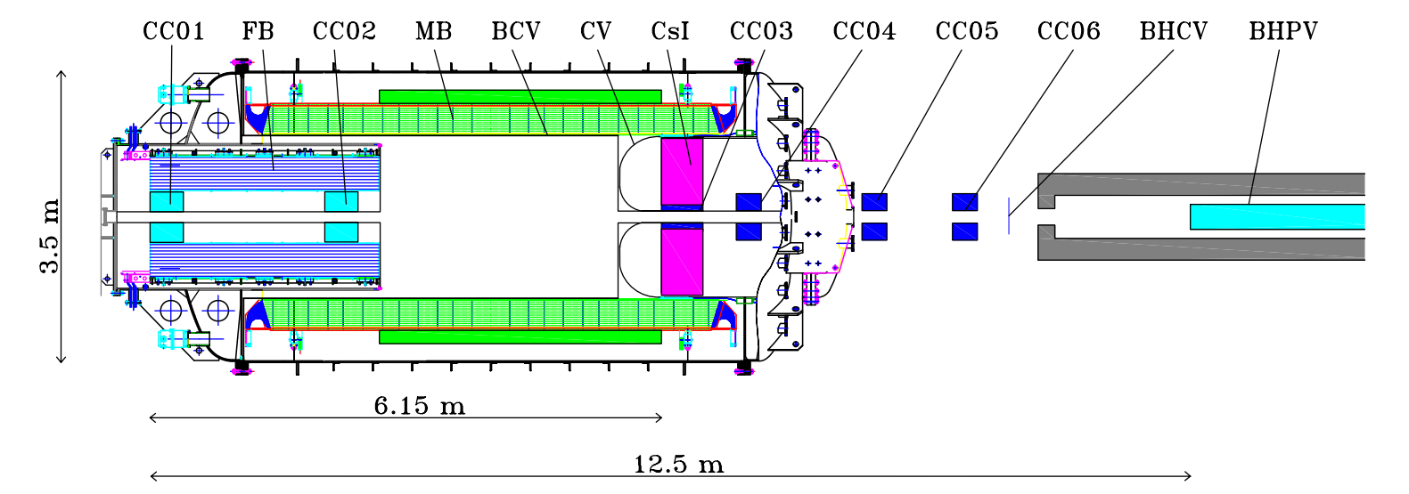
Simulation Method
Incident particle:
Incident energy: 1 GeV

Slide 4
Result
Shows the value of Root Mean Square for $K_{L}^{0}→π^{0}π^{0}π^{0}$ decay.
RMS value is about 15 MeV.
Size of cluster energy is about 250 mm.
Energy distribution for 5 gamma rays about two case:
Fusion for two gamma rays
the other things is one gamma ray missing by through beam hole

Slide 5
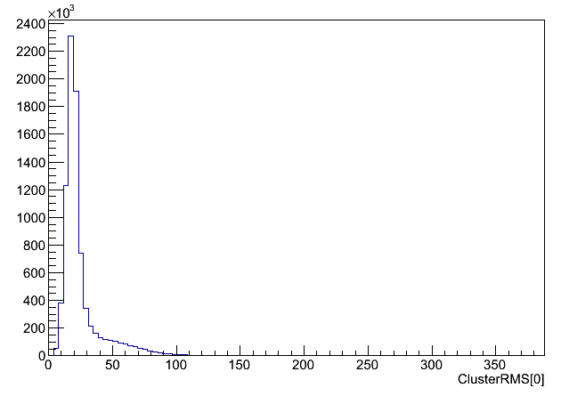
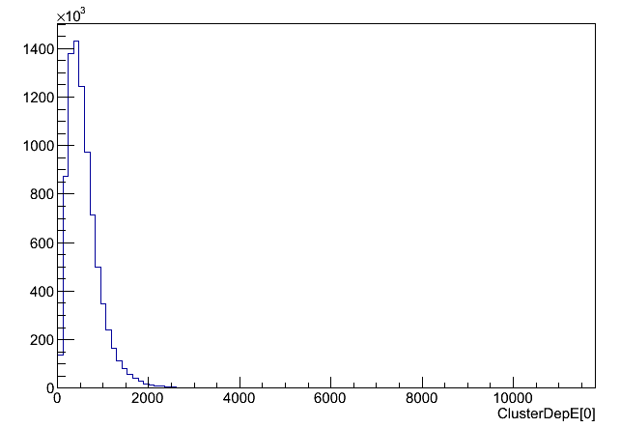
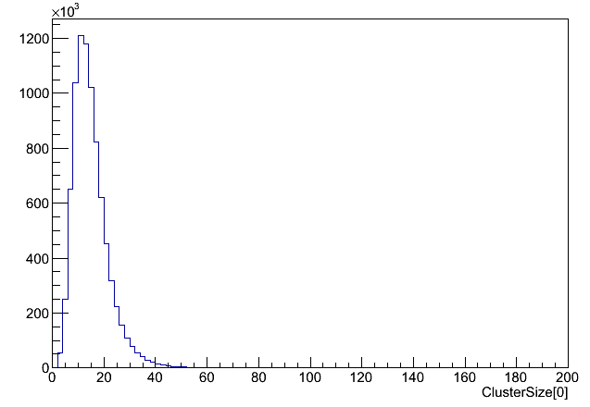
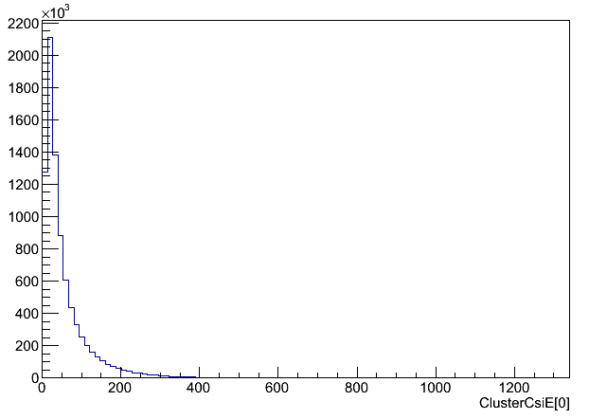
5γ cluster RMS value
5γ cluster fusion
energy of deposit energy
5γ cluster RMS size
Fusion event in 5γ events

Slide 6
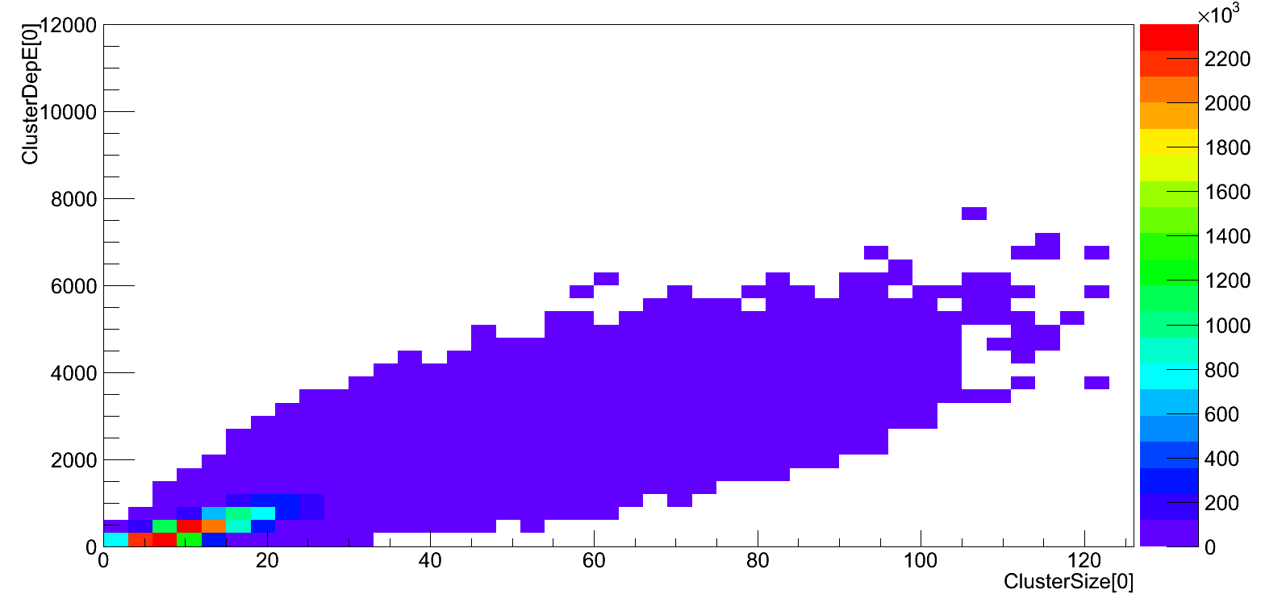
Two dimensions for size of cluster with energy of deposit to CsI electromagnetic calorimeter by $K_{L}^{0}→π^{0}π^{0}π^{0}$ decay.
Under 1000 MeV area for cluster energy and under 250 mm area for size of cluster are common area by $K_{L}^{0}→π^{0}π^{0}π^{0}$ decay.
Fusion event in 5γ events

Slide 7
Conclusion
Study of $K_{L}^{0}→π^{0}π^{0}π^{0}$ decay is important as research.
We simulated the produced 5 gamma rays by $K_{L}^{0}→π^{0}π^{0}π^{0}$ decay.
We calculated to misunderstand for 5 gamma rays from $K_{L}^{0}→π^{0}π^{0}π^{0}$ decay.
The misunderstanding ratio is 0.89% in $K_{L}^{0}→π^{0}π^{0}π^{0}$ decay as $K_{L}^{0}→π^{0}π^{0}γ$ decay
Case of fusion is the main reason to make 5 gamma rays.
The probability of fusion is 86.57% and one gamma missing is 32.42%

