Slide 1

Oscillation phenomena in multiparticle production processes
G. Wilk, NCNR, Warsaw, Poland
and Z. Włodarczyk, UJK, Kielce, Poland
XLVI International Symposium on Multiparticle Dynamics
Seogwipo, Jeju Island, 29 August – 2 September 2016

Slide 2

There is good evidence for the presence of oscillation in counting statistics, in many different, apparently very disparate branches of physics. Examples include:
- oscillations of the high-order cumulants of transport through a Mach-Zender interferometer , and
- in transport through a double quantum dot
- oscillations have been seen in quantum optics (in photon distribution function in slightly squeezed states)
- as well as in elementary particle physics,
further demonstrating the universality of the phenomenon in a large class of stochastic processes. In fact, whereas theoretical studies of a number of different systems have found that the high-order cumulants oscillate as functions of certain parameters, so far no systematic explanation of this phenomenon has been given.
In this presentation we concentrate on oscillation phenomena seen at LHC energies in transverse momentum distributions and multiplicity distributions.
Large transverse momentum distributions apparently exhibit power-like behavior. However, we argue that, under closer inspection, this behavior is in fact decorated with some log-periodic oscillations (seen in all LHC experiments).
In what concerns multiplicity distributions P(N), they are most frequently described by the NBD. However, with increasing collision energy some systematic discrepancies become more and more apparent. The wave structure of the multiplicity distributions already observed by ALICE, CMS (and previously also by UA5) experiments is still hardly significant.
Our result is not directly connected with the wave structure observed in data on P(N) for N> 25. The coefficients Cj (connected with “combinants” ) are completely insensitive to the P(N > (j +1)) tail of the multiplicity distribution, whereas their oscillatory behavior starts from the very beginning.

Slide 3
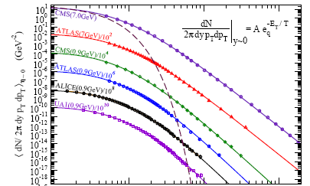
Transverse momentum distributions are characterized by
a quasi-power law (Hagedorn formula or Tsallis distribution)
Transverse momenta distributions of different kinds can be described by a quasi power law formula (known as QCD-inspired Hagedorn formula or Tsallis distribution when the observation is interpreted in terms of the statistical model of particle production, employing the Tsallis non-extensive statistics) which for large values of transverse momenta becomes scale free (independent on T) power distribution
Tsallis distribution successfully describes spectra, the flux of which changes by over 14 orders of magnitude.
C-Y Wong et al., PRD 91 (2015) 114027

Slide 4
Tsallis distribution
C. Tsallis, J.Stat.Phys. 52 (1988) 479
meaning of q ?
Examples of mechnisms leading to
Tsallis distribution:
- Superstatistics
- Stochastic network approach
- Multiplicative noise
- MaxEnt (Shannon entropy)
more information: APPB 46 (2015) 1103 arXiv:1501.01936
BG
R. Hagedorn (1965)

Slide 5
Superstatistics
Superstatistics which is a superposition of two different statistics relevant to driven nonequilibrium systems
with a stationary state and intensive parameter fluctuations [C. Beck et al., Physica A322 (2003) 267]
Tsallis statistics as a special case of superstatistics
BG
gamma distr.
Tsallis
GW and ZW, PRL 84 (2000) 2770
C.Beck, PRL 87 (2001) 180601

Slide 6
transverse momentum distributions are characterized by
a quasi-power law (Hagedorn formula or Tsallis distribution)
hadrons
jets

Slide 7
The values of the corresponding power indices are similar, strongly indicating the existence of a common mechanism behind all these processes

Slide 8
Transverse momenta distribution in jet events
Multiplicity distribution in jet events
NBD:
Poisson:
BD:
[ATLAS, 7 TeV, |y|<1.9, = 0.6]

Slide 9
Self-similarity in jet events following from p-p collisions at LHC
The self-similarity of the scattering process was already recognized by Hagedorn [R. Hagedorn and R. Ranft, Suppl. Nuovo Cim. 6, 169 (1968)], who described the various possible particle states as a ’fireball’ and who defined a fireball as follows:
A fireball is
*... a statistical equilibrium of an undetermined number of all kinds of fireballs, each of which in turn is considered to be...
(back to *)
Clearly, nowadays we would call this a self-similarity assumption.
Also [G. Gustafson and A. Nilsson, Nucl. Phys. B355, 106, (1991)]
QCD predicts that parton fragmentation into final state hadrons proceeds through multiple sub-jet production. This cascade of jets to sub-jets to sub-sub-jets (et cetera) to final state hadrons should demonstrate self-similar behavior.
and [J.D. Bjorken, Phys. Rev. D45, 4077 (1992)]
In QCD extra gluons of lower-pt, scales can also be radiated. This provides new populations of jets, which again extend the entire lego plot, including the extensions we have exhibited. The self-similar character of this extension should be evident.
GW and ZW, Phys.Lett.B 727 (2013) 163 [arXiv:1310.0671]

Slide 10
Tsallis distribution decorated with log-periodic oscillation
transverse momentum distributions
are characterized by
a quasi-power law (Tsallis distribution)
Tsallis distribution is decorated with
log-periodic oscillations
R(E) = a + b cos [c ln(E + d) + f]
a = 0.909, b = 0.166, c = 1.86, d = 0.948 and f = −1.462

Slide 11
Different energies
Fit to data for pp collisions at 0.9 and 7 TeV
from CMS experiment.
Parameters used are, respectively,
(T = 0.135, m = 8) and (T = 0.145, m = 6.7).

Slide 12
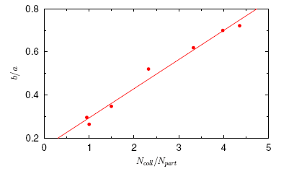
Different collision systems
Fit to data for Pb+Pb collisions (5% centrality)
at 2.76 TeV from CMS experiment.
Parameters used are T = 0.15, m = 7.05

Slide 13
Scale invariance
if for some function O(x), one finds that
O(λx) =μO(x)
then it is scale invariant and its form follows a simple power law,
O(x) = Cx^{-m} with m = -ln μ/ ln λ
This relation can be written as
μλ^{m} = 1 =
where k is an arbitrary integer. It means therefore that, in general,
m = −ln μ/ ln λ + i2πk/ ln λ,
i.e., it is a complex number, the imaginary part of which signals a hierarchy of scales leading to
Log-periodic oscillations

Slide 14
BG distribution
If the scale parameter is dependent on variable
(preferential attachment)
Tsallis distribution
dE → finite
scale
invariant
relation

Slide 15
its solution is power law
with exponent
depending on
and acquiring an imaginary part
In the special case (real solution)
the power
still depends on
and increases with it roughly as
recovers in the limit
the power
in the usual Tsallis distribution

Slide 16
R(E) = a + b cos [c ln(E + d) + f]

Slide 17
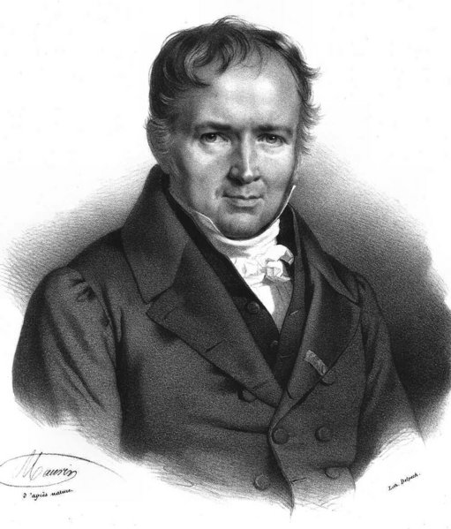
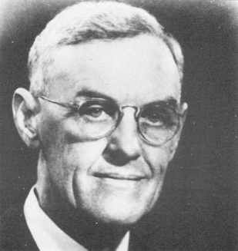
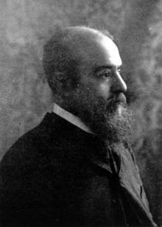

S. D. Poisson (1781-1840)
N
G. W. Snedecor (1881-1974)
R
V. Pareto (1848-1923)
K. S. Lomax
C.Tsallis, 1988
C
?
Log-periodic oscillations

Slide 18
Superstatistics
distr.
C.Beck, PRL 87 (2001) 180601
N
gamma distr.
GW and ZW, PRL 84 (2000) 2770
R
Superstatistics is a superposition of two
different statistics relevant to driven
nonequilibrium systems with a stationary state
and intensive parameter fluctuations
?
C
Log-periodic oscillations

Slide 19
Log-periodic oscillations
results in complex nonextensivity parameter
also the heat capacity
becomes complex:
A complex
means that
and
are shifted in phase and that the entropy production in the system differs from zero.
where the spectral density of temperature fluctuations
complex multiplicative noise
in Langevin equation
complex
the complex pdf
the imaginary part is proportional to the degree of incompatibility of the correlated stochastic processes.

Slide 20





log-periodic scale parameter T
Stochastic equation for the temperature evolution in Langevin formulation with energy dependent noise
leads to
which for the noise
(and relaxation time
)
is just an equation for the damping harmonic oscillator and has a solution
We could equivalently assume the energy independent noise,
but allow for the energy dependent relaxation time

Slide 21
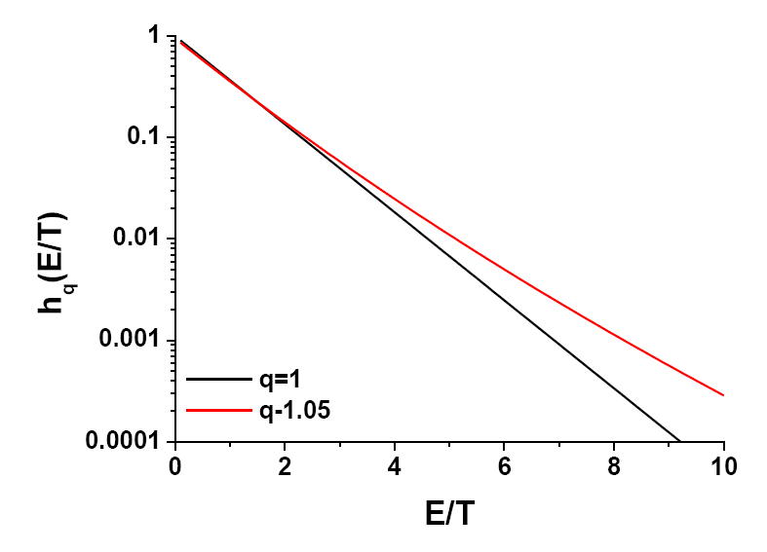
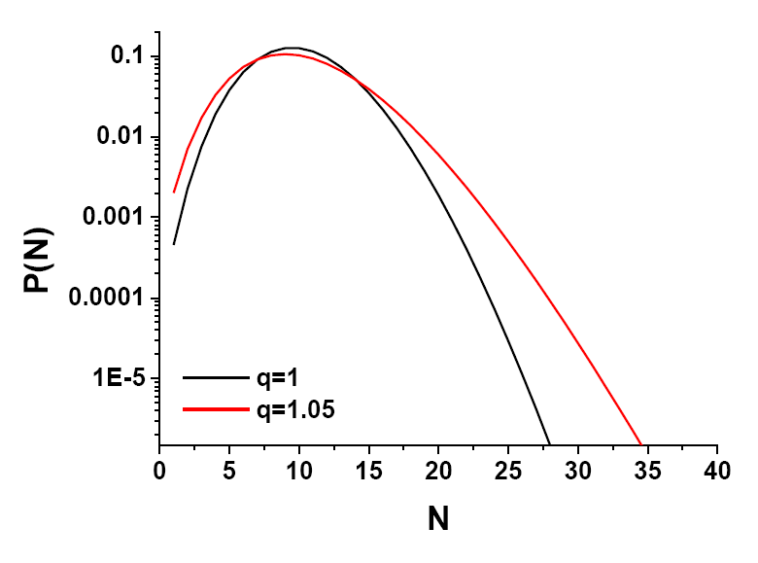
Temperature fluctuations vs. multiplicity fluctuations
G.Wilk, Z.Włodarczyk, PRC79(2009)054903; EPJA40(2009)299; Physica A376(2007)279

Slide 22
multiplicity distributions

Slide 23




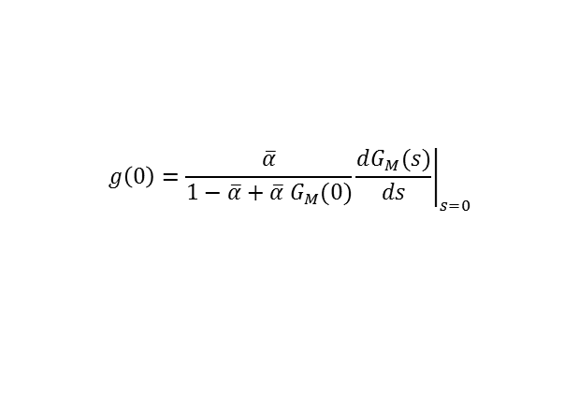

Recurence relation
NBD
Poisson
BD
For
the function
does not depend on the acceptance
$$\overline{α}$$
(acceptance process is described by BD).
However for
$$g\left(0\right)=\frac{\overline{α}}{1−\overline{α}+\overline{α} G_{M}(0)}{\left.\frac{dG_{M}(s)}{ds}\right|}_{s=0}$$
The coefficients Cj tell us how P(N+1) depends on P(N −j), i.e., they encode the memory about particles produced earlier. In the case of the NBD, this memory exponentially disappears with increasing distance (rank) j.

Slide 24



combinants
S. Hegyi, Phys. Lett. B 463 (1999) 126
S.K.Kauffman, M.Gyulassy, JPA11
(1978)1715
Knowing P(N) one can obtain
the coefficients Cj using this recurrence formula
smooth dependence on rank j for NBD

Slide 25


Coefficients , Cj fitted by a triangular wave,
damped exponentially by some exponential factor

Slide 26
Cj emerging from the experimental data
different experiments
different energies
different pseudorapidity windows

Slide 27
coefficients Cj are very sensitive to all changes in the original P(N)
coefficients Cj are insensitive to the statistics

Slide 28

Dynamical Clan Model (DCM)
NBD
DCM
probability of particle emissiom

Slide 29
Results from DCM

Slide 30
Concluding Remarks
Transverse momentum distributions are characterized by a quasi-power law (Tsallis distribution)
decorated with log-periodic oscillations.
Log-periodic structures in the data indicate that the system and/or the underlying physical mechanisms
have characteristic scale invariance behavior. The discrete scale invariance and its associated
complex exponents can appear spontaneously, without a pre-existing hierarchical structure.
Tsallis distribution in energy results in NBD for multiplicity distribution.
We observe strong oscillations of coefficients Cj at LHC energies.
The coefficients Cj tell us how P(N+1) depends on P(N −j), i.e., they encode the memory about particles
produced earlier. For the NBD this memory exponentially disappears with increasing distance (rank) j.
The coefficients Cj are completely insensitive to the P(N > (j +1)) tail of the multiplicity distribution.
Our analysis is not directly connected with the wave structure observed in data on P(N) for multiplicities
N > 25. The oscillatory behavior of Cj is observed starting from the very beginning.

Slide 31
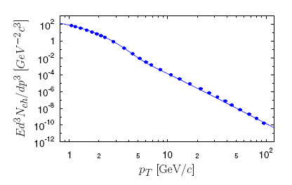
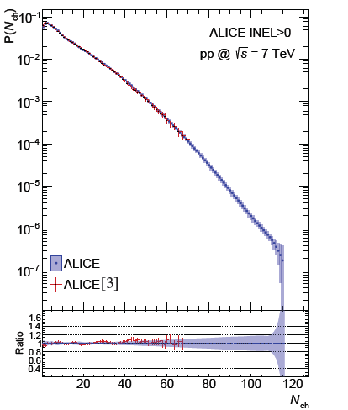
Alternatives? - Two-component models
ALICE
Pb+Pb at 2.76 TeV, c=0-5%
G.G.Barnafoldi et al., JPCS612(2015)012048
A „soft+hard” model…”

Slide 32
Oscillation phenomena or two-component model
Sensitivity of the ratio R and coefficients C_{j} to the systematic uncertainties of the measurement and to the unfolding uncertainties can be checked only by the scrutinous analysis of the raw data with the proper response matrix (and that exceeds our capability).
However, in the case when these oscillations (or some other, equally nonexpected) would be experimentally confirmed, a new, fresh look at the dynamics of multiparticle production processes would be open.

Slide 33
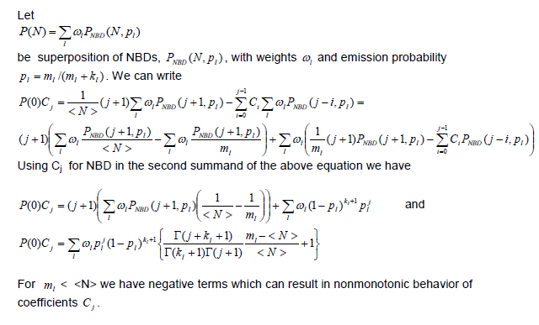
Very recent result:
It turns out that occurence of such oscillations do not eliminate the possible use of a multicomponent NBD. Namely, the multicomponent NBD can, after all, lead to the oscillatory behavior of coefficients C_{j} .

Slide 34
Very recent result:
It turns out that occurence of such oscillations do not eliminate the possible use of a multicomponent NBD. Namely, the multicomponent NBD can, after all, lead to the oscillatory behavior of coefficients C_{j} .

Slide 35
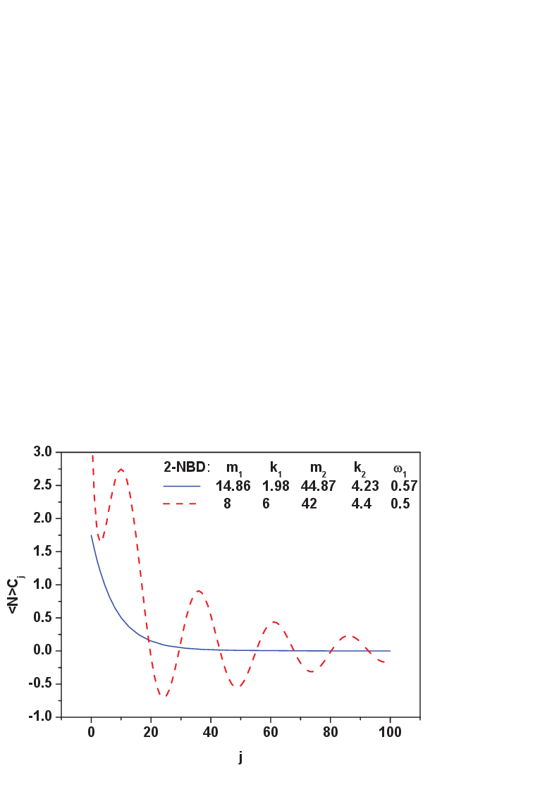
Very recent result:
The 2-component NBD with suitably chosen parameters produces oscillations (dashed line). But those parameters are not the one used so far in fitting P(N) (full line).
Therefore: Possible models of multiparticle production must describe, with the same parameters, both the multiplicity distributions P(N) and the corresponding coefficients C_{j} becsause these coefficients provide us a new information, which can be used to improve models of particle production processes.

Slide 36

여러분의 관심 에 감사드립니다
Thank you for your attention
and I look forward to your comments and questions
References:
Entropy 17 (2015) 384
Chaos, S & F 81 (2015) 487
arXiv:1601.03883

Slide 37
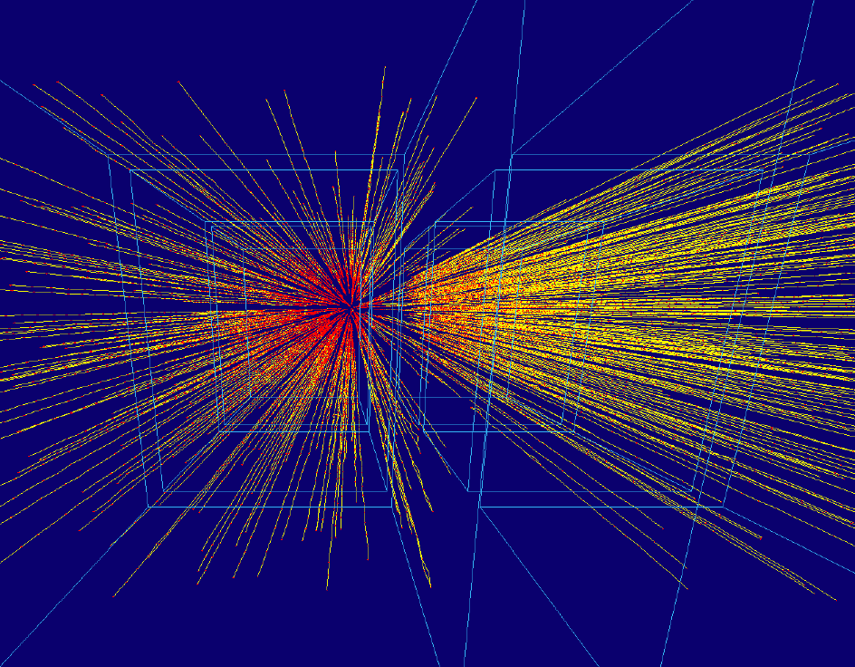
Back-up slides

Slide 38
Frequency of oscillations
Comparison of fit parameters of oscillating term
clearly show that observed frequency given by parameter
is few tens smaller than expected
value for any reasonable
and the hierarchy of evolution
Neglecting the fluctuations of
parameters, after
steps
and
These equation do not change the slope parameter
but frequency of oscillation
becomes
times smaller
Experimental data indicate that
(for
and
)

Slide 39


number of clans
multiplicity in a clan

