Slide 1
GSDC: A Unique Data Center in Korea for Fundamental Research
Global Science experimental Data hub Center
Korea Institute of Science and Technology Information
Sang-Un Ahn

Slide 2
A Few Words About data center

Slide 3
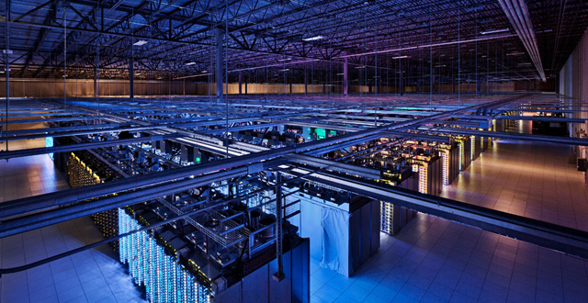
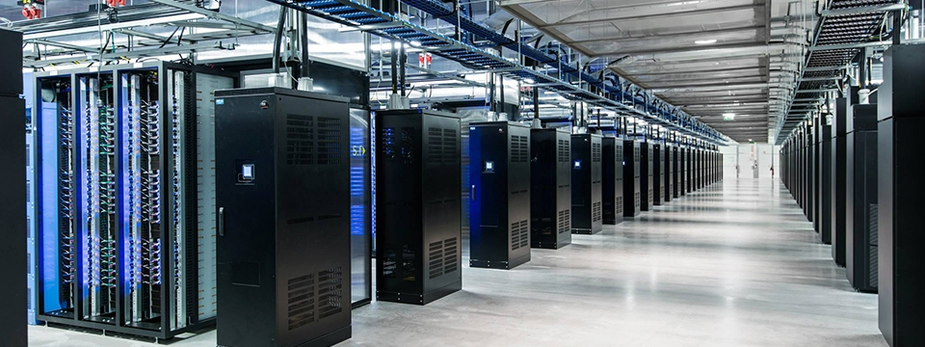
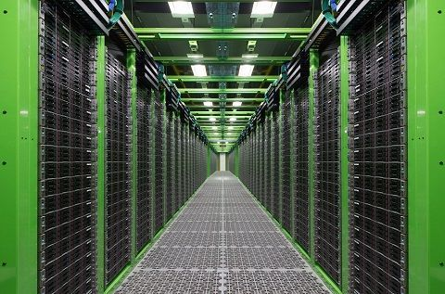
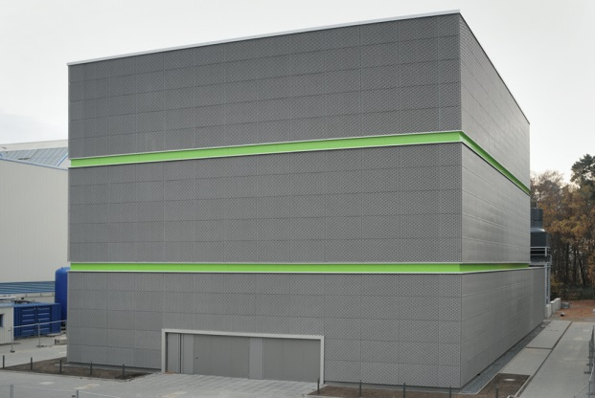
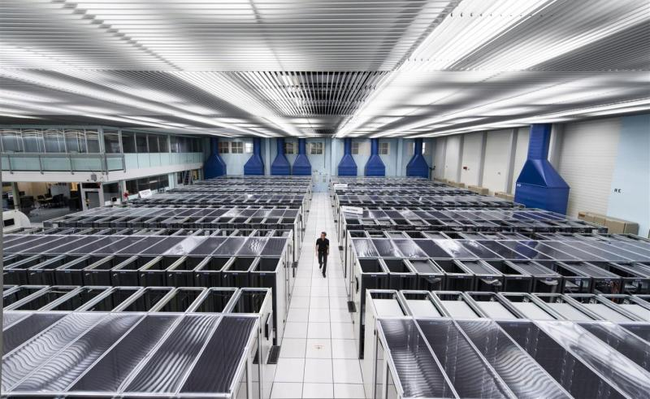
Data Centers
Google
Facebook
NAVER
GSI
CERN
We already benefit from data centers for many-years without knowing their existence
Data centers provide IT services such as web, mail, apps, applications, etc. and make them accessible beyond space-time
Notes:
Recently, we have heard a lot about data center from the internet or news and for physicists you have already known about CERN data center and some of you know about the recent achievement of GSI known as Green Cube, a cutting-edge technology brewed hyper IT infrastructure.

Slide 4
What Data Center is for?
Business
To facilitate processing “Big Data”
Recent business trends have shifted to provide services and products tailored to individual customers based upon their personal interests
The Big Data, mostly obtained from the on-line activity through the Internet via mobile devices and personal computers, is “too” big to be dealt with a mainframe or a conventional supercomputer
To facilitate processing and preserving large-scale of data
Development of high resolution instrumentation for better research has lead to the huge production of data which is far beyond the capability of a researcher’s workstation or a moderate cluster
The reality is worse: the invention of the Grid – intercontinental collaboration of data centers
Research

Slide 5
What is Data Center?
Definition
A facility used to house computer systems and associated components, such as telecommunications and storage systems.
It generally includes redundant or backup power supplies, redundant data communications connections, environmental controls (e.g., air conditioning, fire suppression) and various security devices.
Large data centers are industrial scale operations using as much electricity as a small town.
Security …
-- Wikipedia
Housing computer systems
Redundancy or Backup
Keywords for Data Center
Power efficiency
Security

Slide 6
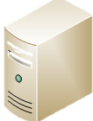
Redundancy
Nowadays IT operations are a crucial aspect of most organizational operations around the world
Business Continuity
Service failure
Business can go on
Reliable IT infrastructure is the key for the business success
Notes:
Highly available or reliable IT infrastructure requires a certain amount of investment on computing facility as well as man-power in which normally an individual person or a small group cannot afford

Slide 7
Highly Available IT Infrastructure
No single point of failure
Removing physically the single point of failure within IT infrastructure
E.g. dual power supplies, dual switches and routers, remote sites
Fast recovery
Automated provisioning and configuration management coupled with alarm system are crucial to achieve the fast recovery
Backup is mandatory
Virtualization and High-Availability add-ons are options for more reliable and agile IT infrastructure
Malfunctioning
Glitches
Monitoring
Alarm
Automated Provisioning
Configuration Management
IT Service

Slide 8
GSDC

Slide 9
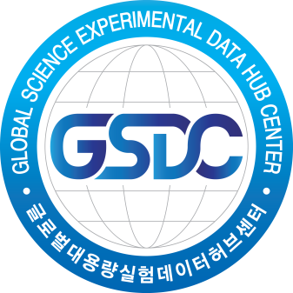
Introduction
GSDC is a government funding project to promote the fundamental research in Korea by providing IT infrastructure
Phase I
Collider physics conducted at CERN, FNAL, KEK
Phase II
Domestic fields requiring large amount of storage and computing power
Asian Hub Center
Phase III
Data Hub Center for Data-intensive research
Phase IV
National Data Center for fundamental research
2025-
2019-2024
2015-2018
2009-2014

Slide 10
Research Support
ALICE
WLCG Tier-1 & Tier-3 (KIAF) / 3,000 (200) Cores / 1.5 PB (200 TB) Disk / 1.5 PB Tape / 10Gbps Dedicated Link up to CERN
CMS
Tier-3 (Non-Grid) / 500 Cores / 500 TB Disk
Belle II
Belle II Grid Tier-2 / 300 Cores / 80 TB Disk
LIGO
LDG Tier-3 / 576 Cores / 150 TB Disk
RENO
Non-Grid / 192 Cores / 250 TB Disk
Genome
Non-Grid / 192 Cores / 250 TB Disk

Slide 11
Complexity in Service Level
ALICE
CMS
Belle II
LIGO
RENO
Genome
Various IT services are required to support each experiment

Slide 12
Tip of the Iceberg

Slide 13
GSDC System Administration S/W Stack
Analysis
Tools
Alice
CMS
Bell
Ligo
Reno
Bio
TEM
People see this
APP
SW
PhEDEx
Monalisa
DAS
CernVM-FS
What really happens
Elasticsearch
Icinga
Splunk
Gmon
System
Monitoring
Check_MK
Kibana
IBM TS3000 System Console
Observium
Ganglia
Logstash
PerfSonar
Foreman
RackTables
Software Defined
Storage
Cisco Nexus Application SW
System
Frontend
RHEVM
IPA
Hitachi
Storage Navigator
oVirt
Stash
EMC OneFS
Dell Force10 Application SW
Hp SIM
Dell OME
Jira
Hitachi
NAS Platform
Kebernetes
Mesos
Confluence
IBM System Storage
Auto
Deploy
Script
P
u
p
p
e
t
Condor
Git
Glusterfs
VLAN
PBS/maui
Pulp
SAN Multipathing
DNS
System
Backend
LDAP
Docker
TSM
DHCP
Kickstart
iLO/iDRAC
XRootD
Syslog
IPMI
PXE
GPFS
SNMP
OS
Scientific Linux
CentOS
RedHat
Atomic
Hitachi
EMC
IBM
Cisco
Dell
Computing Server (600 nodes)
Storage (6PB, D:5/T:1)
Network Switch (49)
D.-S. Jin
J.-H. Kim
H/W
1U
2U
Blade
VM
Disk
Tape
1G
10G

Slide 14
GSDC System Architecture
Fully Redundant Networks
J.-H. Kim

Slide 15
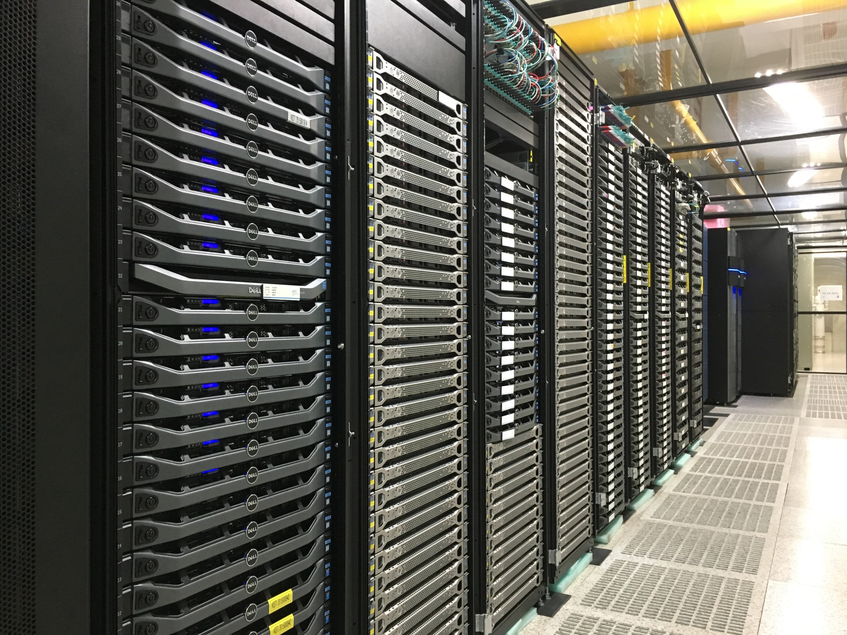
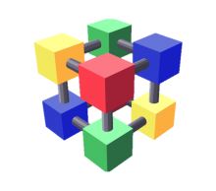
GSDC IT Infrastructure
Highly Available IT Infrastructure
Redundant System Architecture
Virtualization
Automated Provisioning and Configuration Management
Security and User Policy
Single-Sign-On
Well-managed Maintenance Schedule
24-hours Monitoring and On-call Alarm System
IT Operations tightly coupled with User Community

Slide 16
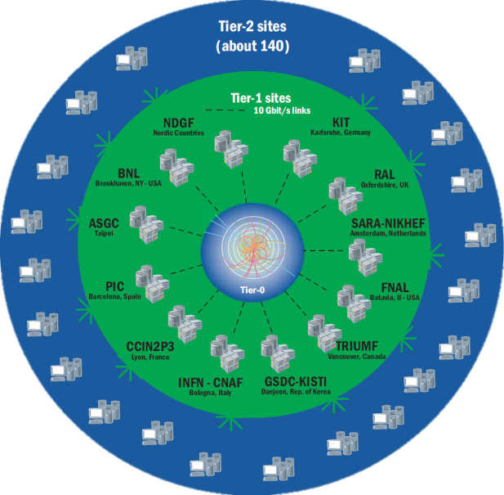
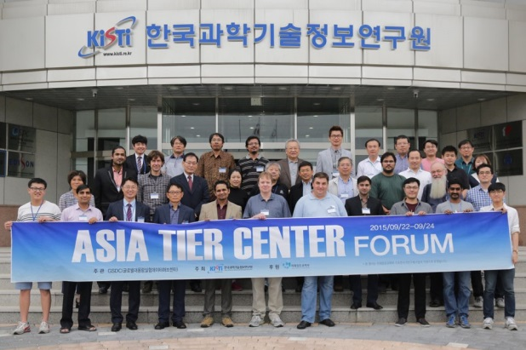
Global Partnership
WLCG Tier-1 since 2014
Full membership of WLCG Collaboration
Connected to closed circuit among CERN Tier-0 and other Tier-1s
Successfully replicating raw data for ALICE (1.5 PB)
More than 3,300 concurrent jobs processed
One of the most reliable Tier-1 (98% Availability achieved in 2015)
Asia Tier Center Forum since 2015
GSDC driven Asian community to consolidate Network environment among Asian Tier Centers
Interconnection between TEIN and GLORIAD-KR has been placed in Hong Kong which improved the connectivity between GSDC Tier-1 and other Tier-2 centers

Slide 17
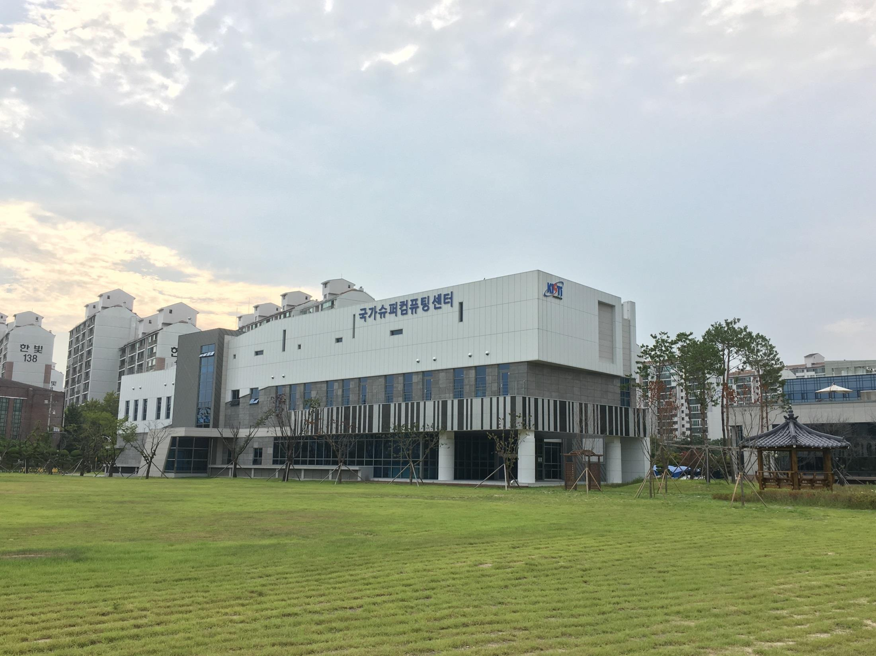
Conclusion
Data Centers are built for processing and storing the large scale of data
Highly available IT Infrastructure is the key of the success of the business and fundamental research
GSDC is the sole Data Center in Korea which government funds for fundamental research
GSDC is being transformed to HA-infrastructure and is targeting the most reliable Data Center in the world

Slide 18
Thank you!

