Slide 1
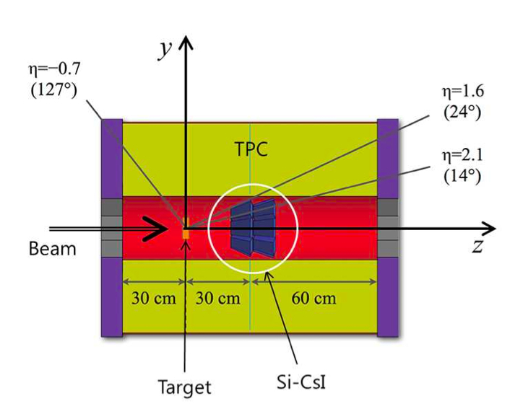
3 station detector is OK?
5M
10 M
Single neutron efficiency
Only 4 station is fired

Slide 2
Two neutron separation efficiency
Separation efficiency : # of correctly separated events/(number of events – no remained signal events)
Geo Condition:
- Distance : 10 m
- Station gap : 60 cm
analysis condition:
- Different station : 10, 1 5 ns
- Same station : 5 ns
3ST case : maximum difference station = 2
4ST case : maximum station difference = 3
3ST case : maximum station difference = 2

Slide 3
Two neutron separation efficiency
Geo Condition:
- Distance : 5 m
- Station gap : 60 cm
analysis condition:
- Different station : 10, 1 5 ns
- Same station : 5 ns

Slide 4
Time difference by station difference

Slide 5
Plan : not use exact value(10ns, 15ns) at different station time condition
---→ use different time value by energy(fitting function)

