Slide 1
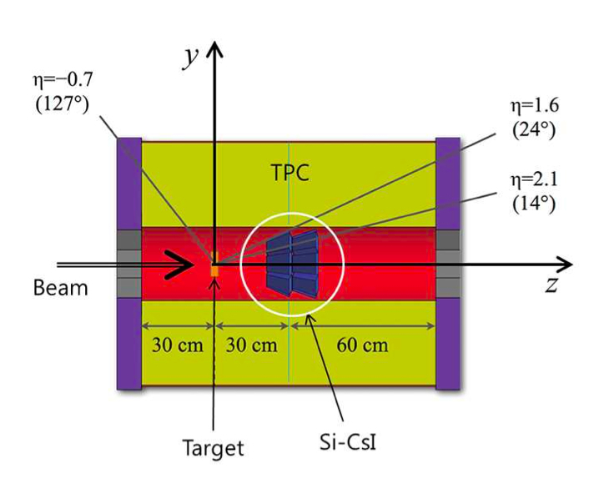
3 station detector is OK?
5M
10 M
Single neutron efficiency
Only 4 station is fired

Slide 2
2 neutron generation (250000 events)
5m, 10m distance from target
Separation efficiency = # of correctly separated events/(number of events – no remained signal events)
5m
10m

Slide 3
3 neutron
5 m
10 m

