Slide 1



Measurement of azimuthal anisotropy at RHIC-PHENIX
ISMD2016
Maya SHIMOMURA for the PHENIX Collaboration
Nara Women’s University

Slide 2
Elliptic Flow (v₂)
Azimuthal anisotropy of produced particles is a powerful probe for investigating the characteristic of the QGP.
At non central collision
Reaction plane (Ψ)
P_{y}
P_{z}
z
Small mean free path
Thermalization
Pressure gradient
P_{x}
Ｙ
x
Elliptic flow
Geometrical anisotropy
Momentum anisotropy
Momentum anisotropy reflects the hot dense matter.
Fourier expansion of the distribution of produced particle angle (φ) to reaction plane (Ψ)
v₂ is the coefficient of the second term → indicates ellipticity
Thermalization should be occurred very early before the geometrical eccentricity is gone.
Notes:
Azimuthal anisotropy of produced particles is a powerful probe for investigating the characteristics of the QGP.
Especially the strength of the elliptic anisotropy (v2), which is defined by the second harmonics of Fourier expansion for the azimuthal distribution of produced particles with respect to the reaction plane, is expected to be sensitive to the early stage of heavy ion collisions.
At non-central collision, the overlap region is geometrically anisotropic, like almond shape as shown in the left figure.
When the matter has small mean free path, interacting each other enough to reach local thermalization, it creates pressure gradient.
The geometrical anisotropy transfers to the anisotropy in the momentum phase space as flow because of this pressure gradient. And V2 indicates the strength of this elliptic flow.
Thus, the measured v2 reflects the equation of state of the dense matter such as QGP, produced
in the collisions.
The important thing here is since the produced particles randomly emit before thermalization, the geometrical eccentricity decrease with time.
Therefore to let the geometrical eccentricity make elliptic flow, the thermalization should be occurred very early before the geometrical eccentricity is totally gone.
mb （バーン） = 10e -31 m^2
fm (フェムト）= 10e-15 m
1 fm^2 = 10e-30 m^2 = 10 mb
λ ～0.6fm << R ～ 6 fm
v2 is the coefficient of the second term → indicates ellipticity
✓In non-central collisions, participant region has almond shape.
➡azimuthal anisotropy in coordinate space
✓If λ<< R, azimuthal anisotropy of the coordinate space is
converted to that of the momentum space.
v2 ; second Fourier harmonics of azimuthal distribution
✓Goodies :
• Clear origin of the signal
• Collision geometry can be determined experimentally
Why do we use elliptic flow as the probe of QGP ?
Sensitive to the initial stage of heavy ion collisions (if the local thermal equilibrium is established)
Initial geometry overlap (eccentricity)
Initial density profile
Equation of state (EOS) : pressure gradient is the driving force of elliptic flow

Slide 3
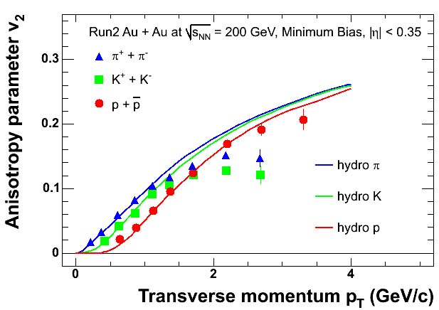
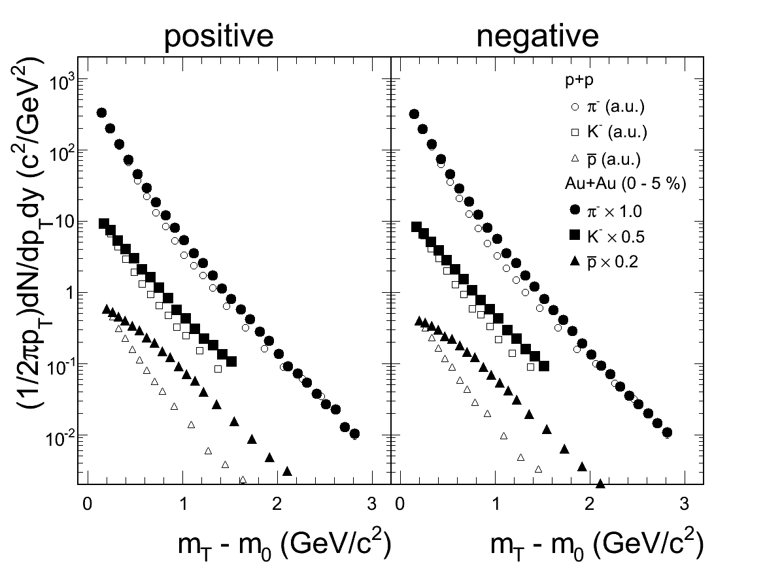
v₂ explained by hydro model
PRL 91, 182301
v₂ at low p_{T} (<~2 GeV/c) can be explained by a hydro-dynamical model
Mass Ordering: v2(π)>v2(K)>v2(p)
Existence of radial flow.
Single particle spectra also indicates radial flow.
PHENIX: Au+Au: PRC 63, 034909 (2004);
p+p: PRC74, 024904 (2006)
convex shape due to radial flow.
Notes:
It was found that the v2 at low pT can be explained by a hydro-dynamical model assuming early thermalization
Spectra for heavier particles
has a convex shape due to collective flow.
spectra :横運動量分布も、流体力学を使ったモデル（Blast-wave Fit）で説明できている。
π/K/pの質量の違いからくる radial flowの効果を含むモデルによって、実験結果が再現でき、p+p実験との差も説明できている。
→ハドロン化後のradial flowが存在

Slide 4
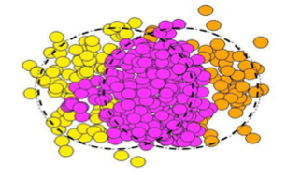
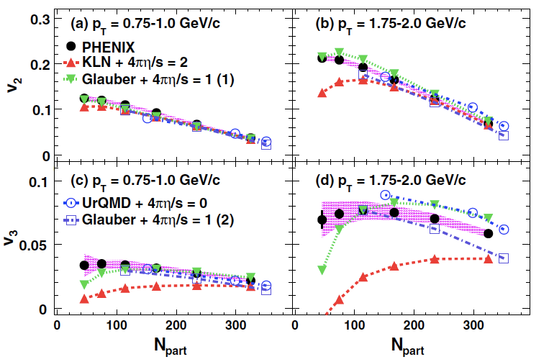
Higher order flow harmonics (v3)
Au+Au 200GeV
PRL 107. 252301
Initial participant fluctuation at event-by-event can lead to triangular particle production (v3).
v3 is expected to further constrains initial condition and viscosity

Slide 5
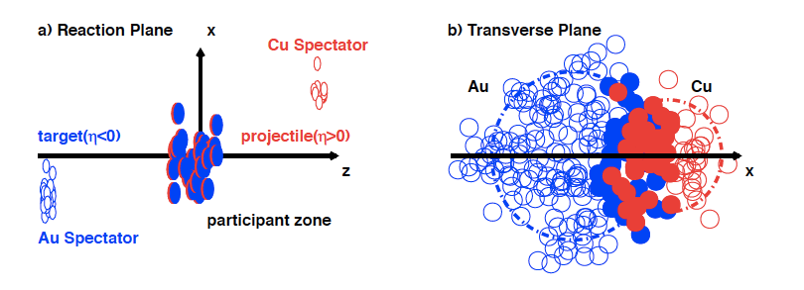
Cu+Au collisions
Asymmetric initial condition provides
Different left/right pressure gradient, particle production.
Initially triangle anisotropy without the participant fluctuation.
vn measurements in CuAu collisions provide additional insight.
Notes:
Longitudinally, above characteristics could be different in Au-going/Cu-going

Slide 6
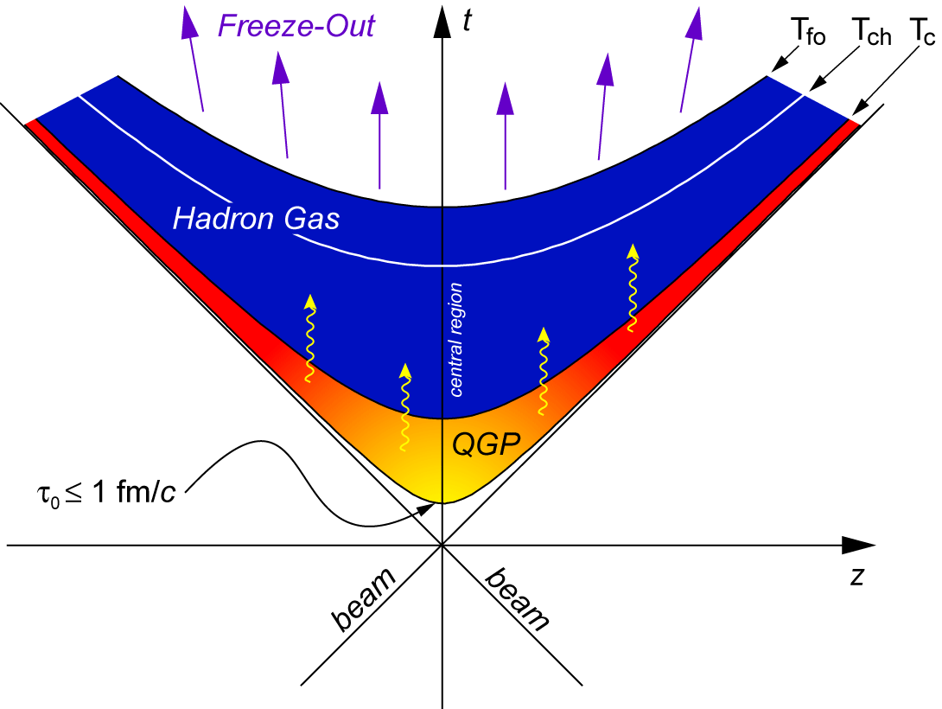
Time Evolution
The matter produced in the high energy heavy ion collision is expected to undergo several
stages from the initial hard scattering to the final hadron emission.
t
Kinematical freeze-out
Hadron gas
Chemical freeze-out
Mixed phase
Hadronization
Expansion & Cooling
QGP
Thermalization
pre-equilibrium
Hard scatterings
Collision
When the matter is thermalized, we expect
Hydro-dynamical behavior at quark level .
Need a comprehensive understanding from thermalization through hadronization to freeze-out.
*Note whenever the matter interacts each other, v₂ could change.
Notes:
This is the diagram of space time evolution after collision.
The matter produced in the high energy heavy ion collision is expected to undergo several stages from the initial hard scattering to the final hadron emission as listed here.
When the matter reaches thermalization and QGP is created, we expect hydro-dynamical behavior at quark level.
Since experimentally we cannot see the QGP directory, we need a comprehensive understanding from thermalization through hadronization to freeze-out
As I said the azimuthal anisotropy is expected to be created at QGP stage by pressure gradient, but it is important to note whenever the matter interacts each other, there is a possibility to make v2 Increase or decrease.
Time scale of space-time evolution of a heavy-ion collision is ~10 fm/c.
The evidence of strong transverse expansion can be related to the equation of state of the dense matter produced at RHIC.
Space-time evolution of a heavy-ion
collision (time scale: ~10 fm/c)
There are some stages
and dynamic changes.

Slide 7
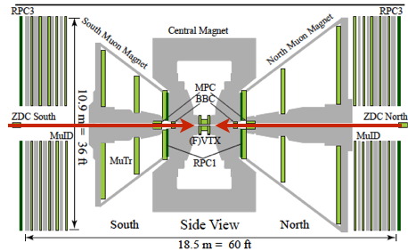
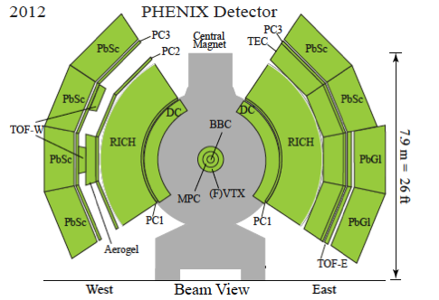
PHENIX detectors
2nd & 3rd Participant Event Plane
-Beam Beam counter(BBC)
Charged particle Tracking
-Drift Chamber(DC) (|η|<0.35)
-Pad Chamber(PC) (|η|<0.35)
-Electro magnetic calorimeter(EMC) (|η|<0.35)
-Forward Vertex Detector(FVTX) (1<|η|<3)
Hadron identification -Time of flight(TOF) (|η|<0.35)
- Electro magnetic calorimeter(EMC) (|η|<0.35)

Slide 8
Charged hadron vn
[PRC.92.034913]
[arxiv:1509.07784]

Slide 9

Energy dependence and Eccentricity scaling
[PRC.92.034913]
v₂ vs. N_{part}
v₂/ε₂ vs. N_{part}
v₂/ε₂ at Cu+Cu and Au+Au agree at same N_{part}.
After ε Scaling, still strong N_{part} dependence
Notes:
Eccentricity scaling suggests early thermalization.

Slide 10
N_{part}^{1/3} Scaling
v₂/(ε₂N_{part}^{1/3}) vs. N_{part}
The dependence can be normalized by N_{part}^{1/3}.
Empirical v2 scaling [PRC.92.034913]
- v₂/(eccentricity*N_{part}^{1/3}) scaling works for all collision systems except small N_{part} at 62 GeV.
- Npart^{(1/3)} is proportional to length scale
Notes:
We found that this difference is scaled by the Npart to 1 over 3 factor.
Left and middle figures are same figures as previous page.
Dividing the middle figure by Npart to 1 over 3 we get Right figure.
You can see all v2 including ALICE one became flat except CuCu 62 GeV results.
This exception may indicate non-sufficient thermalization region.
We are now reaching transition phase both energy scan and participant density scan..
To fill this map we need more detail study.
including Pb+Pb 2.76TeV
- This exception may indicate non-sufficient thermalization region.

Slide 11
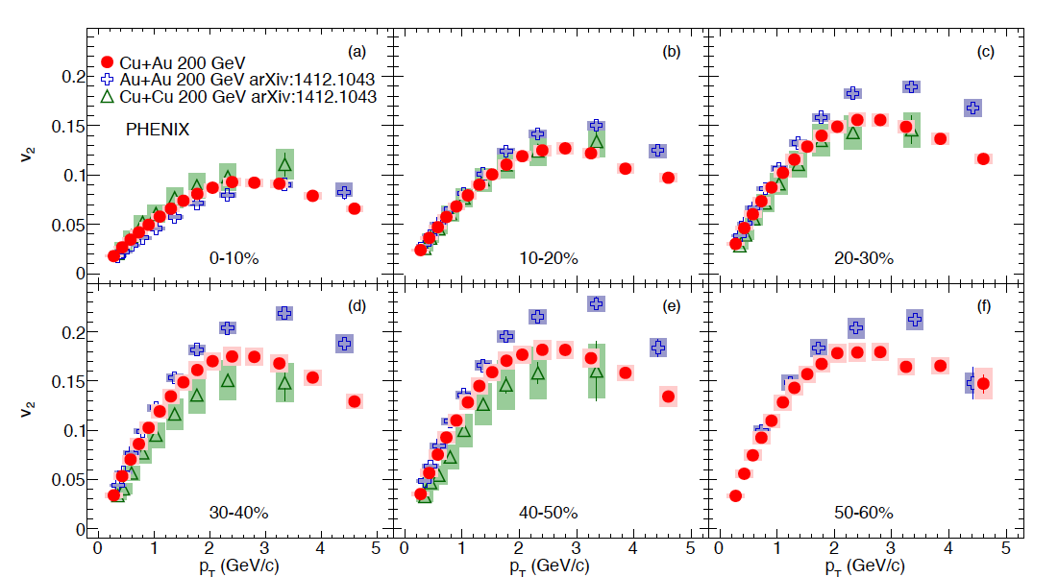
v2 vs. pT for AuAu/CuCu/CuAu
Au+Au and Cu+Cu [PRC.92.034913]
Cu+Au [arxiv:1509.07784]
PRC.92.034913
CuAu is always between AuAu and CuCu.
Similar dependences of centrality and p_{T}
Notes:
v2 for different systems has similar centrality and pT dependence
v2 in CuAu is always between those in AuAu and CuCu

Slide 12
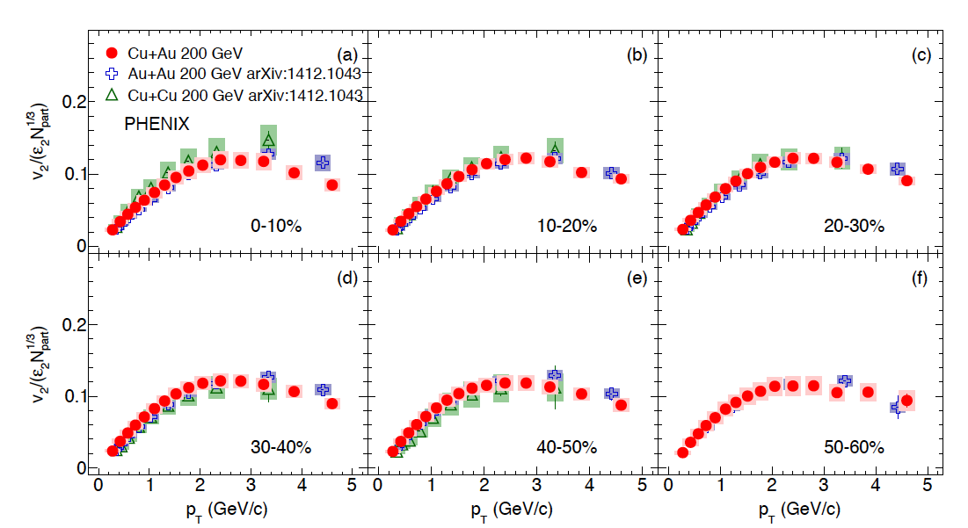
v₂ / ε2*Npart^{(1/3)} vs. p_{T}
arxiv:1509.07784
PRC.92.034913
-v2 is scaled with ε2Npart^{(1/3)}
-ε2Npart^{(1/3)} scaling works well in CuAu too.

Slide 13
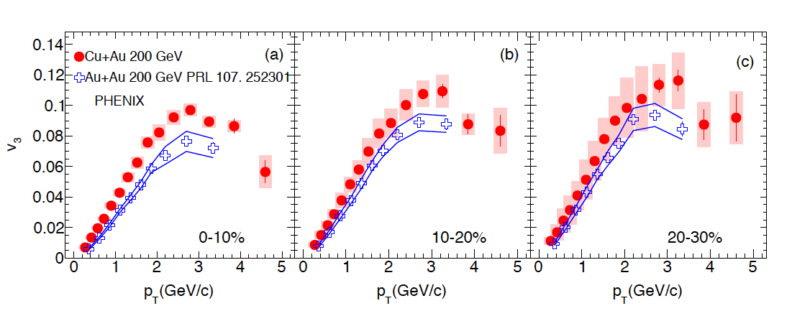
v3 vs. p_{T} for AuAu/CuAu
arxiv:1509.07784
- Weak centrality dependence in AuCu
- CuAu is always bigger than AuAu.

Slide 14
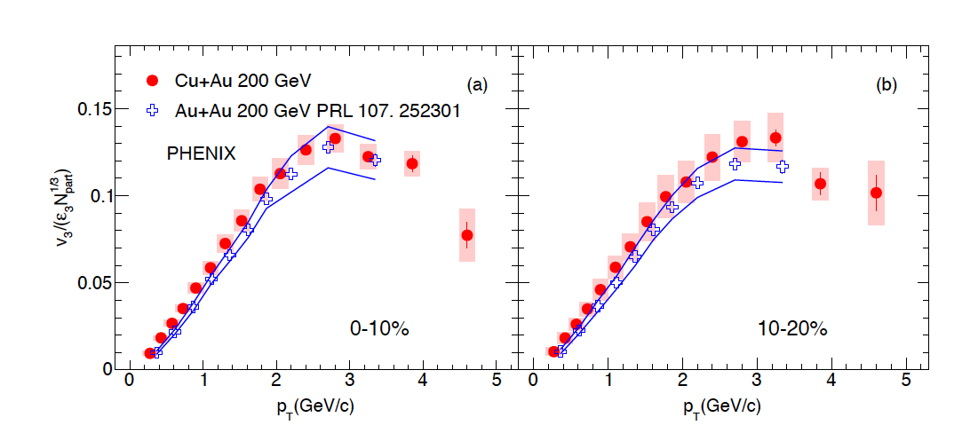
ε3*Npart^{(1/3)} scaling for v3
arxiv:1509.07784
ε3Npart^{(1/3)} scaling works well in v3.
Notes:
Empirical ε3Npart^{(1/3)} scaling is performed
-v3 is scaled with ε3Npart^{(1/3)}
-Npart^{(1/3)} is proportional to length scale

Slide 15
Identified hadron vn

Slide 16
PID v₂ vs p_{T} in AuAu/CuCu

Slide 17
PID v₂ vs p_{T} in AuAu/CuCu
v₂(p_{T}) /n_{quark} vs. KE_{T}/n_{quark} becomes one curve independent of particle species.
Quark number scaling is consistent to the recombination model which assumes the quark level flow at QGP phase.
Notes:
And again you can see the Npart dependence.

Slide 18
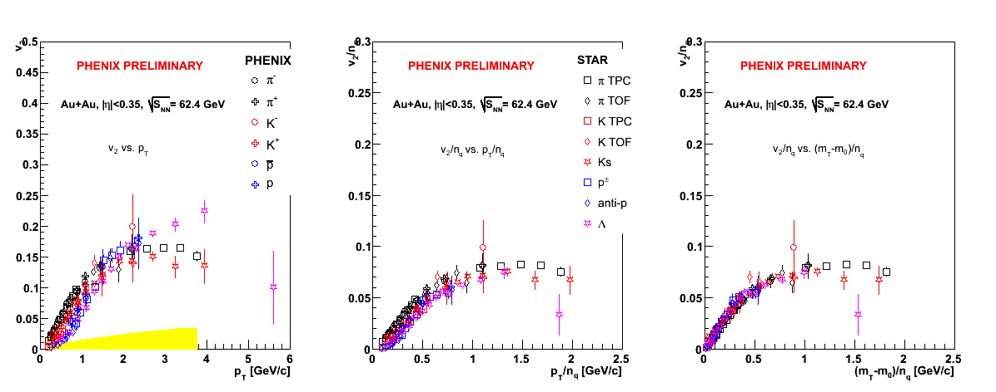
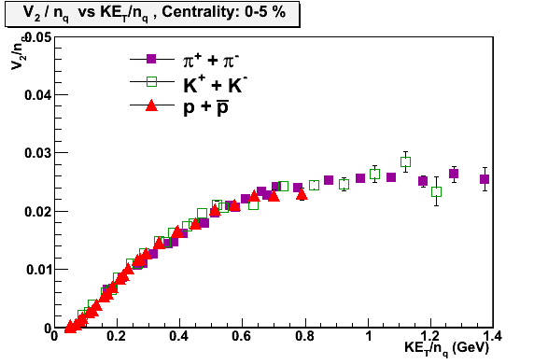
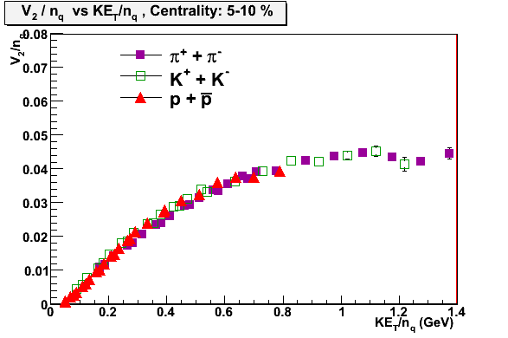
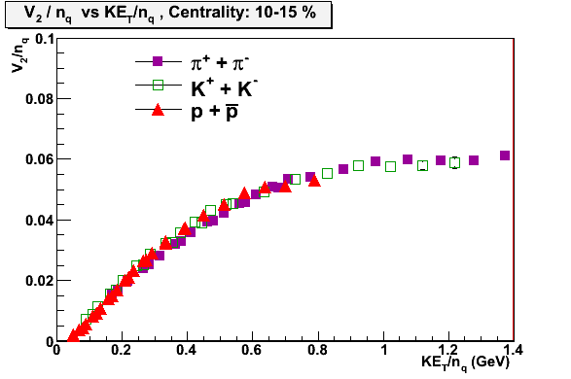
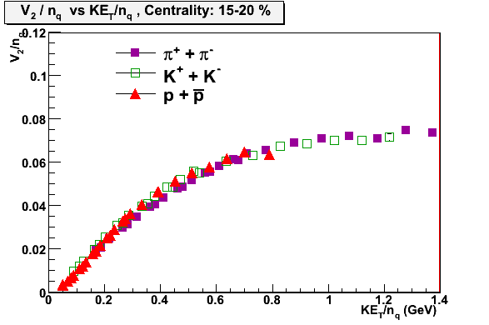
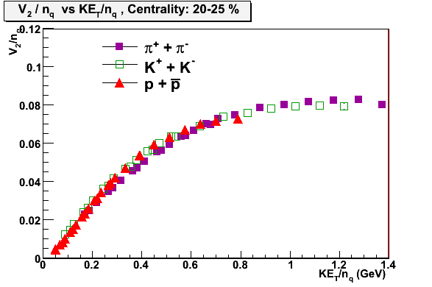
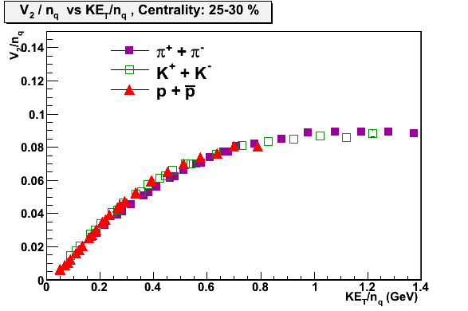
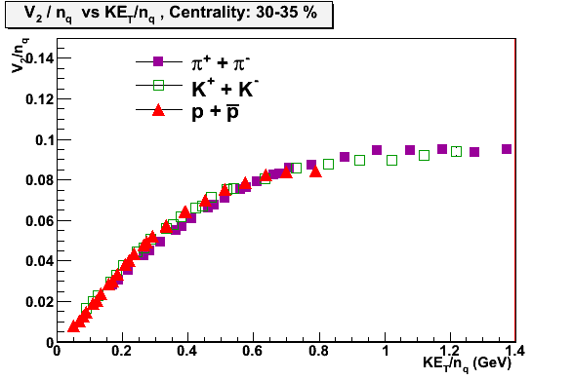
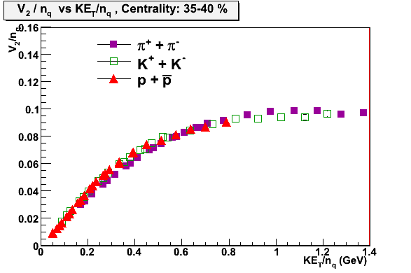
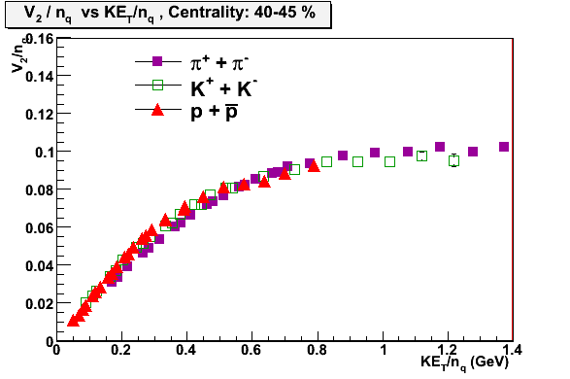
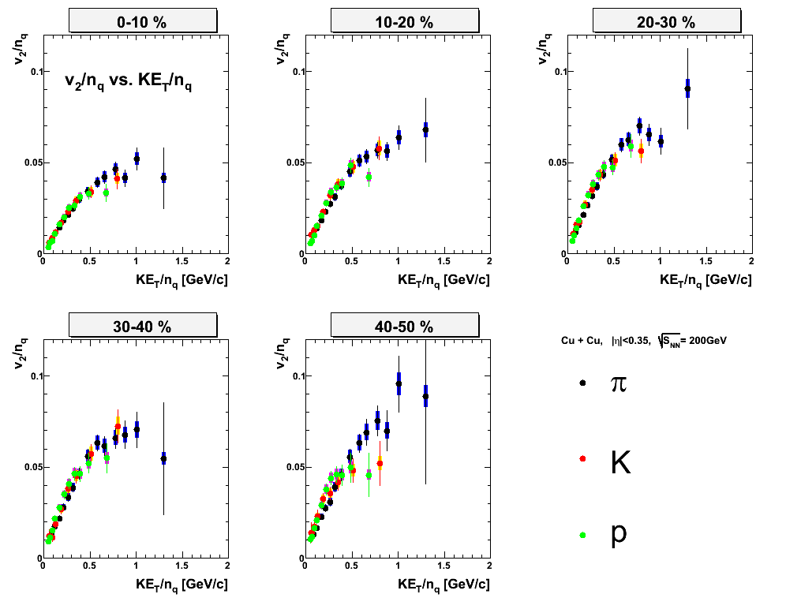
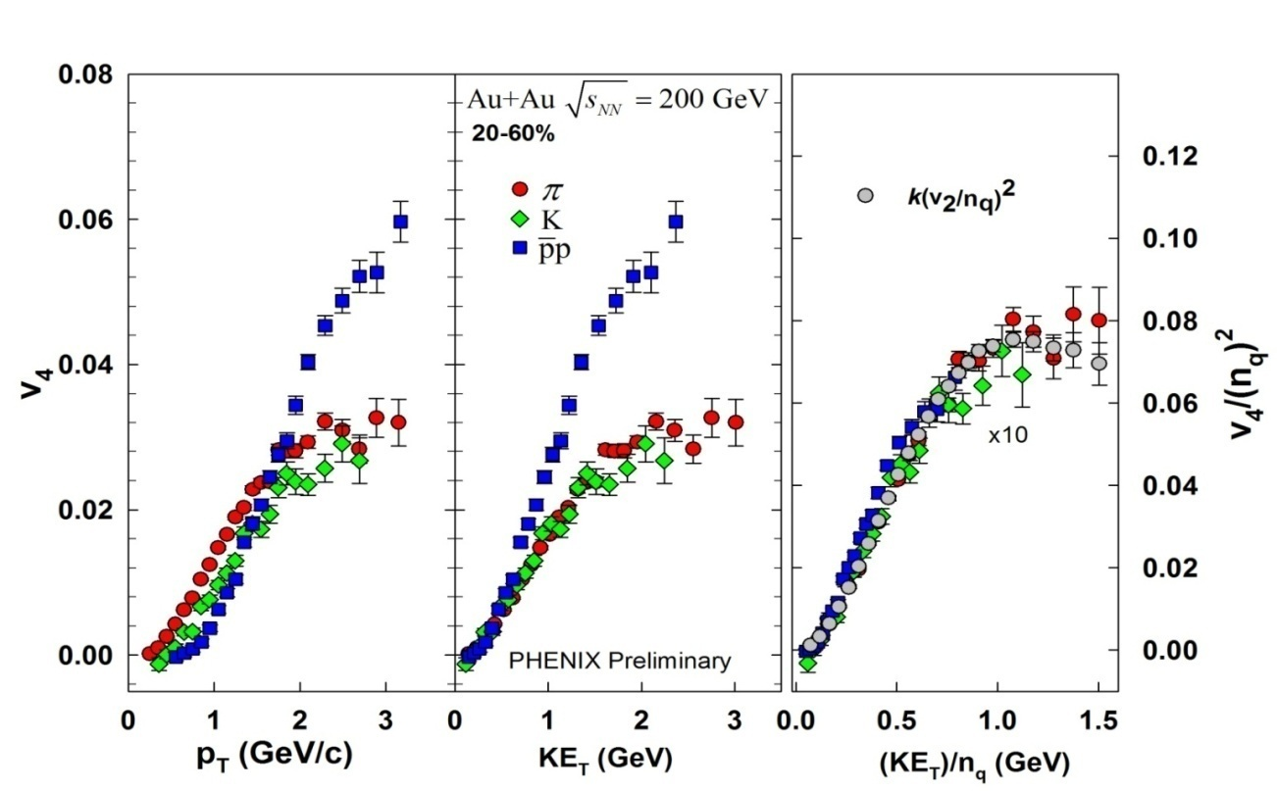
Quark number scaling everywhere
AuAu 62.4GeV PHENIX/STAR
Au+Au 200 GeV (Run7)
PHENIX Preliminary
Cu+Cu 200GeV
v₄ (Au+Au 200GeV)
QM09, A. Taranenko
Quark number scaling work out up to K_{ET} ~1GeV.
Notes:
At RHIC energy, most of other measured v2 results are consistent to the quark number scaling. And even v4 is also consistent.
So this scaling is everywhere above 62 GeV at Au+Au.

Slide 19
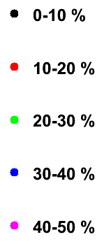

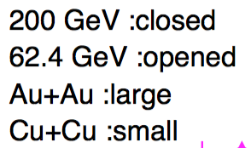
v₂ scaling
Taking all scaling together,
Different Energy and System
  (AuAu200, CuCu200, AuAu62)
Different Centrality (0-50%)
Different particles (π/ K /p)
45 curves
Scale to one curve.
χ2/ndf = 2.1 (with systematic errors)
Notes:
Eventually, including all scalings we found at RHIC, we got a universal v2 scaling.
This figure include 45 curves with AuAu200, CuCu200, AuAu62, for different centrality 0-50 % as 10% step for pi K p .
These RHIC v2 follow the one curve.
To see if the LHC v2 follows this curve, we need to measure the PID v2.
In my opinion, at LHC v2, we already know the energy and eccentricity scaling works and probably quark number scaling will work.
So the Key might be the KET scaling which mean the key will be if the radial flow effect make the proton different or not.

Slide 20
v₂ scaling
Taking all scaling together,
Different Energy and System
  (AuAu200, CuCu200, AuAu62)
Different Centrality (0-50%)
Different particles (π/ K /p)
45 curves
Scale to one curve.
χ2/ndf = 2.1 (with systematic errors)
Notes:
Eventually, including all scalings we found at RHIC, we got a universal v2 scaling.
This figure include 45 curves with AuAu200, CuCu200, AuAu62, for different centrality 0-50 % as 10% step for pi K p .
These RHIC v2 follow the one curve.
To see if the LHC v2 follows this curve, we need to measure the PID v2.
In my opinion, at LHC v2, we already know the energy and eccentricity scaling works and probably quark number scaling will work.
So the Key might be the KET scaling which mean the key will be if the radial flow effect make the proton different or not.

Slide 21
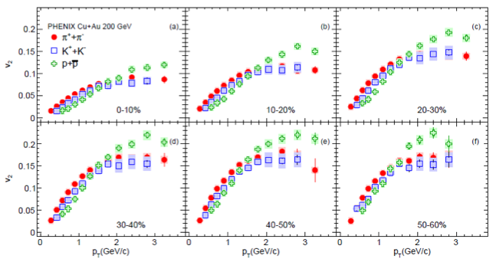
PID v₂ vs p_{T} in CuAu
arxiv:1509.07784
Mass ordering can be seen at low pT
Baryon and meson splitting at mid-pT

Slide 22
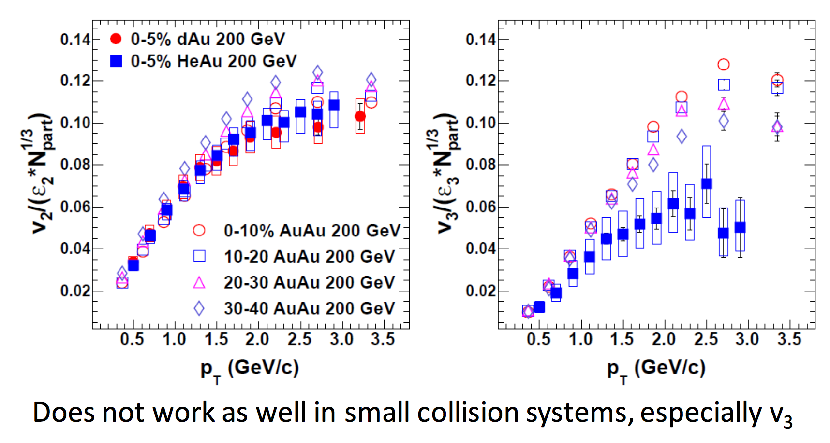
εn*Npart^{(1/3)} scaling at small system
By Sarah compbell at ICHEP2016

Slide 23
Summary
Systematic study of v₂ have been done in Au+Au, Cu+Cu at √s_{NN} = 62.4/200 GeV and recently Cu+Au at 200 GeV.
v₂(p_{T}) follows quark number + KE_{T} scaling in Au+Au (200,62GeV) and Cu+Cu (200GeV).
v₂(N_{part}) / ε₂ are same between Au+Au, Cu+Cu
v_{n} (p_{T}) /(ε_{n}*N_{part}^{1/3}) scaling works in Au+Au (200,62GeV), Cu+Cu(200GeV) and Cu+Au (200GeV) for n =2 and in Au+Au(200GeV) and Cu+Au(200GeV) for n =3, but not for the small system.
Notes:
This is the summary of my talk.
Viscosity is expected to explain the Npart dependence for v2, but
Thank you.

Slide 24
Back Up

Slide 25
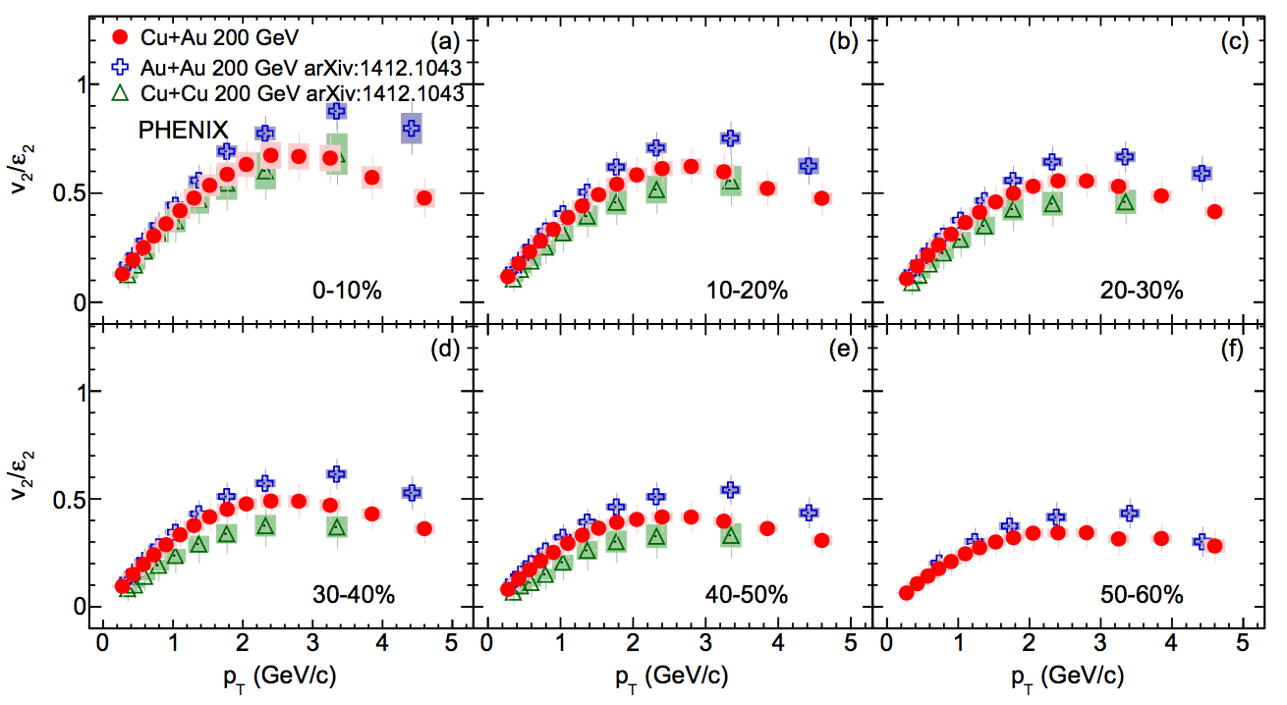
v₂/ε_{n}
This is natural since N_{part} is different.

Slide 26
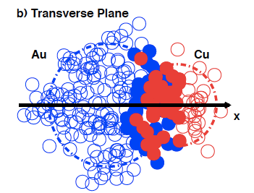
v1 measurement
φ
v1 = <cos(φ-Ψ1)>
Ψ1
The direction of Ψ1 is defined in Cu side spectator
->v1>0 : more particle are emitted to Cu
->v1<0 : more particle are emitted to Au
-Measurement of v1 w.r.t Ψ1 using Au spectator and flipping its sign

Slide 27
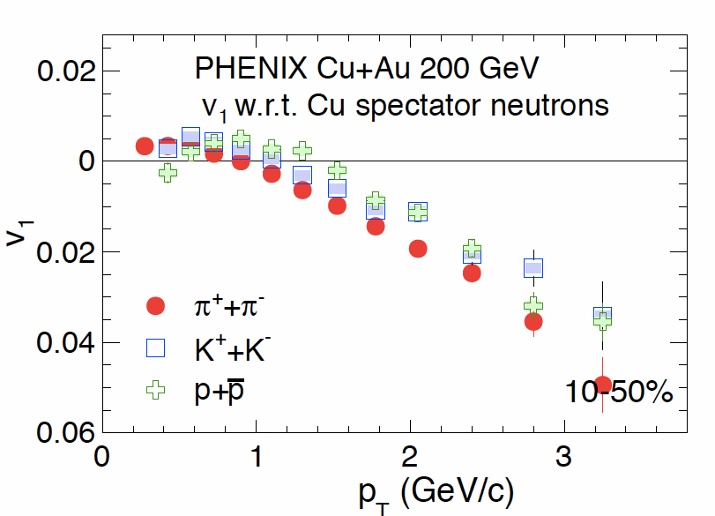
PID v1 in CuAu
arxiv:1509.07784
PID v1
-At low pt , mass ordering is not observed.
-Mass ordering is seen for v1 at 1<pT<2.5GeV
-At high pt, baryon and meson splitting is not observed

Slide 28
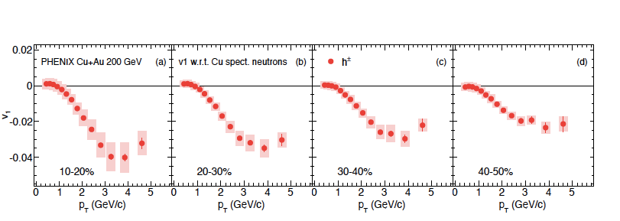
Charged hadron v1
arxiv:1509.07784
Sizable v1 at mid-rapidity is observed for 10-50%
High pt particle are emitted to Au side
-Magnitude decreases from central to more peripheral events
-In peripheral events, Left/Right path length becomes similar

Slide 29
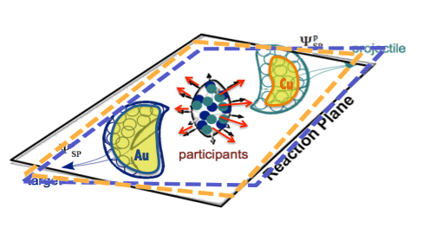
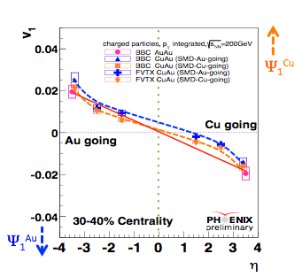

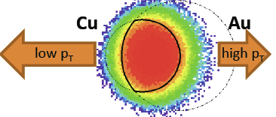
Rapidity dependence of v1
v1>0? (η~0)
E-by-E fluctuation lead to
“ΨS.P ≠ ΨS.P” -> “v1(ΨS.P) ≠ v1(ΨS.P)”
-> v1 = v1(Traditional=η symmetric)
+ v1(fluctuation )
The difference of v1 is seen between two spectator planes.
- Same difference as seen in ALICE
- Fluctuation ?
Traditional v1 in CuAu is positive at mid-rapidty ?
- more low pT particle emitted to Cu side ?
?

Slide 30
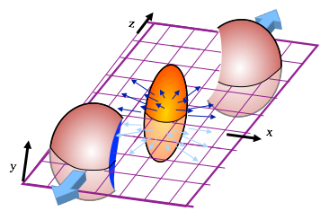
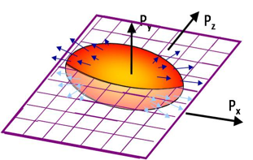
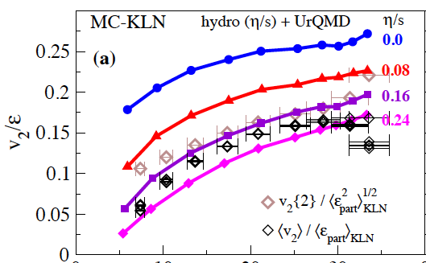

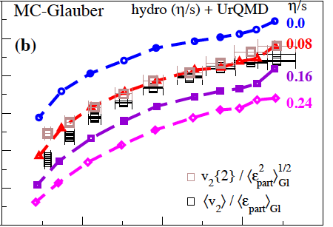

Azimuthal anisotropic flow
Initial spatial anisotropy:ε₂
momentum anisotropy:v2
Anisotropic particle production vn
- Initial spatial condition is converted
to momentum anisotropy
Sensitive to
-initial condition
-viscosity
PRL 106.192301

Slide 31
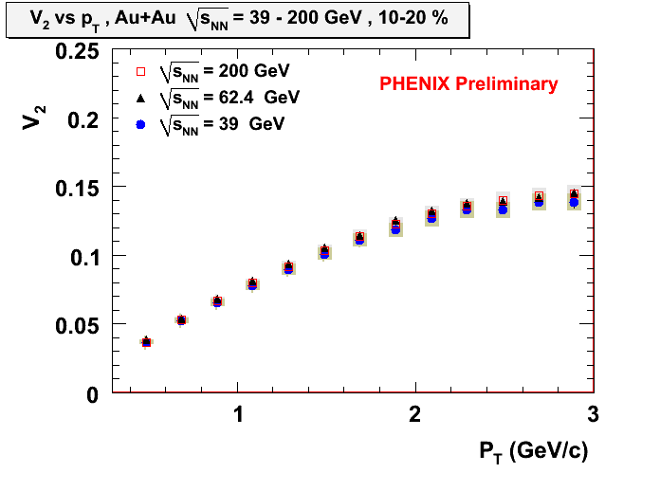
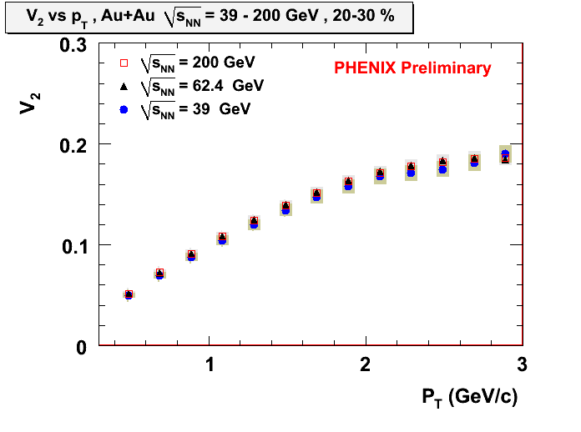
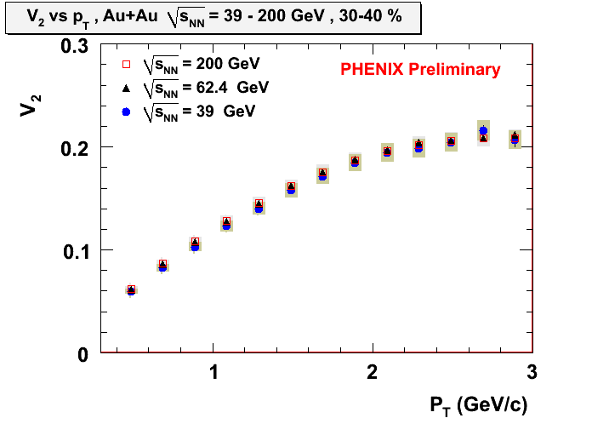
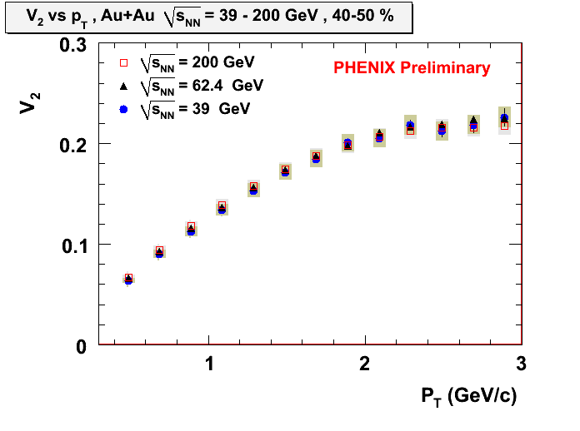
Energy dependence
200, 62.4, 39 GeV
S. Huang, A. Taranenko, R. Lacey (WWND2011)
No energy dependence from 39 GeV to 200 GeV for different collision centralities.
Notes:
We have another new RHIC results for lower energy.
These figures includes 200, 62.4 39 GeV v2 and you see they are beautifully agree for different centralities.

Slide 32
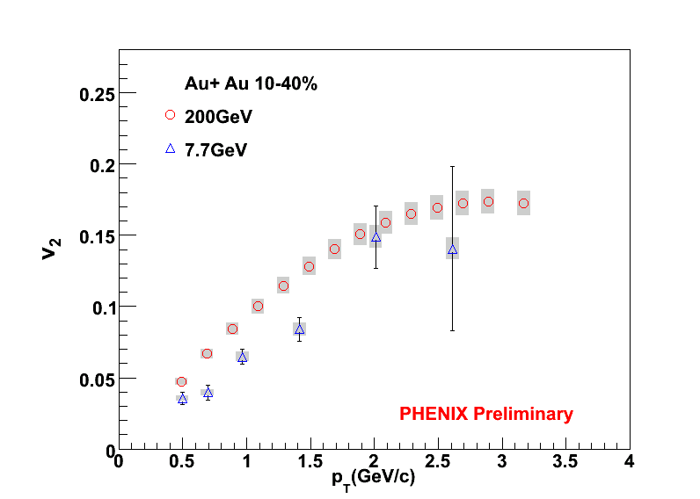
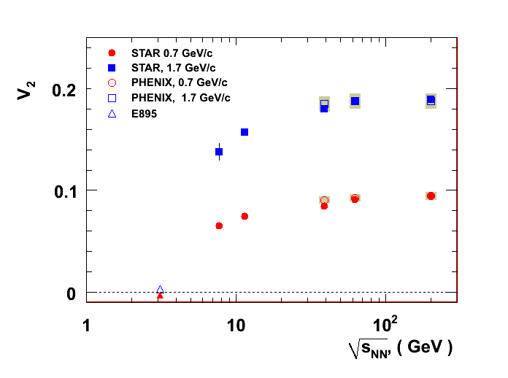
Energy dependence
200, 7.7 GeV
S. Huang, A. Taranenko, R. Lacey (WWND2011)
Preliminary, STAR, PHENIX and E895 data
The v₂ at 7.7 GeV Au+Au is much lower than v₂ of 39 - 200 GeV.
Partonic flow --> Hadronic flow : between 39 and 7.7 GeV ?
→ Need more study for this region.
Notes:
We also have another new results 7.7 GeV at RHIC.
Left figure shows the comparison between 200 and 7.7 GeV v2.
Right figure shows the v2 with certain pT vs. collision energy.
The v2 at 7.7 GeV is much lower than the v2 of others.
This might indicates the region which switch from partonic flow to hadronic flow ?
So, we need more study for this region.

Slide 33
Energy dependence
2.76 TeV, 200 GeV
ALICE ---
Pb+Pb, √s_{NN} = 2.76 TeV
(nucl-ex 0147314)
PHENIX and STAR ---
Au+Au, √s_{NN} = 200 GeV
PHENIX : Phys. Rev. C 80, 024909 (2009)
STAR : Phys. Rev. C 77, 054901 (2008)
Mostly consistent, especially at low p_{T}
Notes:
This is the comparison plot of ALICE v2 with RHIC (PHENIX and STAR) v2.
The bottom shows v2 vs. pT for 0-30% centrality bins as 10 % step and the upper one show 40-50%.
As you see, ALICE and RHIC results are mostly consistent especially at low pT.
Looking more closely, you might find that the STAR results are more consistent to ALICE one and PHENIX shows a little bit larger, especially at 40-50 %.
This might be due to the method difference.
ALICE and STAR results are obtained by 4 particle cumulant method, and PHENIX use the event plane method.
Tsukuba group has been working on these anisotropy measurement with Event Plane at ALICE using some different detectors to determine event plane such as V0 A and C, ZDC, TPC so on.

Slide 34
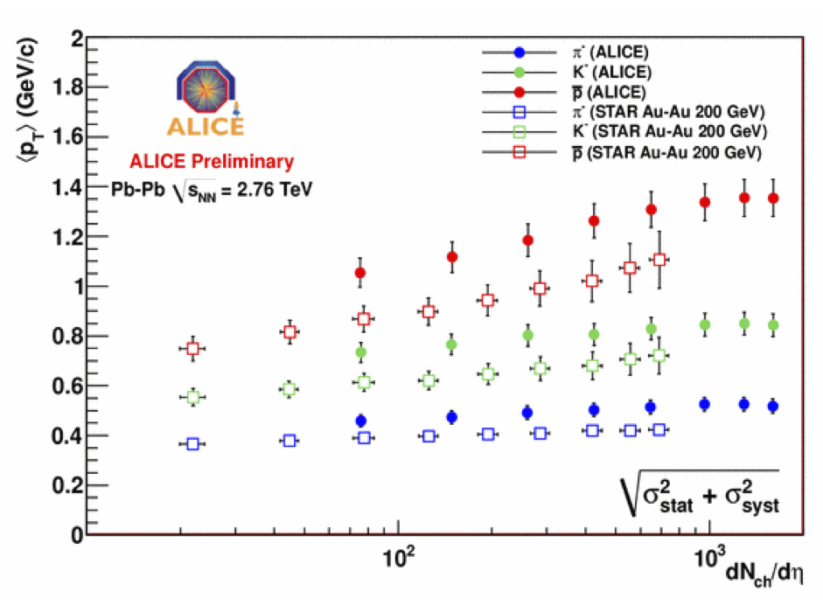
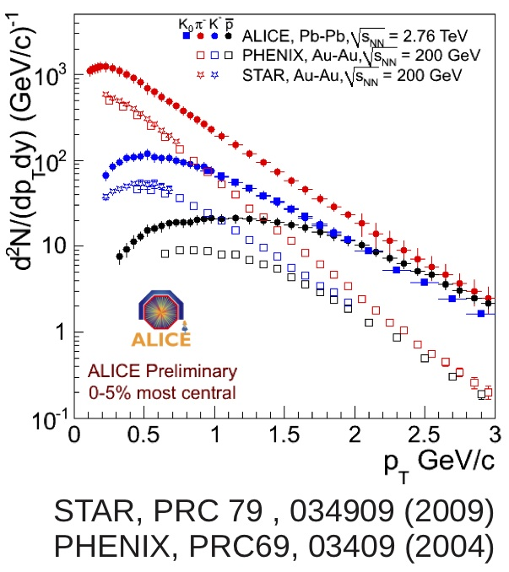
Energy dependence
- Integrated v₂
ALICE QM2011 Alberica’s talk
Integrated v₂ at LHC is larger than v₂ at RHIC.
Is this because of radial flow ?
Probably no.

Slide 35
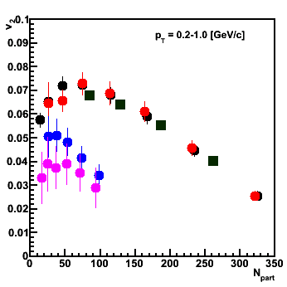
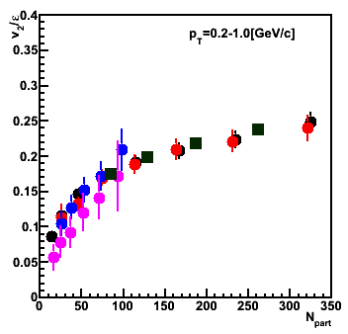
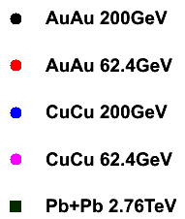

Eccentricity scaling
Pb+Pb, Au+Au, Cu+Cu
Compare v₂ normalized by eccentricity (ε) in collisions of different size.
0.2<p_{T}<1.0 [GeV/c]
phenix preliminary
phenix preliminary
Eccentricity scaling suggests early thermalization.
There is a strong N_{part} dependence.
PHOBOS Collaboration
PRL 98, 242302
Notes:
Next, we compared different system size of collisions.
Left upper figure shows the v2 vs. Npart for five types of collisions listed here including the ALICE v2.
You can see there are difference between different nucleus collision at same Npart.
This is natural because at same Npart they have different initial eccentricity.
Normalizing this initial eccentricity from left figure to right figure, the v2 follows one curve. So the v2 is scaled by eccentricity at same Npart.
PbPb results agree more after this scaling at peripheral points.
This eccentricity scaling suggests early thermalization as I said in the introduction.
And, if the v2 is determined by only eccentricity, it should be flat but it is not.
You can see there is a strong Npart dependence at left figure.

Slide 36

N_{part} Scaling
The dependence can be normalized by N_{part}^{1/3}.
Dividing by N_{part}^{1/3}
v₂ vs. N_{part}
v₂/ε vs. N_{part}
v₂/ε/N_{part}^{1/3} vs. N_{part}
phenix preliminary
phenix preliminary
phenix preliminary
0.2<p_{T}<1.0 [GeV/c]
v₂/eccentricity/N_{part}^{1/3} scaling works for all collision systems including Pb+Pb 2.76TeV
except small N_{part} at 62 GeV.
- This exception may indicate non-sufficient thermalization region.
Notes:
We found that this difference is scaled by the Npart to 1 over 3 factor.
Left and middle figures are same figures as previous page.
Dividing the middle figure by Npart to 1 over 3 we get Right figure.
You can see all v2 including ALICE one became flat except CuCu 62 GeV results.
This exception may indicate non-sufficient thermalization region.
We are now reaching transition phase both energy scan and participant density scan..
To fill this map we need more detail study.

Slide 37
Back Up
For Hydro simulation

Slide 38


Differential v₂ in Au+Au and Cu+Cu Collisions
QGP fluid+hadron gas with Glauber I.C.
Au+Au
Cu+Cu
Same N_{part}, different eccentricity
Au+Au
Cu+Cu
Same eccentricity, different N_{part}

Slide 39






Comparison with hydro-simulation
Hydro calculations done by Prof. Hirano.
ref: arXiv:0710.5795 [nucl-th] and Phys. Lett.B 636, 299 (2006)
π
Hydro should be middle of two data.
Au+Au 200GeV
Au+Au 62.4GeV
Cu+Cu 200GeV
The Au+Au results agree well with hydro but Cu+Cu results don’t.

Slide 40






Comparison of v_{2(data)}/ε_{participant} to v_{2(hydro)}/ε_{standard}
π
Hydro should be middle of two data.
Au+Au 200GeV
Au+Au 62.4GeV
Cu+Cu 200GeV
The Au+Au and Cu+Cu results agree well with hydro.

Slide 41




Comparison with hydro-simulation
Cu+Cu 200GeV
p
Hydro should be middle of two data.
●・・・hydro
●・・・0-10 ％
●・・・10-20％
●・・・hydro
●・・・0-10 ％
●・・・10-20％
Normalized by eccentricities
●・・・hydro
●・・・20-30％
●・・・hydro
●・・・20-30％
v₂(data)/ε_{participant} for proton doesn’t agree with v₂(hydro)/ε_{standard}

Slide 42

Hydro v₂/ε vs. N_{part}^{1/3}
Fitting lines: dash line v₂/ε = a*N_{part}^{1/3}
solid line v₂/ε = a*N_{part}^{1/3} + b

