Slide 1
Plastic Scintillators for Neutron and Charge Particle Detections for LAMPS Experiments at RAON
J. Ahn⁴, B. Hong¹, E. Joo¹, E. Kim³, H. Kim³, Y. J. Kim², Y. K. Kim², Y. J. Ko¹, K. S. Lee¹, J. W. Lee¹, H. Lee⁴, K. S. Lee¹, S. Lee¹, B. Mulilo¹, T. S. Shin²
¹Korea University, Seoul, Korea
²Institute for Basic Science, Daejeon, Korea ³Chonbuk National University, Jeonju, Korea
⁴Pusan National University, Busan, Korea
Contents
Introductions: LAMPS at RAON
Neutron detectors for high-energy experiments
Neutron detectors for low-energy experiments
TOF detectors in LAMPS solenoid spectrometer
Digitization electronics for neutron and TOF detectors
Summary & milestones

Slide 2
1. Introductions: LAMPS at RAON
Large Acceptance Multi-Purpose Spectrometer to maximize the use of nuclear physics researches for neutron-rich nuclei
Main purpose for Symmetry-Energy research
Understanding astronomical phenomena in neutron stars, black holes, and super novae by the EOS of nuclear matter at high density
Pygmy Dipole & Giant Dipole Resonances
Neutron halos and exotic nuclei lying near neutron drip lines
2. Conceptual designs of LAMPS
High-energy experiment (250 AMeV)
Solenoid spectrometer equipped with a 3π-Sr TPC
Dipole spectrometer with a focal plane detector system
Large acceptance of neutron detectors via TOF measurement
Low-energy experiment (< 20 AMeV)
Vacuum system equipped with Si-CsI detectors
Large acceptance of neutron detectors via TOF measurement

Slide 3
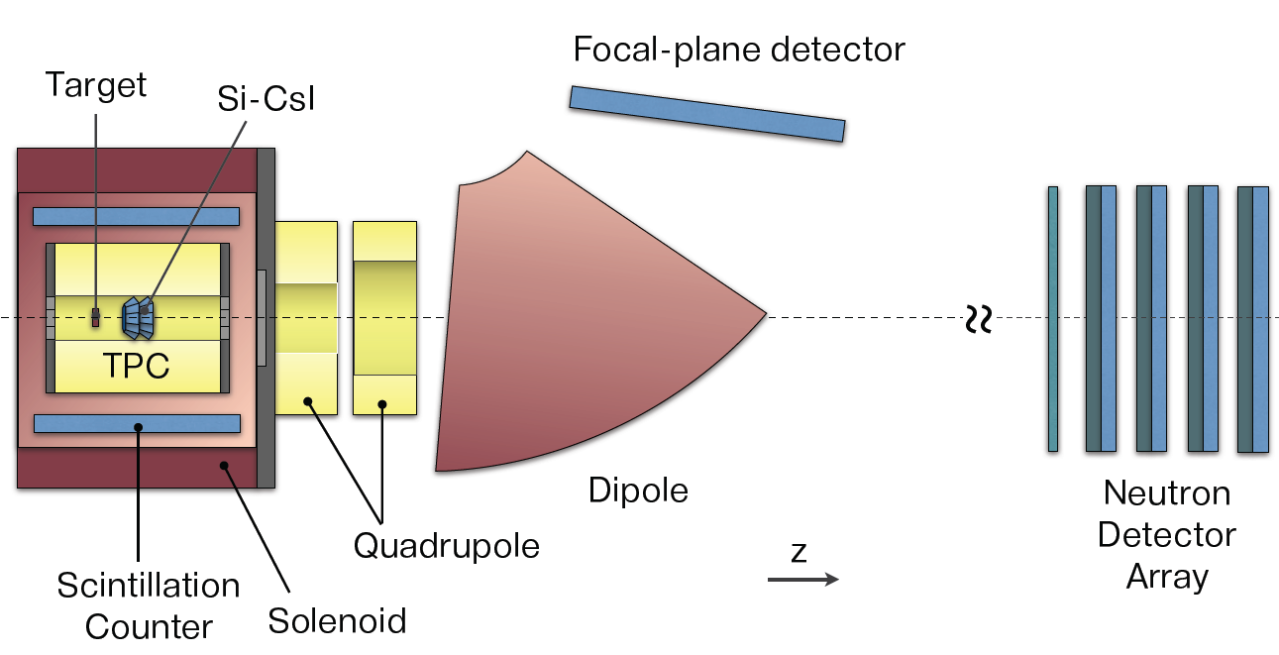
LAMPS: design for high-energy experiment
Solenoid spectrometer
Solenoid magnet (0.6 ~ 1.5 T)
TPC (∆P/P ~ 10⁻²)
Si-CsI array (∆E/E ~ 10⁻²)
Plastic barrel detectors for trigger
Dipole spectrometer
Quadruple-Dipole magnets
(QD or QQD) for focal plane (∆P/P ~ 4 x 10⁻⁴)
Drift chambers
TOF wall
Neutron detector array
Acceptance ~ 34 mSr
∆E/E < 2 x 10⁻²

Slide 4
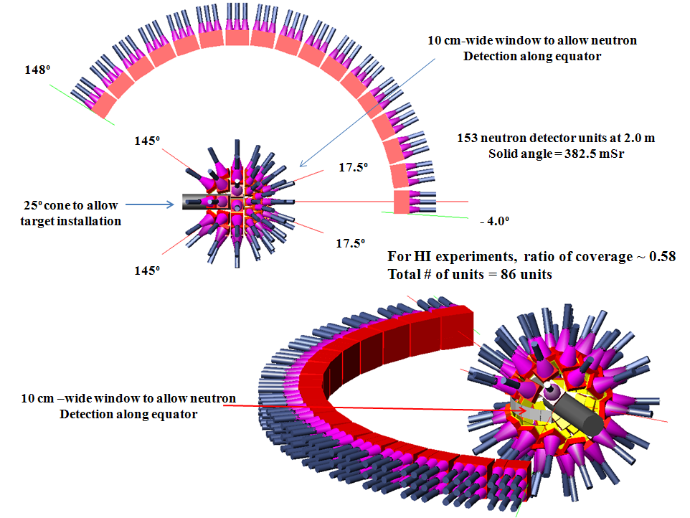
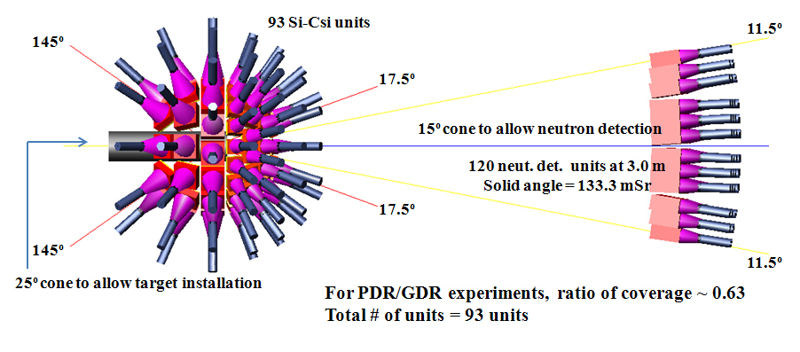
LAMPS: design for low-energy experiment
Vacuum chamber
Si-CsI array (charged particles & γ)
∆E/E ~ 10⁻²
TOF measurement for protons and heavy particles
Particle ID
Neutron detector array
Acceptance = 100 ~ 300 mSr
∆E/E ~ 5.0 x 10⁻² via TOF measurements

Slide 5
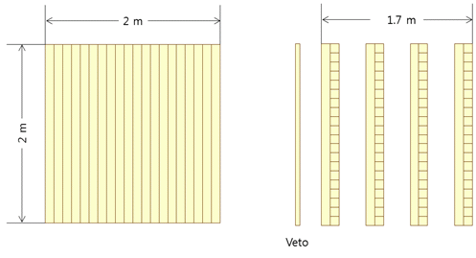
2. Neutron detectors for high-energy experiment
Proposed structure: 4 layers of plastic scintillators (2-m long)
+ 1 Veto plastic layer for charged particle rejection
Each layer composed of 40 10-cm-thick bar detector (20 of each for x and y directions)
Energy range: 30 (10) ~ 300 MeV (10 MeV for the minimum detection)
Acceptance ~ 34 mSr when installed at 10 m from the target
∆t_{TOF}/t_{TOF} ~ 5 x 10⁻³ for 100 MeV at 10-m TOF
∆E/E < 2 x 10⁻² via TOF measurements
→ Required σ_{t} for 100 MeV neutrons ~ 500 ps
ε = 0.60 for single-neutron detection (100 MeV) (GEANT4)

Slide 6
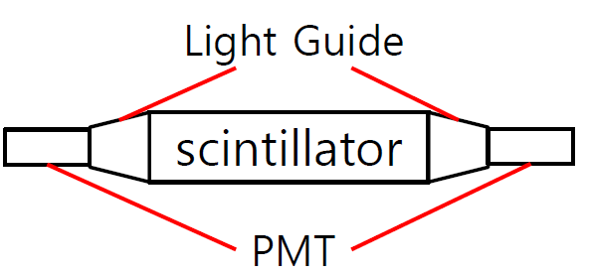
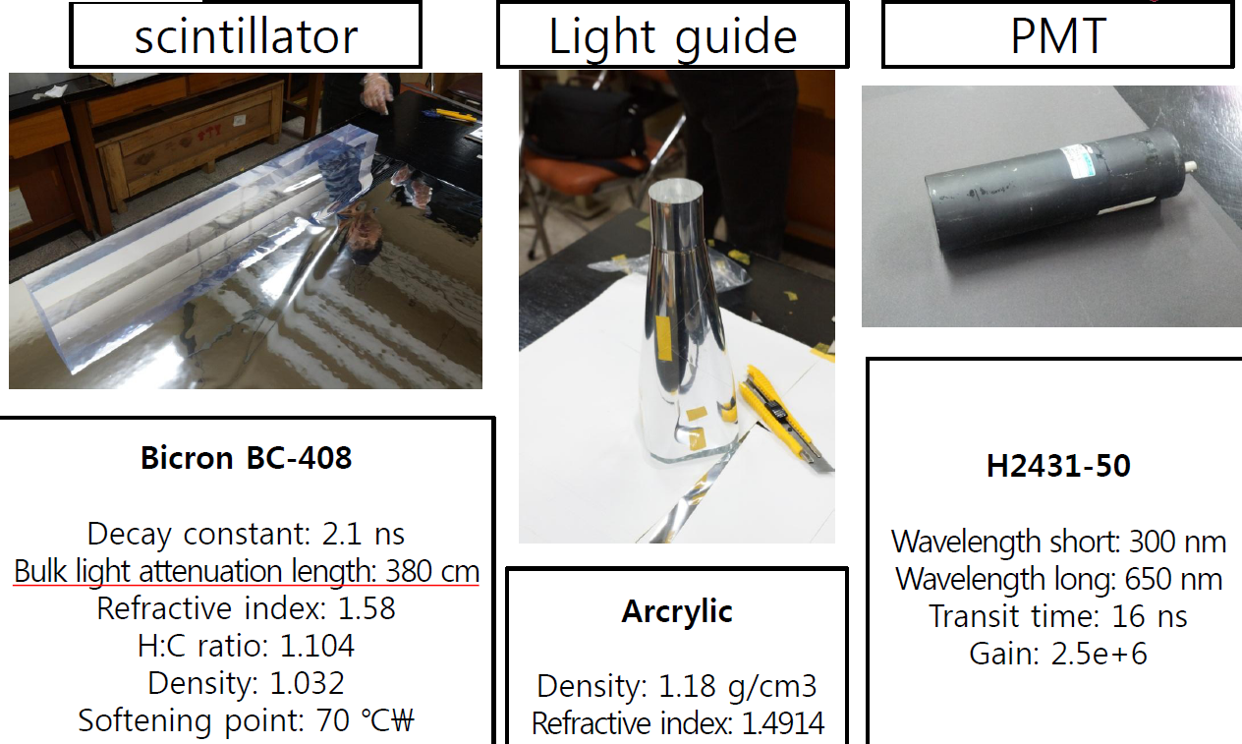
Single detector module for high-energy experiment
n-p elastic scattering
n-¹²C elastic scattering
n+p → d+γ (neutron capture, E_{γ} = 2.23 MeV)
n+¹²C → ¹³C+γ (neutron capture, E_{γ} = 1.2, 3.6, 4.9 MeV)

Slide 7
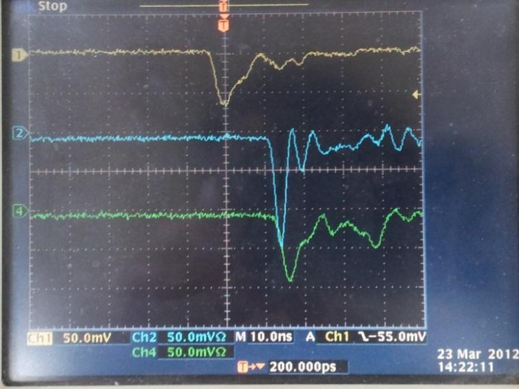
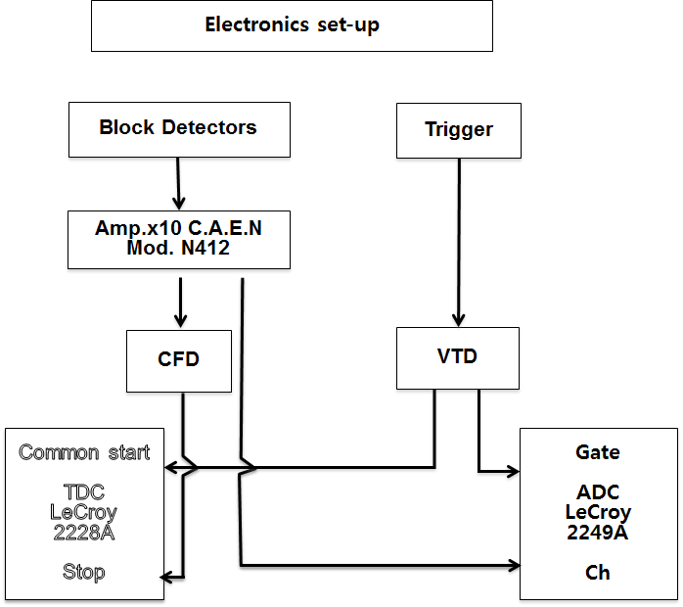
1-m long neutron detector (2012-2013): Test results with ⁶⁰Co & ²⁵²Cf sources
Time-Of-Flight for γ and n
TOF distance = 1.0 m
Used LeCroy 2228 TDC & 2249 ADC
5-cm thick 5-cm diameter disk-shape plastic scintillator for event triggers
Maximum TOF to measure = 50 ns
3.78 n per fission decay and γ’s from gamma transitions
Event triggers
Trigger detector Neutron detector
γ γ
n γ
γ n
n n

Slide 8
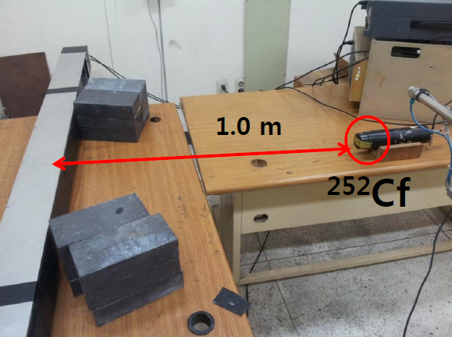
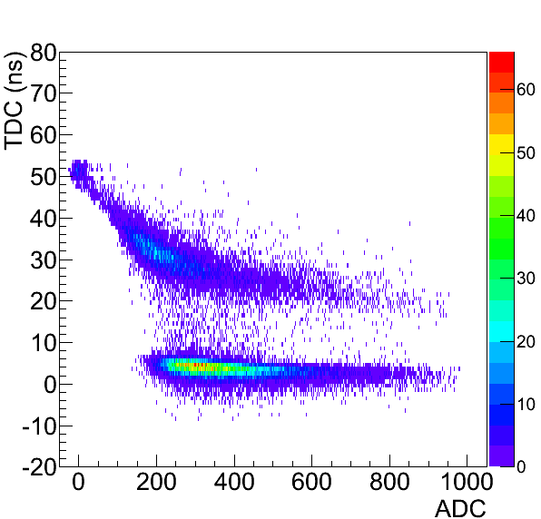
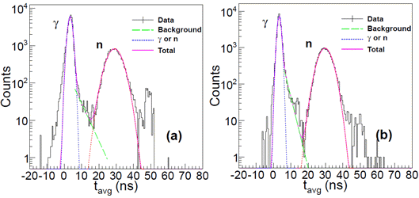
TOF measurement for fission neutrons and gammas from ²⁵² Cf
t_{L}
t_{R}
From Left PMT
From Right PMT

Slide 9
Electronic setup
Maximum/Minimum times to measure (LeCroy 2228) for ²⁵²Cf neutrons: 20 ns/50 ns
Charge range measured by ADC (LeCroy 2249) = 100 fC ~ 25.6 pC
Digitization threshold for neutrons & gammas
Voltage-threshold discriminator (140 mV)
Constant-fraction discriminator (35 mV/ns, 4 ns sampling for trigger)
TOF of a neutron event = mean arrival time
(t_{L} + t_{R})/ 2
→ t₀ for time calibration by using the mean arrival time of gammas
→ Neutron energy
Position of the signal obtained from
∆t = t_{L} - t_{R}
→ Hit positions of neutrons along the bar detector

Slide 10
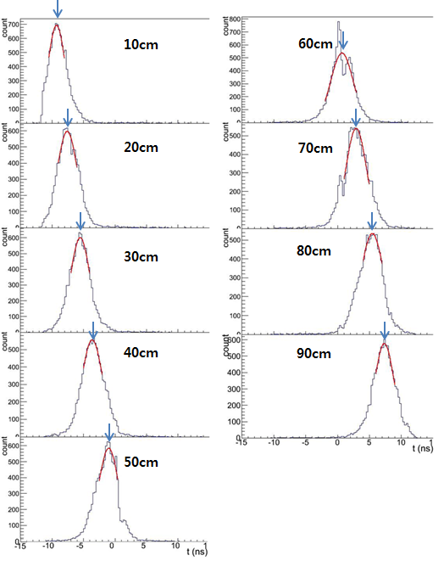
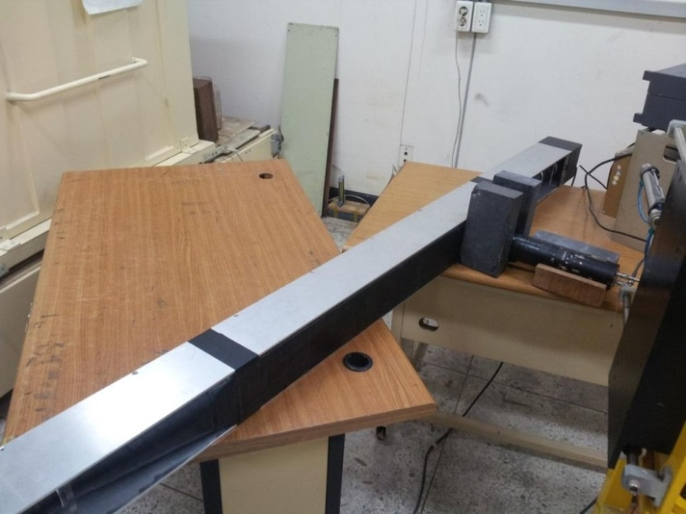
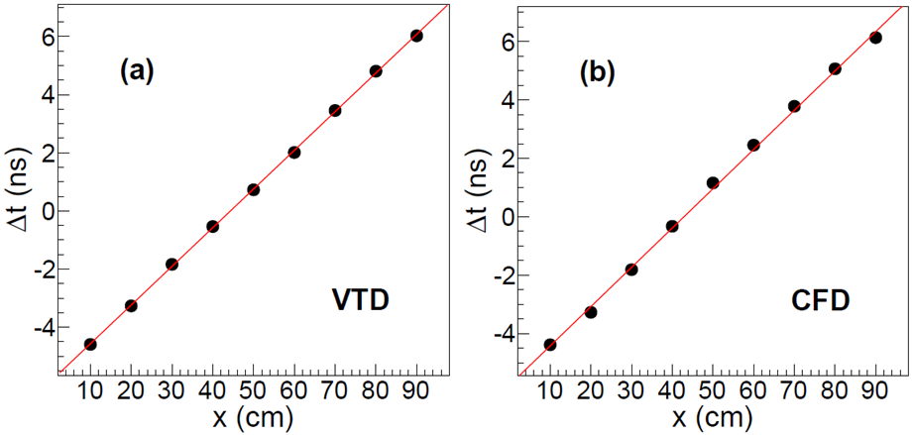
Position resolution using a ⁶⁰Co source
∆t = t_{L} - t_{R}

Slide 11
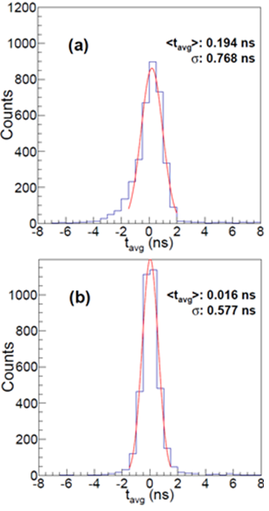
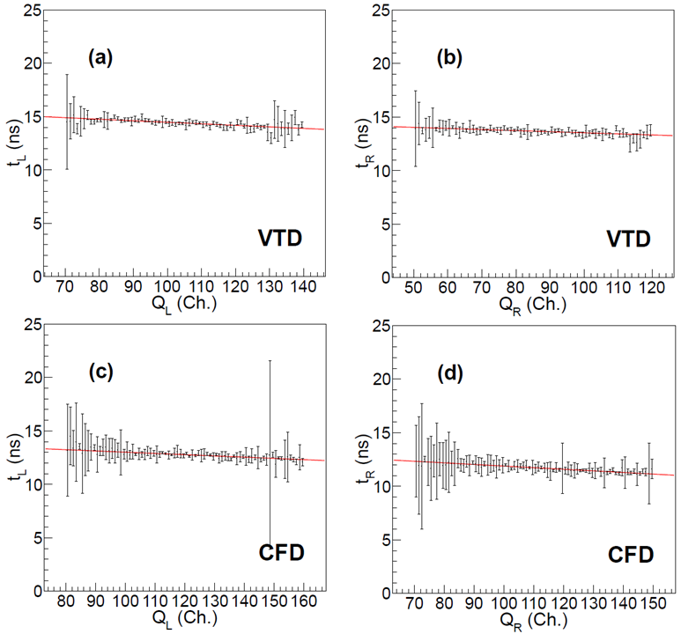
Intrinsic time resolution measured using a ⁶⁰Co source
Accuracy of measuring (t_{L} + t_{R})/ 2
Time-walk correction for signals

Slide 12
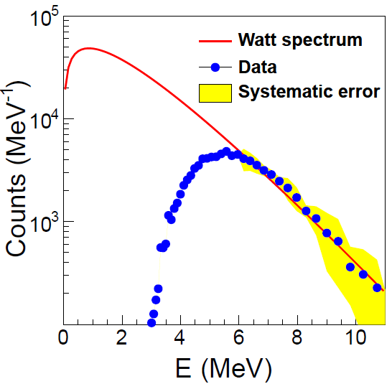
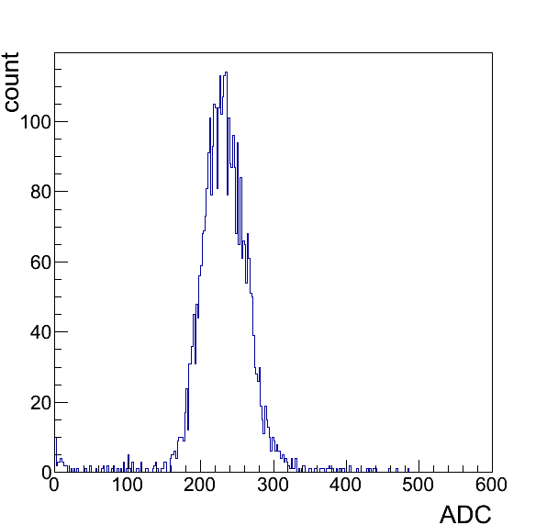
Testing a 1-m bar unit detector for high-energy experiments
Time resolution < 600 ps
Position resolution ~ 8.0 cm
Electron-equivalent energy with 50% efficiency ~ 700 keV
Neutron energy with 50% efficiency ~ 5 MeV
Compton edge for 1.17 & 1.33 MeV γ’s from ⁶⁰Co ~ 1.0 MeV
700 keV
ε ~ 50%
5 MeV
J. Kor. Phys. Soc. 58 (2011) 211
J. Kor. Phys. Soc. 62 (2013) 1227

Slide 13
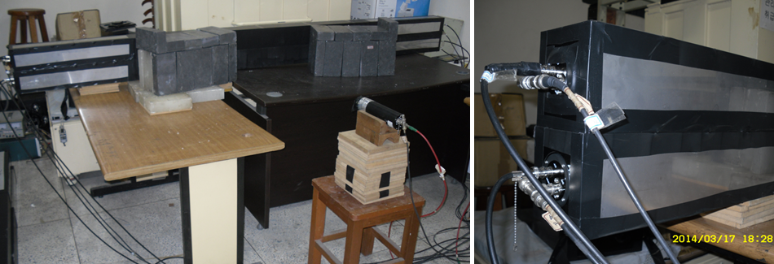
Testing 2-m neutron detectors with cosmic muons, ⁶⁰Co, and ²⁵²Cf sources (2014)
Manufactured 4 real-sized detector modules to check the feasibility for the proposed detector system
Detector R&D with 2 detector layers will be tested with TOF distance of 2.0 m
Neutron-hit structure
Multi-neutron events

Slide 14
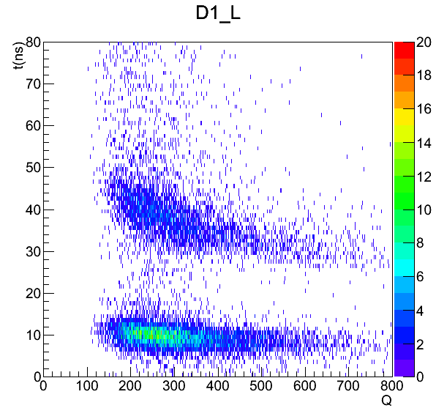
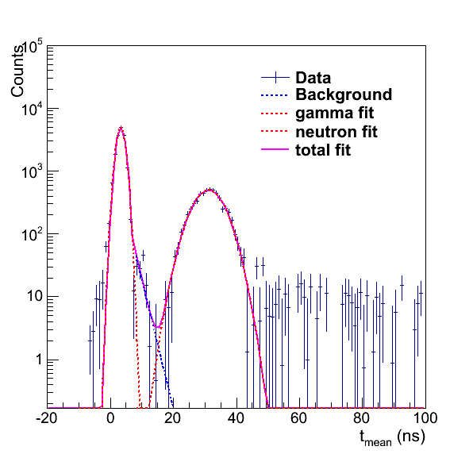
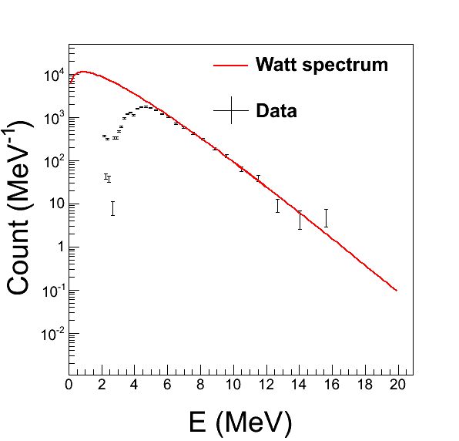
Electronic setup for preliminary tests
TOF distance = 1.0 m
Maximum/Minimum time to measure (LeCroy 2228) for ²⁵²Cf neutrons: 20 ns/50 ns
Charge range measured by ADC (LeCroy 2249) = 100 fC ~ 25.6 pC
Digitization threshold for neutrons & gammas
Voltage-threshold discriminator (180 mV)
Neutron energy with 50% efficiency ~ 4.5 MeV
The realistic time resolution should be measured with high-energy cosmic muons
Then, σ ~ 300 ps
γ
n
n
γ

Slide 15
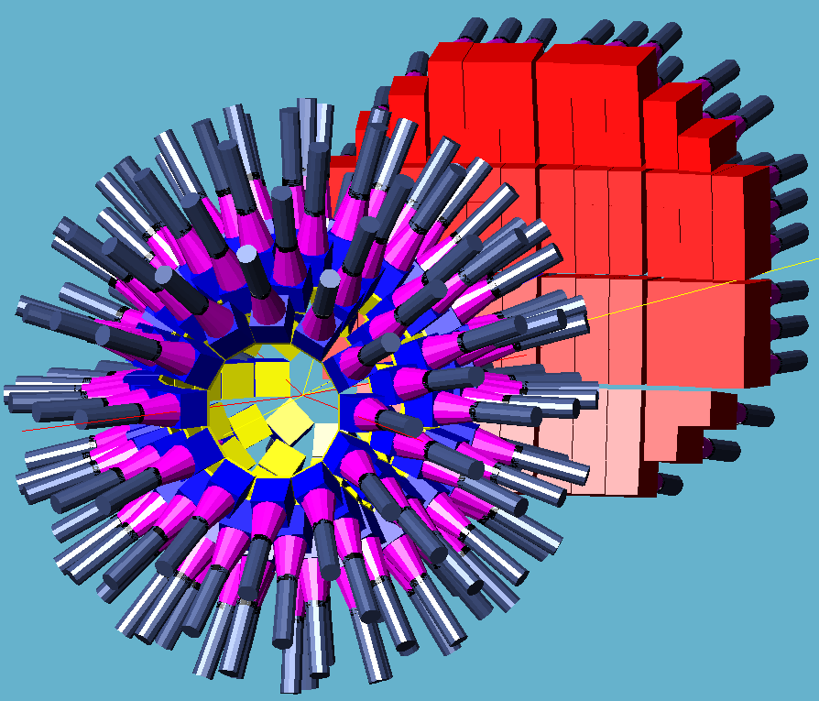
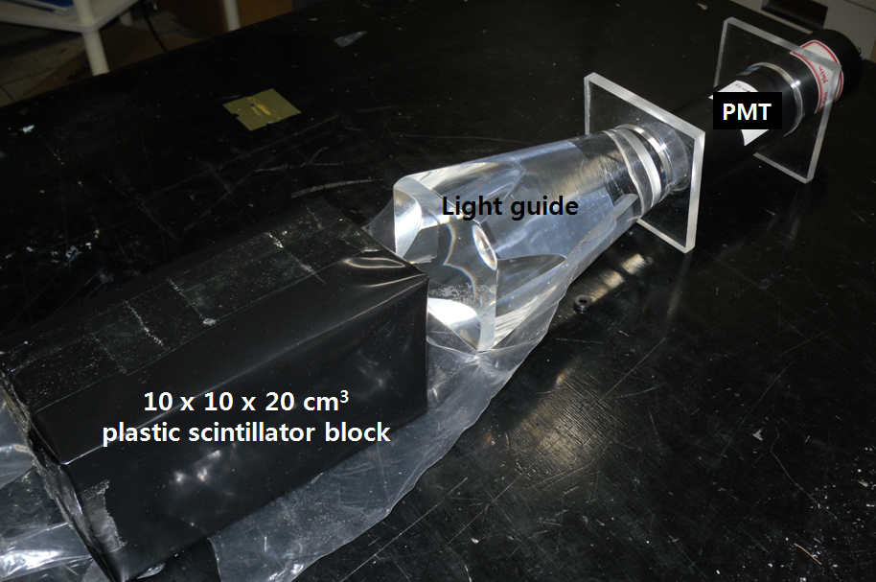
3. Neutron detectors for low-energy experiment
Neutron energy range to detect with ε > 0.7 = 2.5 ~ 30 MeV
Minimum detectable energy ~ 1 MeV with a maximum 200-ns TOF measurement
Basic structure of unit pixel detector: 3 x 3 detector modules
Single detectors: 10 x 10 x 20-cm³ plastic scintillator blocks
Neutron energies measured by a TOF method
∆E/E ~ 5.0 x 10⁻² assuming a 3-m-long TOF length
Depth-of-interaction in the 20-cm long detector → Energy resolution

Slide 16
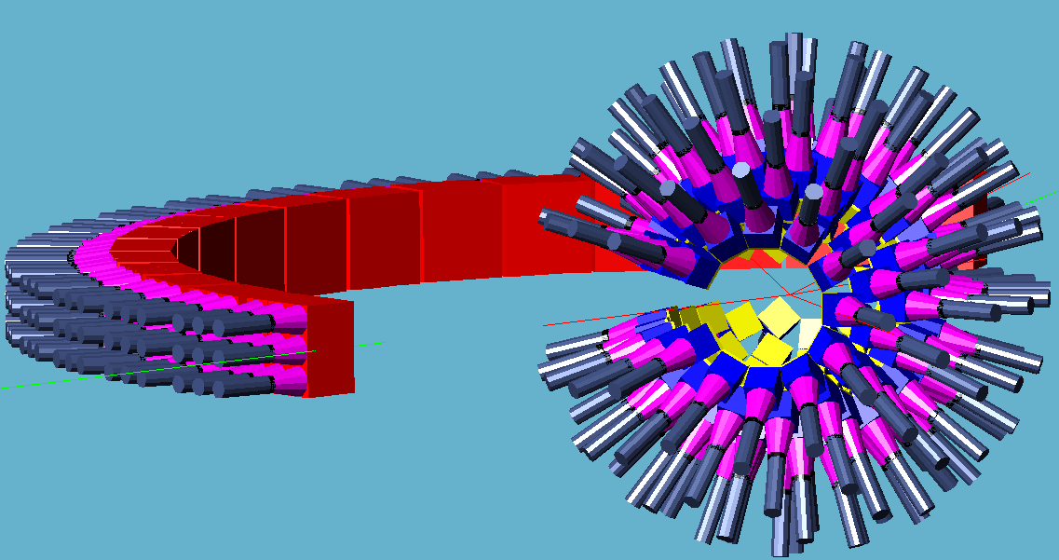
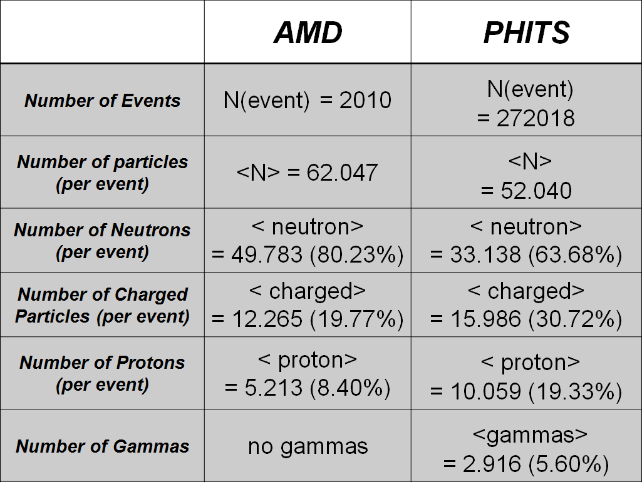
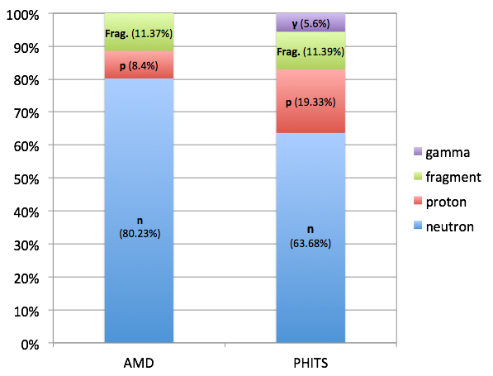
HI collisions for ¹³²Sn+¹²⁴Sn
E_{beam} = 18.5 AMeV
16

Slide 17
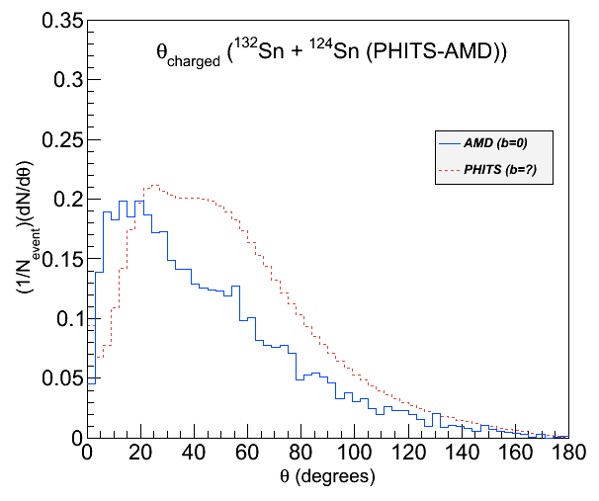
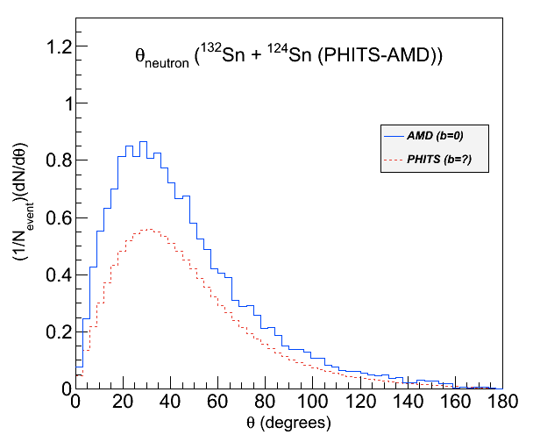
HI collisions for ¹³²Sn+¹²⁴Sn (E_{beam} = 18.5 AMeV)
θ distribution for charged particles
θ distribution for neutrons

Slide 18
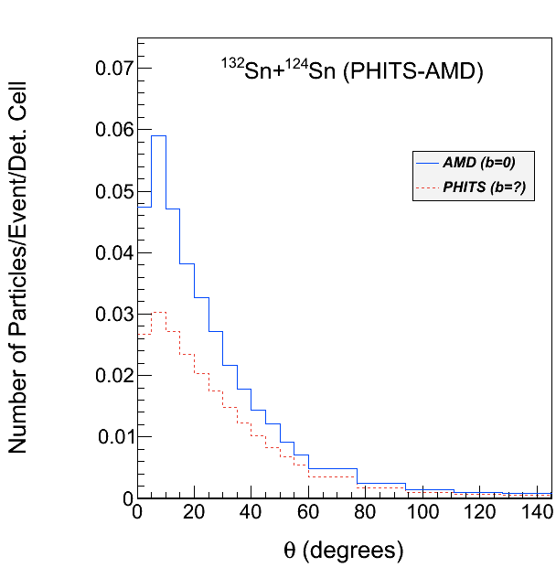
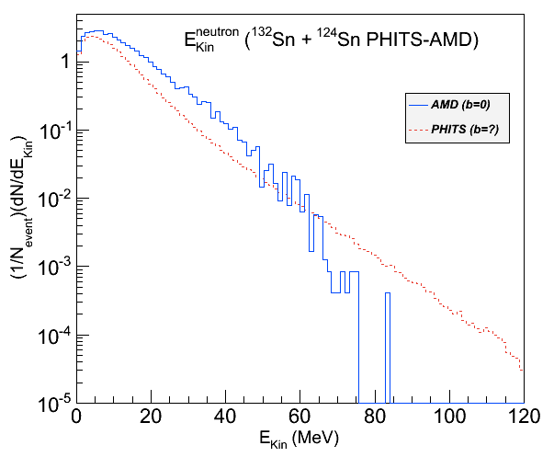
Kinetic energies for neutrons
Occupancy for neutrons

Slide 19
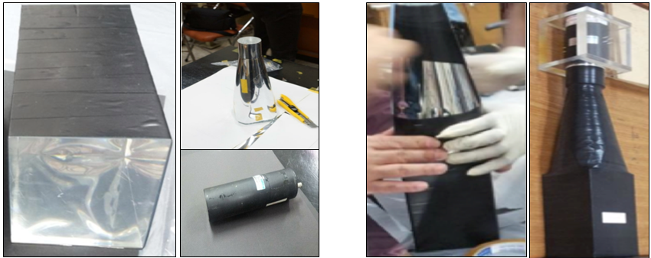
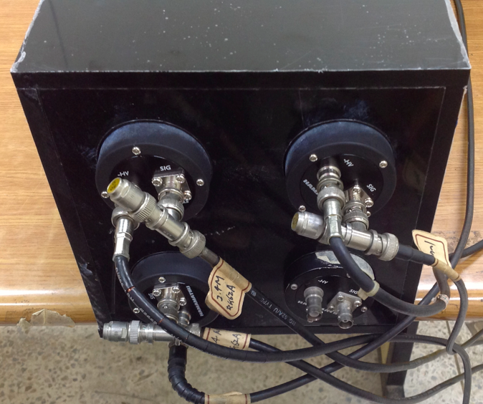
Single detectors using conical-shape light guides (3, 5, 21-cm long)
Unit detector module composed of 4-plastic scintillator blocks

Slide 20
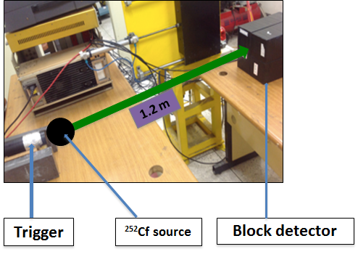
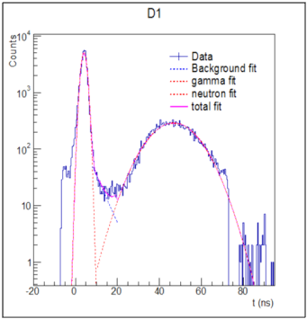
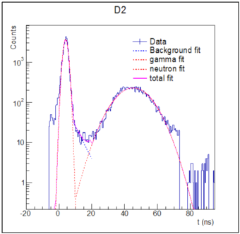
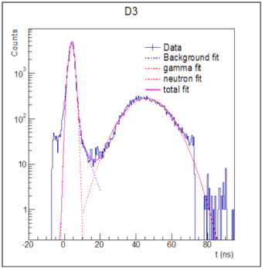
Test with a ²⁵²Cf source
Specification of electronics
Utilized LeCroy-2228 TDC & LeCroy-2249 ADC
Digitization with a CFD
(30 mV/ns, 4 ns sampling for trigger)

Slide 21
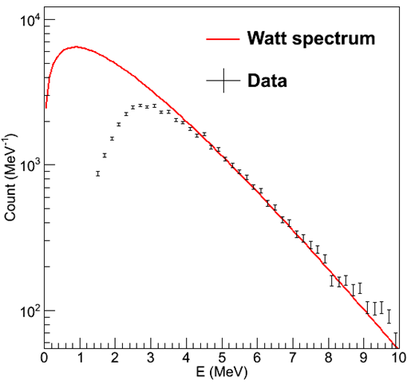
Pixel detectors for low-energy experiments
Maximum TOF set to 80 ns
→ 1.4 MeV neutrons (efficiency ~ 0.2)
Electron-equivalent energy with 50% efficiency ~ 300 keV
Neutron energy with 50% efficiency ~ 2.5 MeV
Advantage of using pixel detectors
Light-collection efficiency is higher
Expect reconstruction of neutron hits becomes easier
→ Much conducive to analyze low-energy multi-neutron events
ε ~ 50%
2.5 MeV

Slide 22
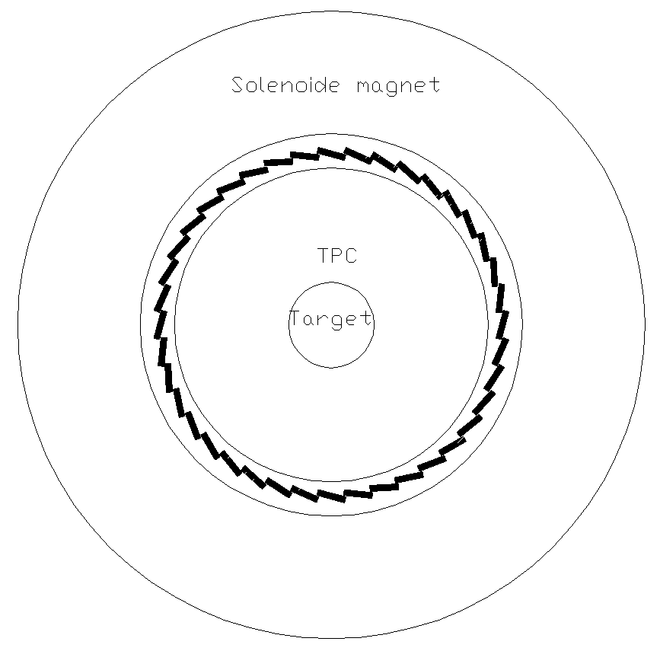
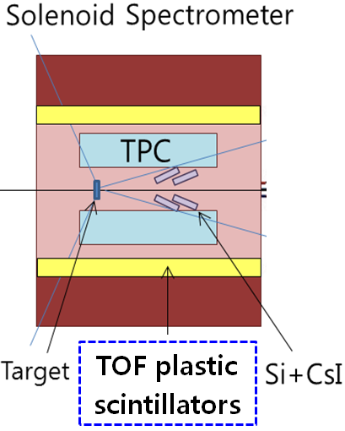
4. TOF detectors in LAMPS Solenoid Spectrometer
Plastic-scintillator array surrounding the TPC for track-matching for charged particles
40 modules equipped one PMT on each side
1.5-m-long, 10-cm wide, and 2.5-cm thick
Chosen thin plastic bars → less sensitive to scattered neutrons

Slide 23
5. Digitization electronics for neutron & TOF detectors
Digitization electronics
Unified module for digitization (CFD) + time measurement + charge measurement
(multi-hit TDC+FADC)
16-channel module with Lemo inputs
Single slot 9u VME type
Bandwidth = 500 MHz
Best time resolution ~ 100 ps
Sensitivity of each sampling: 50 fC minimum/ 200 pC
Minimum/Maximum sampling time interval = 2 ns/50 ns
Minimum/Maximum sampling time interval = 2.5 μs/64 μs
Data bus from the experimental area to the counting bay
Data rate ~ 3.5 GBps
200 detectors for neutron detector
40 detectors charged particle TOF

Slide 24
6. Summary & milestones
1. R&Ds of neutron detectors for LAMPS
Conceptual designs of the neutron detectors
Systematic R&Ds for unit detectors with ⁶⁰Co & ²⁵²Cf source
So far, confirmed that the proposed designs and the performances of the unit-detector are relevant and satisfactory for Symmetry-Energy researches
2. Bar-shape neutron detectors for high-energy experiments
Minimum neutron energy confirmed with ε > 50% was 5.0 MeV
Time resolution tested with low-energy radiation source < 600 ps
But, expected ~ 300 ps for high-energy particle (can be tested with cosmic muons)
→ ∆E/E < 2 × 10⁻² via TOF measurements at 10 m from a target
Position resolution confirmed ~ 8 cm

Slide 25
3. Pixel-type neutron detectors for low-energy experiments
Minimum neutron energy confirmed with ε > 50% was 2.5 MeV
Depth-of-interaction of 20-cm-long detectors: σ ~ 7.0 cm at a 3.0-m TOF distance
→ ∆E/E ~ 5 × 10⁻² via TOF measurements
4. Plans for LAMPS neutron detectors
R&D for a 2-layer mini detector system for high-energy experiments
R&D for a unit-detector composed of 7 scintillators low-energy experiments
Study of neutron-hit structures (currently GEANT4 only)
Discrimination for multi-neutron-hits (currently GEANT4 only)
Discrimination of neutron from gamma backgrounds
5. Designs of electronics and DAQ for LAMPS neutron detectors
Combined 16-channel modules for discriminations, time (multi-hit TDC) and charge (FADC) measurements
3.5 Gbps data bus electrons
Data-acquisition system + GUI

