Slide 1
LAMPS
Time Projection Chamber
HyoSang Lee
High Energy Nuclear Science Team
Rare Isotope Science Project
Institute for Basic Science
LAMPS Review
2014.03.31

Slide 2
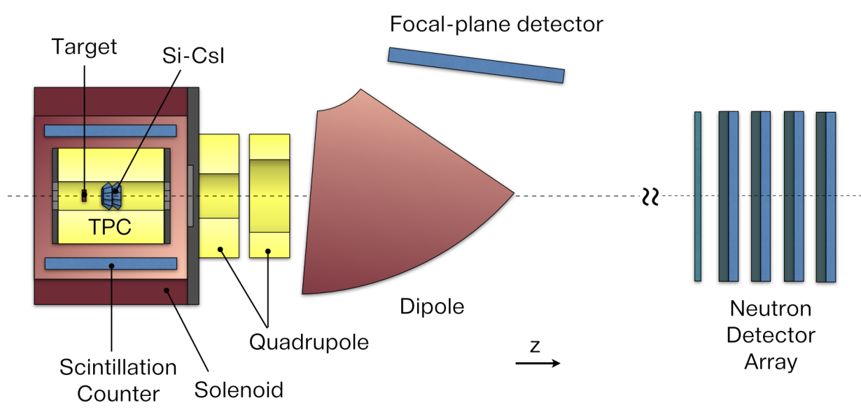
LAMPS TPC
LAMPS High Energy
- heavy ion collisions
- to study the symmetry energy in the EoS of nuclear matter
- designed to cover wide acceptance range
with high detection efficiency and accuracy of charged particles and neutrons
Time Projection Chamber (TPC)
- main detector for tracking of particles
- complete information of charged particle trajectory
- inside of Solenoid magnet

Slide 3
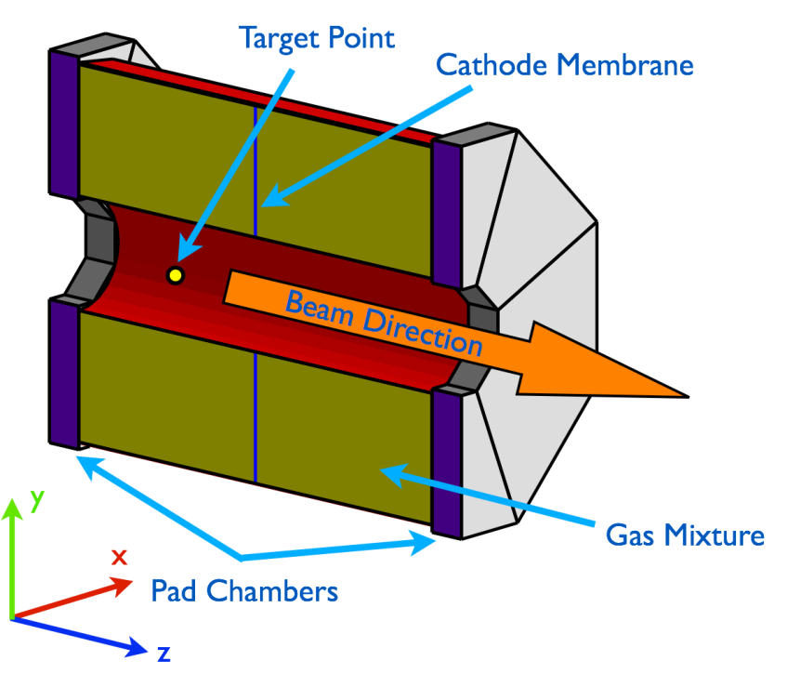
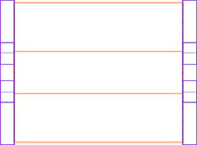
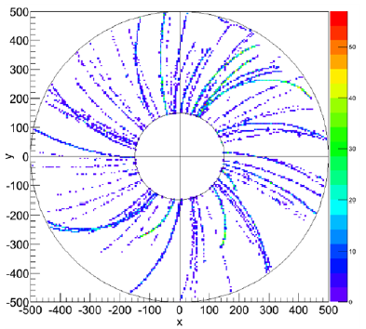
LAMPS TPC
η=-0.7 (127º)
η=1.6 (24º)
400 mm
53.1°
24.0°
150 mm
Beam
Target
500 mm
300 mm
900 mm
Target : 30cm away from the center
Detection range : -0.7(127º) ~ 1.6(24º)
Drift length : 60cm (x2)
Volume : 857L
Cathode Membrane
Amplified by Gas Electron Multiplier (GEM)
Both side readout PAD

Slide 4
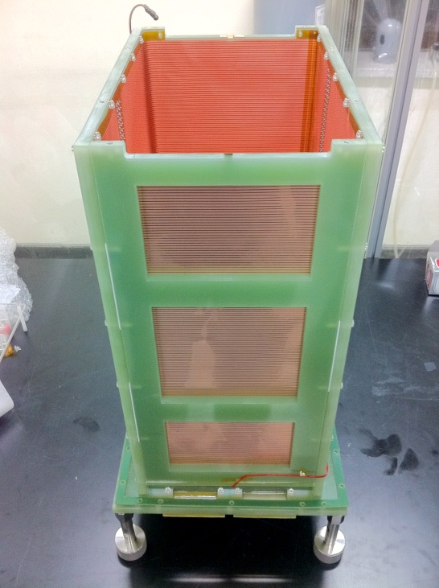
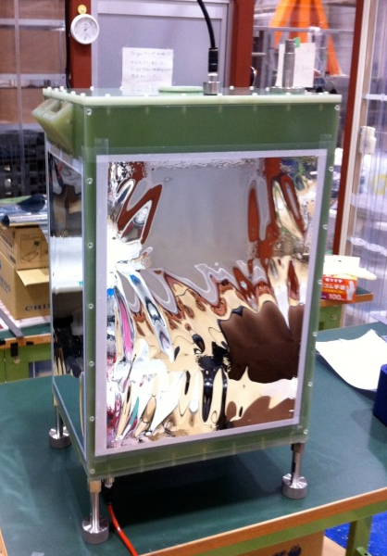
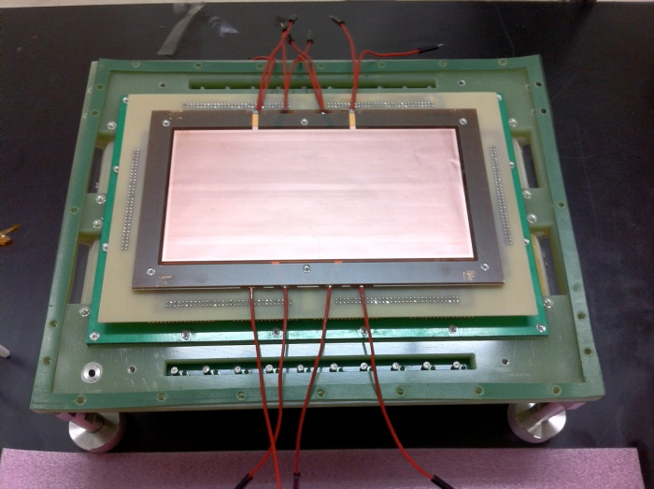
1st prototype TPC
Prototype TPC
Purpose of 1st prototype TPC
Uniform electric field → by Cu strip
3 layers GEM
TPC body : G10 material
fieldstrip
PAD + GEM

Slide 5
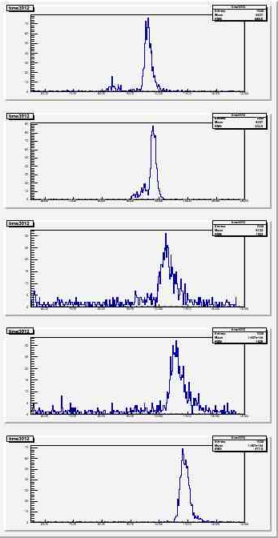
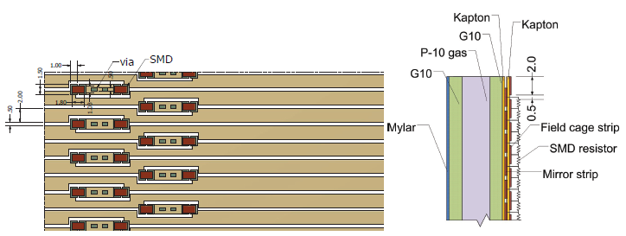
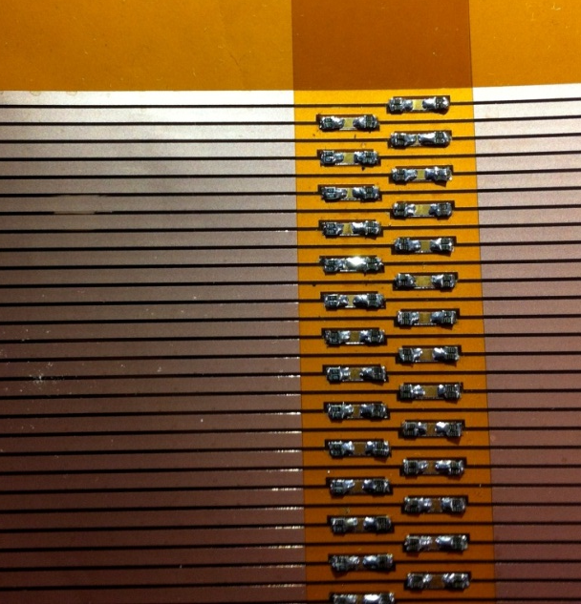
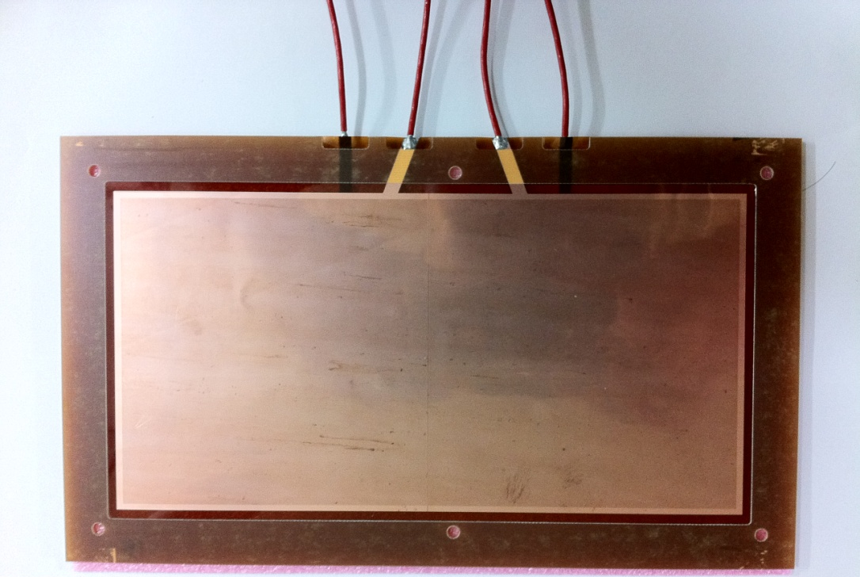
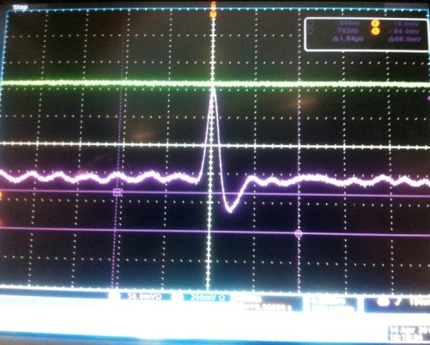
1st prototype TPC
Prototype TPC
Field strip
1 MΩ resistors with 0.1% var.
180V/cm
170V/cm
160V/cm
150V/cm
GEM
10cm x 20cm
3 layers
Divided by two section
Electrode
10cm
Divided
20cm

Slide 6
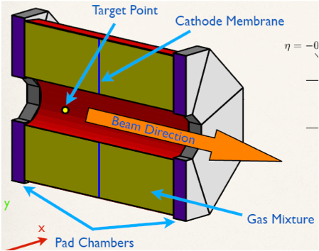
Design
Prototype TPC for LAMPS
Concept of prototype TPC for LAMPS
Optimized design & fabrication method
: 1/2 size of real TPC (1/8 volume)
Honeycomb body for gas chamber
PAD : Hexagon shape
  Test with 5mm & 2.5mm
GEM : Test with large size & specific shape
Field cage : Uniform electric field by cu strip
DAQ : COBO system
Analysis : Development of reconstruction algorism

Slide 7
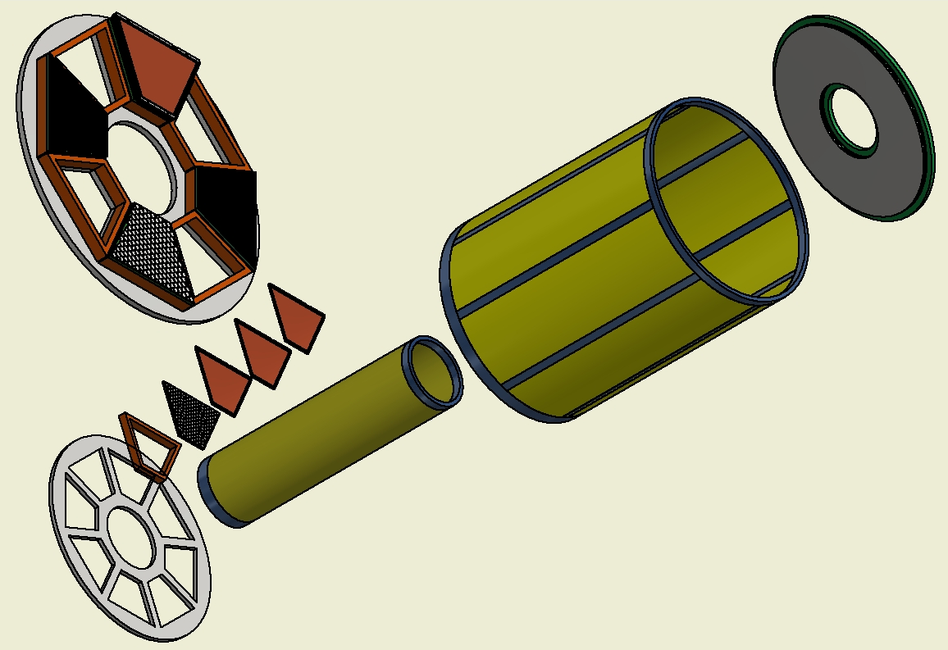
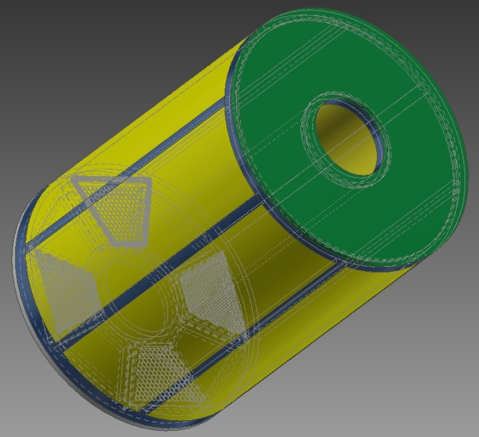
Design
Prototype TPC for LAMPS
½ size of real TPC design
Outer Field Cage
GEM : 3 layers
Cathode
PAD
Drift length : 570 mm
150 mm
Inner Field Cage
490 mm
Bottom to fix PAD & GEM : Al

Slide 8
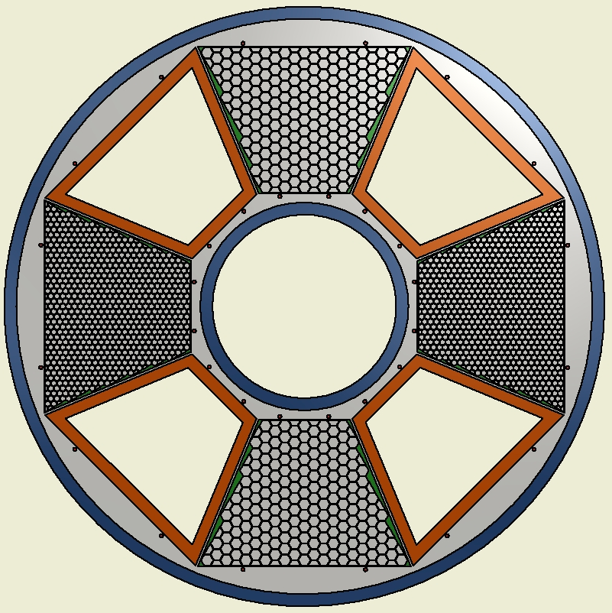
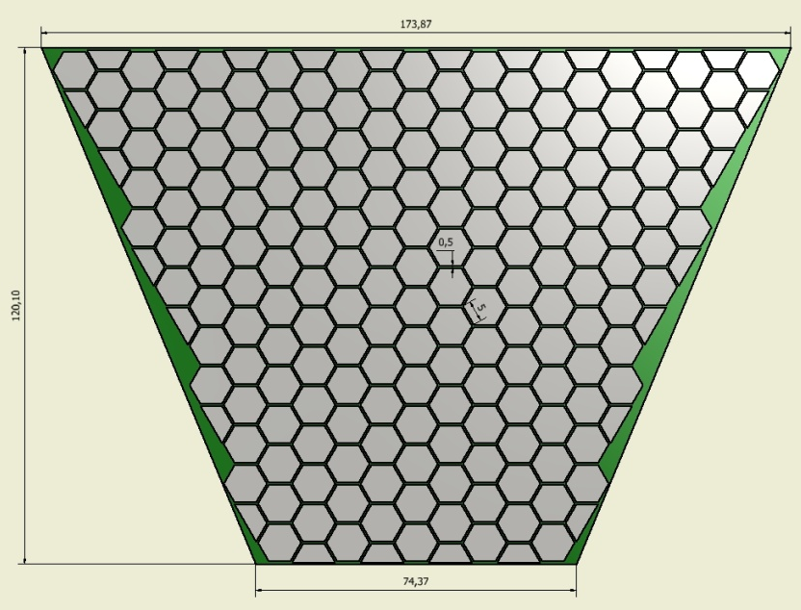
PAD
Prototype TPC for LAMPS
Hexagonal shape : 5mm & 2.5mm
500 μm gap between two pads
Multi-layer PCB board
Trapezoidal (or Octant) shape PCB
4 layers PCB
16 pin SMD type connector
(1.27mm pitch)
5 mm pad
(207 ch)
MAYA pattern
2.5 mm pad (735 ch)
Trapezoidal (or Octant) shape PCB

Slide 9
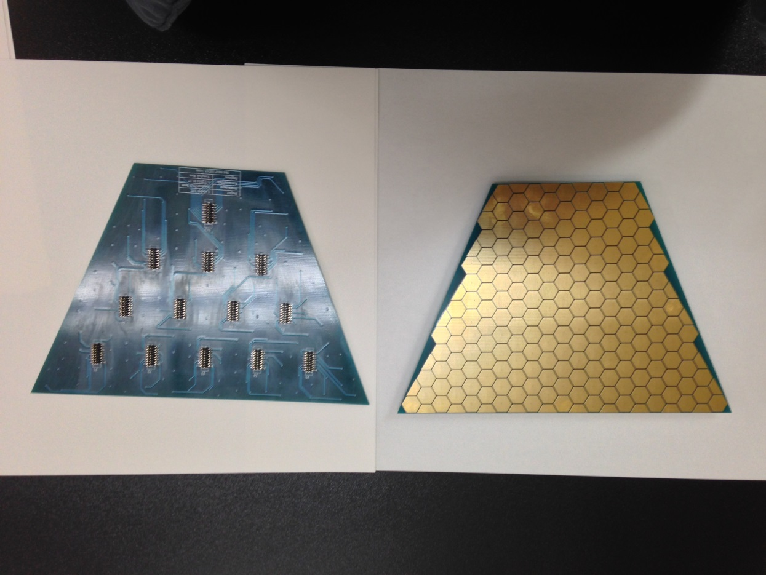
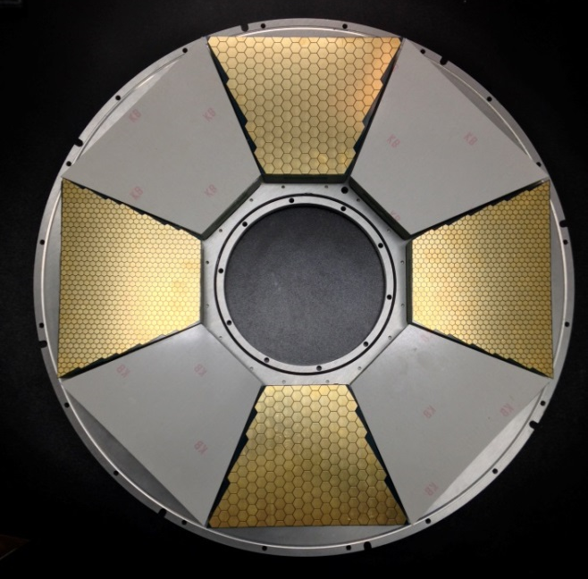
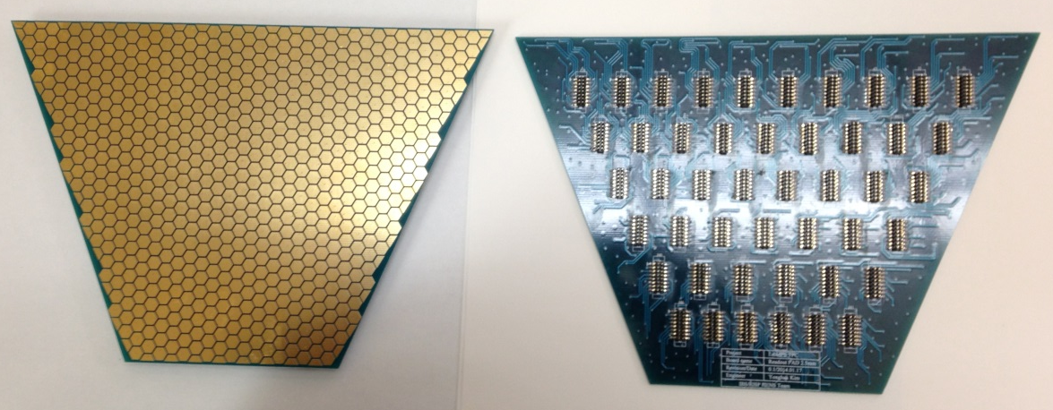
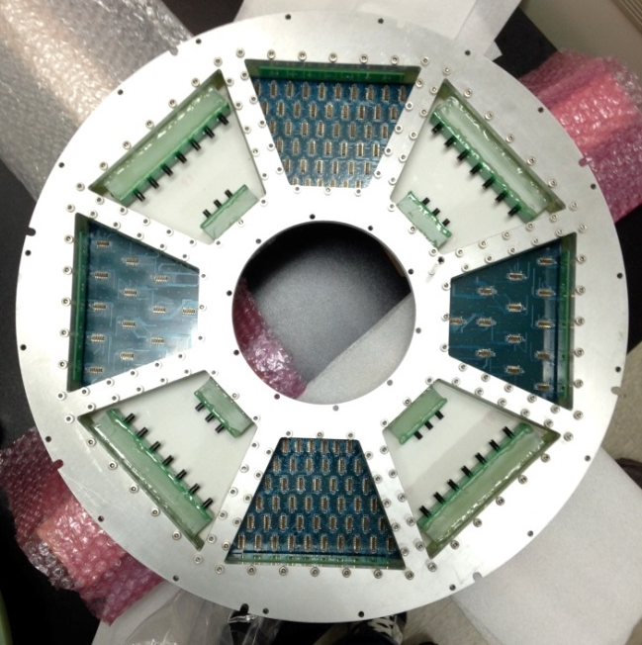
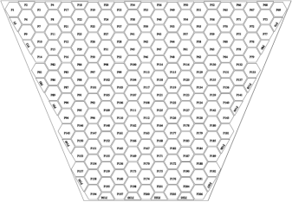
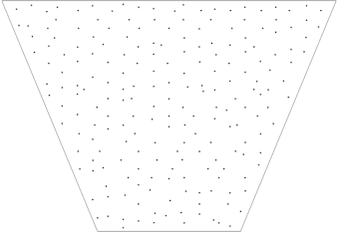
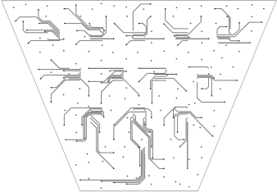
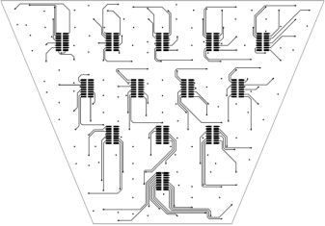
PAD
Prototype TPC for LAMPS
5mm PAD : 207ch
PAD installed in bottom frame
2.5mm PAD : 735ch
16pin SMD connector
PAD PCB design

Slide 10
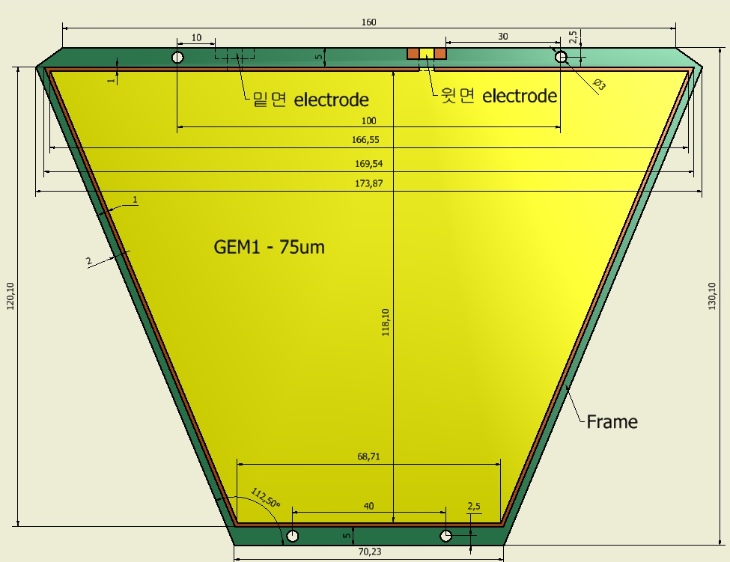
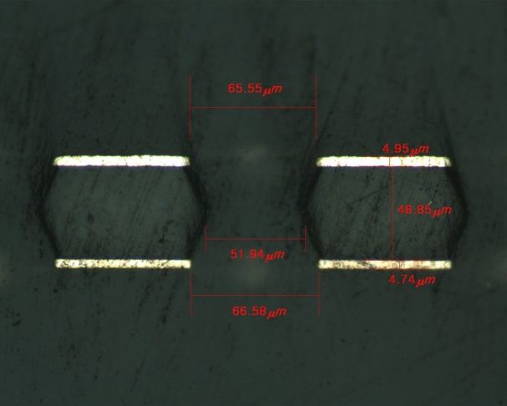
GEM
Design Concept of p.TPC for LAMPS
Trapezoidal shape
50μm & 75μm thickness
160x120 mm²
3 layers for each PAD

Slide 11
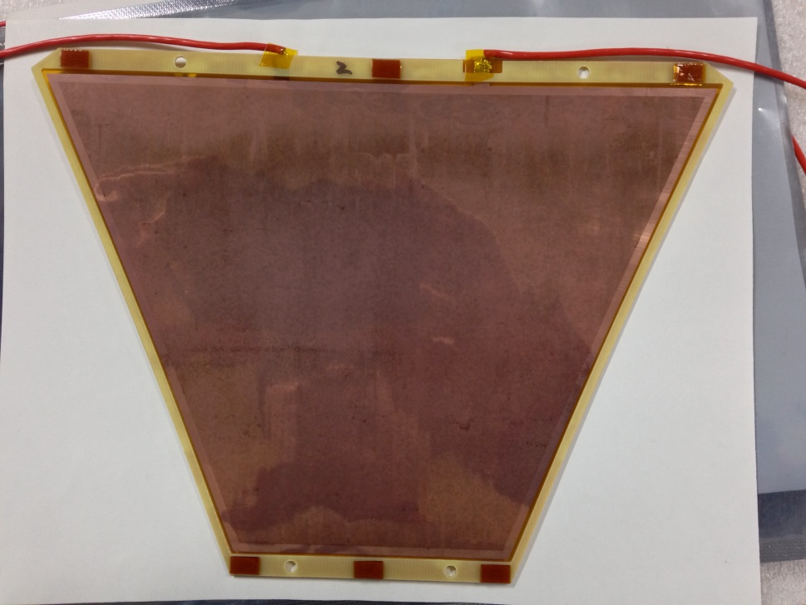
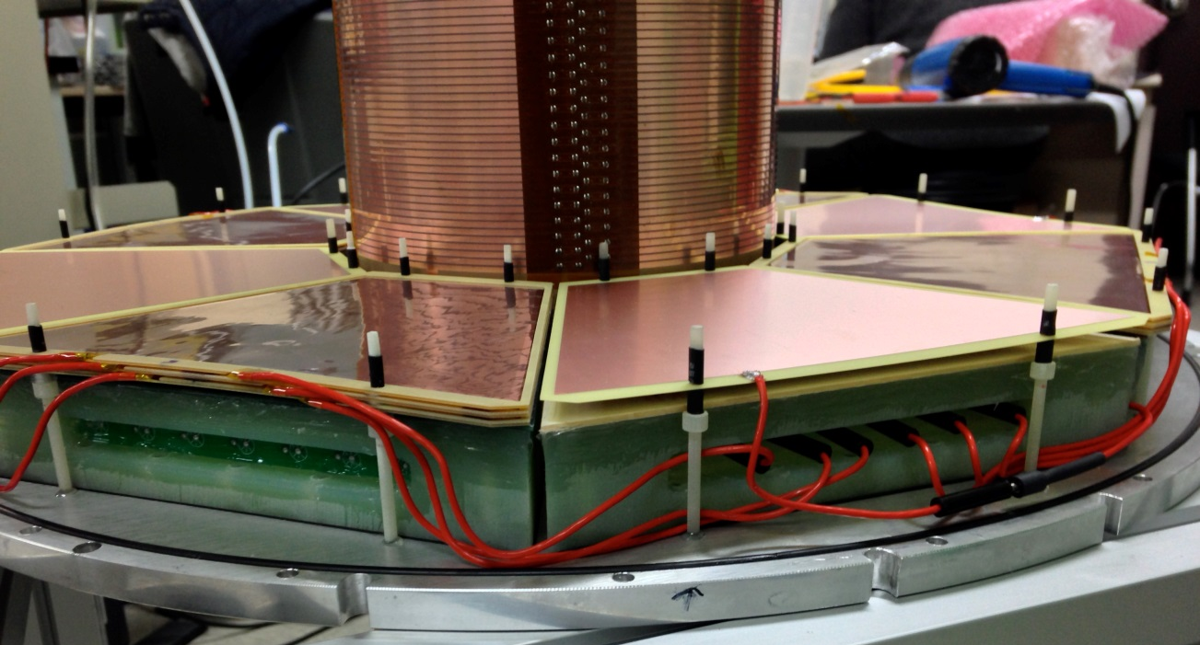
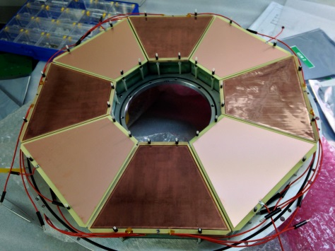
GEM
Design Concept of p.TPC for LAMPS
Electrode
166mm
Electrode
118mm
10cm
Divided
20cm
69mm
3 layers
Dummy cathode

Slide 12

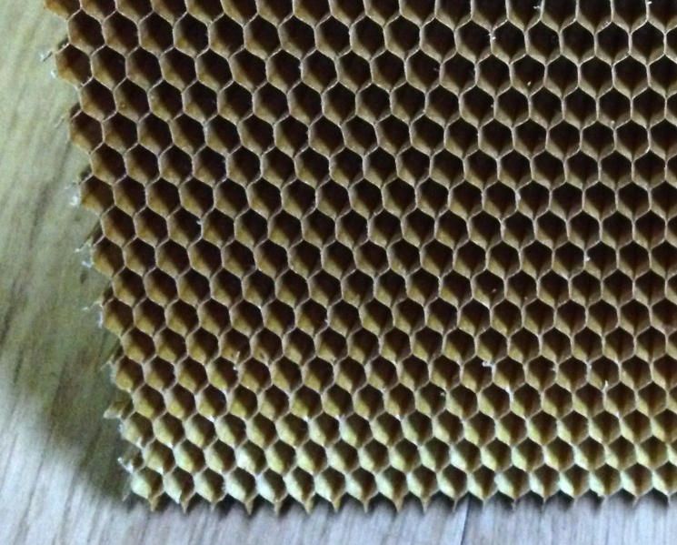
Field Cage
Prototype TPC for LAMPS
1MOhm resistor(0.1%)
35 um thick and 2 mm wide Cu strips
0.5 mm gap between neighboring strips
Mirror strips on the back
1 MΩ resistors with 0.1% var.
TPC body: G10 + Aramid honeycomb
Cross-section of field-cage body
Al Mylar
GRP
GRP
Mirror strip
PI
Field strip
G10
HoneyComb

Slide 13
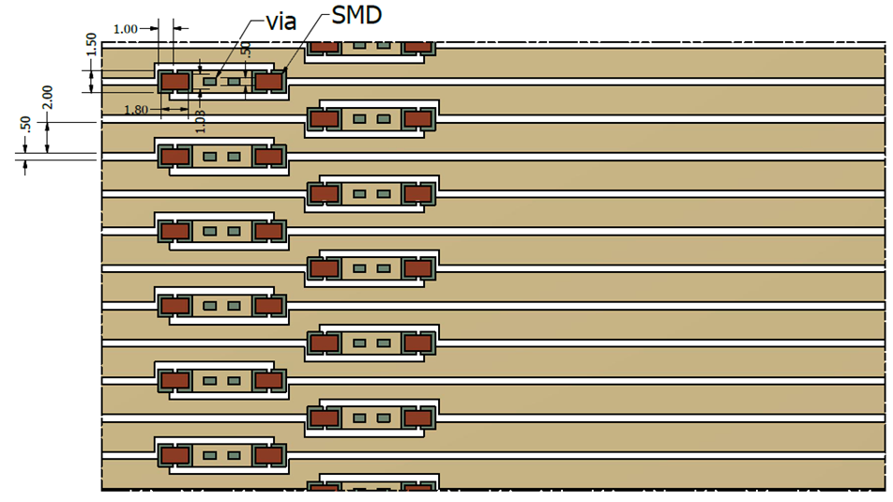
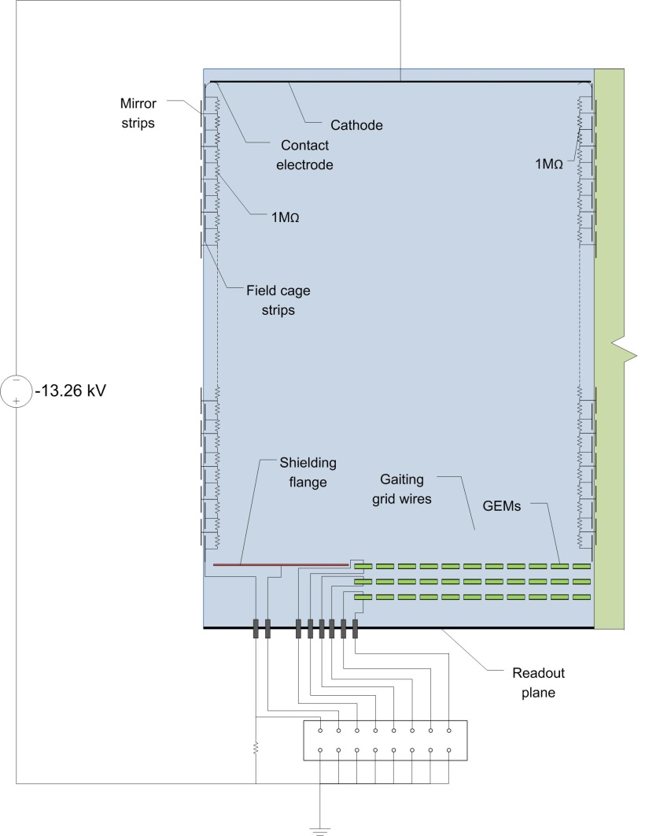
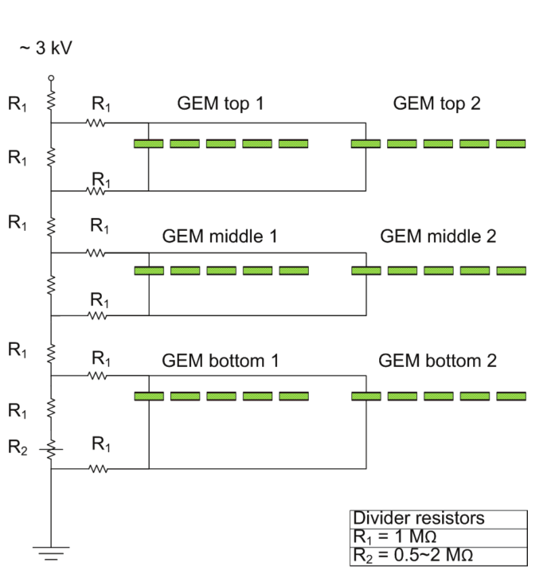
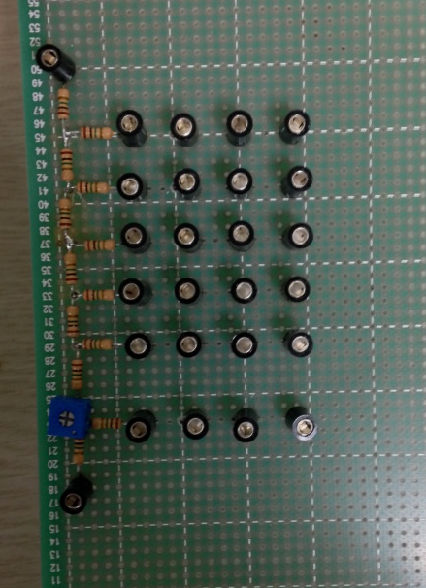
Field Cage
Prototype TPC for LAMPS
Field strip : resistor pattern
PI : 75um
Cu : 35um
2mm
0.5mm
Mirror strip
HV divider circuit for triple GEM
Field strip

Slide 14
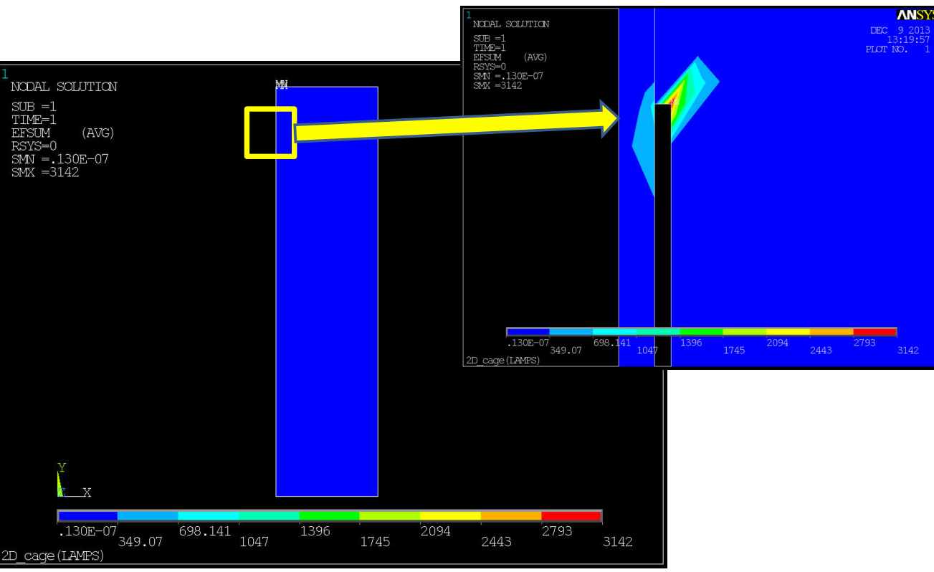
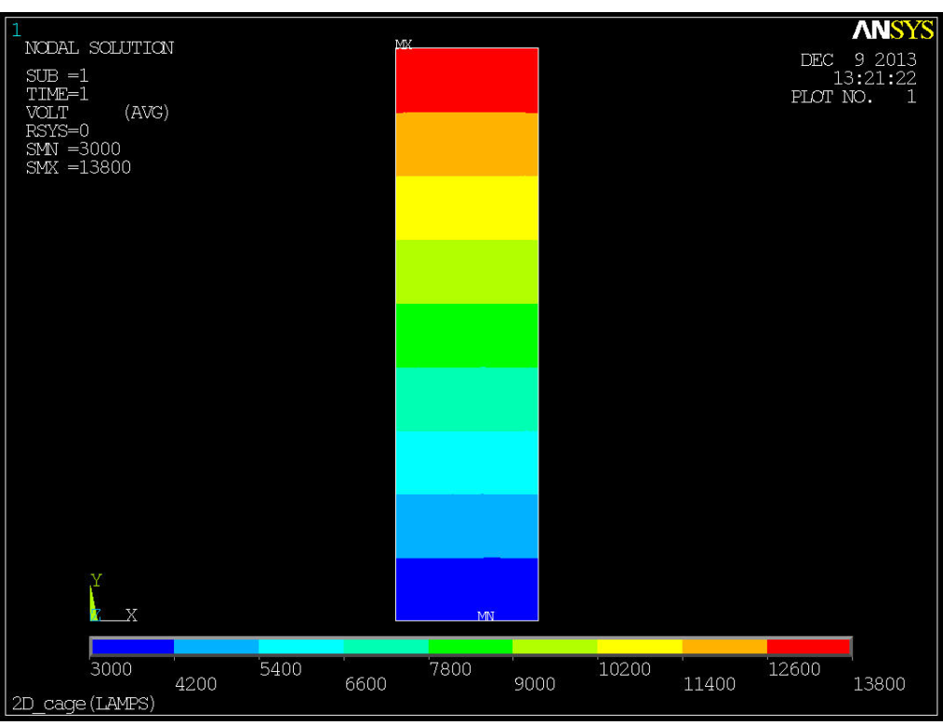
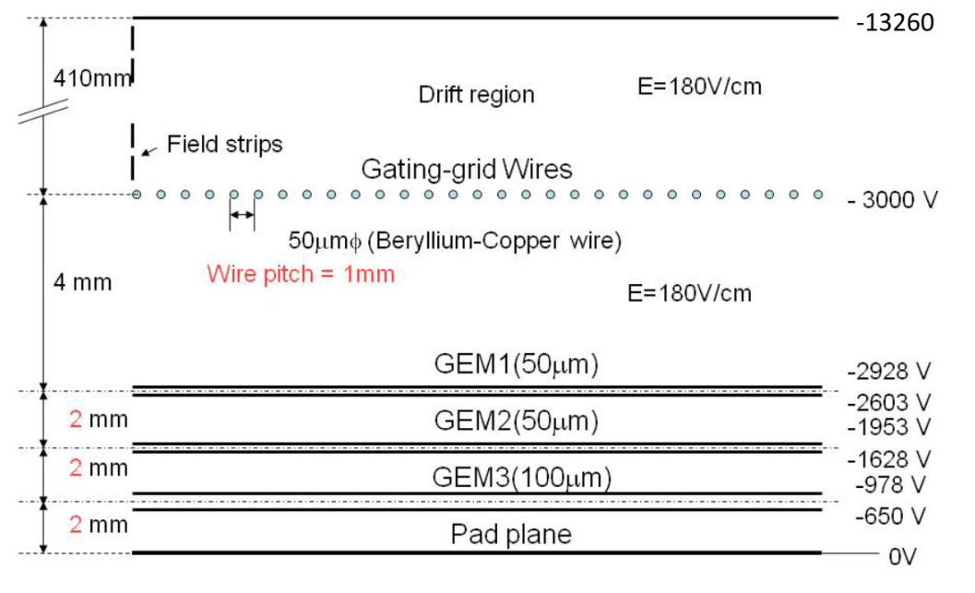
Field Cage
Prototype TPC for LAMPS
E field sum : EFSUM=180V/cm
Potential distribution
570mm
Two resistors chain : ~228MΩ

Slide 15
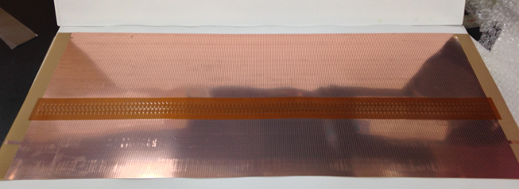
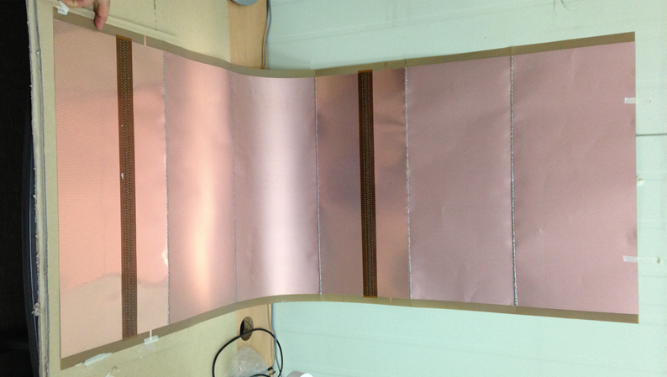
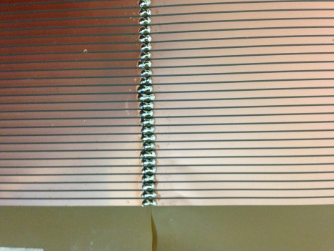
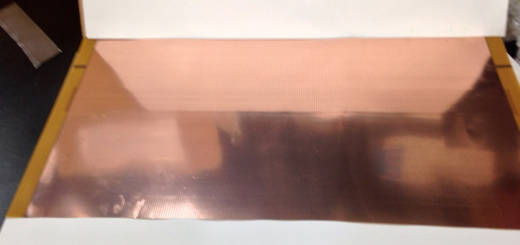
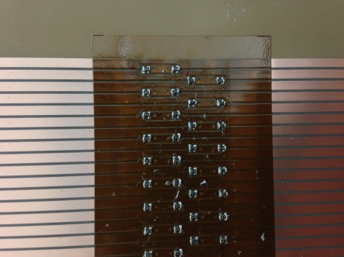
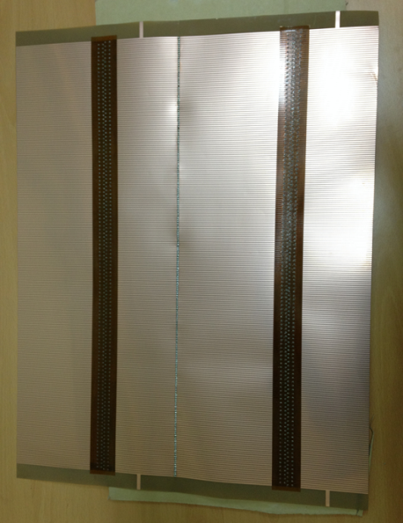
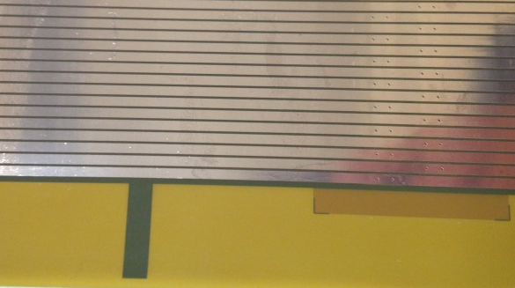
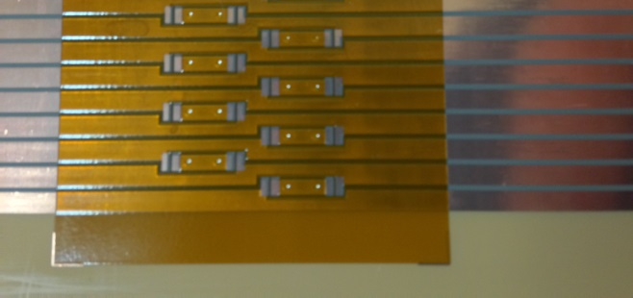
Field Cage
Prototype TPC for LAMPS
Field strip sheet with resistor pattern
Field strip : outer (with 6 sheets)
Field strip sheet without resistor pattern
Two resistor chain
Field strip : inner (with 2 sheets)
resistor pattern
electrode
Two resistor chain

Slide 16
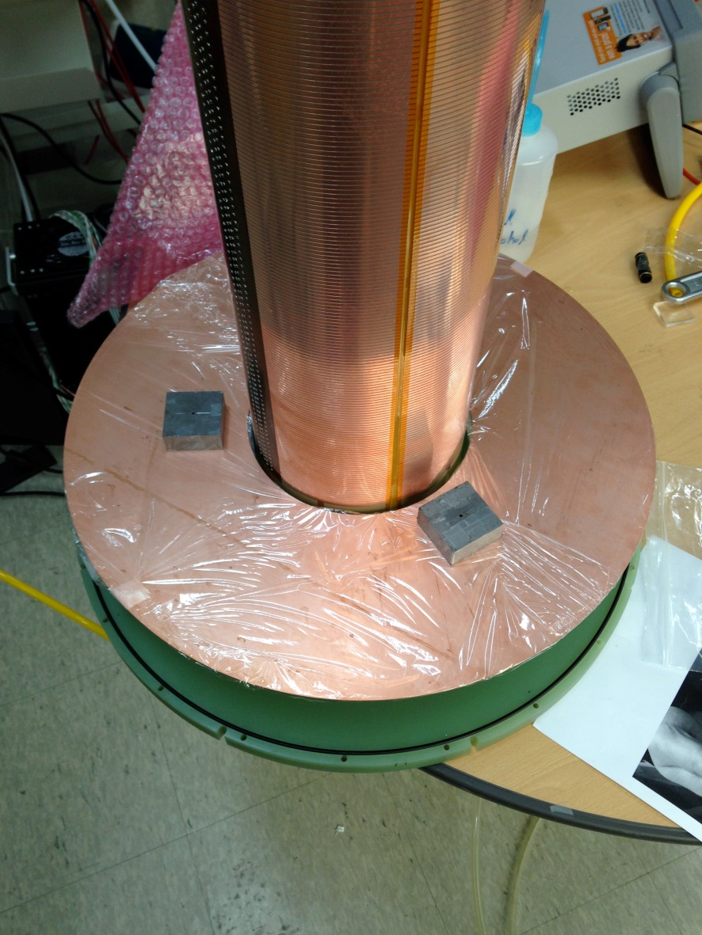
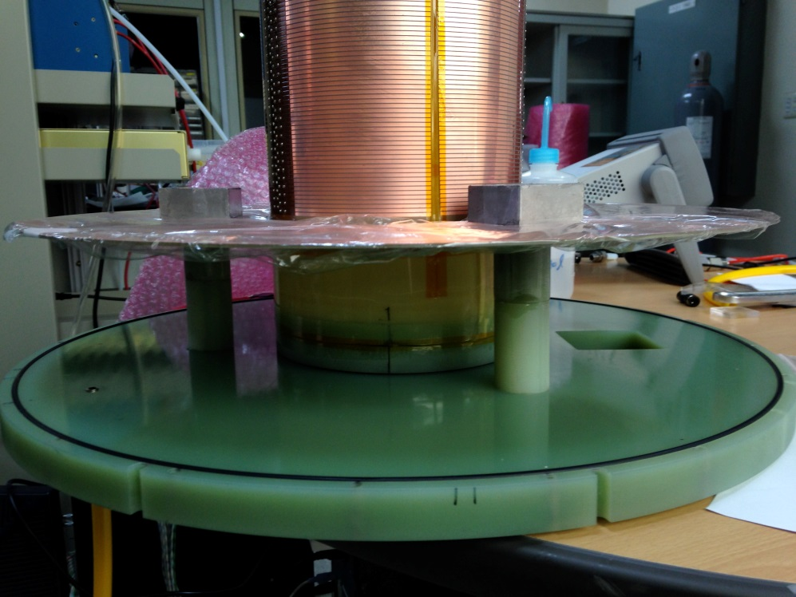
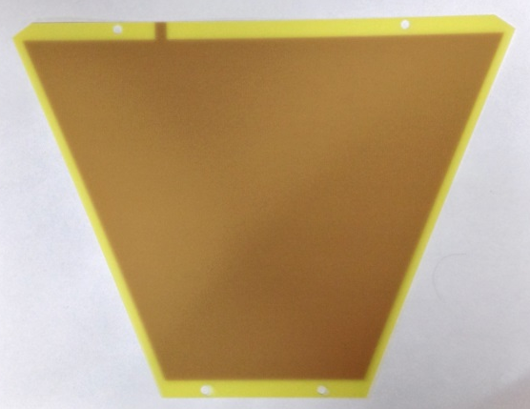
Cathode
Prototype TPC for LAMPS
Cathode
Cathode holder
Cathode holder
HV connector hole
180mm
460mm
Dummy cathode

Slide 17
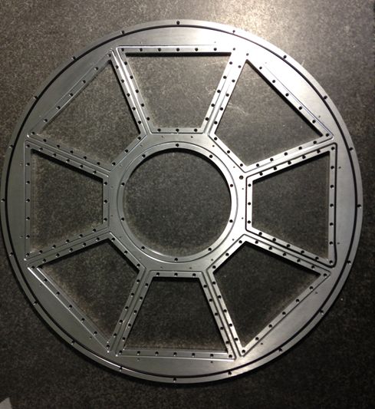





Assembling
Prototype TPC for LAMPS
TPC bottom frame : Al
PAD frame (G10) & HV connector
HV connector
TPC bottom
with PAD + GEM + dummy cathode
TPC bottom with PAD
TPC bottom back
PAD connector
HV connector

Slide 18







Assembling
Prototype TPC for LAMPS
Field Cage with G10 sheet
Field Cage with honeycomb
G10 frame for Field Cage
490mm
Field Cage with field strip
Inner Field Cage
720mm

Slide 19




Assembling
Prototype TPC for LAMPS
Inner Field Cage install
Outer Field Cage install
Prototype TPC
Prototype TPC : back

Slide 20





GET system
DAQ
GET system
ZAP board : to protect AGET chip in AsAd board
TPC
2nd version ZAP
BAV99 chip : small signal diode
ZAP
ASAD : AGET Support for Analog to Digital
A(Asic)GET chip
4 AGET (256 ch)
  in 1 AsAd
12 bit ADC
Pulsar
AsAd
COBO : Collection BOard
Digital data from AsAd
Zero suppression
Network transfer to PC
4 AsAd controlled by 1 COBO
CoBo
PC

Slide 21


R-CoBo system
DAQ
Reduced-CoBo system – Virtual COBO with ML507

Slide 22


GET system
DAQ
1 ASAD : 4GET → 256ch
1 COBO : 4ASAD →1024ch
1 uTCA : 10COBO → 10240ch
5mm size PAD
: ~11000ch x 2 → 2~3 uTCA
2.5mm size PAD
: ~44000ch x 2 → 8~9 uTCA

Slide 23




NARVAL
DAQ
NARVAL (Nouvelle Acquisition temps Réel Version 1.6 Avec Linux)
  runs across a network and acts like a unique program taking data out of the electronic up to providing data to physicist (storage, histogram display and etc).
  - highly distributed acquisition system
  - developed in Ada (but actors can load C/C++ shared library)
  a lots of system to support
  runs many acquisitions in parallel
TPC
GET system

Slide 24


GEM test with small chamber
Current Status
Test
Readout PAD system
Characteristic of GEM
Gain of GEM
New GEM
Comparison of GEM
of two domestic vendor
HV divider
GEM
PAD
ZAP board

Slide 25
Summary
LAMPS High Energy
- heavy ion collisions experiment to study the symmetry energy in the EoS of nuclear matter
- designed to cover wide acceptance range
with high detection efficiency and accuracy of charged particles and neutrons
Time Projection Chamber (TPC)
- main detector for tracking of particles
- complete information of charged particle trajectory
- Target : 30cm away from the center
- Detection range : -0.7(127º) ~ 1.6(24º)
- Drift length : 60cm (x2)
- Cathode Membrane
- Amplified by Gas Electron Multiplier (GEM)
- Both side readout PAD
Concept of prototype TPC for LAMPS
- Optimized design & fabrication method : 1/2 size of real TPC (1/8 volume), Honeycomb body for gas chamber
- PAD : Hexagon shape with 5mm & 2.5mm
- GEM : Test with large size & specific shape
- Field cage : Uniform electric field by Cu strip
- DAQ : COBO system
- Analysis : Development of reconstruction algorism
Current status
- GEM & PAD test with source

Slide 26


Slide 27


Slide 28
Thank you for your attention

Slide 29
backup

