Slide 1
LAMPS Time Projection Chamber
HyoSang Lee
IBS
2014.03.31

Slide 2
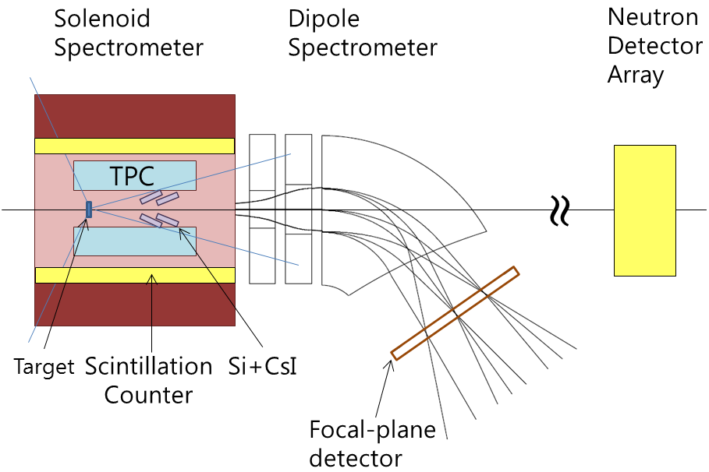
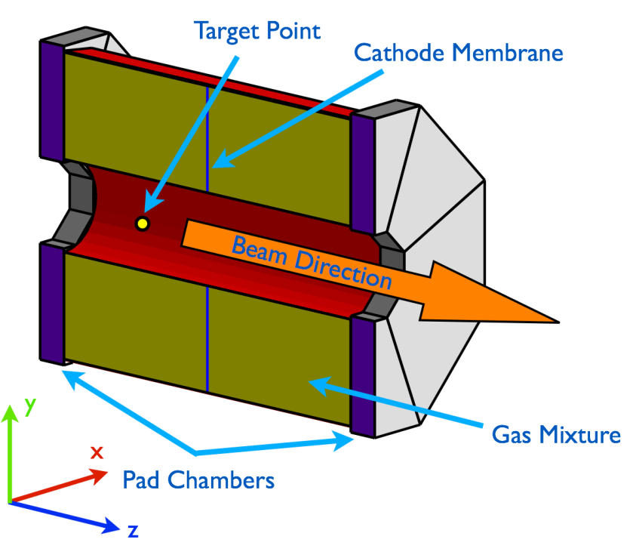
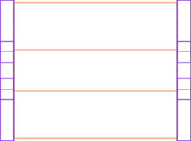
LAMPS TPC
Design Concept of p.TPC for LAMPS
LAMPS High Energy
Complete information of charged particle trajectory
Detection range : -0.7(127º) ~ 1.6(24º)
Volume : 857L
Cathode Membrane
Both side readout PAD
Target : 30cm away from the center
Inside of Solenoid magnet
η=-0.7 (127º)
η=1.6 (24º)
400 mm
53.1°
150 mm
24.0°
Beam
Target
500 mm
300 mm
900 mm

Slide 3
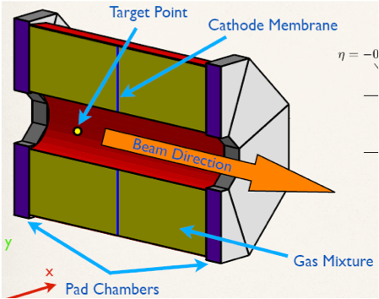
Time Projection Chamber
Design Concept of p.TPC for LAMPS
Concept of prototype TPC for LAMPS
Optimized design & fabrication method : 1/2 size of real TPC (1/8 volume) Honeycomb body for gas chamber
PAD : Hexagon shape
Test with 5mm & 2.5mm
GEM : Test with large size & specific shape
Field cage : Uniform electric field by cu strip
DAQ : COBO system
Analysis : Development of reconstruction algorism

Slide 4
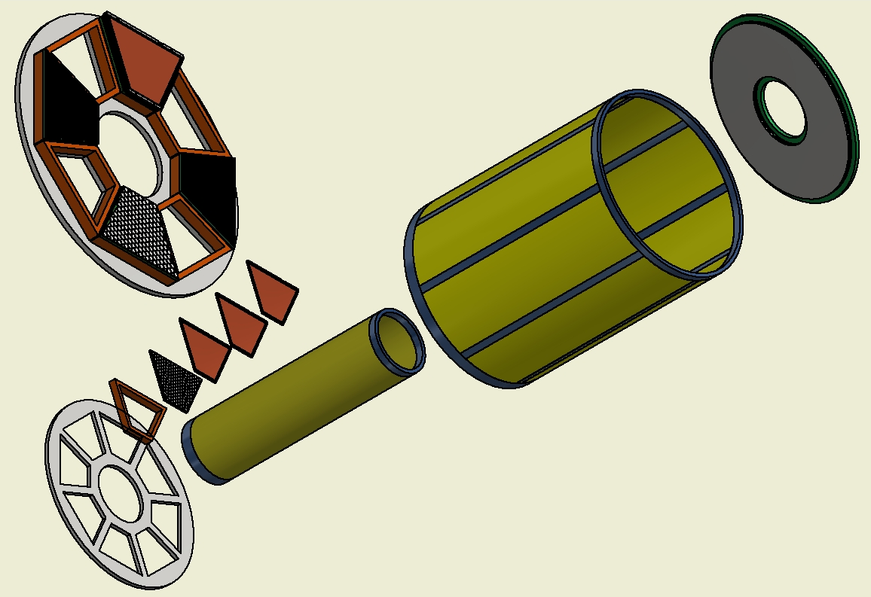
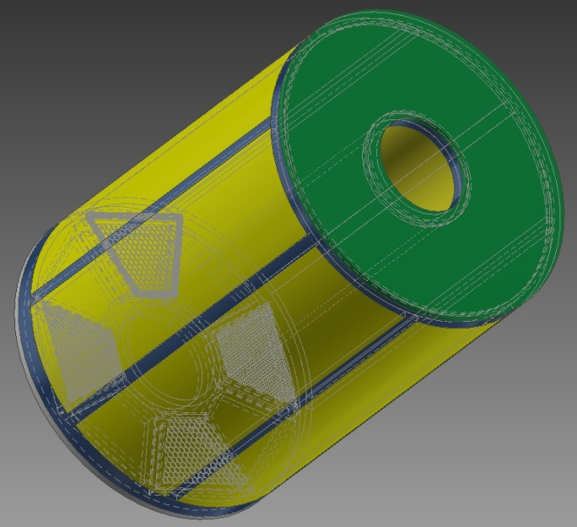
Prototype TPC
Prototype TPC for LAMPS
½ size of real TPC design
Outer Field Cage
GEM : 3 layers
Cathode
PAD
150 mm
640 mm
Inner Field Cage
490 mm
Bottom to fix PAD & GEM : Al

Slide 5
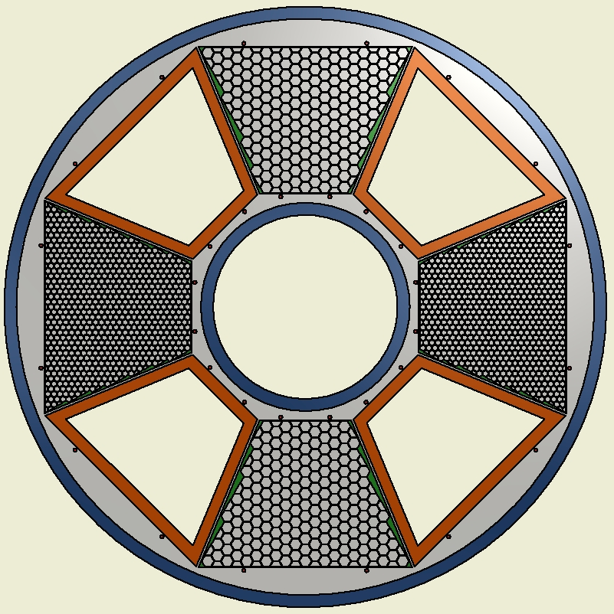
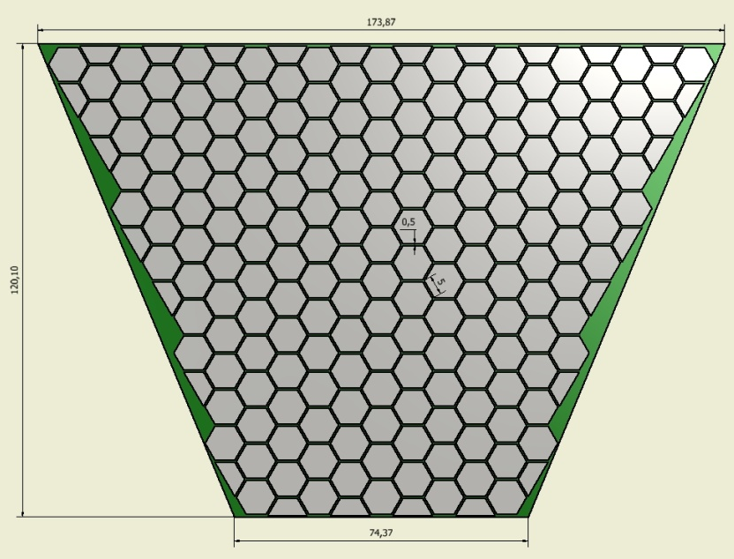
PAD
Prototype TPC for LAMPS
Hexagonal shape : 5mm & 2.5mm
500 μm gap between two pads
Multi-layer PCB board
Trapezoidal (or Octant) shape PCB
4 layers PCB
16 pin SMD type connector (1.27mm pitch)
5 mm pad
(207 ch)
MAYA pattern
2.5 mm pad (735 ch)
Trapezoidal (or Octant) shape PCB

Slide 6
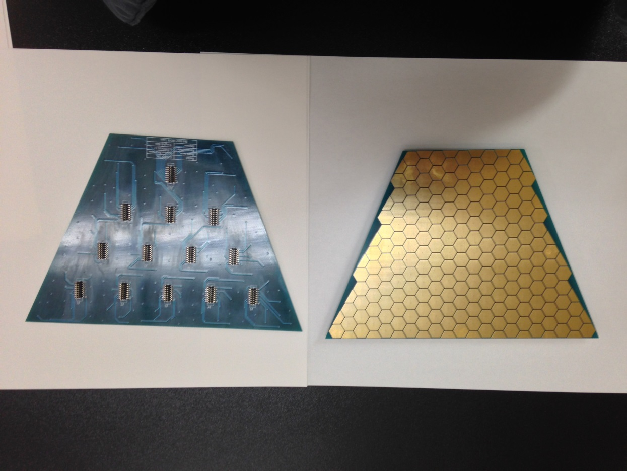
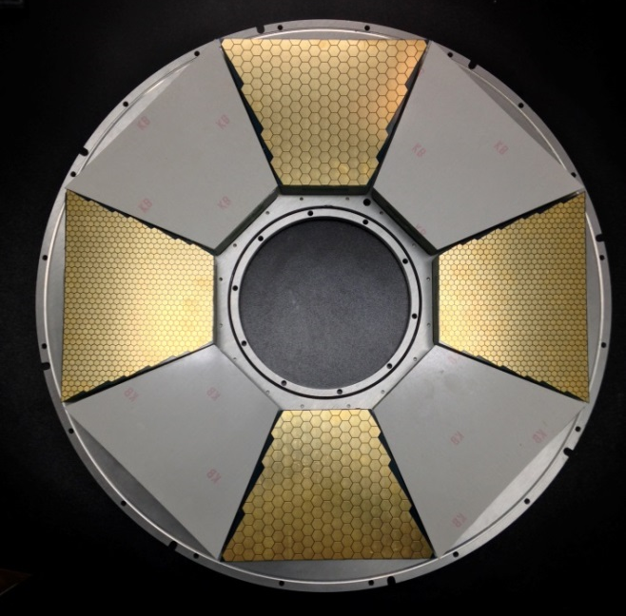
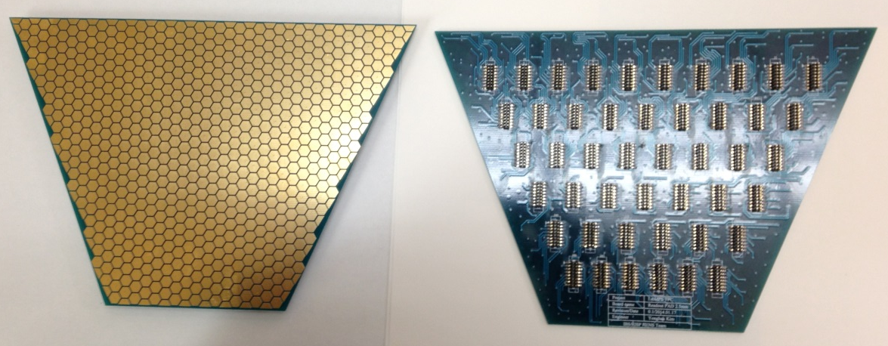
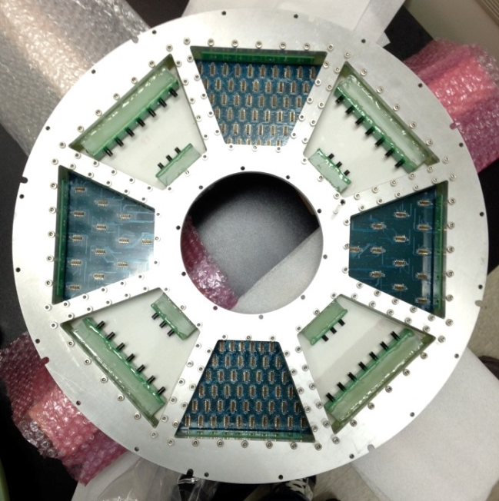
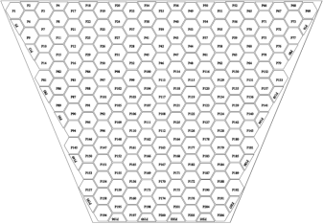
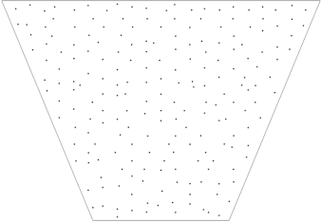
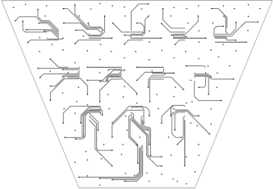
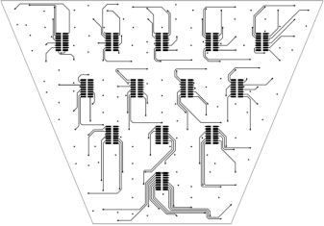
PAD
Prototype TPC for LAMPS
5mm PAD : 207ch
PAD installed in bottom frame
2.5mm PAD : 735ch
16pin SMD connector
PAD PCB design

Slide 7
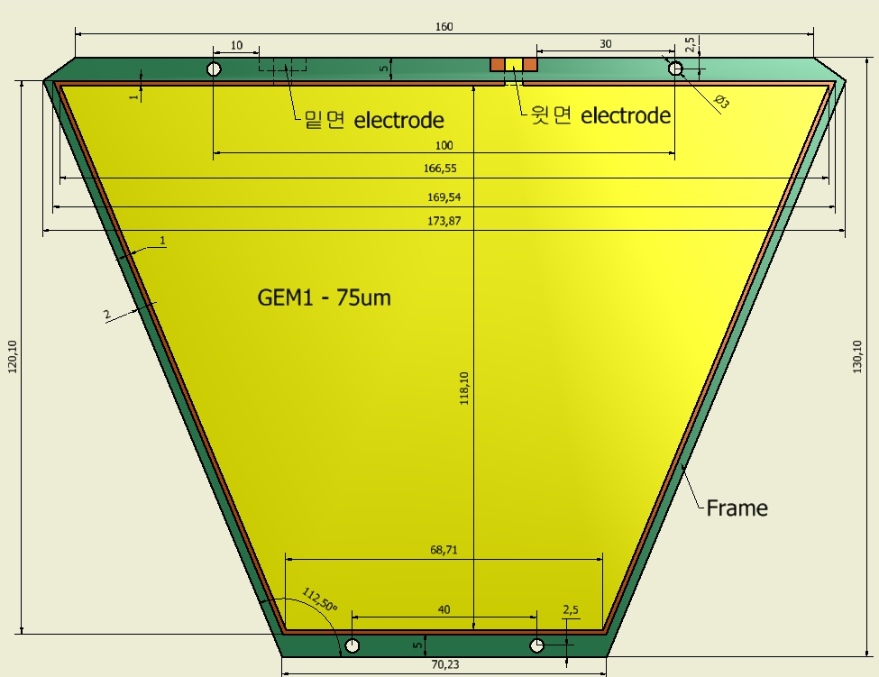
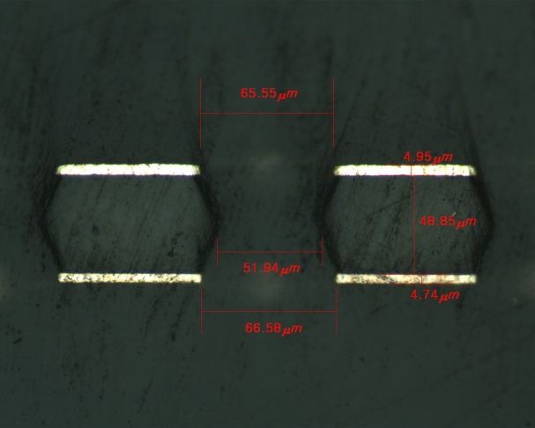
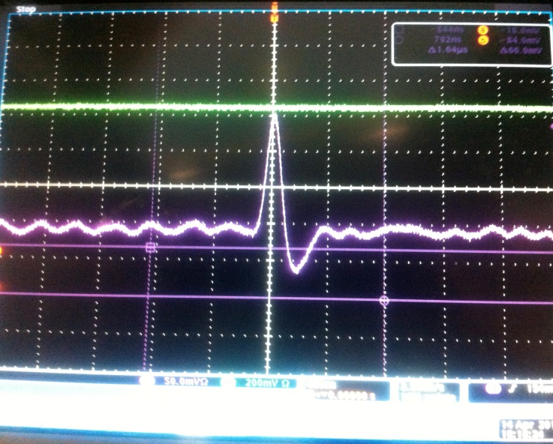
GEM
Design Concept of p.TPC for LAMPS
Trapezoidal shape
50μm & 75μm thickness
160x120 mm²
3 layers for each PAD

Slide 8
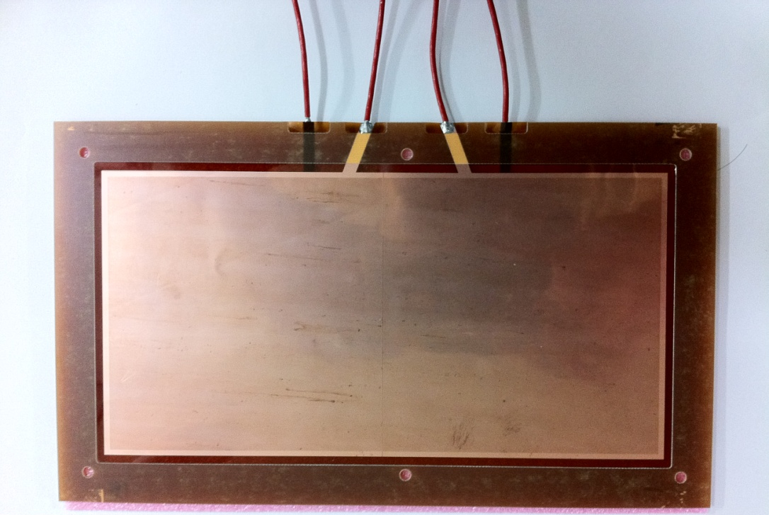
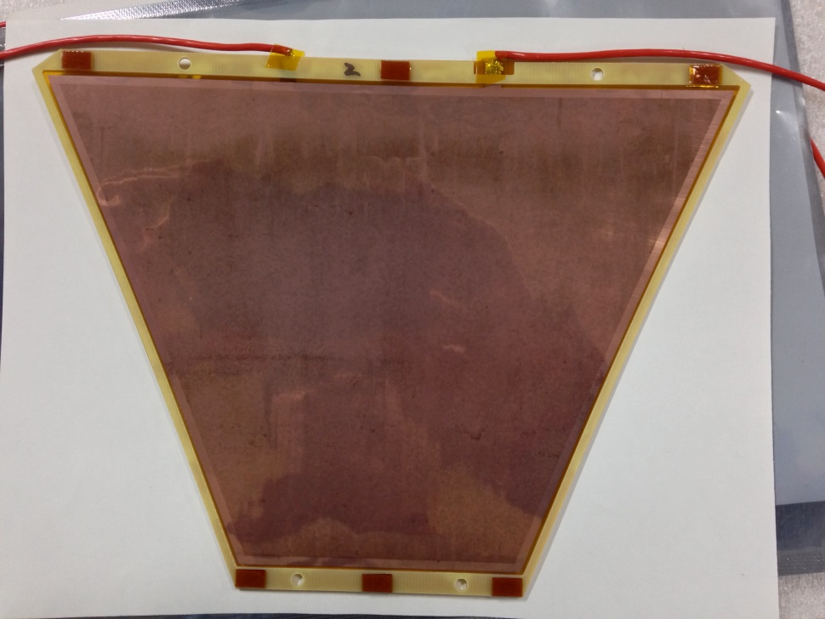
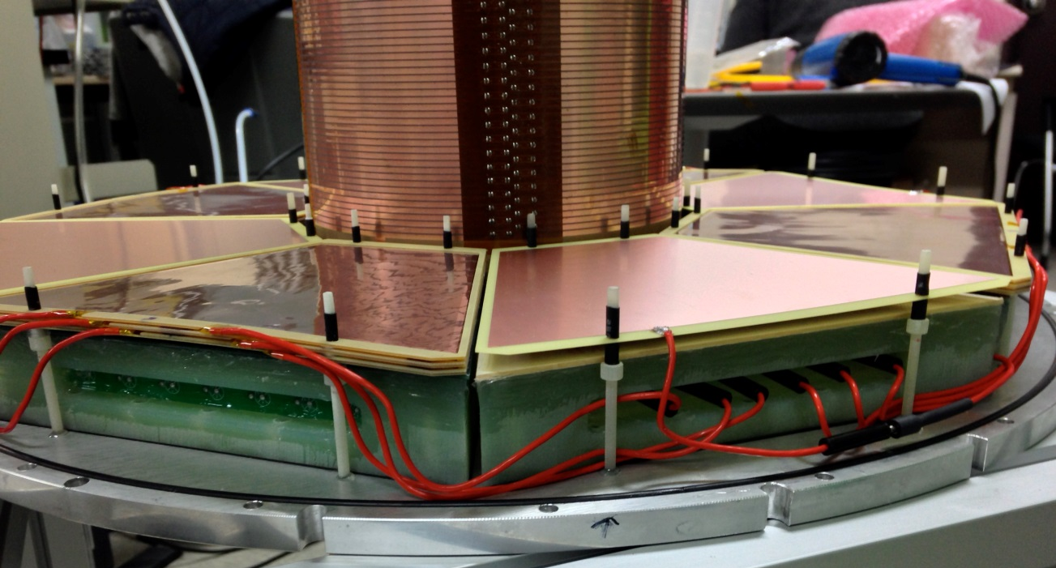
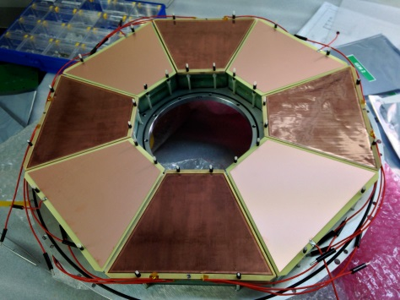
GEM
Prototype TPC for LAMPS
Electrode
166mm
Electrode
118mm
10cm
Divided
20cm
69mm
3 layers
Dummy cathode

Slide 9
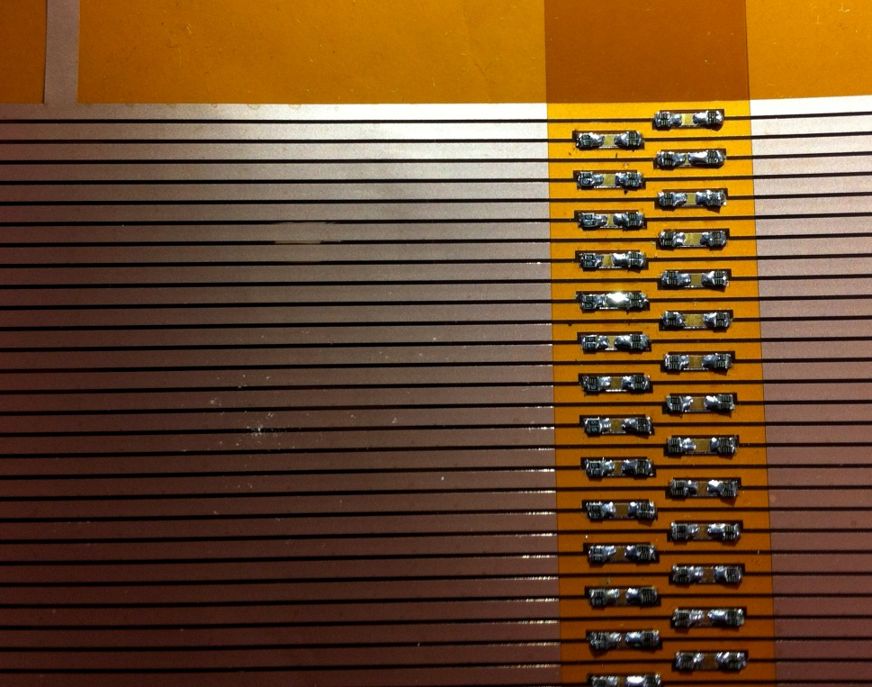
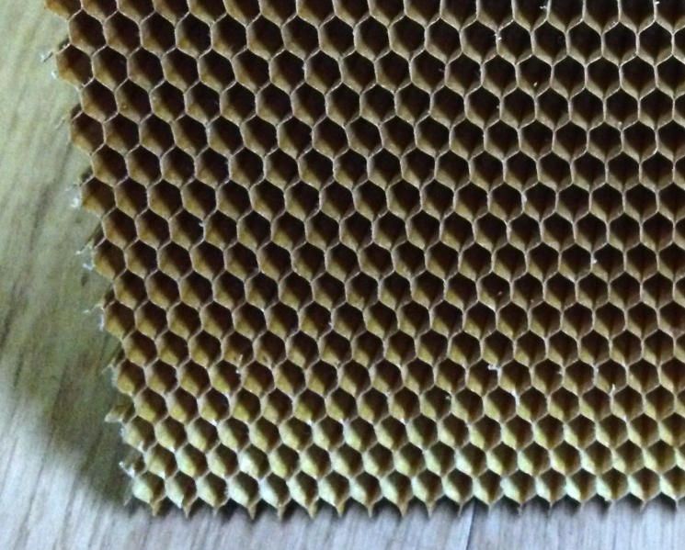
Field Cage
Prototype TPC for LAMPS
1MOhm resistor(0.1%)
35 um thick and 2 mm wide Cu strips
0.5 mm gap between neighboring strips
Mirror strips on the back
1 MΩ resistors with 0.1% var.
TPC body: G10 + Aramid honeycomb
Cross-section of field-cage body
Al Mylar
GRP
GRP
Mirror strip
PI
Field strip
G10
HoneyComb

Slide 10
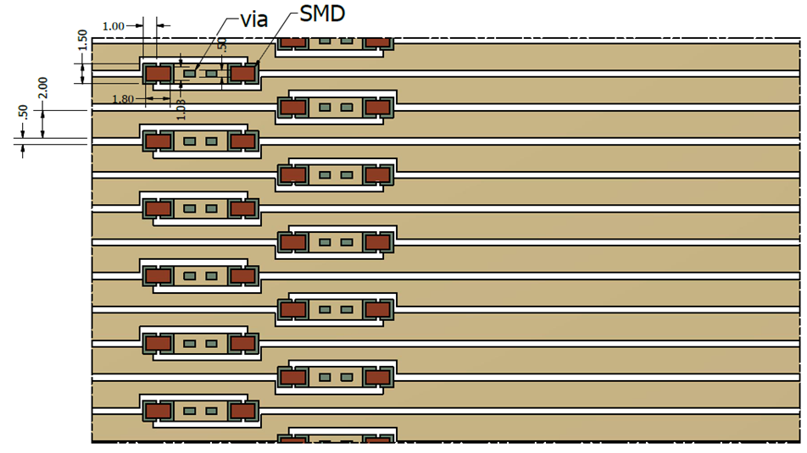
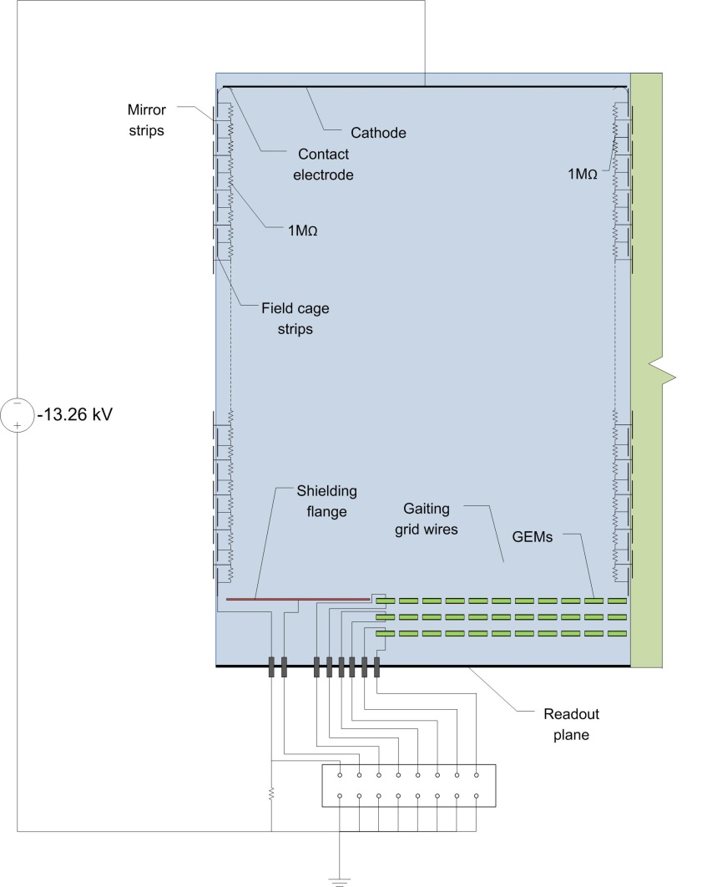
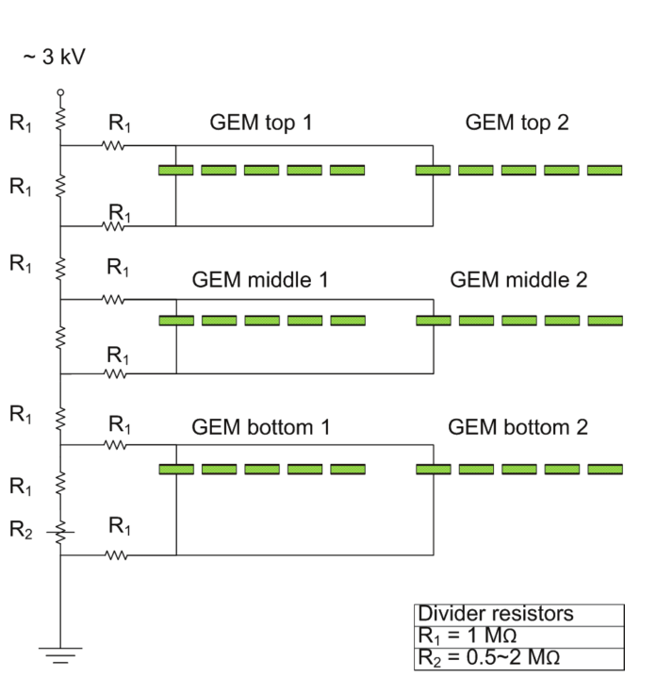
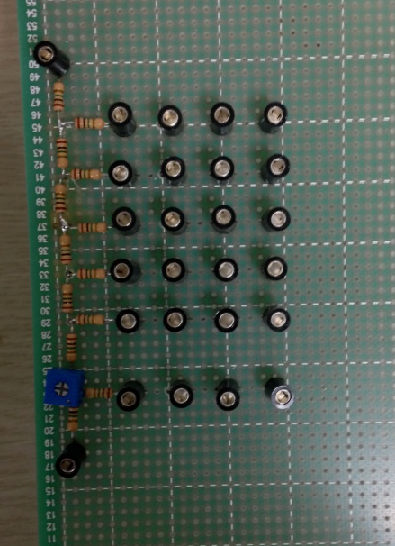
Field Cage
Prototype TPC for LAMPS
Field strip : resistor pattern
PI : 75um
Cu : 35um
2mm
0.5mm
Mirror strip
HV divider circuit for triple GEM
Field strip

Slide 11
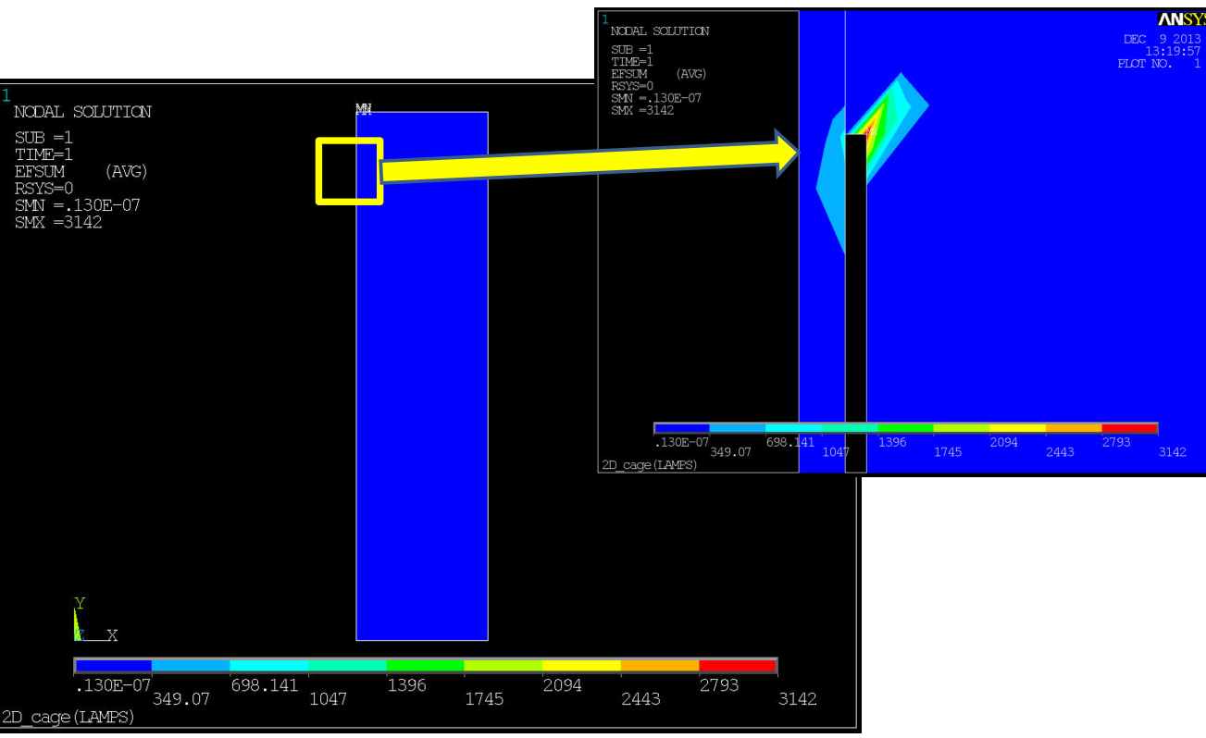
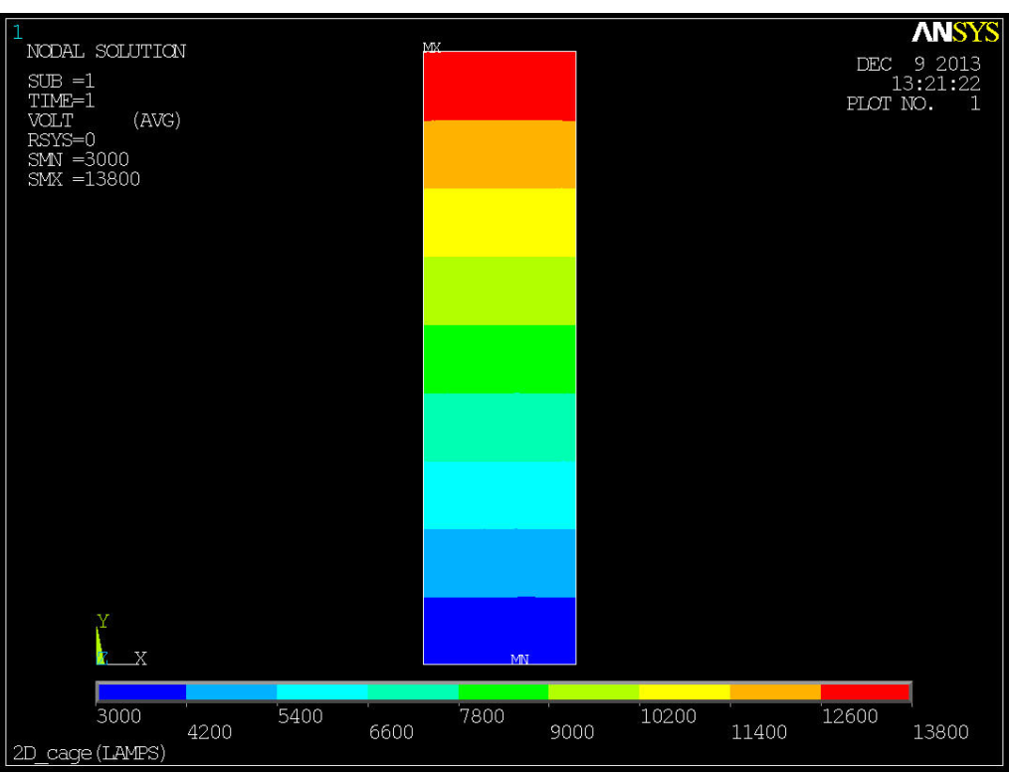
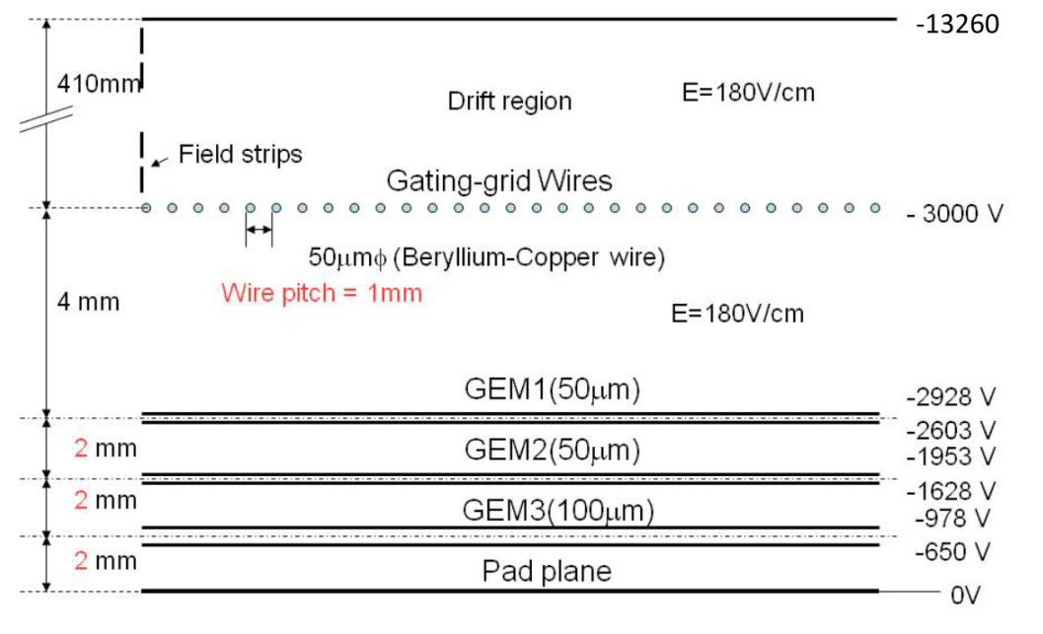
Field Cage
Prototype TPC for LAMPS
E field sum : EFSUM=180V/cm
Potential distribution
570mm
Two resistors chain : ~228MΩ

Slide 12
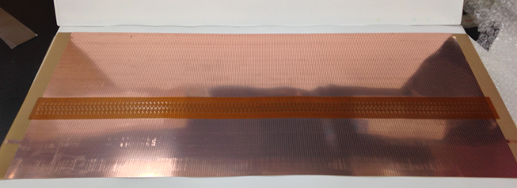
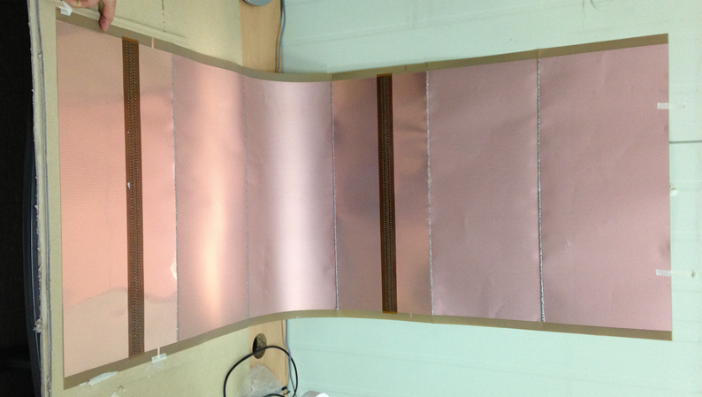
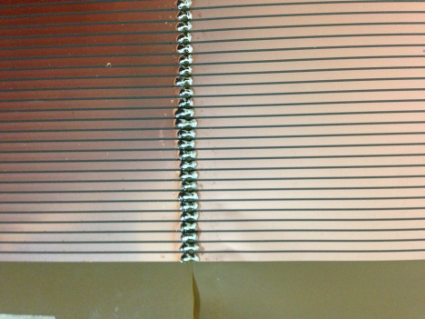
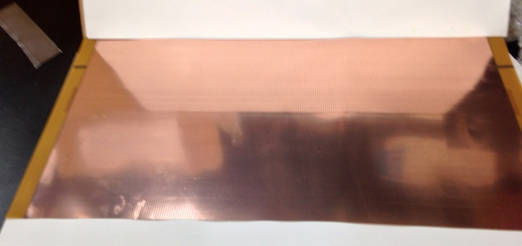
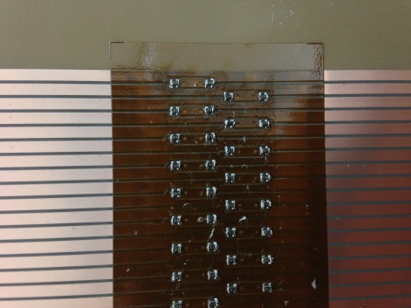
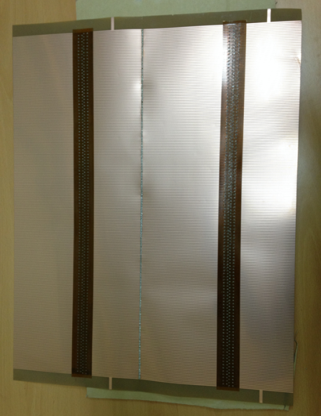
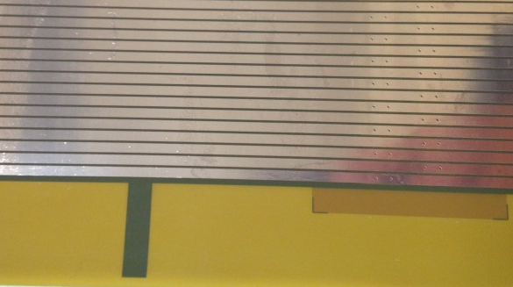
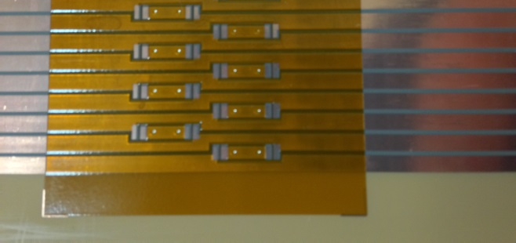
Field Cage
Prototype TPC for LAMPS
Field strip sheet with resistor pattern
Field strip : outer (with 6 sheets)
Field strip sheet without resistor pattern
Two resistor chain
Field strip : inner (with 2 sheets)
resistor pattern
electrode
Two resistor chain

Slide 13
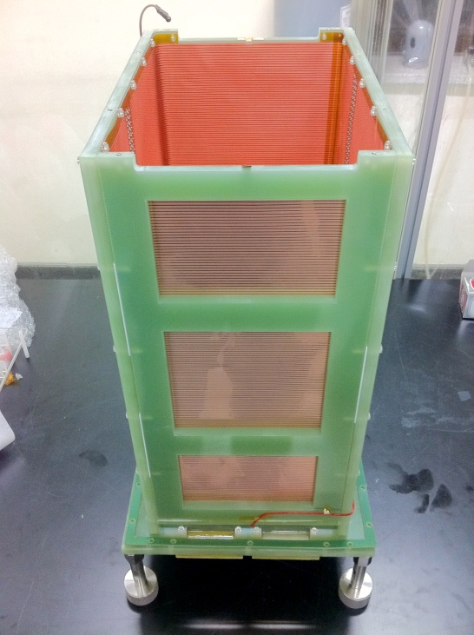
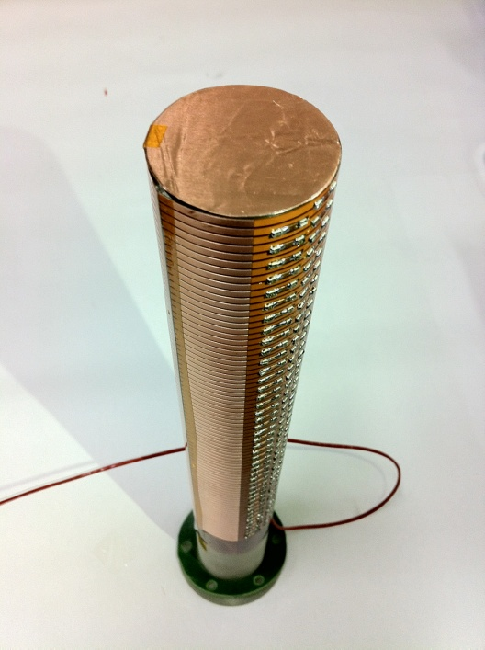
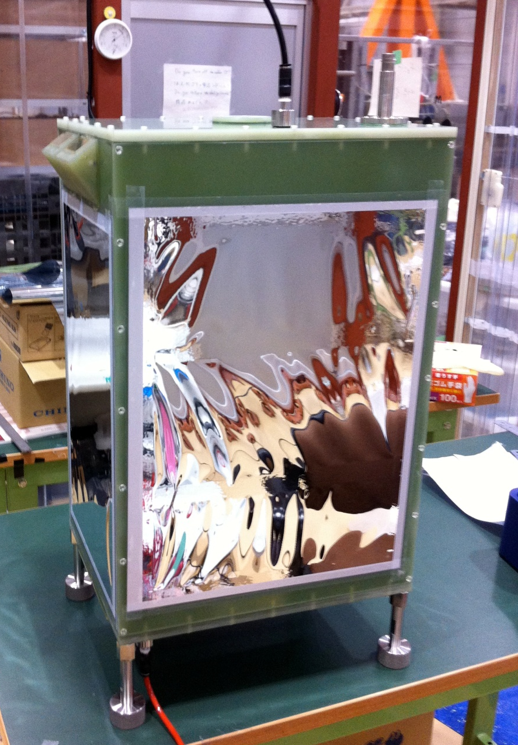
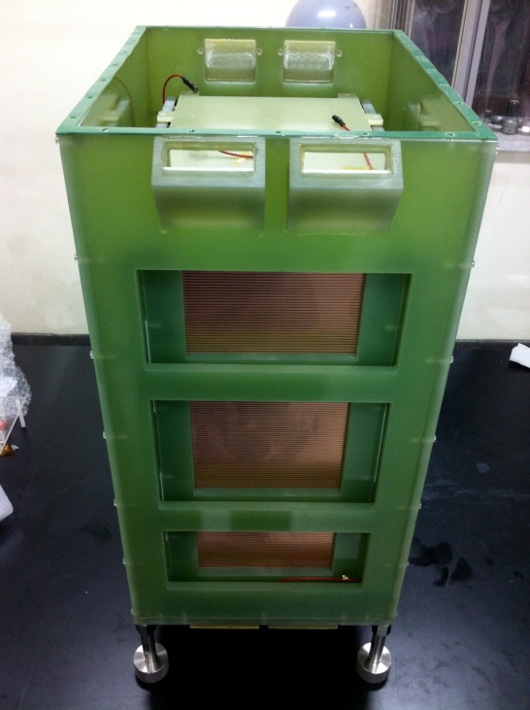
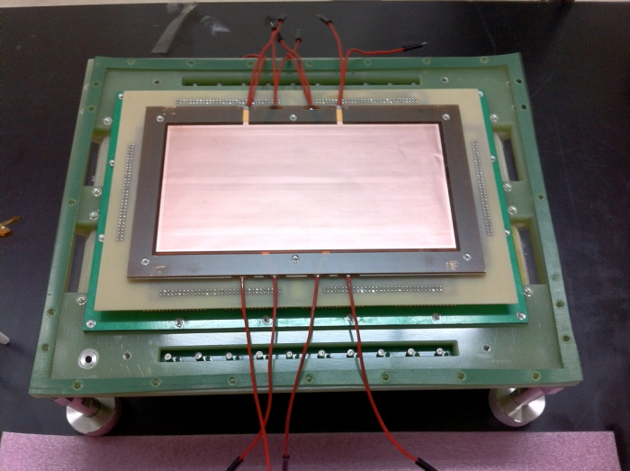
Field Cage
Prototype TPC
prototype TPC
Target Holder
fieldstrip
Fieldstrip + Gas chamber
PAD + GEM

Slide 14
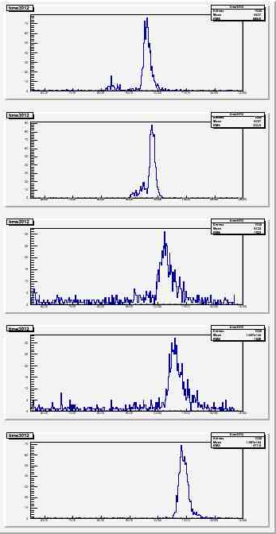
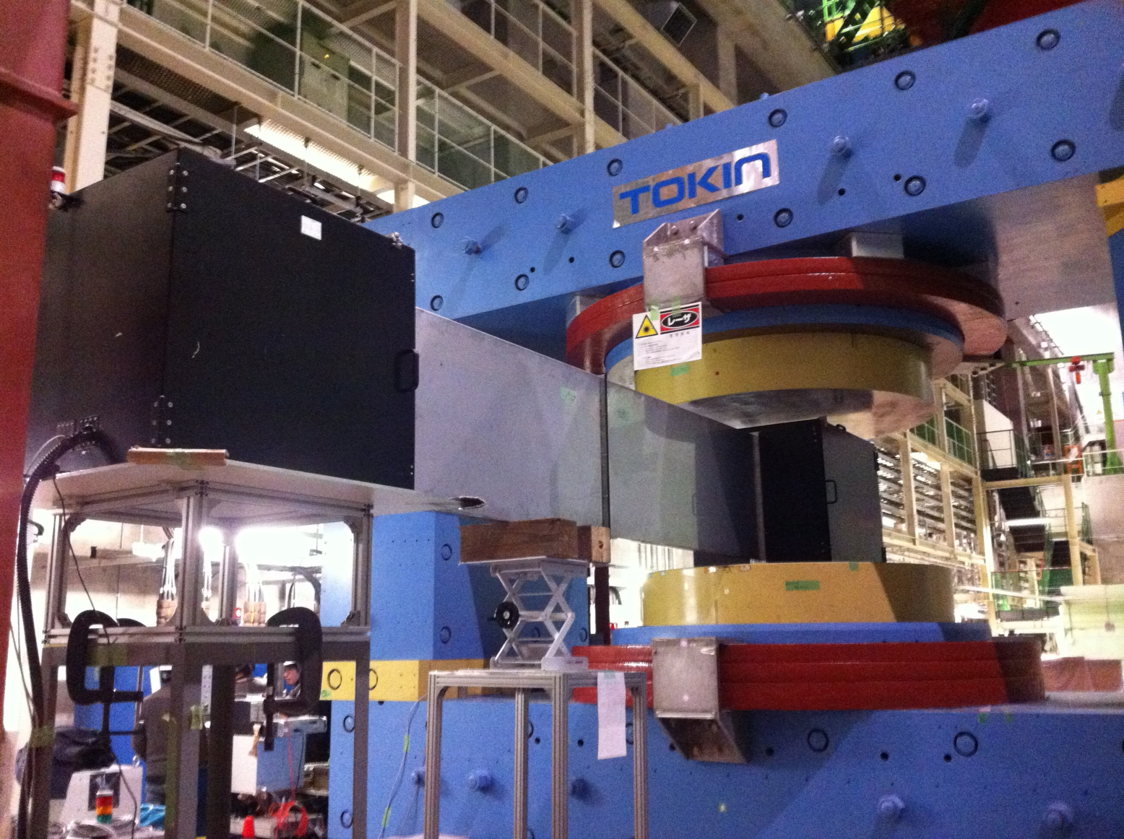
Field Cage test
Laser test
p.TPC test @ J-PARC Hadron Hall
p.TPC – drift velocity
180V/cm
Laser source
170V/cm
Laser direction
p.TPC
160V/cm
150V/cm

Slide 15
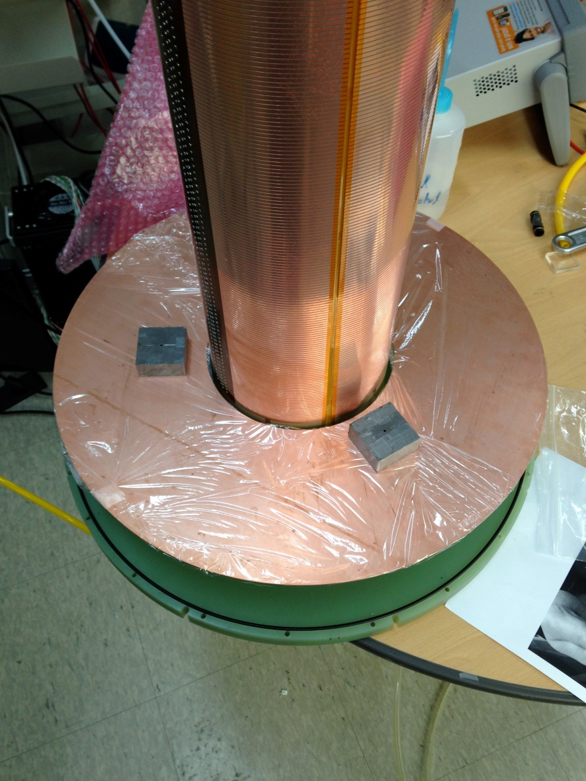
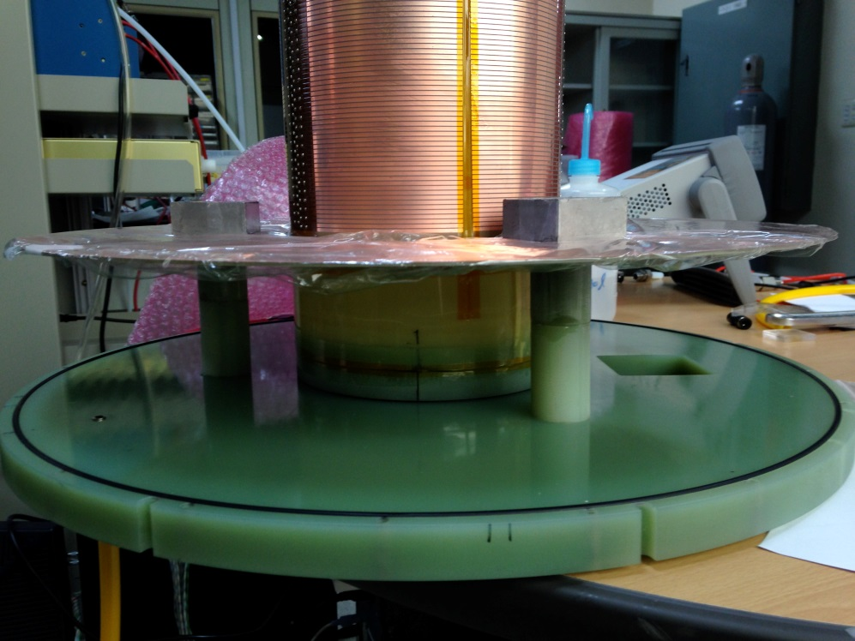
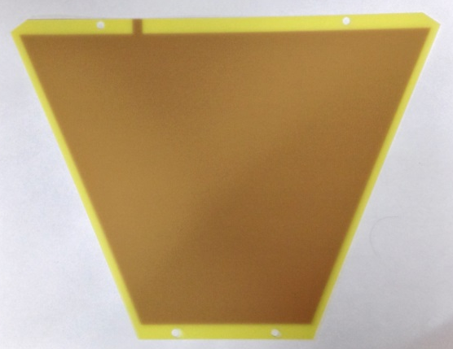
Cathode
Prototype TPC for LAMPS
Cathode holder
HV connector hole
180mm
460mm
Dummy cathode

Slide 16






Time Projection Chamber
Prototype TPC for LAMPS
TPC bottom frame : Al
PAD frame (G10) & HV connector
HV connector
TPC bottom
with PAD + GEM + dummy cathode
TPC bottom with PAD
TPC bottom back
PAD connector
HV connector

Slide 17







Time Projection Chamber
Prototype TPC for LAMPS
Field Cage with G10 sheet
Field Cage with honeycomb
G10 frame for Field Cage
490mm
Field Cage with field strip
Inner Field Cage
720mm

Slide 18




Time Projection Chamber
Prototype TPC for LAMPS
Inner Field Cage install
Outer Field Cage install
Prototype TPC
Prototype TPC : back

Slide 19





Time Projection Chamber
Prototype TPC for LAMPS
GET system
ZAP board : to protect AGET chip in AsAd board
TPC
2nd version ZAP
BAV99 chip : small signal diode
ZAP
ASAD : AGET Support for Analog to Digital
A(Asic)GET chip
4 AGET (256 ch)
in 1 AsAd
12 bit ADC
Pulsar
AsAd
COBO : Collection BOard
Digital data from AsAd
Zero suppression
Network transfer to PC
4 AsAd controlled by 1 COBO
CoBo
PC

Slide 20


Time Projection Chamber
Prototype TPC for LAMPS
1 ASAD : 4GET → 256ch
1 COBO : 4ASAD →1024ch
1 uTCA : 10COBO → 10240ch
5mm size PAD : ~11000ch x 2 → 2~3 uTCA
2.5mm size PAD : ~44000ch x 2 → 8~9 uTCA

Slide 21


Time Projection Chamber
Prototype TPC for LAMPS
Reduced-CoBo system – Virtual COBO with ML507

Slide 22


Slide 23


Slide 24


GEM test with small chamber
Current Status
Test
Readout PAD system
Characteristic of GEM
Gain of GEM
New GEM
Comparison of GEM of two domestic vendor
HV divider
GEM
PAD
ZAP board

Slide 25
Summary

Slide 27
backup

Slide 28


Slide 29


Slide 30


Slide 31


Slide 32


Slide 33




Slide 34


Slide 35
LAMPS prototype-TPC : Plan
Test plan
Cosmic ray test : reconstruct muon track
Fe-55 source test
ExB test in the magnet

