Slide 1
Overview of LAMPS
Review of the LAMPS Project,
IBS, Daejeon, Korea, 31 March, 2014
Byungsik Hong (Korea University)
Outline
Physics of RIB Reactions
Nuclear symmetry energy
Examples of the experimental observables
Plan for LAMPS
Summary

Slide 2
Physics of RIB Reactions
Nuclear collisions with rare-isotope beams
Create nuclear matter with several ($ρ, T, N/Z$)
Exploring the phase diagram & phase transition of strongly interacting matter
Nuclear equation of state (EOS) and its symmetry energy term below and above the saturation density
Nuclear effective interaction
Important to the astrophysical context
Neutron stars & supernova explosion

Slide 3
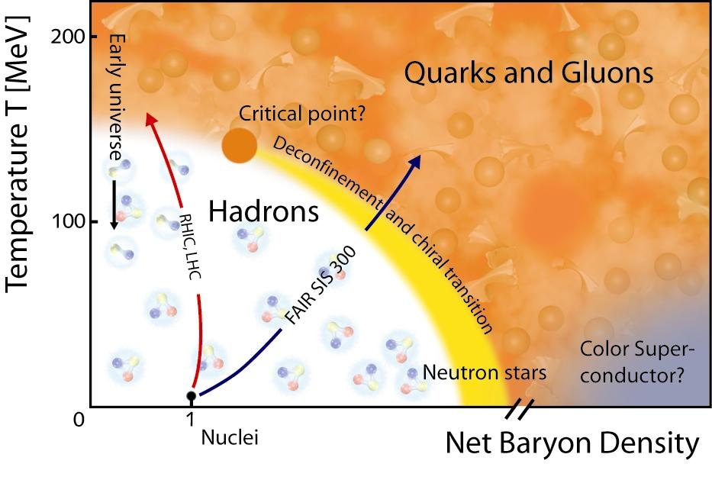
Nuclear Phase Diagram
Quark-hadron
Mixed phase
Liquid-gas
coexistence

Slide 4
Nuclear Phase Diagram
Quark-hadron
Mixed phase
Liquid-gas
coexistence
1
with RIB
0
Supernova IIa
Neutron stars
$$Z/N$$

Slide 5
Physics Program of LAMPS
Nuclear collisions with rare-isotope beams
Create nuclear matter with several ($ρ, T, N/Z$)
Exploring the phase diagram & phase transition of strongly interacting matter
Nuclear equation of state (EOS) and its symmetry energy term below and above the saturation density
Nuclear effective interaction
Important to the astrophysical context
Neutron stars & supernova explosion

Slide 6
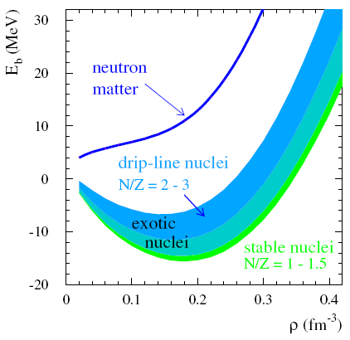
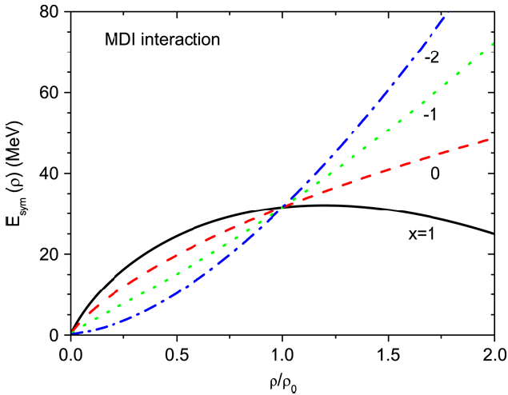
EOS & Symmetry Energy
$E\left(ρ, δ\right)/A=E\left(ρ,δ=0\right)+E_{sym}\left(ρ\right)δ^{2}+𝒪\left(δ^{4}\right)+⋯$
where $ρ=ρ_{n}+ρ_{p}$ and$δ=\frac{ρ_{n}−ρ_{p}}{ρ_{n}+ρ_{p}}$
L.W. Chen et al.,
PRL 94, 032701 (2005)
$E (ρ)/A$ (MeV)
Asy-stiff
Asy-soft
ρ (fm⁻³)

Slide 7
Nuclear Symmetry Energy
$E_{sym}\left(ρ\right)=\frac{1}{3}E_{F} {\left(ρ /ρ_{0}\right)}^{2/3}+{E_{sym}}^{pot}\left(ρ\right)$
Here ${E_{sym}}^{pot}\left(ρ\right)$ is often parametrized as $C{\left(ρ /ρ_{0}\right)}^{γ}$
Useful expansion around $ρ_{0}$
$E_{sym}\left(ρ\right)=J+\frac{L}{3}\left(\frac{ρ−ρ_{0}}{ρ_{0}}\right)+\frac{K_{sym}}{18}{\left(\frac{ρ−ρ_{0}}{ρ_{0}}\right)}^{2}$
where
$L=\frac{3}{ρ_{0}}P_{sym}=3ρ_{0}{\left.\frac{∂E_{sym}\left(ρ\right)}{∂ρ}\right|}_{ρ=ρ_{0}}$ (slope)
$K_{sym}=9{ρ_{0}}^{2}{\left.\frac{{∂_{}^{2}E}_{sym}\left(ρ\right)}{∂ρ^{2}}\right|}_{ρ=ρ_{0}}$ (curvature)
Important constraint on nuclear effective interaction
18

Slide 8
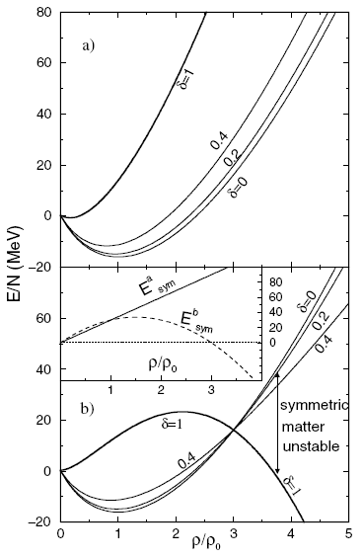
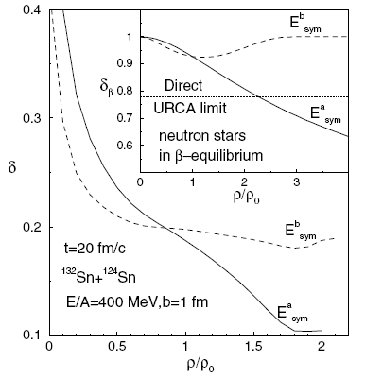
Nuclear Symmetry Energy
B.-A. Li, PRL 88, 192701 (2002)
High (Low) density matter is more neutron rich with soft (stiff) symmetry energy

Slide 9
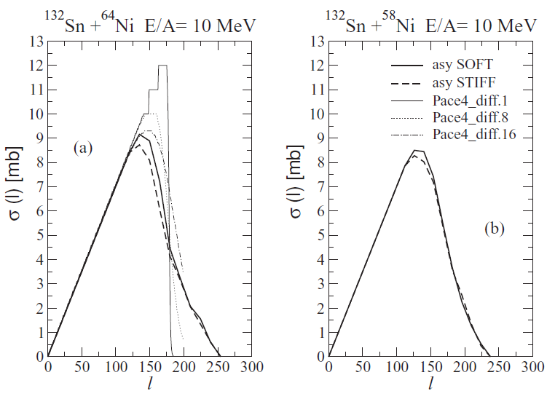
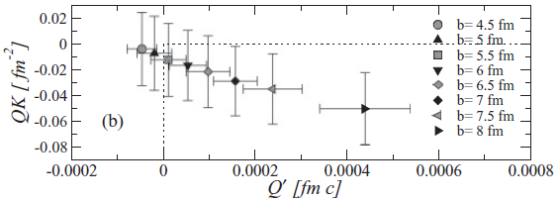
Symmetry Energy in Fusion
C. Rizzo et al., PRC 83, 014604 (2011)
Interplay between fusion and breakup reactions by SMF model
Larger $σ_{Fusion}$ for more neutron-rich system with Asy-soft
Quadrupole moment in x-space
$$Q\left(t\right)=\left\langle 2z^{2}\left(t\right)−x^{2}\left(t\right)−y^{2}(t)\right\rangle$$
Quadrupole moment in p-space
$$QK\left(t\right)=\left\langle 2p_{z}^{2}\left(t\right)−p_{x}^{2}\left(t\right)−p_{y}^{2} (t)\right\rangle$$
¹³²Sn+⁶⁴Ni @ 10 AMeV
Fusion cross section (mb)
Breakup condition
n-rich
n-poor
Macroscopic $σ_{Fusion}$ by PACE4 code prefers larger neutron skin diffuseness of n-rich nuclei
Impact parameter

Slide 10
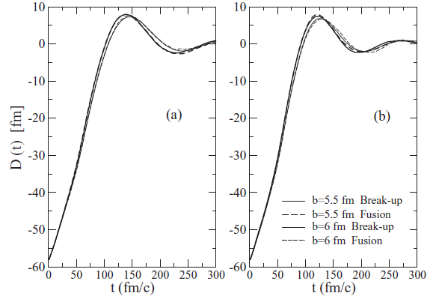
Dipole Emission in Fusion
C. Rizzo et al., PRC 83, 014604 (2011)
Collective dipole bremsstrahlung radiation
(Relative position of CM’s for n and p)
Photon emission probability with $E_{γ}=ℏω$
Asy-
stiff
Asy-
soft
The dipole strength distributions are similar in fusion and breakup

Slide 11
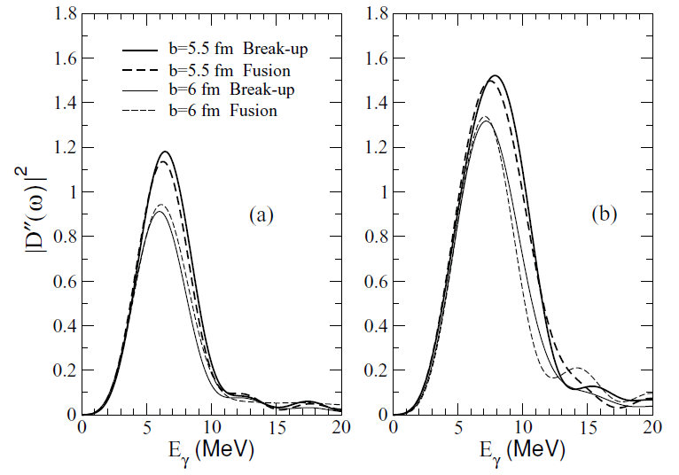
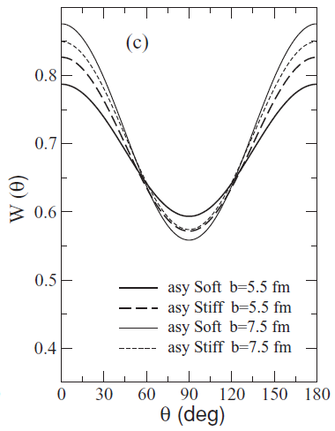
Dipole Emission in Fusion
¹³²Sn+⁵⁸Ni @ 10 AMeV
C. Rizzo et al., PRC 83, 014604 (2011)
Asy-
stiff
Asy-
soft
More γ emission for Asy-soft
Fusion $≈$ Breakup
Stronger angular dependence for Asy-soft
Larger $E_{sym}$ at $ρ< ρ_{0}$ emits γ early with stronger θ asymmetry

Slide 12
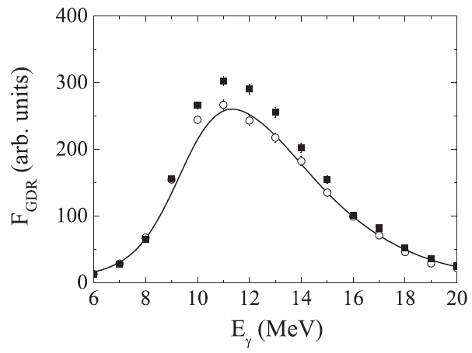
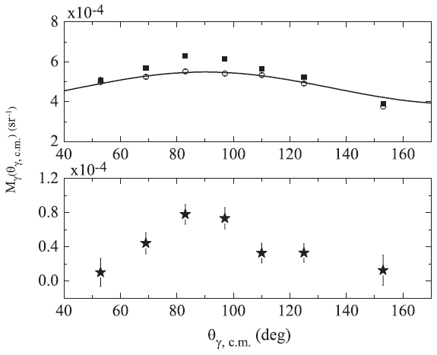
Dipole Emission in Fusion
D. Pierroutsakou et al., PRC 80, 024612 (2009)
Solid symbols: Charge asymmetric ³⁶Ar+⁹⁶Zr @ 16 AMeV
Open symbols: Charge symmetric ⁴⁰Ar+⁹²Zr @ 15 AMeV
Solid lines: CASCADE calculations
10 $≤ E_{γ} ≤$ 14 MeV
Approaching phase: Two nuclei overcome Coulomb barrier
Dinuclear phase: Conversion of relative motion energy in thermal motion
Pre-equilibrium collective dipole radiation emission
Thermally equilibrated compound nucleus with statistical emission

Slide 13
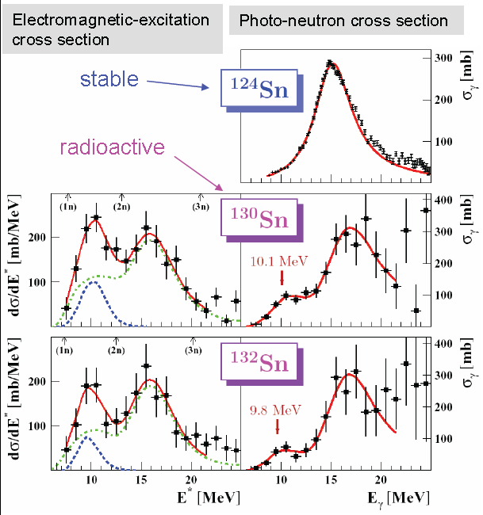
Dipole Response of n-Rich Nuclei
^{124,130,132}Sn+²⁰⁸Pb @ 500 AMeV
Coulomb excitation of neutron-rich ^{130,132}Sn isotopes reveals a peak at ~10 MeV, which is absent for stable isotopes.
P. Adrich et al.,
PRL 95, 132501
(2005)

Slide 14
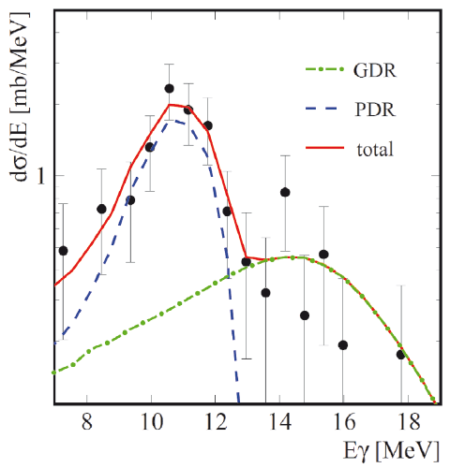
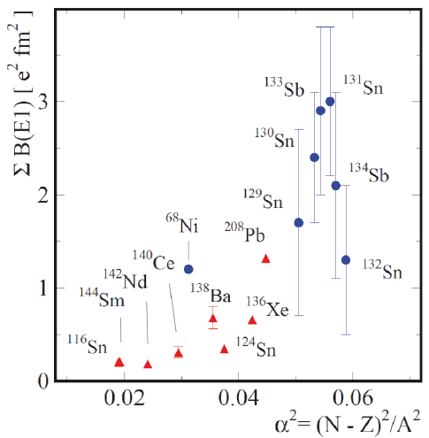
Dipole Response of n-Rich Nuclei
O. Wieland et al., PRL 102, 092502 (2009)
A. Klimkiewicz et al. (LAND),
PRC 76, 051603 (2007)
⁶⁸Ni+Au @ 600 AMeV
Radioactive nuclei: Virtual photon absorption followed by neutron emission or by gamma decay
The strength increases with the isospin asymmetry

Slide 15
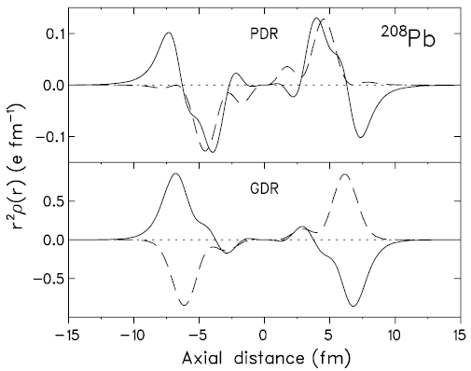
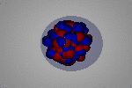
Dipole Response of n-Rich Nuclei
N. Ryezayeva et al., PRL 89, 272502 (2002)
Microscopic quasiparticle phonon model
Interior: n & p move in phase (IS)
Surface: only neutrons contribute
Solid: n
n-p oscillates out of phase (IV)
Dashed: p
Pygmy dipole resonance (PDR) can be interpreted as an oscillation of a n-skin relative to the core

Slide 16
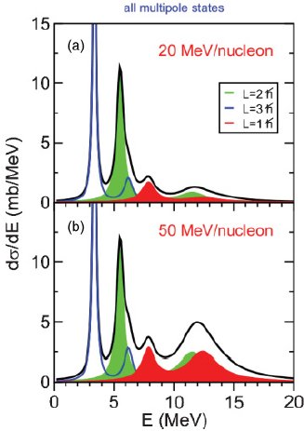
Dipole Response of n-Rich Nuclei
¹⁷O+²⁰⁸Pb
E.G. Lanza et al., PRC 84, 064602 (2011)
HF+RPA with Skyrme interaction
PDR is expected to be excited already @ 20 AMeV of beam energy
Nuclear part: No dependence on $E_{beam}$
AGATA at LNL is studying the excitation of ²⁰⁸Pb via inelastic (¹⁷O,¹⁷O’γ)

Slide 17
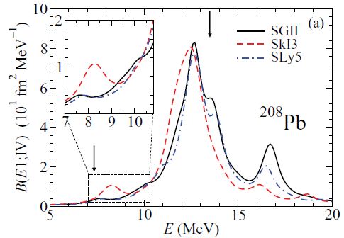
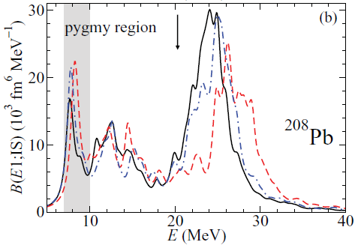
Dipole Response of n-Rich Nuclei
X. Roca-Maza et al., PRC 85, 024601 (2012)
HF+RPA with various Skyrme potentials
$L$ = SGII (38 MeV) < SLy5 (48 MeV) < SkI3 (100 MeV)
Isovector dipole response
Isoscalar dipole response
PDR is sensitive to Asy-EOS: A larger L gives a larger strength

Slide 18
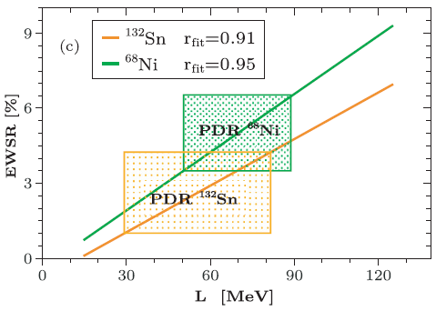
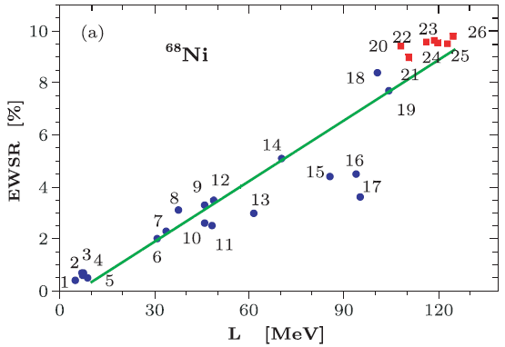
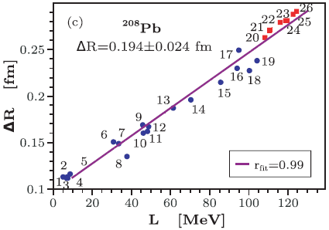
Characteristics of PDR
Carbone et al., PRC 81, 041301 (2010)
Red = RMF
Blue = Skyrme
$L=64.8±15.7$ MeV
$$ΔR\sim Lδ$$

Slide 19
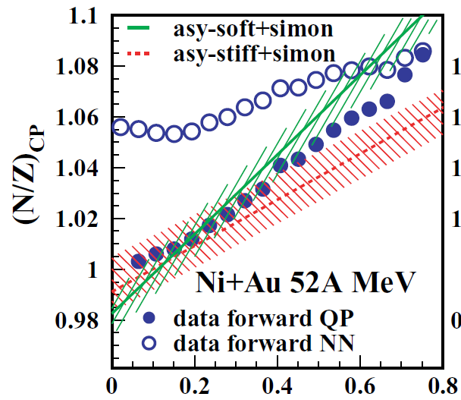
Charge Equilibration
Charge equilibration
In fusion, dipole oscillation is important
In deep inelastic coll., dipole oscillation is overdamped: Diffusion of charges
Degree of equilibration governed by contact time and symmetry energy
Observable: $N/Z$ of light charged particles emitted by PLF as a function of dissipated energy: ${(N/Z)}_{CP}$ vs. $E_{diss}≡E_{cm}−E_{kin}(PLF+TLF)$
E. Galichet et al.,
PRC 79, 064615 (2009)
$$E_{diss}/E_{cm}$$

Slide 20
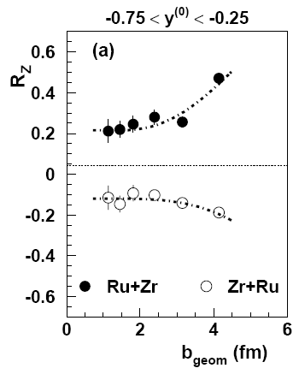
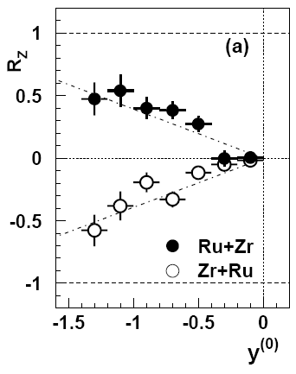
Isospin Mixing/Diffusion
No isospin mixing between symmetric systems
400A MeV
⁹⁶Ru+⁹⁶Zr
R_{X} (X=p)
R_{X} = 0 for complete mixing
A
High-energy applications:
F. Rami et al., PRL 84, 1120 (2000)
B. Hong et al., PRC 66, 034901 (2002)
B
A
R_{X} = -1
A
B
Try any observable $X$ related to $N/Z$ of PLF (or TLF) for isospin migration to neck at LE
B
R_{X} = +1

Slide 21
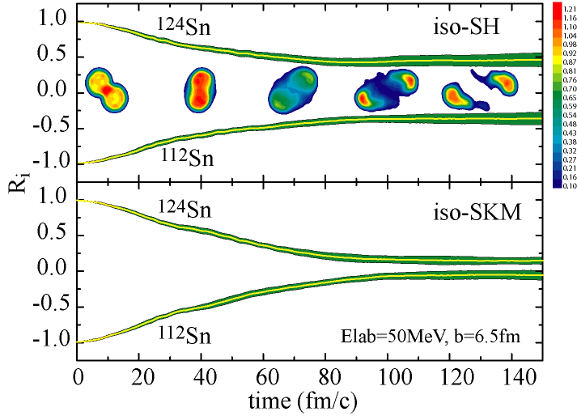
Isospin Mixing/Diffusion
¹²⁴Sn+¹¹²Sn @ 50 MeV/u
stiff
M.B. Tsang et al., PRL 92, 062701 (2004)
$α$=Neutron-isoscaling parameter
soft
Stochastic Mean Field (SMF) Model
J. Rizzo et al., NPA 806, 79 (2008)
$R_{X}$ with $X={(N/Z)}_{PLF}$
stiff
$R_{X}$ with $X=α$
soft
Softer symmetry energy towards equilibrium (R_{X} →0)
Good sensitivity to Asy-EOS

Slide 22
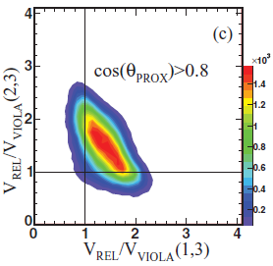
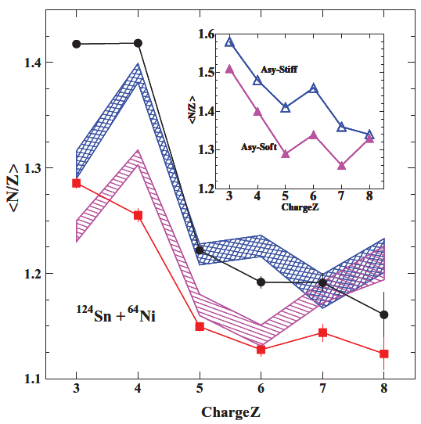
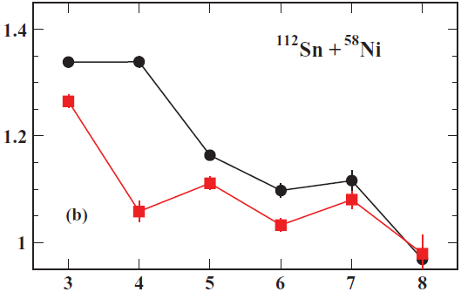
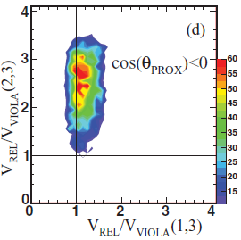
Isospin Migration/Neck Fragmentation
Dynamically emitted IMFs (Z=3~18) from neck in early stage
E. De Filippo et al., PRC 86, 014610 (2012)
Sn+Ni @ 35A MeV (SMF+GEMINI)
CHIMERA
Primaries before GEMINI
The even-odd effect weaker in n-rich system.
Asy-stiff
$$(v_{∥}^{TLF}−v_{∥}^{IMF})/v_{Rel}^{Coul}$$
Asy-soft
Midrapidity
$${\left\langle N/Z\right\rangle }_{IMF}$$
¹¹²Sn+⁵⁸Ni
n-poor
$$(v_{∥}^{PLF}−v_{∥}^{IMF})/v_{Rel}^{Coul}$$
Statistically emitted IMFs (Z=3~18) from PLF in later stage
¹²⁴Sn+⁶⁴Ni
n-rich
$$Z_{IMF}$$
$$Z_{IMF}$$
$$(v_{∥}^{TLF}−v_{∥}^{IMF})/v_{Rel}^{Coul}$$
Isospin diffusion and isospin drift can compete to characterize the midrapidity and projectile residue emission.
Large $v_{∥}^{cm}$
$$(v_{∥}^{PLF}−v_{∥}^{IMF})/v_{Rel}^{Coul}$$

Slide 23
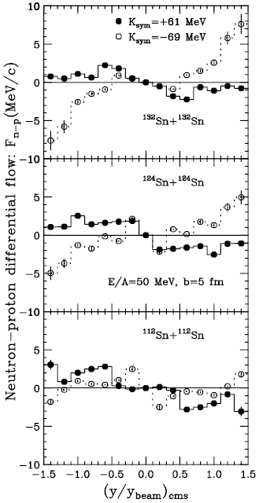
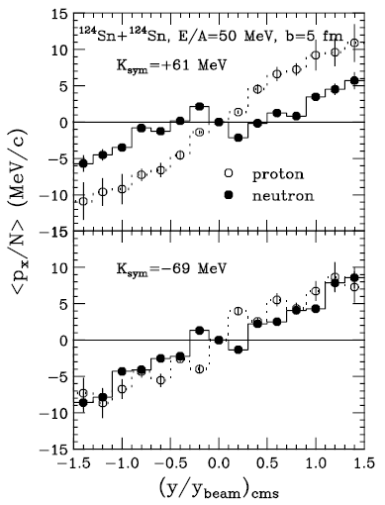
Directed Flow
Large
N/Z
B.-A. Li,
PRL 85, 4221
(2000)
Asy-stiff
Also known as v₁
Asy-soft
Small
N/Z

Slide 24
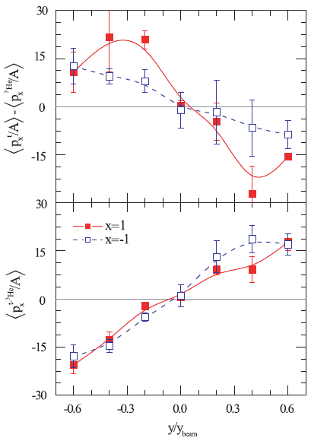
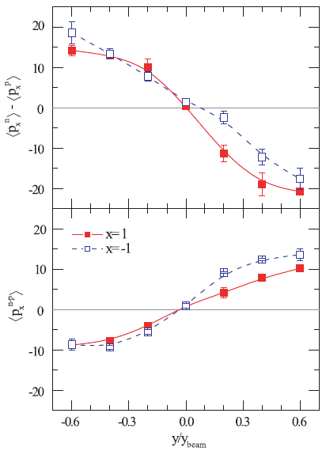
Directed Flow
Relative flow:
t-³He differential flow:
¹³²Sn+¹²⁴Sn @ 400A MeV
$x=1$: Asy-Supersoft
$x=−1$: Asy-Stiff
Larger A ⇒ larger sensitivity to Asy-EOS
G.-C. Yong et al.,
PRC 80, 044608
(2009)

Slide 25
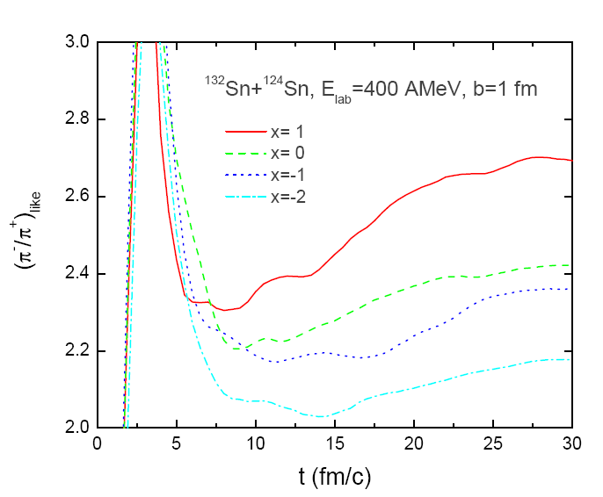
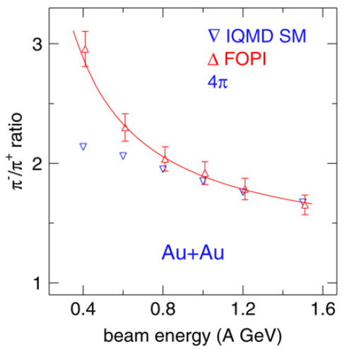
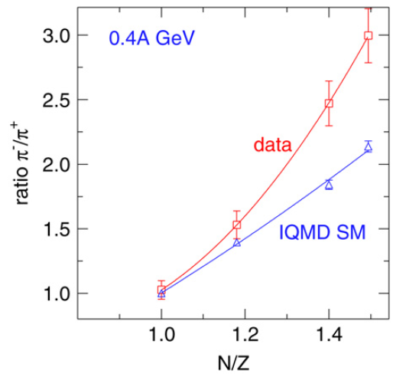
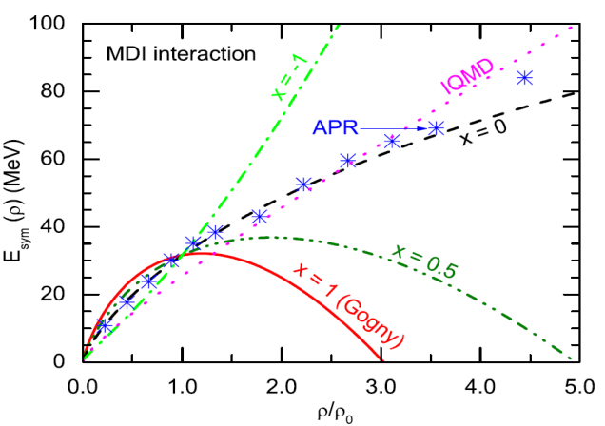
π⁻/π⁺ Ratio
Data: FOPI, NPA 781, 459 (2007)
IQMD: EPJA 1, 151 (1998)
Symmetry energy softer than the present IQMD makes the pion production region more neutron-rich!

Slide 26
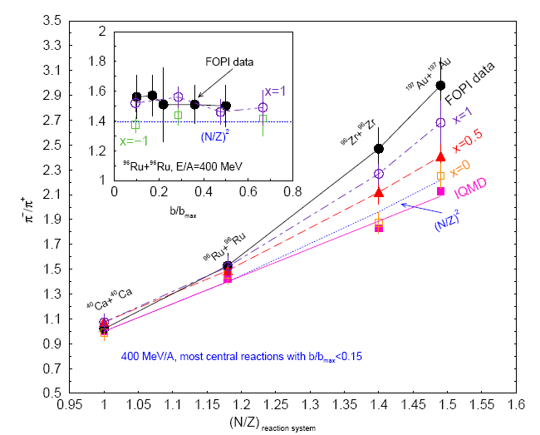
π⁻/π⁺ Ratio
Asy_soft
Future
RI beam experiments, e.g., RAON, RIBF, FRIB, etc.
π⁻/π⁺
Asy_stiff
$${\left(N/Z\right)}_{reaction system}$$

Slide 27
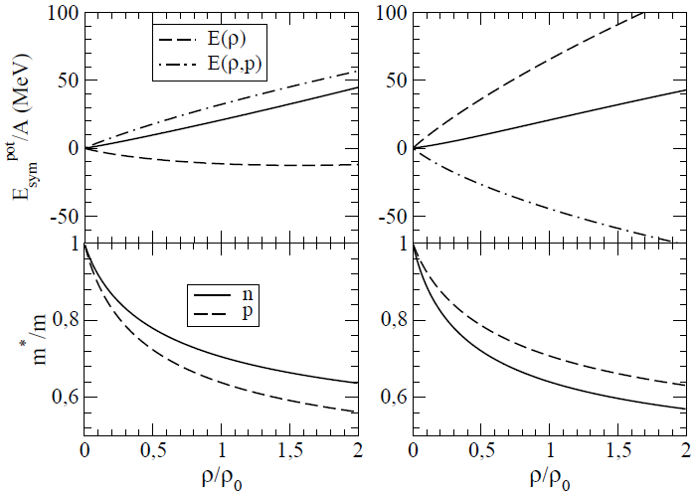
Effective n/p Mass Splitting
V. Giordano et al., PRC 81, 044611 (2010)
Isospin effect on the momentum dependence of the symmetry potential: Different n/p effective masses in asymmetric matter
Asy-EOS: stiff (L = 95 MeV), Asymmetry $β=\frac{N−Z}{A}=0.2$ for ¹⁹⁷Au
$$m_{n}^{∗}>m_{p}^{∗}$$
$$m_{p}^{∗}>m_{n}^{∗}$$
Dashed line, $E(ρ)$: density dependent contribution
Dash-dotted line, $E(ρ,p)$: momentum-dependent contribution
Solid line: sum
Solid line: neutron
Dashed line: proton

Slide 28
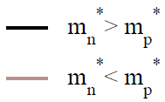
Effective n/p Mass Splitting
V. Giordano et al., PRC 81, 044611 (2010)
Asy-soft (L=19 MeV)
Asy-stiff (L=95 MeV)
Au+Au
n/p
n/p
400A MeV
Midrapidity
p_{T}/p_{proj}
p_{T}/p_{proj}
Integrated over rapidity
E/A (MeV)
E/A (MeV)
The effective-mass effect can be larger than the Asy-EOS effect.

Slide 29
Physics Program of LAMPS
Nuclear collisions with rare-isotope beams
Create nuclear matter with several ($ρ, T, N/Z$)
Exploring the phase diagram & phase transition of strongly interacting matter
Nuclear equation of state (EOS) and its symmetry energy term below and above the saturation density
Nuclear effective interaction
Important to the astrophysical context
Neutron stars & supernova explosion

Slide 30
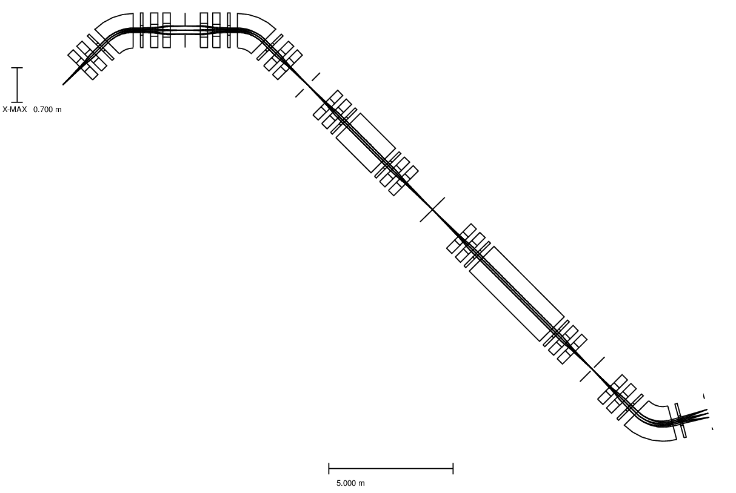
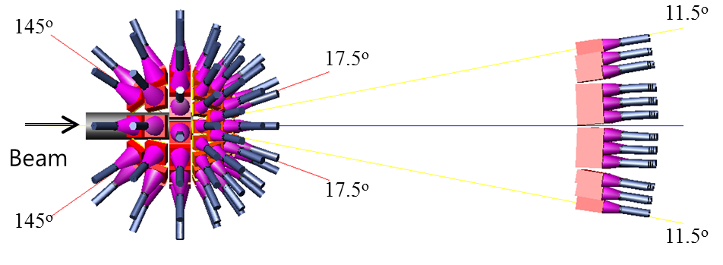
KOBRA
D2
Stage 1
D1
Korea Broad Acceptance Recoil Spectrometer and Apparatus at low-energy experimental area with beams up to 18.5 MeV/u
F1
F0
F2
RI production target at F0
W1
F3
Stage 2
Low-energy LAMPS (LAMPS-L)
at either F3 or independent beamline
W2
Focal plane
detection system
at F5
F4
D3
F5
Si-CsI
Neutron array

Slide 31
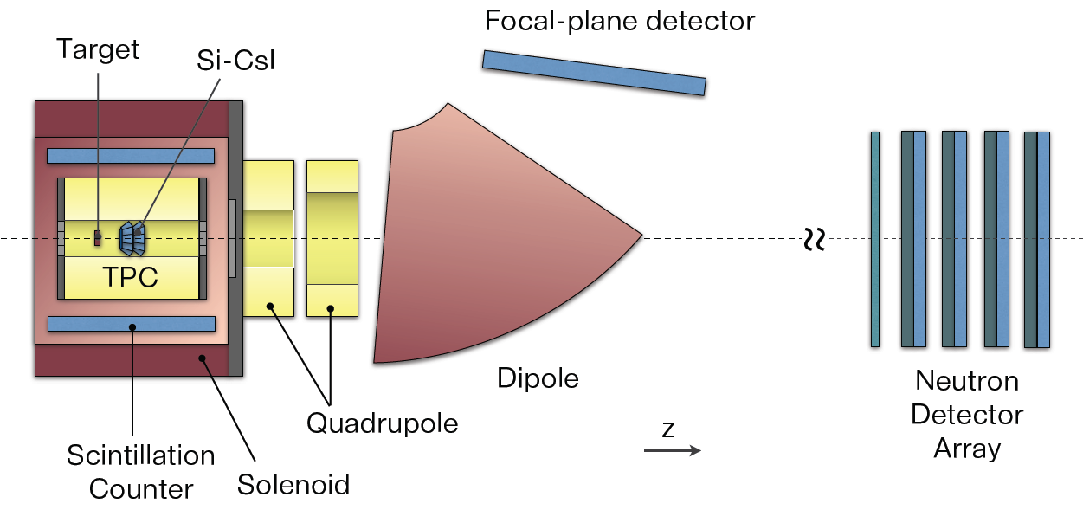
High-Energy LAMPS
Dipole spectrometer is deferred to phase II because of the budget problem.
For the various Coulomb breakup experiments
Gamma Array

Slide 32
Physics Topics to be Covered
For the nuclear symmetry energy
Low-energy LAMPS
Fusion reaction cross section
N/Z of IMF & PLF (charge equilibration)
Isospin mixing/neck fragmentation
Dipole emission
Yield & the polar angle dependence
High-energy LAMPS
Ratio of mirror nuclei
Isospin diffusion
Collective flow
Pion production
Dipole emission with E*
Dipole emission with E_{γ} (Require the gamma array)

Slide 33
Responsibility
Element |  | Participating Institutes | Status & Comments
Magnet |  | IBS | Prototyping
TPC | Hardware+Electronics | Korea U., IBS | Prototyping
 | Software | Korea U., Inha U. | Under the development (SAMURAI TPC)
Neutron Array & Barrel Plastic Detector |  | Korea U., Chonbuk Nat. U. | Prototyping
Si-CsI |  | Kyungpook Nat. U., IBS | Designing
Dipole Spectrometer |  | IBS, Korea U. | Designing

Slide 34
Plan for Today’s Presentations
Subject | Speaker | Comments
Overview | Byungsik Hong (Korea U.)
Schedule & Budget | Taeksu Shin (IBS)
Si-CsI | Young-Jin Kim (IBS) | Low-energy setup included
Dipole Spectrometer | Songkyo Lee (Korea U.) | Optics calculations
Solenoid Magnet | Young-Jin Kim (IBS)
Neutron Array & Barrel Scintillation detector | Kyong Sei Lee (Korea U.)
TPC I | Hyo Sang Lee (IBS) | Prototyping
TPC II | Minjung Kweon (Inha U.) | Software

Slide 35
Summary
Heavy-ion reactions
Create nuclear matter with several ($ρ, T, N/Z$)
Exploring the phase diagram of strongly interacting matter
Nuclear equation of state (EOS) and its symmetry energy term below and above the saturation density
Nuclear effective interaction
Experimental plan
Low-energy and high-energy LAMPS setups to be constructed.
Lots of simulations, optimizations, and prototyping activities are going on.

Slide 36
Participants
Institute | Members
RISP/IBS | D. G. Kim, Y. H. Kim, Young-Jin Kim, Y. J. Kim, Y. K. Kim, H. S. Lee, Taeksu Shin, C. C. Yun
Korea University | J. K. Ahn, Y. Go, Byungsik Hong, G. Jhang, E. Joo, B. Kim, M. Kim, S. H. Kim, J. W. Lee, K. Lee, K. S. Lee, S. H. Lee, S. K. Lee, I. Lugendo, B. Mulilo, J. Park, H. Shim, J. Yoo
Chonbuk National University | Eunjoo Kim, H. H. Kim
Inha University | Minjung Kweon, J. H. Park
Kyungpook National University | H. Park, Post doc, Grad. Students
Current Working Group: 5 Korean Institutes, ~30 collaborators
Plan to form an international collaboration in the future

