Slide 1
Plastic Scintillators for Neutron and Charge Particle Detections for LAMPS Experiments at RAON
J. Ahn⁴, B. Hong¹, E. Joo¹, E. Kim³, H. Kim³, Y. J. Kim², Y. K. Kim², Y. J. Ko¹, K. S. Lee¹, J. W. Lee¹, H. Lee⁴, K. S. Lee¹, S. Lee¹, B. Mulilo¹, T. S. Shin²
¹Korea University, Seoul, Korea
²Institute for Basic Science, Daejeon, Korea ³Chonbuk National University, Jeonju, Korea
⁴Pusan National University, Busan, Korea
Contents
Introductions: LAMPS at RAON
Neutron detectors for high-energy experiments
Neutron detectors for low-energy experiments
TOF detectors in LAMPS solenoid spectrometer
Digitization electronics for neutron and TOF detectors
Summary & milestones

Slide 2
1. Introductions: LAMPS at RAON
Large Acceptance Multi-Purpose Spectrometer to maximize the use of nuclear physics researches for neutron-rich nuclei
Main purpose for Symmetry-Energy research
Understanding astronomical phenomena in neutron stars, black holes, and super novae by the EOS of nuclear matter at high density
Pygmy Dipole & Giant Dipole Resonances
Neutron halos and exotic nuclei lying near neutron drip lines
2. Conceptual designs of LAMPS
High-energy experiment (250 AMeV)
Solenoid spectrometer equipped with a 3π-Sr TPC
Dipole spectrometer with a focal plane detector system
Large acceptance of neutron detectors via TOF measurement
Low-energy experiment (< 20 AMeV)
Vacuum system equipped with Si-CsI detectors
Large acceptance of neutron detectors via TOF measurement

Slide 3
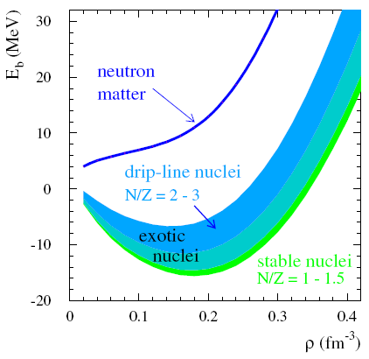
Nuclear Equation of State
δ: asymmetry in p & n
B.-A. Li, L.-W. Chen &
C.M. Ko, Physics Report,
464, 113 (2008)
18
E/A (MeV)
Symmetric
nuclear matter
(ρ_{n}=ρ_{p})
CDR, FAIR (2001)
Isospin
asymmetry
0
ρ
Nucleon
density
δ
F. de Jong & H. Lenske, RPC 57, 3099 (1998)
F. Hofman, C.M. Keil & H. Lenske, PRC 64, 034314 (2001)
ρ (fm⁻³)

Slide 4
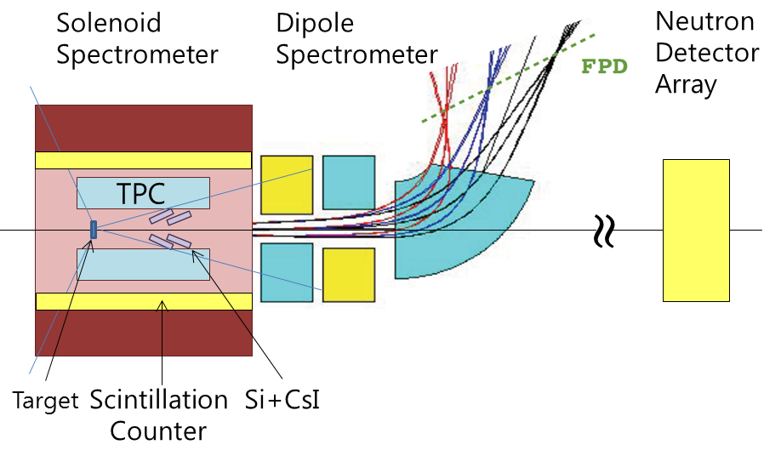
LAMPS: design for high-energy experiment
Solenoid spectrometer
Solenoid magnet (0.6 ~ 1.5 T)
TPC (∆P/P ~ 10⁻²)
Si-CsI array (∆E/E ~ 10⁻²)
Plastic barrel detectors for trigger
Dipole spectrometer
Quadruple-Dipole magnets
(QD or QQD) for focal plane (∆P/P ~ 4 x 10⁻⁴)
Drift chambers
TOF wall
Neutron detector array
Acceptance ~ 100 mSr
∆E/E ~ 2 x 10⁻²

Slide 5
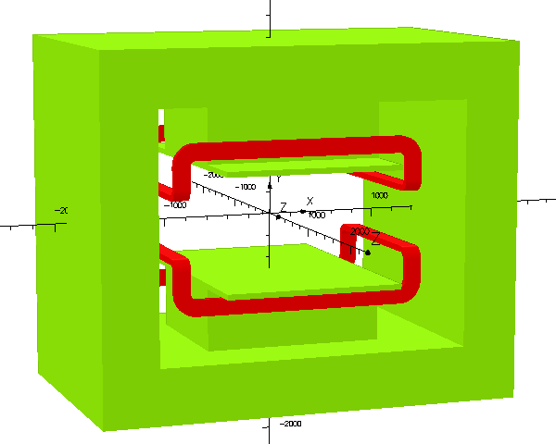
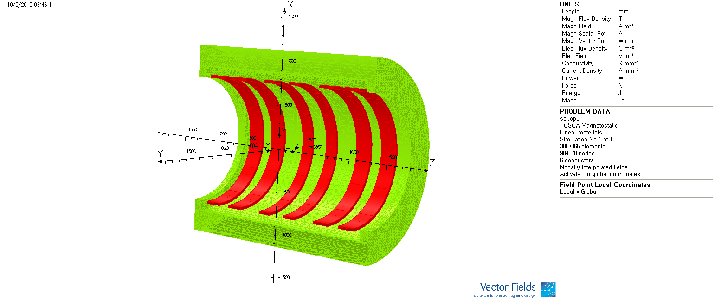
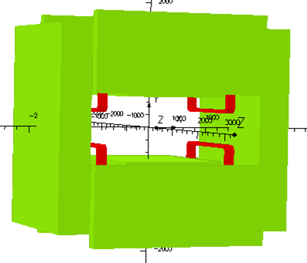
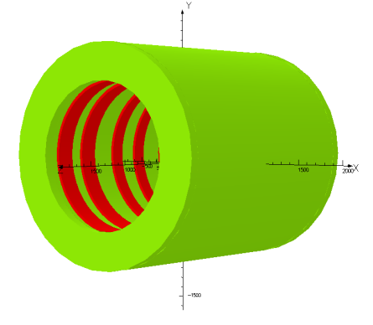
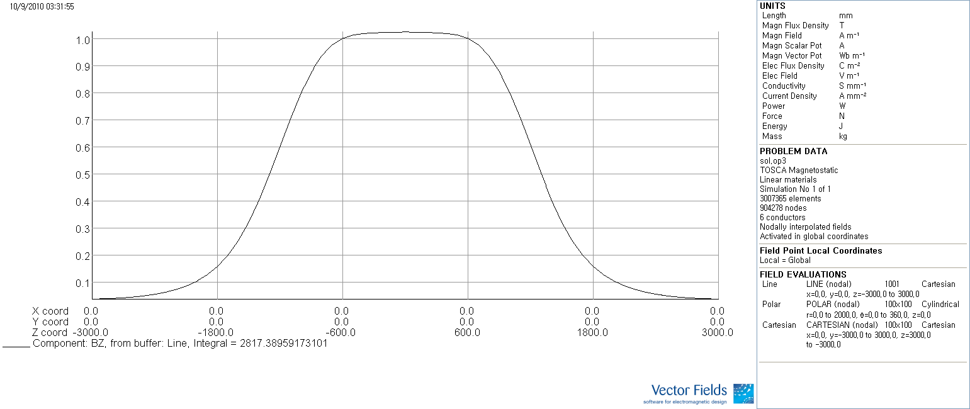
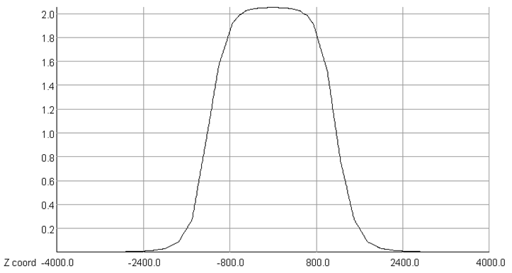
Magnets in the original designs
Simulation by S. Hwang & J. K. Ahn
H-type dipole
Pole size: (x,z)=(150 cm, 100 cm)
Maximum B_{y}: ~ 1.5 T (~ 4 T for SC option)
Gradient: 1.0 T∙m < ∫B_{y}∙dz < 2.0 T∙m
Solenoid
Size (r,z) : (50 cm, 200 cm)
Maximum B_{z}: about 1.0 T

Slide 6
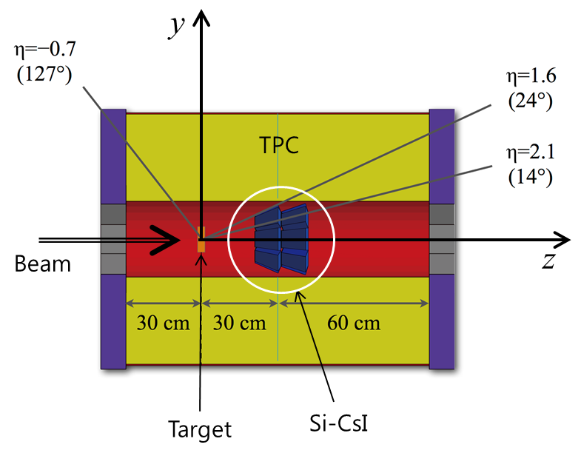
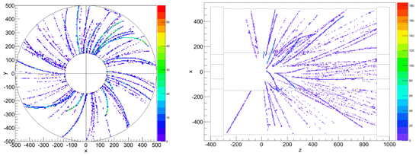
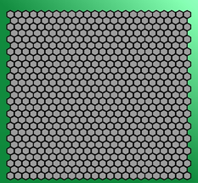
TPC
Gas: P10 or Ar +CO₂ mixture
Drift field: ~ 150 V cm⁻²
Read-out: Triple-GEM & hexagonal pads (5 mm) at both endcaps
Choice of GEMs: higher rate capability from MIPs to heavily ionizing particles
Hexagonal pads
for a prototype

Slide 7
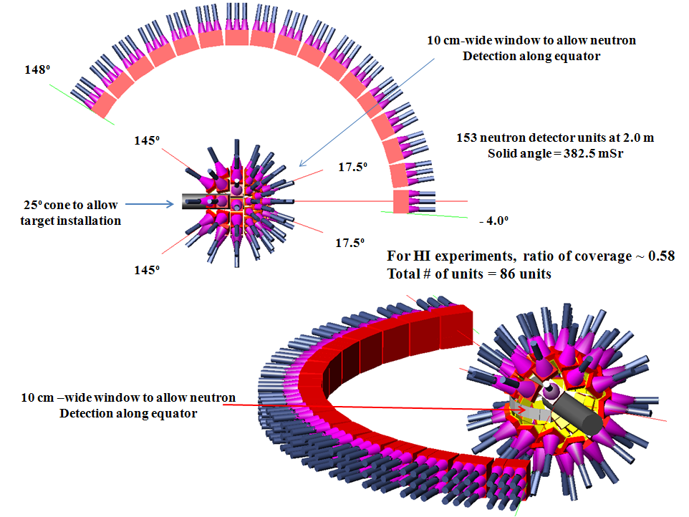
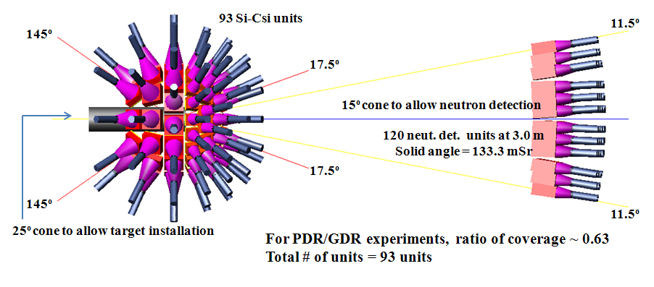
LAMPS: design for low-energy experiment
Vacuum chamber
Si-CsI array (charged particles & γ)
∆E/E ~ 10⁻²
TOF measurement for protons and heavy particles
Particle ID
Neutron detector array
Acceptance = 100 ~ 300 mSr
∆E/E ~ 5.0 x 10⁻² via TOF measurements

Slide 8
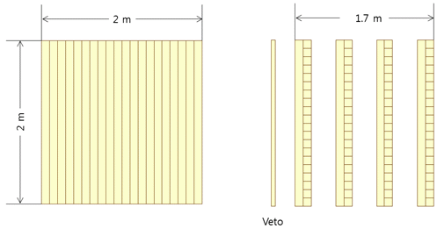
2. Neutron detectors for high-energy experiment
Proposed structure: 4 layers of plastic scintillators (2-m long)
+ 1 Veto plastic layer for charged particle rejection
Each layer composed of 40 10-cm-thick bar detector (20 of each for x and y directions)
Energy range: 30 ~ 300 MeV (10 MeV for the minimum detection)
Acceptance ~ 100 mSr when installed at 15 m from the target
∆E/E ~ 2 x 10⁻² via TOF measurements
→ Required σ for 100 MeV neutrons ~ 500 ps
ε = 0.60 for single-neutron detection (100 MeV) (GEANT4)

Slide 9
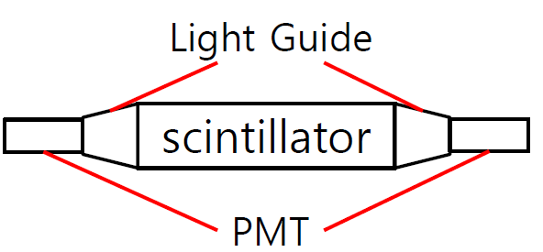
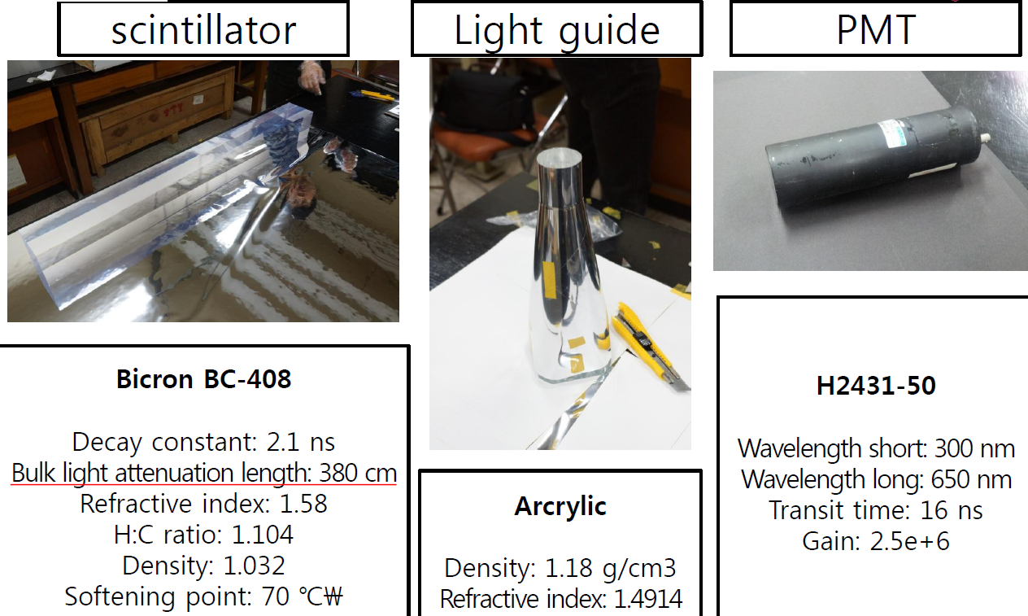
Single detector module for high-energy experiment
n-p elastic scattering
n-¹²C elastic scattering
n+p → d+γ (neutron capture, E_{γ} = 2.23 MeV)
n+¹²C → ¹³C+γ (neutron capture, E_{γ} = 1.2, 3.6, 4.9 MeV)

Slide 10
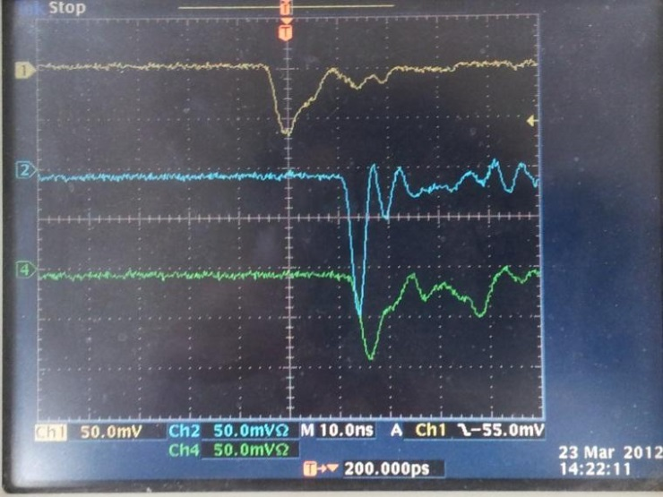
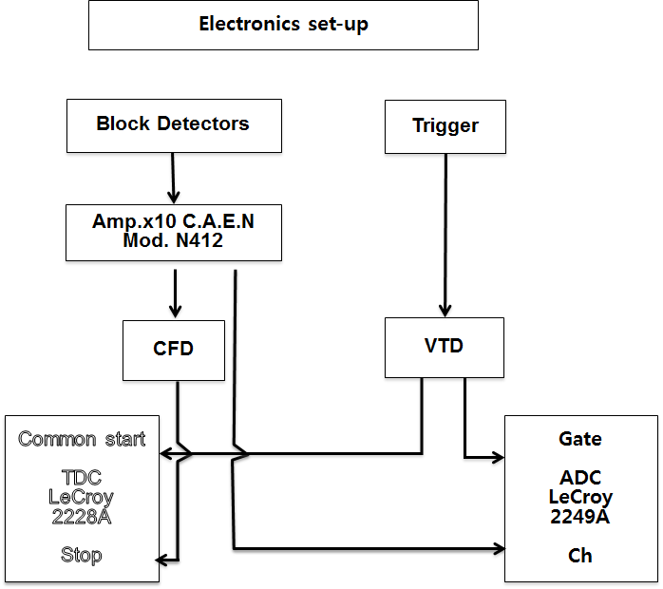

1-m long neutron detector (2012-2013): Test results with ⁶⁰Co & ²⁵²Cf sources
Time-Of-Flight for γ and n
TOF distance = 1.0 m
Used LeCroy 2228 TDC & 2249 ADC
5-cm thick 5-cm diameter disk-shape plastic scintillator for event triggers
Maximum TOF to measure = 50 ns
3.78 n per fission decay and γ’s from gamma transitions
Event triggers
Trigger detector Neutron detector
γ γ
n γ
γ n
n n

Slide 11
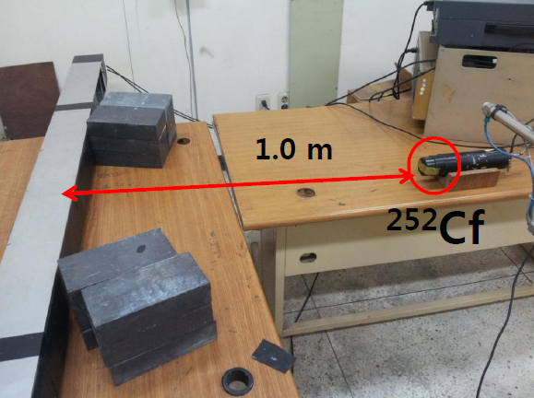
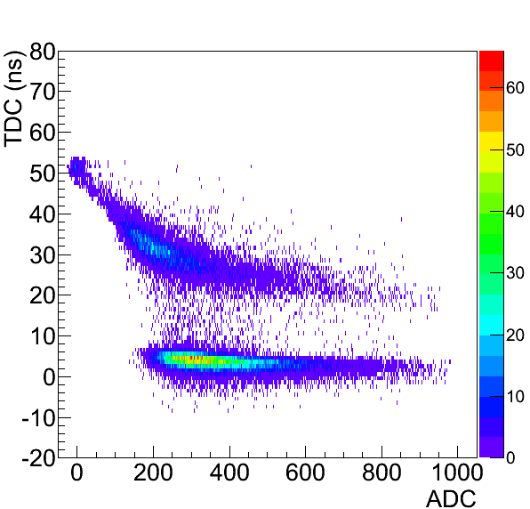
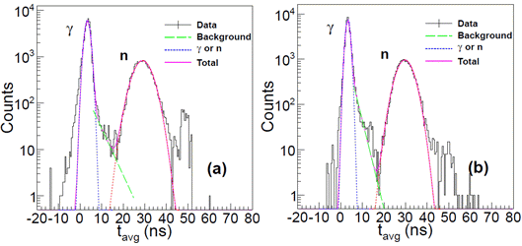
TOF measurement for fission neutrons and gammas from ²⁵² Cf
t_{L}
t_{R}
From Left PMT
From Right PMT

Slide 12
Electronic setup
Maximum/Minimum times to measure (LeCroy 2228) for ²⁵²Cf neutrons: 20 ns/50 ns
Charge range measured by ADC (LeCroy 2249) = 100 fC ~ 25.6 pC
Digitization threshold for neutrons & gammas
Voltage-threshold discriminator (140 mV)
Constant-fraction discriminator (35 mV/ns, 4 ns sampling for trigger)
TOF of a neutron event = mean arrival time
(t_{L} + t_{R})/ 2
→ t₀ for time calibration by using the mean arrival time of gammas
→ Neutron energy
Position of the signal obtained from
∆t = t_{L} - t_{R}
→ Hit positions of neutrons along the bar detector

Slide 13
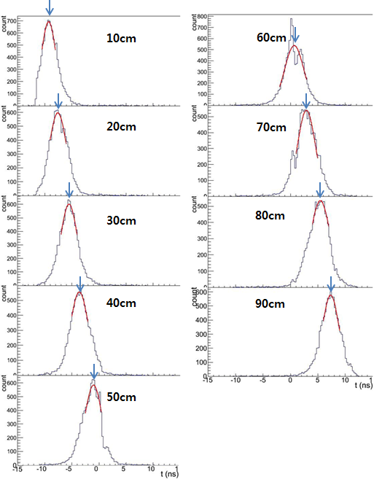
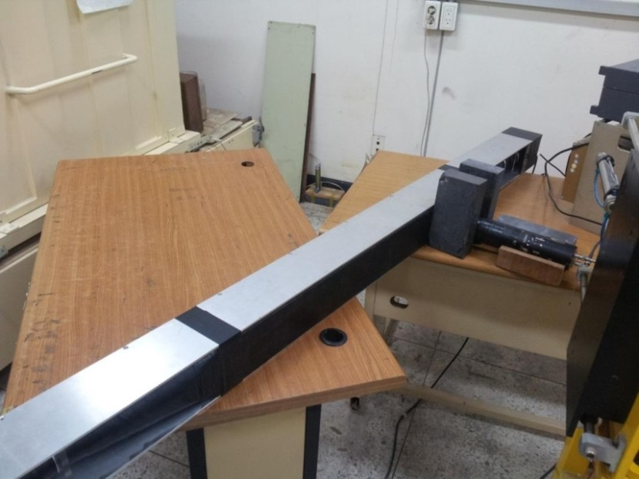
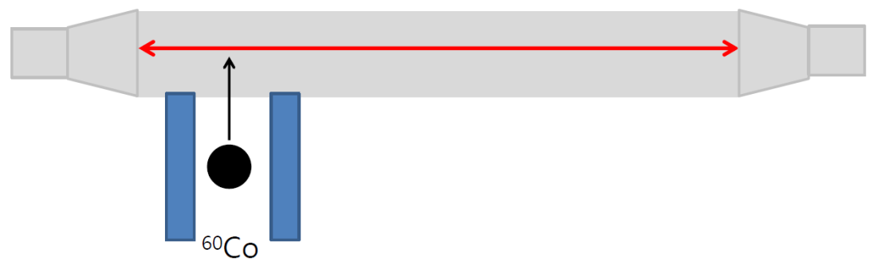
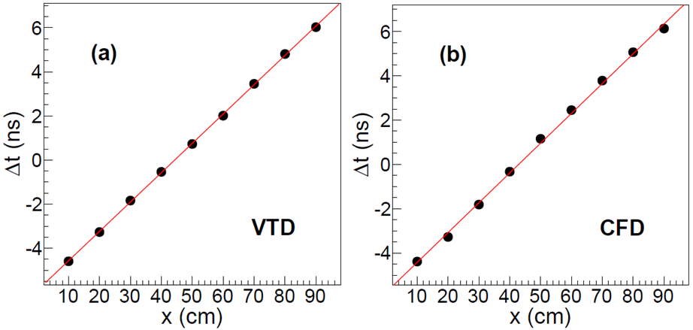
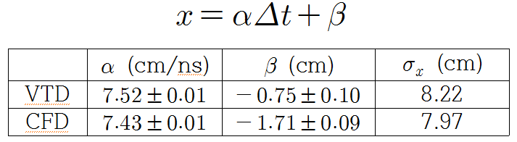
Position resolution using a ⁶⁰Co source
∆t = t_{L} - t_{R}

Slide 14
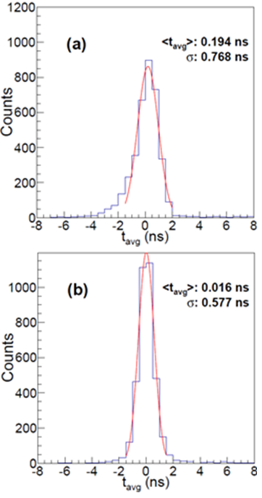
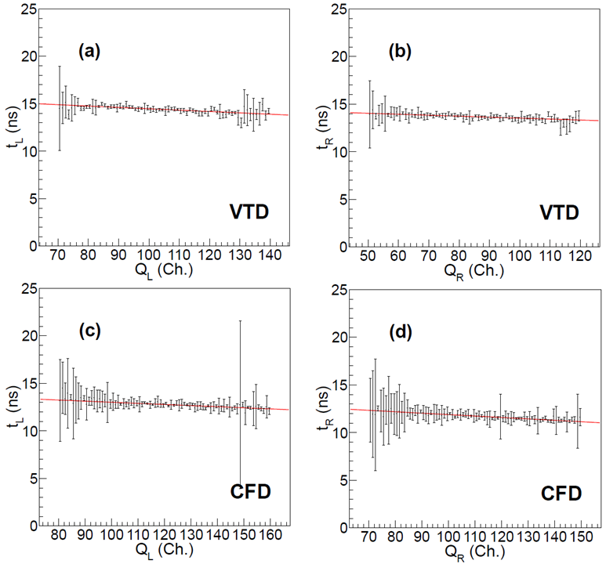
Intrinsic time resolution measured using a ⁶⁰Co source
Accuracy of measuring (t_{L} + t_{R})/ 2
Time-walk correction for signals

Slide 15
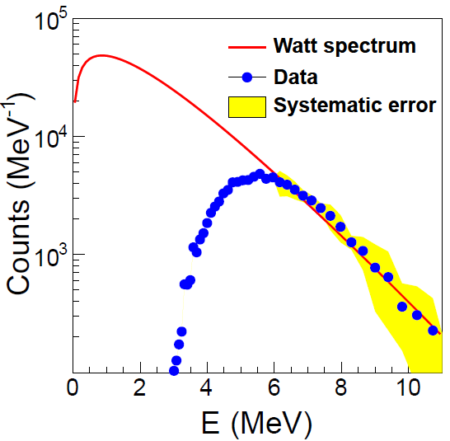
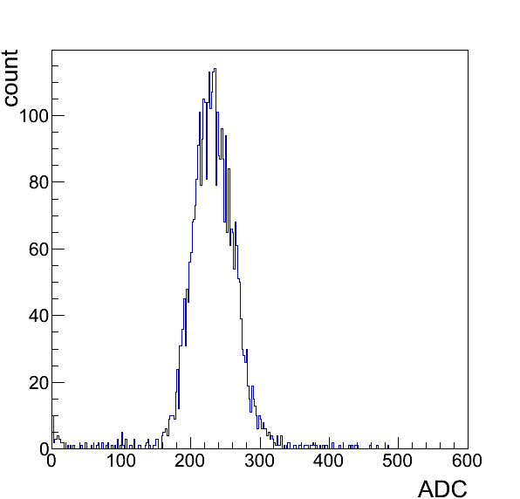
Testing a 1-m bar unit detector for high-energy experiments
Time resolution < 600 ps
Position resolution ~ 8.0 cm
Electron-equivalent energy with 50% efficiency ~ 700 keV
Neutron energy with 50% efficiency ~ 5 MeV
Compton edge for 1.17 & 1.33 MeV γ’s from ⁶⁰Co ~ 1.0 MeV
700 keV
ε ~ 50%
5 MeV
J. Kor. Phys. Soc. 58 (2011) 211
J. Kor. Phys. Soc. 62 (2013) 1227

Slide 16
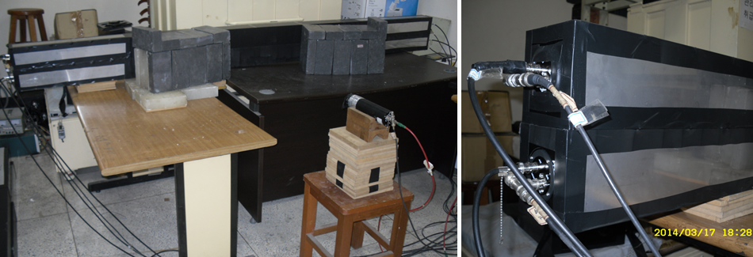
Testing 2-m neutron detectors with ⁶⁰Co & ²⁵²Cf sources (2014)
Manufactured 4 real-sized detector modules to check the feasibility for the proposed detector system
Detector R&D with 2 detector layers will be tested with TOF distance > 2.0 m
Neutron-hit structure
Multi-neutron events

Slide 17
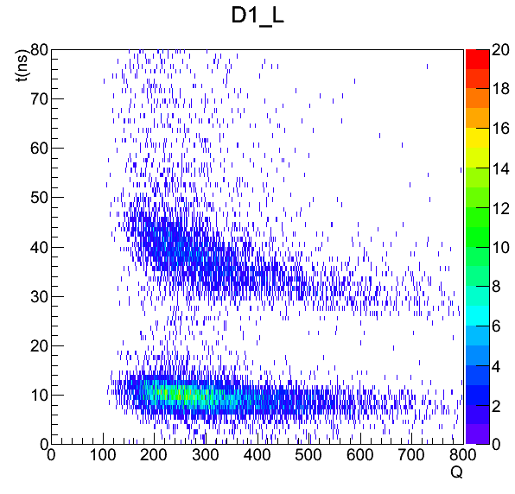
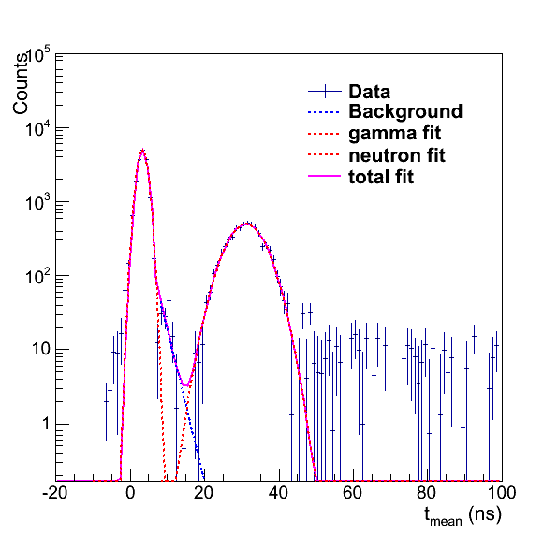
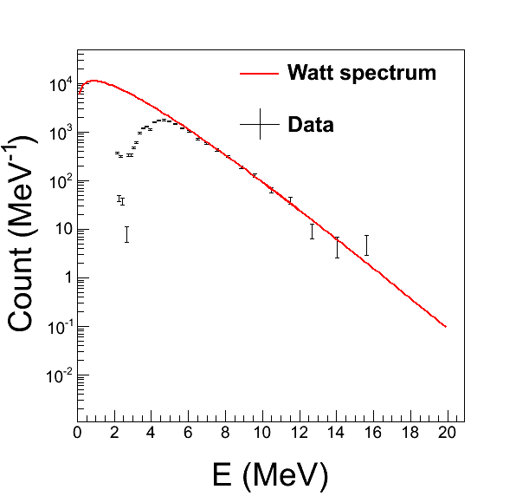
Electronic setup for preliminary tests
TOF distance = 1.0 m
Maximum/Minimum time to measure (LeCroy 2228) for ²⁵²Cf neutrons: 20 ns/50 ns
Charge range measured by ADC (LeCroy 2249) = 100 fC ~ 25.6 pC
Digitization threshold for neutrons & gammas
Voltage-threshold discriminator (180 mV)
Neutron energy with 50% efficiency ~ 4.5 MeV
The realistic time resolution should be measured with high-energy cosmic muons
Then, σ ~ 300 ps or less
n
n
Υ
Υ

Slide 18
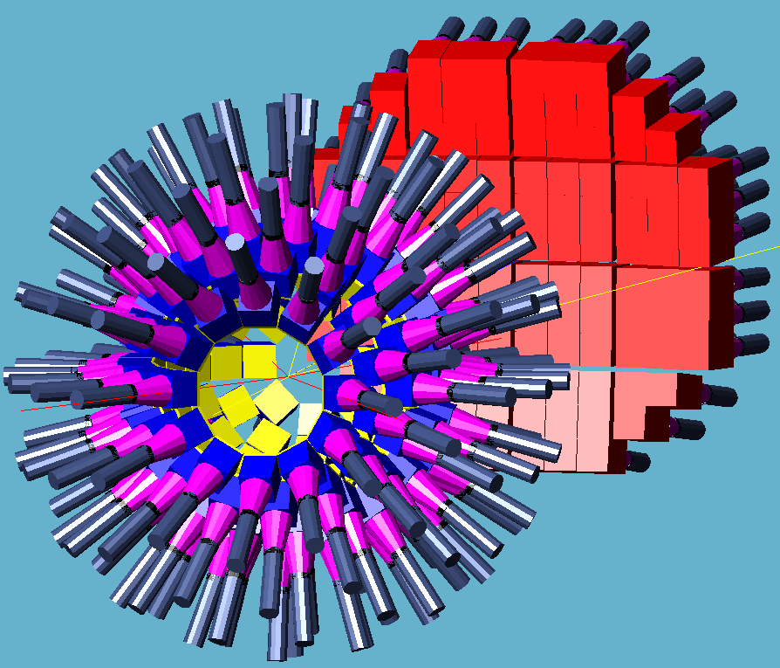
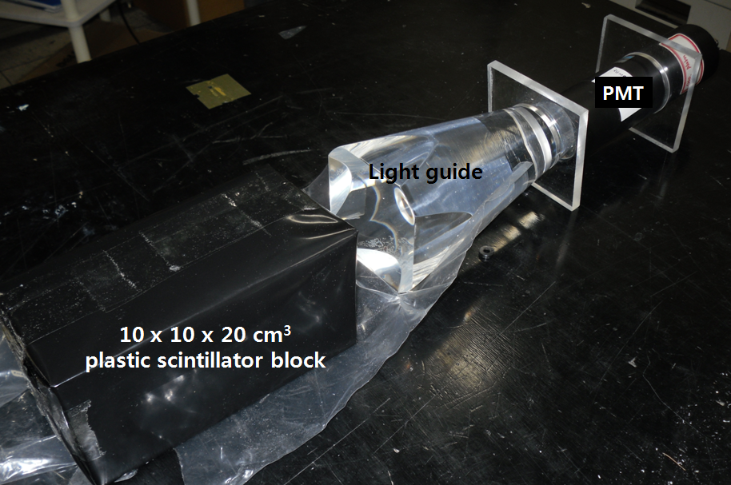
3. Neutron detectors for low-energy experiment
Neutron energy range to detect with ε > 0.7 = 2.5 ~ 30 MeV
Minimum detectable energy ~ 1 MeV with a maximum 200-ns TOF measurement
Basic structure of unit pixel detector: 3 x 3 detector modules
Single detectors: 10 x 10 x 20-cm³ plastic scintillator blocks
Neutron energies measured by a TOF method
∆E/E ~ 5.0 x 10⁻² assuming a 3-m-long TOF length
Depth-of-interaction in the 20-cm long detector → Energy resolution

Slide 19
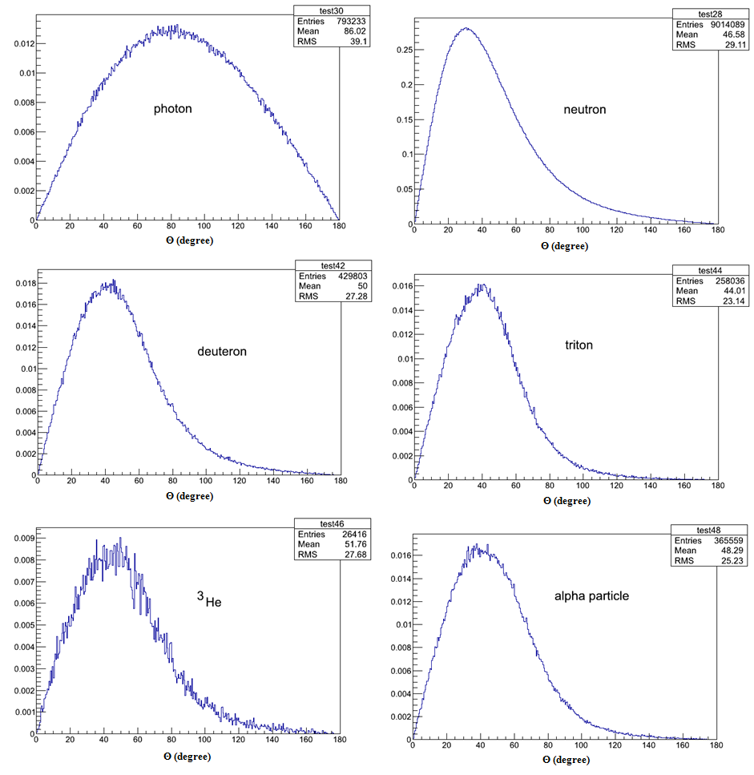
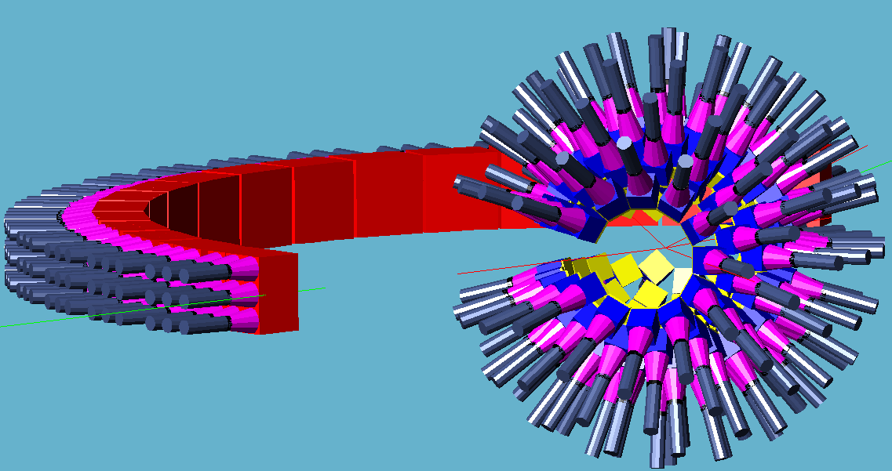
HI collision experiments for Symmetry-Energy with E_{beam} < 20 AMeV
Simulation for 18.5-AMeV ¹³²Sn+¹²⁴Sn collisions in low-energy LAMPS experiment (Y. J. Kim, IBS)
Angular Distributions for
γ, n, p, d, ³He, and ⁴He
PHITS (Particle and Heavy Ion Transport code System)

Slide 20
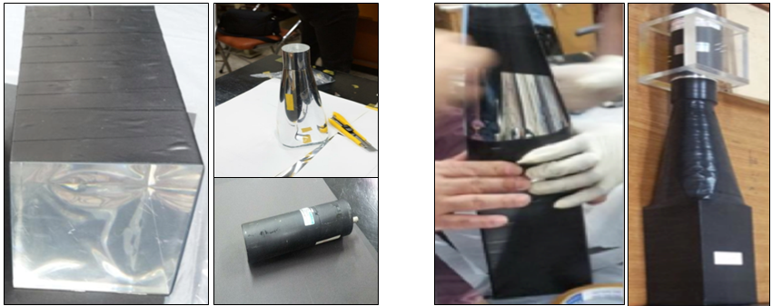
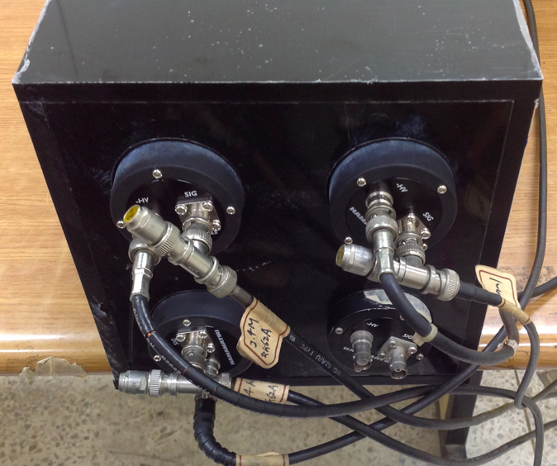
Single detectors using conical-shape light guides (3, 5, 21-cm long)
Unit detector module composed of 4-plastic scintillator blocks

Slide 21
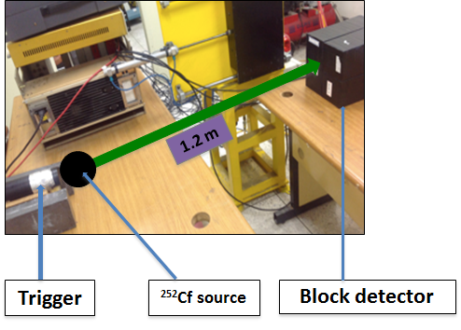
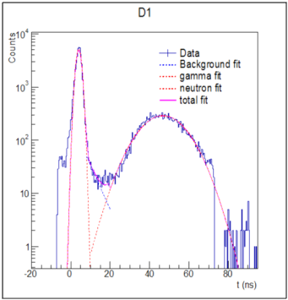
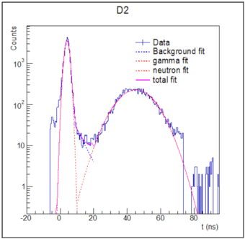
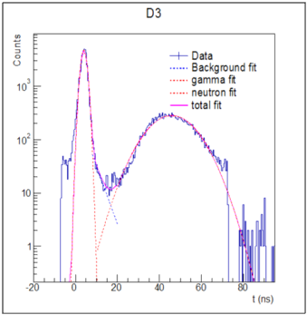
Test with a ²⁵²Cf source
Specification of electronics
Utilized LeCroy-2228 TDC & LeCroy-2249 ADC
Digitization with a CFD
(30 mV/ns, 4 ns sampling for trigger)

Slide 22
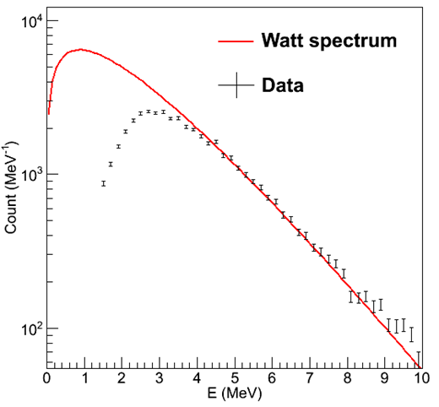
Pixel detectors for low-energy experiments
Maximum TOF set to 80 ns
→ 1.4 MeV neutrons (efficiency ~ 0.2)
Electron-equivalent energy with 50% efficiency ~ 300 keV
Neutron energy with 50% efficiency ~ 2.2 MeV
Advantage of using pixel detectors
Light-collection efficiency is higher
Expect reconstruction of neutron hits becomes easier
→ Much conducive to analyze low-energy multi-neutron events
ε ~ 50%
2.2 MeV

Slide 23
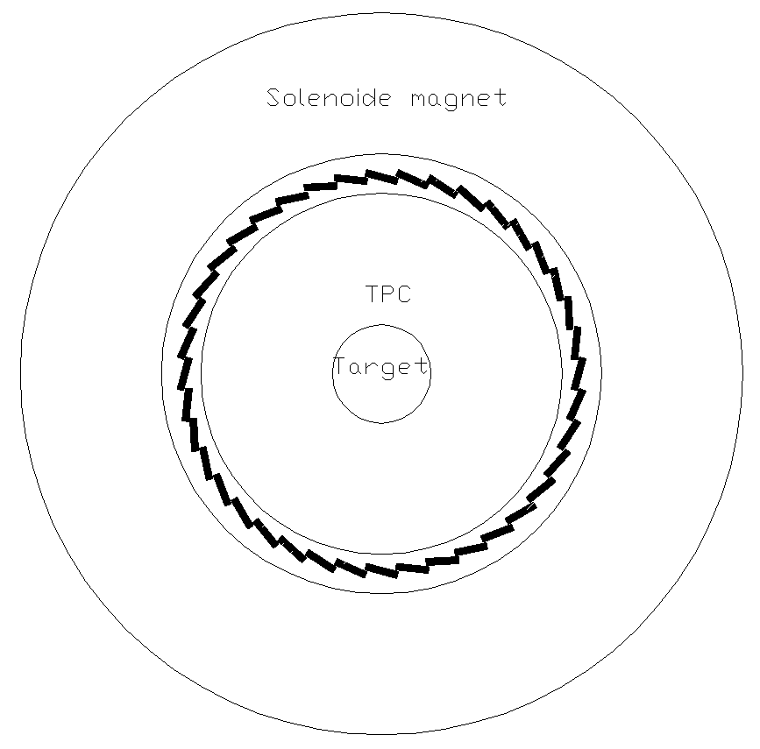
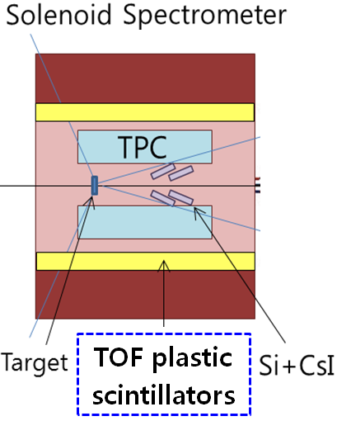
4. TOF detectors in LAMPS Solenoid Spectrometer
Plastic-scintillator array surrounding the TPC for track-matching for charged particles & nuclear fragments
~ 40 (80) modules equipped one PMT on each side
2.0-m-long, 10-(5)cm wide, and 2-cm thick
Thinner plastic bars → less sensitive to scattered neutrons

Slide 24
5. Digitization electronics for neutron & TOF detectors
Digitization electronics
Unified module for digitization (CFD) + time measurement + charge measurement
(multi-hit TDC+FADC)
16-channel module with Lemo inputs
Single slot 9u VME type
Bandwidth = 500 MHz
Best time resolution ~ 100 ps
Sensitivity of each sampling: 50 fC minimum/ 200 pC
Minimum/Maximum sampling time interval = 2 ns/50 ns
Minimum/Maximum sampling time interval = 2.5 μs/64 μs
Data bus from the experimental area to the counting bay
Data rate ~ 3.5 GBps
200 detectors for neutron
100 detectors charged particle TOF

Slide 25
6. Summary & milestones
1. R&Ds of neutron detectors for LAMPS
Conceptual designs of the neutron detectors
Systematic R&Ds for unit detectors with ⁶⁰Co & ²⁵²Cf source
So far, confirmed that the proposed designs and the performances of the unit-detector are relevant and satisfactory for Symmetry-Energy researches
2. Bar-shape neutron detectors for high-energy experiments
Detectable range of neutron energy confirmed > 5.0 MeV
Time resolution tested with low-energy radiation source ~ 600 ps
Expected ~ 300 ps for high-energy particle (can be tested with cosmic muons)
→ ∆E/E ~ 2 x 10⁻² via TOF measurements at 15 m from a target
Position resolution confirmed ~ 8 cm

Slide 26
3. Pixel-type neutron detectors for low-energy experiments
Minimum neutron energy confirmed with ε > 50% < 2.5 MeV
Depth-of-interaction of 20-cm-long detectors: σ ~ 7.0 cm at a 3.0-m TOF distance
→ ∆E/E ~ 5 x 10⁻² via TOF measurements
4. Plans for LAMPS neutron detectors
R&D for a 2-layer mini detector system for high-energy experiments
R&D for a unit-detector composed of 7 scintillators low-energy experiments
Study of neutron-hit structures (currently GEANT4 only)
Discrimination for multi-neutron-hits (currently GEANT4 only)
Discrimination of neutron from gamma backgrounds
5. Designs of electronics and DAQ for LAMPS neutron detectors
Combined 16-channel modules for discriminations, time (multi-hit TDC) and charge (FADC) measurements
3.5 Gbps data bus electrons
Data-acquisition system + GUI

Slide 27
Backup

Slide 28
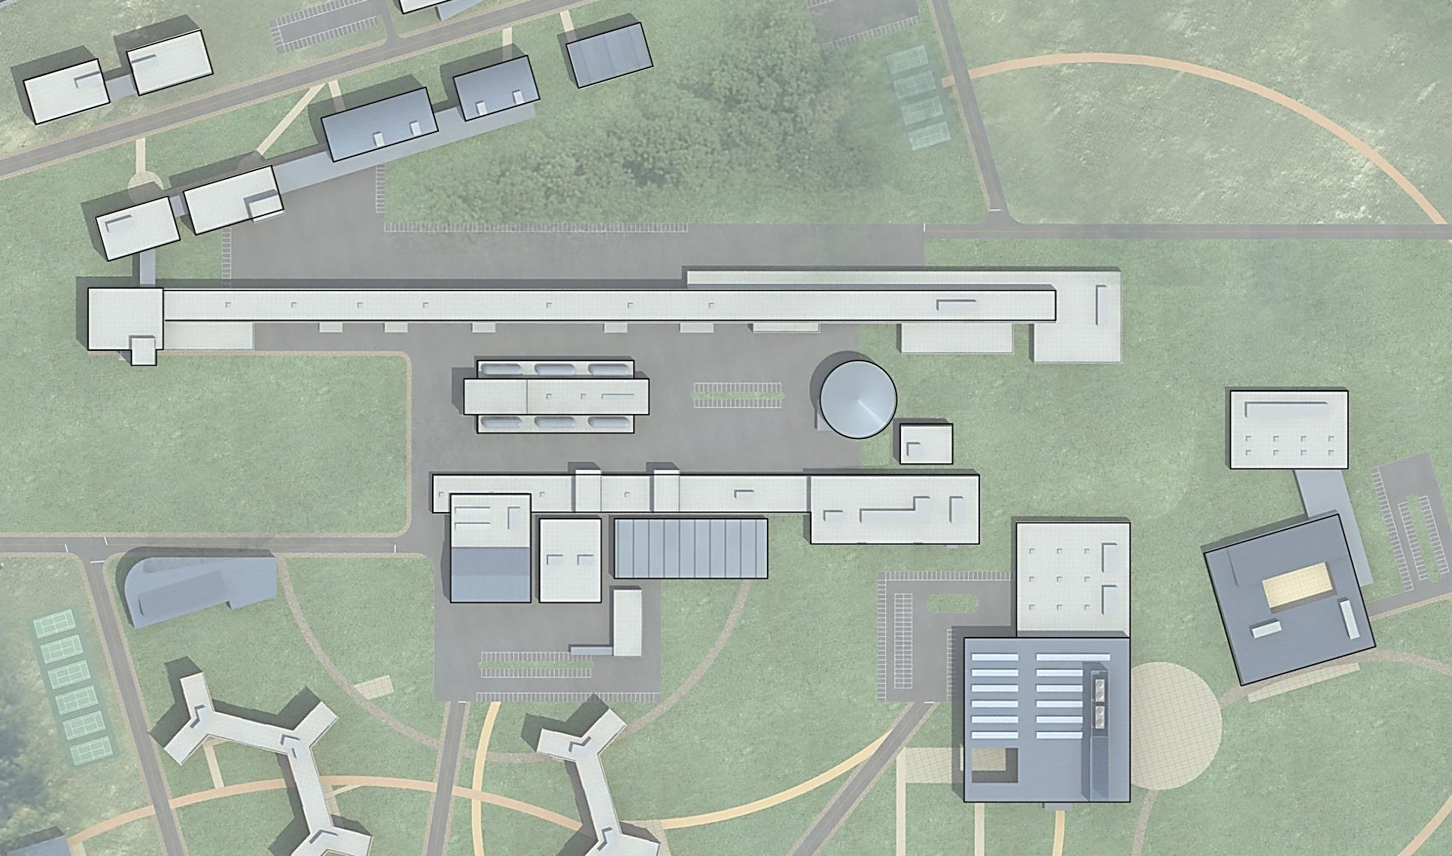
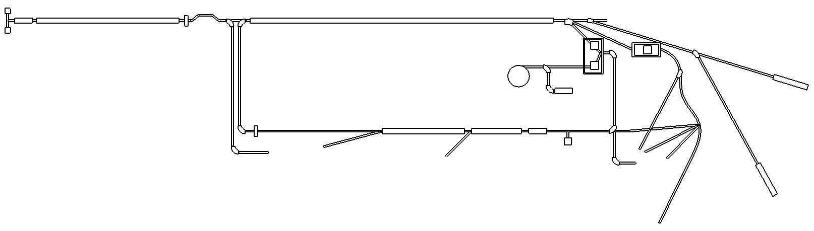
RAON: Rare Isotope Accelerator Facility
RAON user community
200 MeV/u, 9Ⅹ10⁸pps(¹³²Sn)
200 MeV/u, 8puA (U)
28GHz SC ECR IS
IFF LINAC
RFQ
SCL
SCL
Future extension
β=0.041, β=0.085
QWR QWR
Stripper
β=0.285, β=0.53
HWR HWR
400KW
H₂+
D+
ISOL
target
Cyclotron
p: 70/100MeV, 1mA
In-flight
target
70KW
ISOL LINAC
Nuclear Data
Nuclear Data
17.5 MeV/u
SCL
SCL
RFQ
Stripper
β=0.10
QWR
β=0.04
QWR
ECR IS
Fragment
Separator
Low-energy experiments
Atomic
Physics
Nuclear Astrophysics
Material Science
Medical/Bio Science
Medical Science
High-energy
experiments
Nuclear Physics

Slide 29
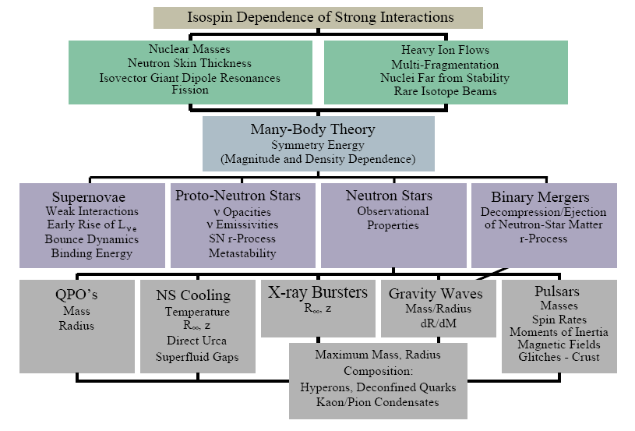
Importance of Symmetry Energy
Effective field theory, QCD
π⁻/π⁺
K⁺/K⁰
n/p
³H/³He
γ
isodiffusion
isotransport
+ isocorrelation
isofractionation
isoscaling
A.W. Steiner, M. Prakash, J.M. Lattimer and P.J. Ellis, Physics Report 411, 325 (2005)

Slide 30
30
IFF Linac Beam Specification
Ion Species | Z/ A | Ion source output |  | SC linac output
 |  | Charge | Current (pµA) | Charge | Current (pµA) | Energy (MeV/u) | Power (kW)
Proton | 1/ 1 | 1 | 660 | 1 | 660 | 610 | 400
Ar | 18/ 40 | 8 | 42.1 | 18 | 33.7 | 300 | 400
Kr | 36/ 86 | 14 | 22.1 | 34-36 | 17.5 | 265 | 400
Xe | 54/ 136 | 18 | 18.6 | 47-51 | 12.5 | 235 | 400
U | 92/ 238 | 33-34 | 11.7 | 77-81 | 8.4 | 200 | 400
Estimated RIBs based on ISOL
Isotope | Half-life | Yield at target (pps) | Overall eff. (%) | Expected Intensity (pps)
⁷⁸Zn | 1.5 s | 2.75 x 10¹⁰ | 0.0384 | 1.1 x 10⁷
⁹⁴Kr | 0.2 s | 7.44 x 10¹¹ | 0.512 | 3.8 x 10⁹
⁹⁷Rb | 170 ms | 7.00 x 10¹¹ | 0.88 | 6.2 x 10⁹
¹²⁴Cd | 1.24 s | 1.40 x 10¹² | 0.02 | 2.8 x 10⁸
¹³²Sn | 40 s | 4.68 x 10¹¹ | 0.192 | 9.0 x 10⁸
¹³³In | 180 ms | 1.15 x 10¹⁰ | 0.184 | 2.1 x 10⁷
¹⁴²Xe | 1.22 s | 5.11 x 10¹¹ | 2.08 | 1.1 x 10¹⁰
RAON user community

Slide 31
31
RAON RI Beam intensities compared for ISOL & IFF
RIB species | ISOL (pps) | In-Flight Fragmentation (pps) | Comment
¹⁵O | 5x10⁸ via ¹⁹F(p,αn), LiF pressed powder | To be estimated | Nuclear astropysics
⁹⁴Kr | 4x10⁹ | 4x10² | Nuclear structure
¹⁰⁹Y | 2x10⁵ | <10² | New discovery at RIKEN
¹¹⁷Mo | Not available due to low vapor pressure | <10³ | New discovery at RIKEN
¹³²Sn | 9x10⁸ | 2x10⁵ | Symmetry energy for double magic
¹⁴²Xe | 1x10¹⁰ | 1x10⁴ | Symmetry energy
¹⁴⁴Cs | 7x10⁸ | 3x10⁴ | Nuclear astrophysics
KoRIA user community
RAON user community

Slide 32
Experimental Observables
Signals at sub-saturation densities
Sizes of n-skins for unstable nuclei
n/p ratio of fast, pre-equilibrium nucleons
Isospin fractionation and isoscaling in nuclear multifragmentation
Isospin diffusion (transport)
Differential collective flows (v₁ & v₂) of n and p
Correlation function of n and p
³H/³He ratio, etc.
Signals at supra-saturation densities
π⁻/π⁺ ratio
Differential collective flows (v₁ & v₂) of n and p
Azimuthal angle dependence of n/p ratio with respect to the R.P.
Correlation of various observables
Simultaneous measurement of neutrons and charged particles

Slide 33


Assuming Perfect Time Resolution
E_{det} estimated by ToF
Assuming σ_{t} = 1 ns

Slide 34


Assuming Perfect Time Resolution
Assuming finite s_{t}

Slide 35

200 MeV/u, 9Ⅹ10⁸pps(¹³²Sn)
200 MeV/u, 8puA (U)
28GHz SC ECR IS
IFF LINAC
SC ECR IS
Future extension area
RFQ
SCL
SCL
Future plan
Stripper
Cyclotron
K~100
H₂+
D+
μ, Medical
research
ISOL LINAC
70 kW ISOL
target
400 kW
In-flight
target
Medical science
18.5 MeV/u
Stripper
SCL
RFQ
Charge
Breeder
Fragment
Separator
Low energy experiments
Nuclear Astrophysics
Material science
Bio science
Nuclear data
Atom trap
experiment
ISOL with cyclotron driver (70 kW)
Atomic / Nuclear physics
High energy
experiments
LINAC
Beam line [for acceleration]
Nuclear Physics
Beam line [for experiment]
Target building
Experimental Hall
RAON user community

Slide 36


Layer Number vs. ToF
Efficiency as a function of
the distance from the target

Slide 37

1. Introduction
RAON: Rare Isotope Accelerator Facility
Nuclear Physics
Exotic nuclei near the neutron drip line
Super-Heavy Elements (SHE)
Equation-of-state (EoS) of nuclear matter
Nuclear Astrophysics
Origin of nuclei
Paths of nucleosynthesis
Neutron stars and supernovae
ISOL+IFF+ISOL
ISOL+IFF+ISOL(Trap)
Atomic physics
Limits of nuclear existence
Fundamental conservation law
Nuclear data using fast neutrons
Basic data for future nuclear energy
Radioactive waste transmutation
Material science
Production & Characterization of new materials
Dynamic image in nm scale
Medical and Bio sciences
Advanced therapy technology
Mutation of DNA
RAON user community

Slide 38

28GHz SC ECR IS
RAON: Rare Isotope Accelerator Facility
200 MeV/u, 9Ⅹ10⁸pps(¹³²Sn)
200 MeV/u, 8puA (U)
18.5 MeV/u

Slide 39
RAON: Specification
High intensity RI beams by ISOL & IFF
70 kW ISOL from direct fission of ²³⁸U induced by 70 MeV and 1 mA proton cyclotrons
400 kW IFF by 200 MeV/u, 8 pμA ²³⁸U
High energy, high intensity neutron-rich RI beams
¹³²Sn, ¹⁴²Xe at ~250 MeV/u with intensity > 10⁸ pps
Exploring more exotic RI beams by using multi-step RI production processes by combining ISOL & IFF
Design for maximal use of the facility for basic nuclear physics and applications
RAON user community

Slide 40


Slide 41


LAMPS probes symmetry-energy up to ρ₀/ρ ~ 2 with 200 AMeV
Bao-An Li, PRL 88, 192701 (2002)
Phys Rep. 464 113 (2008)
Case 1
At nuclear matter density ρ > ρ₀ ( = 0.16 fm⁻³)
Case 1: Eª_{sym}(ρ) = E_{sym}(ρ₀) u, u_{c}= ρ/ρ₀
Case 2: E^{b}_{sym}(ρ) = E_{sym}(ρ₀) u (u_{c} – u)/(u_{c} – 1), u_{c}=ρ/ρ₀
Case 1
Case 2
Case 2
High (Low) density matter is more neutron rich with soft (stiff) symmetry energy

Slide 42
LAMPS/RAON: exploring a wide range of N/Z asymmetry
The symmetry energy at sub-saturation density and supra-saturation density with ~ 250 AMeV
RIBF
FRIB
LAMPS/RAON
MSU
GSI
FAIR

Slide 43



Si-CsI arrays
Energy measurement and particle ID for both nuclear fragments and γ’s
100 μm thick Si
50-mm thick CsI
Full absorption for all charged particles
ε > 70% for γ’s
Another solution
Thin plastic-CsI arrays for measurement of lower-energy HI fragments
Particle occupancies (PHITS)
Black: all charge particles
Red: γ BLUE: protons

