Slide 1
LAMPS prototype-TPC design
이효상
2013.09.06

Slide 2
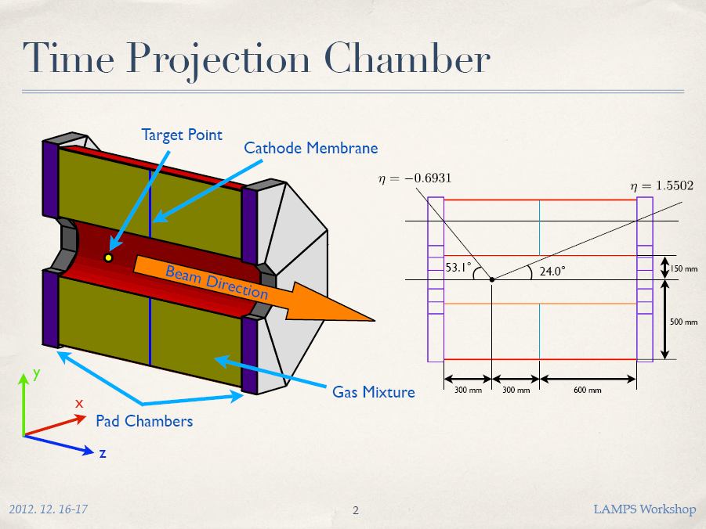
LAMPS TPC

Slide 3
LAMPS prototype-TPC
Motivation
Uniform electric field : field strip
PAD : Hexagon shape with 5mm or 2.5mm
Cathode : Membrane
GEM : Large size? Shape?
Gas chamber
Optimized design & construction method
Data taking : CoBo system
Reconstruction algorism
½ size

Slide 4
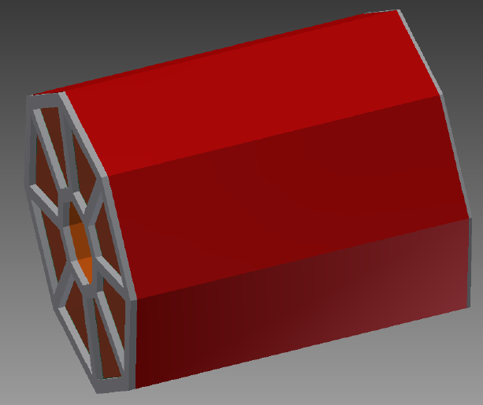
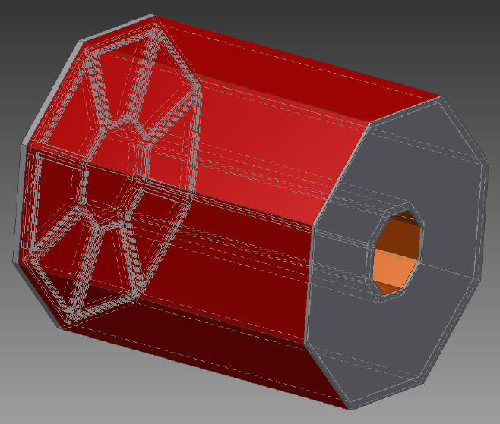
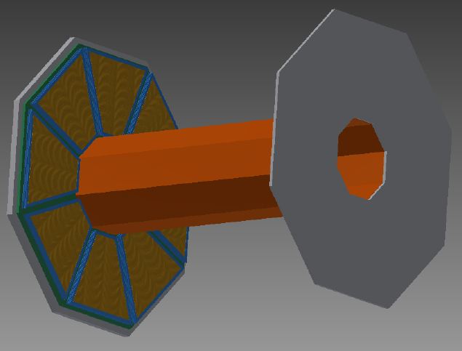
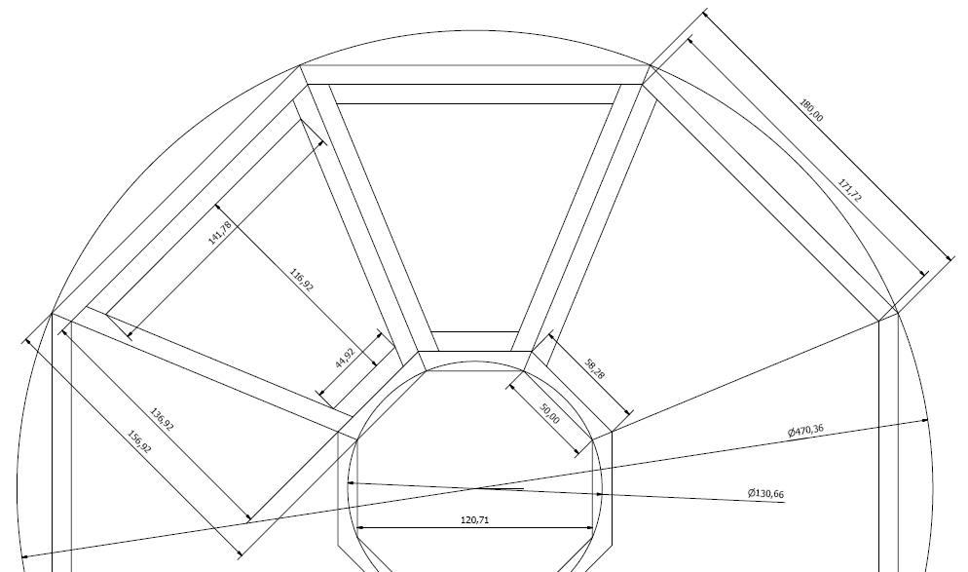
LAMPS prototype-TPC : design
180
142
117
50
470
130

Slide 5
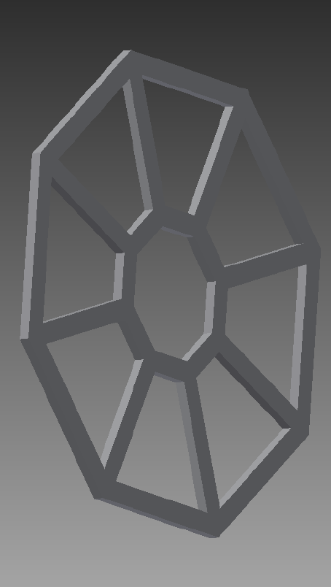
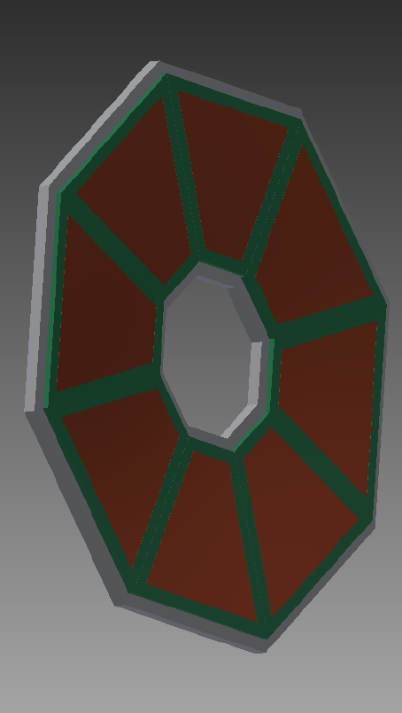
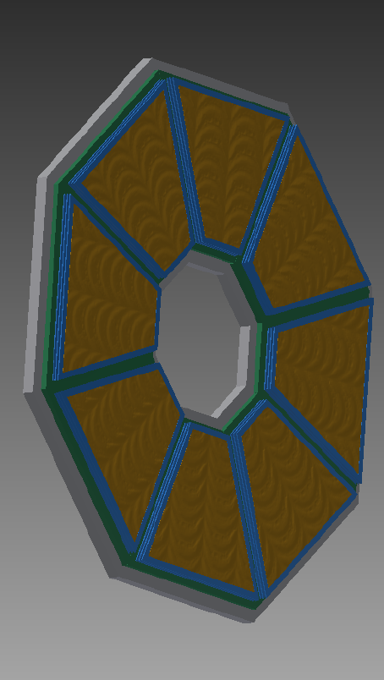
LAMPS prototype-TPC : PAD & GEM
Gas chamber (bottom)
PAD board
GEM : 3layers

Slide 6
LAMPS prototype-TPC : PAD
180
142
117
45
50
470
157
130

Slide 7
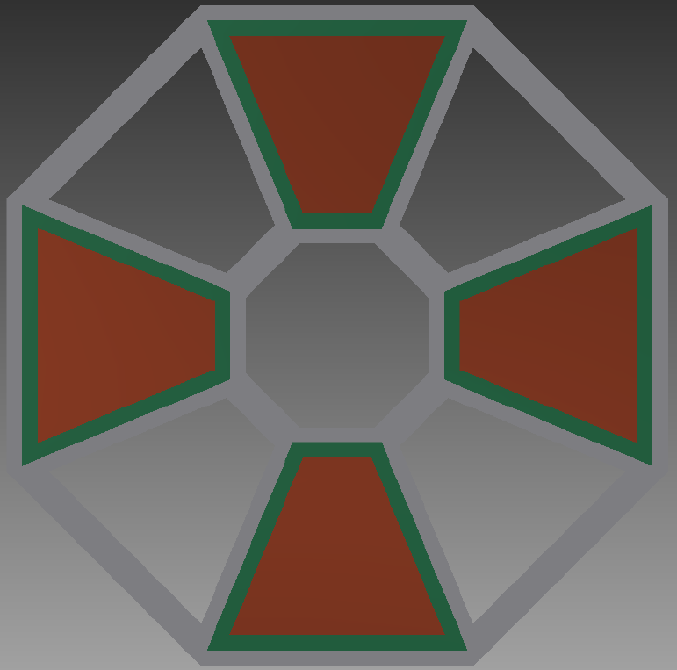
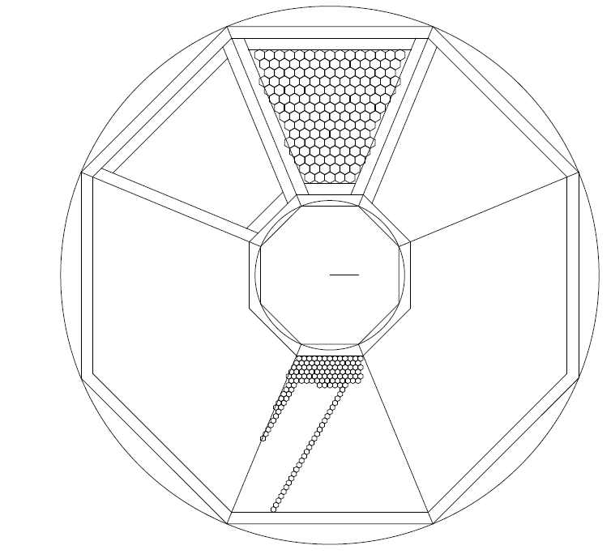
LAMPS prototype-TPC : PAD configuration
5mm
: ~154ch
→ 1R-CoBo
2.5mm
: ~674ch
→ 2R-CoBo
2.5mm
5mm

Slide 8
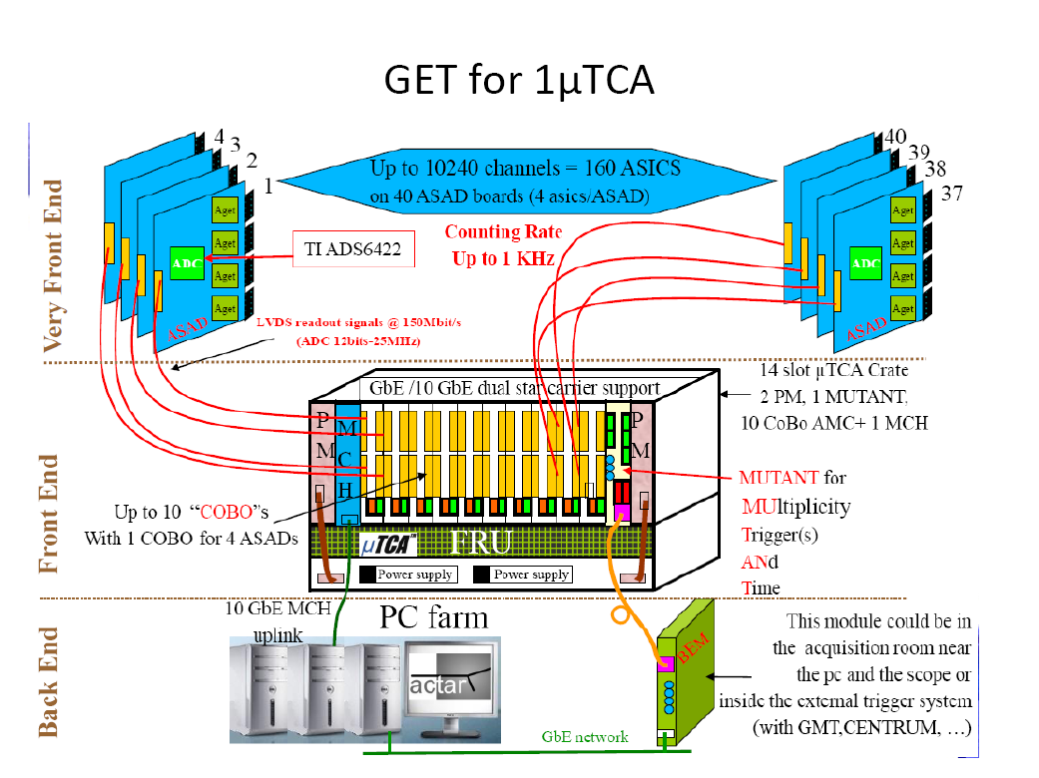
LAMPS prototype-TPC : Estimated channel
1 ASAD : 4GET → 256ch
1 COBO : 4ASAD →1024ch
1 uTCA : 10COBO → 10240ch
5mm size PAD : ~11000ch x 2 → 2~3 uTCA
2.5mm size PAD : ~44000ch x 2 → 8~9 uTCA

Slide 9
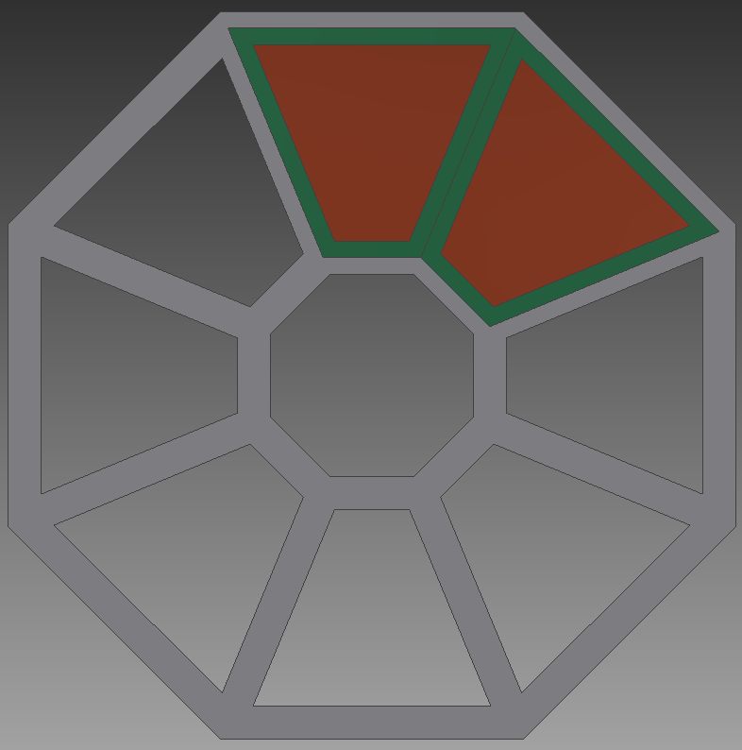
LAMPS prototype-TPC
Key point of prototype-TPC design
reduce dead region
PAD configuration
Connection between PAD & FEE(ZAP) : one board or PAD & connector board
R-CoBo system
Membrane Cathode
GEM : Large size? Shape?

Slide 10
LAMPS prototype-TPC : Plan
Test plan
Cosmic ray test : reconstruct muon track
Fe-55 source test
ExB test in the magnet

Slide 11
LAMPS prototype-TPC

Slide 12
LAMPS prototype-TPC
Motivation
Uniform electric field : field strip
PAD : Hexagon shape with 5mm or 2.5mm
Cathode : Membrane
GEM : Large size? Shape?
Gas chamber
Optimized design & construction method
Data taking : CoBo system
Reconstruction algorism
½ size

Slide 13
LAMPS prototype-TPC

Slide 14
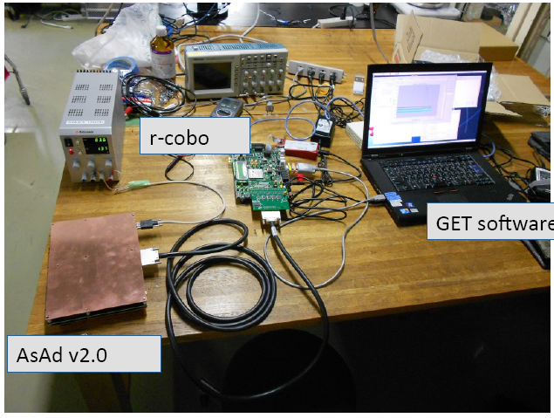
LAMPS prototype-TPC

