Slide 1
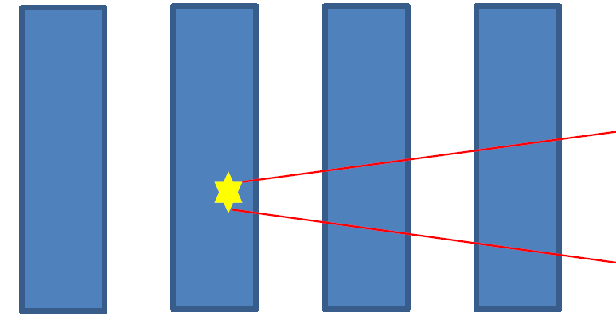
Neutron Detector Simulation 2013 / 09 / 13
Korea University Nuclear Physics Lab.
BumGon Kim

Slide 2
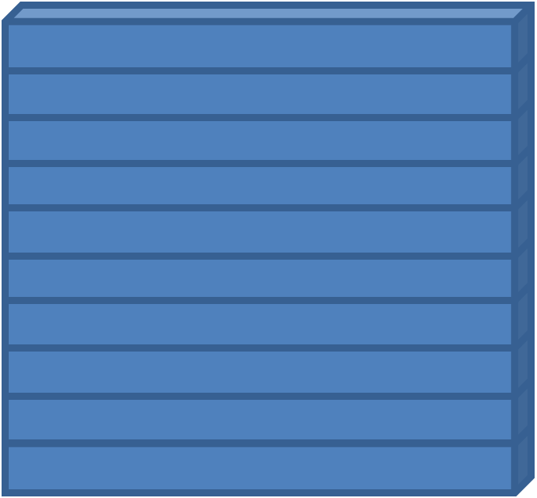
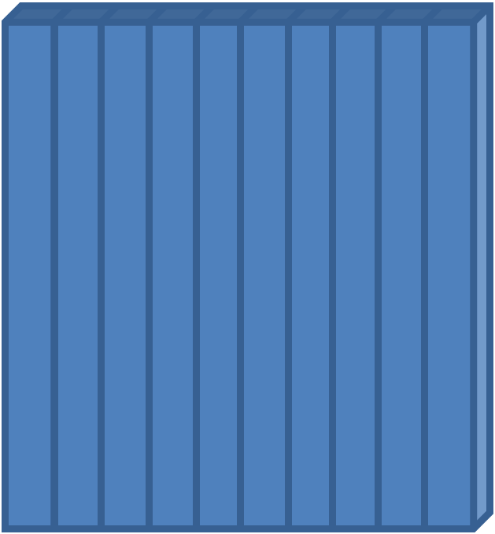
Neutron Bar Detector
Horizontal Vertical
Horizontal layer + Vertical layer = 1 Stack
Structure to know the locations where neutrons have passed.
→ To recognize the path where neutrons have traveled.

Slide 3
Multi-neutron Recognition Basic Algorithm
Geometric Condition
1st layer : within 30 cm from 1st hit.
2nd layer : 40 cm
3rd layer & 4th layer : 60 cm
2. Betha Condition
- β > ${\text{β}}_{12}$ : earlier incoming, larger velocity(loss of energy).

Slide 4
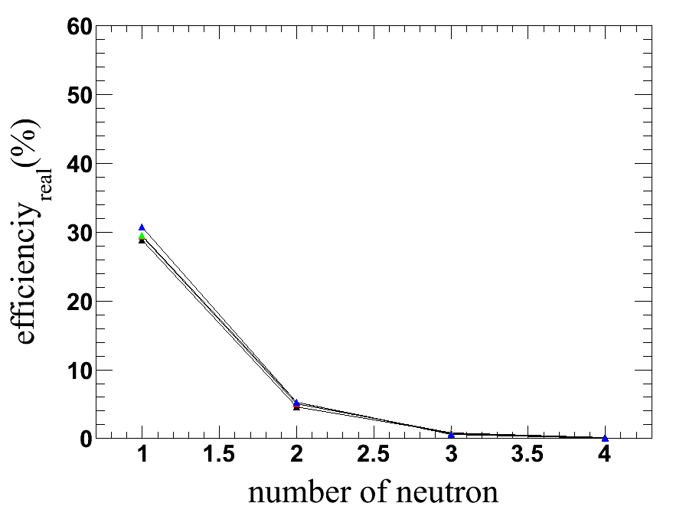
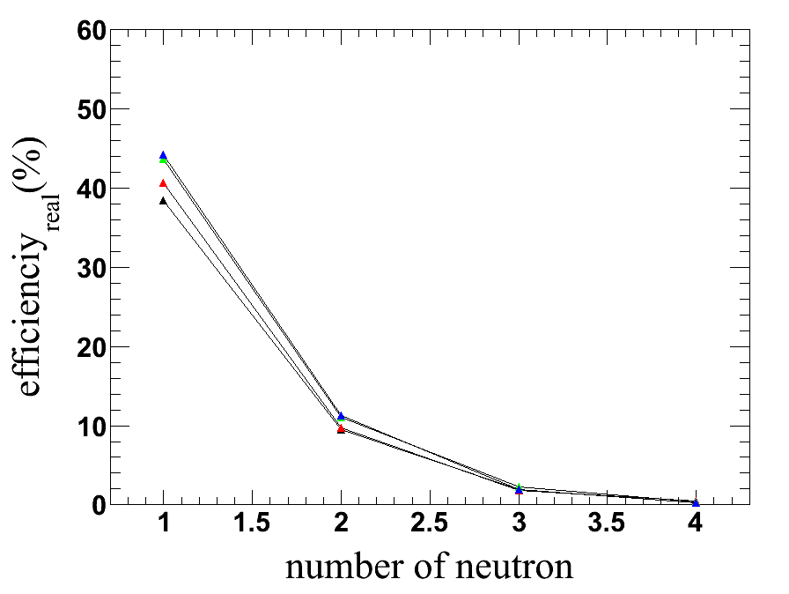
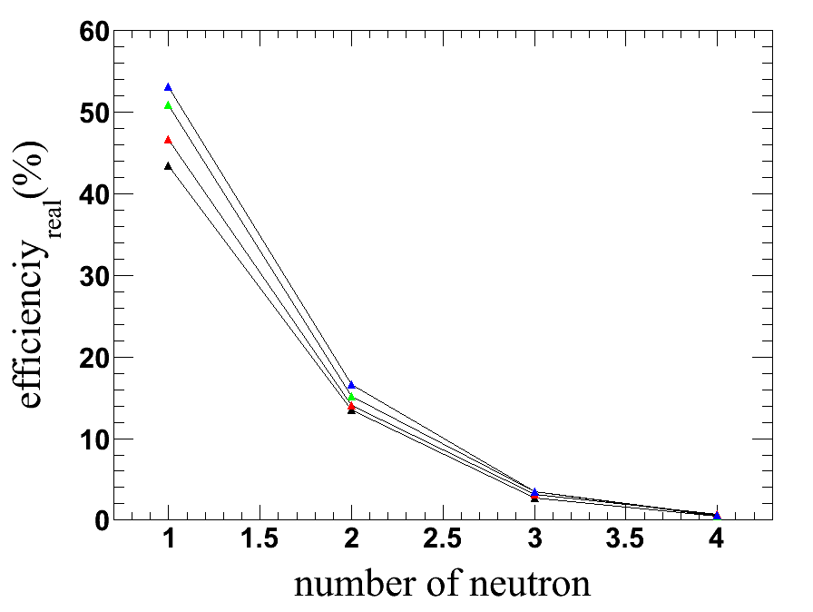
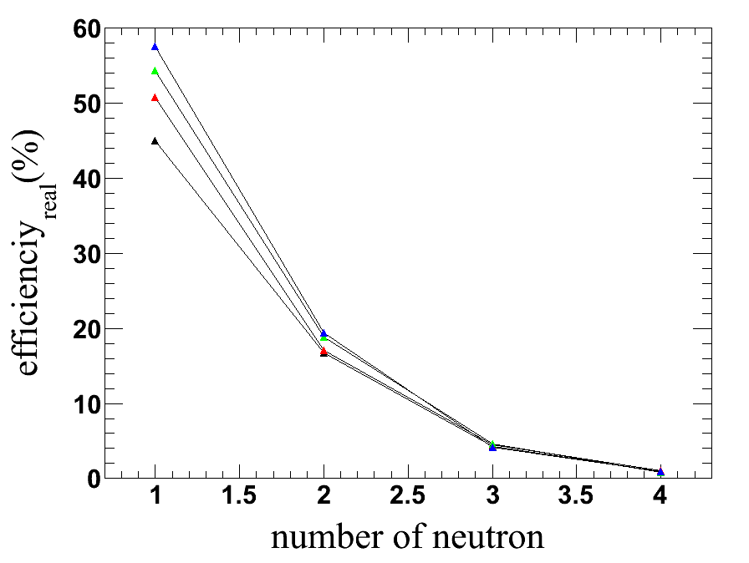
(Correction!)The Number of Stacks & Real Efficiency
Real Efficiency(%) = (# of well recognized)/(# of event-Null event) * (1-fake rate) * 100
Neutron Energy : 100 ~ 300 MeV, Time Resolution : 0.3 ns
2 stack, 40 cm gap 4 stack, 40 cm gap
Black : 3 MeV,
Red : 5 MeV,
Green : 7 MeV,
Blue : 10 MeV
6 stack, 40 cm gap 8 stack, 40 cm gap

Slide 5
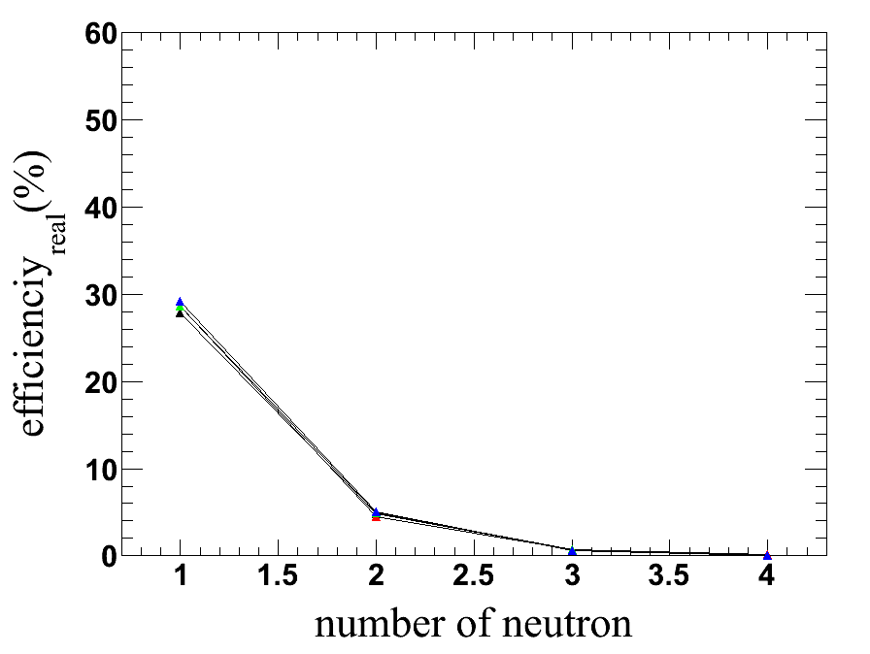
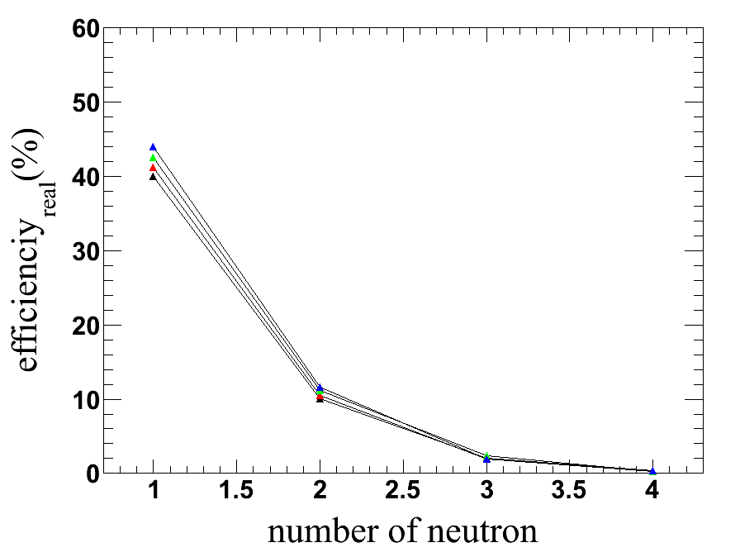
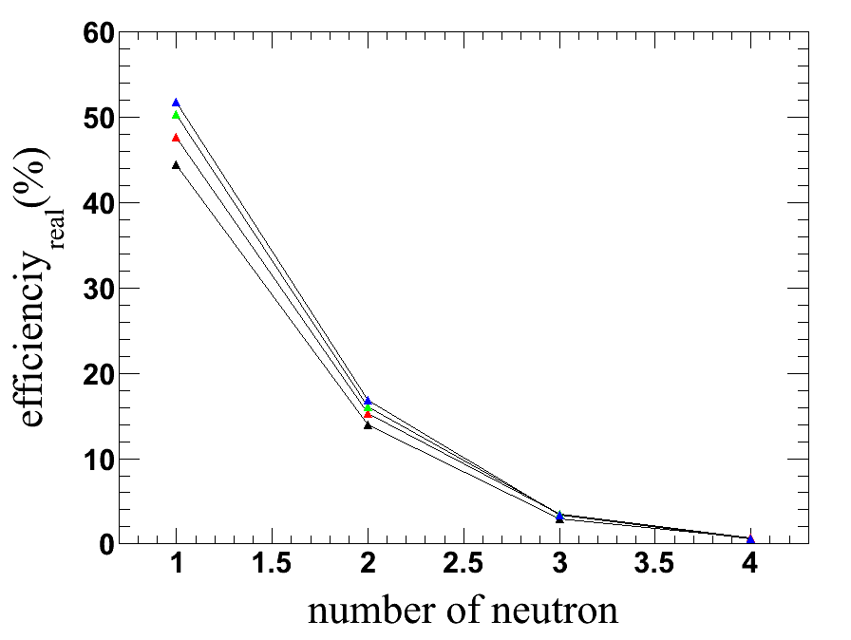
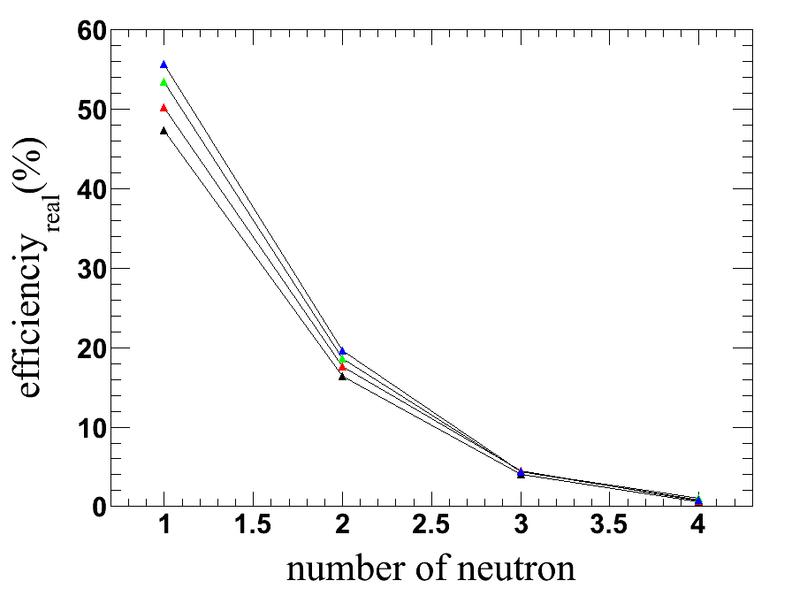
The Number of Stacks & Real Efficiency
Real Efficiency(%) = (# of well recognized)/(# of event-Null event) * (1-fake rate) * 100
Neutron Energy : 100 ~ 300 MeV, Time Resolution : 0.3 ns
2 stack, 60 cm gap 4 stack, 60 cm gap
Black : 3 MeV,
Red : 5 MeV,
Green : 7 MeV,
Blue : 10 MeV
6 stack, 60 cm gap 8 stack, 60 cm gap

Slide 6
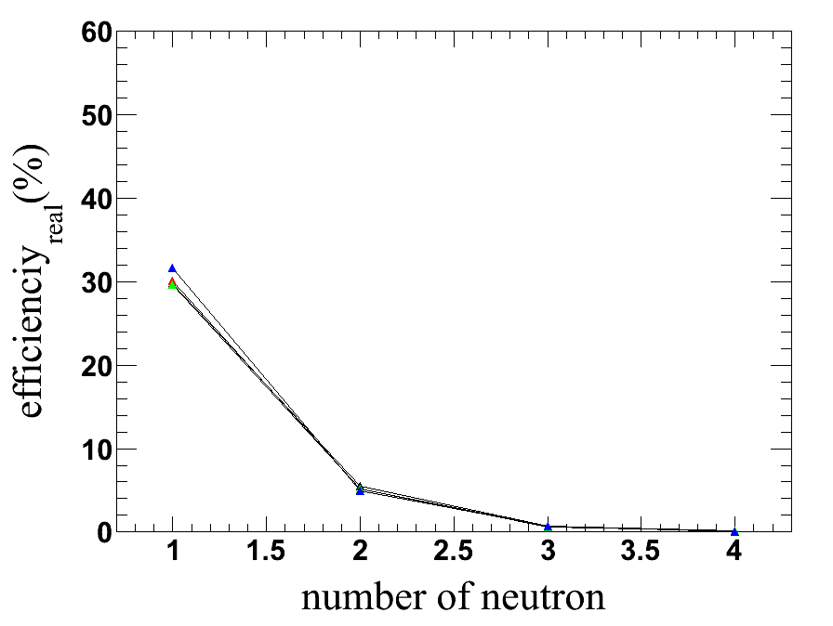
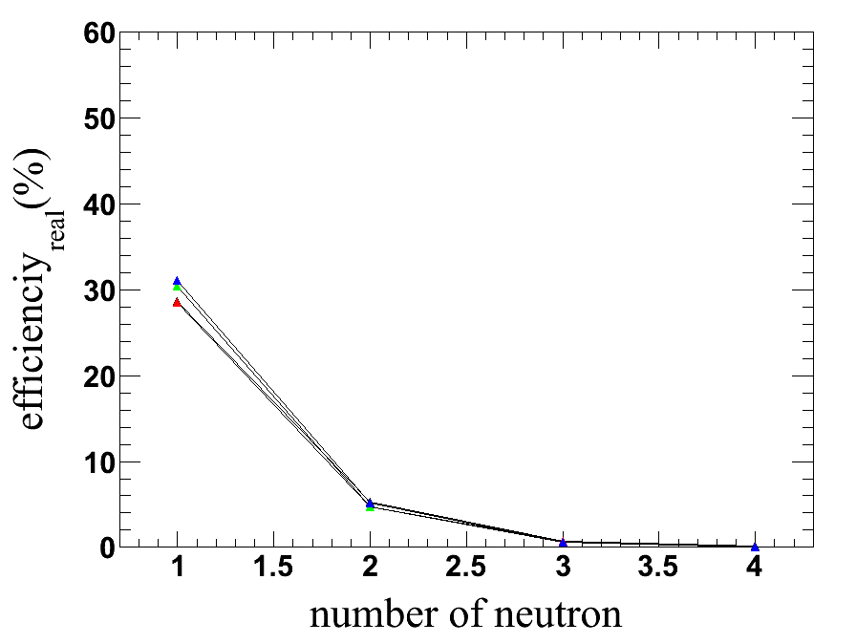
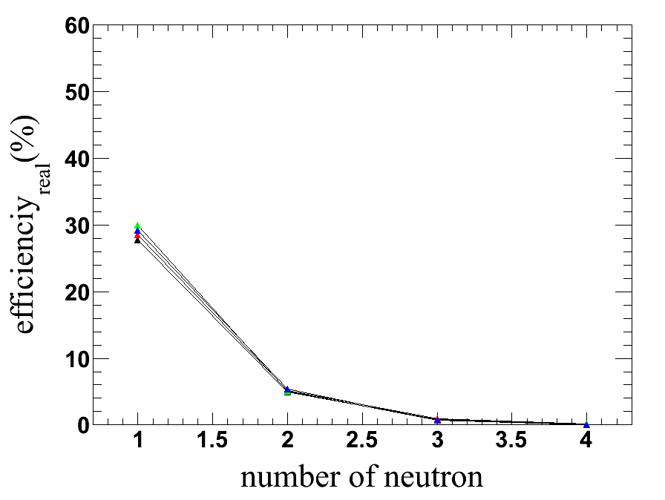
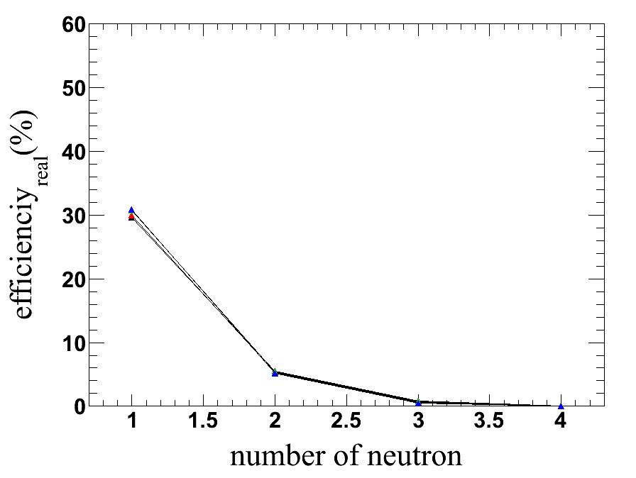
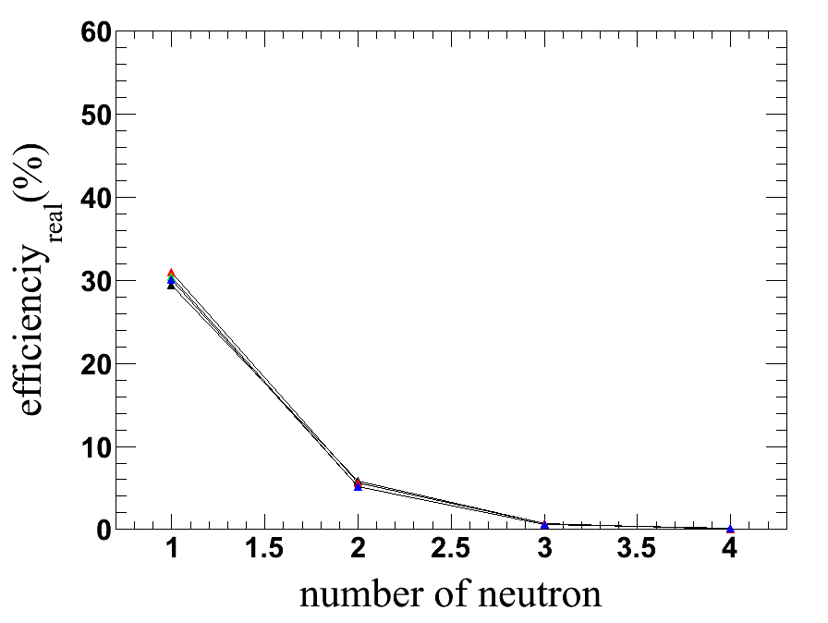
Two Stacks & Gap
20 cm gap 40 cm gap 60 cm gap
80 cm gap 100 cm gap 120 cm gap
-

Slide 7
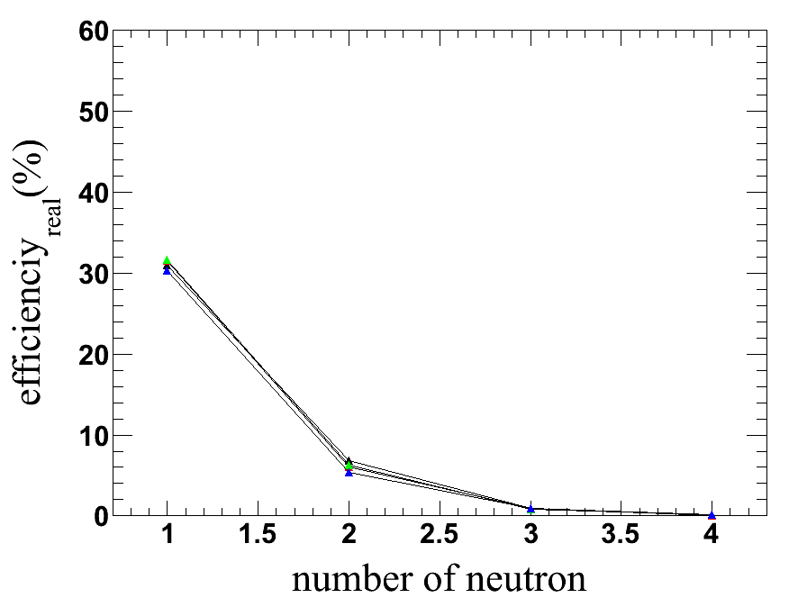
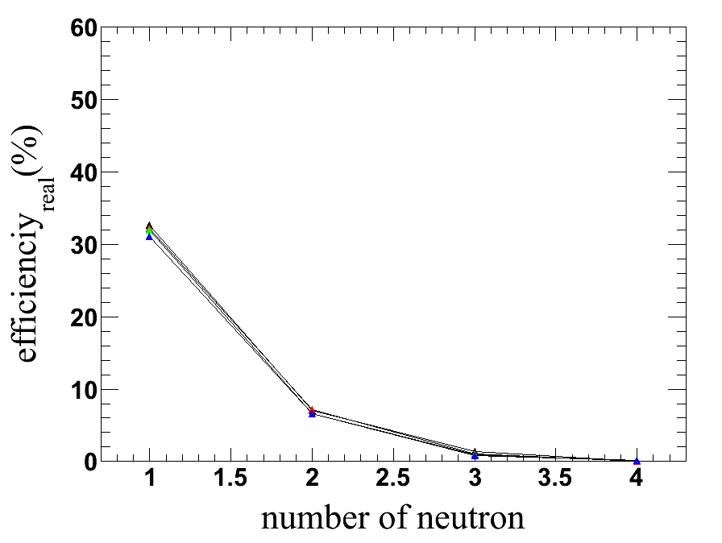
Two Stacks & Gap
220 cm gap 400 cm gap

Slide 8
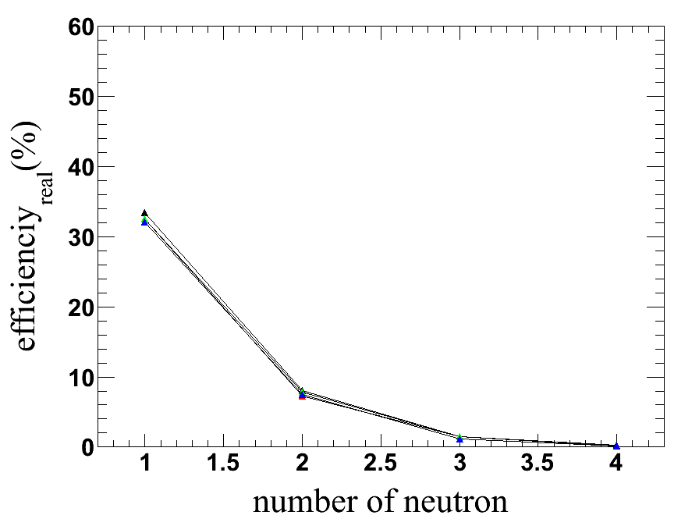
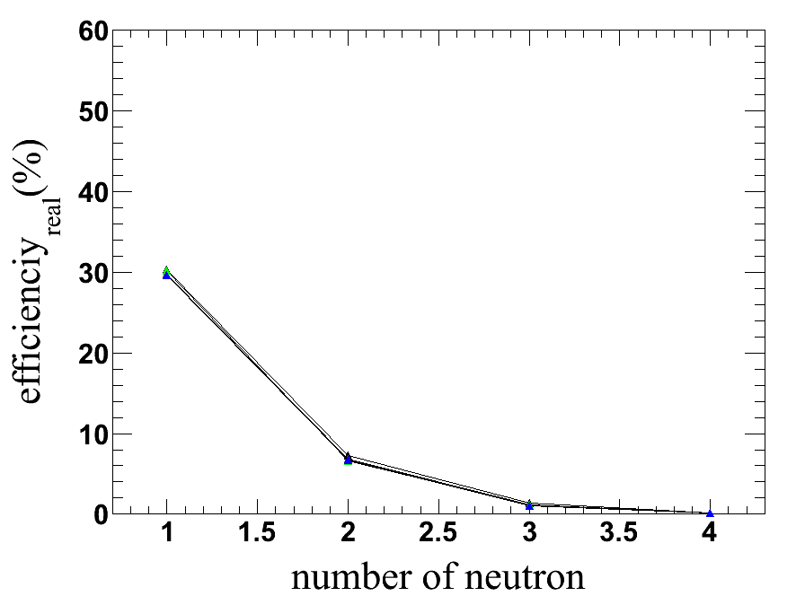
Two Stacks & Gap
800 cm gap 1600 cm gap
Gap이 약 800 cm 전후일 때, efficiency 가 가장 높다.

Slide 9
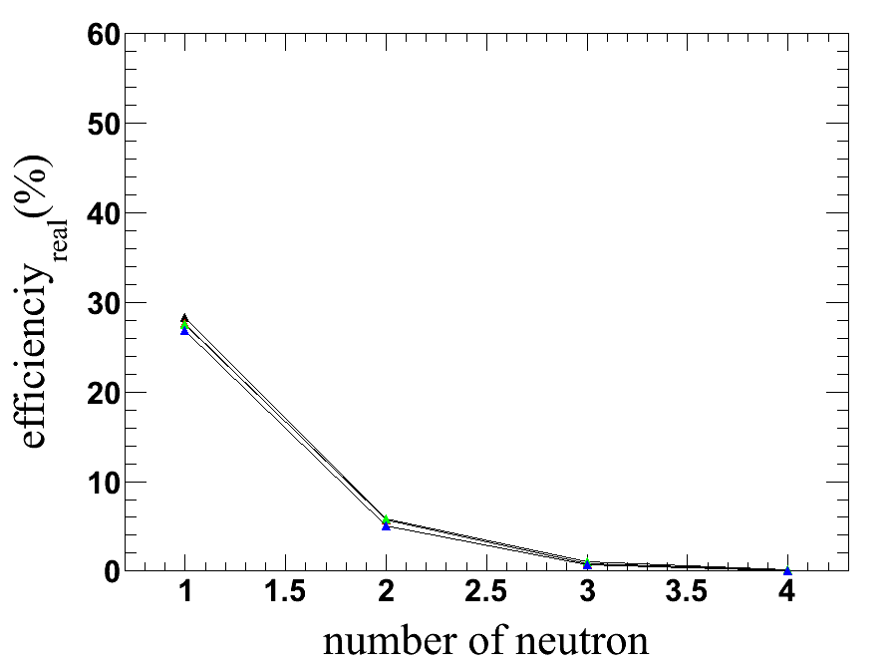
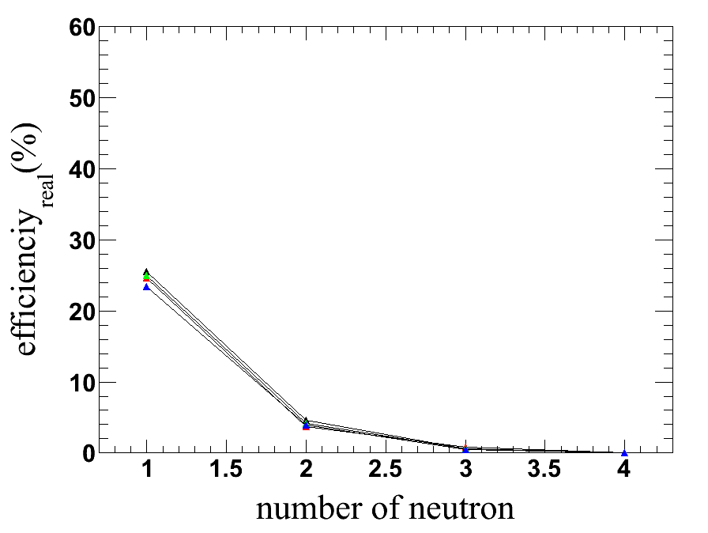
Two Stacks & Gap
3200 cm gap 6400 cm gap
Gap이 800 cm 보다 커질수록, efficiency가 점차 감소한다.
→ Back Scattering 의 감소에 의한 영향보다, gap의 증가로 인한 영향이 더 커진다.

Slide 10
Analysis
- When the threshold is 3 & 5 MeV, efficiency of the case of the
60 cm gap is higher than that of the case of the 40 cm gap.
When the threshold is 7 & 10 MeV, efficiency of the case of the 40 cm gap is higher than that of the case of the 60 cm gap.
In the event of two stacks, in the region of the gap is longer than 20 cm & shorter than 80 cm, efficiency becomes lower gradually as long as the length of the gap becomes longer.
→ It may be caused by decrease of the cross section
(decrease of the solid angle) by the result of increase of the
length of the gap.

Slide 11
Analysis
In the region of the length of the gap is longer than 80 cm & shorter than 800 cm,
efficiency becomes gradually higher as long as the length of the
gap becomes longer.
→ It may be caused by weakening of the effect of back scattering
by the result of increase of the length of the gap.
In the region of the length of the gap is longer than 800 cm,
efficiency becomes lower as long as the length of the gap
becomes longer.
→ It may be caused by the domination of the effect of
decrease of the cross section(decrease of the solid angle)
by the result of increase of the length of the gap.

Slide 12
Conclusion
In case of the two stacks(in the region of the length of the gap is
longer than 40cm & shorter than 800 cm), as long as the length
of the gap become longer, efficiency become gradually higher.
But, in the event of many neutrons, change of the gap is
insignificant.
Need to find another ways to improve the efficiency.

