Slide 1
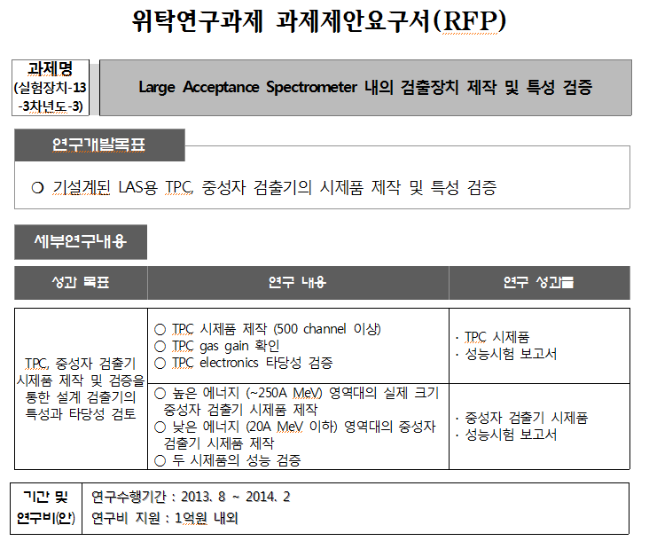
1/8 size TPC prototype
0.1 x 0.1 x 2 m³
with different scintillator
10 x 10 x 20 cm³
과제종료일: 2014년 2월 28일
최종보고서제출: 2014년 3월 30일

Slide 2
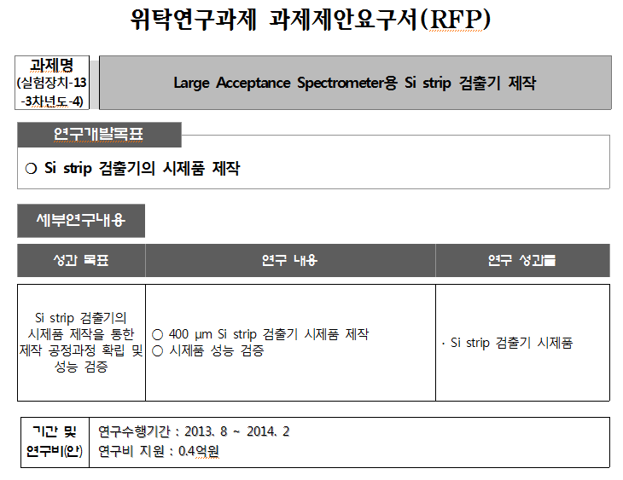
32 ch 300μm strip
100 μm Si detector 개발기술
과제종료일: 2014년 2월 28일
최종보고서제출: 2014년 3월 30일

Slide 3
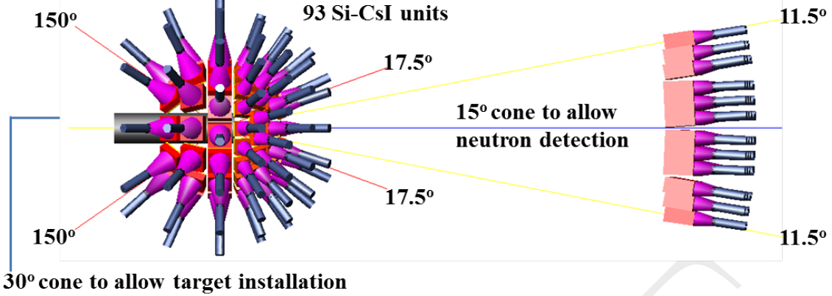
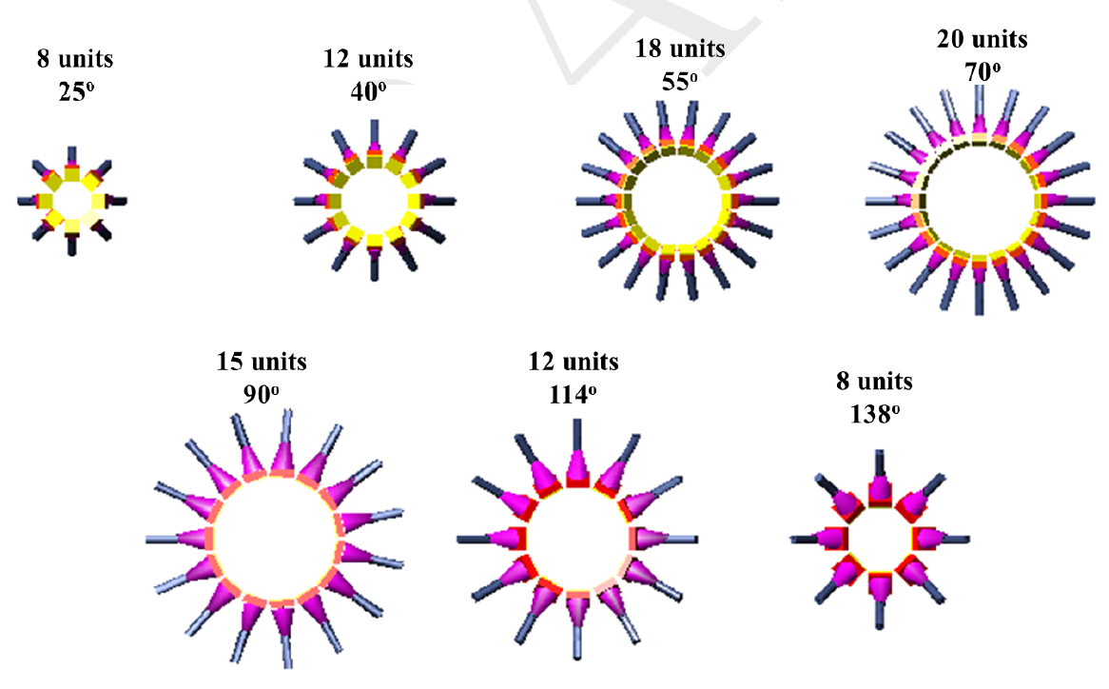
LAMPS-L Si-CsI Detector
9 x 9 cm²
100 μm thick Si pad
(3 x 3 segment)
5 cm thick CsI crystal with PMT readout
15 x 15 cm²
100 μm thick Si pad
(3 x 3 segment)
5 cm thick CsI crystal with PMT readout

Slide 4
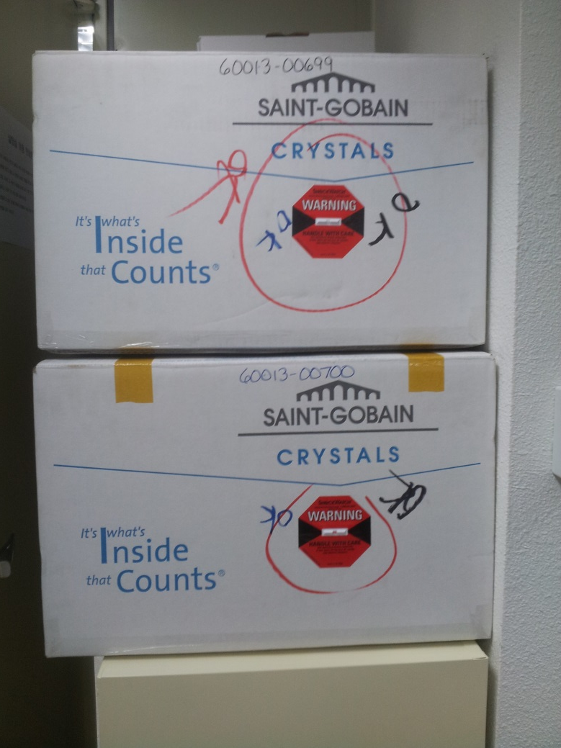
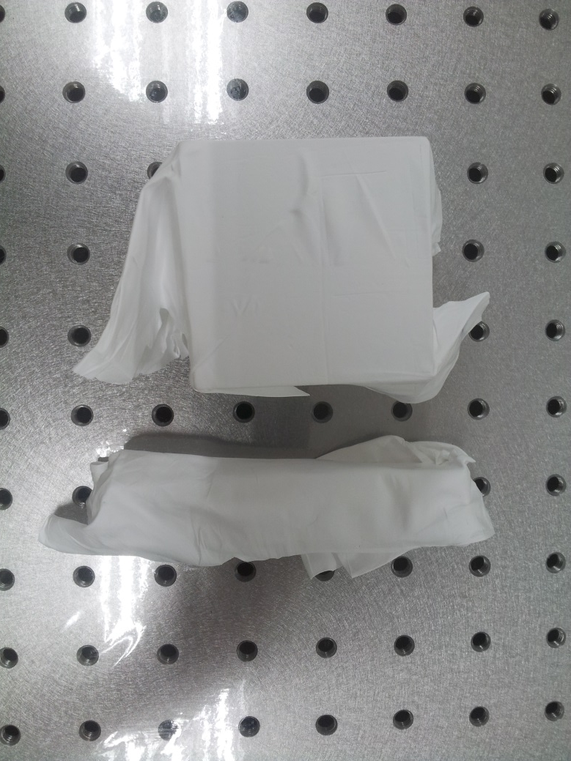
CsI Detector R&D Plan
2 5”x5” NaI(Tl) detectors at RISP → PMT bases are ordered
2 5”x3” CsI(Tl) detectors are ordered
2 CsI(Tl) crystals from KNU are at RISP
going to assemble soon & test with source
Need intensive low energy Si-CsI Geant4 simulation

Slide 5
LAMPS Budget
장치명 | 세부장치 | 예상연구비
저에너지 실험장치 | Si detector & electronic (100 detectors & channels) | 4억
 | CsI detector & electronics (100 detectors & channels) | 18억
 | Neutron detector & electronics (160 detectors & channels) | 11억
 | Vacuum chamber | 2억
합계 |  | 35 억
장치명 | 세부장치 | 예상연구비
DAQ & Electronics | DAQ (Event builders + network switchs) | 13억 5천
 | DAQ electronics | 10억
합계 |  | 23억 5천
장치명 | 세부장치 | 예상연구비
공통장비 | Start counter & electronics | 1억 5천
 | Solid target (Au, Pb, Ca, Ni, 3종의 Sn) | 5억
합계 |  | 6억 5천

Slide 6
LAMPS Budget
장치명 | 세부장치 | 예상연구비
고에너지 실험장치 | Solenoid magnet (solenoid moving system + collimator) | 60억
 | Dipole magnet | 50억
 | Quadrupole magnet (2 quadrupole magnets + dipole rotation station) | 20억
 | Vacuum chamber | 3억
 | TPC detector & electronics (1 detector & 100k channels) | 60억
 | Neutron detector & electronics (220 detectors & 440 channels) | 42억
 | Si detector & electronics (70 detectors & 2240 channels) | 4억
 | CsI detector & electronics (70 detectors & 1120 channels) | 21억
 | Focal plane detector & electronics (MWDC+ToF) | 25억
합계 |  | 285억
Total: 350 억
Request to cut some
LAMPS-H has to be put as a stage

Slide 7
LAMPS Budget
장치명 | 세부장치 | 예상연구비
고에너지 실험장치 | Solenoid magnet (solenoid moving system + collimator) | 60억
 | Dipole magnet | 50억
 | Quadrupole magnet (2 quadrupole magnets + dipole rotation station) | 20억
 | Vacuum chamber | 3억
 | TPC detector & electronics (1 detector & 100k channels) | 60억
 | Neutron detector & electronics (220 detectors & 440 channels) | 42억
 | Si detector & electronics (70 detectors & 2240 channels) | 4억
 | CsI detector & electronics (70 detectors & 1120 channels) | 21억
 | Focal plane detector & electronics (MWDC+ToF) | 25억
합계 |  | 285억
Dipole spectrometer & Si-CsI detector are for upgrade
Total: 227 억
162 억

Slide 8
LAMPS Schedule
구분 | 년도 | 내용
4차년도 | 14.3 ~ 15.2 | R&D
5차년도 | 15.3 ~ 16.2 | R&D
6차년도 | 16.3 ~ 17.2 | 낮은 에너지 실험장치 제작
7차년도 | 17.3 ~ 18.2 | 낮은 에너지 실험장치 제작 및 설치 높은 에너지 실험장치 제작
8차년도 | 18.3 ~ 19.2 | 낮은 에너지 실험장치 시운전 높은 에너지 실험장치 제작
9차년도 | 19.3 ~ 20.2 | 낮은 에너지 실험장치 시운전 및 실험 높은 에너지 실험장치 설치

Slide 9
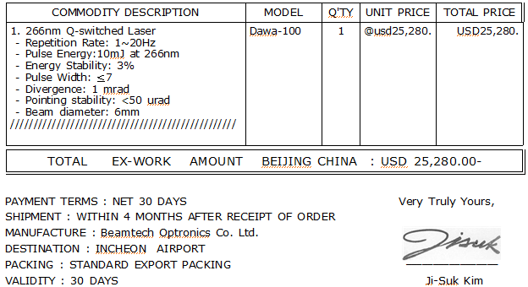
TPC R&D Plan
All electronics requested from PNU are at RISP
There are some difficulties
All of them got tax reduction and they have to be at RISP
Hard to make a plan for sending them to PNU
Laser system
~2800 만원

Slide 10
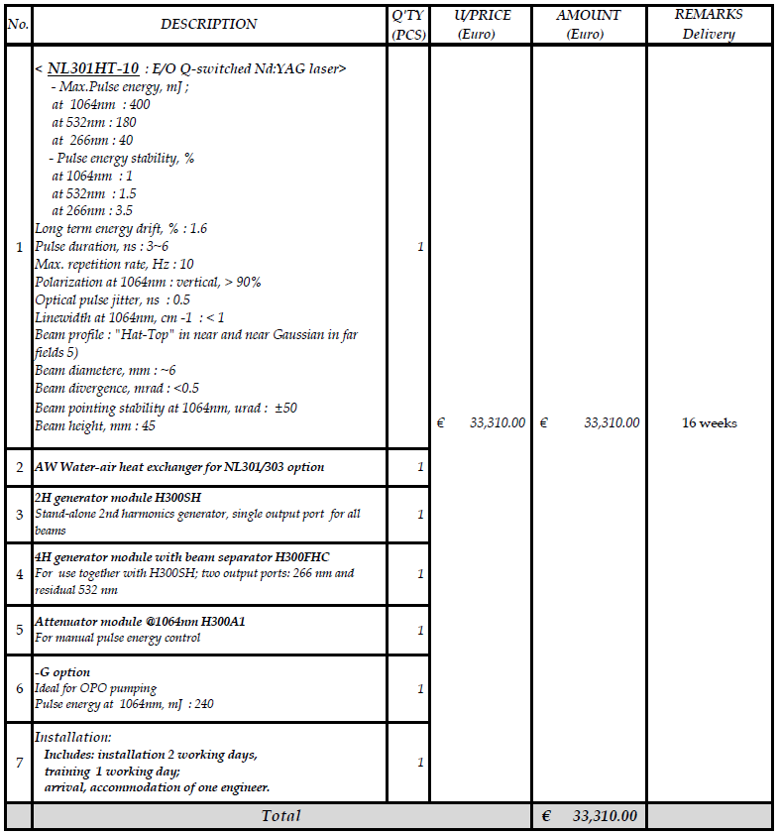
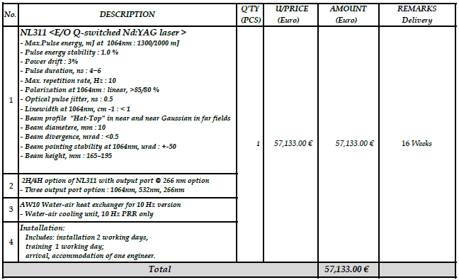
TPC R&D Plan
All electronics requested from PNU are at RISP
There are some difficulties
All of them got tax reduction and they have to be at RISP
Hard to make a plan for sending them to PNU
Laser system
~4800 만원
~8200 만원

Slide 11
TPC R&D Plan
All electronics requested from PNU are at RISP
There are some difficulties
All of them got tax reduction and they have to be at RISP
Hard to make a plan for sending them to PNU
Laser system
Can we setup TPC test bench at RISP?

