Slide 1

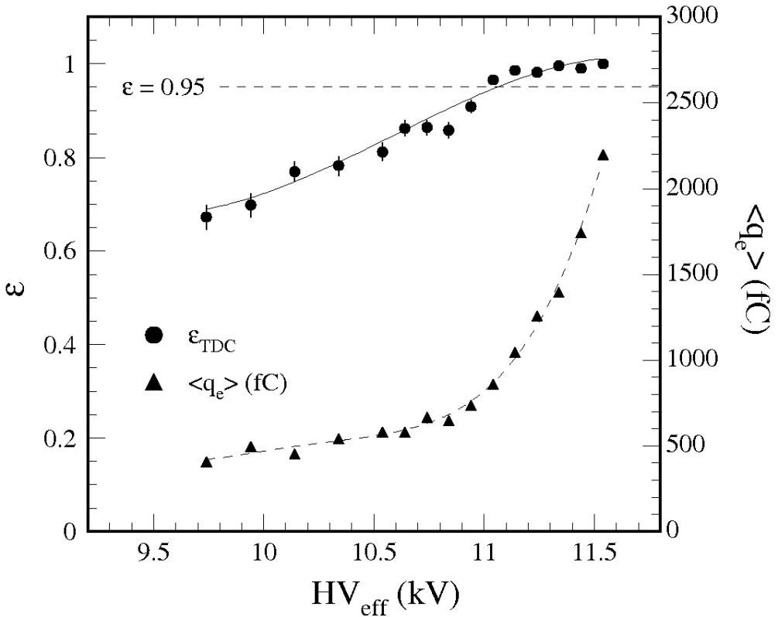
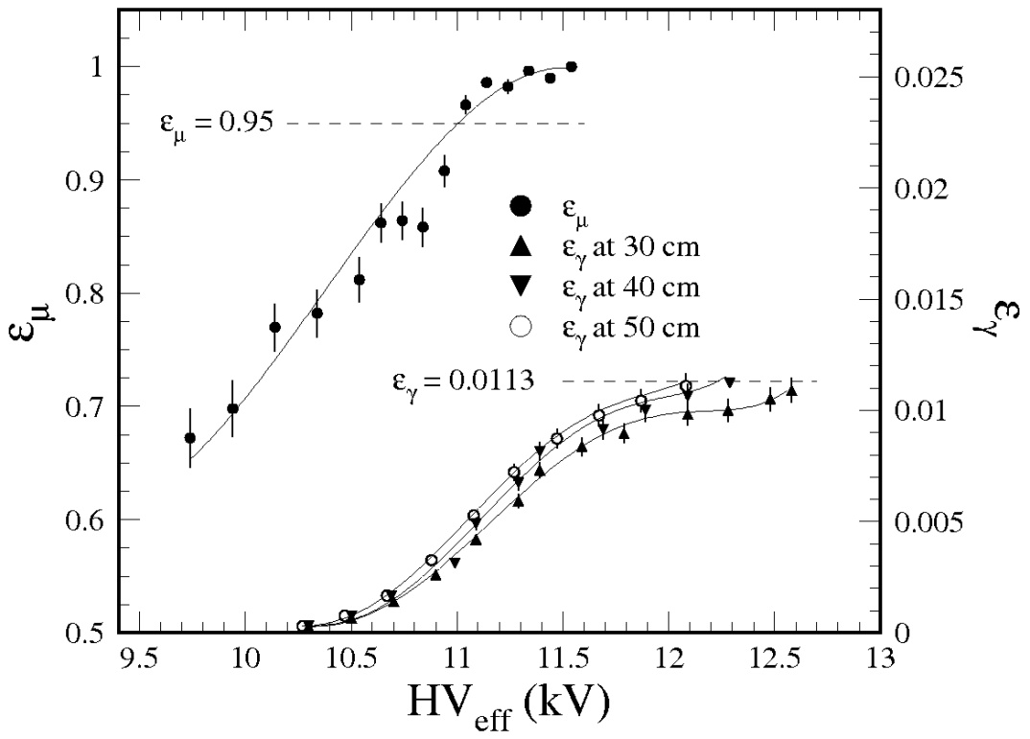
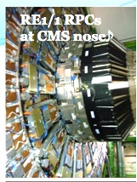
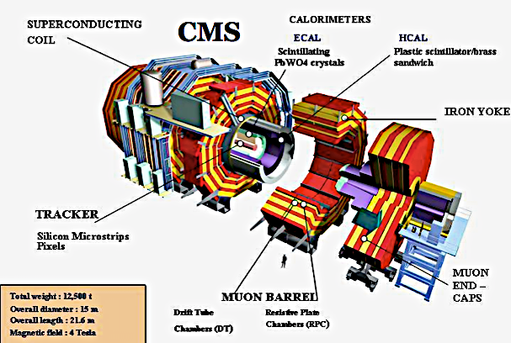
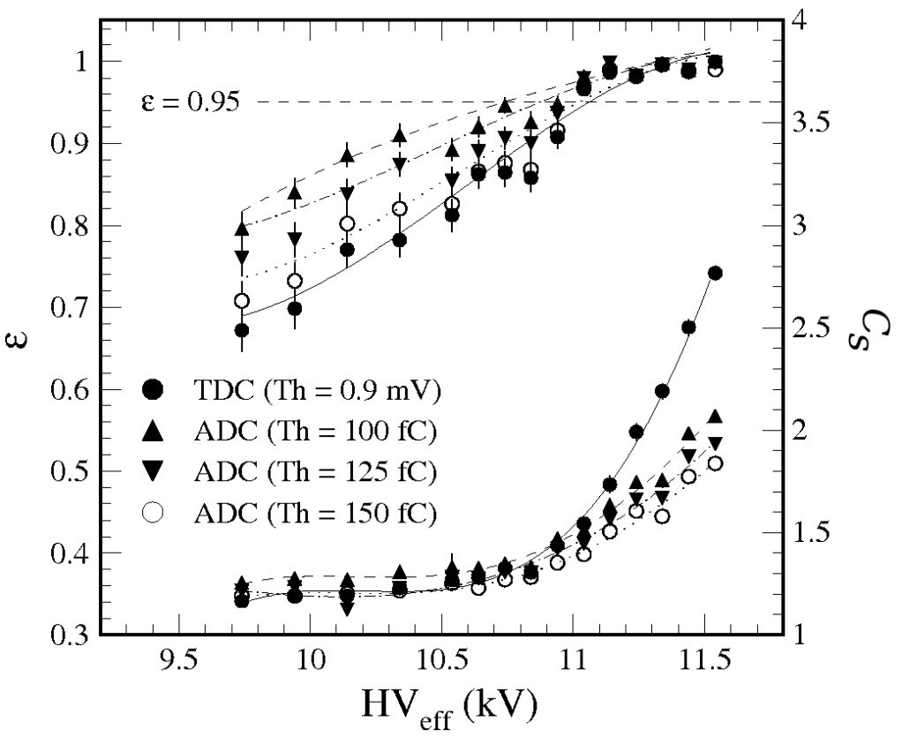
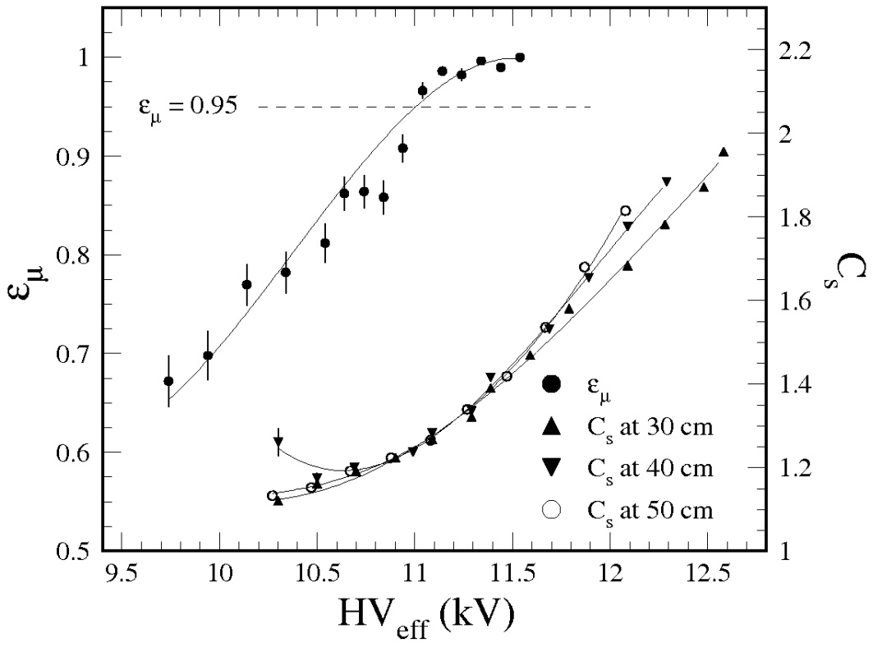
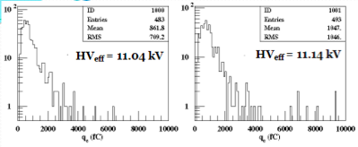
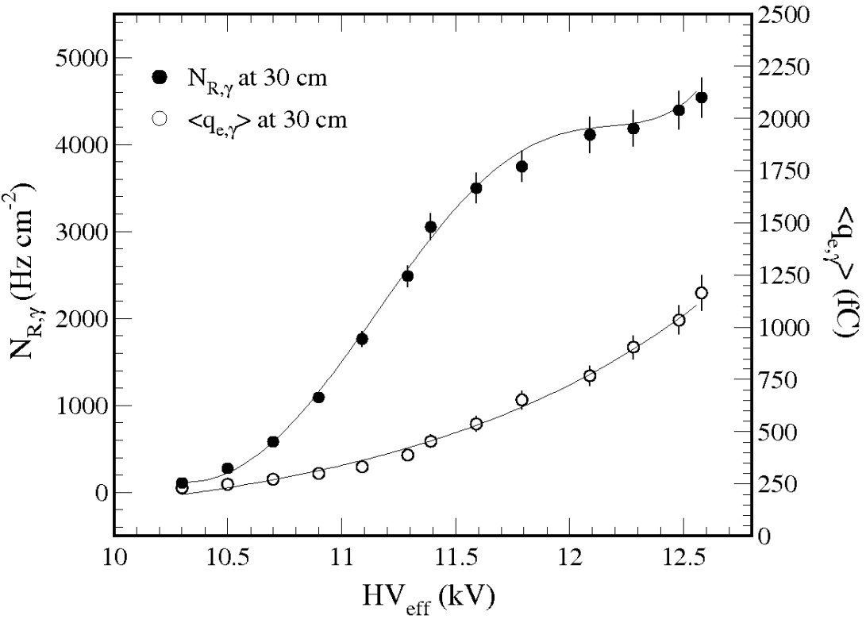
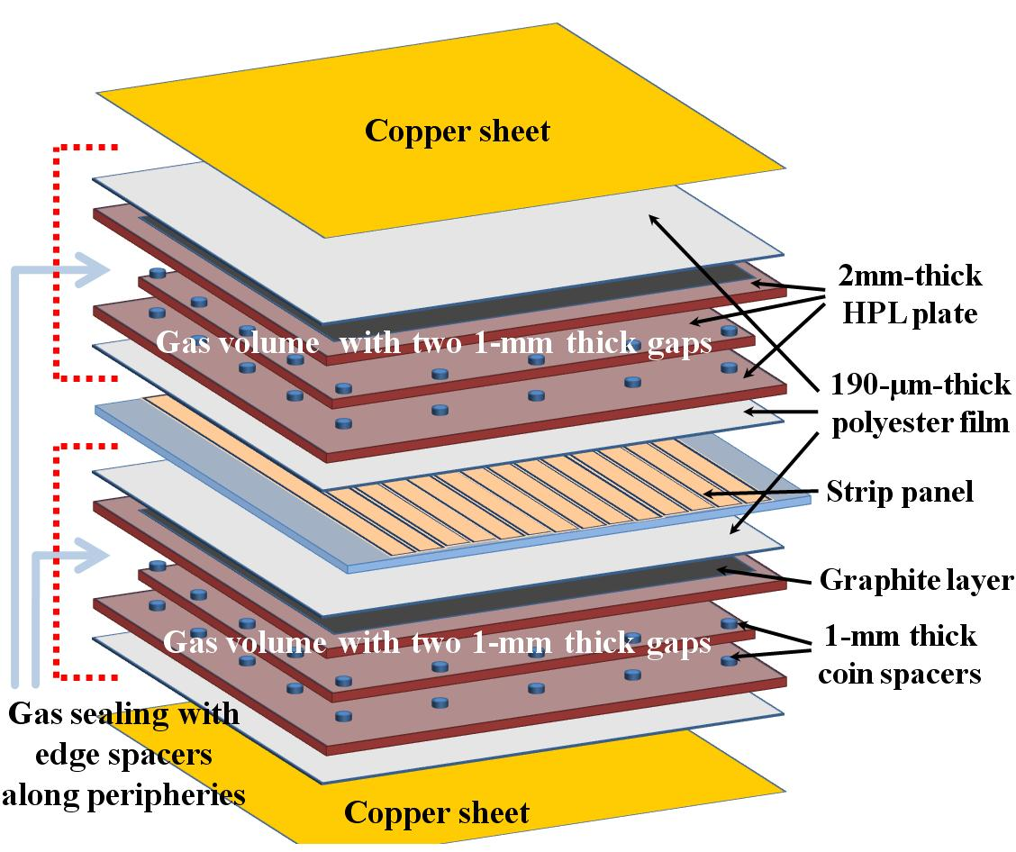
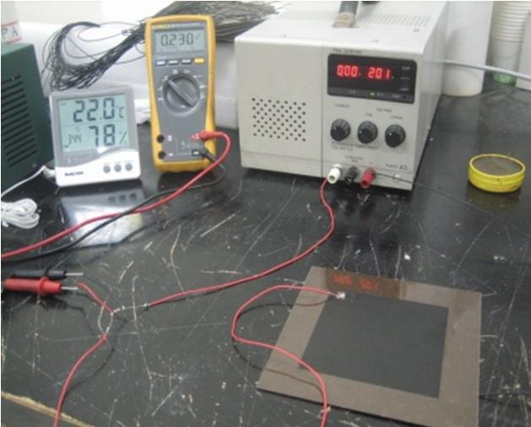
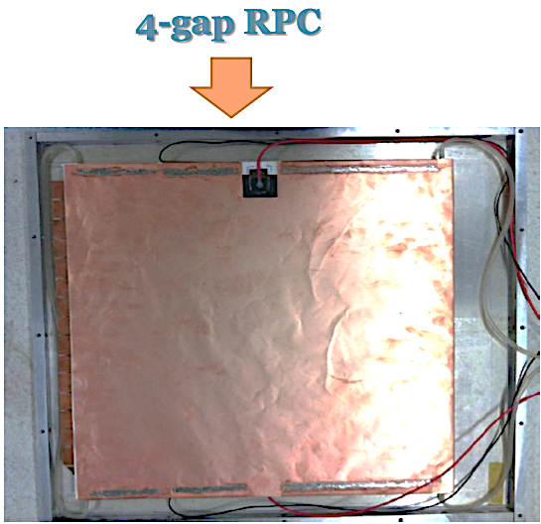
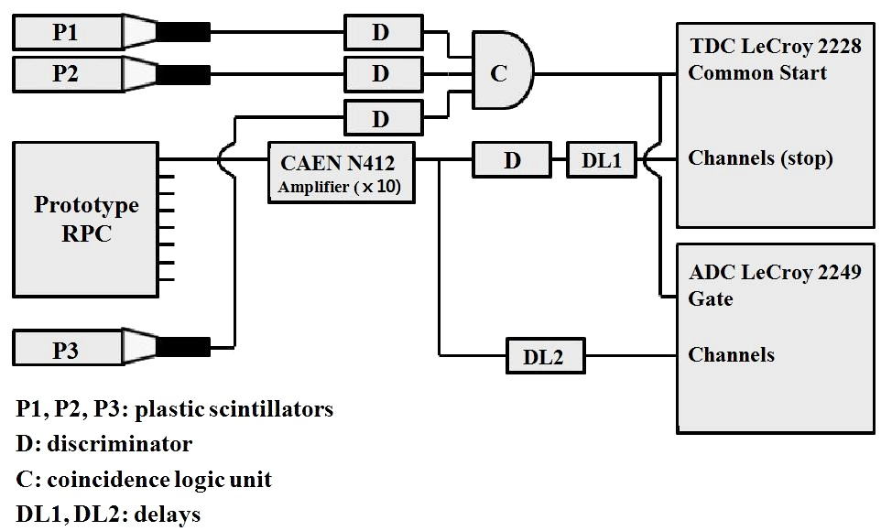
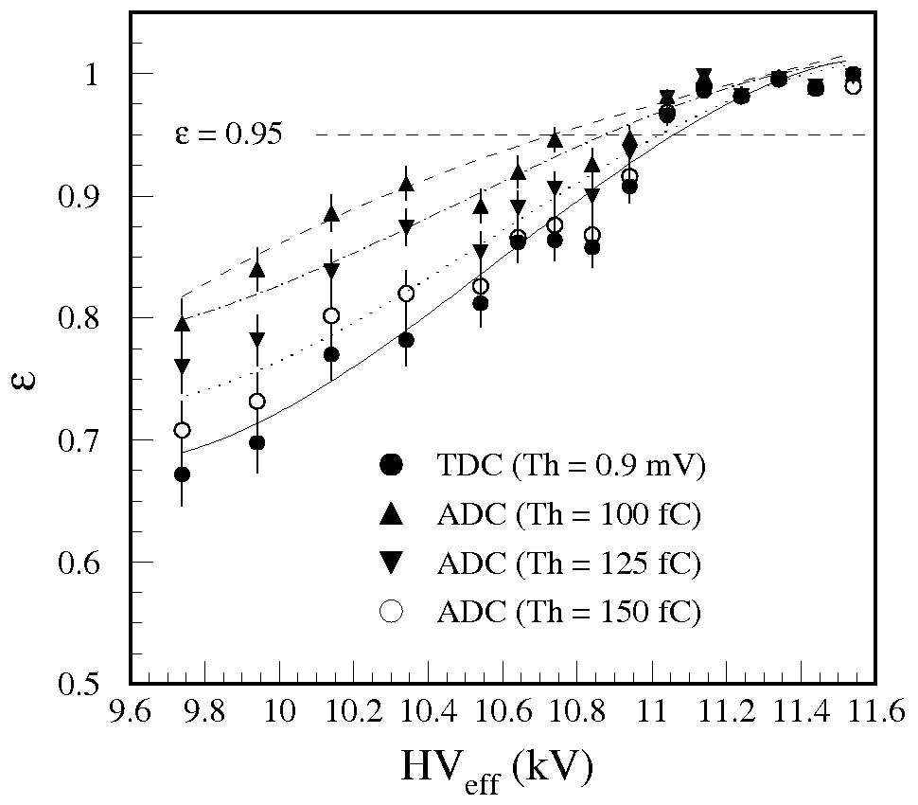
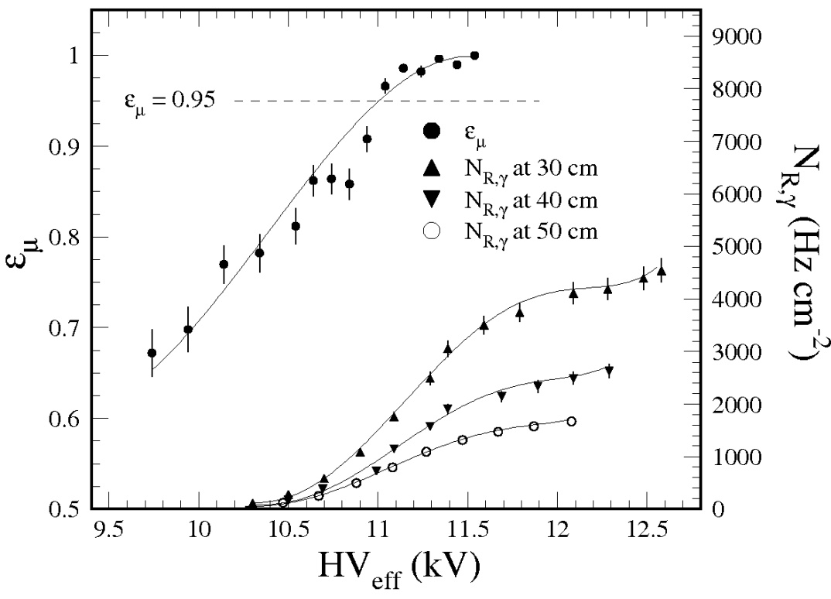
FOUR-GAP PHENOLIC RPC’S TEST RESULT WITH
COSMIC MUONS AND HIGH-RATE GAMMAS
Benard Mulilo, Byungsik Hong, Chong Kim, Eunah Joo, Genie Jhang, Hyuncheol Kim, Kisoo Lee, Kwang-Souk Sim, Kyongsei Lee¹,
Mihee Jo, Park Sung Keun¹,Seung Su Shin, Shin Young Kim¹, Songkyo Lee, Suhyun Lee^{,3}, Yeonju Go^{2,3},⁴
¹Korea University, ²Nuclear and High Energy Physics Laboratory
202013
ABSTRACT
Efficiencies & mean charges of muons
Muon and gamma efficiencies
Development of an oiled four gap Phenolic RPC for for use as high-rate particle in high energy physics experiments.
INTRODUCTION
Prototype RPC with 4 gaps made from HPL plates has been built.
Detector aims at reducing probability of radiation induced degradation &
Improvement of the detection rate capability.
Properties obtained using muons & gammas from a 200-mCi ¹³⁷Cs source
MOTIVATION
R & D to develop Panel-type multigap RPC using:
Oiled phenolic HPL resistive plates
95% Freon & 5% Iso-Butane Gas Mixture.
With high η covering: 0.9 < |η| < 2.1
Efficiencies & mean cluster sizes
Mean cluster size
Charge distribution of muons
Gamma rate & mean charge
PROTOTYPE PANEL-SHAPE 4-GAP RPC FABRICATION
Resistivity, ρ ~ 5.0 ⅹ10¹⁰ Ωcm at 20ºC
2- & 4-GAP RPC COMPARISON
 | 2-gap RPCs | 4-gap RPCs
Gap thickness | 2.0 mm | 1.0 mm
Total gap thickness | 4.0 mm | 4.0 mm
<q_{e}>avalanche mode | 2.5 ~ 7 pC | 1.2 ~ 2.5 pC
<q_{e}>at 200V> HV_{95%} | 4.0 pC | 1.4 pC
Type of HPL | Phenol+Mel | Phenol+Mel
Thickness of HPLs | 2.0 mm | 2.0 mm
Resistivity of HPLs | 1 ~ 5 ⅹ10¹⁰ Ωcm | ~ 1ⅹ10¹⁰ Ωcm
Rate capability | < 2.0 kHz cm⁻² | > 3.0 kHz cm⁻²
ELECTRONICS SETUP
TDC stops threshold = 9mV.
ADC thresholds in offline mode.
Scintillator signal voltage threshold = 30mV.
Noise data & γ-rays obtained by 1kHz clock trigger using 2GHz pulse generator
SUMMARY
4-gap RPC fabricated with similar tech. as 2-gap RPCs used in CMS.
Size of muon efficiency plateau ≥ 600V for 4-gap RPCs.
At 200V above HV_{0.95} , <q_{e}> ~1.25pC with threshold ~150fC.
HV shifts~ 500V at N_{γ} = 4.5 kHz cm⁻² with ρ = 5.0 ⅹ10¹⁰ Ωcm
No degradation found at N_{γ} = 4.5 kHz cm⁻²
Aging issue:<q_{e}> ~1/3 of 2-mm double gap RPCs.
MILESTONES
QA based R&D for the 4-gap RPC manufacture procedure and parts.
Real-size prototype 4-gap RPCs in the high-η regions (RE1/1, RE2/1, RE3) could be used.
Gate width for avalanche pulses (FWHM < 10ns) = 40ns.
Accuracy for avalanche charge for each event = 20~ 60fC.
Triggers->3 plastic scintillators; time resolution~500ps.
TEST RESULTS
(1) Test with Cosmic Muons
(2) Test with High-Rate ϒ’s
REFERENCE
Muon Efficiencies
Gamma rates
CMS collection, Detector performance and software? Technical design report Volume 1, CERN-LHCC 2006-001 (2006)
CMS collaboration, The Muon project, technical design report, CERN-LHCC-97-032 (1997).
H.C. Kim et al>, Quantitative aging study with intense irradiation tests for the CMS forward RPCs, Nucl. Instrum. Meth. A 533 (2009) 102.
M. Abrescia et al., Study of long-term performance of CMS RPC under irradiation at the CERN GIF, Nucl. Instrum. Meth. A 533 (2004) 102.
S. H. Ahn et al., Characteristics of a double gap resistive plate chamber for the endcap region of CMS/LHC: data vs simulation in avalanche mode, Nucl. Instrum. Meth. A 533 (2004) 32.
For more details, please contact: Prof. Lee Kyongsei, Department of Physics, Korea University; Email: kslee0421@korea.ac.kr

