Slide 1



Status of PHENIX RPCs at Run 13
C. Kim¹, * B. Hong¹, Eunah Joo¹,
and PHENIX Forward Upgrade Group²
¹ Department of Physics and Korea Detector Laboratory, Korea University, Seoul 136-713
²Brookhaven National Laboratory, New York 11973
for the PHENIX collaboration

Slide 2
Outline
Introduction
  RHIC and PHENIX
  W physics
  PHENIX Run 13
PHENIX RPCs
  Overview
  Production, QA, and Installation
  Status at Run 13
Summary and Perspectives

Slide 3
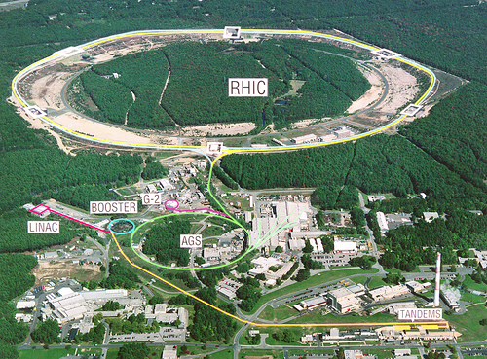
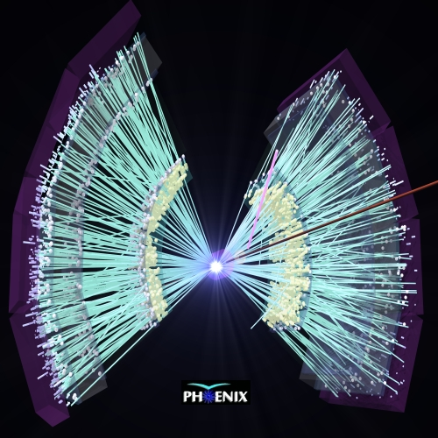
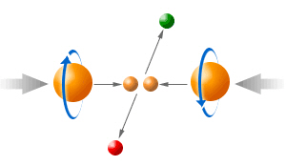
1. Introduction - a. RHIC and PHENIX
PHOBOS
BRAHMS
PHENIX
STAR
RHIC (Relativistic Heavy-Ion Collider) at BNL, NY, US:
    Max. √s_{NN} : 510 GeV (pp) / 200 GeV (AA)
    Max. luminosity: 1.5 × 10³² cm⁻² s⁻¹ (pp) / 2 × 10²⁶ cm⁻² s⁻¹ (AA)
    The only machine capable of colliding high-energy polarized proton beams
PHENIX (Pioneering High-Energy Nuclear Interactions eXperiment):
    One of the two ongoing physics experiments at RHIC
    Goal: Discover and examine the QGP & Analyze the proton spin

Slide 4
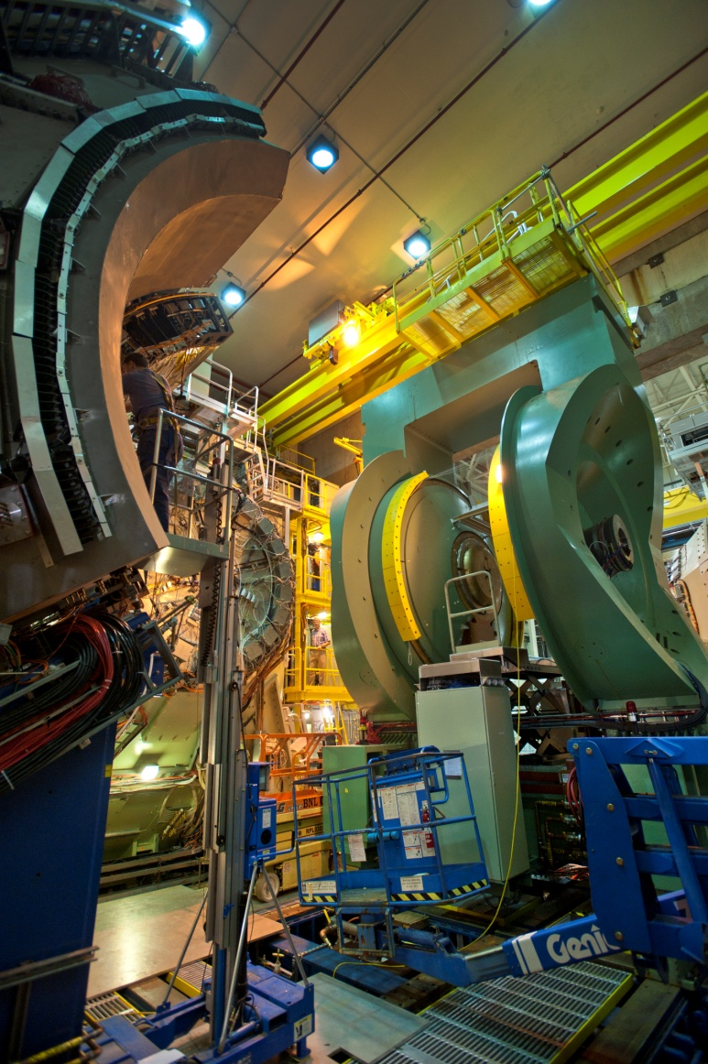
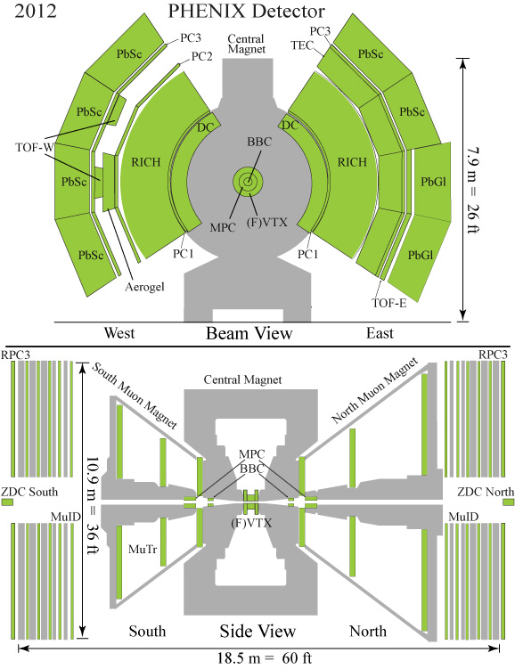
1. Introduction - a. RHIC and PHENIX
PHENIX detector

Slide 5
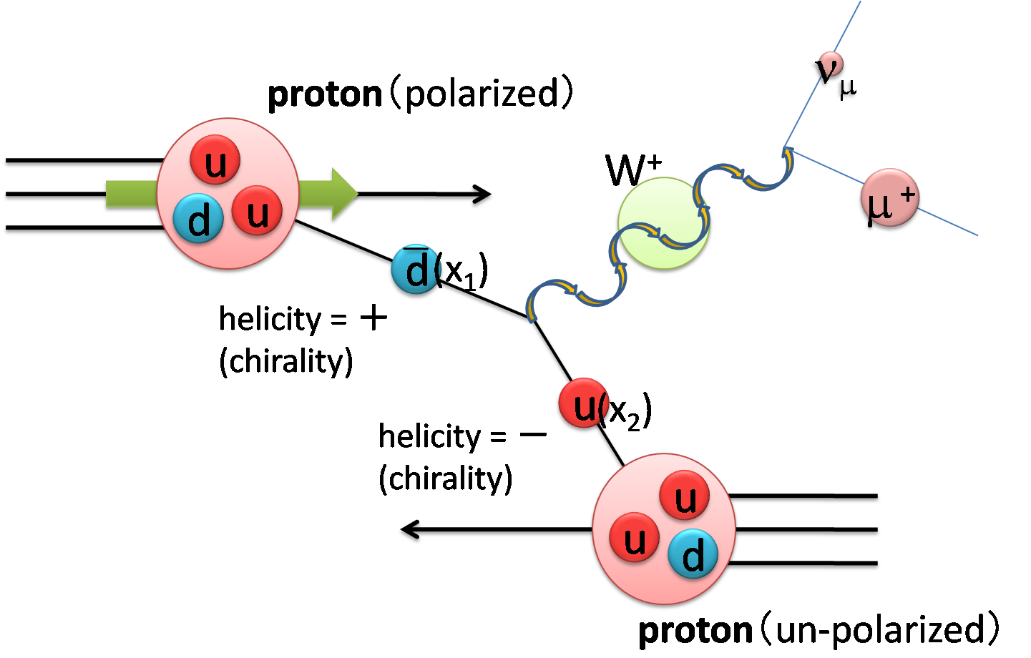
1. Introduction - b. W physics
Spin crisis:
    DIS result at 1980s: proton spin is not a simple sum of its constituent quarks
    Component-by-component approach:
    quarks/antiquarks, gluons, and their angular momenta
    → ½ = ½ΔΣ + ΔG + L_{z}
W measurement at PHENIX:
    Full flavor separation of quarks/antiquarks
    Measure the polarization of the quark by leptons decayed from W boson
ΔΣ = 0.366 ± 0.017
for Q² = 10 and 0.001 ≤ x ≤ 1
A_{L}^{W}: single spin asymmetry
p: beam polarization (Max. 70 % for 510 GeV pp)
N^{L(R)}(W) : # of events contains the muons from W
with corresponding helicity (L or R)

Slide 6
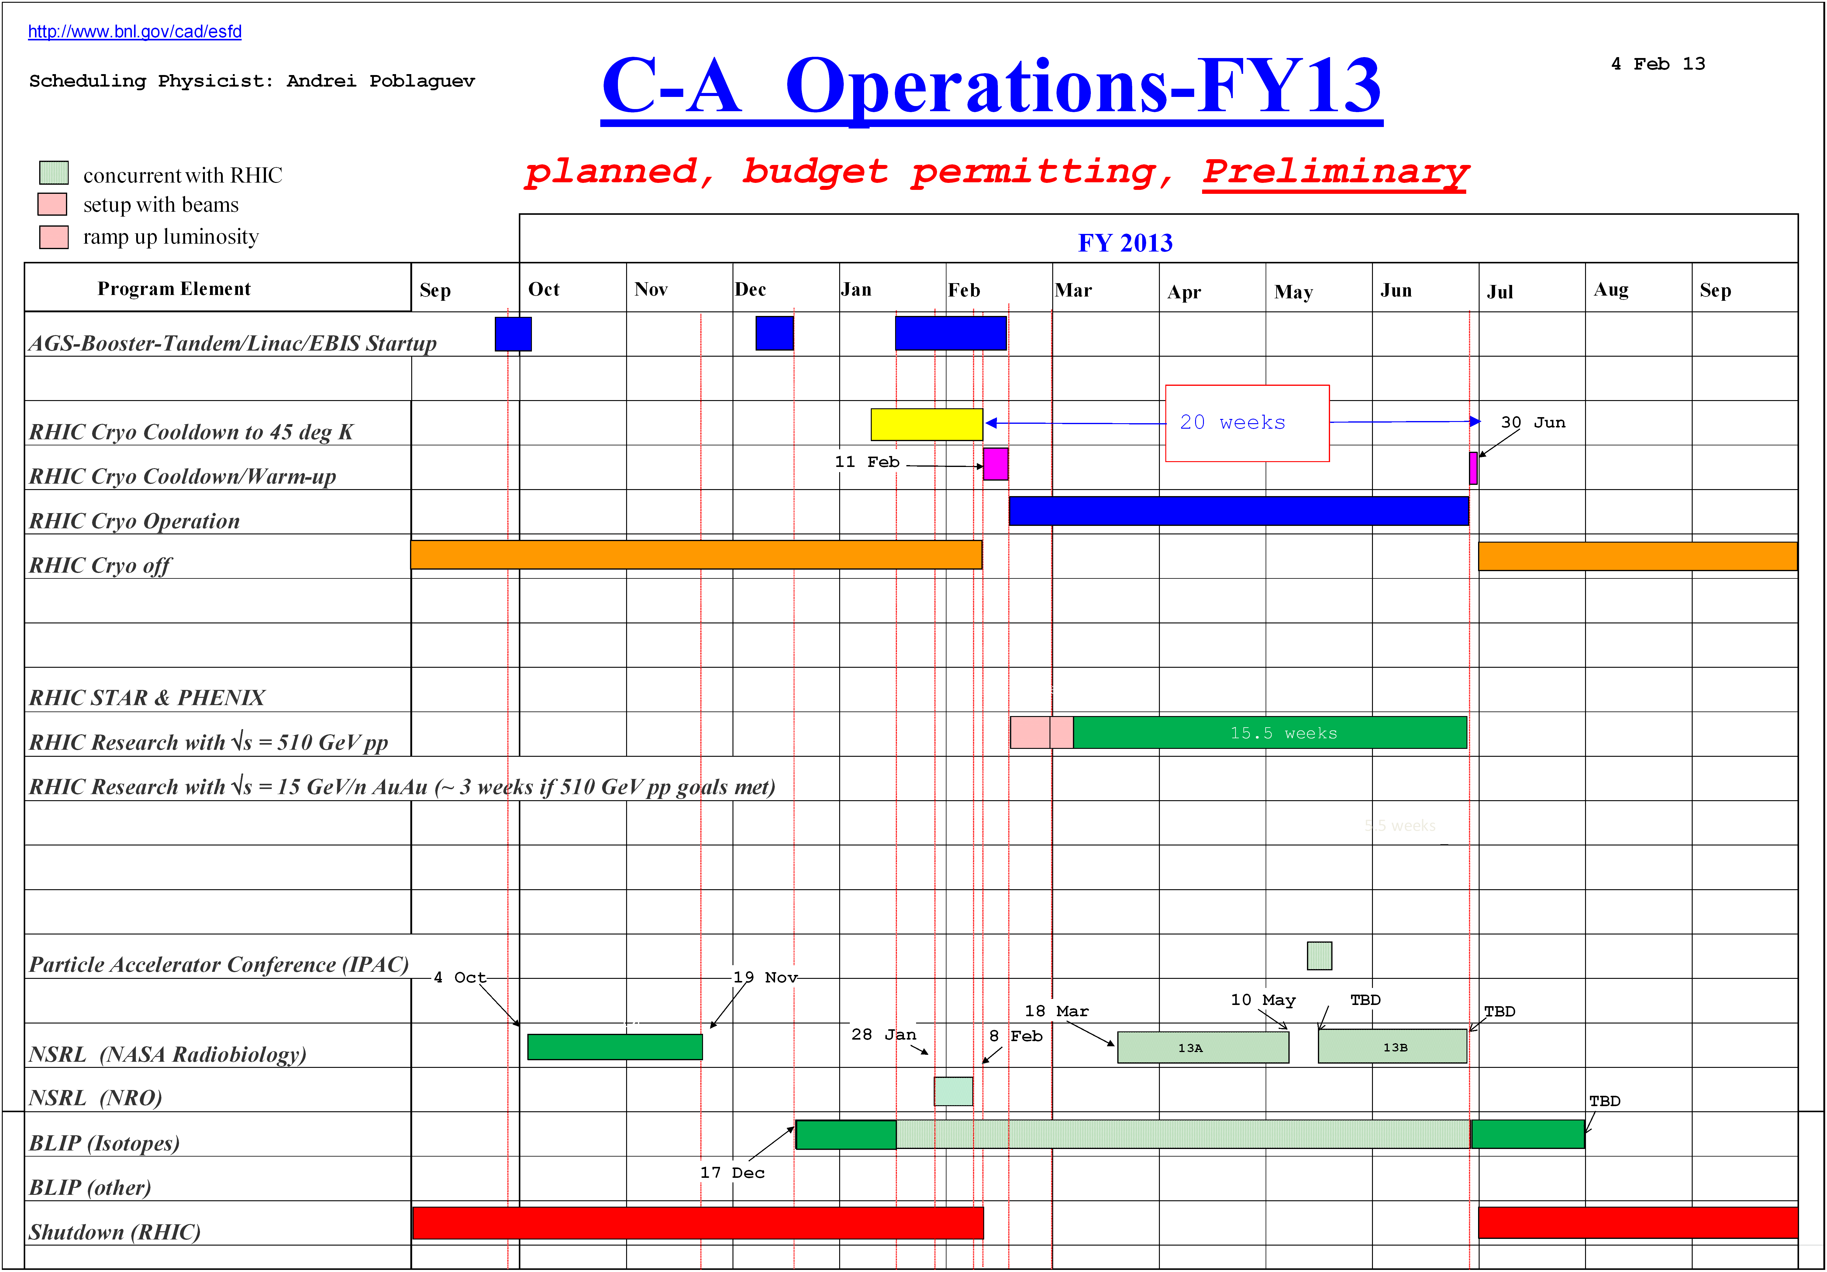
1. Introduction - c. PHENIX Run 13
PHENIX Run 13 - focused Run for the W measurement
    Major updates from Run 12: RPC1 integrated to trigger, FVTX data available

Slide 7
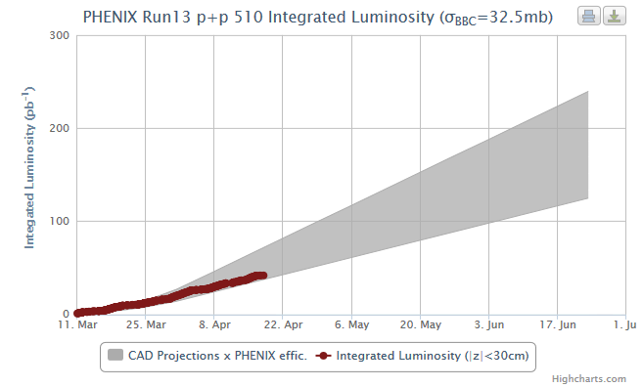
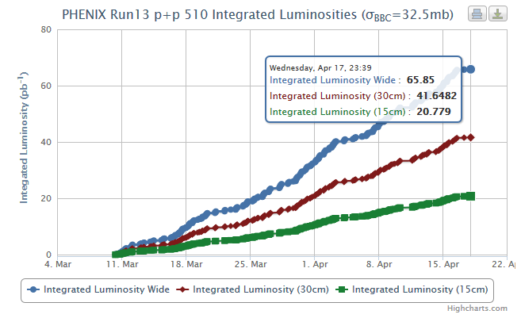
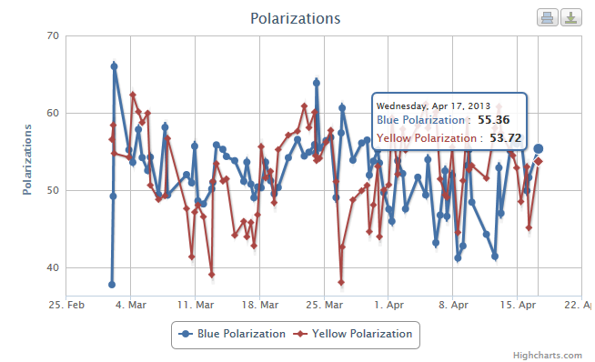
1. Introduction - c. PHENIX Run 13
Achieved (Run 11/12)
 | Goal (total) | Run 11 | Run 12
L (pb⁻¹) | 300 | 17 | 30
P (%) | 55 | 51 | 56
Run 13
 | Goal (total) | Current (4/15) | Target
L (pb⁻¹) | 300 | ~ 40 | 250
P (%) | 55 | ~ 50 | 55

Slide 8
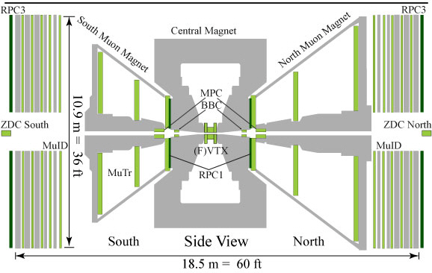
2. PHENIX RPCs - a. Overview
RPC 3
MuTRG
RPC 3
RPC 1
  SS310 (35 cm) absorber
PHENIX forward muon trigger upgrade for W program
  35 cm SS310 (Stainless Steel) absorber: reduce low-p hadron’s punch through
  MuTRG: fast determination of high momentum tracks (tracking)
  RPC: provide timing information and rough position information (timing + tracking)

Slide 9
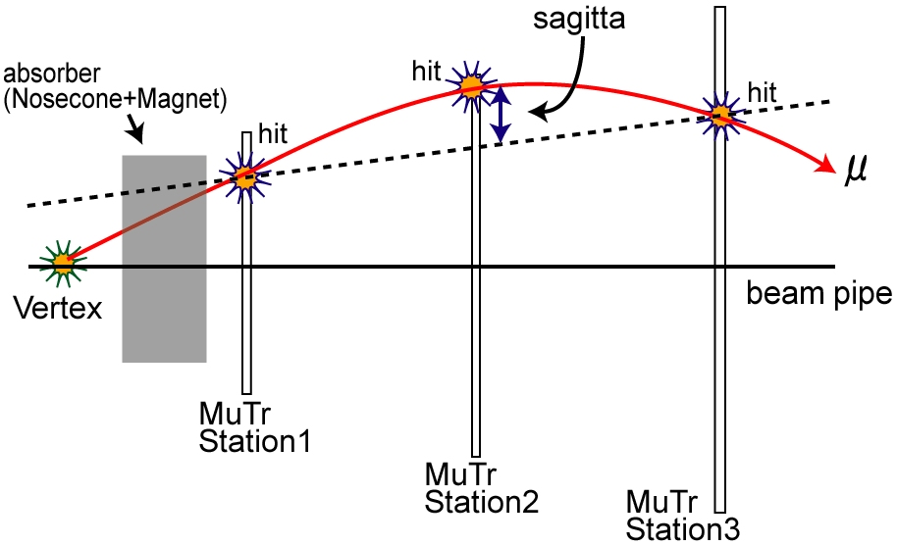
2. PHENIX RPCs - a. Overview
  SS310 (35 cm) absorber
RPC 1
RPC 3
Momentum selectivity through online sagitta measurement
    Uses MuTr station 1, 2, 3 and RPC station 1, 3
    Implement trigger using fast, parallel logic on FPGA’s
    Beam related background rejected by RPC’s timing information

Slide 10
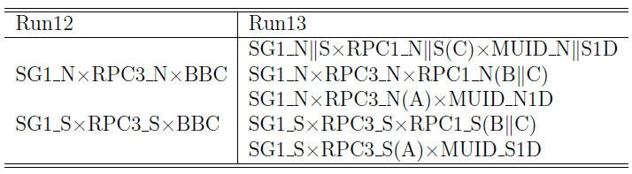
2. PHENIX RPCs - a. Overview
Update in Run 13 trigger configuration: RPC1 integrated to the DAQ during Run 12
1.185
1.388
483.3
η acceptance of RPCs
(side view)
1.615
376.1
1.653
361.0
Run 13
1.949
1.993
264.1
252.2
Run 12
2.069
RPC1
2.557
141.6
~ 105
RPC3
~ 64
~ 40
Beam pipe
155.75
908.05

Slide 11
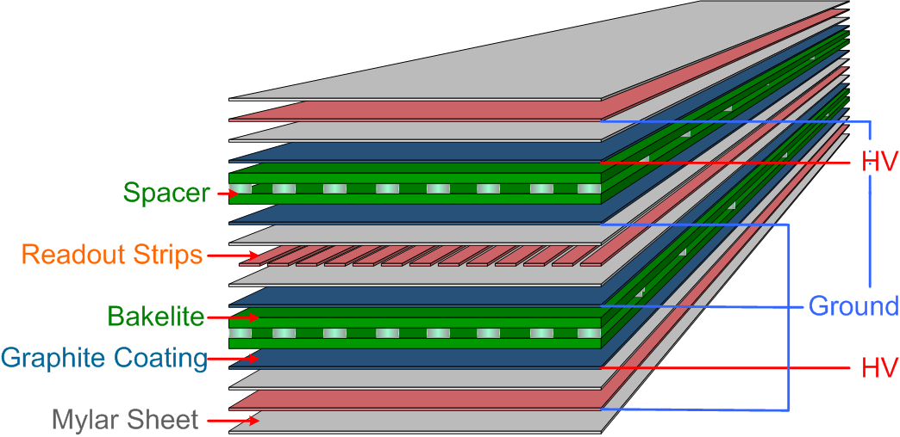
2. PHENIX RPCs - a. Overview
PHENIX RPC requirements Most conditions are same as those for the CMS endcap RPCs
Time resolution | ≤ 3 ns
Average cluster size | ≤ 2 strips
Efficiency | ＞ 95 %
Rate capability | 0.5 kHz/cm²
Average noise rate | ＜10 Hz/cm²
# of streamer mode | ＜10 %
Module frame (Al)
Mylar sheet
Cu foil (2 mm)
PHENIX muon trigger RPC
    Bakelite double gap RPC
    Based on CMS endcap RPC technology and expertise
    Fast time response: 1 ~ 2 ns for MIP
    Gas mixture:
      95 % C₂H₂F₄ (R134A, base gas for avalanche mode RPC)
      4.5 % i-C₄H₁₀ (isobutane, photon quencher)
      0.5 % SF₆ (electron quencher)
      ~ 40 % relative humidity

Slide 12

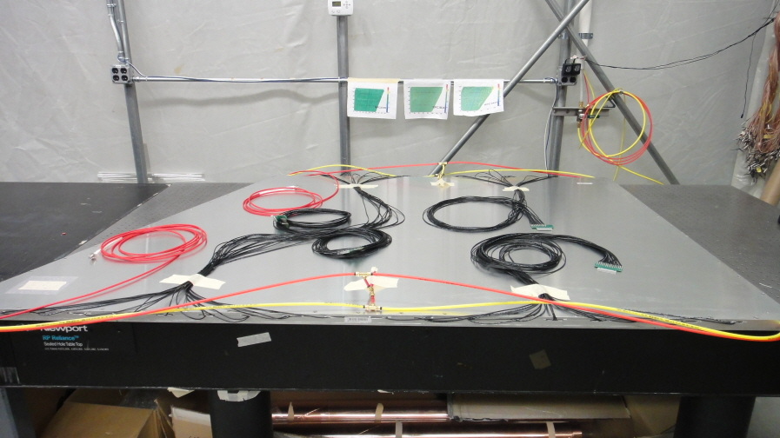
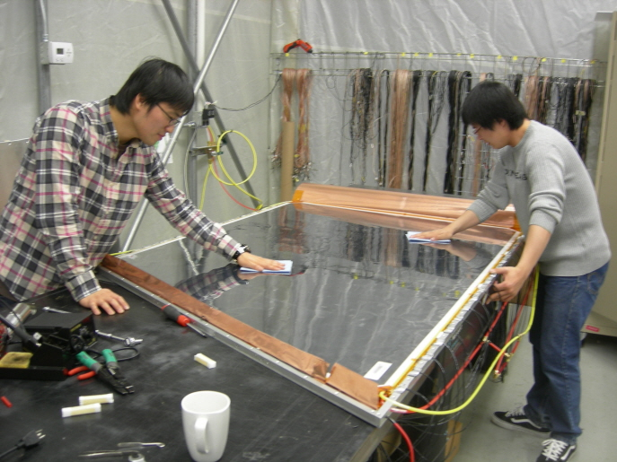
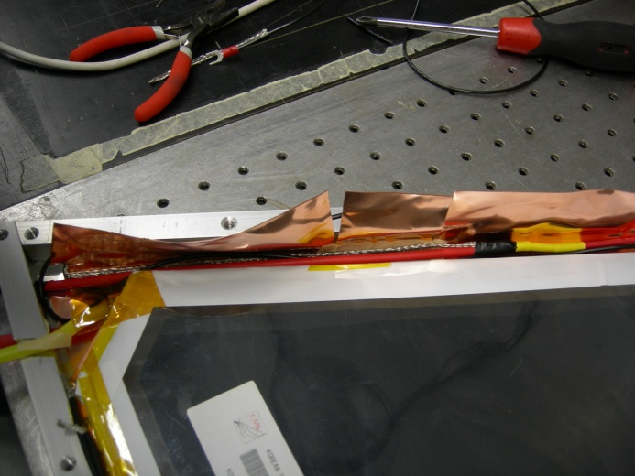
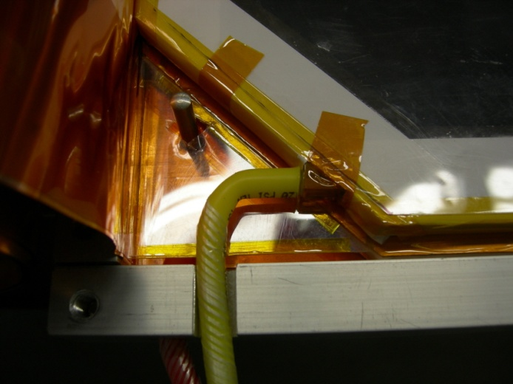
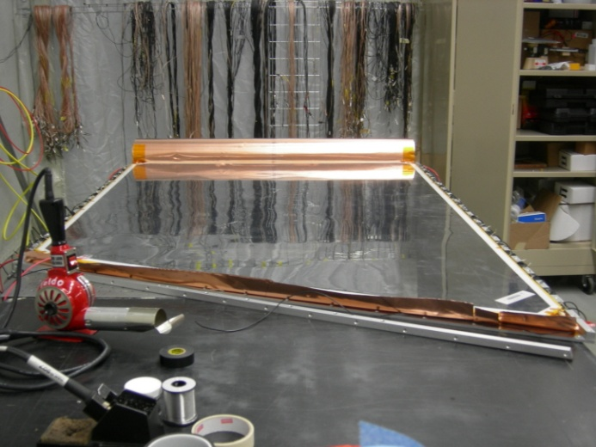
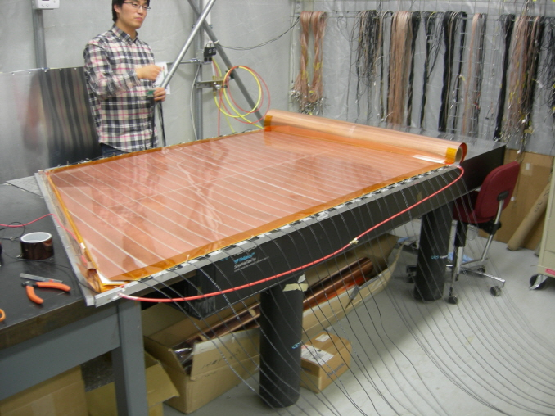
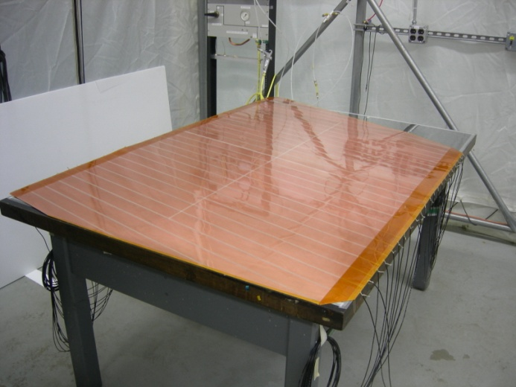
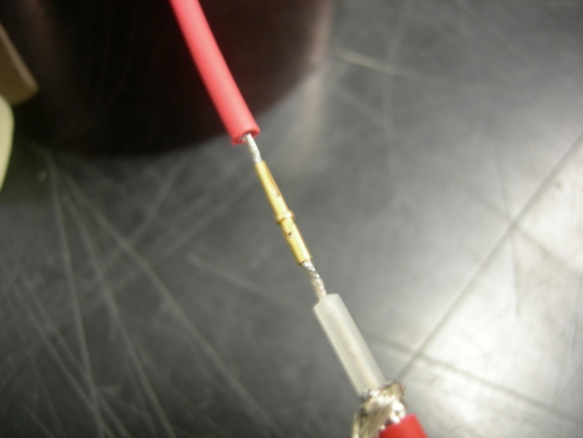
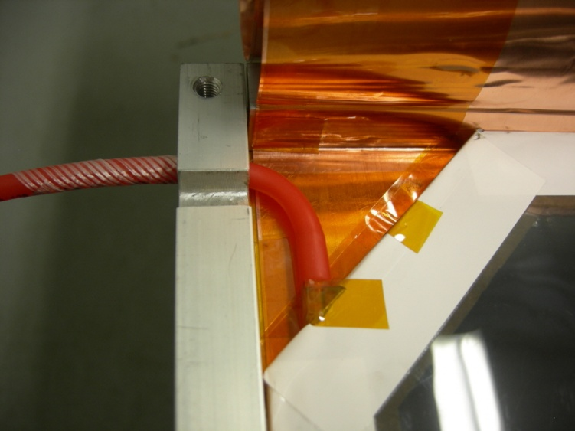
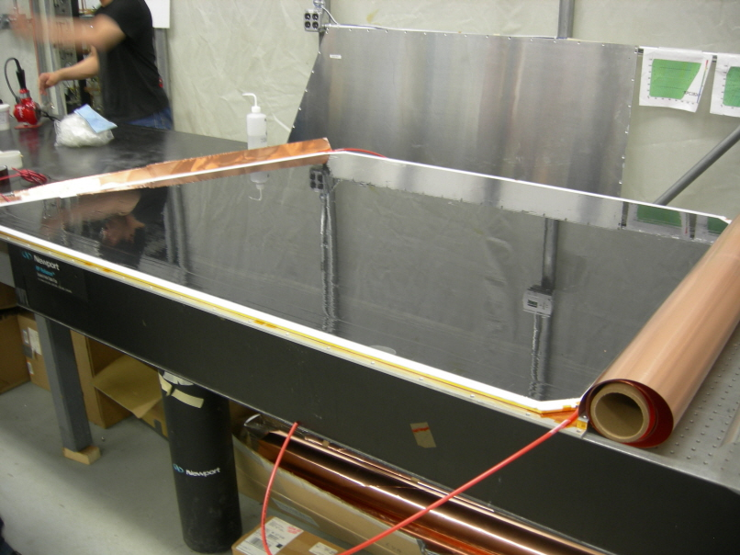
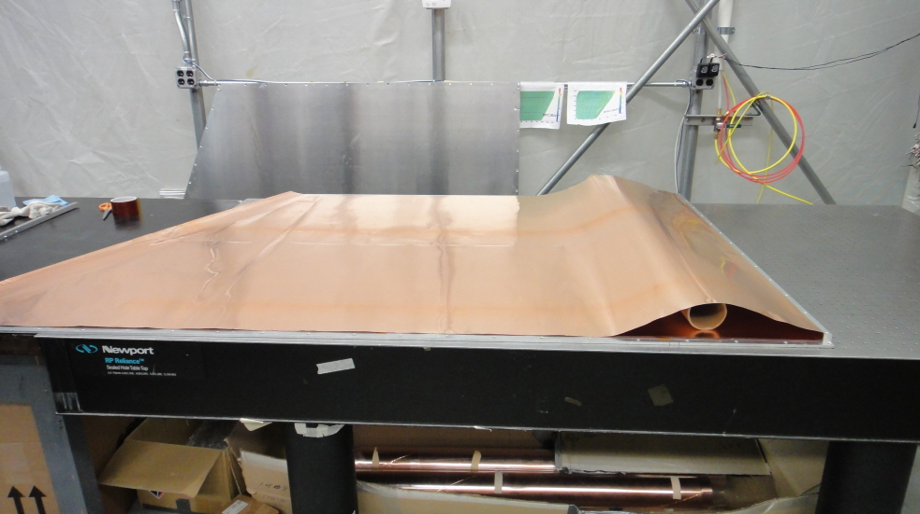
2. PHENIX RPCs - b. Production, QA, and Installation
Cu readout strip
Gap
Module assembly flow
2 mm Cu foil
Module frame (Al)
Lay down a Mylar sheet & Cu foil
on the bottom module frame
Put lower gap &
Attach service lines (HV, gas)
Prepare readout strips &
Place it on the lower gap
Put upper gap on the strip &
Attach service lines
Put a Mylar sheet on upper gap &
Wrap the cu foil
Fully assembled RPC detector module
Place lower gap into Cu foil & Connect Polyethylene gas tubes
Connect CPE cable to H.V cable on the bottom RPC gap
Connect CPE cable to the H.V cable (upper gap)
Preparing readout strip (attach signal cables)
Put upper gap on the readout strip
Put readout strip on the lower gap
Connected gas tube
Before wrap the Cu foil
Connect gas tubes to the upper gap
Lay down Cu foil on the Mylar sheet (+ frame)
Close module frame
Assembly of module 3C
Modules for the station 3: ALL (total 96) modules were produced

Slide 13
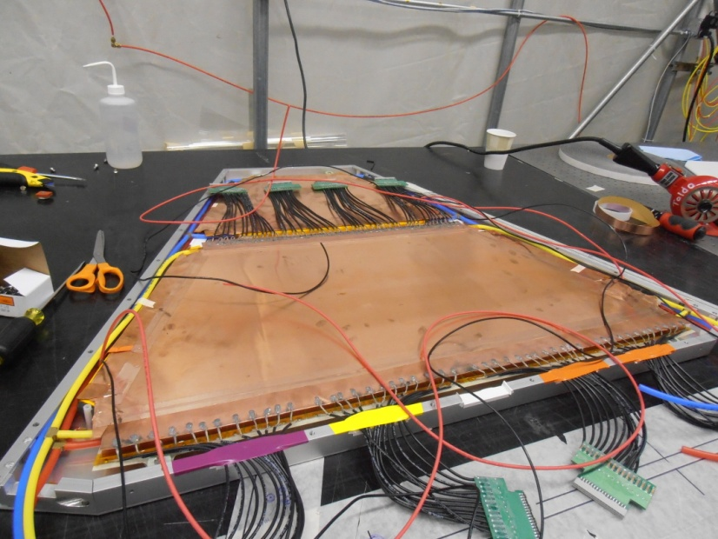
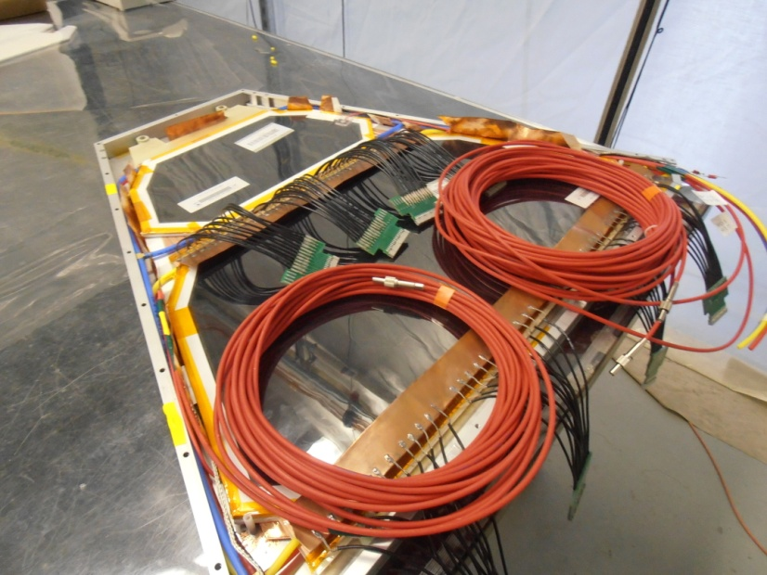
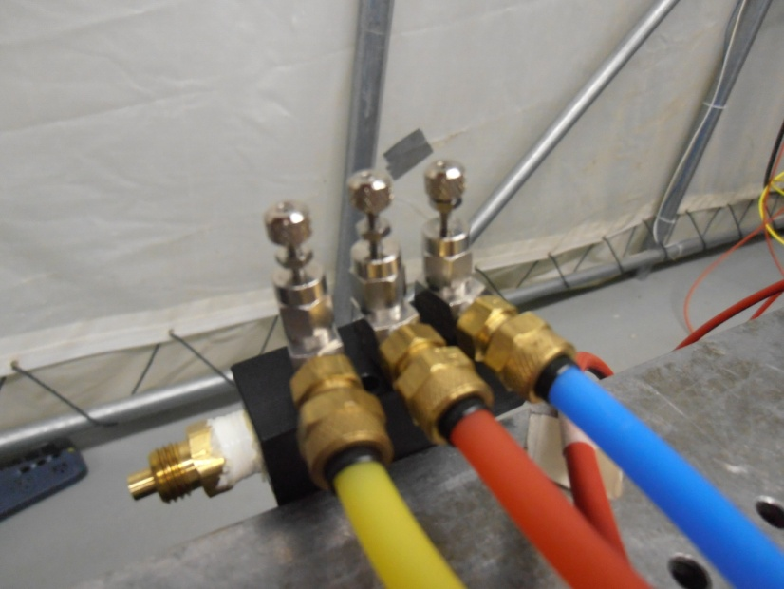
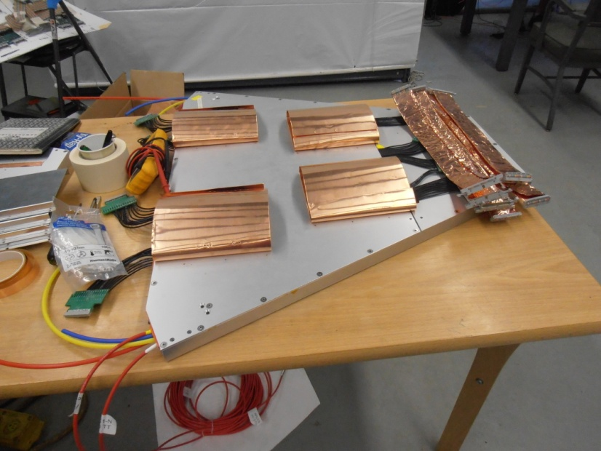
2. PHENIX RPCs - b. Production, QA, and Installation

Slide 14
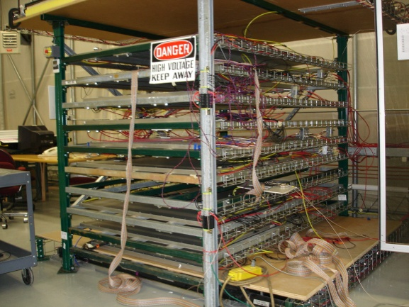
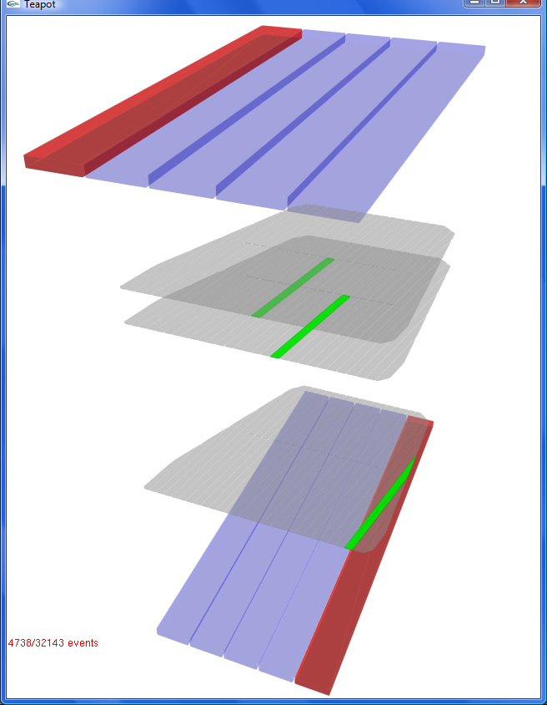
2. PHENIX RPCs - b. Production, QA, and Installation
Module QA
RPC cosmic ray test stand - event display
Before assembly
(Gap QA)
Spacer pop check
Gas leakage check
HV hold
Dark current
cosmic ray
trigger scintillators
RPC readout strip
planes
After assembly
(module QA)
Noise rate check
Cosmic ray test
cosmic ray trajectory
QA (Quality Assurance) for a detector module:
    Before assembly: spacer condition, gas leakage, HV hold and dark current
    After assembly (test by cosmic muons):
    noise rate, total & strip efficiency, time resolution & cluster size

Slide 15
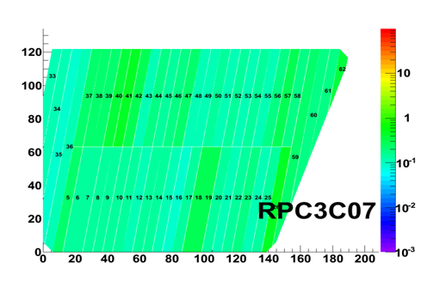
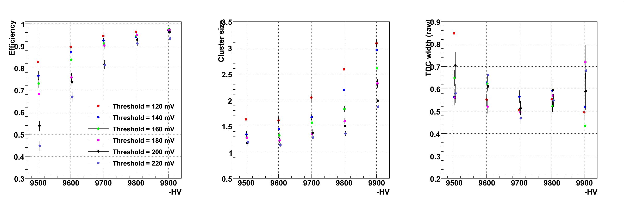
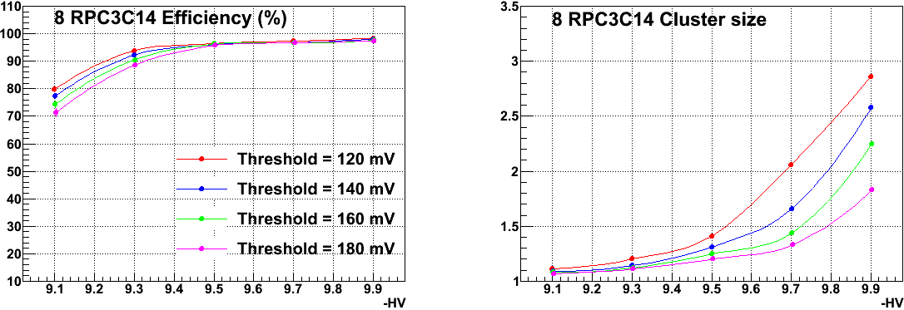
2. PHENIX RPCs - b. Production, QA, and Installation
Module QA results
Noise rate:
RPC HV = 9.5 kV, PHENIX RPC FEE threshold = 160 mV
Time resolution vs. HV
Raw TDC :
1 unit = 100 ns/44 = 2.41 ns
Noise rate (Hz/cm²)
Efficiency of a module (%) vs. HV
with different threshold
Cluster size of a module vs. HV
with different threshold
PHENIX requirements
Operation voltage
Operation voltage
PHENIX requirements

Slide 16
2. PHENIX RPCs - b. Production, QA, and Installation
RPC 3
RPC 3
2.05 m
Module C
RPC3
Module B
4.93 m
Module A
0.54 m
Station 3 (16 half octants)
A half octant (3 RPC modules)
RPC station 3
    One side (N or S) of RPC station 3 is composed of 16 half octants
    A half octant is composed of 3 RPC modules (type A, B, and C)
    Each module is a double-gap RPC which satisfies PHENIX requirements

Slide 17
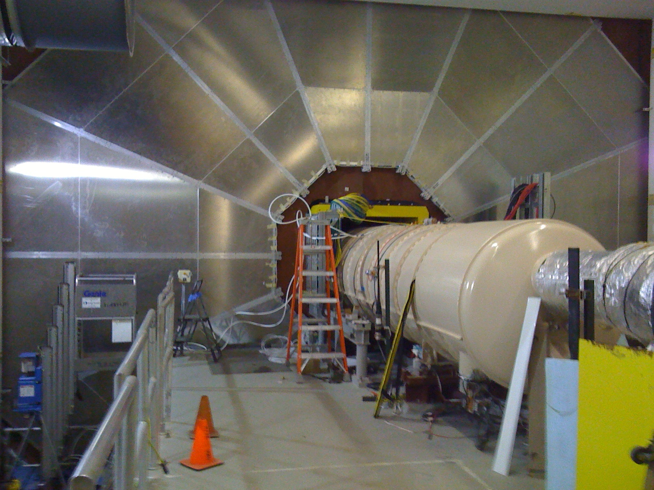
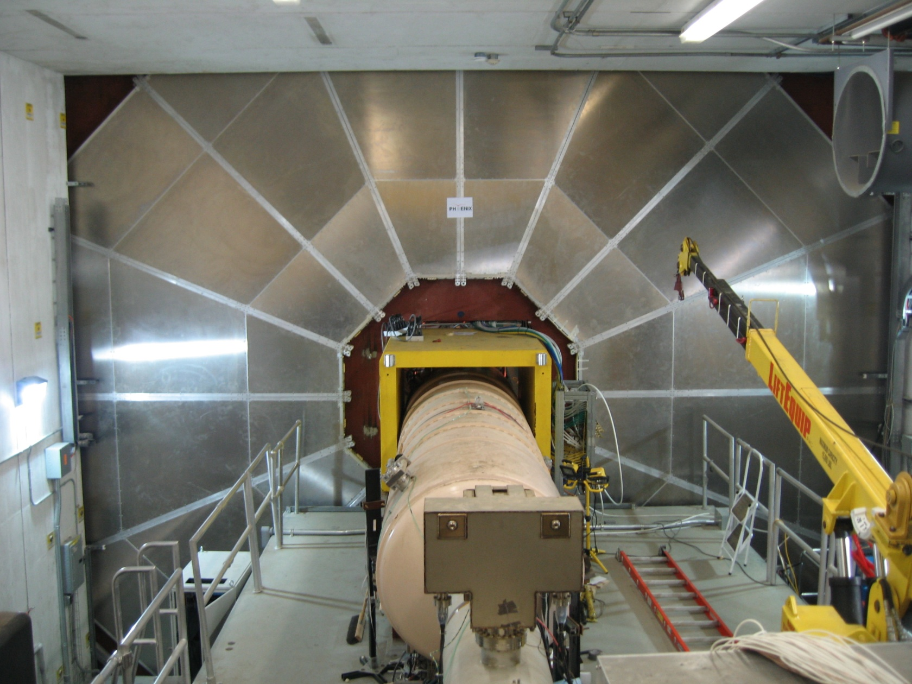
2. PHENIX RPCs - b. Production, QA, and Installation
RPC3N - installation (Nov. 11th, 2009)
RPC3S - installation (Sep. 22nd , 2010)
Fully integrated to the PHENIX DAQ system during Run 11

Slide 18
2. PHENIX RPCs - b. Production, QA, and Installation
90 cm
RPC1
Octant
67 cm
RPC 1
34 cm
RPC station 1
    Composed of 16 octants for both sides (8 octants per side)
    Each octant is a double-gap RPC

Slide 19
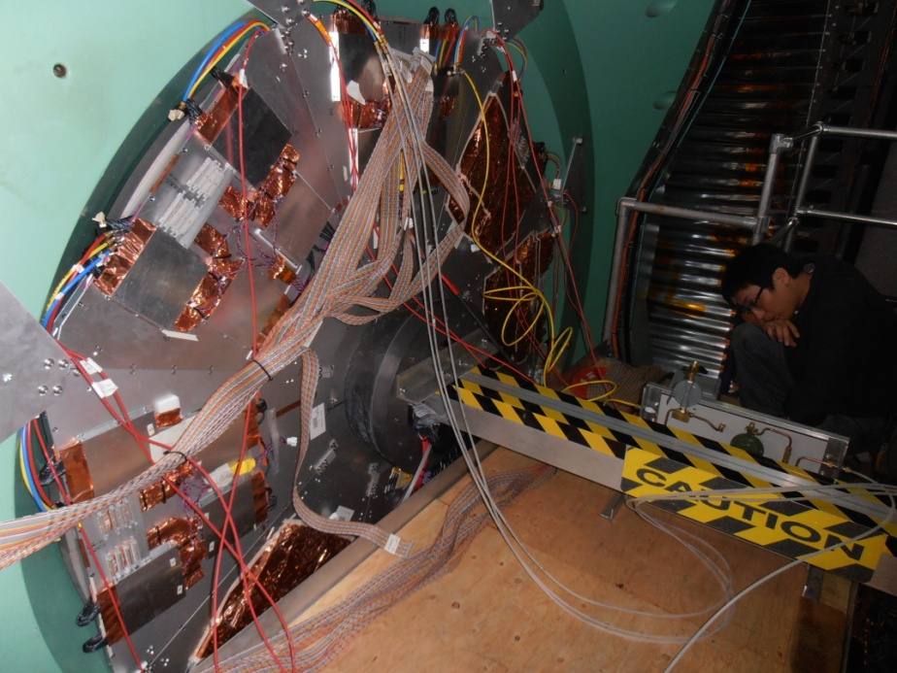
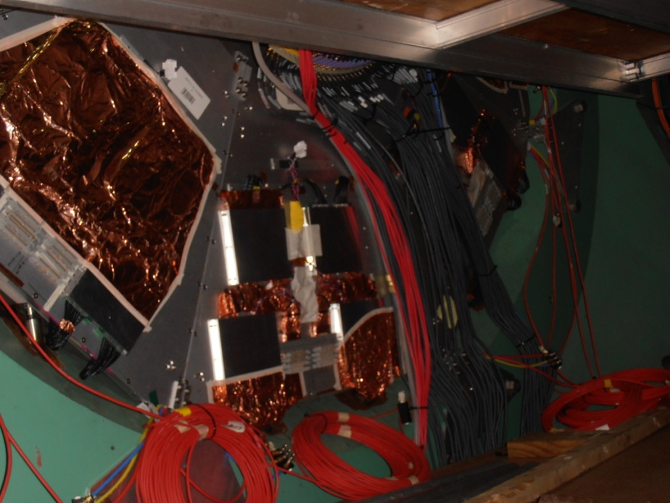
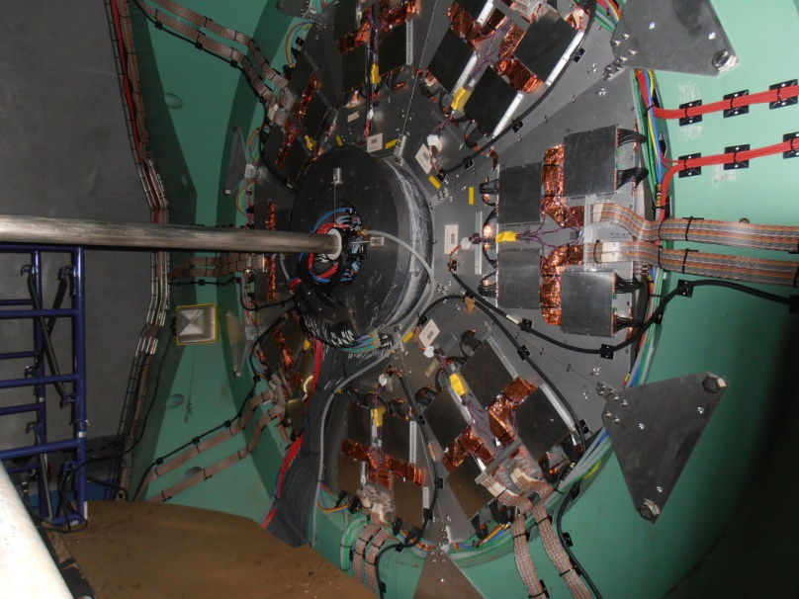
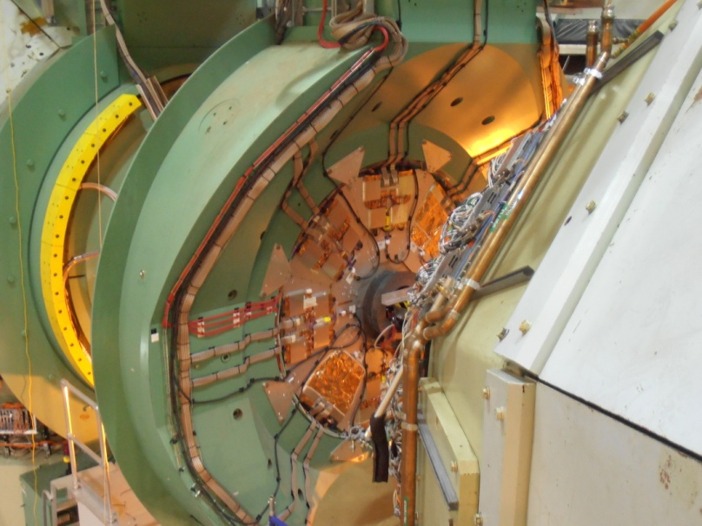
2. PHENIX RPCs - b. Production, QA, and Installation
RPC1N - installation (Sep. 22nd , 2011)
RPC1S - installation (Dec. 07th , 2011)

Slide 20
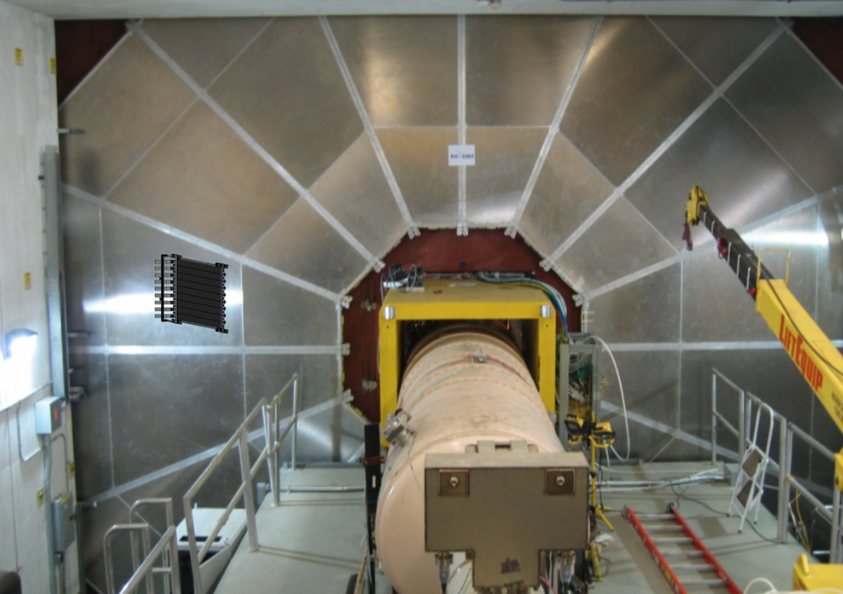
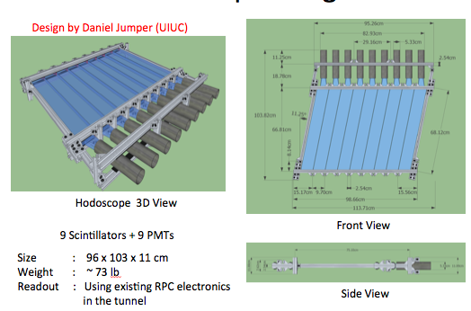
2. PHENIX RPCs - b. Production, QA, and Installation
Hodoscopes for absolute efficiency measurement
MuID
RPC3
MuTR
Hodoscope
Location on the rear side of RPC Station 3
Design

Slide 21
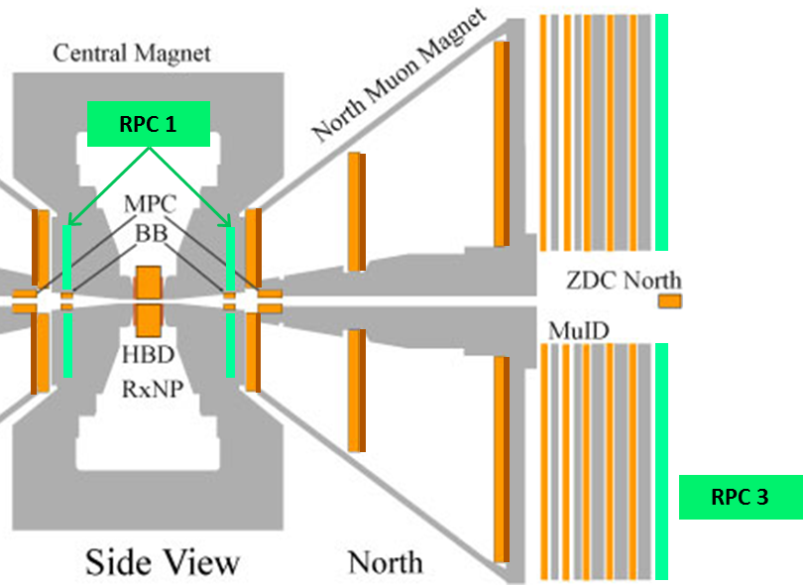
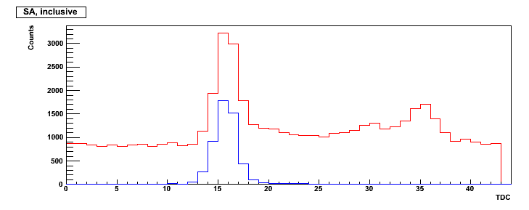
2. PHENIX RPCs - c. Status at Run 13
μ
(extrapolated)
Rpc3DCA
Efficiency (ε)
# of μ tracks w/ RpcDCA cut
# of μ tracks
ε_{relative} =
MuTR
* only very basic cut are applied in following
efficiency/TDC histograms (next pages)
Raw TDC of RPC
Count
TDC peak timing (t)
Muon Track Associated Hit
* The numerator in efficiency definition
corresponds to Muon Track Associated Hit
TDC (106 ns for 44 bins)

Slide 22
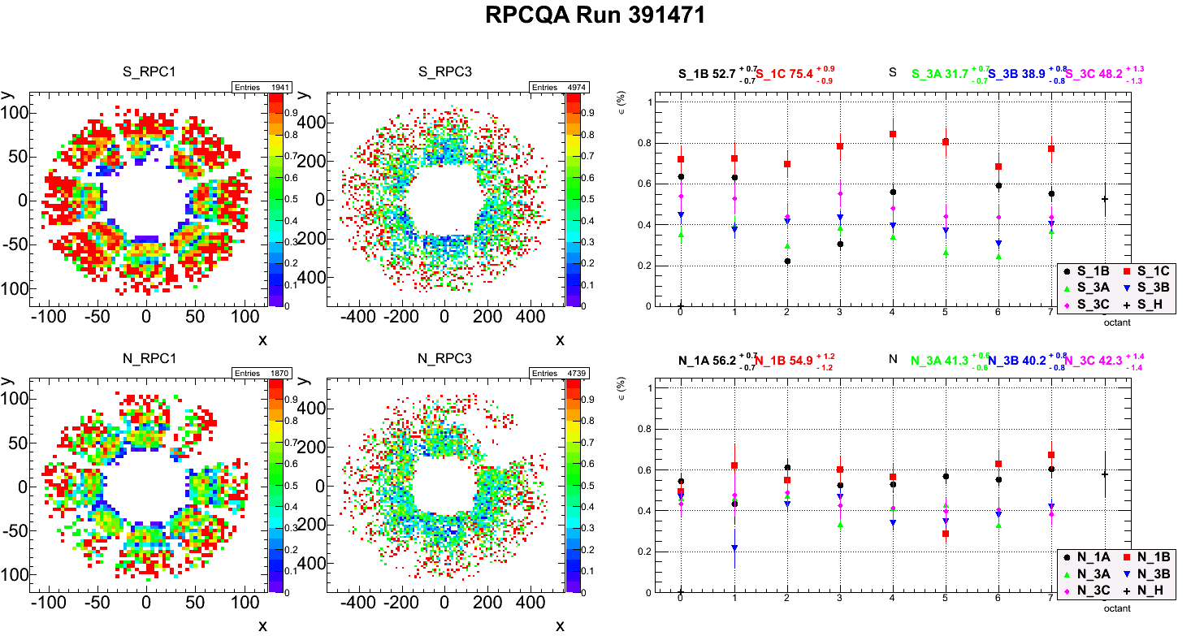
2. PHENIX RPCs - c. Status at Run 13
Sample efficiency for Run 391471 (Apr 15)
    Height dependence observed: vary from side and module type
    Optimization is still ongoing
  * Please note this is QA-purpose online production figures for a Run: NOT even fast production data!

Slide 23
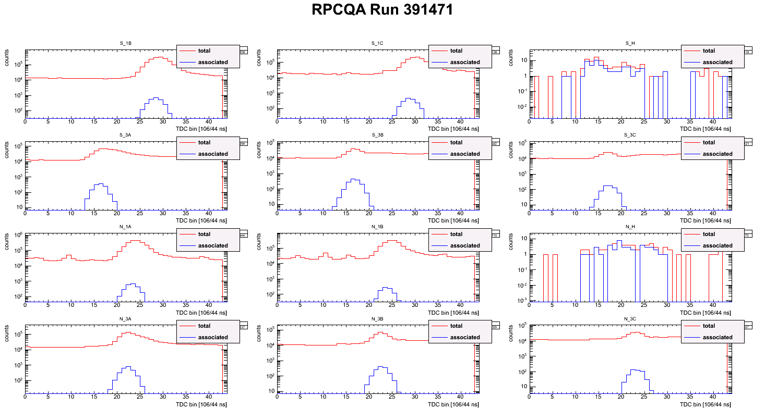
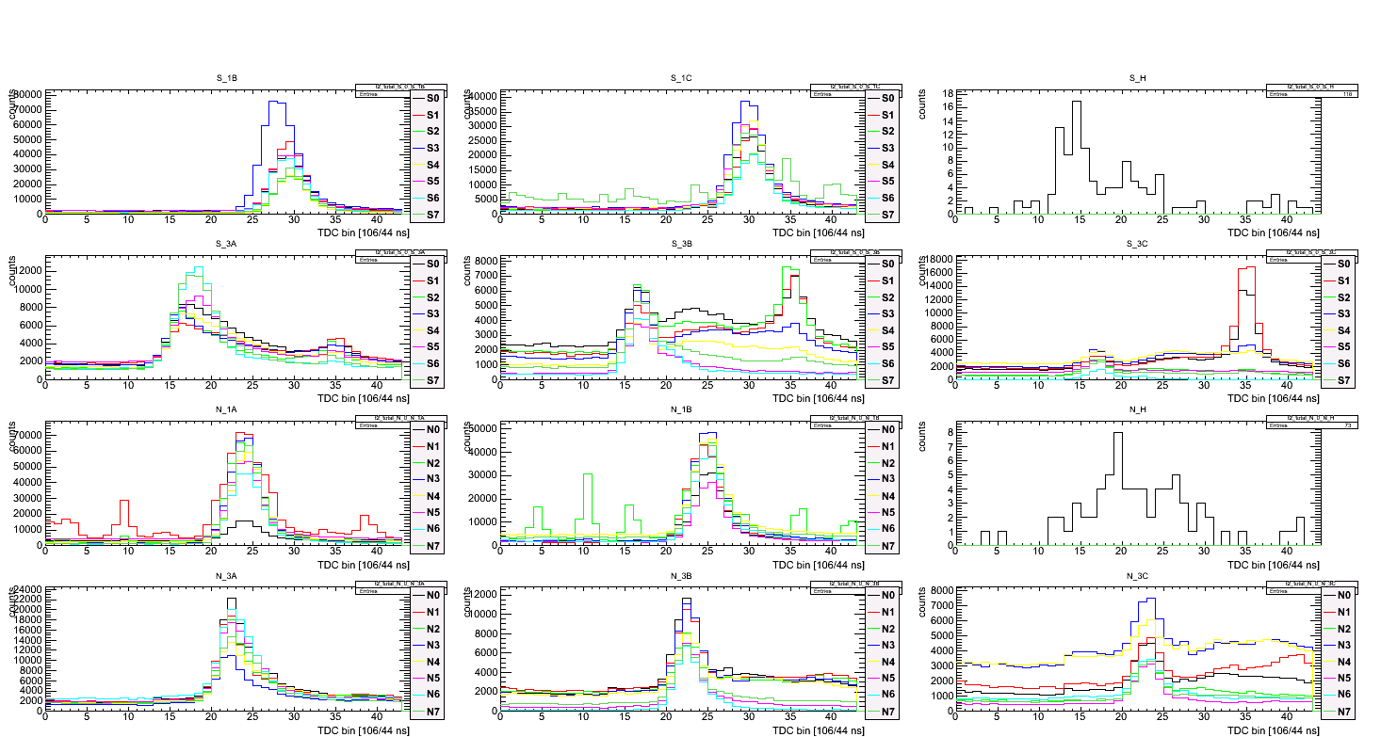
2. PHENIX RPCs - c. Status at Run 13
S_1B
S_1C
S_H
S_1B
S_1C
S_H
S_3A
S_3B
S_3C
S_3A
S_3B
S_3C
N_1B
N_1C
N_H
N_1B
N_1C
N_H
N_3A
N_3B
N_3C
N_3A
N_3B
N_3C
Sample timing distributions for Run 391471 (Apr 15)
    All octants/HO structures merged for the quick check
    Both merged/separated case shows beam-related hit timing very well

Slide 24
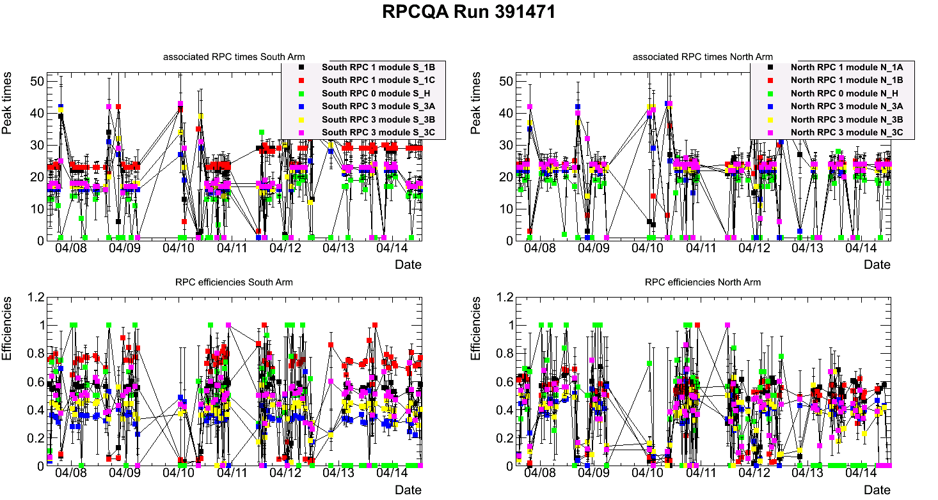
2. PHENIX RPCs - c. Status at Run 13
Sample vs. Time (date) histograms near Run 391471 (Apr 15)
    Peak timing is almost fixed: still got a peak in range even if timing shift occurred
    Most of efficiencies also fixed within resonable range

Slide 25
3. Summary and Perspectives
Summary:
    PHENIX RPCs are fully integrated to the PHENIX forward trigger system
    Run 13: dedicated Run for the PHENIX W program
      Integrated L goal for the Run: 250 pb⁻¹
      P goal for the Run: 55 %
      Major difference from Run 12:
      RPC1 integration to the trigger → significant improvement in rejection power
Perspectives:
    Further optimization is still ongoing

Slide 26
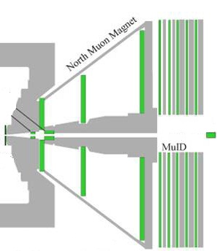
Backup
PHENIX muon arms (before upgrade)
Acceptance
- 1.2 < |η| < 2.2
- Δφ = 2π
Muon Tracker (MuTR)
  - 3 stations of CSCs
Muon ID (MuID)
  - 5 gaps of larocci tube in x & y directions
  - Total 80 cm thick steel absorber (plates)
Muon tracking and triggering
- Tracking by hit positions from each station
- Most hadrons are absorbed before
reaching last gap of the MuID
- Current 1st level rejection factor (RF):
~ 100 (MuID based 1st level trigger)
Muon
Hadron
Muon Tracker
(MuTr)
Muon ID
(MuID)

Slide 27
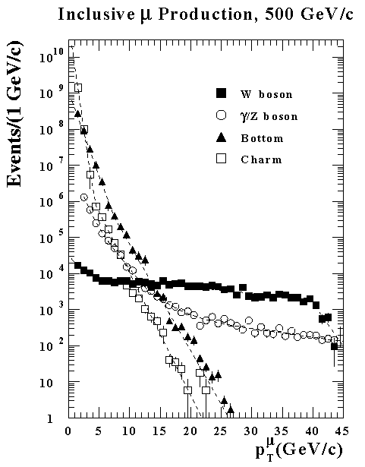
Backup
Simulated muons into Muon Arms
(2000 pb⁻¹, with PYTHIA 5.7)
W measurement at PHENIX muon arms
√s = 500 GeV
σ = 60 mb
L = 1.5 x 10³² cm⁻²s⁻¹
→ 3.0 x 10³² cm⁻²s⁻¹ (after luminosity upgrade)
Total interaction rate: 9 MHz
DAQ limit: 2 kHz
Required 1st level rejection factor (RF): 4500
Dedicated trigger system is required:
→ Forward muon trigger upgrade
After trigger
upgrade
MuID base trigger
(before trigger upgrade)

Slide 28

Backup
Resistive Plate Chamber
(RPC) (Φ segmented)
Trigger events with straight track
(e.g. Dstrip <= 1)
Level 1
Trigger
Board
Trigger
RPC
FEE
MuTRG
Amp/Discri.
Transmit
Data
Merge
Trigger
5%
Optical
MuTRG
MRG
MuTRG
ADTX
1.2Gbps
2 planes
Trigger
MuTr
FEE
RPC / MuTRG data are
also recorded on disk
95%
B
Interaction Region
Rack Room

Slide 29

Backup

Slide 30

Backup

