Slide 1




Introduction and Status of W physics
in PHENIX Muon Arms
Chong Kim
Korea University ¹ / RIKEN ²
¹ Department of Physics, Korea University, Seoul 136-713, South Korea
² RIKEN, 2-1 Hirosawa, Wako, Saitama 351-0198, Japan
for the PHENIX collaboration
KPS 2013 Fall, Changwon

Slide 2
Outline
Physics motivation
PHENIX Muon Arms
  W physics
  Detectors and Recent Runs
W → μ analysis
  Preselection
  W likelihood
  Composing PDFs
  S/BG ratio estimation
  Single spin asymmetry (A_{L})
Summary and Perspectives

Slide 3
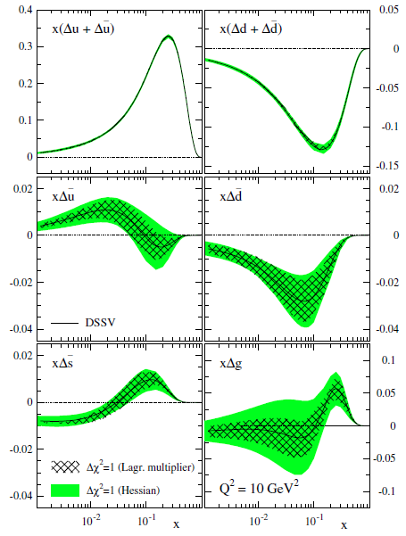
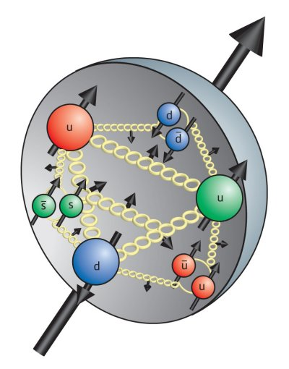
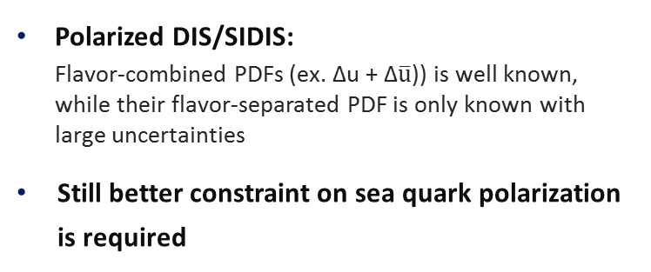
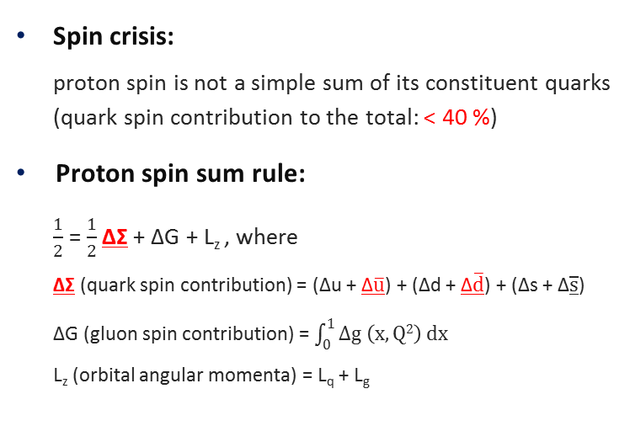
1. Physics motivation
Spin crisis:
proton spin is not a simple sum of its constituent quarks
(quark spin contribution to the total: < 40 %)
Proton spin sum rule:
$\frac{1}{2}$ = $\frac{1}{2}$ ΔΣ + ΔG + L_{z} , where
ΔΣ (quark spin contribution) = (Δu + Δ$\overline{u}$) + (Δd + Δ$\overline{d}$) + (Δs + Δ$\overline{s}$)
ΔG (gluon spin contribution) = $\int_{0}^{1}{Δg \left(x, Q2\right) dx}$
L_{z} (orbital angular momenta) = L_{q} + L_{g}
u
u
d
Polarized DIS/SIDIS:
Flavor-combined PDFs (ex. Δu + Δ$\overline{u}$)) is well known,
while their flavor-separated PDF is only known with
large uncertainties
Still better constraint on sea quark polarization
is required
D. de Florian et al,
PRD 80. 034030 (2009)

Slide 4
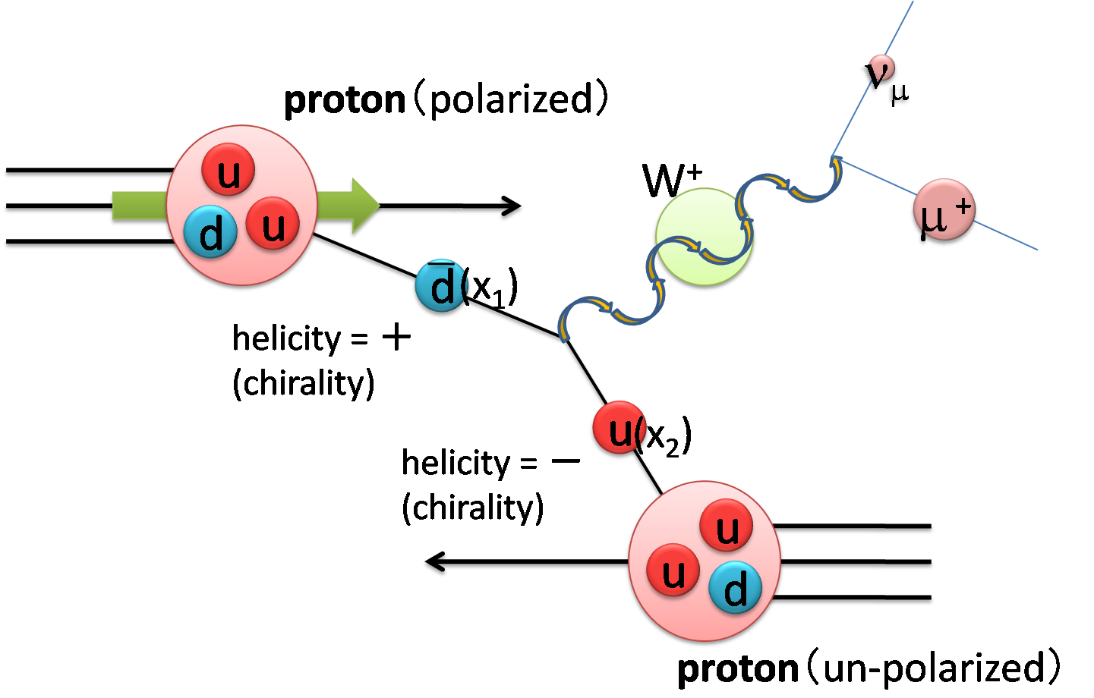
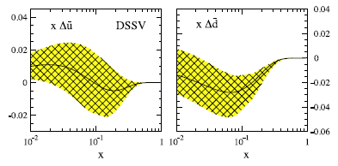
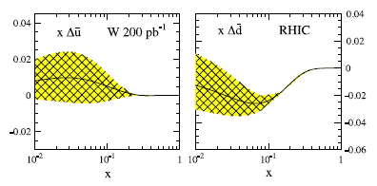
2. PHENIX Muon Arms – a. W physics
D. de Florian and W. Vogelsang,
PRD 81. 094020 (2010)
W physics in RHIC/PHENIX
  Target maximal parity-violating W bosons produced via polarized p – unpolarized p collision
  Measure the Single spin asymmetry (A_{L}) of the quark, by using leptons directly decayed from W bosons
Advantages:
  Fixed flavor combination: full flavor separated measurements
  No dependence on fragmentation functions: direct and clean signal

Slide 5
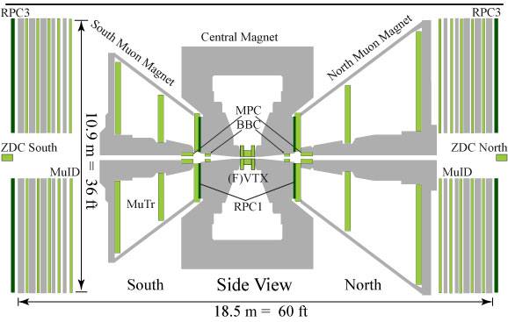
2. PHENIX Muon Arms – b. Detectors and Recent Runs
Recent longitudinally polarized pp runs
μ
Year | √s | L (pb⁻¹) | P (%) | FoM (P²L)
2009 | 500 | 8.6 | 39 | 1.3
2011 | 500 | 16.7 | 48 | 3.8
2012 | 510 | 31.5 | 51.9 | 8.5
2013 | 510 | 146.0 | 55 | 44.2
* Int. L under condition of |Vertex _{z}| < 30 cm
PHENIX Muon Arms (2013)
  Acceptance: 1.2 < |η| < 2.2 (S) / 2.4 (N) and Δφ = 2π
  Tracking: FVTX, MuTR
  Triggering and PID: MuID and RPCs
  Radial B field: 0.72 (T·m) at θ = 15˚

Slide 6
3. W → μ analysis

Slide 7
3. W → μ analysis – a. Preselection
Preselection of μ candidates:
by using Basic cut to several signal-sensitive Kinematic variables
  Kinematic variables: χ², DCA_{r} , Rpc1DCA, Rpc3DCA, DG0, DDG0
Basic cut: requirements for rough μ identification
  Apply loose requirements to χ², DG0, and DDG0
  16 < p_{T} < 60 (GeV)
  Last recorded hit in the MuID gap = 4 (5th and last)
DDG0
Track
0
1
2
3
4
MuTR
St 1
y
Track
Rpc3DCA
DG0
x
Rpc1DCA
DCA_{r}
z
RPC1
MuTR
MuID
RPC3

Slide 8
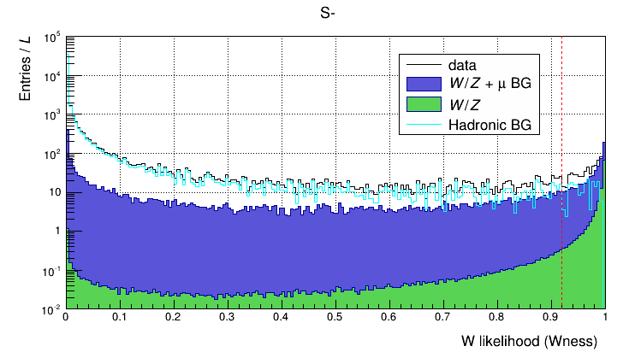

3. W → μ analysis – b. W likelihood
W signal
MC simulation
(PYTHIA + PISA)
χ², DCA_{r}, Rpc1DCA, Rpc3DCA, DG0, DDG0
(preselected signal-sensitive kinematic variables)
μ backgrounds
data
Compose 1st PDFs (Probability Density Function):
λ = p(χ²) · p(DCA_{r}) · p(Rpc1DCA) · p(Rpc3DCA) · p(DG0, DDG0)
W likelihood
$$= \frac{λ_{ signal }(x_{i})}{{λ }_{signal }(x_{i})+λ_{ BG }(x_{i})}$$
South Arm, W ⁻ → μ⁻
Data:
Run 12 pp510
Signal (PYTHIA + PISA):
W → μ and Z → μ
Signal + μ backgrounds (PYTHIA + PISA):
Direct γ, onium, Opencharm, Openbottom,
W → hadron/tau, and Z → hadron/tau
Hadronic backgrounds (fakes)
Following talk by Sangwha Park

Slide 9
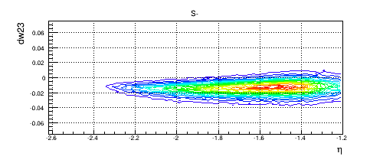
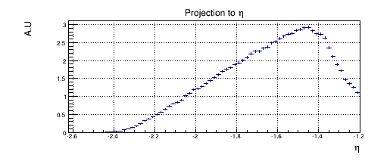
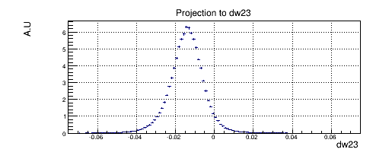
3. W → μ analysis – c. Composing PDFs
W
MC
Preselected kinematic variables
μ BG
data
1st PDFs by each variables
W likelihood
Scale each sample by luminosity
Define variables for fit: η and dw23
* dw23 (reduced azimuthal bending) ≡ p_{T} × sin θ × dφ23
dφ23
W MC, South Arm, W ⁻ → μ⁻
Projection to η
A.U
dw23
Projection to dw23
η
MuTR
St 3
A.U
y
η
dw23
MuTR
St 2
θ
z
x

Slide 10
3. W → μ analysis – c. Composing PDFs
W
MC
Preselected kinematic variables
μ BG
data
1st PDFs by each variables
W likelihood
Scale each sample by luminosity
Define variables for fit: η and dw23
then collect samples satisfying W likelihood cut (ex. > 0.92)
dw23 ≡ p_{T} × sin θ × dφ23
Total data
composition
- Size: surviving events
- Green: W events
- Violet: μ BG
- Cyan: Hadronic BG
Compose 2nd PDFs by using η and dw23:
λ _{signal} (η, dw23)
by W MC
λ _{μ BG} (η, dw23)
by μ background MC
λ _{Hadronic BG} (η, dw23)
by driven from data
Compose final combined PDF: λ _{final}
→ perform unbinned maximum likelihood fit

Slide 11

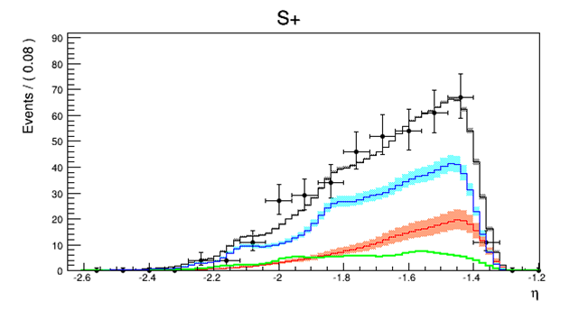
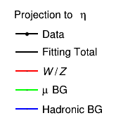
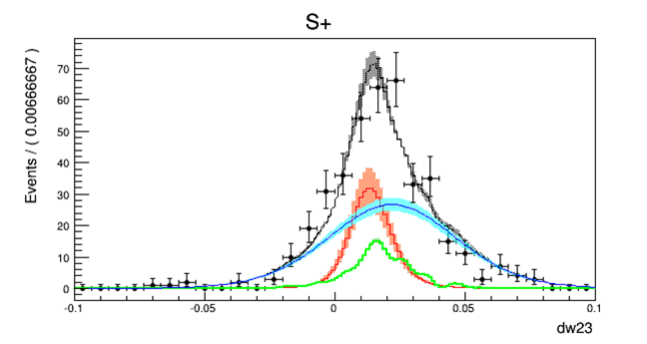
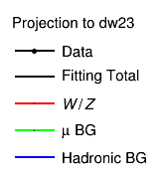
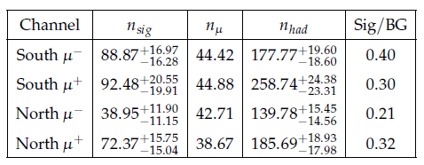
3. W → μ analysis – d. S/BG ratio estimation
2D unbinned max. likelihood fit:
← 1D projections onto each variable
Signal (fit): W → μ and Z → μ
μ backgrounds (fixed):
sum of various channels of μ BG
(L scaled & total efficiency corrected)
Hadronic backgrounds (fit)
Estimated S/BG ratio (preliminary)

Slide 12
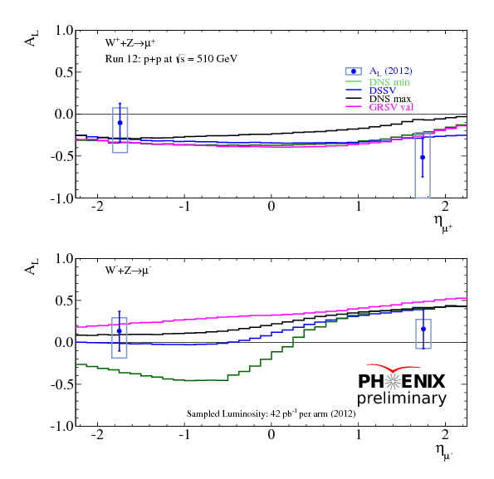
3. W → μ analysis – e. Single spin asymmetry (A_{L})
Run 12 preliminary
Beam combined asymmetries for mid / forward rapidity WRT η _{mean}
Different cut and method applied for mid/forward rapidity
Shows optimistic agreement with theoretic expectation

Slide 13
4. Summary and Perspectives
Summary
  W physics in RHIC/PHENIX:
  target better constraint on flavor-decomposed sea quark polarization
  Longitudinally polarized pp in PHENIX:
    Total achieved int. L: ~ 200 pb⁻¹
    Avg. polarization: ~ 55 % for Run 12/13
  W → μ in PHENIX Muon Arms:
    Main analysis method:
      Backgrounds dominant in region of interest: estimation of direct S/BG ratio is impossible
      Estimation of S/BG ratio by using unbinned maximum likelihood fit
    Major challenge: separation of Hadronic backgrounds from in-flight decay
    Estimated S/BG ratio: ~ 0.2 to ~ 0.4, varies by side and charge
    Single spin asymmetry: shows optimistic agreement to the theoretic expectation

Slide 14
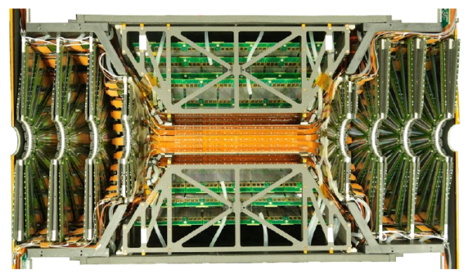
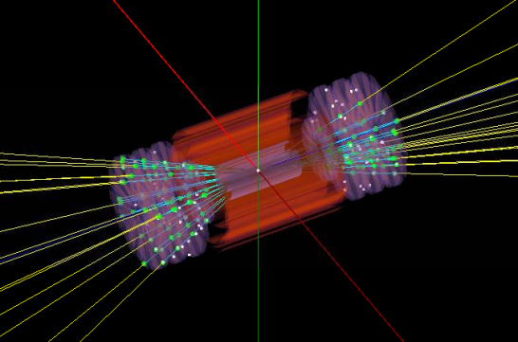
4. Summary and Perspectives
Perspectives
  Refine current using factors: efficiency tune, various cross checks…
  Inclusion of FVTX matching variables:
    3 additional high-precision variables available!
    Looking forward enhanced statistics in region of interest as well as reduced error
    Major update required for the proper integration: ongoing
W signal
MC simulation
(PYTHIA + PISA)
χ², DCA_{r}, Rpc1DCA, Rpc3DCA, DG0, DDG0
+ FVTX_dr, FVTX_dφ, FVTX_dθ
μ backgrounds
data
Compose 1st PDFs
W likelihood
…
FVTX event display

Slide 15
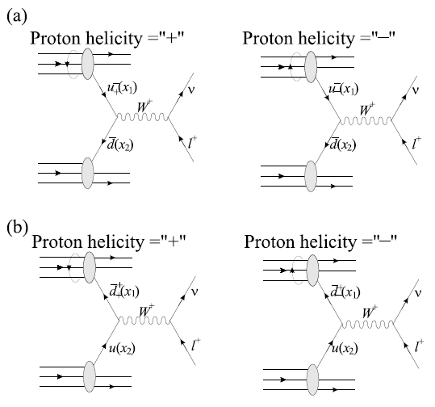




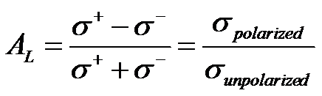
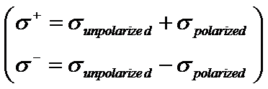
Backup – W measurement in PHENIX
    If W pdoruction processed only through (a),
    If processed only through (b),
    In general, the asymmetry is a
    superposition of two cases:
    * To obtatin the asymmetry for W⁻,
    swap u and d

Slide 16
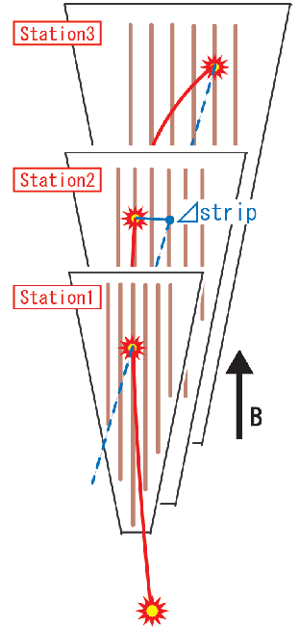
Backup – Forward μ trigger upgrade
Resistive Plate Chamber
(RPC) (φ segmented)
Trigger events with straight track
(e.g. Dstrip <= 1)
Level 1
Trigger
Board
Trigger
RPC
FEE
MuTRG
Amp/Discri.
Transmit
Data
Merge
Trigger
5%
Optical
MuTRG
MRG
MuTRG
ADTX
1.2Gbps
2 planes
Trigger
MuTr
FEE
RPC / MuTRG data are
also recorded on disk
95%
B
Interaction Region
Rack Room

Slide 17
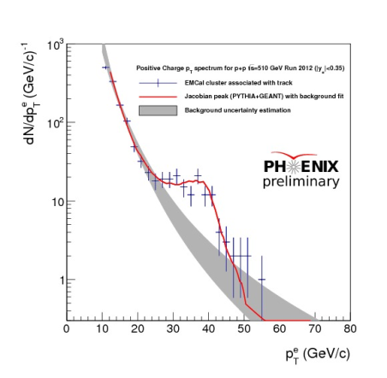
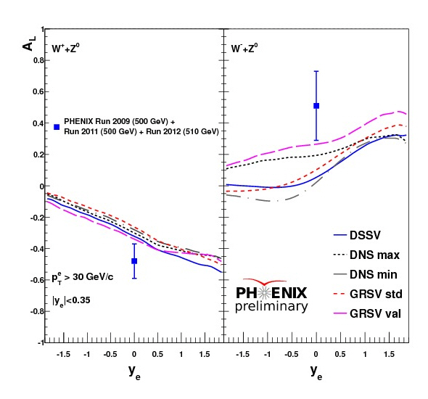
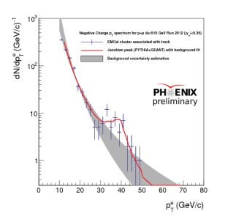

Backup – Central Arm W analysis
R = 0.4
$$\frac{Econe− Ecandiate}{Ecandiate}<10 (\%)$$

Slide 18
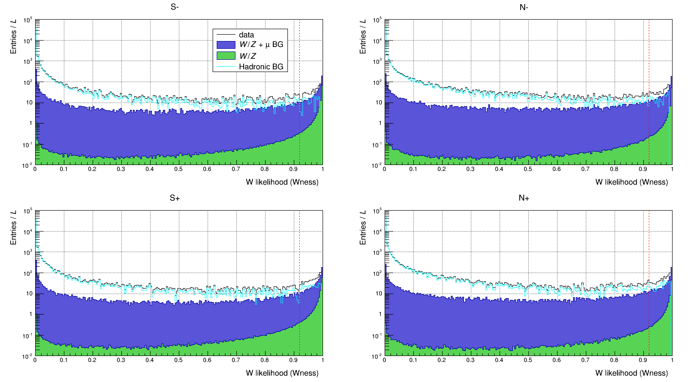
Backup – W likelihood distribution

Slide 19
Backup – MC Production statistics and Luminosity
Ref. 368630 (low)
pytune100 | k factor | # of gen events (M) | x-section (mb) | luminosity (pb-1)
data (common) | 1.5 | N/A | N/A | 43
dy (direct photon) | 1.5 | 11600 | 5.32E-002 | 218.0
light | 1.5 | 311.1 | 5.94E+001 | 0.0
onium | 1.5 | 32910 | 1.35E-001 | 243.8
openbottom | 1.5 | 1552 | 7.30E-003 | 212.6
opencharm | 1.5 | 145940 | 5.71E-001 | 255.6
w | 1.5 | 65.1 | 1.66E-006 | 39216.9
whad | 1.5 | 120 | 1.66E-006 | 72289.2
wjet | 1.5 | 11.9 | 1.20E-006 | 9916.7
wtau | 1.5 | 118 | 1.66E-006 | 71084.3
z | 1.5 | 81.5 | 1.59E-005 | 5125.8
zjet | 1.5 | 11.9 | 1.02E-006 | 11666.7
zonly | 1.5 | 0.000001 | 1.33E-007 | 0.0
Ref. 367466 (mid)
pytune100 |  | # of gen events (M) | x-section (mb) | luminosity (pb-1)
data (common) | 1.5 | N/A | N/A | 43
dy (direct photon) | 1.5 | 48510 | 5.32E-002 | 911.8
light | 1.5 | 152 | 5.94E+001 | 0.003
onium | 1.5 | 69790 | 1.35E-001 | 517.0
openbottom | 1.5 | 4489 | 7.30E-003 | 614.9
opencharm | 1.5 | 250830 | 5.71E-001 | 439.3
w | 1.5 | 451.2 | 1.66E-006 | 271807.2
whad | 1.5 | 335 | 1.66E-006 | 201807.2
wjet | 1.5 | 13.3 | 1.20E-006 | 11083.3
wtau | 1.5 | 346 | 1.66E-006 | 208433.7
z | 1.5 | 253.7 | 1.59E-005 | 15956.0
zjet | 1.5 | 13.2 | 1.02E-006 | 12941.2
zonly | 1.5 | 136.8 | 1.33E-007 | 1028571.4
Ref. 367593 (high)
pytune100 |  | # of gen events (M) | x-section (mb) | luminosity (pb-1)
data (common) | 1.5 | N/A | N/A | 43
dy (direct photon) | 1.5 | 6400 | 5.32E-002 | 120.3
light | 1.5 | 193.6 | 5.94E+001 | 0.003
onium | 1.5 | 55470 | 1.35E-001 | 410.9
openbottom | 1.5 | 4003 | 7.30E-003 | 548.4
opencharm | 1.5 | 134220 | 5.71E-001 | 235.1
w | 1.5 | 173.4 | 1.66E-006 | 104457.8
whad | 1.5 | 81 | 1.66E-006 | 48795.2
wjet | 1.5 | 8.2 | 1.20E-006 | 6833.3
wtau | 1.5 | 82 | 1.66E-006 | 49397.6
z | 1.5 | 245.2 | 1.59E-005 | 15421.4
zjet | 1.5 | 8.2 | 1.02E-006 | 8039.2
zonly | 1.5 | 106.5 | 1.33E-007 | 800751.9

Slide 20
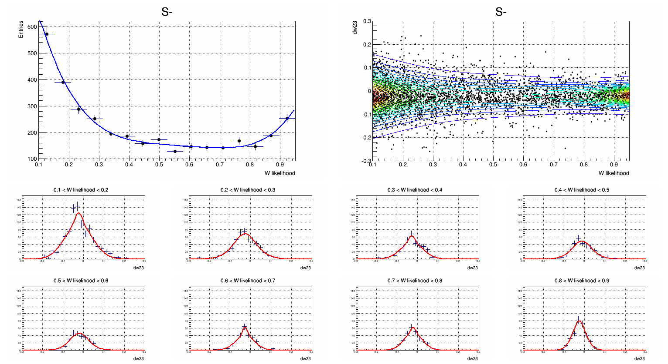
Backup – Data driven Hadronic backgrounds: extrapolate dw23

Slide 21
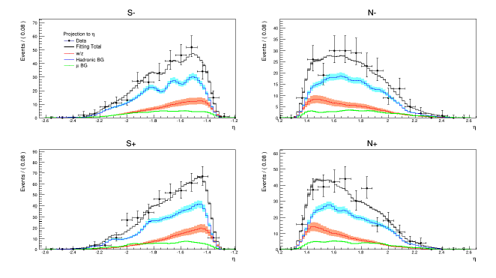
Backup – Fit results (preliminary)

Slide 22
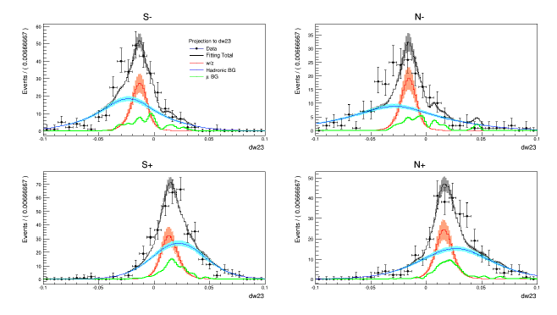
Backup – Fit results (preliminary)

Slide 23
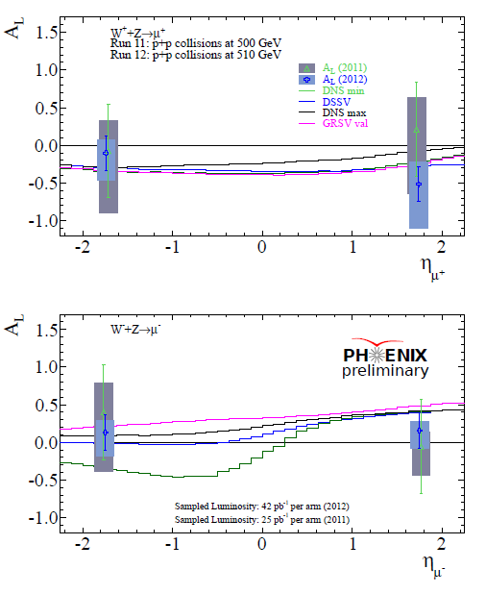
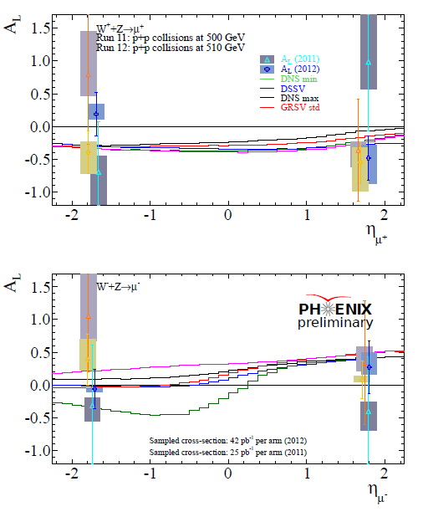
Backup – Beam separated/Run11 and 12 A_{L}

Slide 24
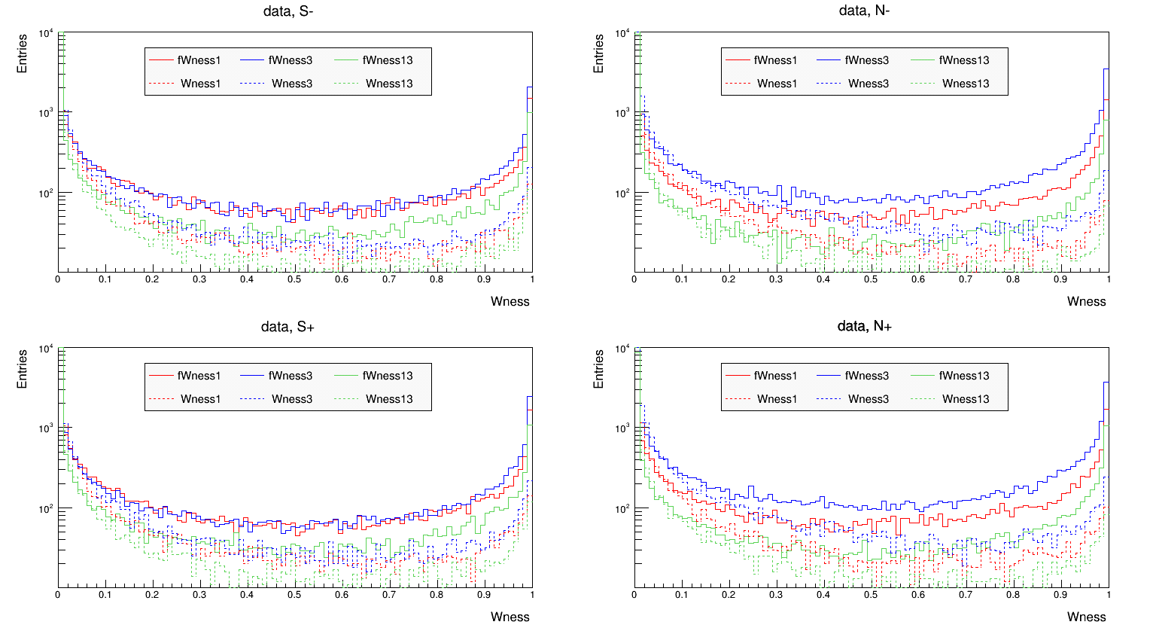
Backup – FVTX updated W likelihood distribution

