Slide 1
Status and Plans: LAMPS neutron detectors
Nucl. Phys. Group @ KU

Slide 2
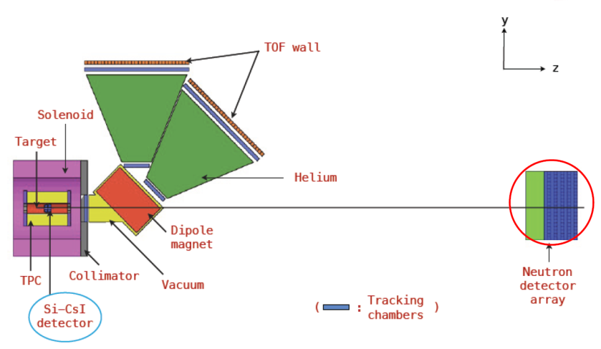
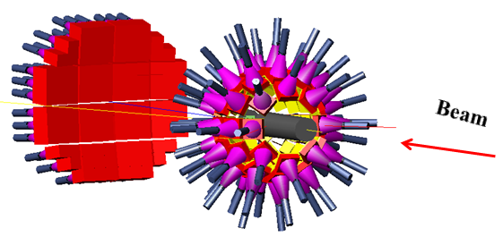
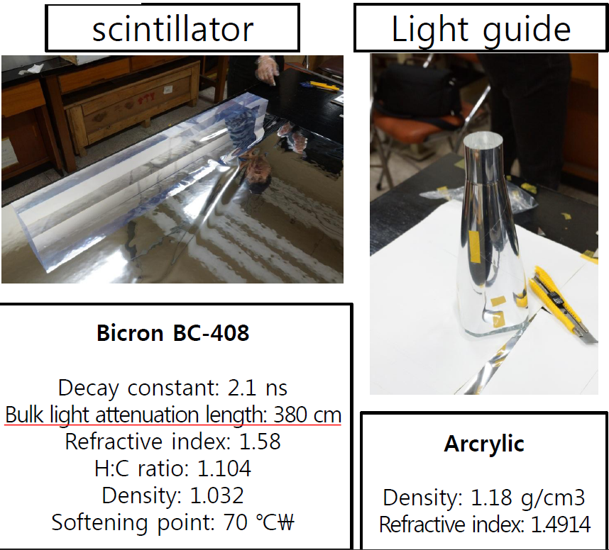
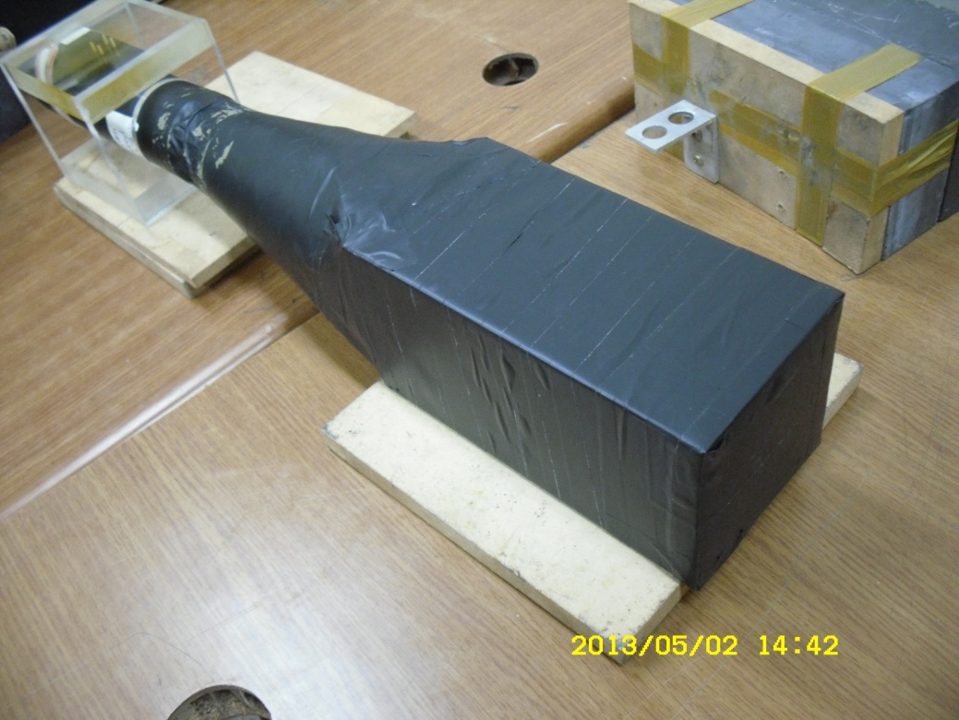
Neutron detectors for LAMPS experiments
High energy experiments (~ 250 AMeV)
Low-energy experiments (< 20 AMeV)

Slide 3
Bar neutron block detectors for low-energy experiments
Detector R&D: focused on Neutron detectors for low-energy experiments
Maximum beam-energy @ RAON = 18.5 AMeV
Pixel structure with bar-detectors (20 cm)
→ optimized for multi neutron events
Neutron energy to be measured: 2 MeV ~ 30 MeV
(efficiency > 50% for 2 MeV neutrons)
1 Hamamatsu H2431 PMTs for the photon sensor on one side of a detector.
The minimum detectable deposited energy for a block detector in virtue of the high light-collection efficiency ~ 200 keV (electron equivalent) with a Hamamatsu H2431 PMT (gain ~ 2 ⅹ 10⁵)
Energy resolution is restricted by the detector DOI rather than the intrinsic time resolution due to the short TOF length,
(σ_{t} ~ 500 ps is already good enough)
σ_{t} ~ 3% with a 5-m TOF length

Slide 4
Proposed tasks in 2013
Construction and test a super module composed of 4 unit detectors
→ Test with a ²⁵²Cf and fast neutrons produced by proton beams (KIRAMS)
→ Presentation of Kisoo & Benard
Optimal layout of high-energy detector system
MC for the low-energy & high-energy detector system
Ordered 15 scintillator blocks to build ~ a few 2x2 super modules
Comparison of the detector properties for Raxon and Bicron modules
But, realized 3x3 modules is minimum size of the detector units to investigate the realistic neutron data:
Neutron-hit clusters (cluster size, time bet. hits)
Multi-neutron events (directly affects to the efficiency)
Build a super module composed of 7 unit detectors
→ 4 Raxon and 3 Bicron modules
Tests with a ²⁵²Cf and fast neutrons produced by proton beams (KIRAMS)
~ 10 Bicron scintillator blocks with the same size will arrive us.

Slide 5
Plans
Optimization of light guides
→ The typical long-conical shape ones cause light loss due to attenuation.
→ Min. detectable energy with eff. = 50% should be ~ 2 MeV instead of 5~6 MeV.
By the end of Sept. : construction of a super modules composed 7 detector modules → Test with a ²⁵²Cf
By the end of 2013:
→ Test with fast neutrons at KIRAMS
Proton rate for trigger ~ 5 x 10⁴
~ 40 MeV and 1 nA proton beams
A series of collimators: 20-mm thick PMMA panel with a hole matrix
Fe neutron production target: 6-mm thick iron plate
Dead time allowed for DAQ ~ 0.85
By the end of 2013 fiscal year:
→ Construct and test of a second super module
Presentations
2013 Fall KPS: Oral presentation
IEEE NSS/MIC: Poster (conference note required ?)
ICABU: Poster (submission to JKPS required)

Slide 6
Pb collimators
Pb collimators
Proton beam
0.2 nA
2x10⁹ Hz
FWHM ~ 6 mm
5 mm hole
~ 5 x 10⁴ Hz
at trigger PMT
10⁸ Hz
10⁶ Hz
FWHM
~ 30 mm
5 x 5
2.5 mm
holes
5 mm hole
60 cm
25 cm
25 cm
30 cm
150 cm

