Slide 1
Neutron detectors for high energy RAON experiments
Neutron detector setup for low-energy HI collision & Pygmy Dipole Resonance experiments
Maximum beam-energy in RAON = 18.5 AMeV
Unit detector → The detector array should be reassembled so as to meet the experimental condition of a particular experiment.
Neutron energy to be measured: 1 MeV ~ 50 (?) MeV (Mean < 10 MeV)
Because the neutron energies to be detect are much lower than the high-energy, we chose block-shape plastic scintillators instead of bars.
1 Hamamatsu H2431 PMTs for the photon sensor on one side of a detector.
Used reflection film covering light guides except for the detector front facing the target to enhance the light collection efficiency.
The minimum detectable deposited energy for a block detector in virtue of the high light-collection efficiency ~ 100 keV (electron equivalent) when we use a Hamamatsu H2431 PMT with a gain of ~ 2 ⅹ 10⁵.
=> ~ 0.5 MeV for a proton: factor 5 higher for a proton than an electron due to quenching of scintillation lights.
=> Minimum detectable neutron energy ~ 1 MeV
Time resolution, σ_{t} < 300 ps

Slide 2
Returned the 15 plastic detector bars to Jtech because of the poor detector quality.
For the low-energy neutron detector modules, we decided that
Rexon will manufacture again only 4.
→ Will test (new) 4 Rexon modules.
The rest 11 modules were refunded.
→ Jtech will order ~ 10 module from Bicron.
In addition, we ordered two Bicron modules via Jtech
→ Will test (new) 4 Bicron modules.
Seem to be taking about 3 months till get all the right block scintillators for the low-energy neutron measurements

Slide 3
We repeat testing the bar-neutron detectors with a different electronics setups for future experiment
Remove the coincidence between the trigger and detector signals
→ Trigger by the trigger detector only
→ This test has to be investigated for a future test in KIRAMS for low-energy neutron detectors.
Test with ²⁵²Cf and ⁶⁰Co as we did for the bar detector in 2012.
Without the coincidences of the trigger with the neutron detector signals, the electronics setup becomes a lot simpler.
→ But, the usable TOF time length would be extended from 40 ns more than to 65 ns in LeCroy 2228.
→ Extending the measurable energy range below 5 MeV ?
→ We confirm the measurable neutron-energy range from the data.
In the previous test, the minimum detectable deposited energy for a bar detector ~ 800 keV for an electron when we use a Hamamatsu H2431 PMT with a gain of ~ 2 ⅹ 10⁵ .
→ ~ 2.5 MeV for a proton: factor 3 higher for a proton than an electron due to quenching of scintillation lights.
→ Have to confirm

Slide 4
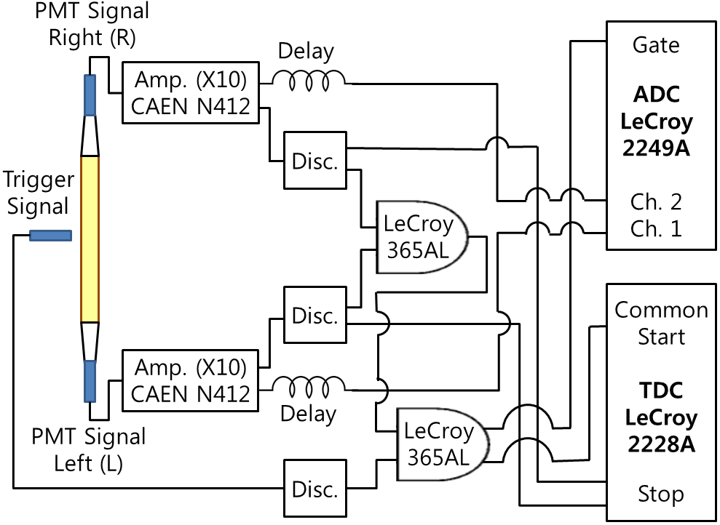
Test with ²⁵²Cf and ⁶⁰Co sources
²⁵²Cf for neutron measurements
⁶⁰Co for time resolution measurements

