Slide 1
130123 QQD & QQDD system
KIM, ShinHyung

Slide 2
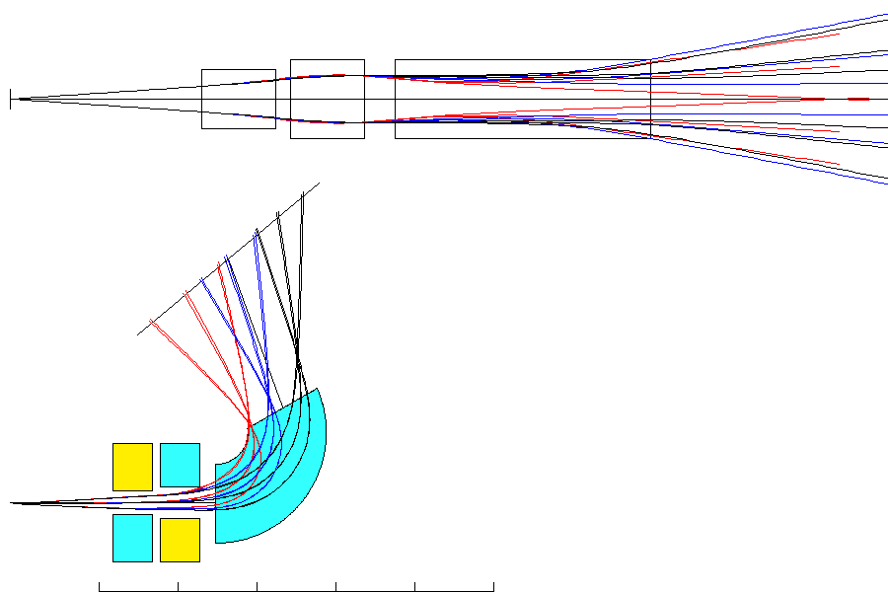
QQD system
Q1
Q2
D
40 MeV
276.8 MeV/c
[side view]
20 MeV
194.7 MeV/c
proton
KE=10MeV
p=137.3 MeV/c
1.3 m→Q1→0.1 m→Q2→0.2 m→D1→2 m→C
Q1 : L=50 cm, gap=30 cm, B=-0.5 T/m
(x-focusing)
Q2 : L=50 cm, gap=40 cm, B=+1.1 T/m
(y-focusing)
D1 : θ=110°, gap=40 cm, w1=1 m, w2=1 m,
R=0.9 m, B=-0.82 T, β1=0° β2=10°
[top view]

Slide 3
[side view]
11°
0.416 m
20 MeV
194.7 MeV/c
40 MeV
276.8 MeV/c
proton
KE=10MeV
p=137.3 MeV/c
0.473 m
[top view]
21°

Slide 4
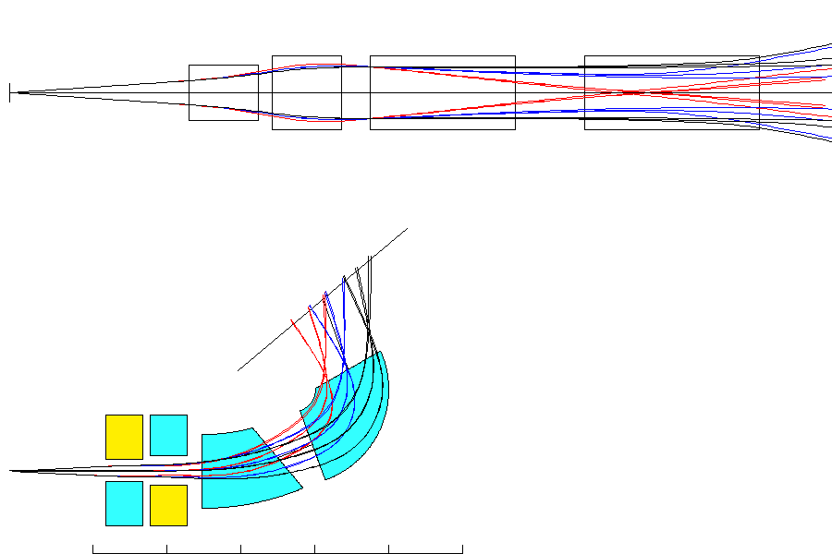
QQDD system
[side view]
Q1
Q2
D1
D2
1.3 m→Q1→0.1 m→Q2→0.2 m→D1→0.5 m→D2→1 m→C
[top view]
40 MeV
20 MeV
Q1 : L=50 cm, gap=30 cm, B=-1.0 T/m
(x-focusing)
Q2 : L=50 cm, gap=40 cm, B=+1.2 T/m
(y-focusing)
D1 : θ=20°, gap=40 cm, w1=1 m, w2=1 m,
R=3.0 m, B=-0.20 T, β1=0° β2=20°
D2 : θ=90°, gap=40 cm, w1=1 m, w2=1 m,
R=0.8 m, B=-0.85 T, β1=0° β2=10°
proton
KE=10MeV
p=137.3 MeV/c

Slide 5
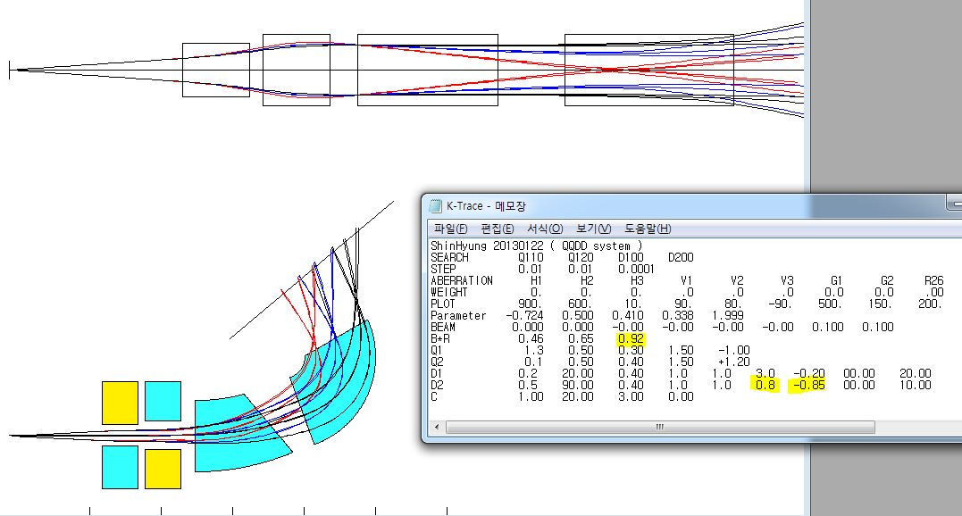
11°
[side view]
0.425 m
[top view]
14°
0.350 m

Slide 6
back up slide

Slide 7
QQD system : Variables
R= orbit radius of central ray
θ = bending angle
β1, β2 = shim angles
θ
β2
R
β1
B_D는 10MeV beam이 그림과 같이 모서리를 지나도록 조정!
B_Q1 : field gradient of Q1 [T/m]
B_Q2 : field gradient of Q2 [T/m]
B_D : field strength of D [T]
[top view]

Slide 8
QQD system : fixed values
w1= 1 m
w2= 1 m
β2=10°
β1=0°
[top view]
L=0.5 m
L=0.5 m
1.3 m
0.1 m
0.2 m
gap=0.4 m
Q1
Q2
D
gap=0.3 m
gap=0.4 m
[side view]

Slide 9
QQD system : measured values
y
beam의 y방향 divergence angle
[side view]
z
Q1
Q2
D
height of focal plane
[top view]
width of focal plane
tilted angle
of focal plane
Q1
Q2
D

