Slide 1
Symmetry energy 연구용
대면적 스펙트로미터
(Large Acceptance Multipurpose Spectrometer, LAMPS) 설계
고려대학교 이경세

Slide 2
위탁 세부과제 목표
고에너지용 실험 (최대 250 AMeV) 및
낮은 에너지 (~ 20 MeV) Day-1 physics 실험용 장치 상세 설계
중성자 섬광검출기 (neutron array detector) (고려대)
중성자 검출기 performance 시뮬레이션 (GEANT4)
중성자 검출기 prototype detector test
2. Time Project Chamber (고려대/부산대)
GEM-TPC simulation
GEM prototype detector
DAQ 및 검출기 electronics (부산대)
LAMPS DAQ system 설계
GEM-TPC electronics
4. 낮은 에너지 physics simulation (전북대)

Slide 3
LAMPS detector project
1. High-energy, high-intensity neutron-rich RI beams
Neutron-rich RI beams (ex. ¹³²Sn, ¹⁴²Xe) at maximum ~250 AMeV up to ~ 10⁶ pps
Low-energy detector system for Day-1 experiments
Symm. Energy and PDR/GDR with ~ 20 AMeV
Physics motivations
Equation of state (EOS) of neutron-rich nuclear matter at low & high density up to ρ ~ 2ρ₀
1. Probing E_{sym} of neutron-rich matters at a wide range of density from neutron-rich HI collisions
2. Understanding astronomical phenomena in neutron stars, and super novae by the EOS of nuclear matter at high density
3. Nuclear synthesis
4. Exotic nuclei lying near neutron drip lines

Slide 4
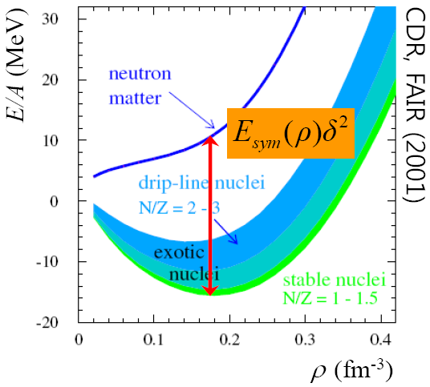
Symmetry Energy 연구
Nuclear Equation Of State (EOS) of nuclear matter in the isospin space
Symmetric matter
symmetry energy
ρ_{n}=ρ_{p}
Energy in symmetric matter
Energy per nucleon
density
ρ_{n} : neutron density
ρ_{p} : proton density
ρ₀ : Saturation density
Nucleon density ρ=ρ_{n}+ρ_{p}
0
ρ=ρ_{n}+ρ_{p}
δ
???
PRC 64, 034314 (2001)

Slide 5
LAND/ALADIN: slope parameter,
L between 30 ~ 60 MeV for ¹³²Sn

Slide 6
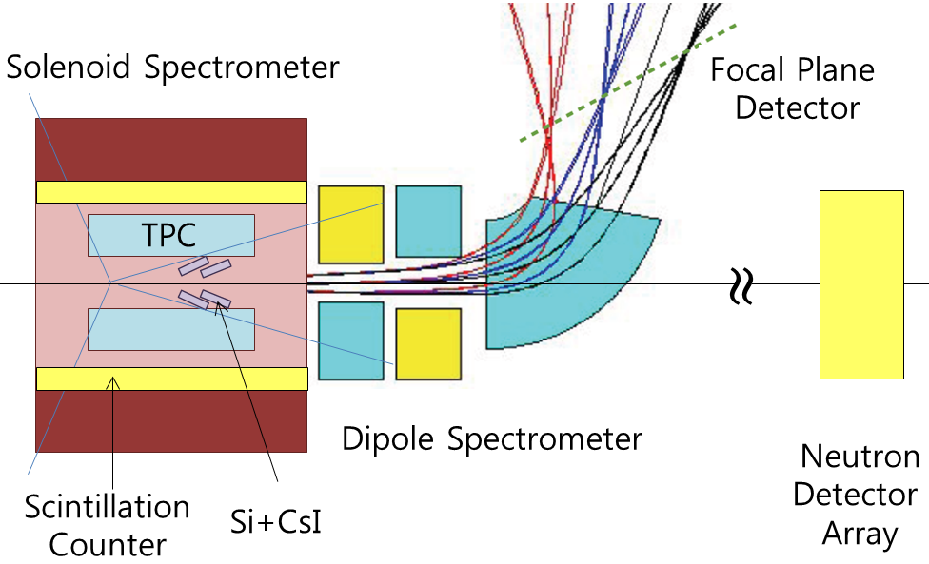
LAMPS for High-energy
Experiments (conceptual)
LAMPS for Symm.E
with ~ max 250-AMeV
¹³²Sn, ¹⁴²Xe, and stable HI …
Target system
Silicon-strip tracker
Super-conducting dipole magnet
Beam
monitoring
system
Vacuum
He bag
TPC
TOF array
Neutron calorimeter
Solenoid magnet
Tracking chambers
~ 3 π Sr
~ 30 mSr
50 mSr
Solenoid magnet
+ TPC
+ silicon-strip tracker
Dipole magnet
+ tracking chambers
+ TOF array
Neutron calorimeter at +- 8º

Slide 7
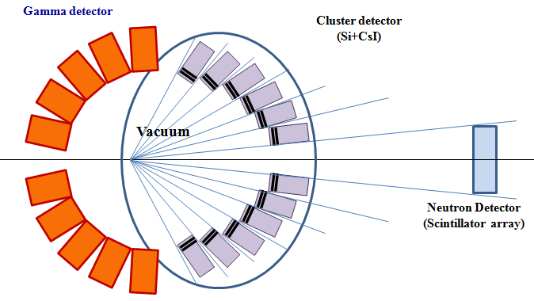
Performance at RISP (김영진)
1. Design of experimental setup
For low energy (E_{beam} < 20 MeV/u)
For high energy (E_{beam} > 20 MeV/u)
2. Optics calculation for dipole magnet (고에너지 실험)
Rotatable dipole magnet and focal plane
3. Detector simulation and R&D
TPC (~ 8 Sr acceptance) ← 위탁과제
ΔE-E (Si+CsI) ← 위탁과제
Focal plane detector system
(dipole spectrometer, 고에너지 실험)
Focal plane ToF
(σ_{t} < 100 ps for Δp/p<10⁻³ at β=0.5)
Neutron Wall ← 위탁과제
(capable for neutron tracking)
Gamma/charged-particle array
(Pigmy/Giant dipole resonance)

Slide 8
Cylindrical TPC
TPC in a solenoid magnet @ 1 T
- Acceptance ~ 8 Sr for π⁺, π⁻, p, n, d, t, ³He, ⁴He and fragments up to ⁷Li
TPC capable of measuring from MIP (π⁻ and π⁺) to fragments.

Slide 9
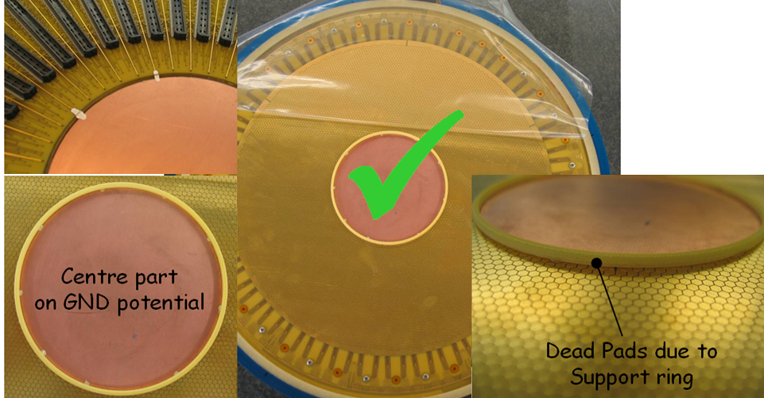
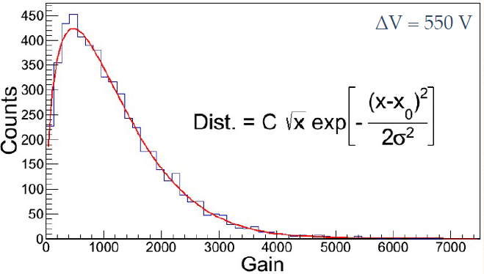
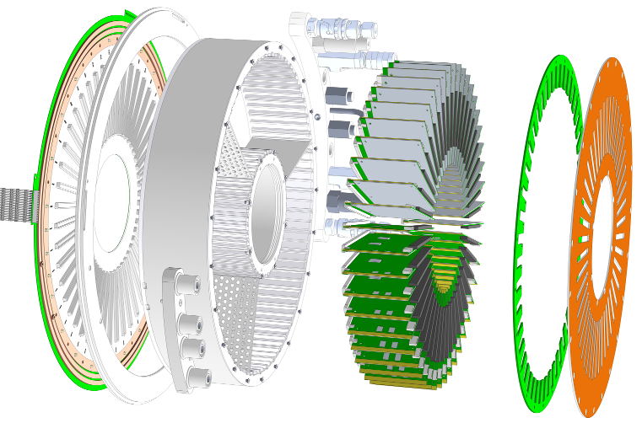
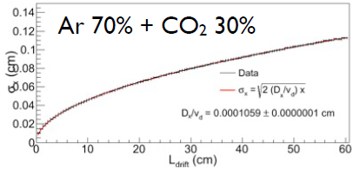
Simulations GEM-TPC
Triple GEM amplication
Gas: 70% Ar + 30% CO₂
Maximum drift length: 60 cm
Readout pads ~ 90 k (2.5 mm hexagonal pads)
~ 22 k (5.0 mm hexagonal pads)
Charge for MIPs ~ 160 pC
Digi. threshold ~ 100 pC
Electronics Flange
Gain with a
single GEM
Dispersion

Slide 10
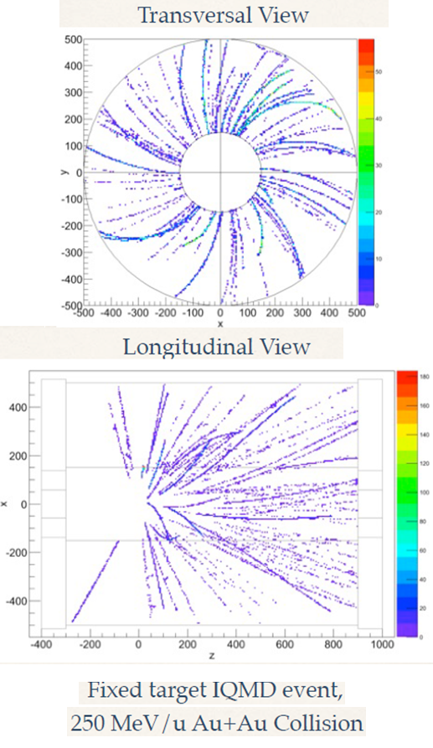
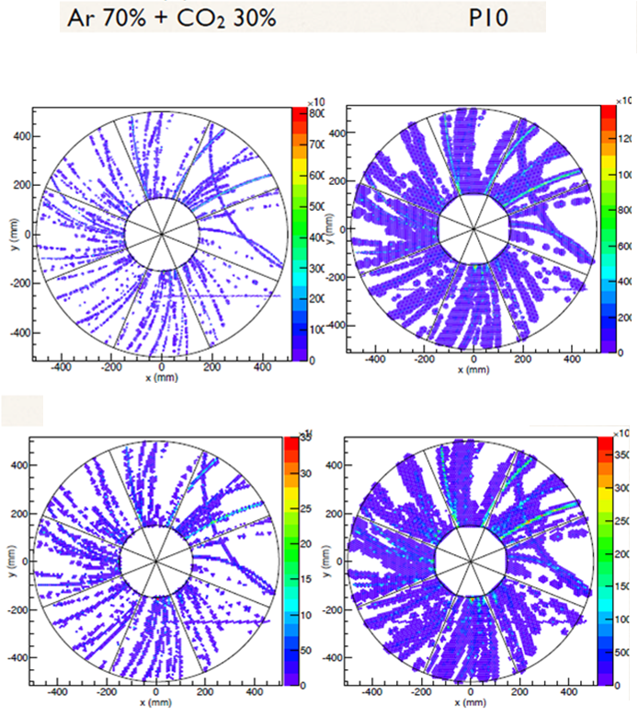
2mm-hex pads
5 mm-hex pads

Slide 11
Current planned hardware R&Ds for TPC
GEM Detector
1) Procurement of six 10 x 10 cm² GEM foils (KU)
Design of Triple-GEM detector hex pads (PNU and KU)
Electronics
1) Procurement of 256-channel FEE s (including ASIC chips) from GET collaboration (PNU and IBS)
DAQ design (PNU)
Electronics for Level-1 triggers for individual detectors
Global trigger electronics and DAQ

Slide 12
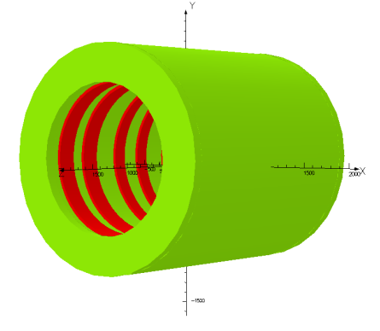
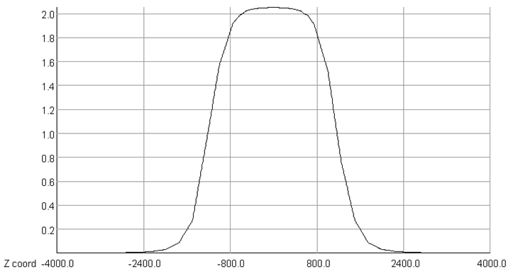
Solenoid and dipole magnets in the original conceptual designs
H-type Dipole
Pole size (x,z) : (150 cm, 100 cm)
Maximum B_{y} = 1.5 T
Gradient : 0.5 T∙m < ∫ B_{y} dz < 1.5 T∙m
Solenoid
Size (r,z) : (50 cm, 200 cm)
Maximum B_{z} ~ 1.0 T

Slide 13
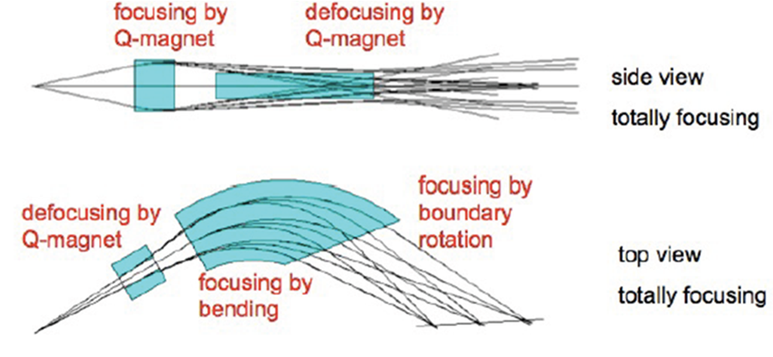
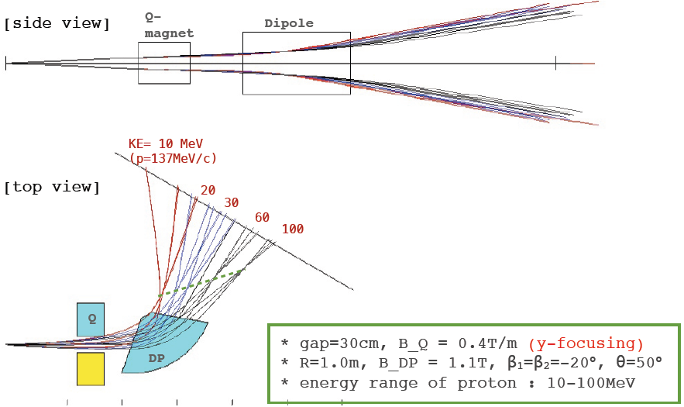
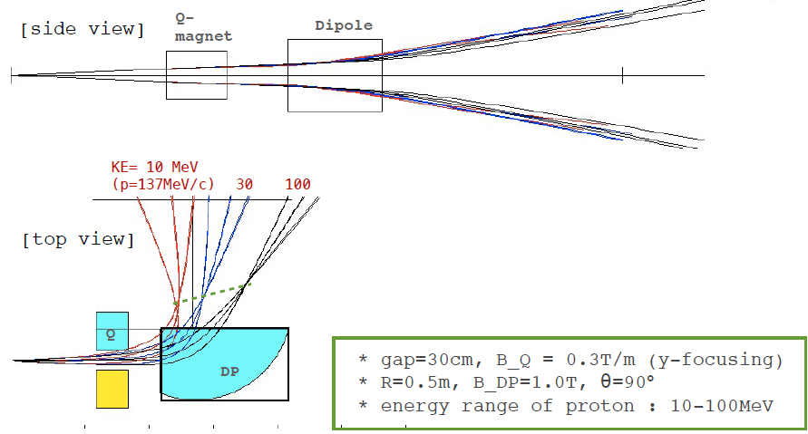
Magnet designs
Simulation for dipole magnets for a QD system (KU and IBS)
Other options for a QD system

Slide 14
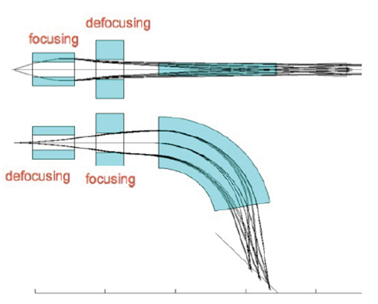
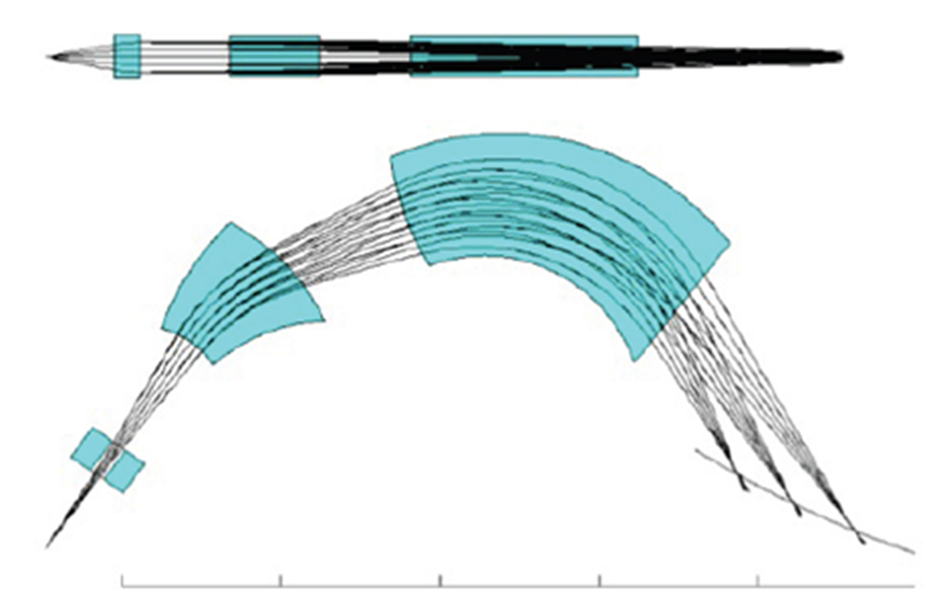
Milestones
1) Considering various designs
Not just D or QD,
but QQD, QQDD, QDD etc.
2) More precise simulation
Needs GICOSY with Geant4 to solenoid effect for low-energy particles
QQD system
QDD system

Slide 15
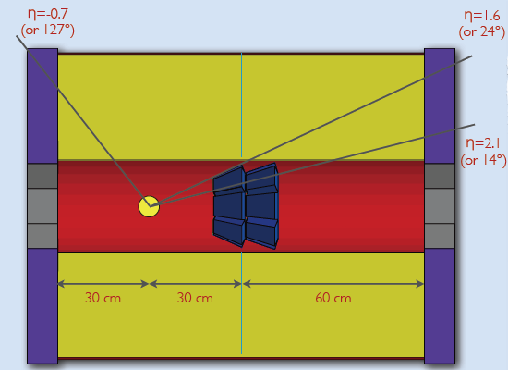
Silicon-CsI array in beam-pipe region
Coverage: 1.6 < η < 2.1
Identification of particles with Z=9
Silicon layers: 100 + 400 + 400 μm
CsI blocks: trapezoidal with a 10-cm depth

Slide 16
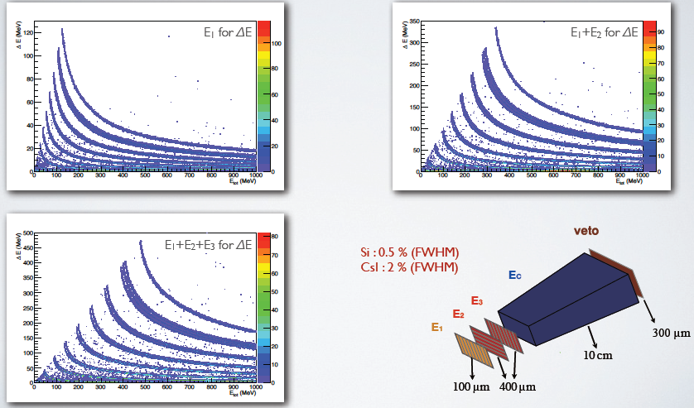
Measurement of energies with particle identifications

Slide 17
Sector division in a Si-CsI ring
1) A reliable occupancy per pixel ~ 0.1
2) 16 channels for a single module
3) Total number CsI channels in a ring = 8 x 16 = 128

Slide 18
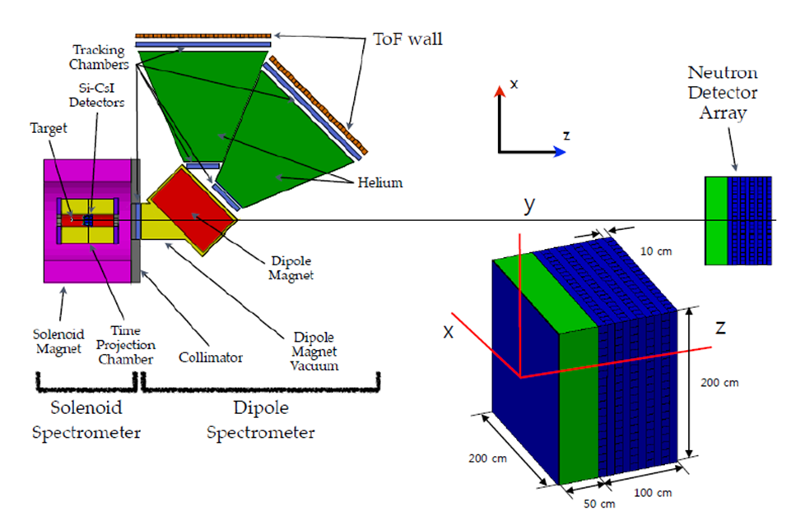
Neutron detector for high-energy experiment

Slide 19
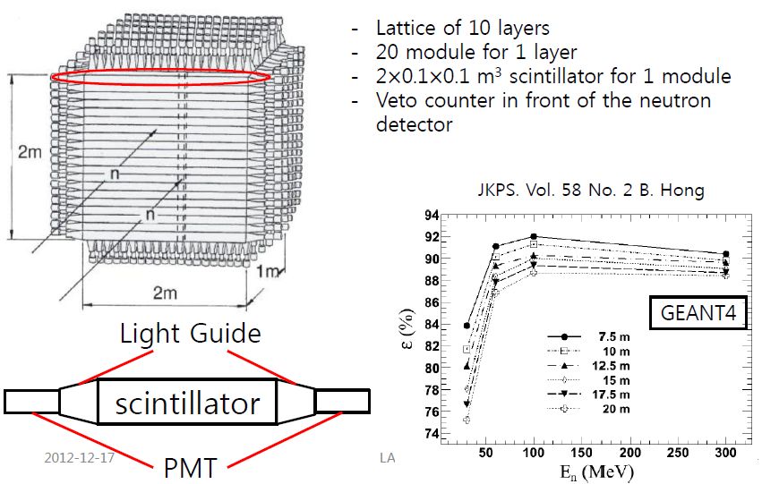

Slide 20
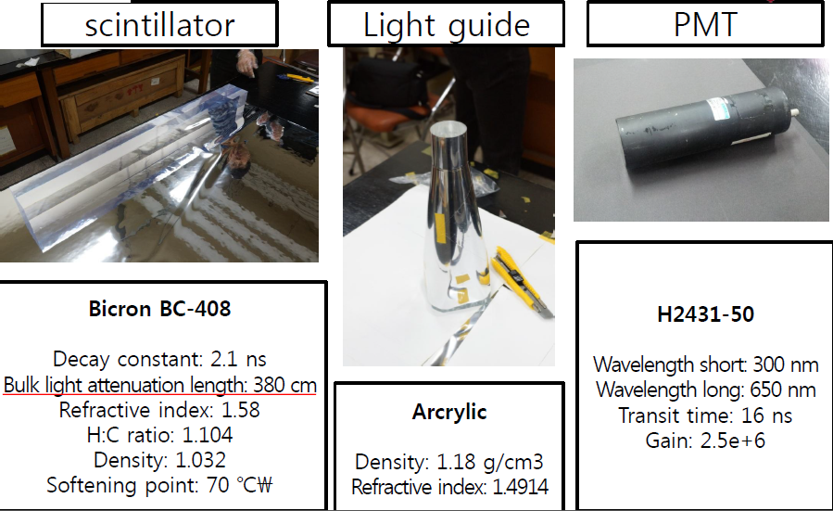
Prototype detector module
1) PMT readout at both ends of 100-cm bar
2) Time resolution for (t_{R} + t_{L})/2 ~ 500 ps
3) Position resolution for t_{R} – t_{L} ~ 5 cm

Slide 21
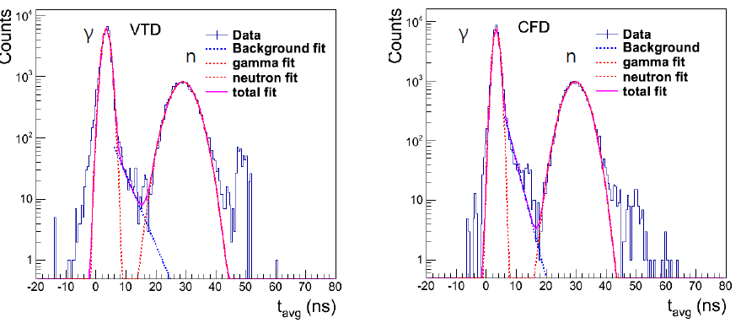
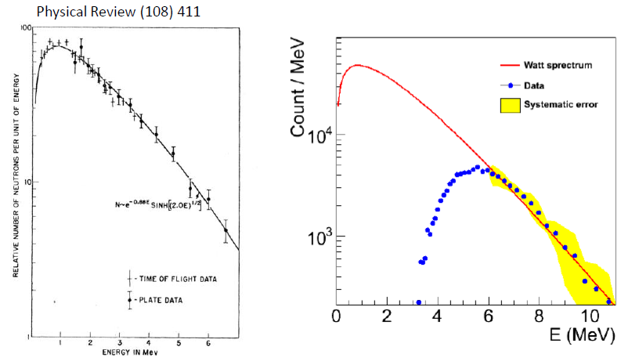

Slide 22
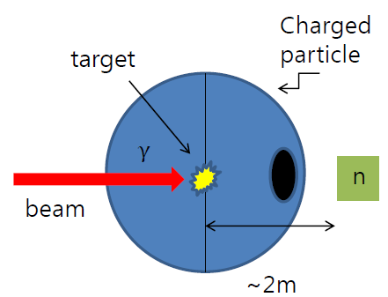
New Hardware R&D (KU and IBS) for low-energy experiments
Super module for neutron detection system for low-energy experiments
1) A super model Composed of 9 plastic blocks
Ordered 15 plastic blocks (Rexon) and 20 light guides
Planned to perform beam tests
Measurable neutron energy ~ 1 MeV
Gamma & charged
particle detector array
Target
Beam

Slide 23
Current Status & Milestones
목표: 고에너지용 실험 (최대 250 AMeV) 및 낮은 에너지 (~ 20 MeV) Day-1 physics 실험용 장치 상세 설계 완료
현재까지 완료된 연구 내용
1. 중성자검출기
IQMD/GEANT4 활용 고에너지 실험 중성자 검출기 설계
고에너지 실험용 중성자 검출기 prototype detector 및 실험
2. TPC/Si-CsI
Triple GEM simulation (GEANT4)
Si-CsI array (GEANT4)
DAQ 및 검출기 electronics
LAMPS DAQ system 설계
GEM-TPC electronics
4. 고에너지 실험 LAMPS spectrometer 기초 설계
Dipole magnet (D, QD systems)
5. 낮은 에너지 physics simulation
IQMD/GEANT4 활용 Si/CsI array data performance 도출

Slide 24
향후 3개월 간 수행할 연구 내용
1. 중성자검출기
IQMD/Gemini/GEANT4 활용 낮은 에너지 실험 중성자 검출기 설계
낮은 에너지 실험용 중성자 검출기 super module prototype detector 제작
²⁵²Cf 및 양성자 빔 활용 실험
Multi-hit 분석 알고리즘 개발
2. Time Project Chamber
시뮬레이션을 통한 TPC 용 Triple GEM prototype 구조 설계
DAQ 및 검출기 electronics
LAMPS DAQ prototype 구축
GEM-TPC electronics 발주
4. 고에너지 실험 LAMPS spectrometer 상세 설계 완성
Solenoid magnet (field map simulation)
Dipole magnet (D or QD → QQD, QDD, or QQDD)
5. 낮은 에너지 physics simulation
IQMD/GEMINI/GEANT4 활용 낮은 에너지 실험 event generation 및 data performance simulation

