Slide 1
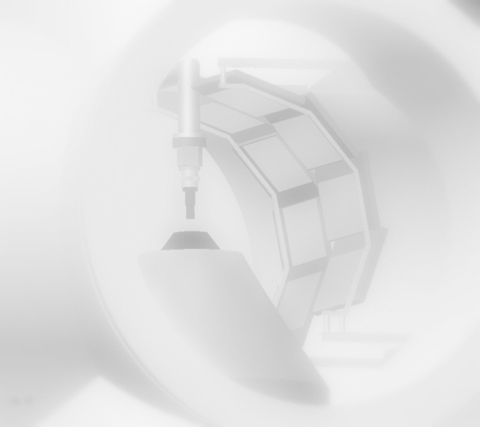
Gas jet target system for KOBRA
Andy Chae (kchae@skku.edu)
http://nucastro.skku.edu

Slide 2
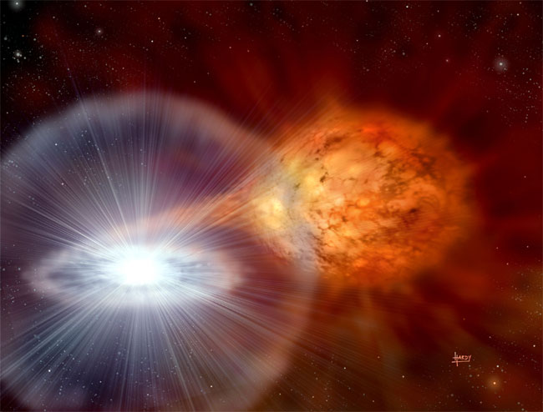
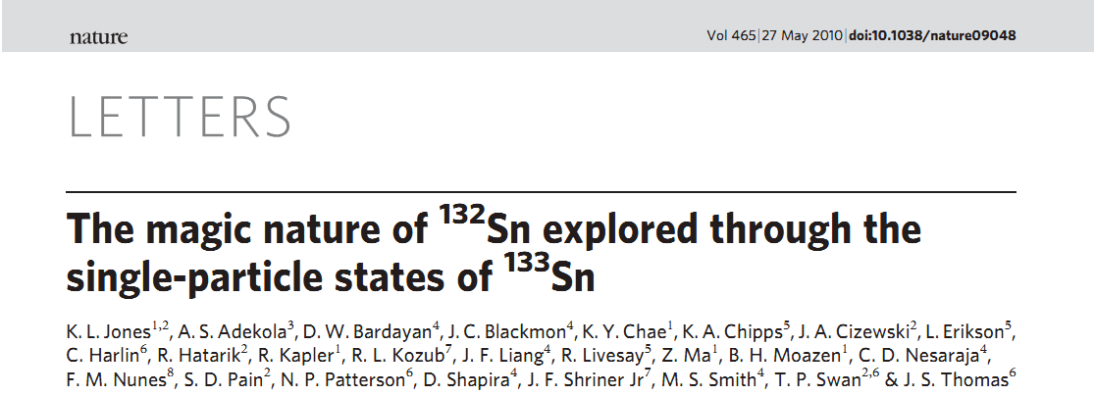
Needs in experimental nuclear astrophysics & structure
• radiative capture
- (p,γ), (α,γ)
• transfer reactions
- (d,p), (³He,d)
¹³²Sn(d,p)¹³³Sn in inverse kinematics
• excellent exotic beams
• durable, pure targets
• pioneering detection system
• detection of heavy recoils

Slide 3
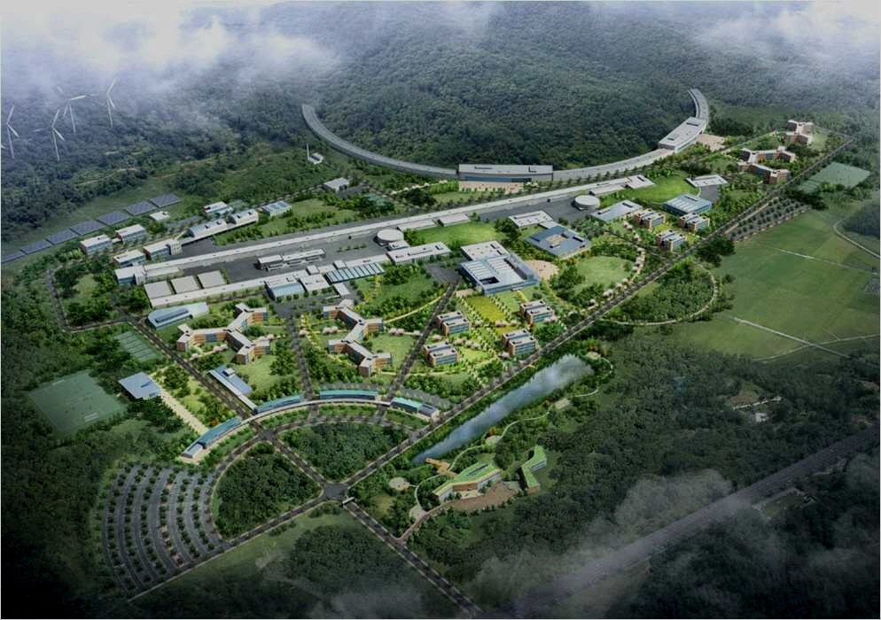
Beams
• beams
• targets
• detector systems
• recoil spectrometer
The RAON will push the frontiers of experimental nuclear physics further away from the stability!

Slide 4
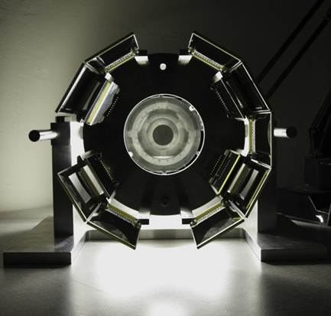
Detection system
• beams
• targets
• detector systems
• recoil spectrometer
High efficiency, high solid angle coverage for particle detection

Slide 5
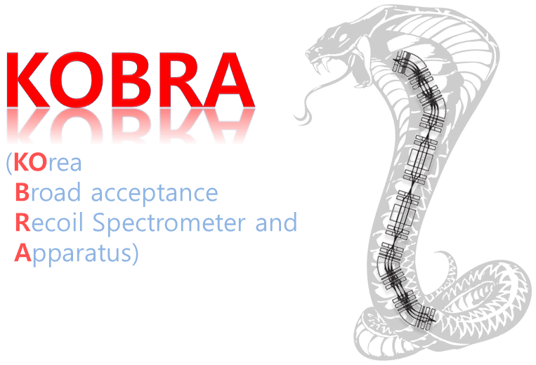
Heavy recoil separation
• beams
• targets
• detector systems
• recoil spectrometer

Slide 6
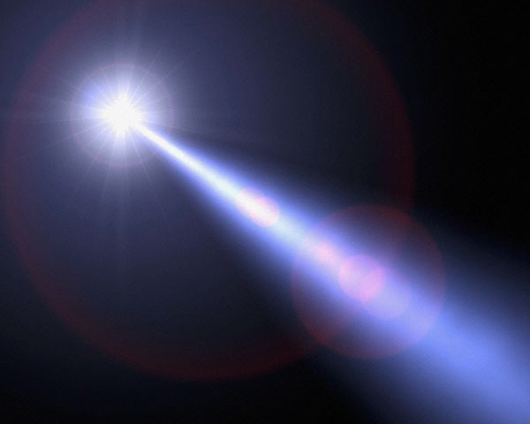
What about targets?
• Foils:
may require backing materials,
suffer from inhomogeneities, and
be plagued with contaminants
• Gas cells:
require reasonably thick windows
• Extended (windowless) gas targets:
can’t be used to measure angular distributions

Slide 7

Target constraints
• To play nicely with the new exotic beams and high-segmentation, large-solid-angle detector systems, a target is needed which is dense, highly localized, and pure
dense: ~10¹⁹ nuclei/cm²
localized: target size ~ beam spot size, and thin to prevent energy loss and straggling
pure: scattered contaminants contribute to background, which can’t be tolerated in low-statistics measurements
Jet
Experiments in
Nuclear
Structure and
Astrophysics

Slide 8
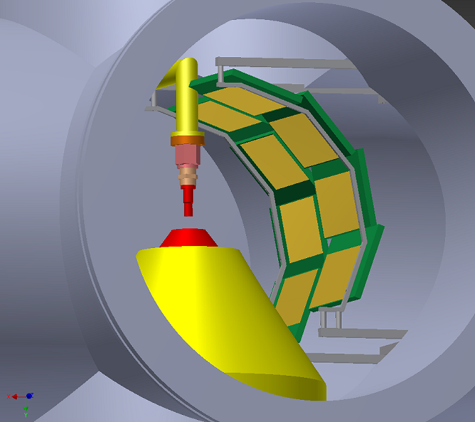
Solution
By creating a jet of light gas (H or He) with the correct engineering,
a target that is dense, pure, homogeneous, and localized can be produced!

Slide 9
Basic components
JET
PUMPING
COMPRESSOR
GAS CLEANING
RESERVOIR

Slide 10
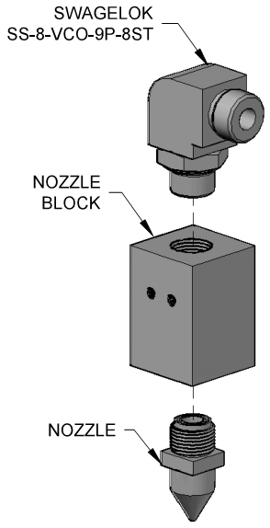
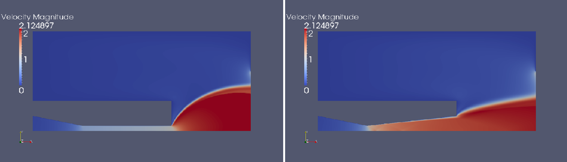
Nozzle block

Slide 11
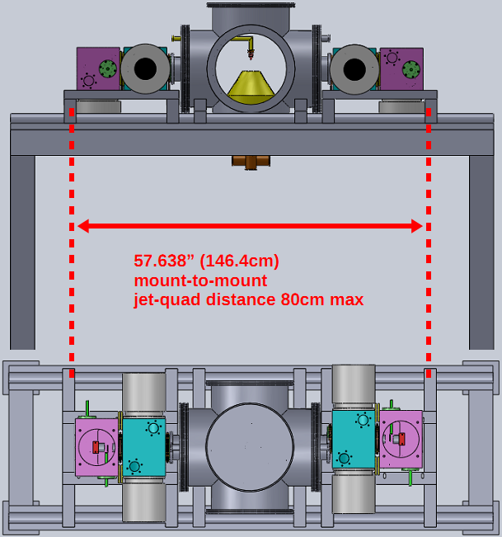

Slide 12
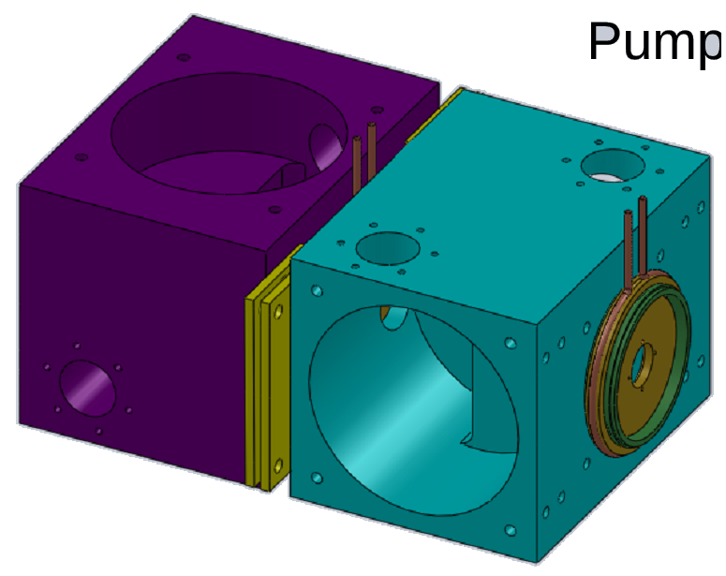
Differential Pumping System

Slide 13
Important Totals
• 103 kW total power consumption
(pumps alone are about 70% of this consumption)
• 8.8 tons total weight + ~ 150 kg beamline-supported
• < 28 gpm (106 liters per minute) cooling water
• ~ 15 m² total footprint

Slide 14
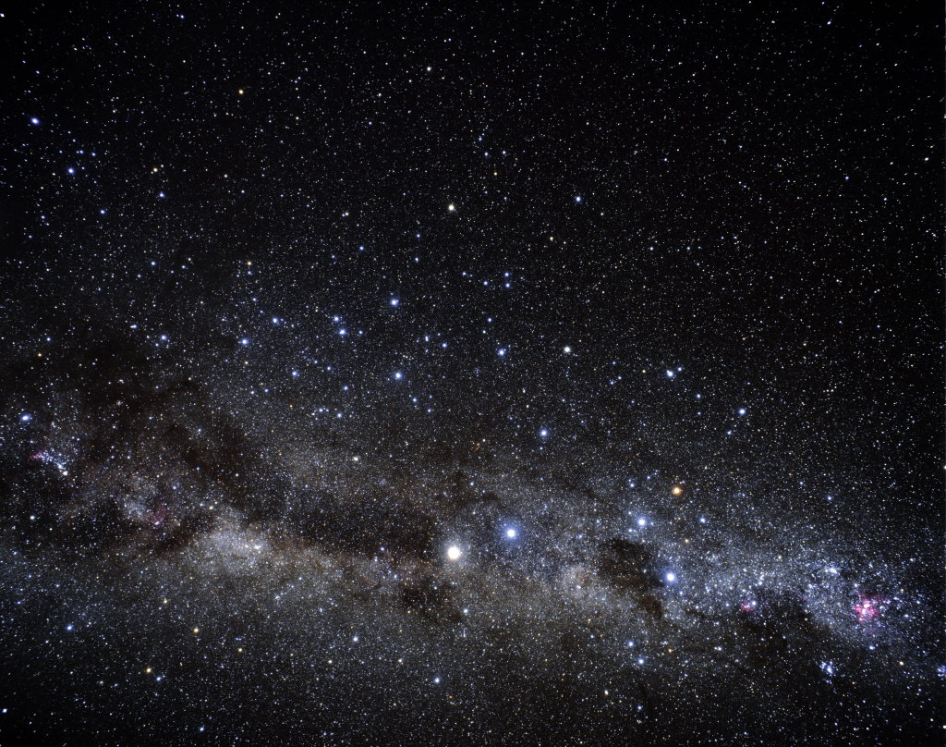
Experimental Campaigns
• (³He,d) proton transfer reactions
- constraint of proton capture reaction too weak to measure directly
(proton scattering to locate resonances)
- important to novae and x-ray bursts: ²⁵Al, ²⁹P, ³⁰P, ³³Cl, ³⁴Cl, ³⁵Ar, ³⁷Ar,
³⁷K, ³⁸K, ⁴⁵V, etc.
• direct (α,p)
- ¹⁴O, ¹⁸Ne, ²²Mg, ²⁶Si, ³⁰S in x-ray bursts
• (d,p) transfer reactions
- constrain (n,γ)
- progress in reaction formalism
- can also constrain (p,γ) with mirror arguments
• direct (p,γ) and (α,γ) reactions (with a recoil separator)

Slide 15
Appendix

Slide 16
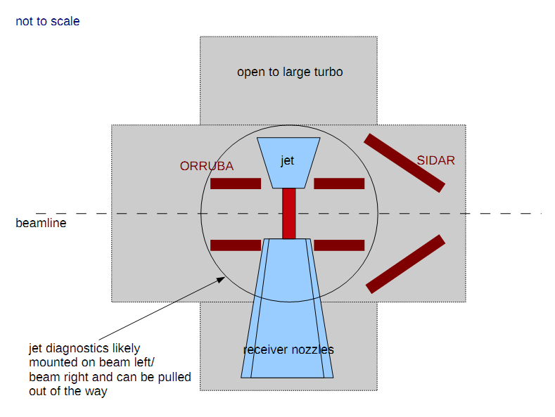
Schematics

Slide 17
Funds
· Uwe Greife
Custom compressor $220k
Gas chiller $40k
Pumps $250-300k
Machining of parts $100k
Extraneous vacuum components $50k
Infrastructure $150
Gas $60k
Total $940k
· Dan Bardayan: Early Career
· Jeff Blackmon:
· Hendrik Schatz: $400k for implementation of JENSA at ReA3

Slide 18
What about targets?
• inverse kinematics
• low intensity exotic beams
• light targets for hydrogen- or helium-induced reactions
• reaction products can have low energies
• high efficiency, high-solid-angle coverage for particle detection
• recoil/γ detection

Slide 19
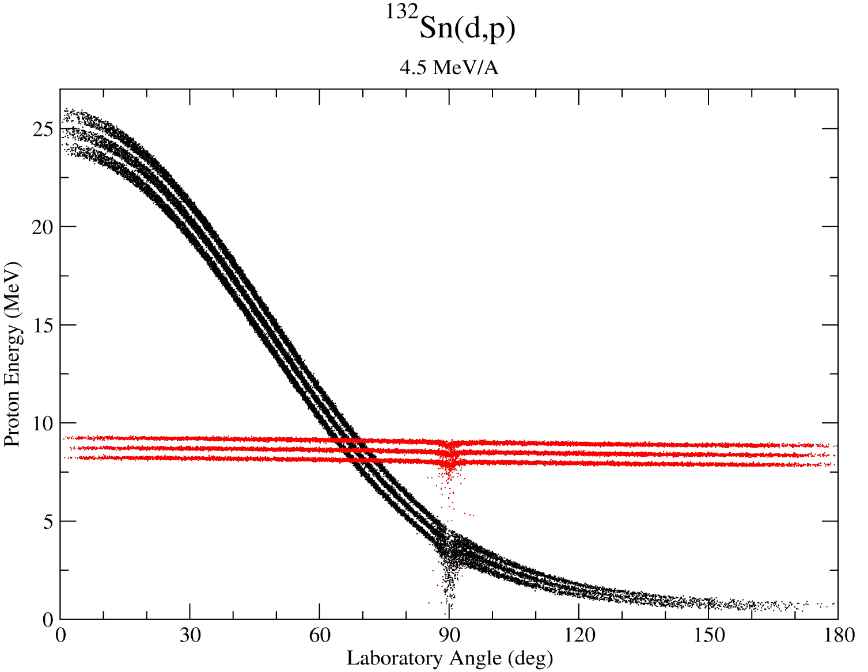
¹³²Sn(d,p)¹³³Sn kinematics
• unfavorable kinematics → Reduced Q-value Resolution
• The technique is applicable to all isotopes which can be made into a beam
• In many cases, it’s impossible to use radioactive target!

