Slide 1
Establishing a Frontier Recoil
Separator in RISP
- Installation/development of CRIB
- New properties for KRS
- Development of research groups

Slide 2
Experience for CRIB

Slide 3
Facility Development
- Good design and efficient construction
- Establish research programs
- Continuous system development
- Development of research groups

Slide 4
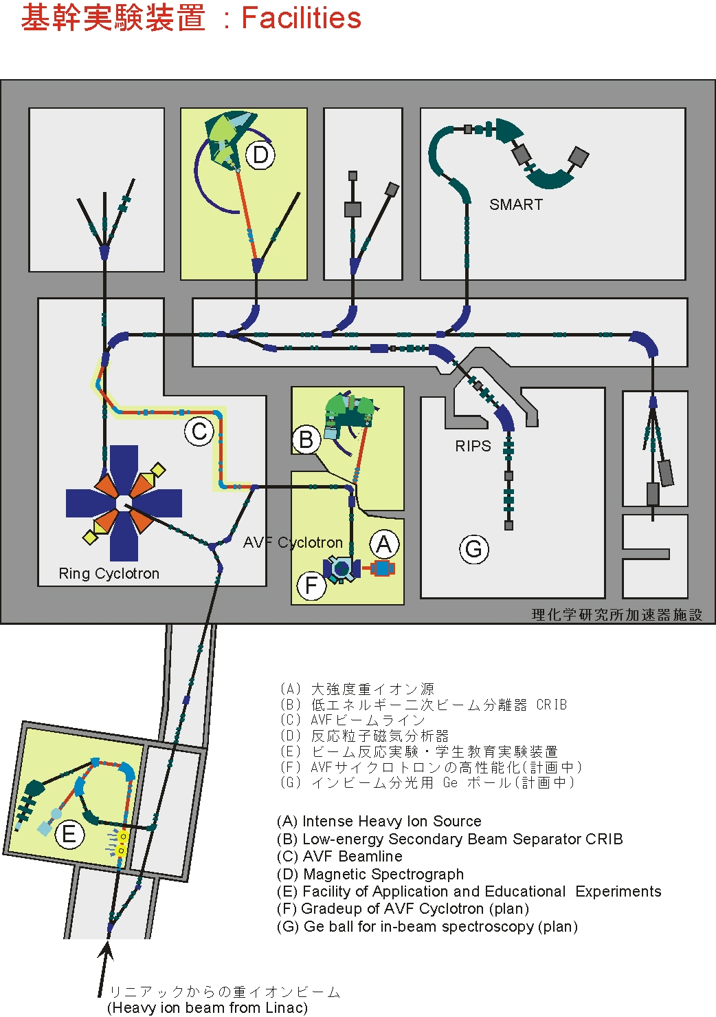
CNS Facilities at RIKEN
PA
RIBF
(Under CNS-RIKEN joint
venture program 2000- )
CRIB
AVF Upgrade Project
AVF-BT
Ge
AVF
/HyperECR
/ SuperECR
CSM
CNS-BT

Slide 5
CRIB Project Outline
1997.4 CNS established. New cyclotron facility planning started.
1997 Design work for a low-energy RI beam facility started.
1999.6 Project proposal submitted to RIKEN
1999.10 Shutdown the SF cyclotron
2000.3 CNS moved to Wako for joint venture with RIKEN
2000 Installation of CRIB to E7 room
2001.2 First Program advisory committee for CRIB
2001 First beam to the production target
2001 Installation of Wien Filter
Installation of a window-less gas production target
2001 Installation of flat-top acceleration mode for AVF cyclotron
2003 Completion of Wien Filter
2007 Installation of a cryogenic production target
2009 Installation of a non-destructive beam monitor

Slide 6
year
Bidding
start
Confirm
basic design
Producer
decided
Tuning/testing
Technical discussions
w/ Producers
Production
Installation
Confirm
final design

Slide 7
Summary of Research Activities at CRIB and the Scope
2011.6
Outline of CRIB project
CRIB Facility and AVF Upgrade Project
- Ion Source development
- AVF development (E > 10 MeV/u, and H=1, 3, K=45→79)
- Beam line development (optimization + non-destructive
beam monitoring)
- New cryogenic production target
- Wien filter
3. Research Programs at CRIB
- Nuclear Physics
Proton and alpha structures
- Nuclear Astrophysics
(a,p) direct measurements, ANC and Trojan Horse Methods
- Applications
4. Possibilities

Slide 8
AVF Upgrade Project

Slide 9
Direct Method with RI Beams
RIB intensities reaction type
10⁴ pps → Resonant scattering w/thick target method
eg. ²²Mg+p
10⁶ pps → Rearrangement reactions
eg. (α,p), (α,n), (d,p), . . .
10⁸ pps → (p,γ), (α,γ), . . .
Total system development=AVF Upgrade project
1. Ion source 2. Accelerator
- SuperECR - FT mode, Modify central region
3. Beam transport 4. Production target
5. Separator - Multipole element

Slide 10
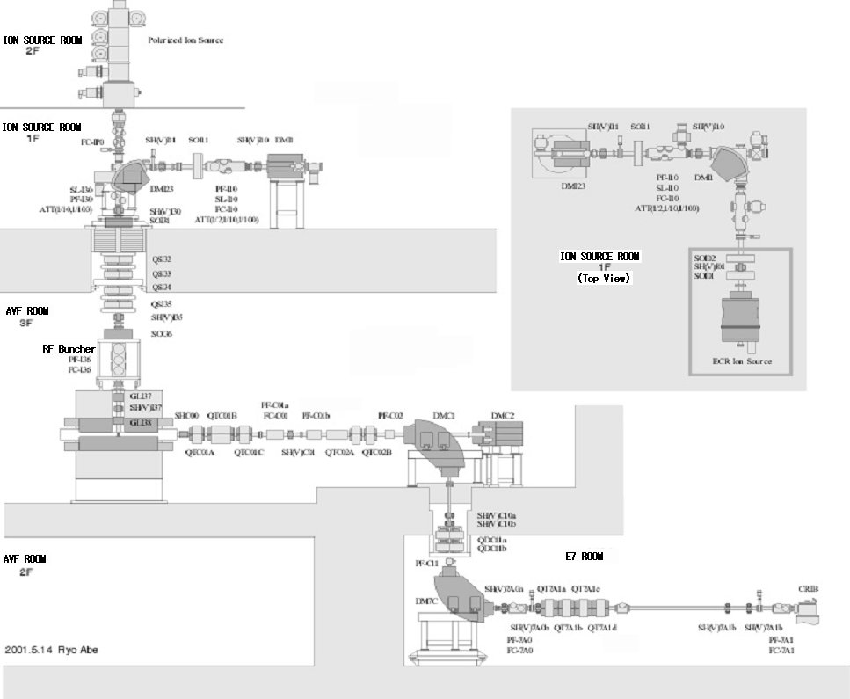
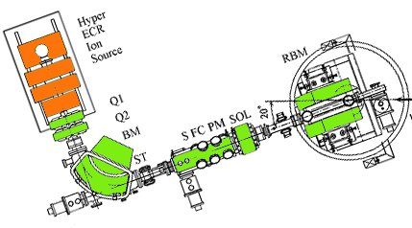
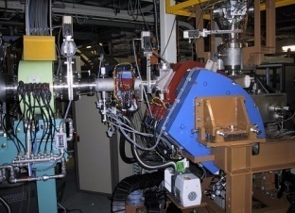
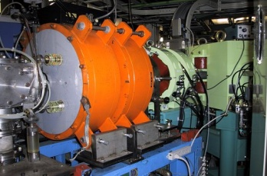
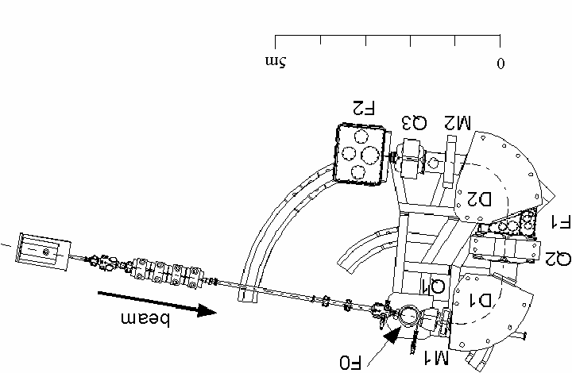
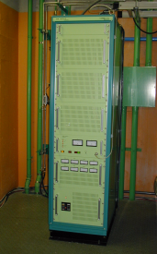
AVF Upgrade Project
New IS BT
HyperECR
+Super ECR
Multi-beam
switcher
Glaser
lens
AVF
PA
+flat-top
+K=45 => K=79
CRIB
+New central inflector
+ H=2+(1)
New CRIB BT
+Cryogenic target

Slide 11
Under AVF Upgrade Project
● Extensive ion source installation, and development
Two ECR sources, beam switcher, etc.
Many new beam species with high intensities.
● Installation of flat-top mode acceleration ⇒ better quality beam
● Higher beam energies of the primary beams; 6 ⇒ 12 MeV/u
● Higher beam intensities of the primary beams; ⇒ > 1 pμA
● New beam line for CRIB
● Non-destructive primary beam monitor while RI beam
production
● Complete Wien Filter system ⇒ Better purity RI beams
● Cryogenic target ⇒ Achieved 2x10⁸ pps of ⁷Be
● Low-energy RI beam monitoring ⇒ Introduction of MCP
● Gamma detector array for radiative capture reactions
10 NaI detectors are prepared.
● Active target-detector system(GEM-MSTPC) development
Possibilities;
● Primary beam quality → window-less gas production target
● High quality RI beams
→ Installation of multi-pole elements for aberration correction
● Room background reduction

Slide 12

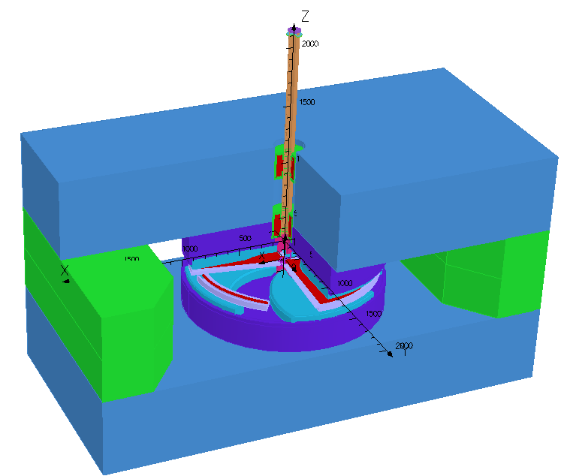
Beam dynamics simulation through the AVF cyclotron
● Optimized the operation mode.
* Tested with N14 beam acceleration.
● Made a best design of the central region of the cyclotron for high efficient acceleration
● Identified the reliable operation scheme. New monitor systems suggested.
Injection line
Injection line
Dee
De
ESD
ESD
Magnet sectors
Magnet sectors
Sergey B. Vorozhtsov
2008/04/7 08 CNS Guidance
Notes:
12

Slide 13
CRIB Facility

Slide 14
CNS Facilities at RIKEN
PA
RIBF
(Under CNS-RIKEN joint
venture program)
CRIB
AVF Upgrade Project
AVF-BT
Ge
AVF
/HyperECR
/ SuperECR
CSM
CNS-BT

Slide 15
A low-energy inflight-type RI Beam
Separator (CRIB)
Cryogenic
Production
target
F0
Heavy ion beams of 5-10 MeV/u from AVF
Double
achromatic
analyzer
F1
Degrader
Achromatic
focal plane
● RIB ~ 10³⁻⁸ pps at F3
● ΔE/E ~ 0.5 – 1 %
● Purity ~ 90 - 100 %
F2
Wien Filter
F3
(±200 KV)
0 5 m

Slide 16
RIB intensity to be obtained at CRIB
・Production target
・Primary beam intensity
~Ix10 by Cryogenic target
10⁸ pps → direct measurement
of (p,γ) reactions
2
Z
10⁸
10⁷
10⁶
105
available
N
Notes:
cross section 2mb → 1.5 x 10**8 pps

Slide 17
Radioactiv Beams produced by CRIB (A<20) - with room temperature target -
Secondary Beam | Primary Beam | Reaction | Target (mg/cm2) | Intensity (1/sec) | Purity
⁷Be⁴⁺ 8.1 A MeV | ⁷Li³⁺ 150 pnA | (p,n) | H₂ gas (0.67) | 3×10⁵ | 100%
¹⁰C⁶⁺ 6.1 A MeV | ¹⁰B⁴⁺ 200 pnA | (p,n) | CH₄ gas (1.33) | 1.6 ×10⁵ | 90 %
¹³N⁷⁺ 6.5 A MeV | ¹³C⁵⁺ 500 pnA | (p,n) | H₂ gas (0.33) | 2×10⁵ | 95 %
¹⁴O⁸⁺ 6.7 A MeV | ¹⁴N⁶⁺ 500 pnA | (p,n) | CH₄ gas (1.33) | 1.7×10⁶ | 80 %
¹⁸F⁹⁺ 2.7 A MeV | ¹⁸O⁴⁺ 500 pnA | (p,n) | H₂ gas (0.67) | 1.5×10⁵ | 98%
¹¹C 3.4 A MeV | ¹⁰B⁴⁺ 200 pnA | (³He,np) | ³He gas (0.25) | 1.7×10⁴ | 17 %
¹²N 3.9 A MeV | ¹⁰B⁴⁺ 200 pnA | (³He,n) | ³He gas (0.25) | 2.5×10³ | 3 %
⁸Li 6.5 A MeV | ⁷Li³⁺ 330 pnA | (d,p) | D₂ gas (1.33) | 2×10⁵ | 98 %
¹⁷N 2.0 A MeV | ¹⁸O⁶⁺ 750 pnA | (⁹Be,¹⁰B) | Be foil (2.5) | 1×10⁵ | 25 %

Slide 18
Radioactiv Beams produced by CRIB (A>20) - with room temperature target -
Secondary Beam | Primary Beam | Reaction | Target (mg/cm²) | Intensity | Purity
²¹Na 4.2 A MeV | ²⁰Ne⁸⁺ 200 pnA | (³He,np) | ³He gas (0.25) | 2.3×10⁴ | 12 % no WF
²²Mg 4.6 A MeV | ²⁰Ne⁸⁺ 200 pnA | (³He,n) | ³He gas (0.25) | 6.6×10³ | 3 % no WF
²⁵Al 4.0 A MeV | ²⁴Mg⁸⁺ 125 pnA | (³He,np) | ³He gas (0.25) | 1.2×10⁴ | 6 % no WF
²⁶Si 4.0 A MeV | ²⁴Mg⁸⁺ 125 pnA | (³He,n) | ³He gas (0.25) | 3×10³ | 1.5 % no WF
²³Mg 4.0 A MeV | ²⁴Mg⁸⁺ 125 pnA | (d,t) | D₂ gas (0.33) | 3.2 ×10⁴ | 12 % no WF
³⁹Ar¹⁵⁺ 4.0 A MeV | ⁴⁰Ar¹¹⁺ 120 pnA | (3He,α) | ³He gas (1.0) | 3.2 ×10⁴ | 20 %
Notes:
3x4=12

Slide 19
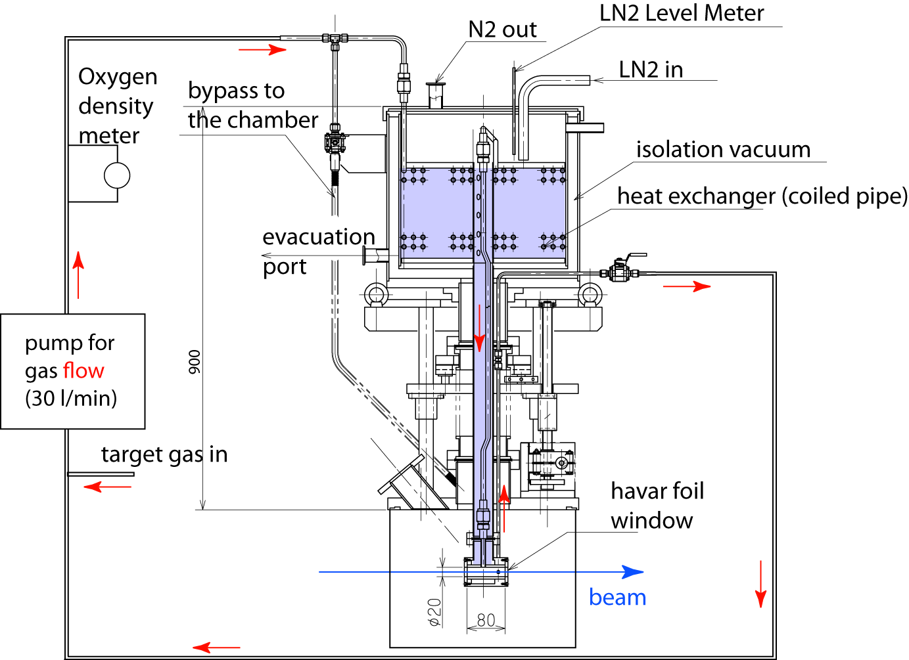
Re-circulation cryogenic production target
Target durability ~ x 3-4 Gas target density ~x 3
Features:
Lq. N₂ cooling (automatic refill)
for the better cooling power (<100 W) and thicker target.
Forced target gas flow (100 l/min) to have a better cooling and to avoid local density reduction by the beam.
Oxygen density monitor in the gas system.
Hydrogen room sensor.
~ x 10 intensity increase
H₂ target cooled by
liquid Nitrigen
⁷Be ~ 2x10⁸ achieved !
with 1.8 pμA
RI beam
Flow ≦100 lit/min.

Slide 20
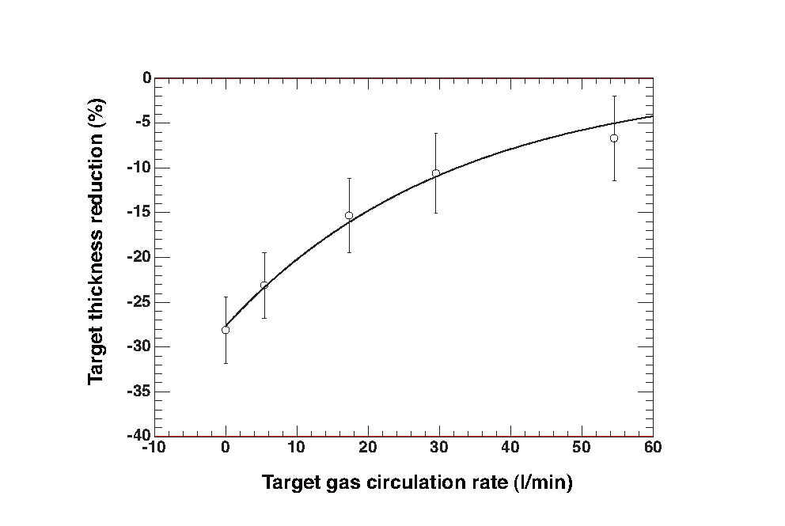
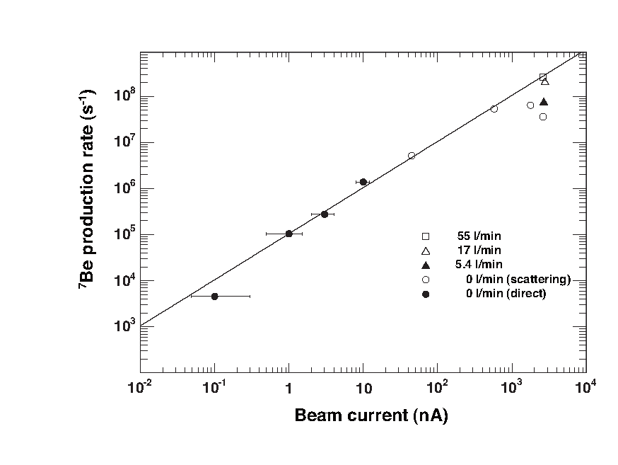
Circulation recovers the density loss
⁷Beproduction rate
with 1.4 pμA
Gas circulation recovers
the density loss
density
loss !
Recovery
Same problem for plasma target ! → fast flow target

Slide 21
CRIB Machine Times Accepted
year | number of programs | allocated days
2001 | 3 | 19
2002 | 6 | 35
2003 | 7 | 37
2004 | 4 | 18
2005 | 8 | 59
2006 | 6 | 47
2007 | 2 | 6.5
2008 | 8 | 50.5
2009 | 3 | 22
2010 | 4 | 52
SUM | 51 | 346
* Commisioning and facility test times are not included.

Slide 22
²¹Na(α, p) reaction

Slide 23

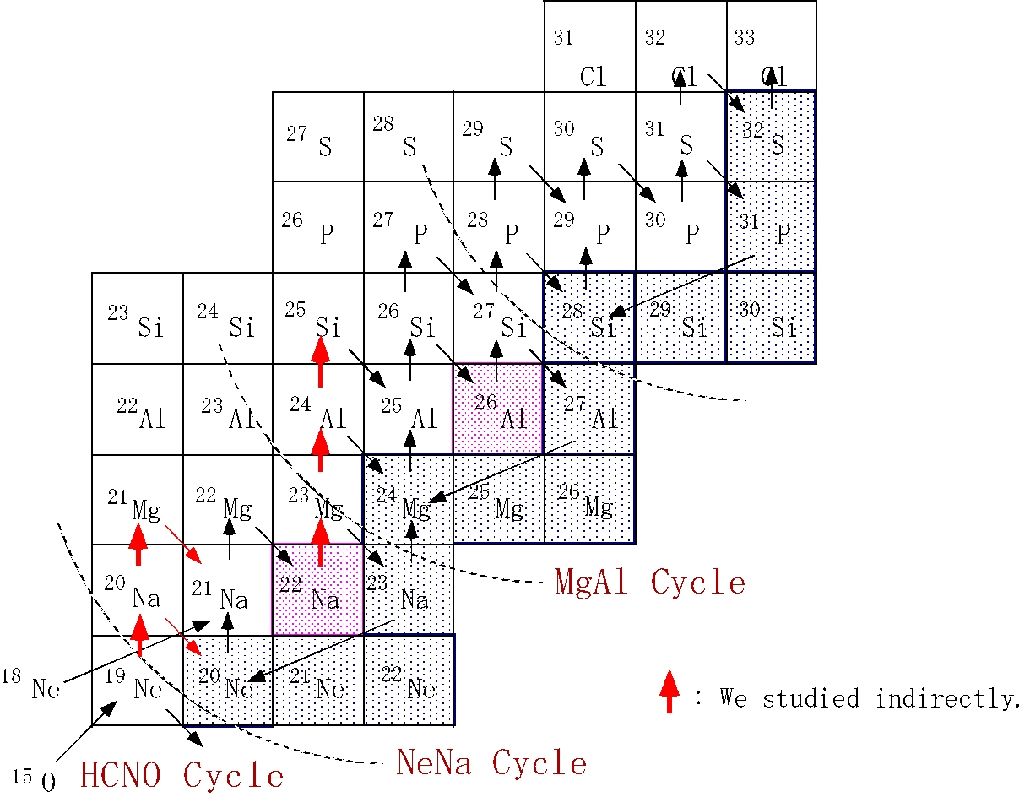
Early Stage of rp-Process
Cycle;
4H→⁴He+Q
rp-process
？
αp-process
Targets of
nuclear γ-ray
observation
?

Slide 24
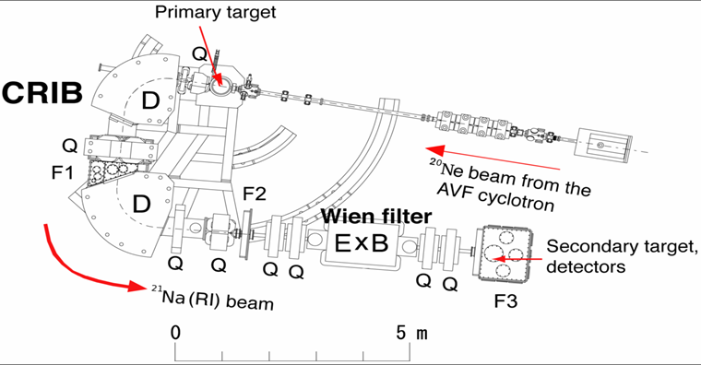
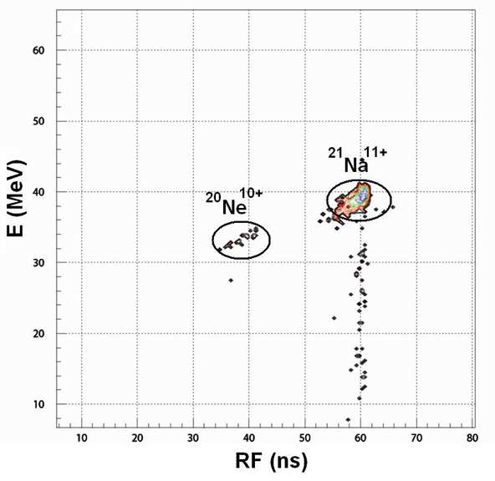
Beam production
²⁰Ne(d,n)²¹Na in inverse kinematics
6.2 MeV/u
²¹Na beam
Energy:
39.5 ± 0.9 MeV
Purity:
83 – 95 %
Intensity:
~ 5x10⁵ pps
Slit
Purity < 10 %
Purity > 90 %
PPAC < 10⁶ pps

Slide 25
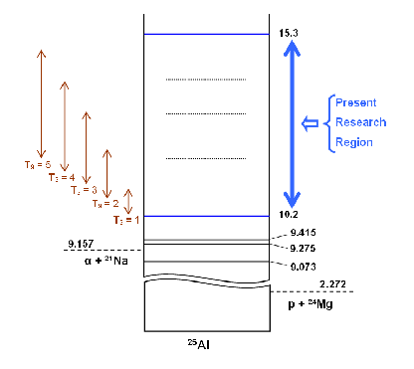
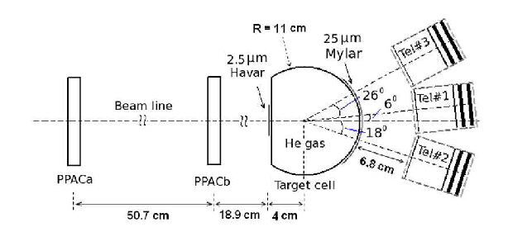
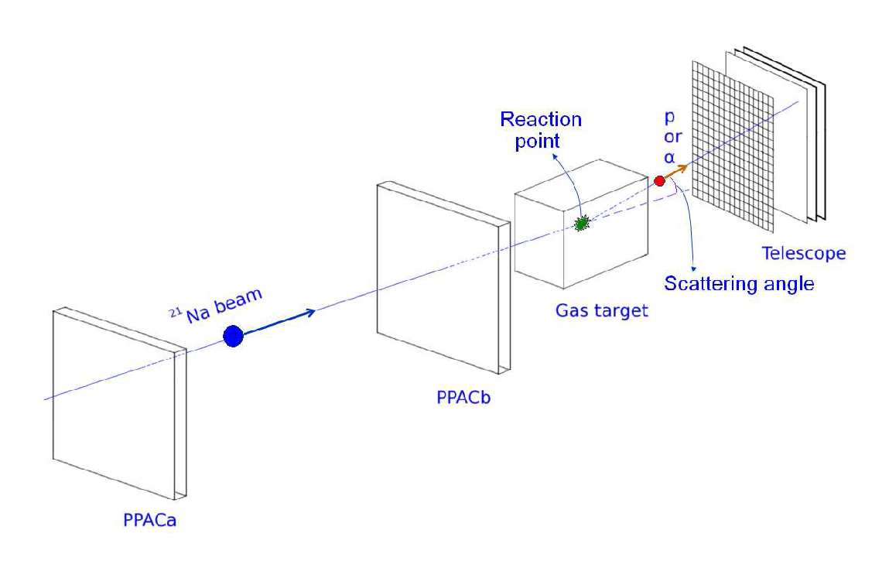
Physics Problem and Exp. setup
Binh
(x4,y4)
(x3,y3)
α+²¹Na
x
p+²⁴Mg
(x2,y2)
(x1,y1)
²⁵Al

Slide 26
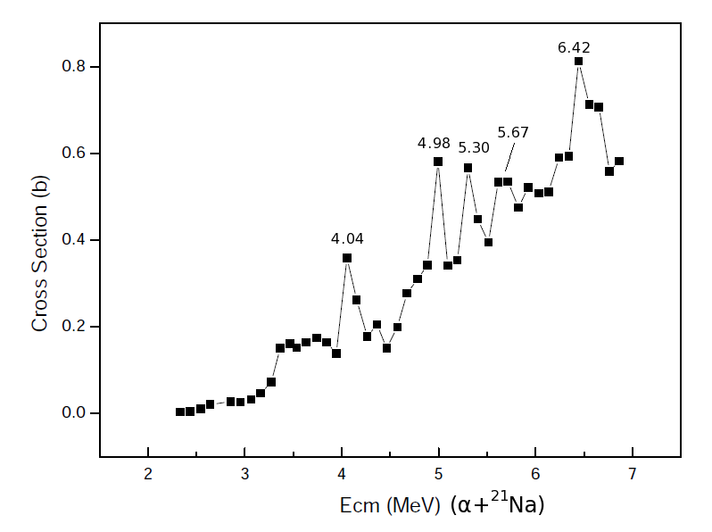
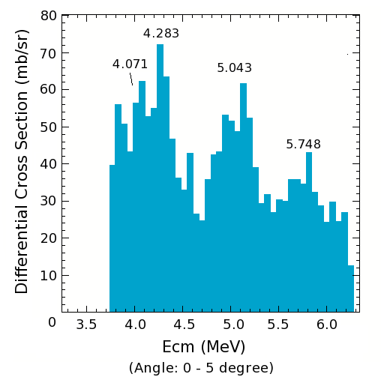
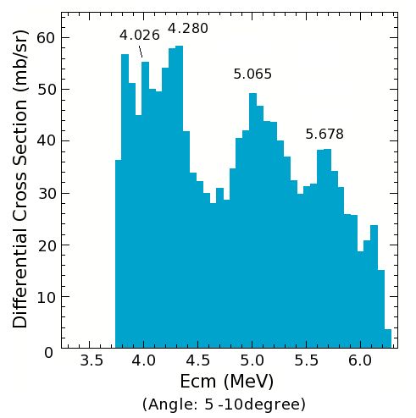
21Na(a,p) Study
²¹Na(α,p_{o}) ²⁴Mg
(Gruhle, NPA286)
²¹Na+α
resonant
elastic
scattering
Θ_{L}=0-5º
Θ_{L}=5-10º
Preliminary
Notes:
NPA286, 523, 1977

Slide 27
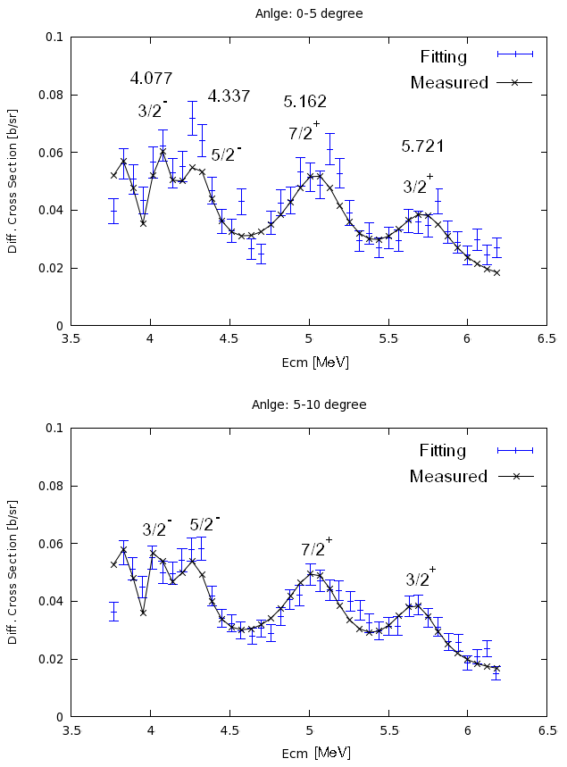
θ=0-5º
R-Matrix Analysis
4.08
4.34 5.16 5.72
Resonance Parameters
E_{r} (MeV) | Г_{α}(MeV) | J^{π} | l
4.077 | 0.1487 | 3/2⁻ | 3
4.337 | 0.2779 | 5/2⁻ | 3
5.162 | 0.7393 | 7/2⁺ | 2
5.721 | 0.4356 | 3/2⁺ | 2
Preliminary
θ=5-10º

Slide 28
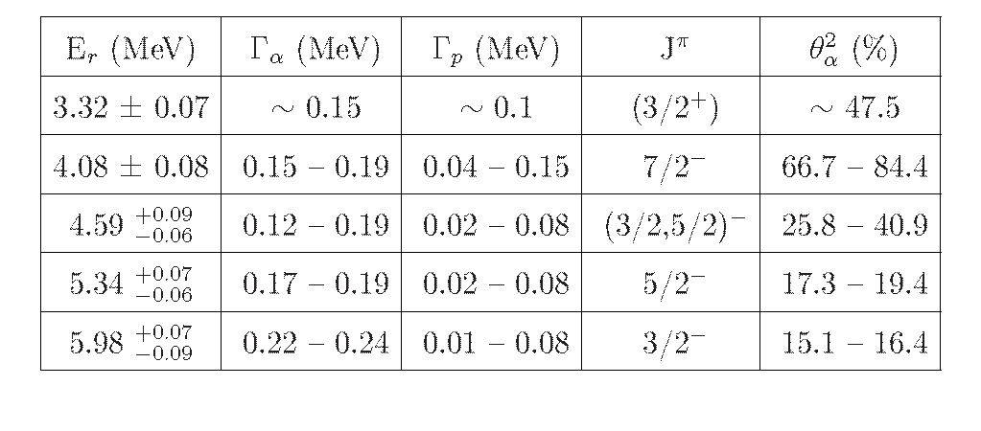
R-matrix analysis on ²¹Na(α,α)
α Reduced Width/
Wigner limit
α-cluster
resonances !

Slide 29
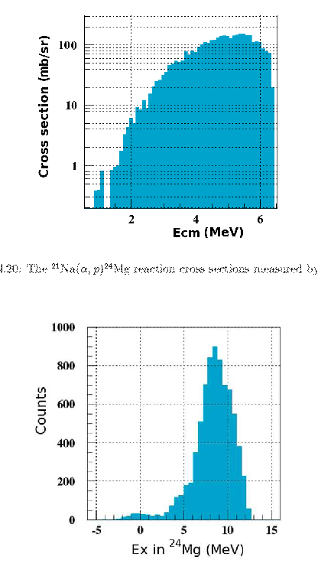
Transition strengths of ²¹Na(a,p)²⁴Mg
Transitions to
high-lying states
in ²⁴Mg
Present rate
includes
only (α,p₀)
(α,p₀)
(Ex(²⁵Al)-Q(a))

Slide 30
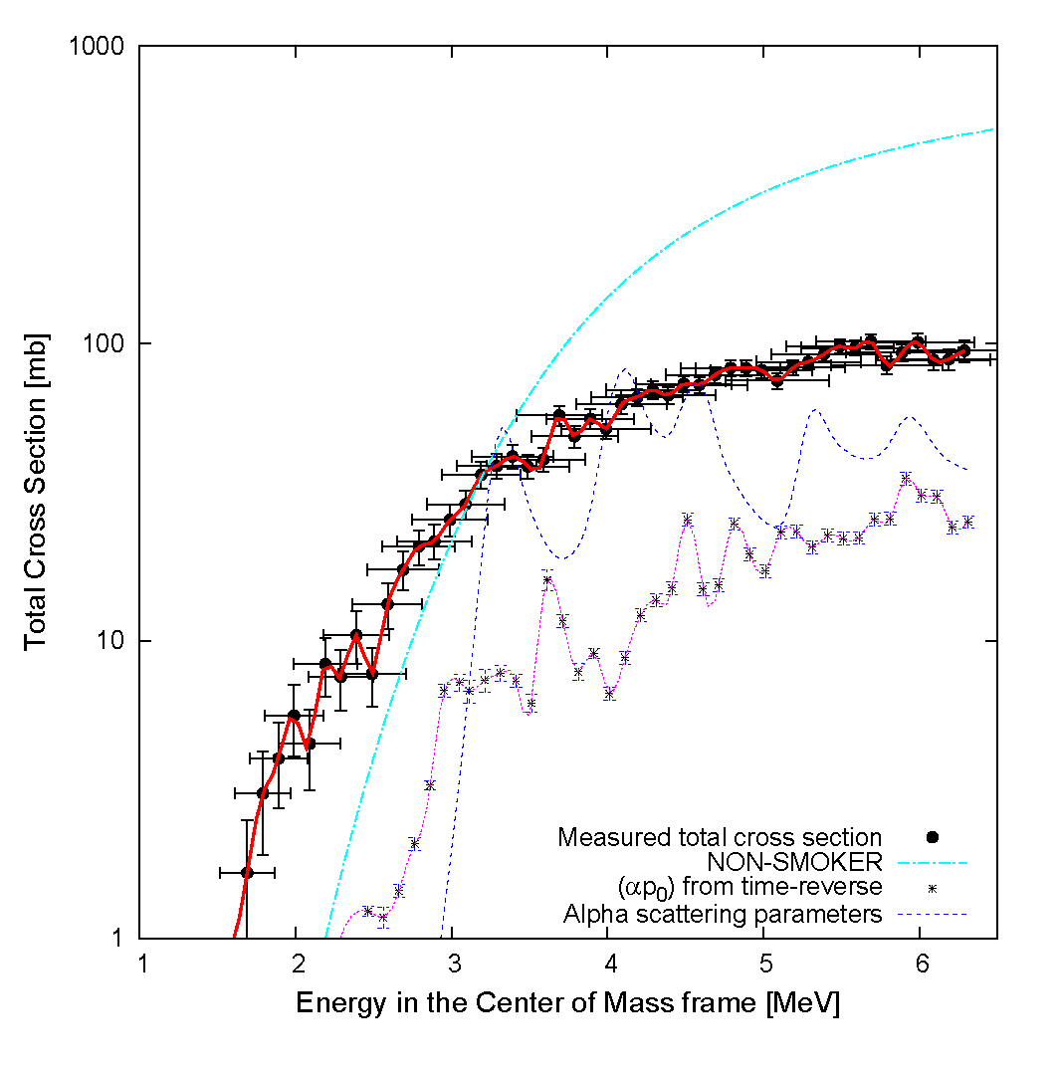
²¹Na(α,p)²⁴Mg Reaction Cross Sections
Large
enhancement !
Non-Smoker
Direct
measurement
Calculated
(from α-scatt.)
(α,p₀) data
(from time rev.)

Slide 31
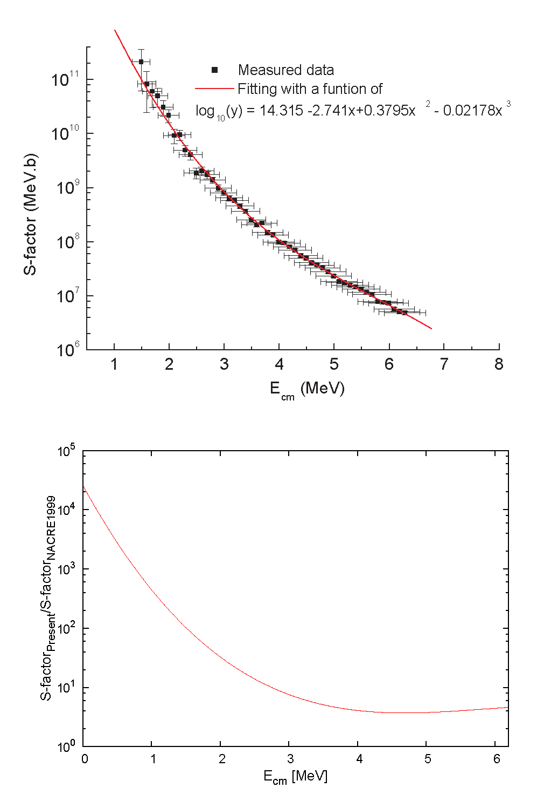
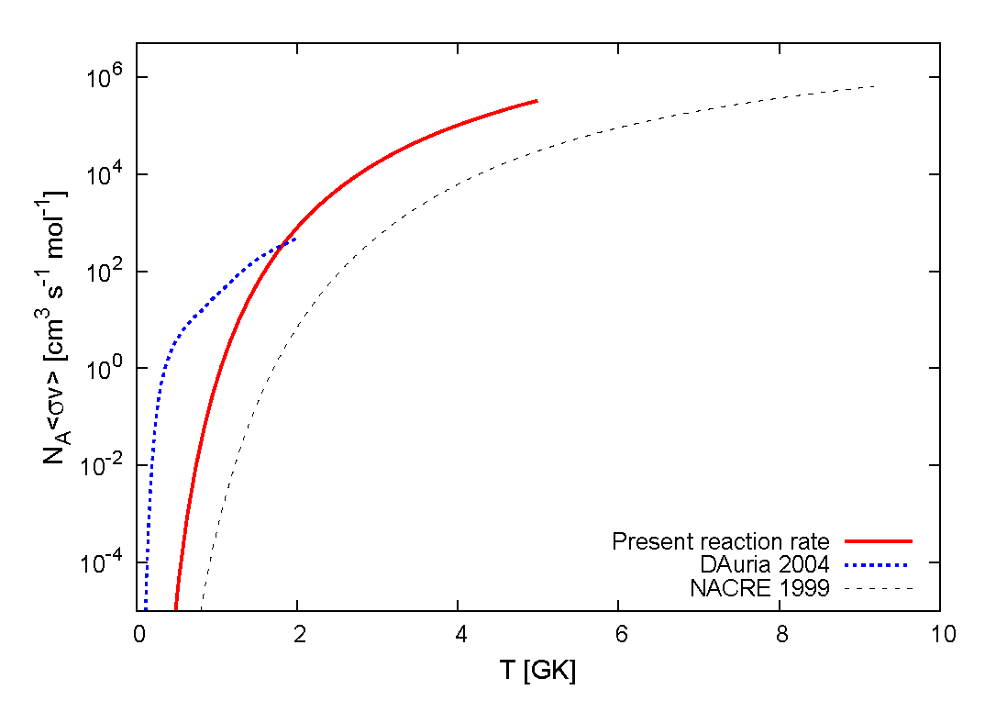
Reaction rate of ²¹Na(α,p)²⁴Mg
Present ²¹Na(a,p)
NACRE; ²¹Na(a,p)
(accepted presently)
S-(present) / S(NACRE)
S-(present) / S(NACRE)
D’Auria; ²¹Na(p,g)
αp-process
wrong? !
Ecm(MeV)
Ecm(MeV)
T(GK)
²²Mg
²³Mg
Ignition temperature a half ?
Scenario pathway is wrong ?
²¹Na
²²Na

Slide 32
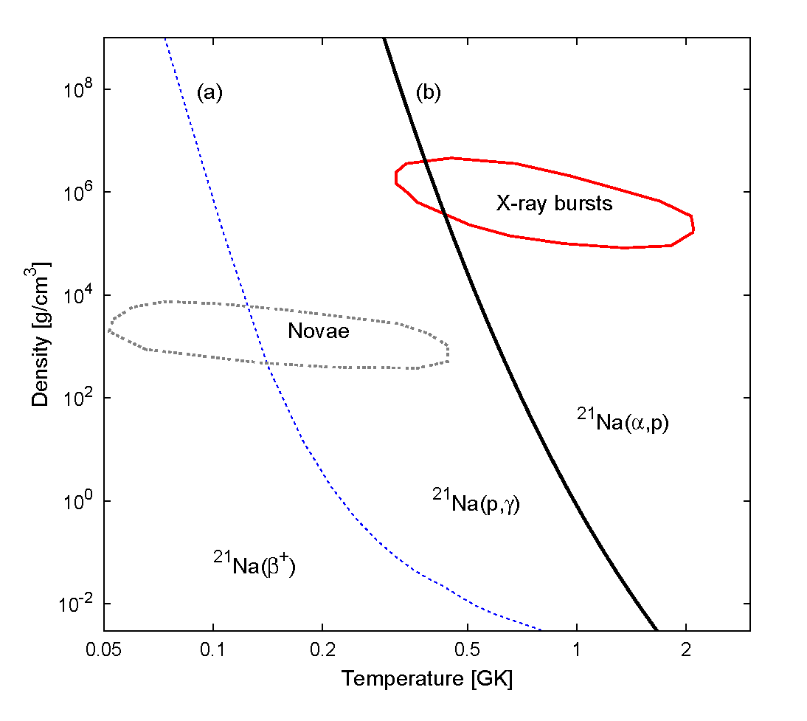

Slide 33
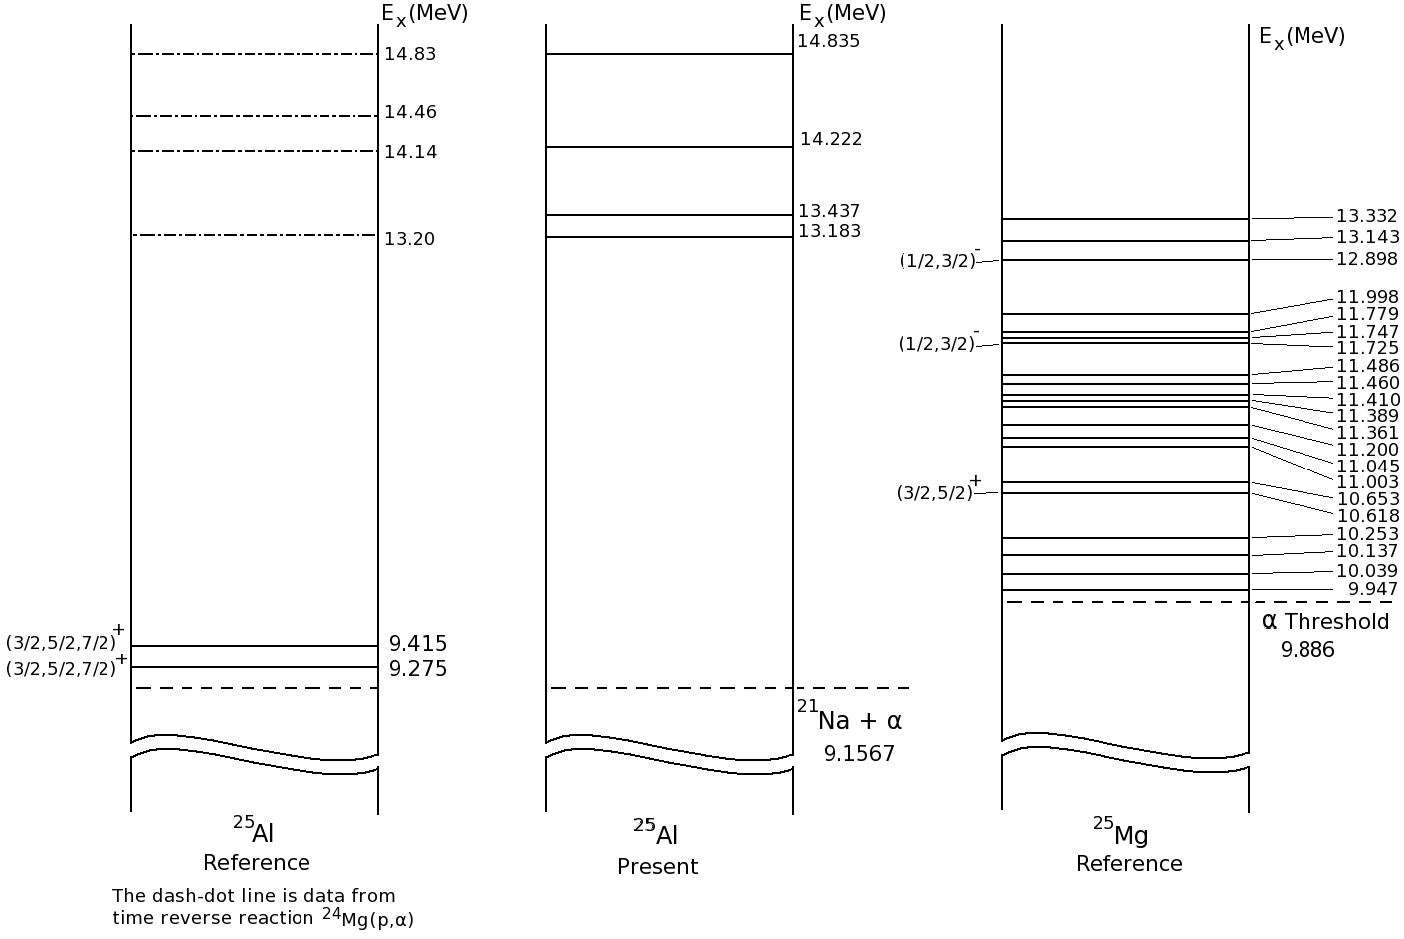
Levels for ²¹Na(α,p)
²⁵Al
References
²⁵Al
Present
²⁵Mg
References
Notes:
Ga primarily decides the r.r.

Slide 34
Application Programs
at CRIB

Slide 35
Application programs
1) Production of Polarized Radioactive Beams via The Inverse-
kinematics Reactions and Their Application
(K. Asahi/TIT)
2) Environmental dependence on the half-life of nuclei
(T. Otsuki/Tohoku Univ.)
3) Detector development for RIBF experiment
(Sumikama/Tokyo University of Science, and
S. Nishimura/RIKEN)
→ Successful measurements of r-process nuclei (PRL, 2011)

Slide 36



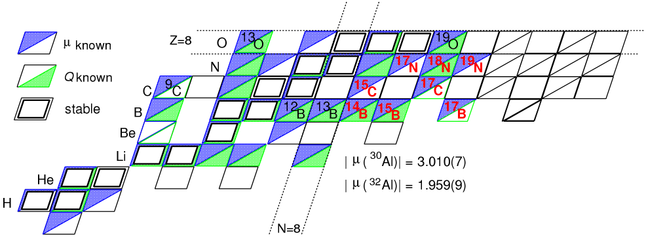
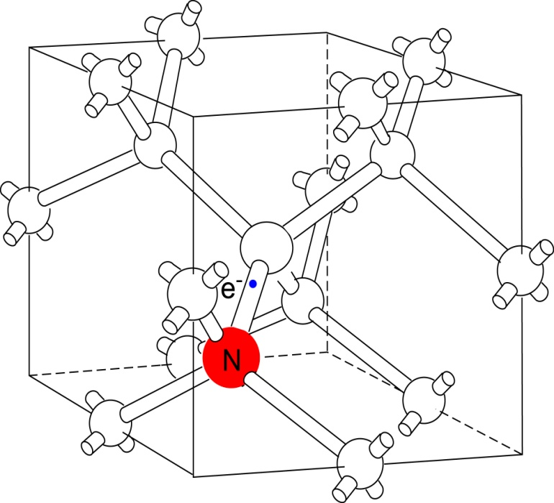
Physics with Spin-Polarized Beam and b-NMR
Nuclear Physics
Nuclear moments measurement
Asahi
Condensed Matter Physics
Probe of behavior of impurity implanted into semiconductor
Goal: research behavior of nitrogen implanted into diamond
Asahi Group
C
μ_{N}
e
¹²B
μ_{N}
Si
¹²B

Slide 37
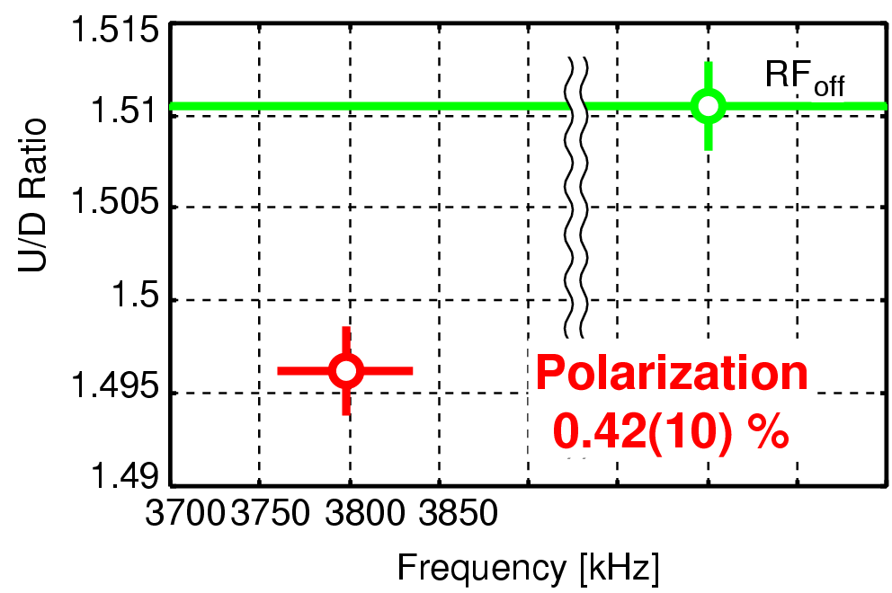
¹⁷N β-NMR Spectrum
B₀=7.0771 kG
MgO stopper
A_{β} Q = -0.57

Slide 38
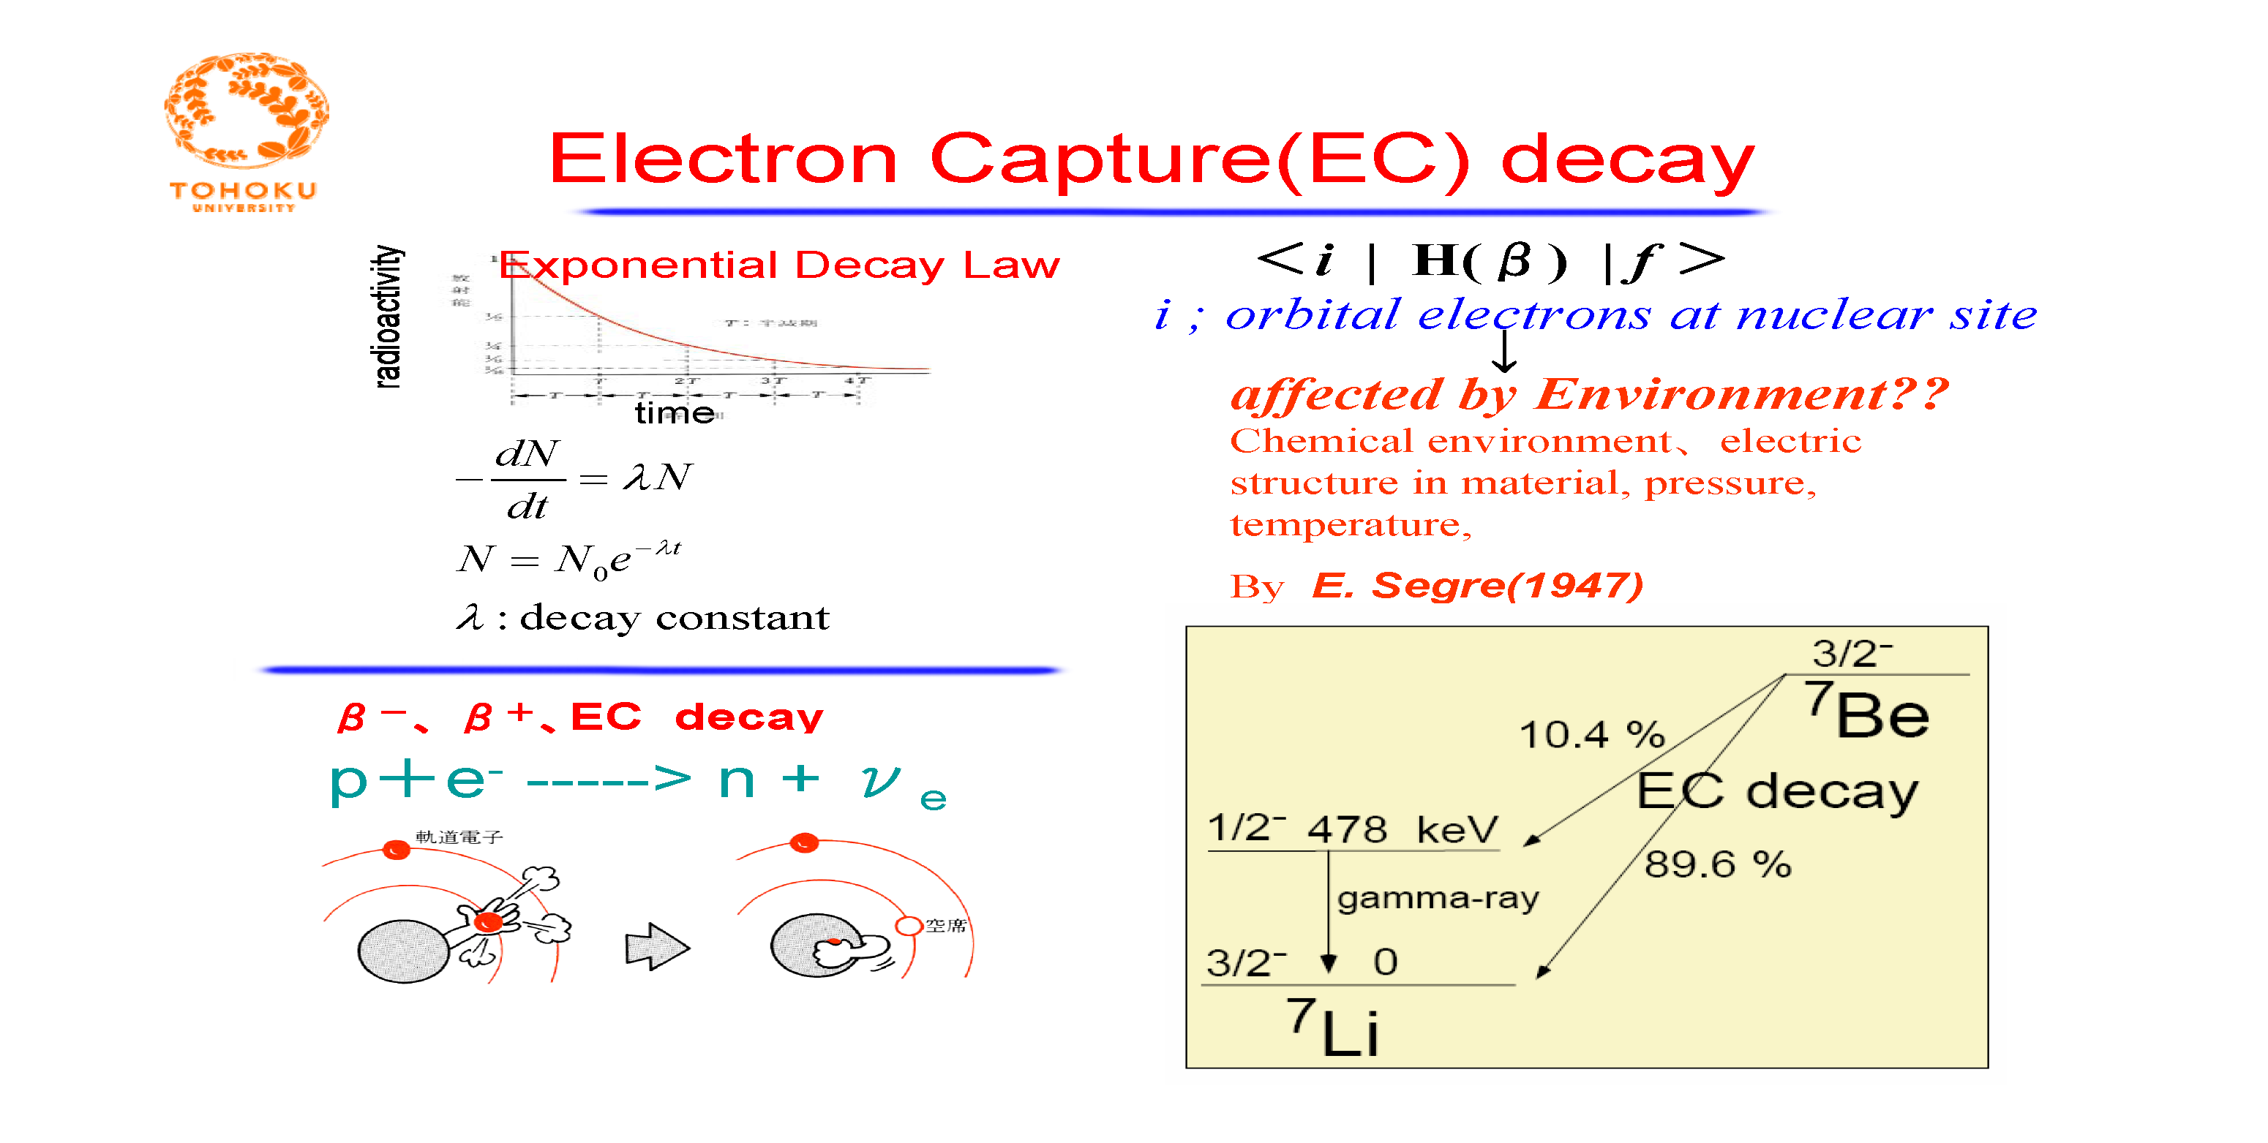
Otsuki

Slide 39
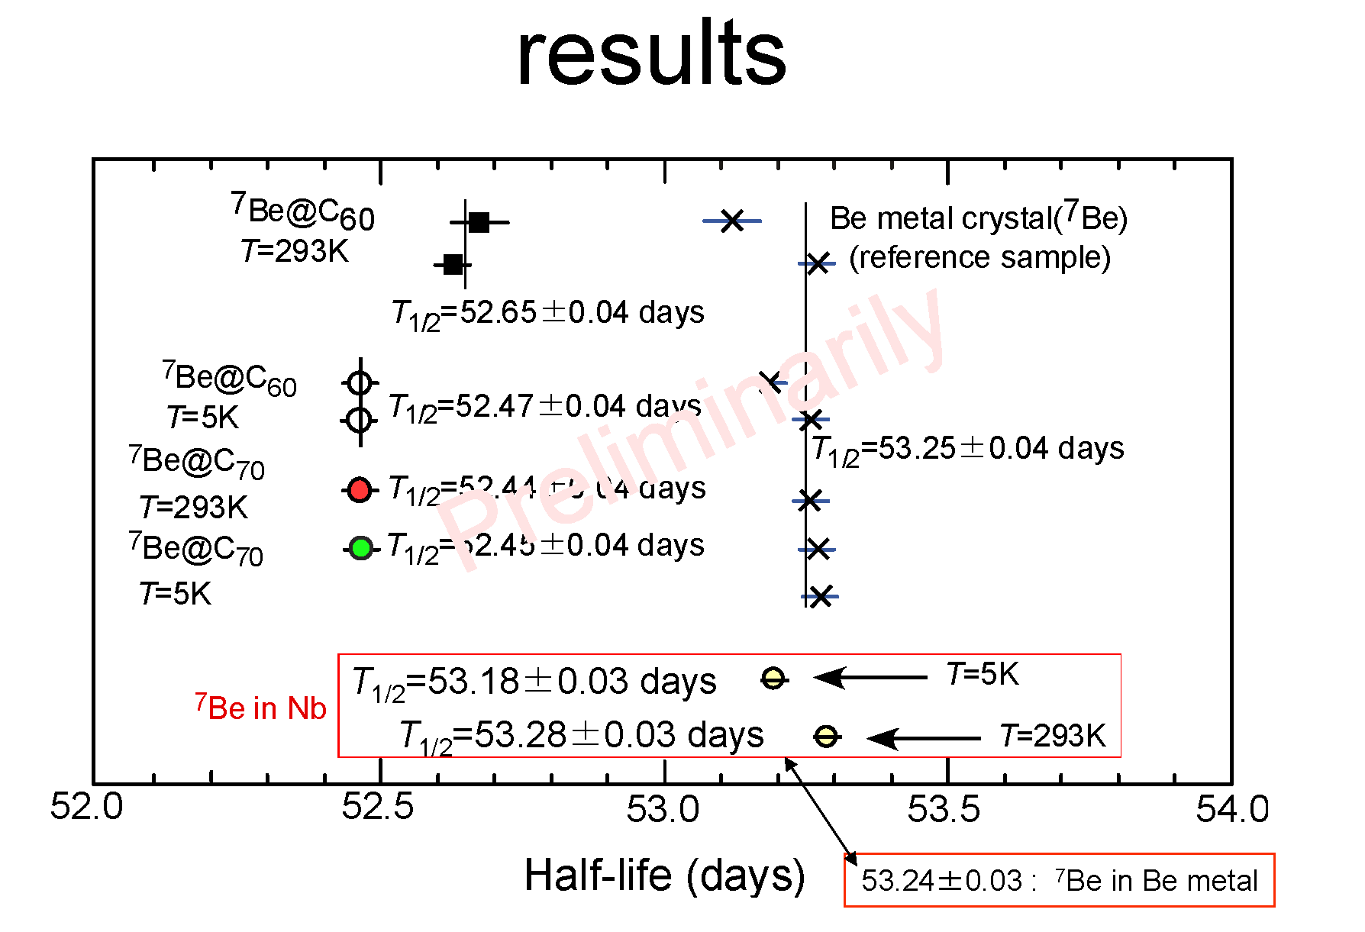

Slide 40
Possibilities at CRIB

Slide 41
Direct Method with RI Beams
RIB intensities reaction type
10⁴ pps → Resonant scattering w/thick target method
eg. ²²Mg+p
10⁶ pps → Rearrangement reactions
eg. (α,p), (α,n), (d,p), . . .
10⁸ pps → (p,γ), (α,γ), . . .
Total system development=AVF Upgrade project
1. Ion source 2. Accelerator
- SuperECR - FT mode, Modify central region
3. Beam transport 4. Production target
5. Separator - Multipole element

Slide 42
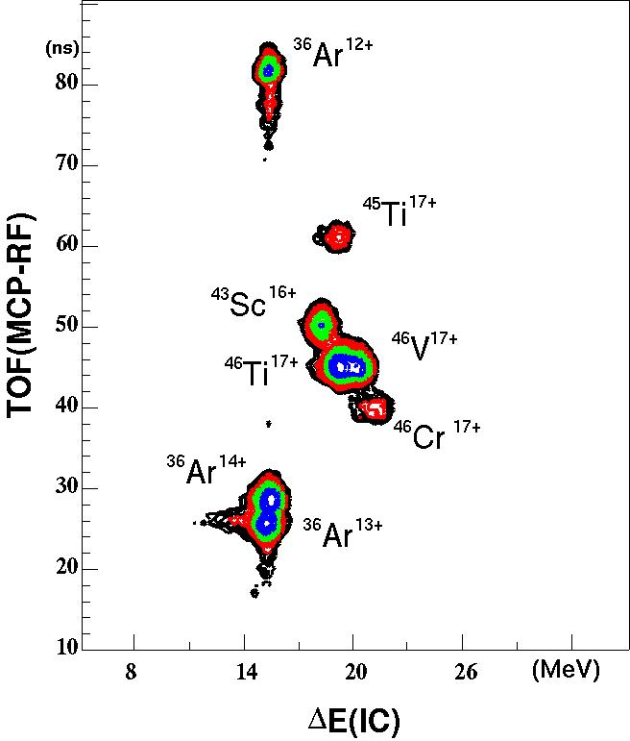
RI beam of A=40-50 production by
a fusion reaction of ¹²C+³⁶Ar at 3.6 MeV/u
Wakabayashi
Clean particle
separation !
⁴⁶Cr¹⁷⁺
(2%, 7pps)
@80pnA
Nuclide | ⁴⁶Cr | ⁴⁶V | ⁴⁵Ti | ⁴⁶Ti | ⁴³Sc | ³⁶Ar
Purity(%) | 2 | 9 | 2 | 16 | 5 | 51
Rate(pps) | 6 | 27 | 7 | 49 | 14 | 157
Half life | 260ms | 422.4ms | 184.8min | stable | 3.891h | stable
Figure of PI at F3

Slide 43
Possibilities for the CRIB facility
Primary beam quality
Production target; window-less→ x10
Secondary beam quality; size→ 1/2
Wien filter transmission; 30→ > 80%
RI beams of A > 40
Beams of fission fragments; very high intensity
Background for gamma spectroscopy;
→ in beam γ-spectroscopy
8. Active target → versatile for many type
reaction studies
Notes:
Emittance ?

Slide 44
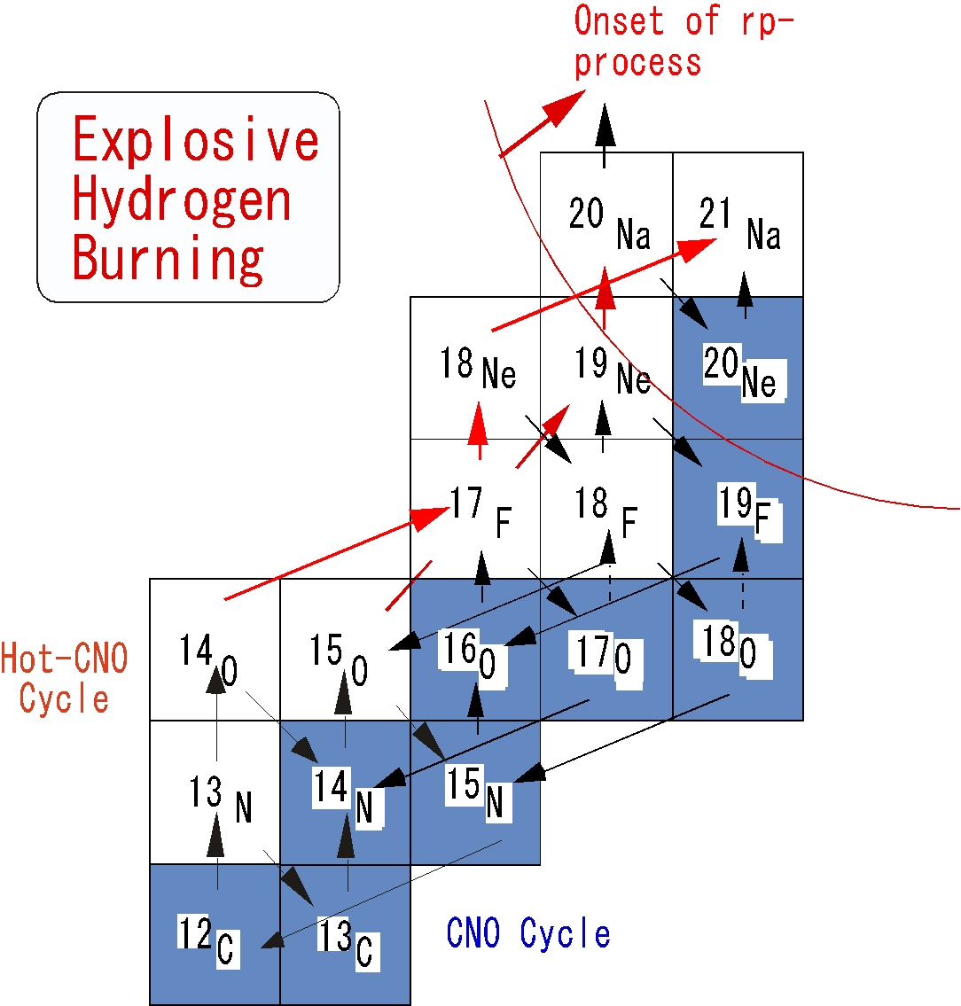
High T rp-Process
He,
Hahimoto
(p,γ) + (α,p), (α,γ)
(e.g. X-ray burst, SNe)
¹⁴O(α,p)¹⁷F
Notani, Hahn
¹³N(p,γ)¹⁴O
Teranishi
¹⁸F(p,α)¹⁵O

Slide 45
T=3/2 levels in A=9 nuclei
Teranishi
Only the first and second T=3/2 levels are well known experimentally.
J^{π} and Γ
structure of ⁹Li and its analog
Energy systematics of isobaric multiplets (Thomas-Ehrman shift)

Slide 46
Possibilities of Physics at CRIB
Complete (α,p) studies – done only for high T
Direct measurement of (p,γ) and (α,γ)
α-cluster structures in unstable nuclei
Particle structure in unstable nuclear region
- isobaric analog states (Teranishi)
5. Physics with RI beams of A = 40-60
6. Physics with spin polarized beams
7. Physics with fission fragments
8. . . .
Notes:
Emittance ?

Slide 47
International Collaborations
Chung Ang University
Ewha Womans University
Seoul National University
CIAE, Beijing
IMP, Lanzhou
IOP, Vietnam
University of McMaster
Michigan State University
ATOMKI, Hungary
IOP, Orsay
INFN, Catania
University of Padova
University of Edinburgh
University Sao Paulo
RIKEN
Kyushu University
Tohoku University
Osaka University
Tsukuba University
Yamagata University
KEK
Tokyo I. T.
Kyoto University
+ Others
Thanks for all
for supporting CRIB
and collaborations

Slide 48
Nuclear Physics Experiments at KRS
Direct reaction study of stable/unstable nuclei
2. Resonant scattering
Elastic, rearrangement, capture
Fusion/ Fission product spectroscopy
with in-beam spectroscopy
Rare event study
5. New research domains
We need to determine the basic functions;
RIB production – degrader, WF
Large acceptance for in-beam spectroscopy - two stage,
large bite
High resolution particle spectroscopy – large p dispersion
Polarized RIB – rotatable stage
Fission fragment spectroscopy ? - GARIS mode,
Priority setup for KRS project
Subjects, group
Group
Time line of research activities and of building the groups

Slide 49
Establish an Extensive Inflight separators
at low energies
1. Primary beams
- Ion Source – intensity, species, emittance,
- Accelerator – efficiency, emittance, flat-top mode,
- beam line – efficiency, square beams, emittance aperture
2. Production target – window-less prod. target w/fast flow
or plasma window target
– production reactions and yields
3. Separator
- basic property – production/reaction scheme
for capture reactions, fusion/fission residues,
angular acceptance,
– high-resolution spectrometer use, etc.
– room separation (room background)
- efficiency, acceptance, non-zero degree producntion (pol. RIB).
- purity – Wien filter or RF deflector, parallel degrader
- RI beam property – small spot size, parallel beam
(higher order aberration)
- RI beam monitor – fast, high eff. counter (PPAC, diamond, ..)
4. Experimental target/ detectors

Slide 50
2012
2013
2014
2015
2016
2017
2018
RISP construction
SCL1 or SCL3 (18.5 MeV/u)
Recoil spectrometer
Construction/tuning
SIB/RIB exp.
Discussion/
Producers
bidding
Basic design
Final design
RIB exp. @other labs.
Cyclotron installation
ISOL
RIB exp.
Building construction
Notes:
See 11/1 2012 mail from Kwon

Slide 51
Construction work
In-house persons
Company A
Company A
Separator
Wien Filter
Production target
Control system
Company B
Detailed drawings
Manufacturing
Setting
Company C

Slide 52
Nuclear Physics Experiments at KRS
Direct reaction study of stable/unstable nuclei
2. Resonant scattering
Elastic, rearrangement, capture
Fusion/ Fission product spectroscopy
with in-beam spectroscopy
Rare event study
5. New research domains
Need design study
till 2013 February
We need to determine the basic functions;
RIB production – degrader, WF
Large acceptance for in-beam spectroscopy - two stage,
large bite
High resolution particle spectroscopy – large p dispersion
Polarized RIB – rotatable stage
Fission fragment spectroscopy ? - GARIS mode,
Priority setup for KRS project
Subjects, group
Group
Time line of research activities and of building the groups

Slide 53
If possible, concentrate the efforts
on the low energy part.
↑
Research output
Man-power

Slide 56
present
Bidding
Confirm
basic design
Producer
decided
Tuning/testing
Technical discussions
w/ Producers
Production
Installation
Confirm
final design

Slide 57
Summary of Research Activities at CRIB and the Scope
2011.6
Outline of CRIB project
CRIB Facility and AVF Upgrade Project
3. Research Programs at CRIB
4. Possibilities

Slide 58
Make a nuclear astrophysics physics forum in the pacific rim
based on CRIB, pelletron in Hanoi, KoRia, ….
● Exchange information and ideas
● Make collaboration works
● Make a symposium
● Enhance the nuclear astrophyscs activities in the area

Slide 59
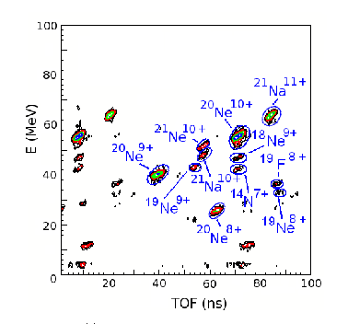
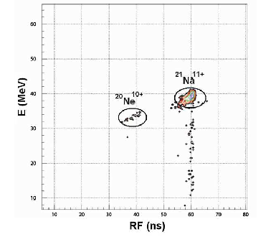

Slide 60
21Na(a,p)24Mg Reaction Cross Sections

Slide 61
21Na(a,p) Study
²¹Na(α,p_{o}) ²⁴Mg
(Gruhle, NPA286)
Θ_{L}=0-5º
Θ_{L}=5-10º
²¹Na(α,α)
Preliminary
Le/CRIB coll.
Notes:
NPA286, 523, 1977

Slide 62
