Slide 1
Simulation of the field map in the solenoid magnet
Do Gyun Kim (IBS)
2012. 12. 16
LAMPS Workshop 2012

Slide 2
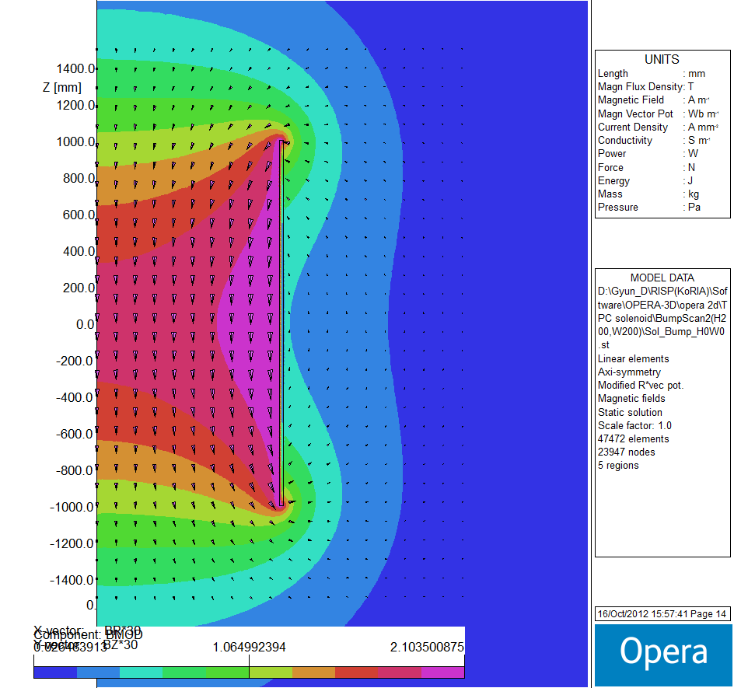
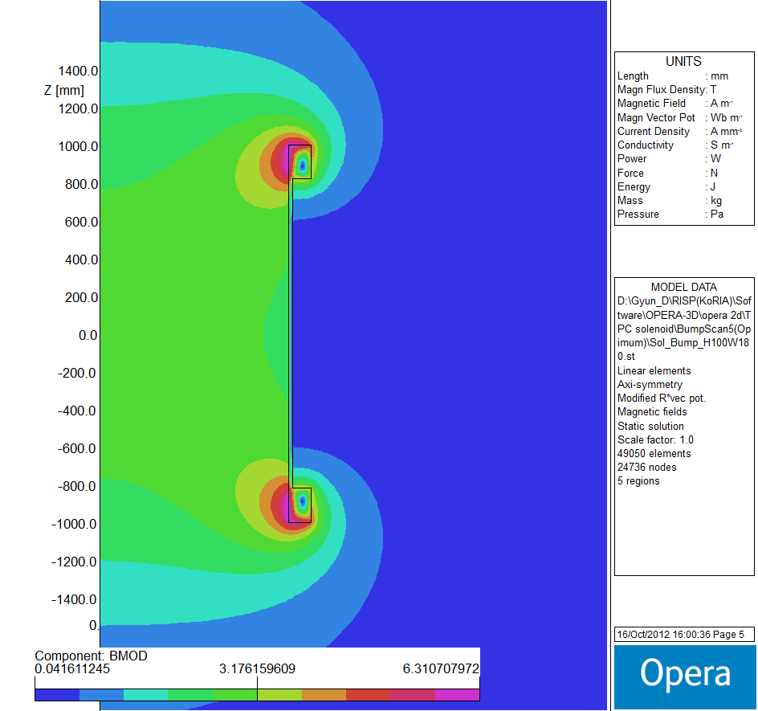
Solenoid (bump coil)
Solenoid (20mm*2000mm)
(J: 100 A/mm²)
Solenoid with Bump coil
(Hb:100mm, Wb:180mm)

Slide 3
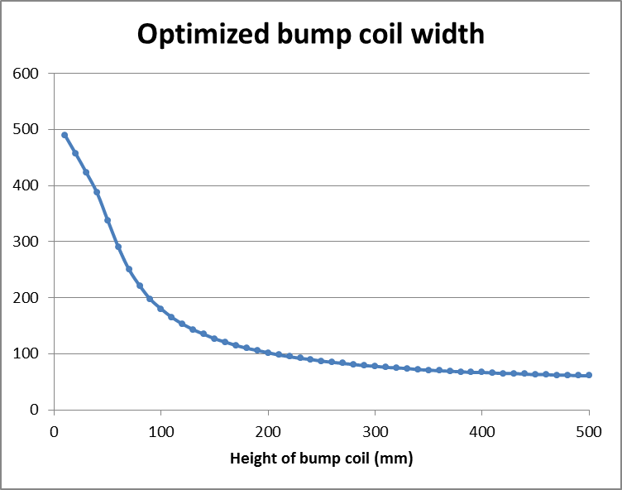
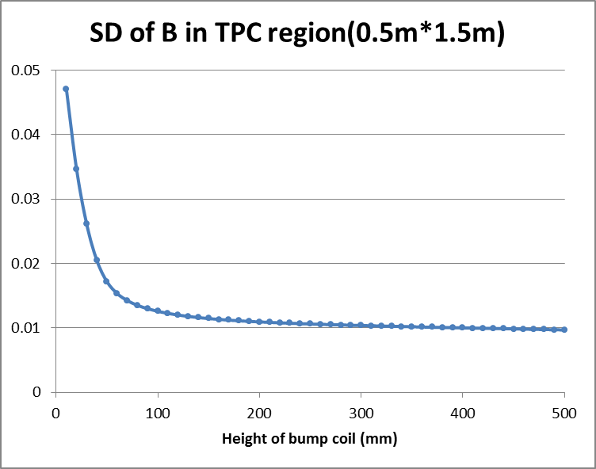
Field uniformity (Bump coil)
As the height of bump coil increases, optimized width of bump coil decreases.
Standard deviation of B-field in the TPC region decreases with increasing height of bump coil.

Slide 4
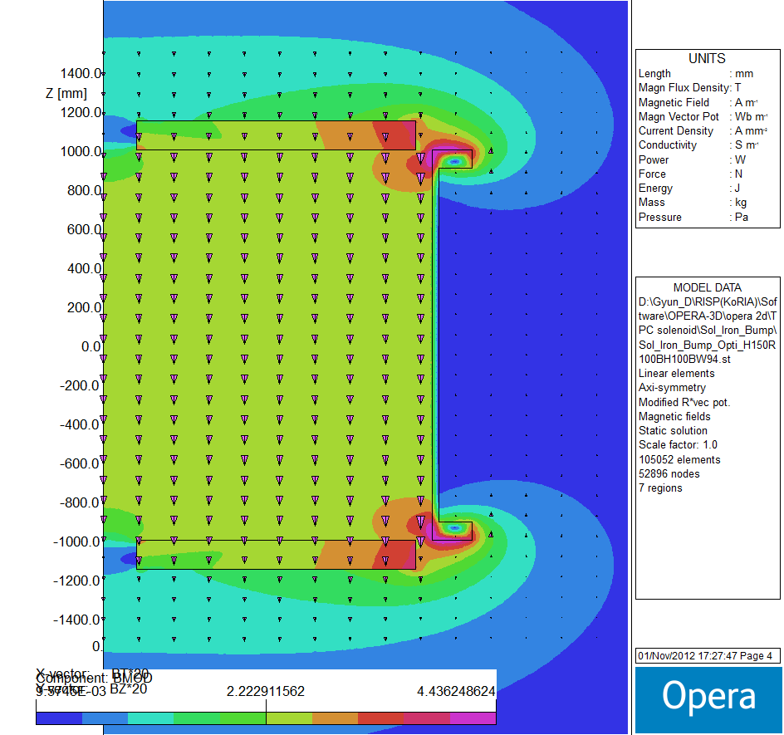
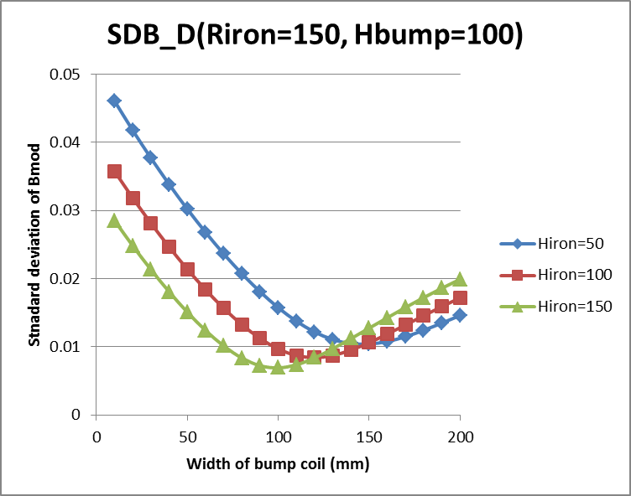
Field uniformity (Iron plate)
Standard deviation of B-field in the TPC region decreases with increasing thickness of iron plate and decreasing radius of hole of iron plate.

Slide 5
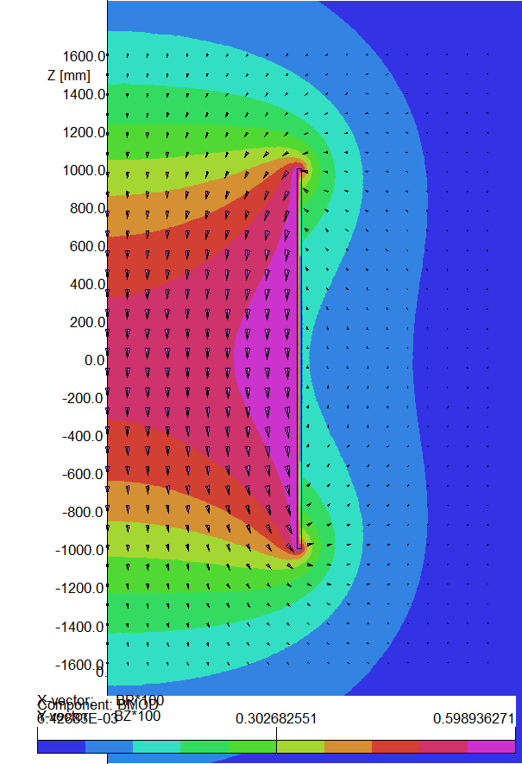
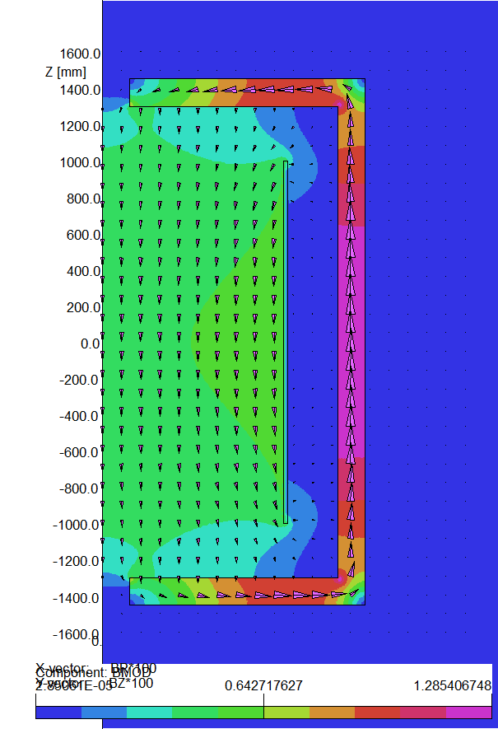
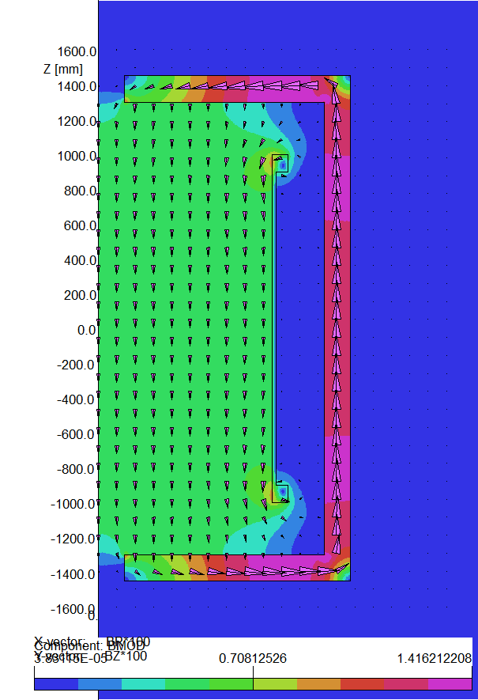
Field distribution
Simple solenoid
with Return yoke
Bumped Solenoid
with Return yoke
Simple Solenoid

Slide 6
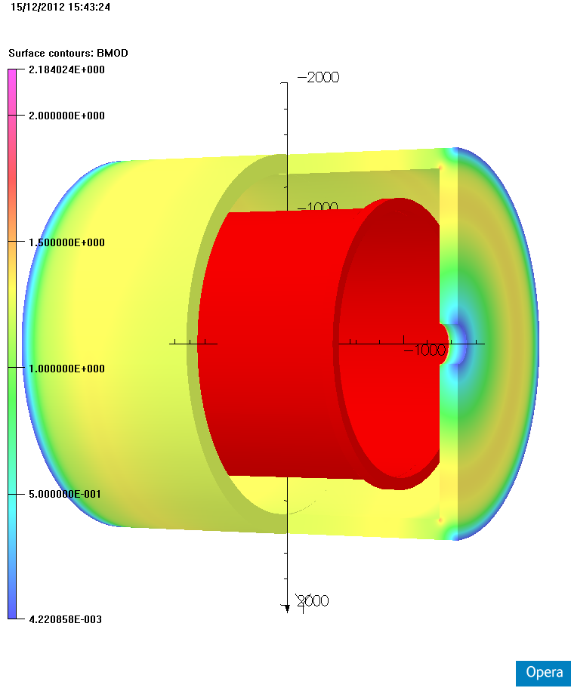
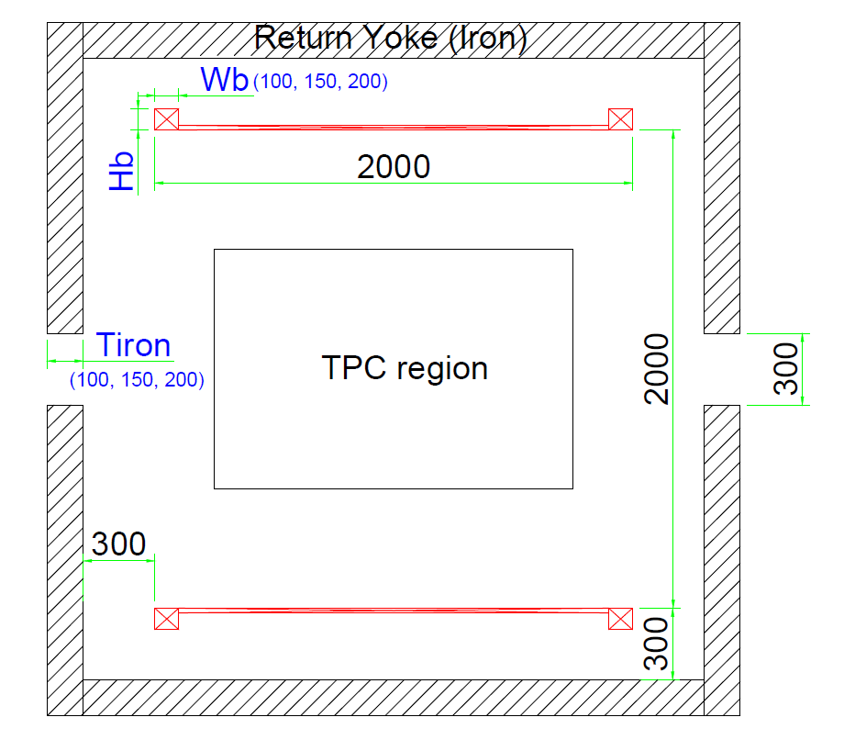
Solenoid magnet design

Slide 7
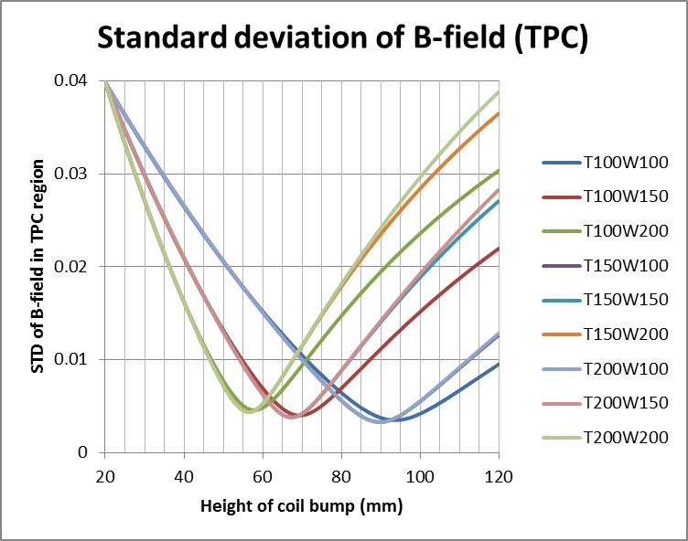
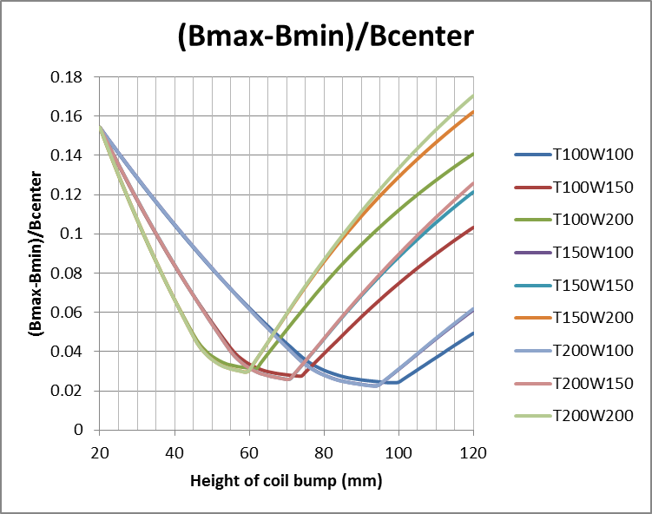
B-field uniformity
Wb=100
Hb:90~94
Wb=100
Hb:94~99
Wb=150
Hb:67~69
Wb=150
Hb:70~74
Wb=200
Hb:56~58
Wb=200
Hb:59~61
Minimum STD of B-field (*10⁻³)
 | T100 | T150 | T200
W100 | 3.49 | 3.29 | 3.29
W150 | 4.00 | 3.80 | 3.79
W200 | 4.57 | 4.38 | 4.37
Standard deviation of B-field in the TPC region decreases with increasing thickness of return yoke and decreasing width of bump coil with optimized bump height.

Slide 8
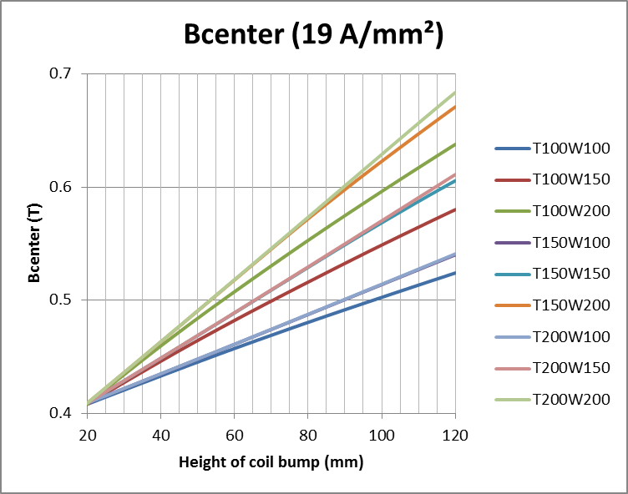
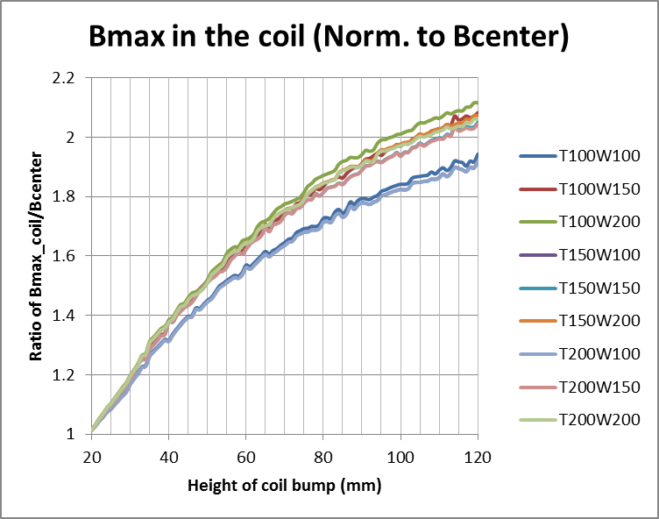
B-field (center, coil)
Wb=200
0.82 T
Wb=200
0.51 T
Wb=100
0.89 T
Wb=150
0.86 T
Wb=100
0.50 T
Wb=150
0.50 T
B-field at the center of solenoid with optimized bump coil is about 0.5 T
Maximum B-field in the coil with optimized bump coil is 0.8 ~ 0.9 T

Slide 9
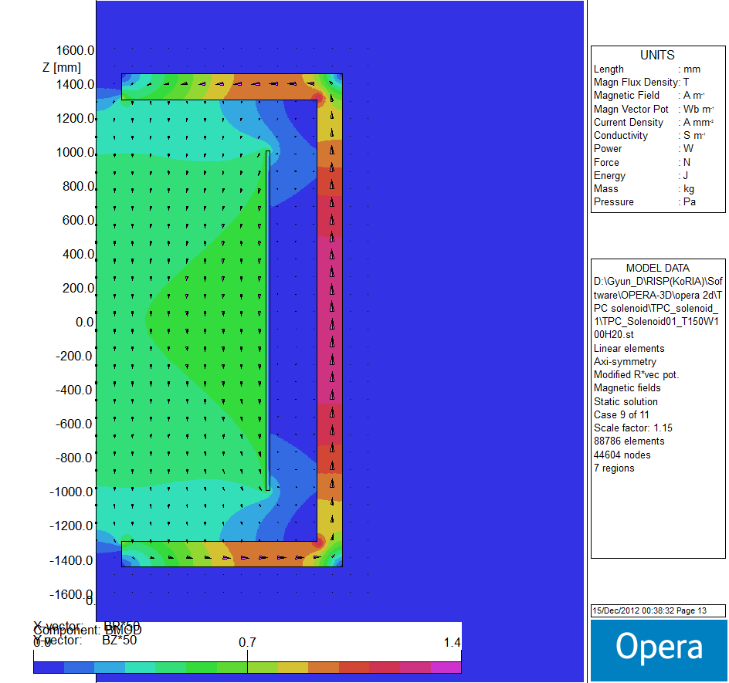
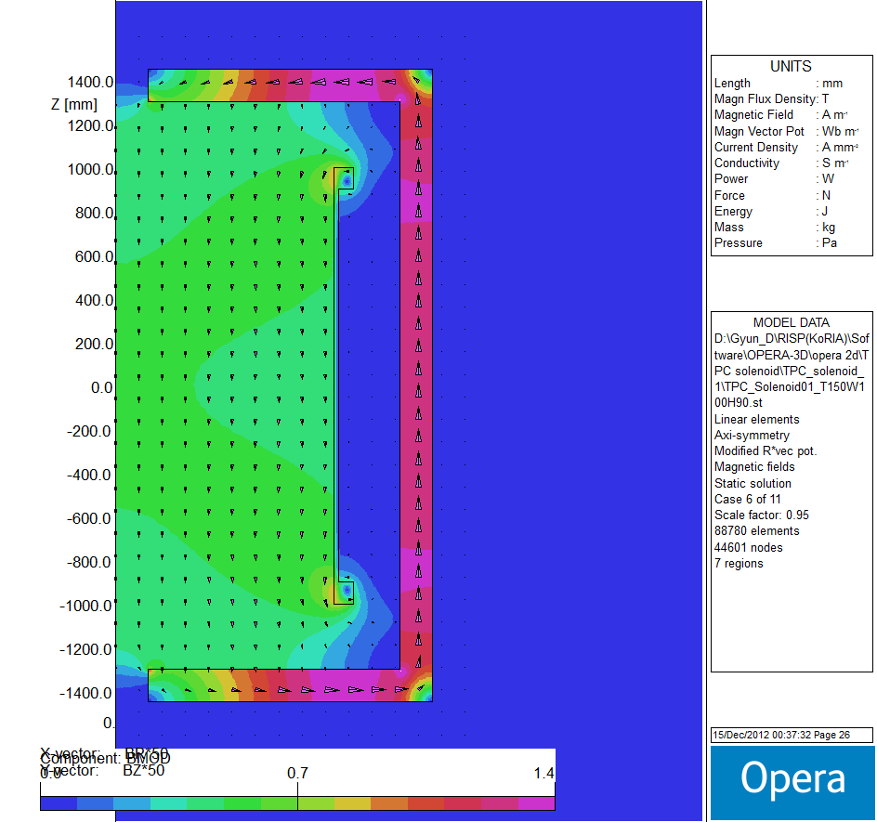
B-field distribution (Bmod)
Simple solenoid
with Return yoke
Bumped Solenoid
with Return yoke
Thickness of return yoke: 150 mm

Slide 10
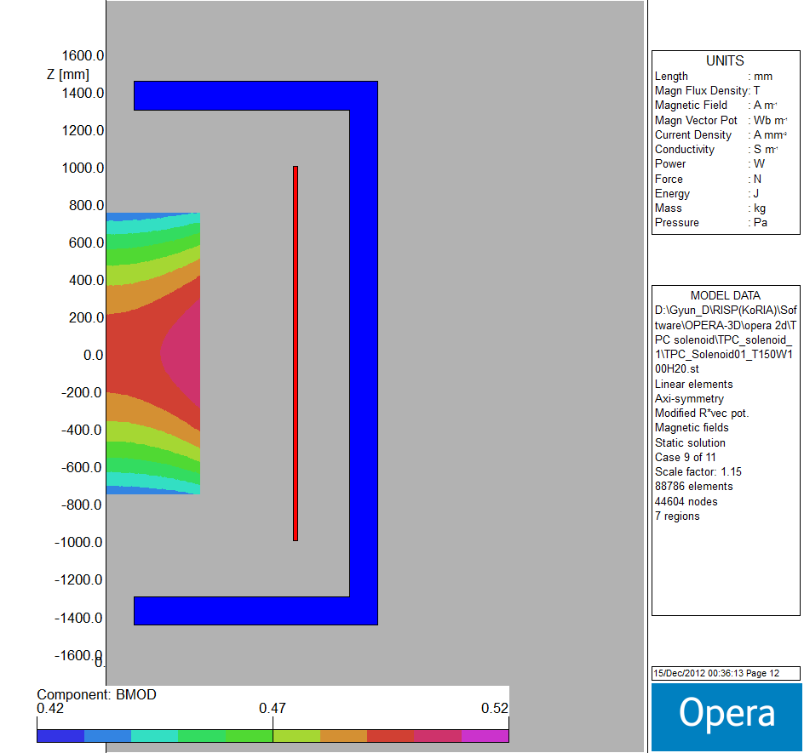
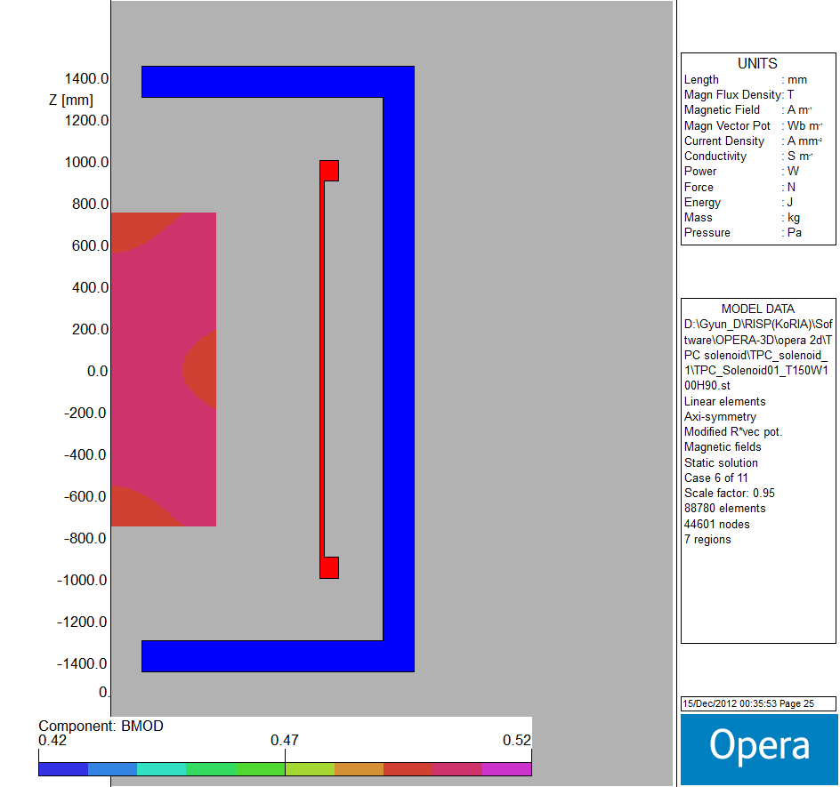
B-field distribution (TPC)
Simple solenoid
with Return yoke
Bumped Solenoid
with Return yoke
ΔB~0.076 T
ΔB~0.012 T

Slide 11
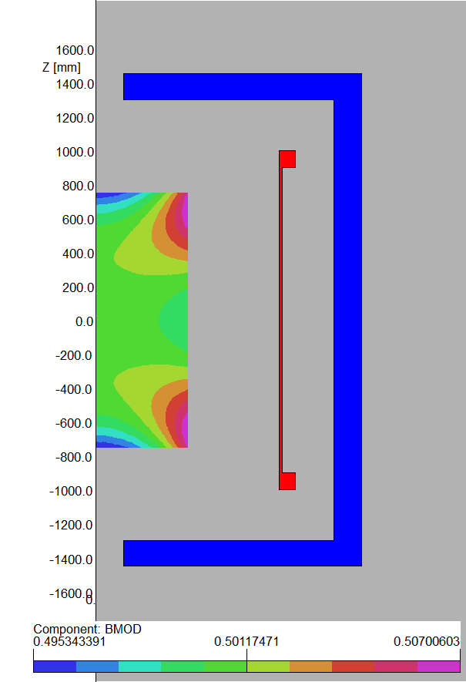
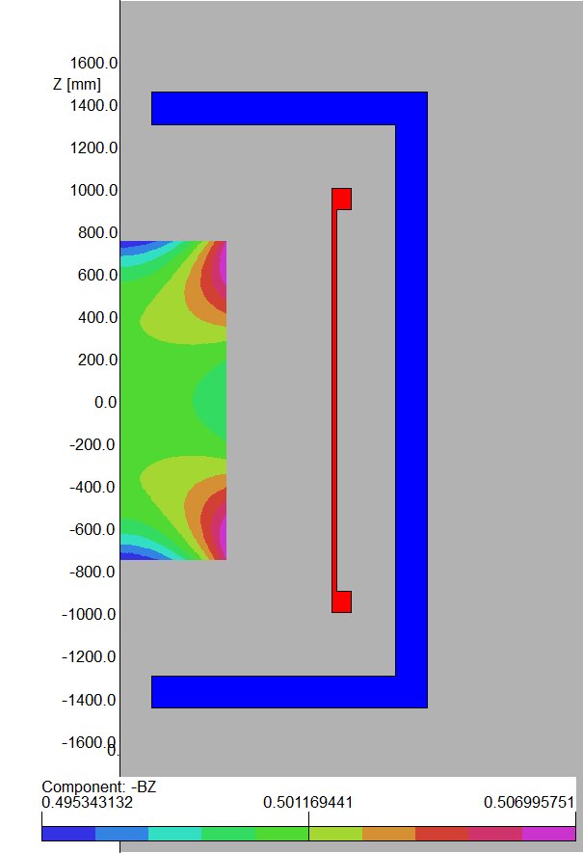
B-field distribution (TPC)
Bmod: 0.495~0.507 T
-53~64G (-1.1~1.3%)
Bz: 0.495~0.507 T
-53~64G (-1.1~1.3%)
Br: -0.008~0.008 T
±80G (±1.6%)
Bcenter: 0.5006 T

Slide 12
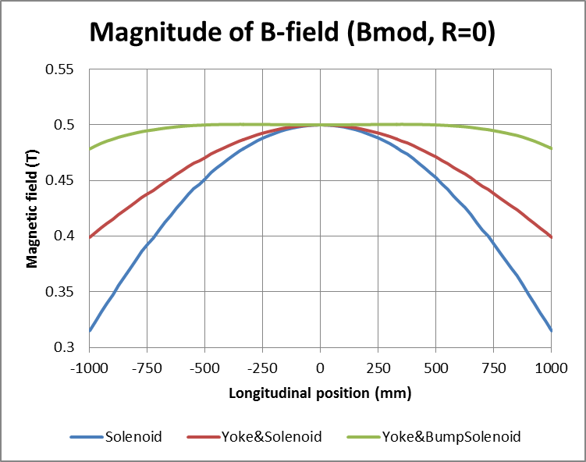
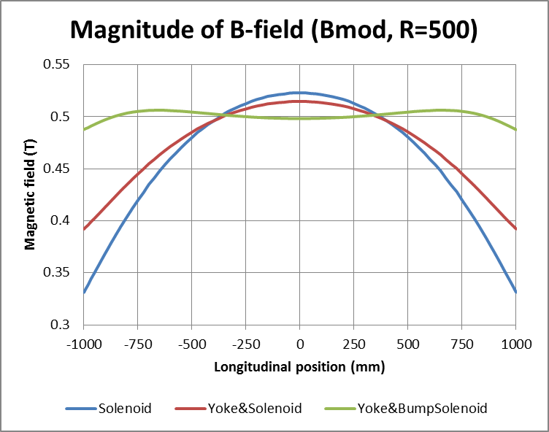
B-field distribution (Bmod)
TPC | Simple solenoid | Simple solenoid with Return yoke | Bumped Solenoid with Return yoke
ΔBmod (R=0mm) | 0.107 T | 0.062 T | 0.006 T
ΔBmod (R=500mm) | 0.103 T | 0.070 T | 0.008 T

Slide 13
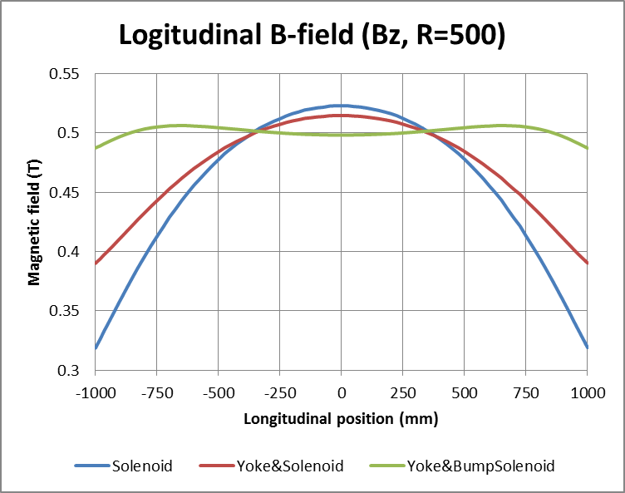
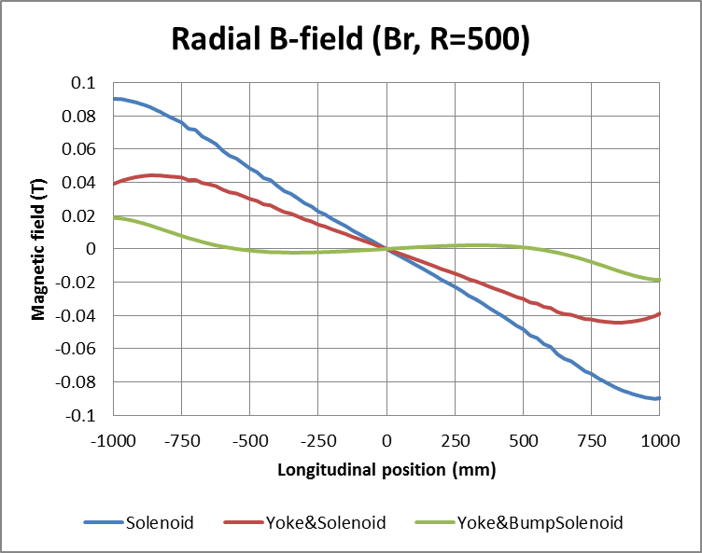
B-field distribution (Bz, Br)
TPC | Simple solenoid | Simple solenoid with Return yoke | Bumped Solenoid with Return yoke
ΔBz (R=500mm) | 0.110 T | 0.072 T | 0.008 T
ΔBr (R=500mm) | ±0.076 T | ±0.043 T | ±0.008 T

Slide 14
Conclusions
Standard deviation of B-field can be reduced up to about 0.003 with return yoke and bump coil (ΔB/B ~ 1.5%).
Cooling system and supporting structure should be considered.
Magnet design should consider its technical realization.

