Slide 1
Beam Optics of RAON Recoil Spectrometer
C.C Yun, IBS

Slide 2
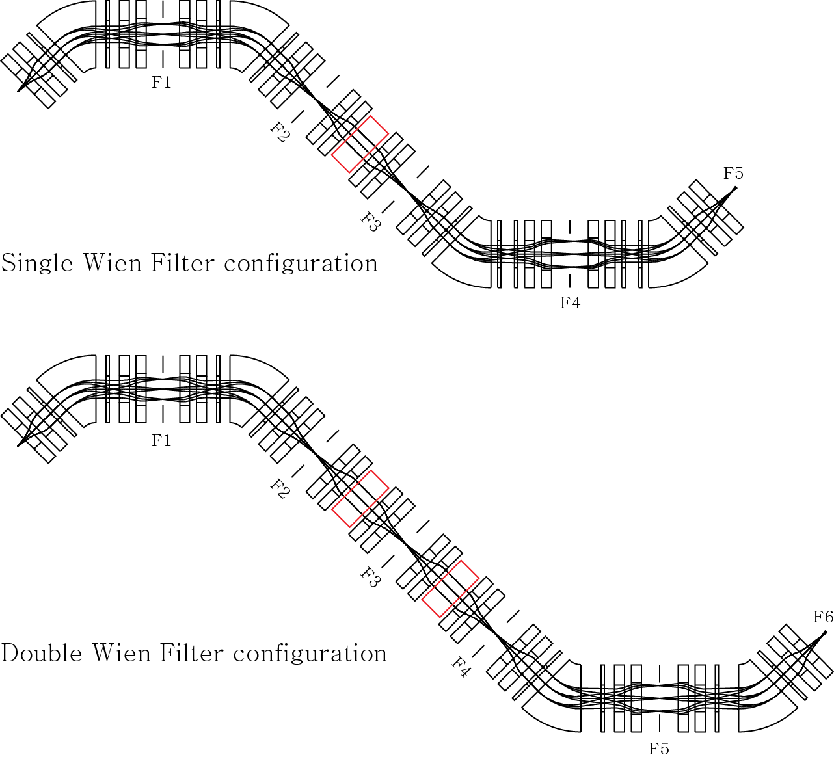
I. 1st order optics calculation (hard edge fringing field)
Single Wien Filter configuration
Double Wien Filter configuration
II. 2nd order optics calculation (hard edge fringing field)
Single Wien Filter configuration
Two Wien Filter configuration

Slide 3
Configuration and Magnet component
Two dispersive focus points and tree achromatic points ( for single Wien filter)
Two dispersive focus points and four achromatic points ( for double Wien filter)
4 Dipole magnet with 1.5 radius and 45 deg. deflection angle
Q-doublet with effective length of 30 cm and pole tip radius of 10 cm
Multi-pole with effective length of 10 cm and pole tip radius of 10 cm
Wien filter with effective length of 1.5 m

Slide 4
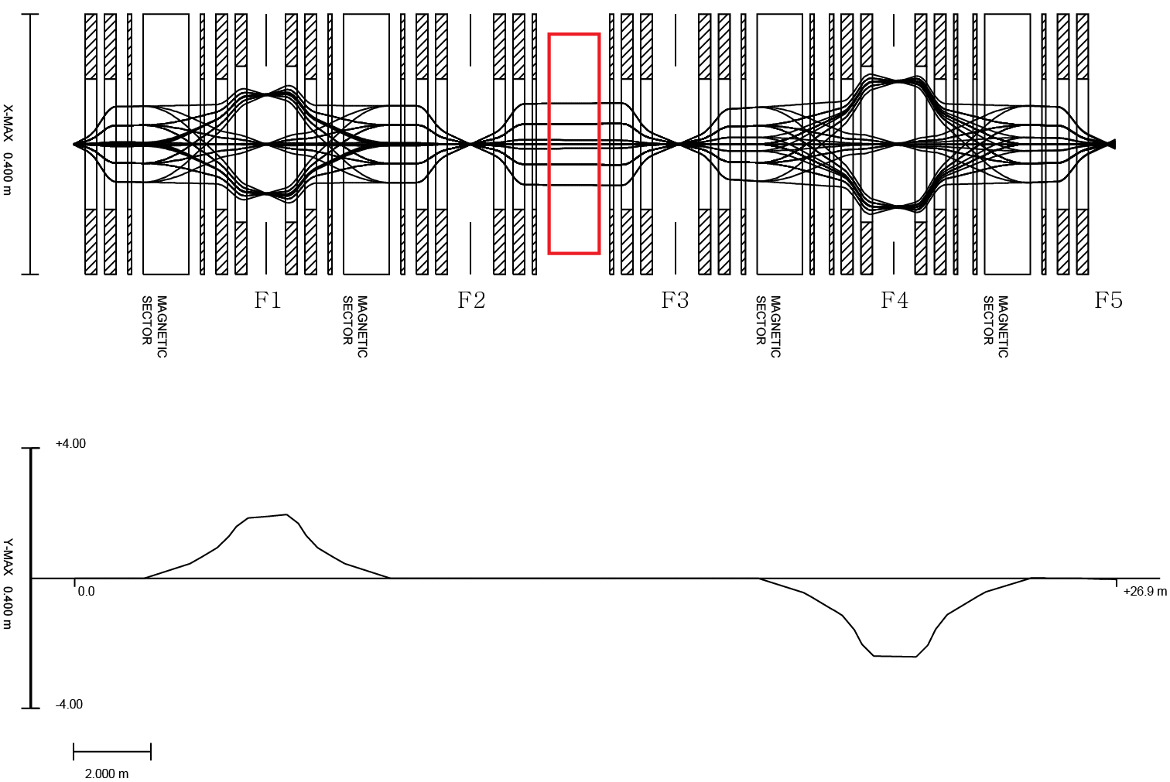

1st order optics calculation of Single Wien filter configuration
$$R=\frac{D}{2X_{0}M+δ_{1}+δ_{2}}$$
Single Wien filter configuration
Momentum acceptance ± 5.0 %
Angular acceptance ± 50 mrad in horizontal
± 50 mrad in vertical
Resolving Power (assumption of 1 mm beam size )
R = 1900 @ F1
R = 2400 @ F4
Initial beam condition
± 30 πmm mrad in horizontal and vertical
± 4.0 % momentum spread

Slide 5
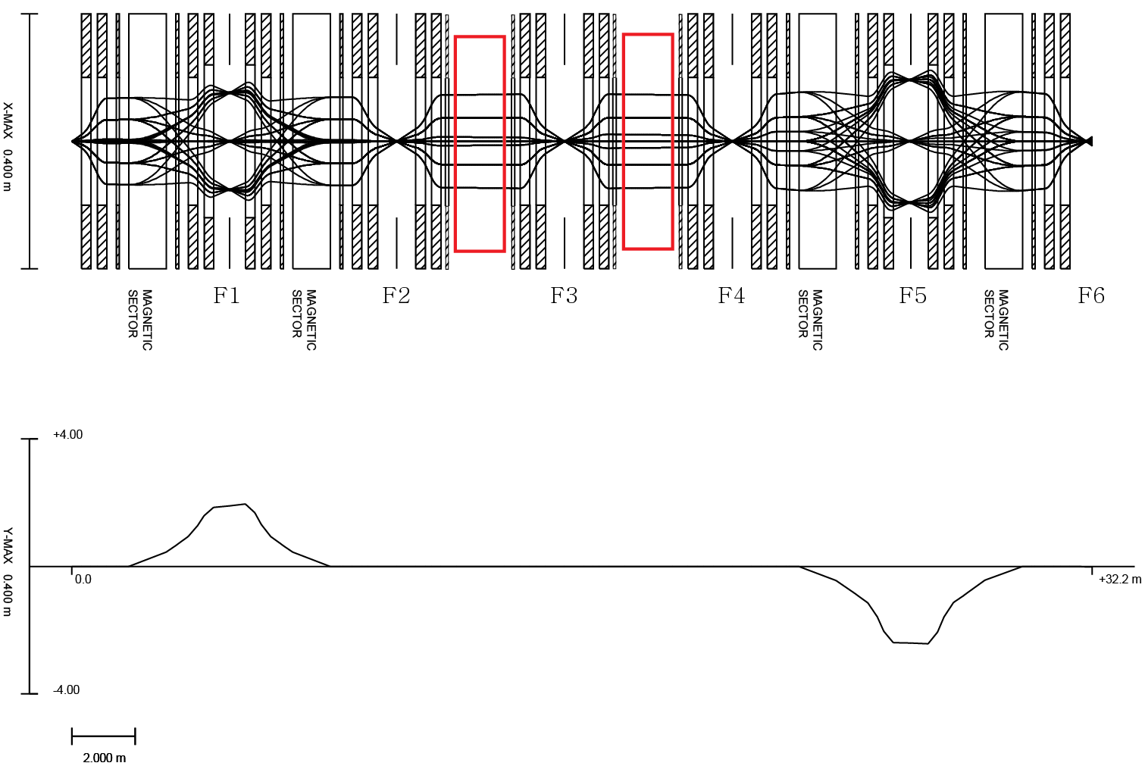
1st order optics calculation of Double Wien filter configuration
Double Wien filter configuration
Momentum acceptance ± 5.0 %
Angular acceptance ± 50 mrad in horizontal
± 50 mrad in vertical
Resolving Power (assumption of 1 mm beam size )
R = 1900 @ F1
R = 2400 @ F5
Initial beam condition
± 30 πmm mrad in horizontal and vertical
± 4.0 % momentum spread

Slide 6
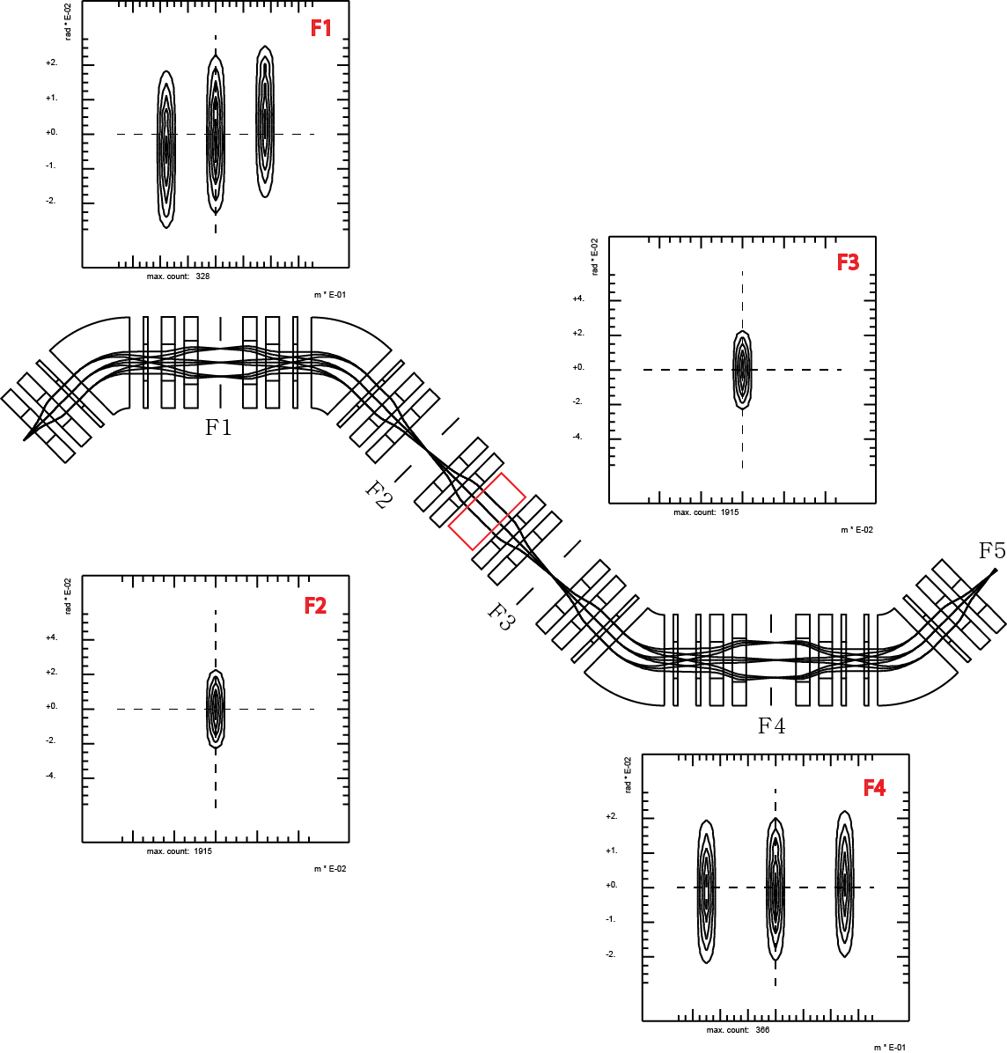
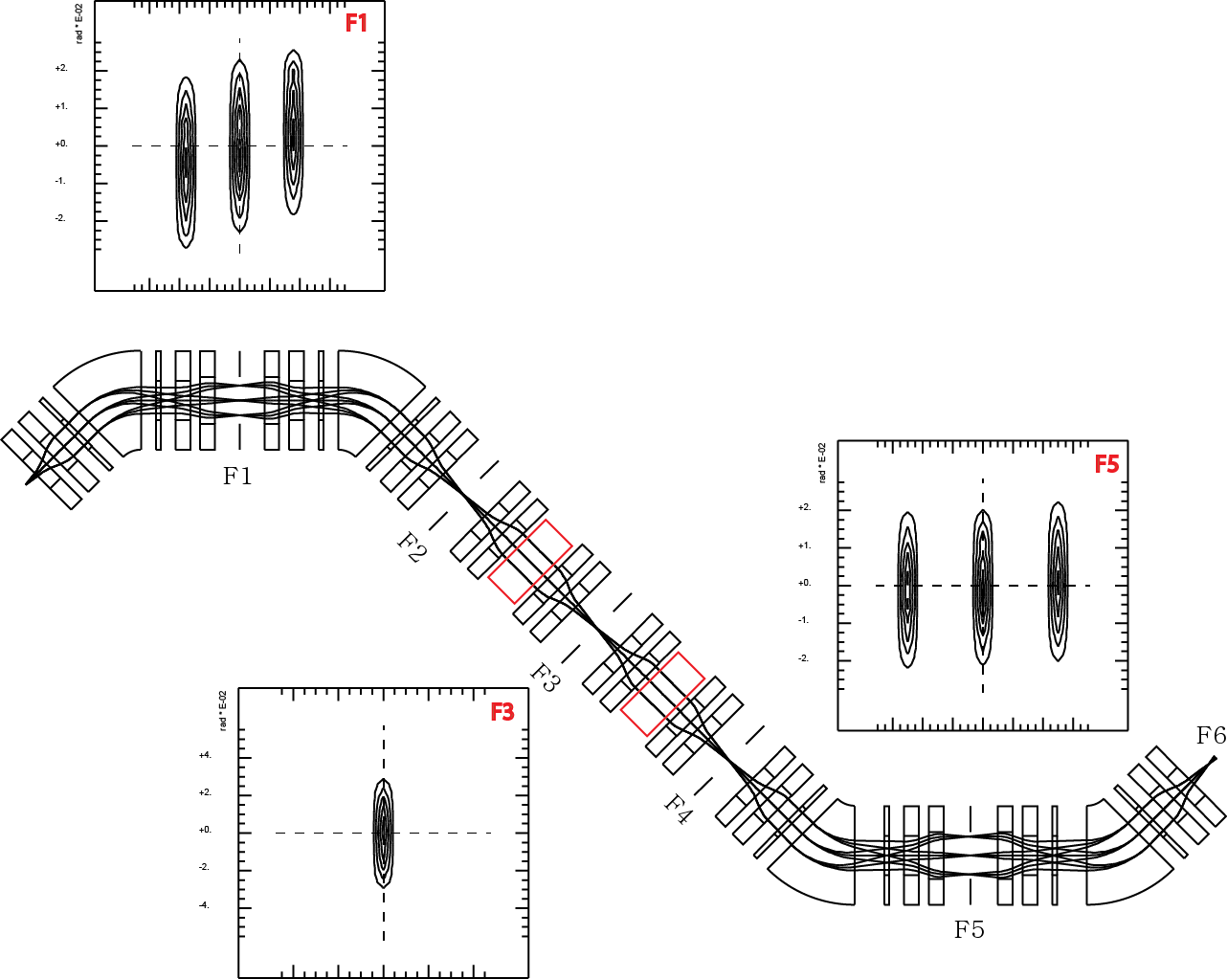
Single Wien filter 1st order
Beam Profile at each focus point
Double Wien filter 1st order

Slide 7
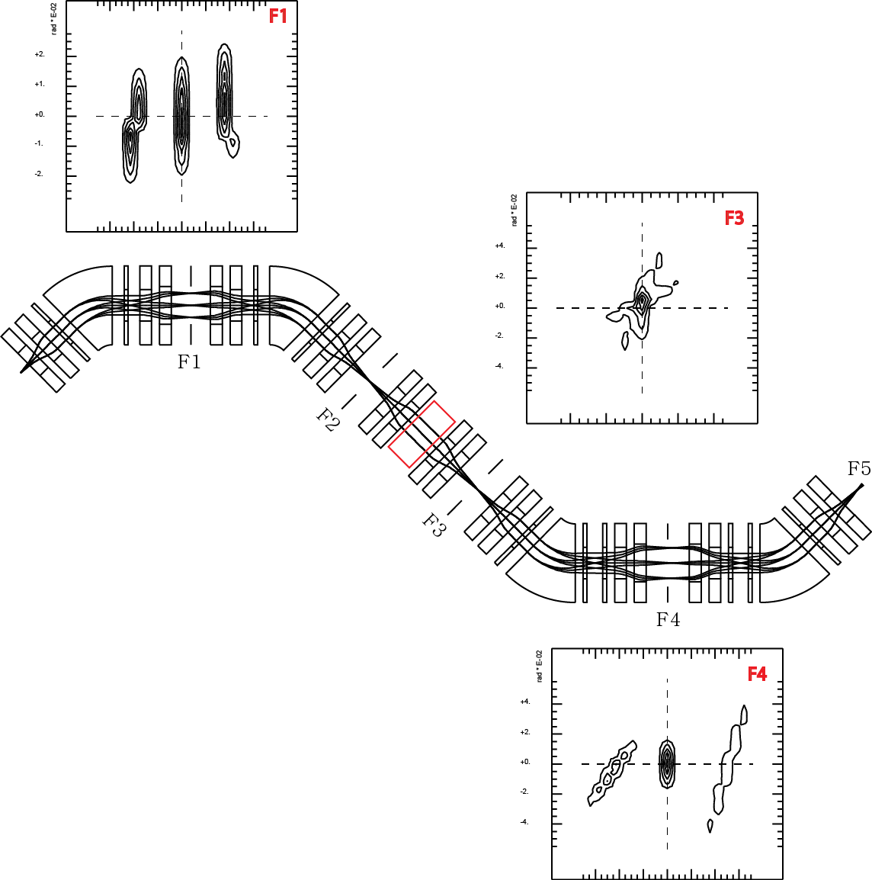
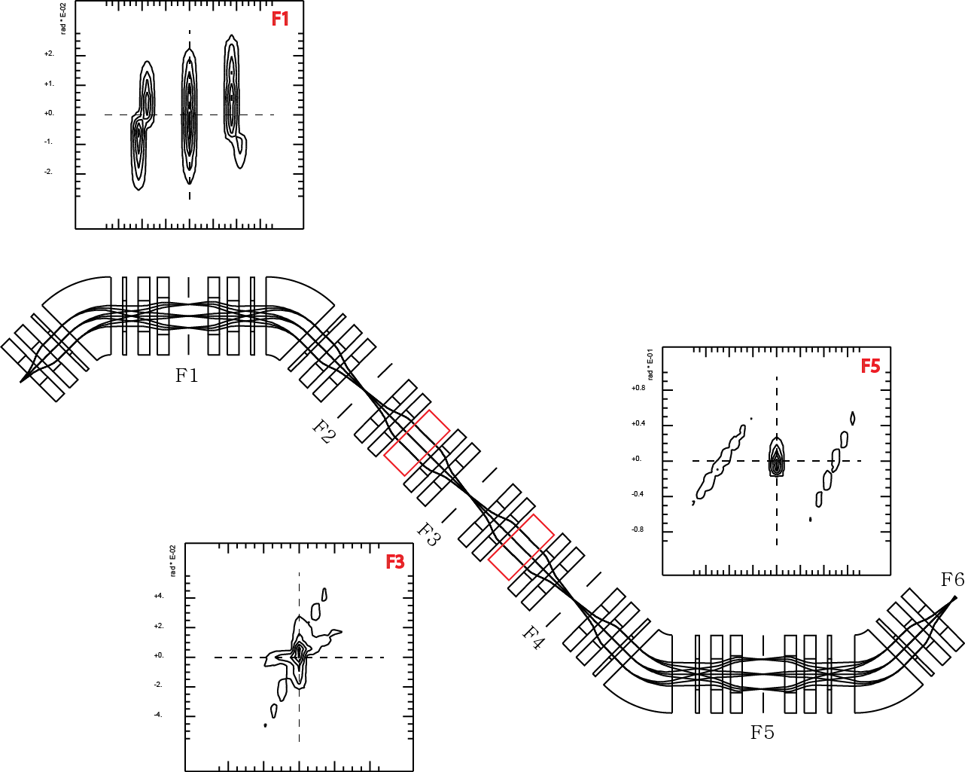
Single Wien filter 2nd order
Beam Profile at each focus point
Double Wien filter 2nd order

Slide 8



Determination of multi-pole position by Coupling Coefficient
$$d(X,AD)/ds$$
$$d(X,AA)/ds$$
$$d(X,DD)/ds$$

Slide 9
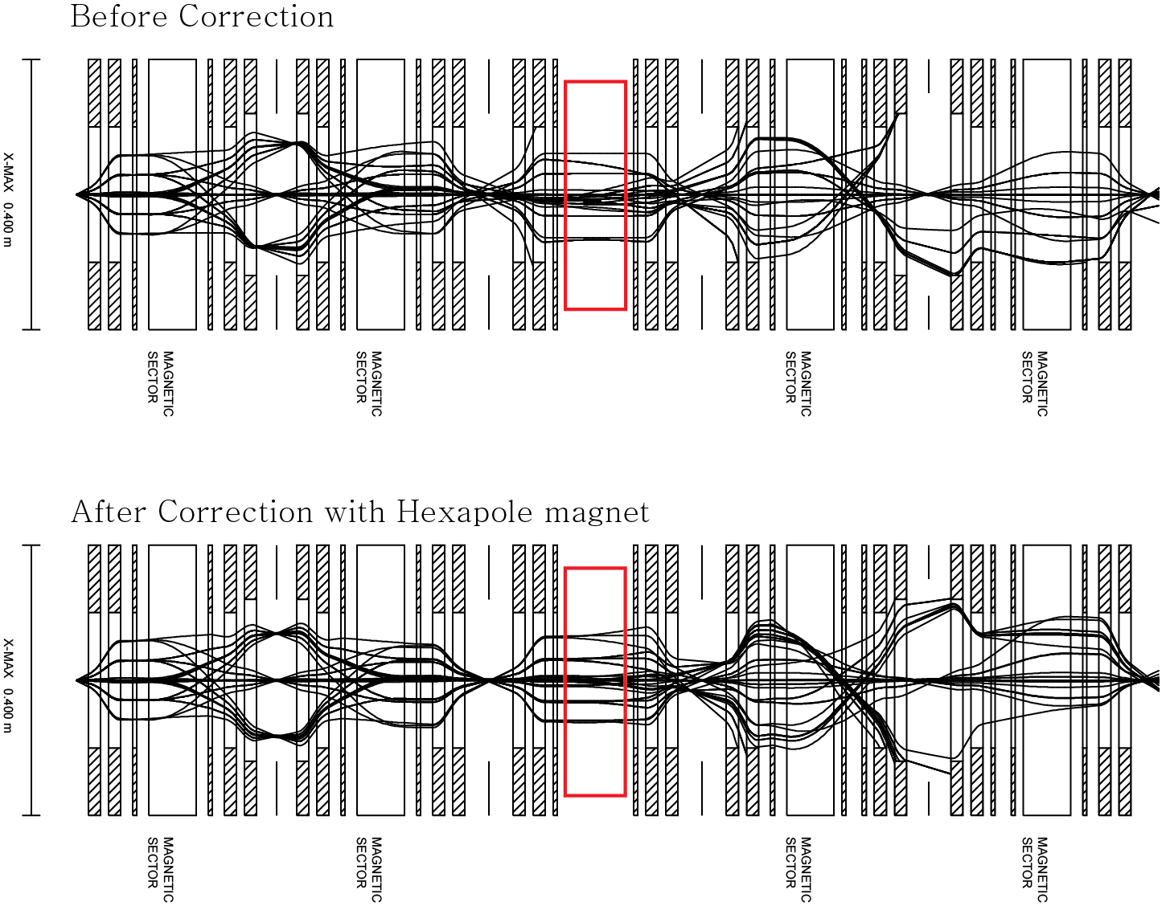
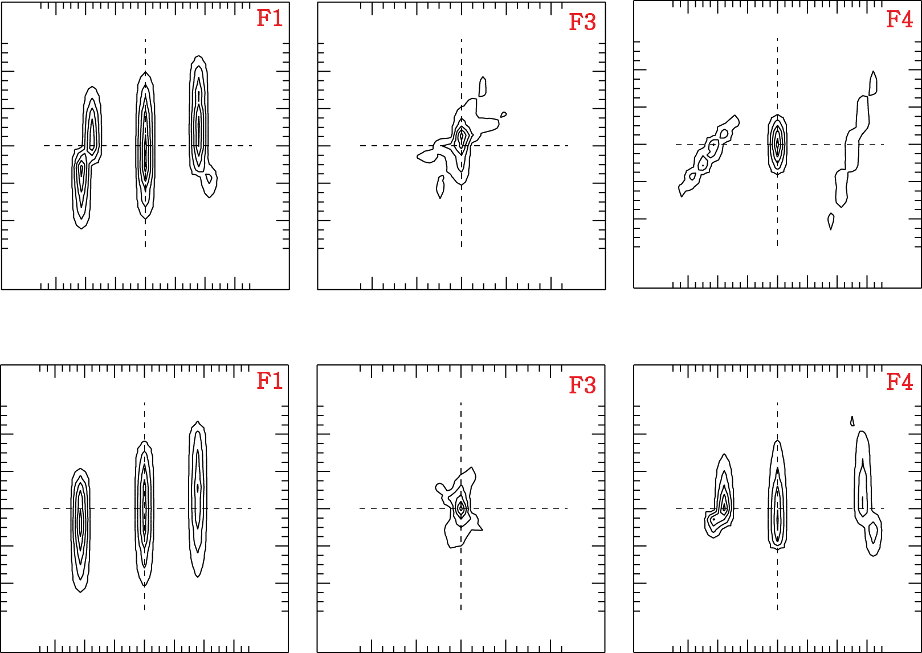
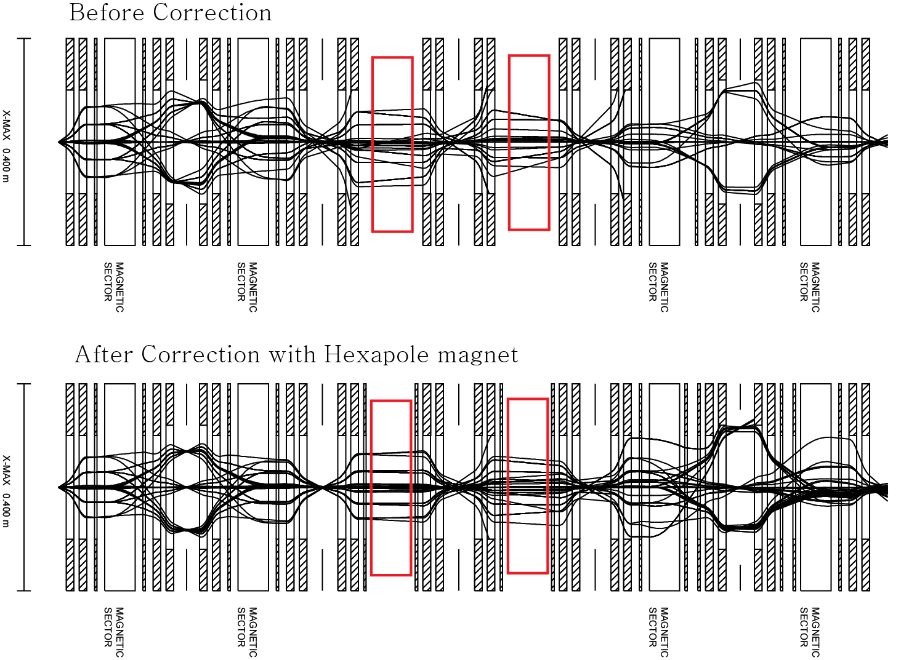
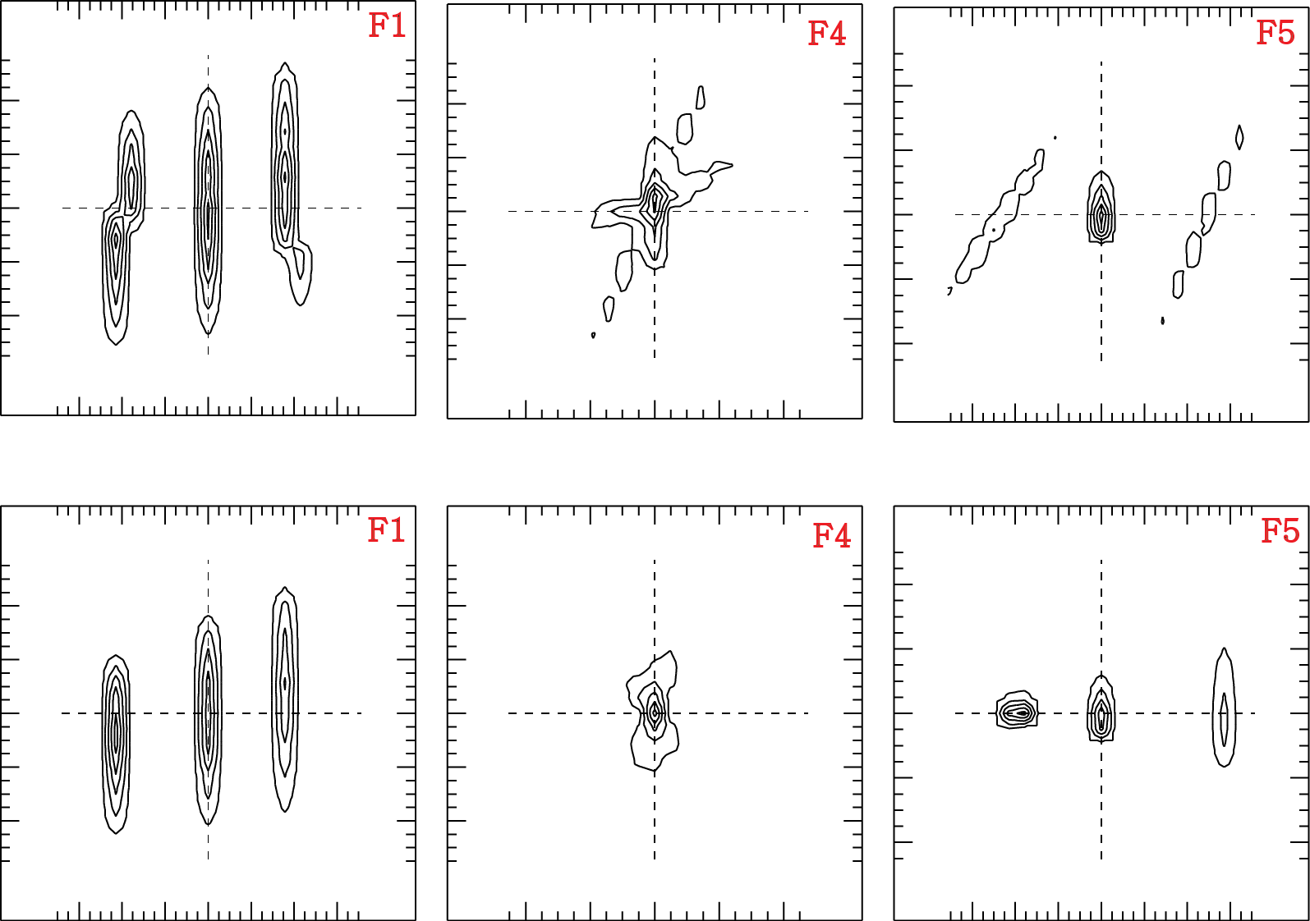
F1
F3
F4
Before correction
After correction
F1
F4
F5
Before correction
After correction

Slide 10
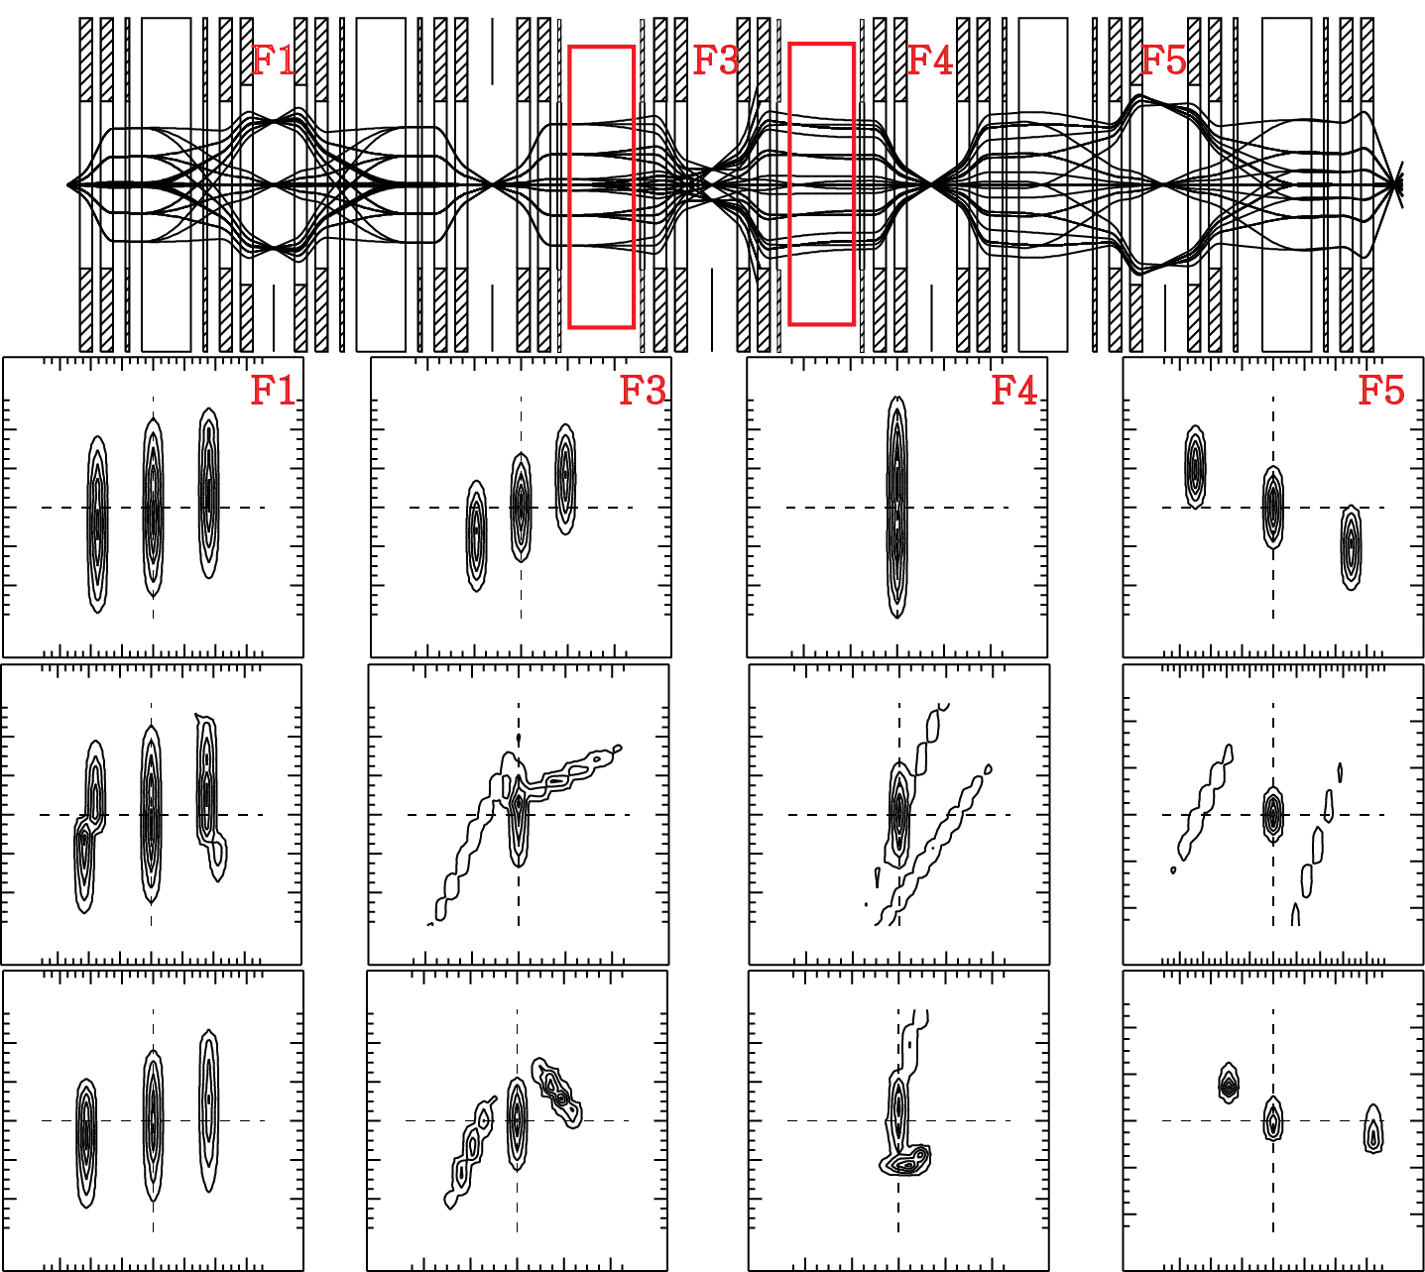
In the case of Double Wien Filter
1st order
2nd order
2nd order
correction

Slide 11
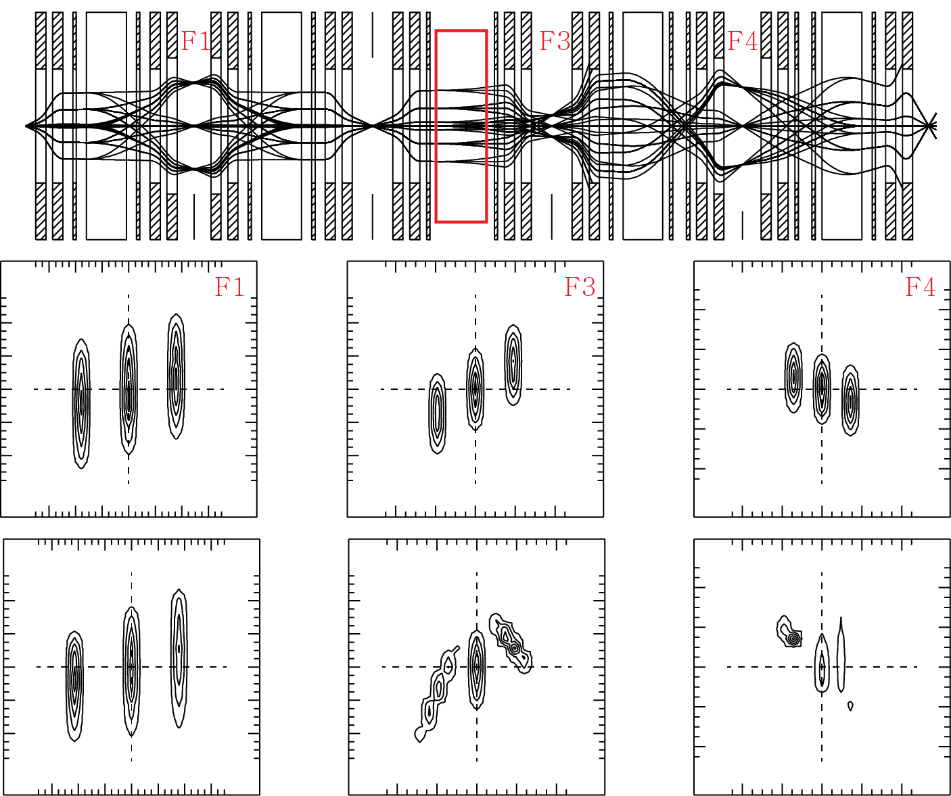
In the case of Single Wien Filter
1st order
2nd order
correction

Slide 12
1st , 2nd order optics calculation with fringing field
→ Design Q-magnet, Wien filter and Hexapole magnet
→ Include Energy degrader
Monte Carlo simulation ( MOCADI…… )
→ Beam production, Separation, and purity

