Slide 1
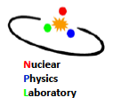
Precision Measurement of a Prototype Neutron detector for the Future LAMPS Experiment in KoRIA
이기수*, 베나드, 이경세, 홍병식
Korea University
Nuclear Physics Laboratory

Slide 2
Contents
1. Introduction
2. Pulse analysis using ⁶⁰Co
3. TOF measurement of neutrons and gamma rays using ²⁵²Cf
4. Conclusions

Slide 3
1. Introductions
KoRIA(Korea Rare Isotope Accelerator)
- A future multipurpose accelerator for the basic and applied sciences
LAMPS(Large Acceptance Multi-Purpose Spectrometer)
- primary purpose->nuclear symmetry energy
- versatile for nuclear structure and nuclear astrophysics
Neutron detector
- In RI Heavy-Ion collision n/p ratio is important for Symmetry energy
- designed for neutrons of 10 < E_{n} < 400 MeV

Slide 4
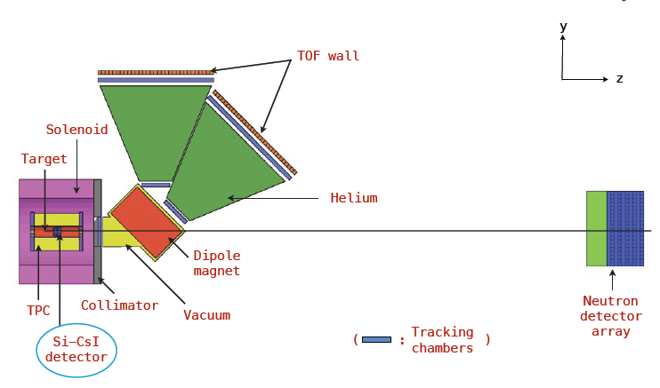
LAMPS
x

Slide 5
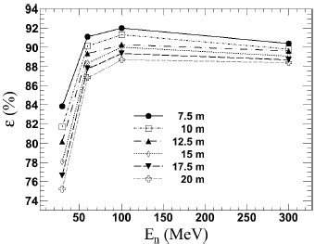
LAMPS neutron detector
Lattice of 10 layers
20 module for 1 layer
2m length 10$×$10 cm² scintillator for 1 module
Detect 10 < E_{n} < 400 MeV
Veto counter is placed in front of the neutron detector
JKPS. Vol. 58 No. 2 B. Hong
GEANT4
Light Guide
scintillator
PMT

Slide 6
Signal process of neutrons in plastic scintillators
n-p elastic scattering
n-¹²C elastic scattering
n+p->d+γ (neutron capture, E_{γ} = 2.23 MeV)
n+¹²C->¹³C+γ (neutron capture, E_{γ} = 1.2, 3.6, 4.9 MeV)
Dominant process for signals
-Neutron capture for low energy neutrons
-n-p elastic scattering for high energy neutrons

Slide 7
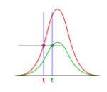
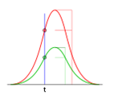
VTD&CFD
Voltage Threshold Discriminator
Constant Fraction Discriminator
Cut by absolute voltage limit
Cut by voltage for defined time
C.A.E.N. Mod. N844
C.A.E.N. Mod. N415A

Slide 8
Condition
Coincidence measurement
- Threshold for signal: 140 mV
- Threshold for trigger: 20 mV
Gate
ADC
LeCroy 2249A
ch1
ch2
Right
detector
Left
Amp.$×$10
C.A.E.N. Mod. N412
Disc.
OR
LeCroy 365AL
Amp.$×$10
C.A.E.N. Mod. N412
Common start
TDC
LeCroy 2228A
stop
Disc.
AND
LeCroy 365AL
Trigger
BC-408 disc
Disc.
C.A.E.N. Mod.
N844

Slide 9
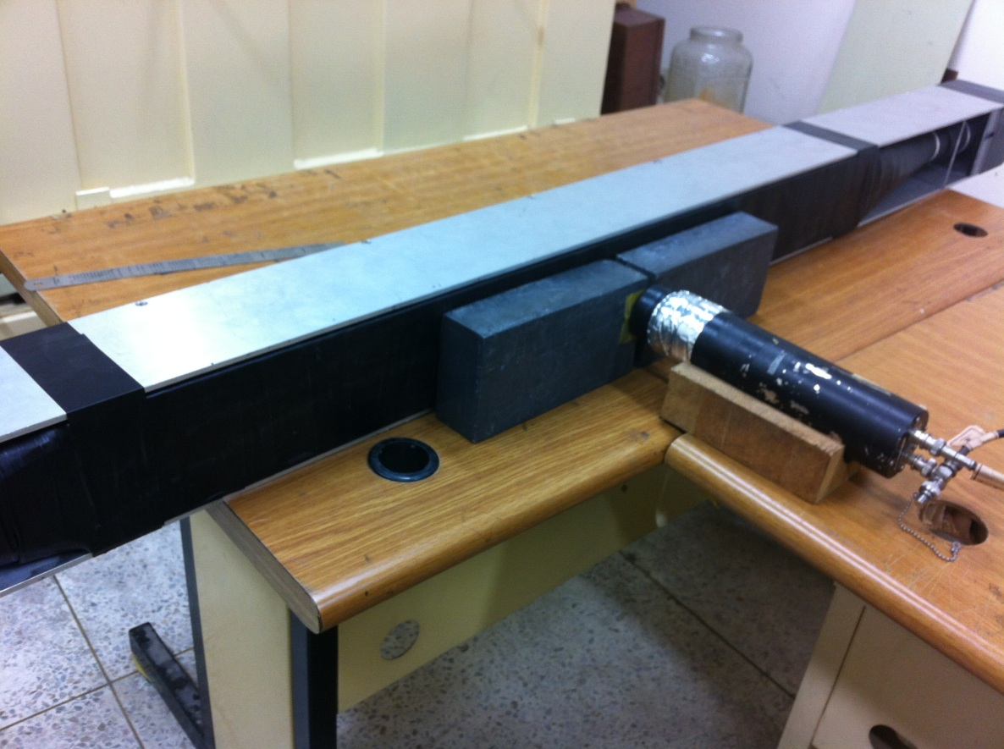
2. Pulse analysis using ⁶⁰Co
⁶⁰Co
⁶⁰Co
⁶⁰Co emits back-to-back γ with energy 1.17, 1.33 MeV
Determine position using time difference of each side
Measurement carried out moving each 10 cm from left side

Slide 10
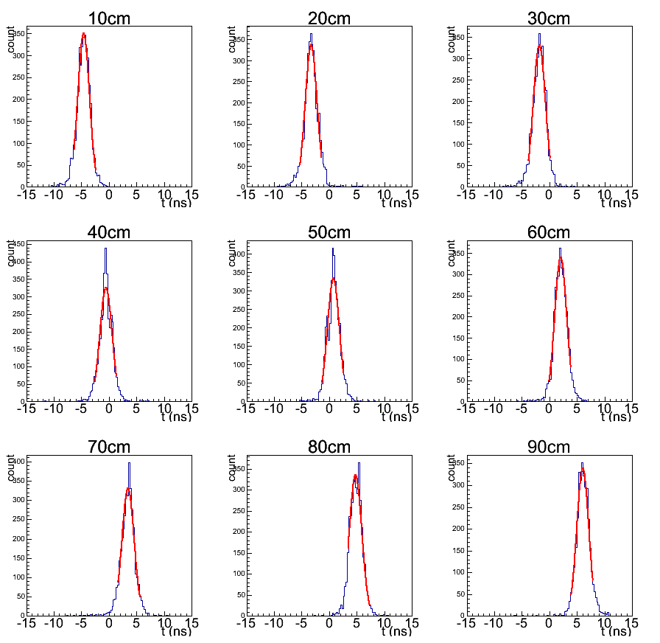
Time difference of each position
$t_{left}−t_{right}$
Time peak moves along position

Slide 11
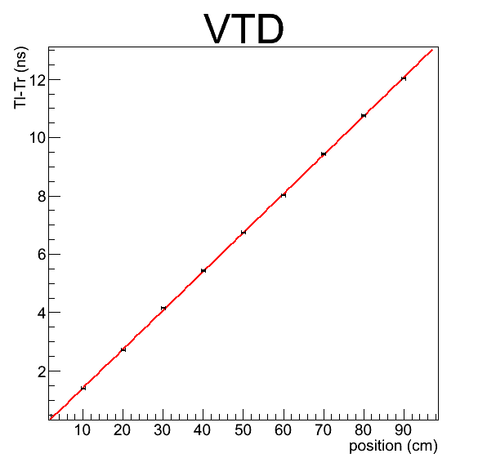
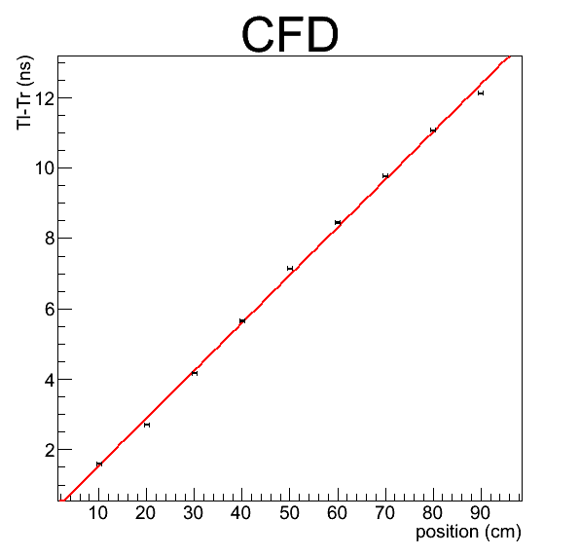
Position resolution
$x=\left(7.51828±0.0167386\right)∆t−\left(0.714768±0.123239\right)$
Resolution: 0.24 cm
$x=\left(7.42745±0.0124035\right)∆t−\left(1.59476±0.101991\right)$
Resolution: 0.2 cm

Slide 12
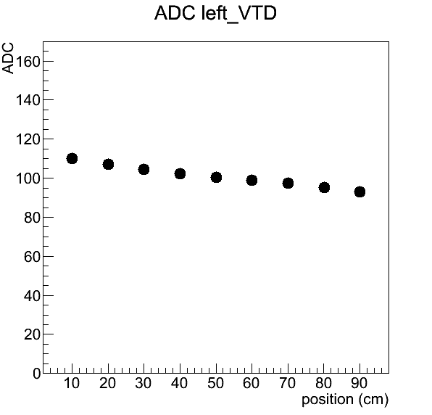
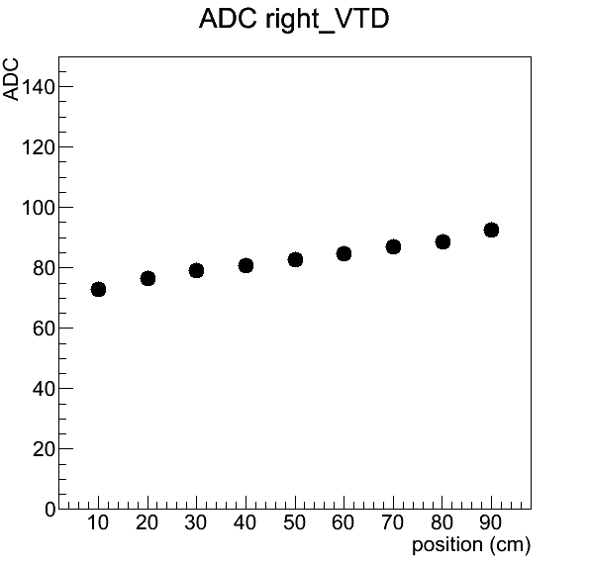
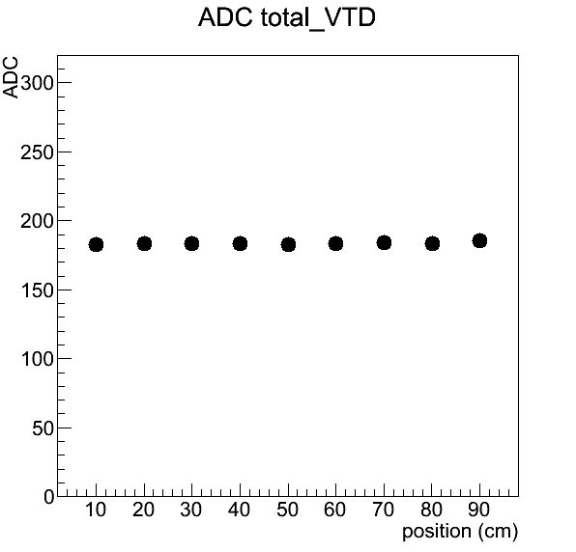
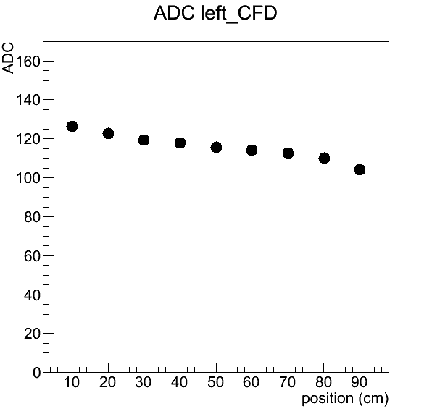
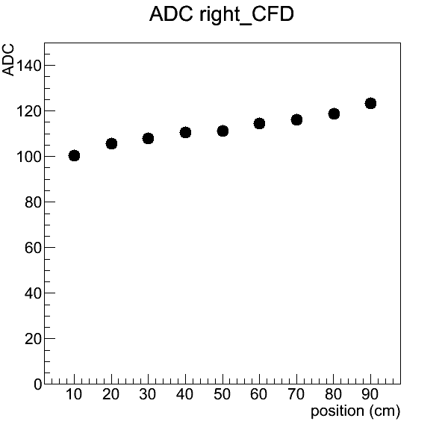
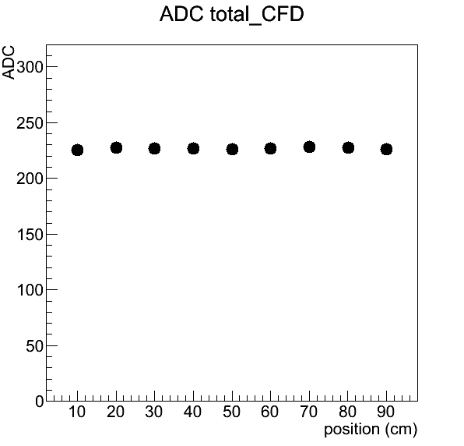
ADC attenuation

Slide 13
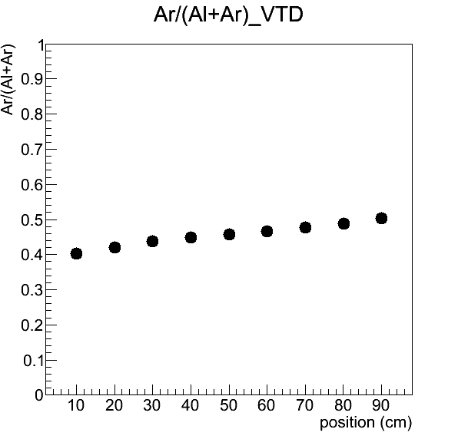
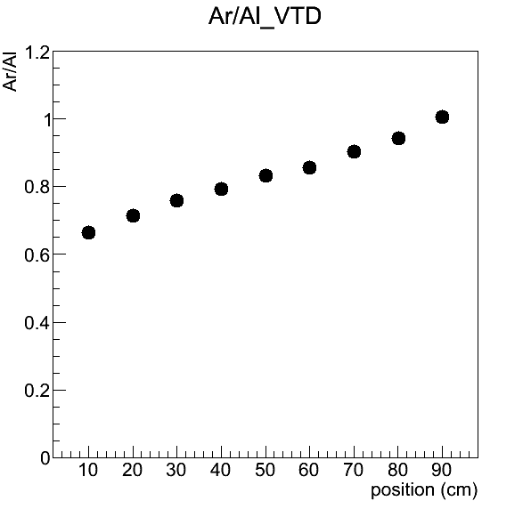
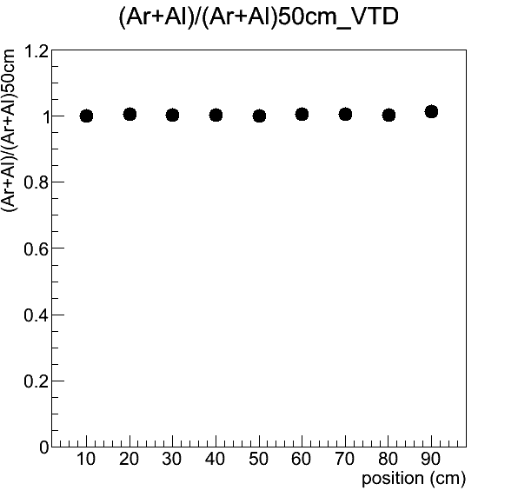
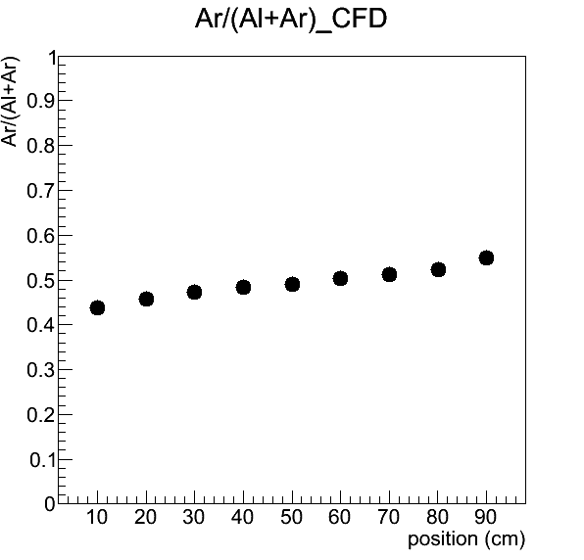
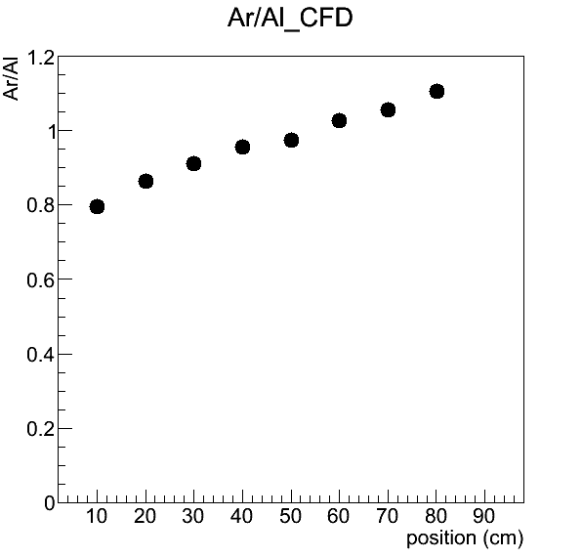
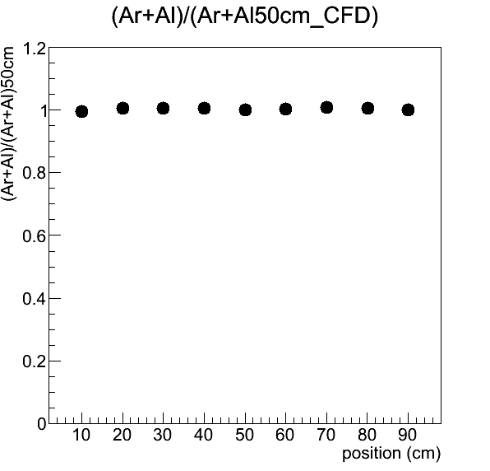
ADC ratio

Slide 14
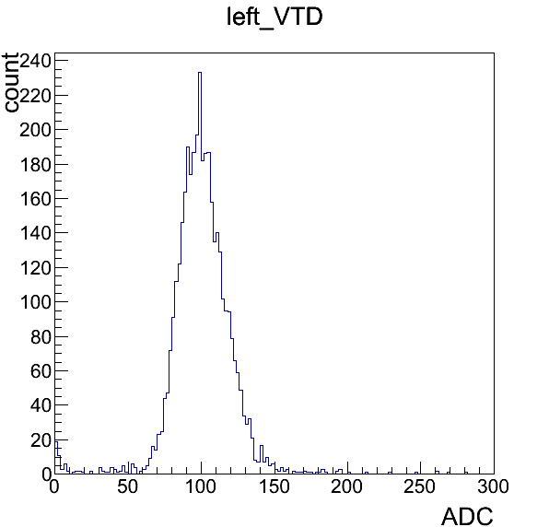
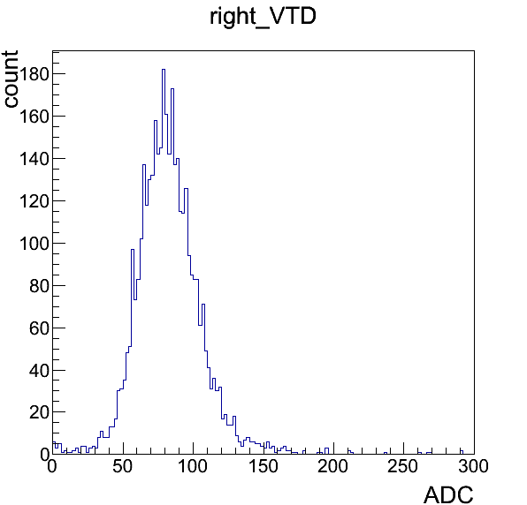
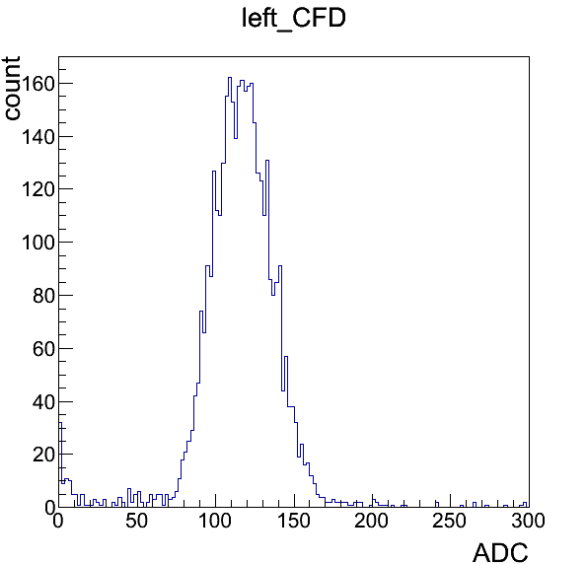
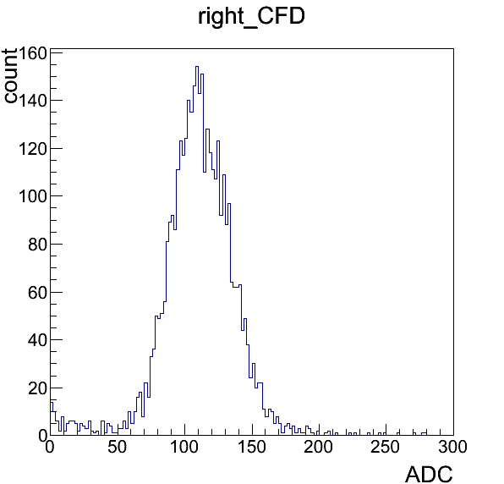
Compton edges
Compton edge of γ from ⁶⁰Co: 1.04 MeV
VTD
Compton edge: 120, 110
Threshold: 80, 50-> 347 , 236 keV
CFD
Compton edge: 140, 135
Threshold: 90, 90-> 334, 347 keV

Slide 15
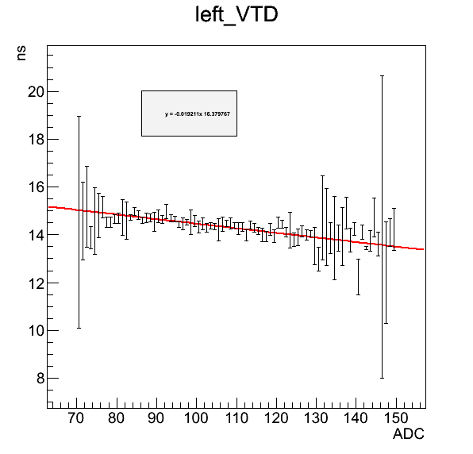
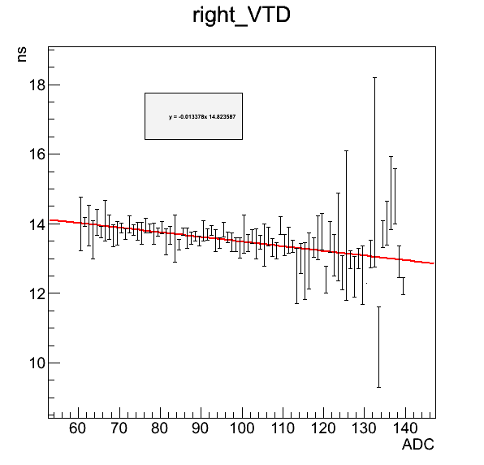
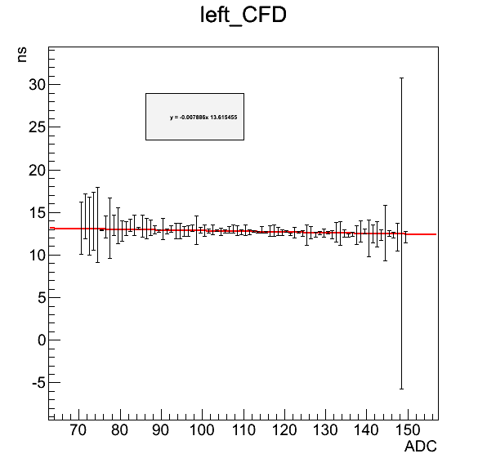
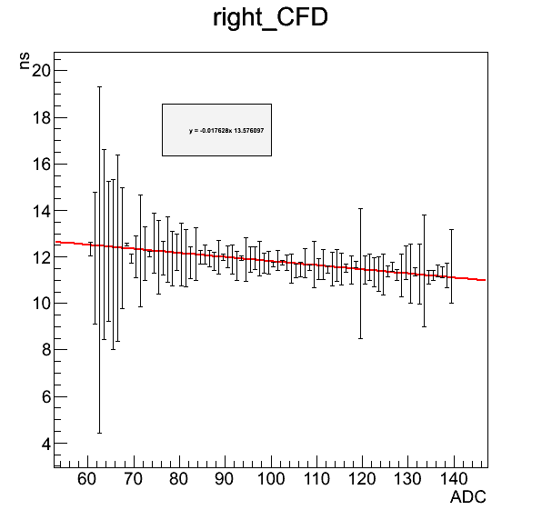
Time Walk Correction
${}_{red}^{}{χ_{l}^{2}}=0.9625$
${}_{red}^{}{χ_{r}^{2}}=0.9418$
${}_{red}^{}{χ_{l}^{2}=0.6007}$
${}_{red}^{}{χ_{r}^{2}}=0.5936$

Slide 16
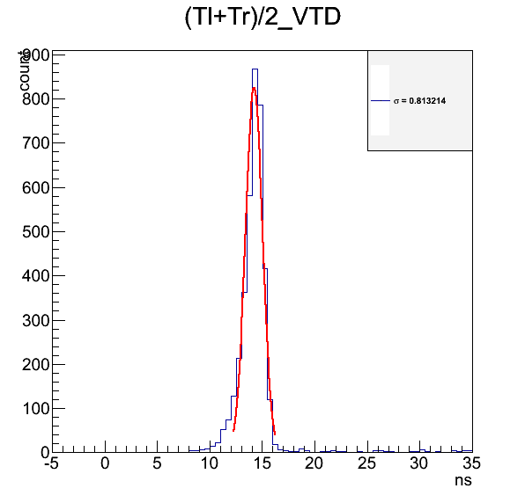
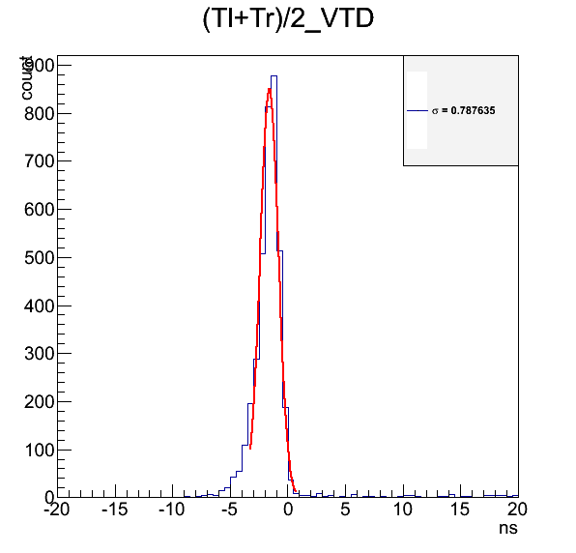
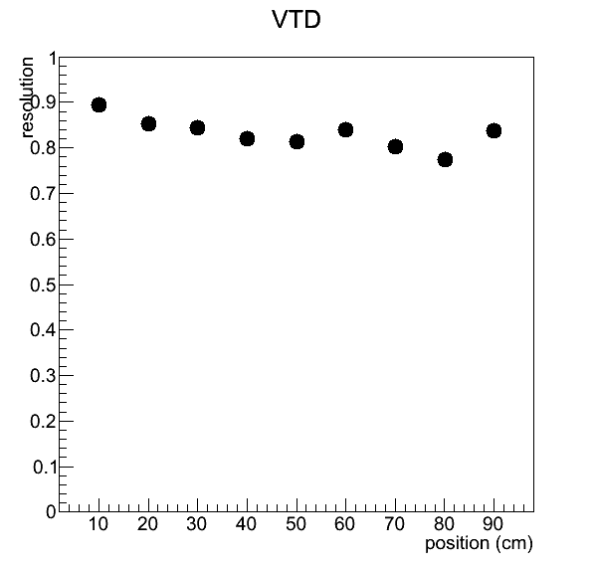
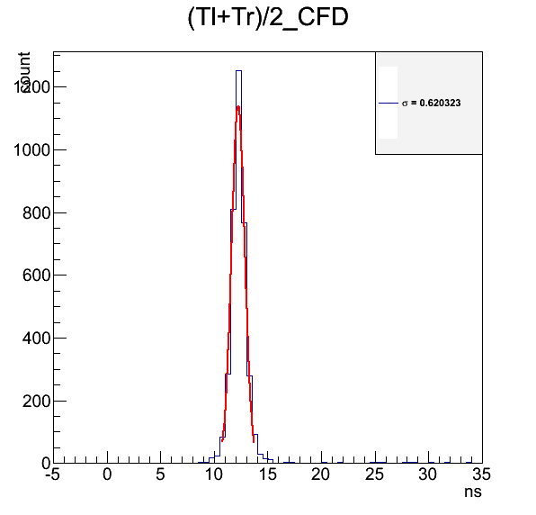
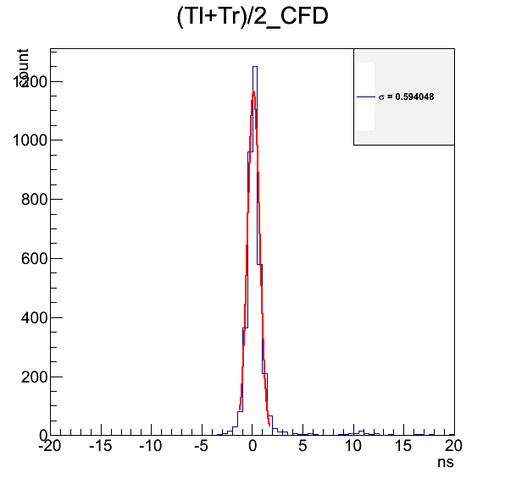
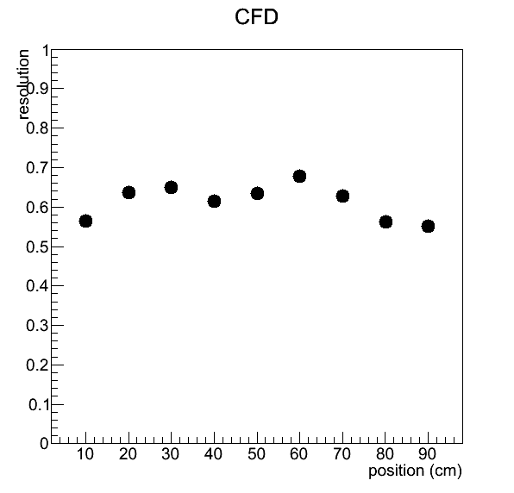
Time Walk Correction

Slide 17
3. TOF measurement of neutrons and gamma rays using a ²⁵²Cf
1.0 m
²⁵²Cf
- ²⁵²Cf fission emits γ and n
- Some combination of signals exist
- 1 m distance is not enough to separate 4 combination
Trigger | Detector
γ | γ
n | γ
γ | n
n | n
Notes:
Gate 55ns

Slide 18
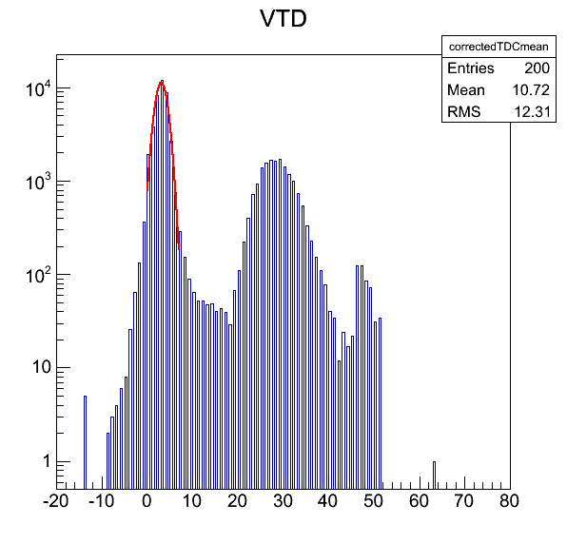
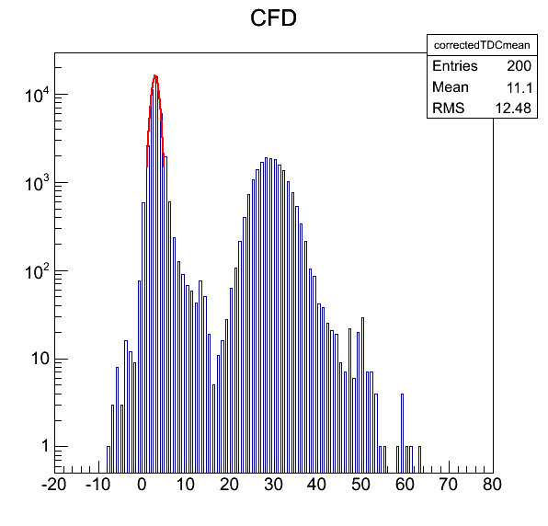
Time-Of-Flight distributions for γ and n
n
$σ_{γ}=1.33883 ns$
Neutron region: 19~42 ns
γ
n
$σ_{γ}=0.907419 ns$
Neutron region: 17~44 ns
γ

Slide 19
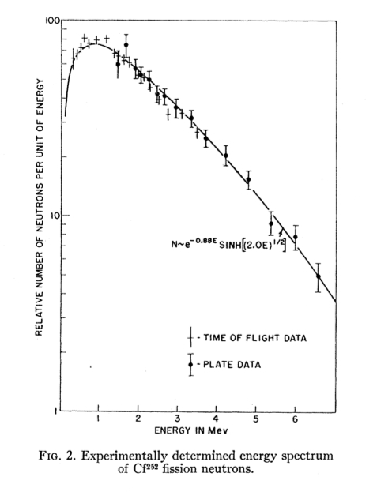
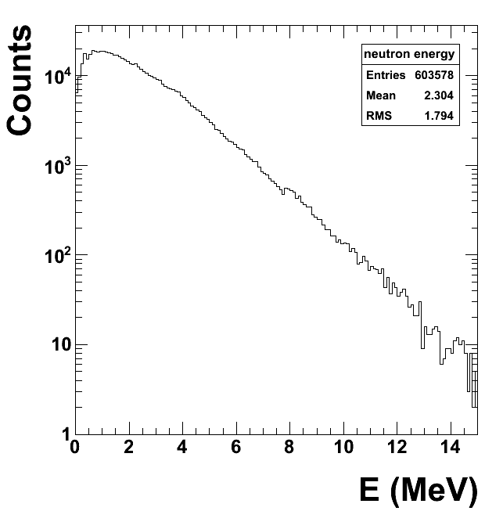
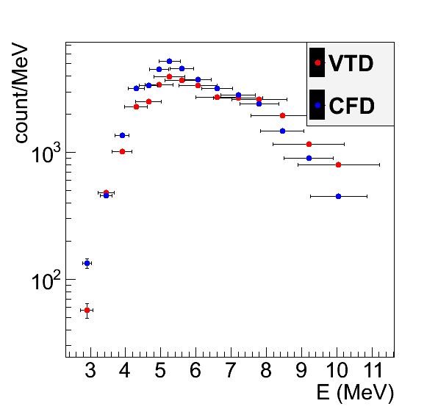
Fission neutrons from ²⁵²Cf and Watt spectrum
Physical Review (108) 411
96.9% α decay+3.1% fission decays
Neutron energy: 0.04~15 MeV
Mean neutron energy: 1.7 MeV
Average number of neutrons per fission: 3.76
Mean gamma energy 0.87 MeV
Average number of γ per fission: 8
80%
20%

Slide 20
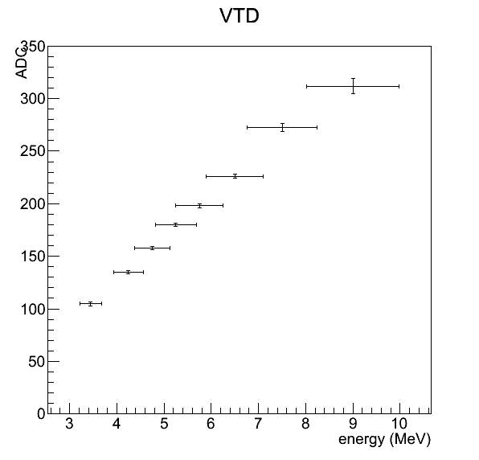
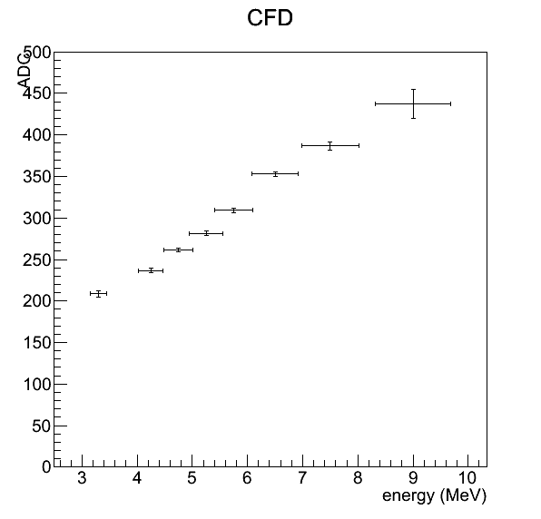
ADC for energy
Linear dependence in energy and ADC
Minimum and maximum energy are not linear

Slide 21
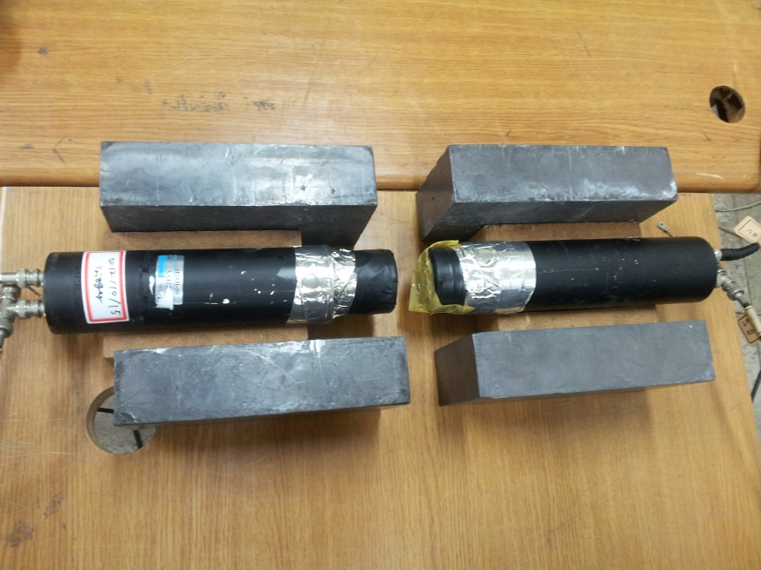
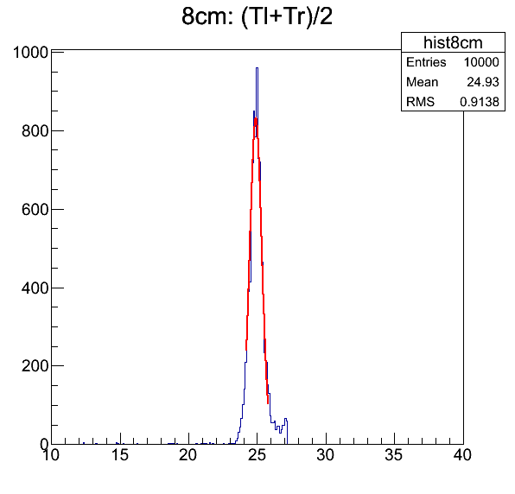
Trigger resolution
Resolution of 1 trigger: 308 ps
Resolution of VTD: 788 ps
Resolution of CFD: 594 ps
VTD-trigger: 725 ps
CFD-trigger: 507 ps
Resolution of one side
VTD: 513 ps
CFD: 359 ps

Slide 22
5. Conclusions & Future tasks
Conclusions
1. Resolution to determine the hit position: VTD->0.24 cm, CFD->0.2 cm
->important to discriminate multi-hit events
2. Light loss due to attenuation of the light<14%(VTD), <20%(CFD) for the 1 m long detector module
->neutron detector for LAMPS is 2 m long
3. Time Walk Correction reduces resolution
4. Digitization: threshold for electron-equivalent signals~340 keV
5. In this test, neutrons emitted from ²⁵²Cf with E_{n}>~5 MeV were reliably measured from a TOF method
6. Resolution of one side is 513 ps(VTD), 359 ps(CFD)

Slide 23
Back Up

Slide 24
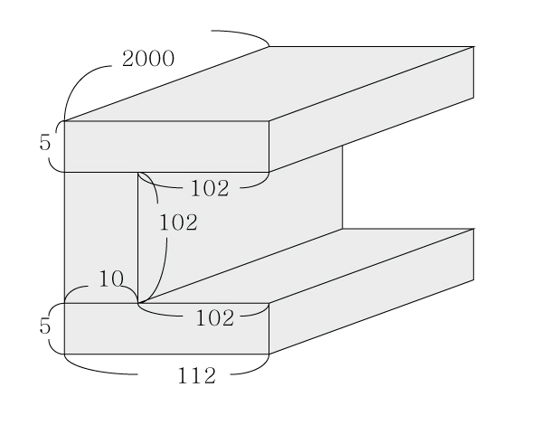
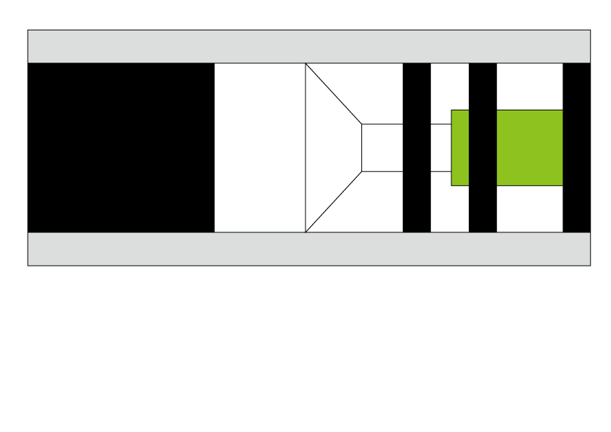

Slide 25
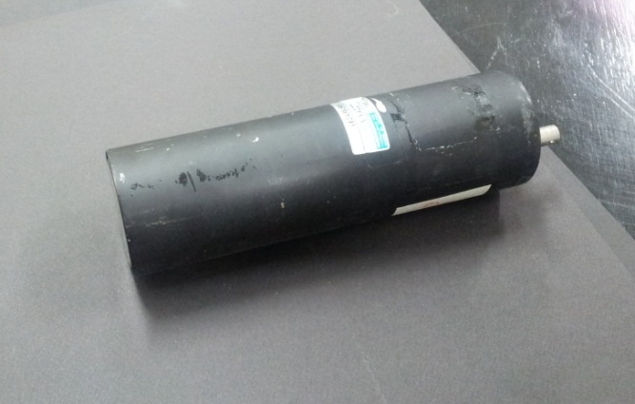
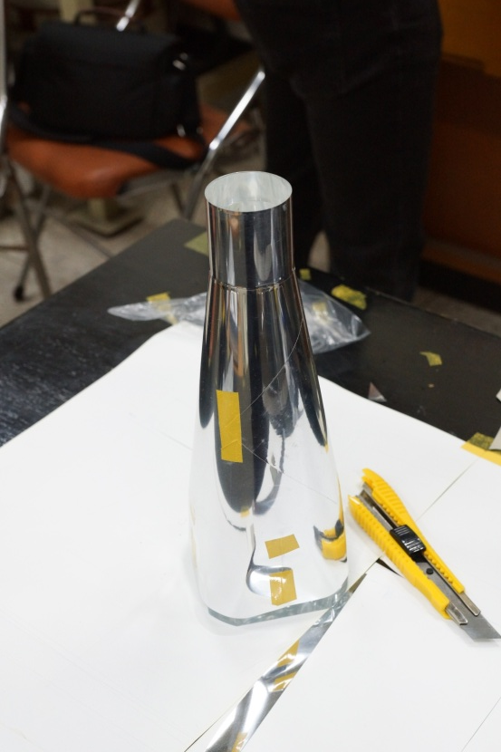
Single detector module for LAMPS neutron detector
scintillator
Light guide
PMT
H2431-50
Wavelength short: 300 nm
Wavelength long: 650 nm
Transit time: 16 ns
Gain: 2.5e+6
Bicron BC-408
Decay constant: 2.1 ns
Bulk light attenuation length: 380 cm
Refractive index: 1.58
H:C ratio: 1.104
Density: 1.032
Softening point: 70 ℃\
Arcrylic
Density: 1.18 g/cm3
Refractive index: 1.4914

Slide 26
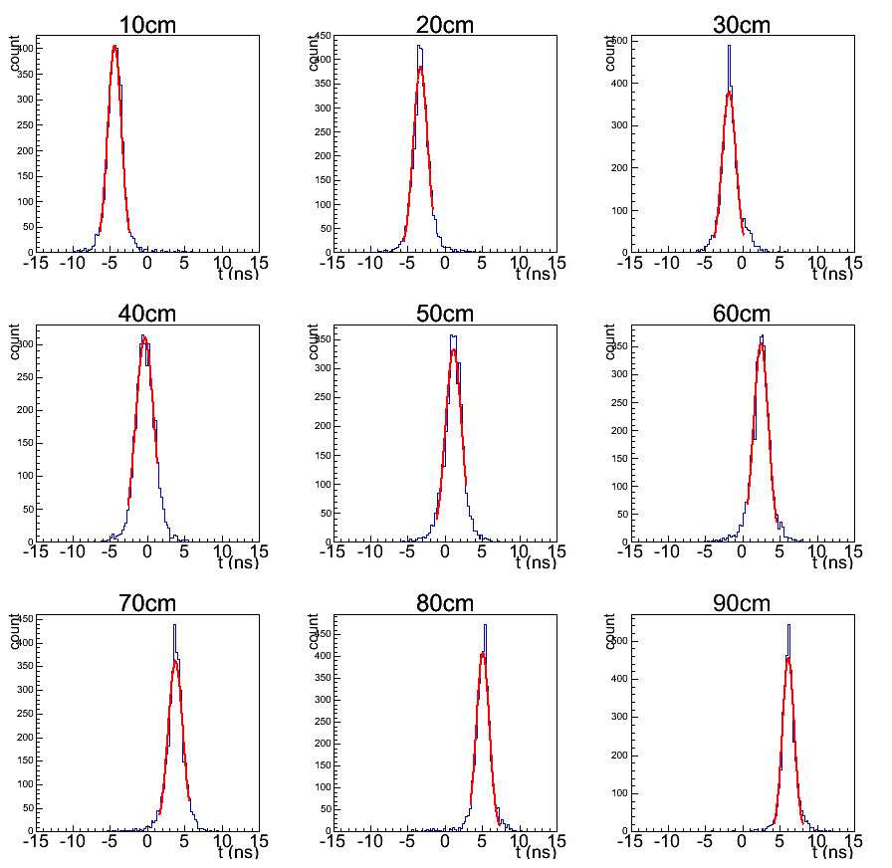
CFD time difference

Slide 27
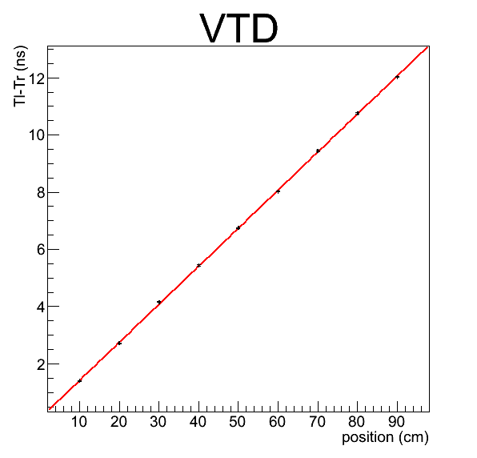
Position resolution systematic first
$x=\left(7.51828±0.0167386\right)∆t−\left(0.714768±0.123239\right)$
Resolution: 0.24 cm
$x=\left(7.42745±0.0124035\right)∆t−\left(1.59476±0.101991\right)$
Resolution: 0.2 cm

Slide 28
Time Walk Correction

Slide 29
ADC for energy

