Slide 1
2012_11_02_labmeeting
주은아

Slide 2
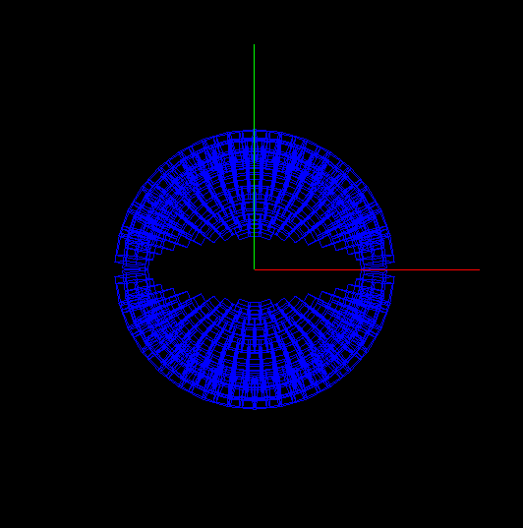
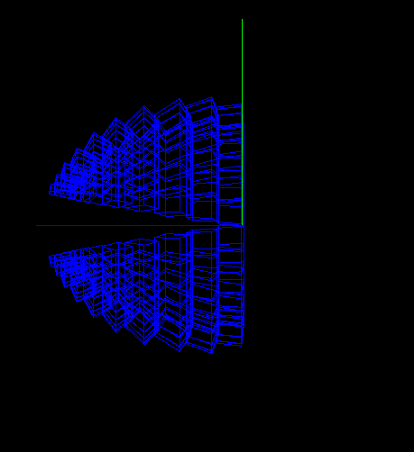
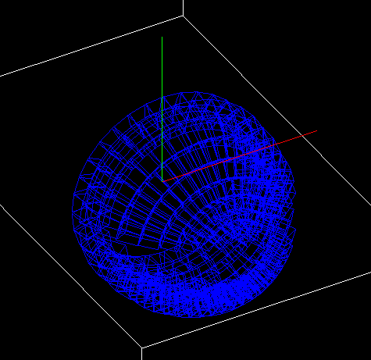
DayOne Design
10 rings
Nch(p, d, t, α, pi+, pi-) < 0.2

