Slide 1
2012_10_19_labmeeting
주은아

Slide 2
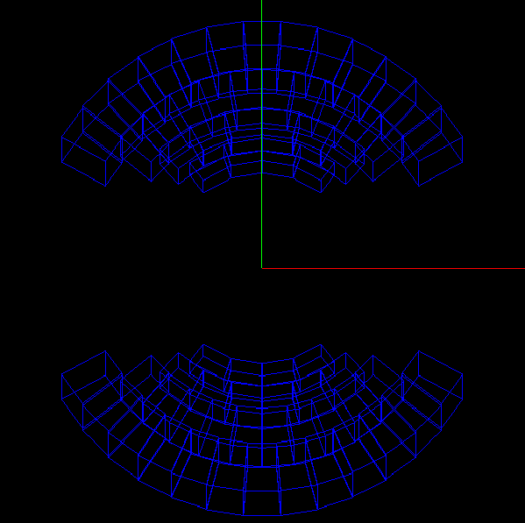
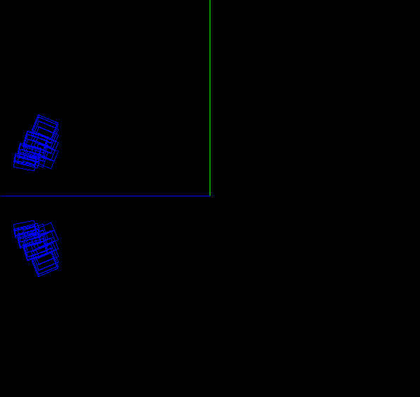
Current status
y
y
15°
x
z
10°~ 25° coverage

